Slide 1
The importance of self-care
Kawana L. Webb, LCSW-C

Slide 2
Learning objectives
Provide an overview of the concepts of self-care
Increase participants knowledge of the importance of self-care
Define components of self care and integrate into practice
Demonstrate self-care methods that participants can utilize during times of stress
Define burnout, compassion fatigue, compassion satisfaction and secondary trauma and how they affect our everyday life

Slide 3

The expectation that we can be immersed in suffering and loss daily and not be touched by it is as unrealistic as expecting to be able to walk through the water without getting wet
~ Remen

Slide 4
WHAT IS COMPASSION FATIGUE
It is a type of stress caused by caring for others
It can occur suddenly
Symptoms of Compassion Fatigue are:
  Less ability to function
  More stress than usual
  Caregiver feels traumatized
  Working harder, getting less done
  Irritability
  Feeling bored
  More sickness, aches, and pains
  http://thecaregiverspace.org/what-is-compassion-fatigue/

Slide 5
What is compassion satisfaction
Compassion satisfaction is about the pleasure you derive from being able to do your work.
For example, you may feel like it is a pleasure to help others through what you do at work. You may feel positively about your colleagues or your ability to contribute to the work setting or even the greater good of society through your work with people who need care.

Slide 6
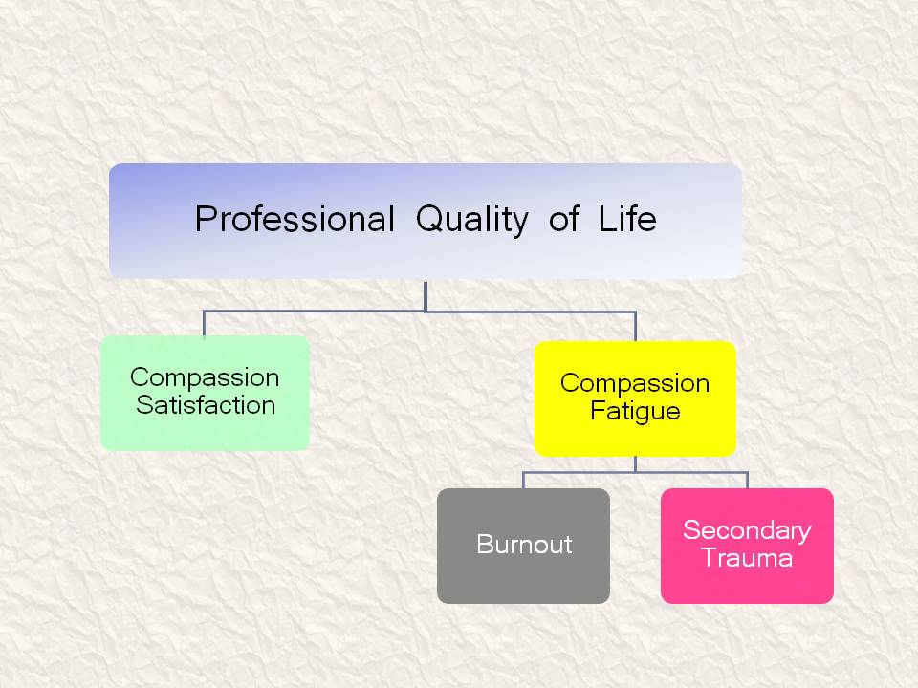

Slide 7

What is burnout?
A relatively frequent outcome of chronic stress that has received considerable attention
Refers to the gradual extinguishing of energy of a helping professional
Schaufeli, Leiter & Maslach, 2009, p. 205
Maslach and Leiter, 2005
Cox and Stiner, 2013

Slide 8
Silver Lining
Burnout is the opportunity to rediscover what makes you happy.

Slide 9
10 signs you may be experiencing burnout
1. Exhaustion
2. Lack of Motivation
3. Frustration, Cynicism and other negative emotions
4. Cognitive Problems
5. Slipping Job Performance
6. Interpersonal Problems at Home & at Work
7. Not Taking Care of Yourself
8. Being Preoccupied with work.. When you’re not at work
9. Generally Decrease Satisfaction
10. Health Problems
https://www.forbes.com/sites/learnvest/2013/04/01/10-signs-youre-burning-out-and-what-to-do-about-it/#41035838625b

Slide 10
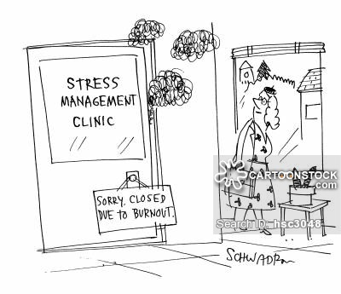

Slide 11
Boundaries and professionalism
When you are stressed/burned out you may find yourself…..
* Sharing too much personal information with clients and coworkers
* Sharing information about other staff members
* Complaining about your agency or workload
* Developing dual relationships
* Wanting to develop a personal relationship with a client
* Downplaying other team members or disciplines
    “They don’t work as hard as me …. “
* Upstaging their problems/issues with your own
      “If he think that’s bad …..”

Slide 12

How can I enjoy my job more…..
3 psychological tricks that will make you enjoy your job more

Slide 13
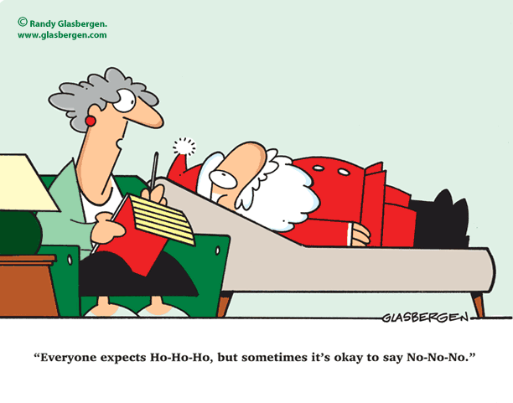
Being proactive / burnout prevention

Slide 14
Being proactive/ burnout prevention
1. Manage your level of stress. Stress can cause physical problems (blurred vision, stomach irritation, high blood pressure) and changes in behavior (irritability, lack of concentration, change in appetite). Note your symptoms and discuss with a doctor, as needed. Try to find relaxation techniques that work for you.
2. Be realistic. The care you give does make a difference, but many behaviors can't be controlled. Grieve the losses, focus on positive times as they arise, and enjoy good memories.
3. Know you're doing your best. Remember that the care you provide makes a difference and that you are doing the best you can. You may feel guilty because you can’t do more.
4. Take a break. It's normal to need a break from your daily duties/activities. No one can do it all by themselves.
5. Accept changes as they occur. People are variables and they are forever changing. They may require care beyond what you can provide on your own. Becoming aware of community resources and care options can make your job easier.
https://www.alz.org/help-support/caregiving/caregiver-health/be_a_healthy_caregiver

Slide 15
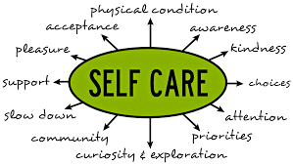
What is good self care

Slide 16
Individual coping strategies
Exercising allowing for self reflection
eating healthy
mental health counseling mindfulness
Visiting with family & friends
Mediation Journaling

Slide 17

You know you don’t have good self care when….
Give me some examples……

Slide 18
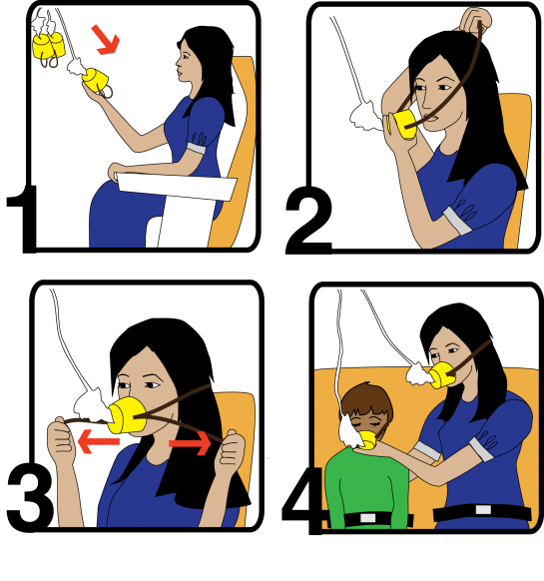
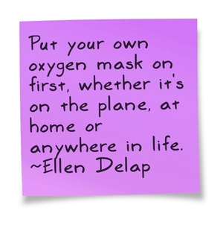

Slide 19

Self-care video
https://youtu.be/w0iVTQS8ftg

Slide 20
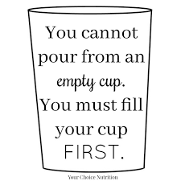
WHAT IS SELF-CARE
Around the room you will find chart paper with the
3 KEY Components of Self Care :
MIND
SPIRIT
BODY
Please visit each paper and write an example of self-care for each component
Example: MIND – Music; BODY – Exercise; Spirit – Meditate
You can look at the Self-Care List for ideas

Slide 21
WHY IS SELF-CARE IMPORTANT
It leads to Poor Quality of Life
Poor self-care = burnout = dissatisfaction = leaving the social work/home visiting field
Poor self-care = reduced ability to be empathic
“In light of recent and significant research indicating that social workers engaged in direct practice are likely to develop symptoms of secondary traumatic stress, it is imperative that the social work profession devotes greater attention to and creates greater awareness of these issues.” (Professional Self-Care and Social Work, policy statement approved by the NASW Delegate Assembly, 2008)

Slide 22
Lets develop our self care plan
https://youtu.be/GWwwPb6akqA?t=14

Slide 23
Lets develop a personal self care plan

Slide 24
Top self-care tips for helping professionals
* Take inventory of where things are – What’s on your plate?
* Start a Self-Care Idea Collection
* Find time for yourself everyday
* Delegate & learn to ask for help
* Have a transition from work to home
* Learn to say yes or no more often
* Assess your trauma inputs – work/non-work related
* Learn more about Compassion Fatigue and trauma
* Make time for supervision and/or peer support
* Attend workshops and trainings

Slide 25
