Slide 1
Maternal Marijuana Use: Weeding Out the Myths
Katrina S Mark, MD FACOG
Assistant Professor
University of Maryland School of Medicine
9/19/2018

Slide 2
Objectives
Identify the scope of the issue
Legalization/decriminalization
Marijuana in pregnancy
Patient/provider perceptions
Truths
Unknowns
Marijuana in postpartum and breastfeeding
Evaluating bias
Tips and talking points

Slide 3
Scope

Slide 4
Marijuana Use: The Scope
In 2016
37.6 million Americans (13.9%) had used marijuana in the past year
24 million (8.9%) used in the past month
First use by 2.6 million, 50% aged 12 -17
Range in pregnancy 3 – 34%
In 2016 NSDUH reports 4.9% in last month
NSDUH, 2016

Slide 5
SAMHSA 2017 Data
Several data trends between 2015 and 2017 for pregnant women are also of concern with data trends in the wrong direction with respect to use of illicit drugs, including cocaine, marijuana and opioids., Approximately 7 percent of pregnant women have used marijuana in the past 30 days with 3 percent reporting daily use.
Notes:
Substance abuse and mental health services administration
National survey on drug use and health

Slide 6
Co-Morbidities
Substance use disorder
Opiates 4.6x higher
Alcohol 6x higher
Tobacco 6.2x higher
Cocaine 9.3x higher
Psychiatric diagnoses
Women with mood disorders are 2-3x more likely to use cannabis
70% of bipolar women use marijuana
30% of bipolar women have a SUD

Slide 7
Definitions
Drug dependence
Use that results in withdrawal symptoms when the drug is discontinued
Substance use disorder
Pattern of use characterized by tolerance, craving, inability to control use, and continued use despite adverse outcomes

Slide 8
ASAM Definition
Addiction – a chronic disease of brain reward, motivation, memory and related circuitry... It is characterized by inability to consistently abstain, impairment in behavioral control, craving, diminished recognition of significant problems with one’s behaviors and interpersonal relationships, and a dysfunctional emotional response.
Notes:
This leads to why some women who might casually use prior to pregnancy now qualify as having a substance use disorder or addiction once they become pregnant, because the stakes have changed

Slide 9
Legalization and Changing Perceptions

Slide 10
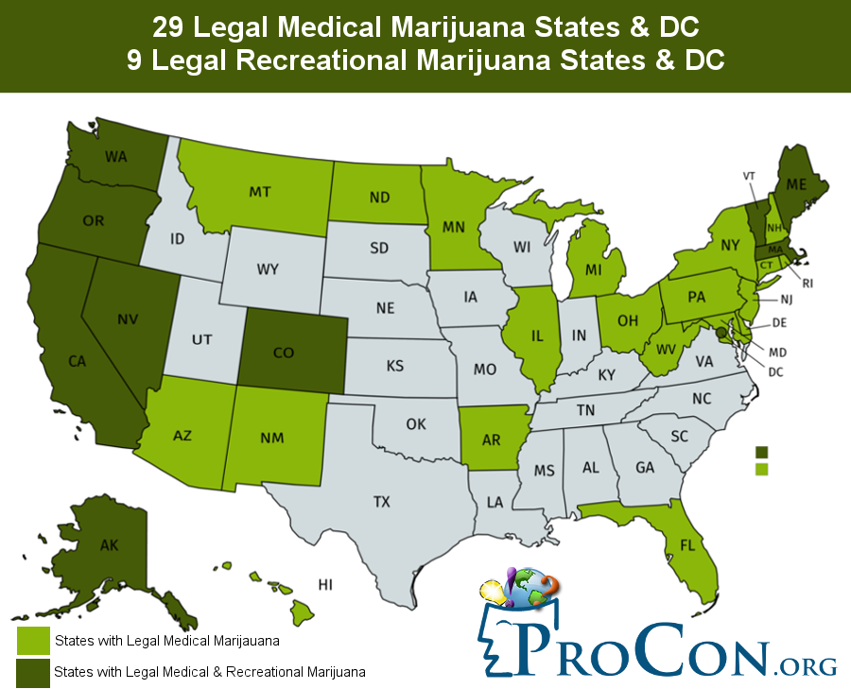
Legalization
Notes:
Many more states have decriminalized (made it a civil rather than a criminal offense)

Slide 11
Colorado
Doubled use within the first year of legality
Increase in potency
Increase in non-smoking use (vaping, edibles, lotions, ect)

Slide 12
Perceptions of Harm
Cerda, JAMA Pediatrics 2016

Slide 13
Perceptions of Harm
Pearson, Crim Just 2002

Slide 14
Perception of Harm
Mark, J Addict Med, 2017

Slide 15
Legalization and Perception of Harm
Mark, J Addict Med, 2017

Slide 16
Marijuana in Pregnancy

Slide 17
Epidemiology
3-34% of pregnant women
Most women stop or cut back during pregnancy
46-78% quit
Most that do not quit cut back
Most women relapse postpartum
Ryan, Pediatrics 2018

Slide 18
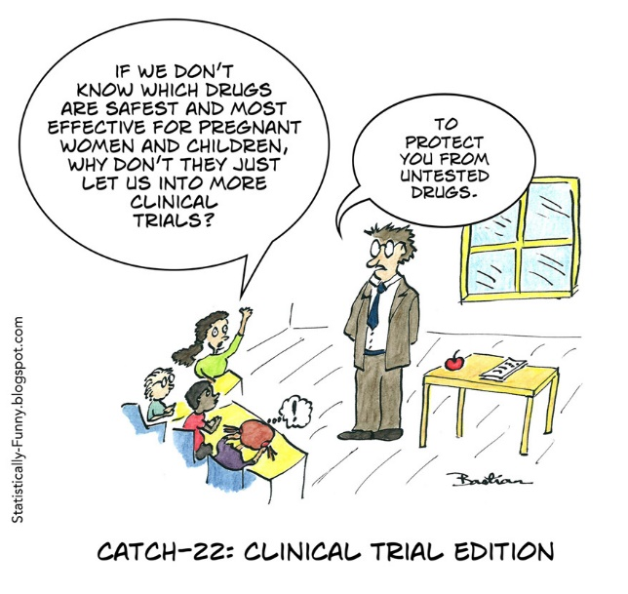
Why Don’t We Have the Answers?
Retrospective
Confounding
Other drugs
Reason for use (nausea)
Socioeconomic factors
Income
Education
Nutrition
Stress
Measurement
Self report/biologic sampling
Dose relationship
Timing of exposure
Most women stop

Slide 19
Biologic versus Self Report
31% of women with positive screen self-reported use
43% of women who self reported had positive biologic screen
So what do you use for research?
Shiono, Am J Obstet Gynecol, 1995

Slide 20
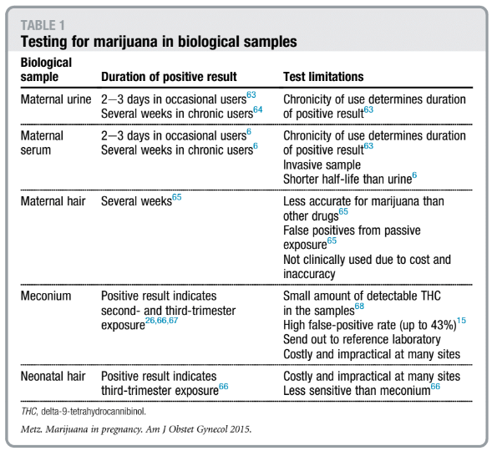

Slide 21
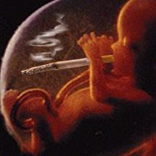
The Known
Marijuana crosses the placenta
Metz, AJOG 2015

Slide 22
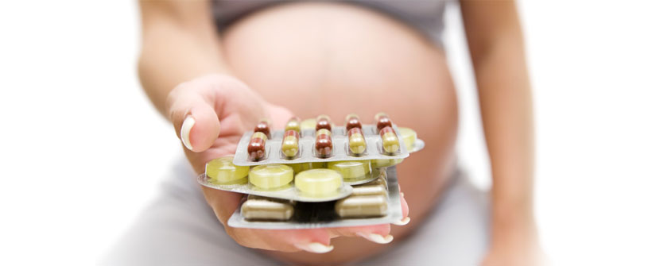
Fetal Effects
Marijuana is not a teratogen
Metz, AJOG 2015

Slide 23
Fetal Effects: Possible
Growth restriction
Confounded by tobacco
If there is an effect, likely small and unclear consequences
Stillbirth
Most studies exclude due to history of stillbirth
Increased risk of stillbirth (THC in umbilical cord)
Possibly confounded by tobacco use
Metz, AJOG 2015
Notes:
Physiologically plausible but conflicting studies (likely related to dosage and timing of exposure as well as confounding factors)

Slide 24
Fetal Effects: Possible
Preterm Birth
Conflicting results
Confounders (history of PTB, iatrogenic)
Positive biologic screen seems more correlated
Unclear the effects (early versus late preterm)
Metz, AJOG 2015

Slide 25
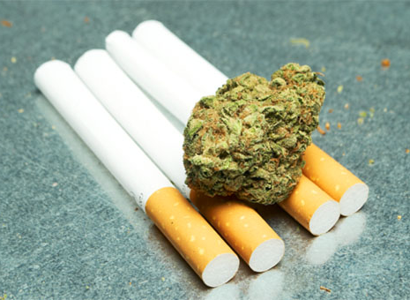
Concurrent Tobacco Use
Increased risk compared to tobacco alone
Preterm birth (OR 2.6)
Low birth weight (OR 2.8)
Pre-eclampsia (OR 2.5)
Chabarria, AJOG 2016

Slide 26
Long-term Effects: Neurodevelpoment
Animal Studies
Alterations in the dopaminergic pathway (reward)
Increased hyperactivity
Learning disabilities
Memory impairment
Metz, AJOG 2015

Slide 27
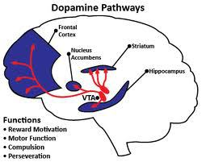
Neurodevelopment: Human Studies
Autopsies
Dose dependent decrease in dopamine receptors
Metz, AJOG 2015

Slide 28
Neurodevelopment: Human Studies
Decreased language comprehension
Difficulty with attention
Memory impairment
Increased hyperactivity
Increased impulsivity
Younger age at onset of substance use
Metz, AJOG 2015

Slide 29
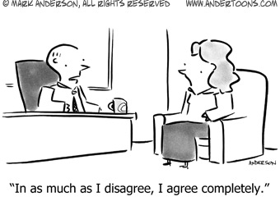
Neurodevelopment: Clear as Mud
Inconsistent results between two major studies
Behavioral changes seen between ages of 4 and 9
Many confounding factors

Slide 30
Breastfeeding
Marijuana is detected in breastmilk
Bertrand, Pediatrics 2018

Slide 31
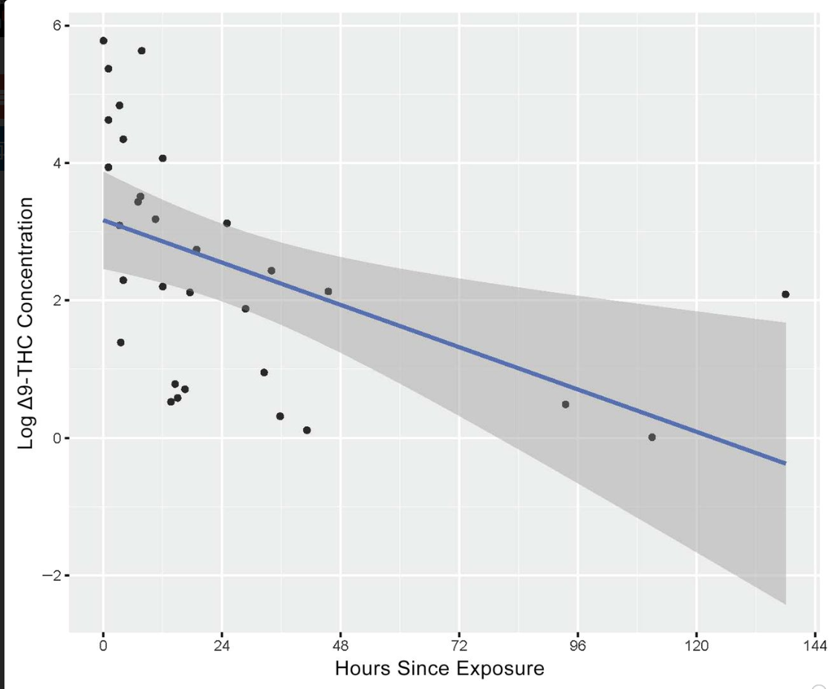
Breastfeeding
Detection for up to 6 days
Related to dose and frequency of use
Decreased approximately 3% per hour after exposure
Half life of approximately 27 hours
Extremely variable concentrations, likely due to lipophilic nature
Bertrand, Pediatrics 2018

Slide 32
Benefits of Breastfeeding
Decreased infections
GI, ear infections, respiratory disease
Decreased diabetes
Decreased obesity
Decreased rates of SIDS
Improvement in postpartum blood loss
Child spacing
Maternal/infant bonding
Decreased maternal diabetes
Decreased maternal breast/ovarian cancer
Bertrand, Pediatrics 2018

Slide 33
Recommendations
AAP: “Street drugs such as PCP, cocaine and cannabis can be detected in human breastmilk and their use by breastfeeding mothers is of concern, particularly in relation to the infant’s long-term neurodevelopment, and are thus contraindicated”
“Maternal substance abuse is not a categorical contraindication to breastfeeding.”
Bertrand, Pediatrics 2018
Notes:
Levels that infants are exposed to are approximately 1000 times lower than those in the adult

Slide 34
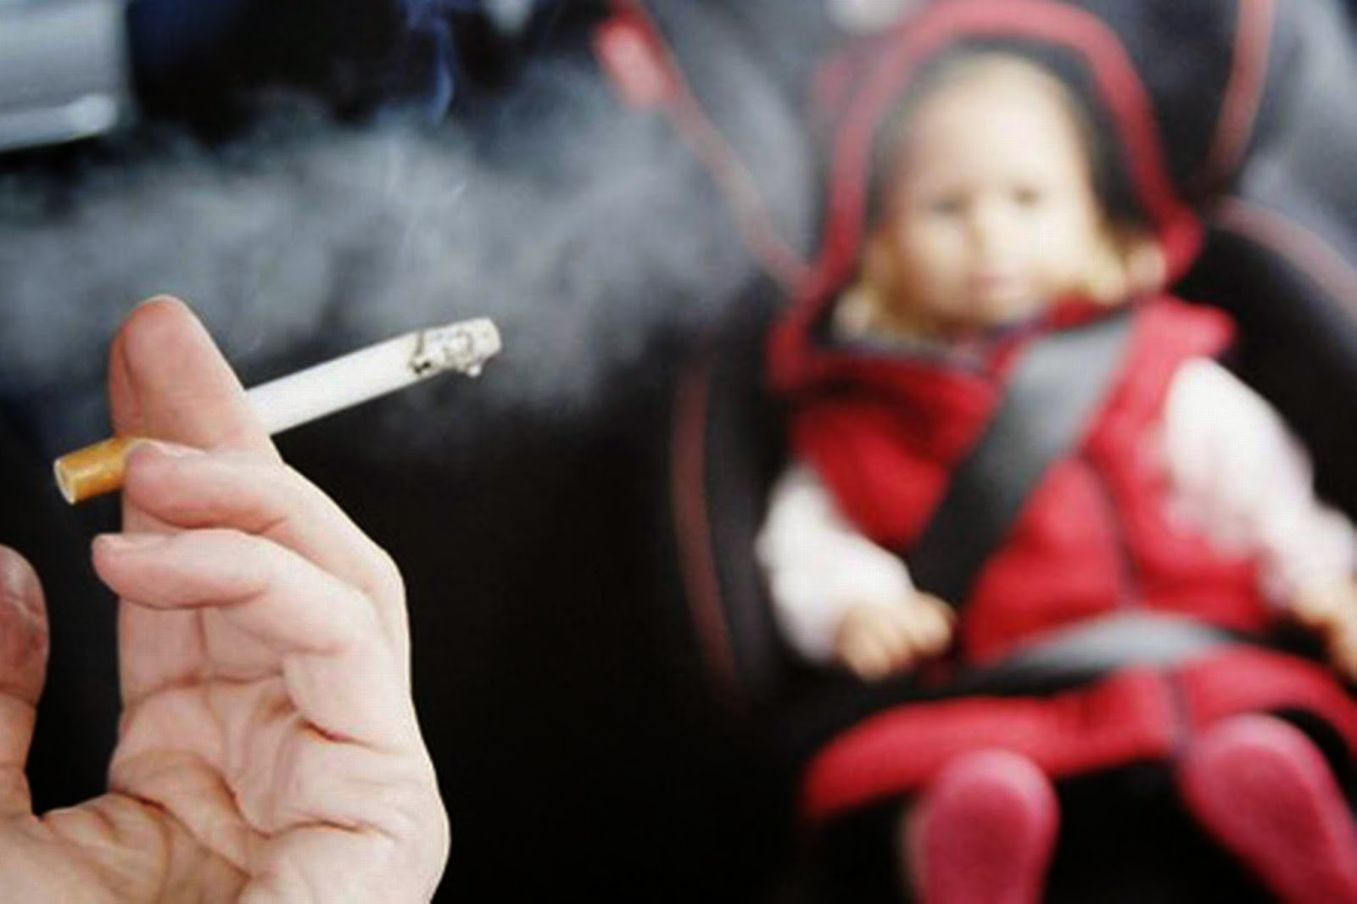
Marijuana: Postpartum
High rates of relapse
Second hand exposure to the infant
Holitzki, CMAJ Open 2017

Slide 35
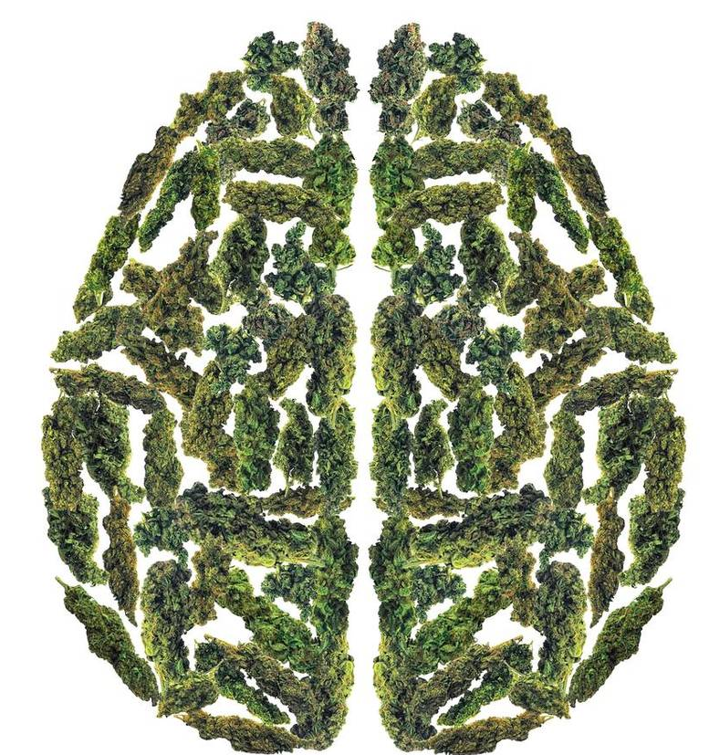
Maternal Effects
Decreased attention
Decreased concentration
Decreased speed of information processing
Decreased memory
Decreased associative learning
Scott, JAMA Psychiatry 2018

Slide 36
Maternal Effects
Cannabis associated psychosis
Contaminating substances
Pulmonary effects
Acute bronchodilation
Longterm can cause airway obstruction

Slide 37
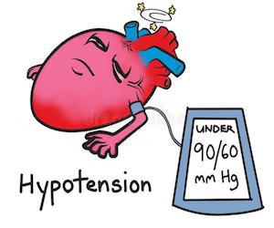
Maternal Effects: Cardiovascular
Vasodilation
Tachycardia
Orthostatic hypotension
Increased cardiac output with no increased BP
Increased risk of MI
Thomas, Am J Cardiol 2014

Slide 38
What Can We Do?
Notes:
So, we all agree that marijuana in pregnancy is bad, and we don’t want women to relapse postpartum – but how can we help?

Slide 39
SBIRT
Screening
Brief Intervention
Referral to Treatment
SAMHSA.gov

Slide 40
Universal Screening
Notes:
Screen everyone regardless of risk factors. The downside is more cost/time, but the upside very much outweigh this negative. Providers become more comfortable with screening and integrate it into their routine care, everyone gets screened so no one is missed, decreases discrimination and actually makes patients more comfortable and open.

Slide 41
ACOG
Screening for substance use should be part of comprehensive obstetric care and should be done at the first prenatal visit in partnership with the pregnant woman.
Screening based only on factors such as poor adherence to prenatal care or prior adverse pregnancy outcome can lead to missed cases, stereotyping and stigma.

Slide 42
Purpose of Screening
Testing should result in a medical “good”, not merely the capture and stigmatization of those with a disease. The good should pertain to the mother and the fetus.
Physicians should advocate for universal screening only as strongly as they advocate for social support and addiction care services for those subsequently identified.
Terplan and Minkoff, Obstet & Gynecol 2017
Notes:
Should be to promote health of mother and fetus, prevent neonatal abstinence syndrome but also longterm benefits to both (bonding, health, ect)
If screening were to determine who were good mothers or act as a surrogate for home environment, why aren’t father’s and caregivers tested?
About point #1 – I can tell you personally as a pregnant woman that people that you have never even met all of a sudden have a lot of interest in your life and a lot of advice about what you are doing. It is common for society to stop seeing women as humans and to start seeing them as incubators that are carrying the most precious and important cargo during pregnancy.

Slide 43
Information/Feedback
23% of providers did not acknowledge positive screen
48% of providers did not provide specific counseling
70% of counseling time spent on punitive counseling
African Americans 10x more likely to receive punitive counseling
Holland et al, Pt Educ Couns, 2016

Slide 44
Evaluating Bias Racial Discrimination
Collected urine samples from delivering women in Florida
White women: 15.4%
African American women: 14.1%
Public clinic: 16.3%
Private clinic: 13.1%
African American women 10x more likely to be reported to social services
Chasnoff, NEJM 1990
Notes:
Even when given the identical information about two different patients, healthcare providers still succumb to their own bias

Slide 45
Brief Intervention
Ask pros/cons
Give information/feedback
Assess readiness to change
Advise/negotiate
Follow up
SAMHSA.gov
Notes:
Motivational interviewing
Required in about 15% of people screened
Takes about 5-15 minutes
Billable

Slide 46
Information/Feedback
Unbias facts
Admit when harm is unclear/unknown
Provide information in non-judgmental way
Do not focus counseling on legality of substance

Slide 47
Intervention/Referral
Moderate to high risk use
Comprehensive approach
Substance abuse counselors
Cognitive behavioral therapy
Support groups

Slide 48
Provider Tool Kit

Slide 49
Provider Toolkit
Know the facts
Understand reasons for use
Capitalize on motivations to quit

Slide 50
Common Reasons for Use
Relaxation
Socialization
Anxiety
Nausea/vomiting
Notes:
Offer alternatives for socialization and relaxation

Slide 51
Mental Health Comorbidities
Higher rates of depression, anxiety, OCD, bipolar depression, schizophrenia
Screen for depression and anxiety
Most psychiatric medications can be continued in pregnancy
Referral and treatment

Slide 52
Nausea and Vomiting
Jarlenski, Drug Alcohol Dep 2018

Slide 53
Nausea and Vomiting

Slide 54
Nausea and Vomiting
Notes:
Low quality evidence of efficacy, almost all in cancer.

Slide 55
Hyperemesis Syndrome
Intractable vomiting with cessation of marijuana
Incidence unknown
Physiology unknown (possible withdrawal)
Hot baths improve symptoms
Typically resolves within 1 week of abstinence

Slide 56
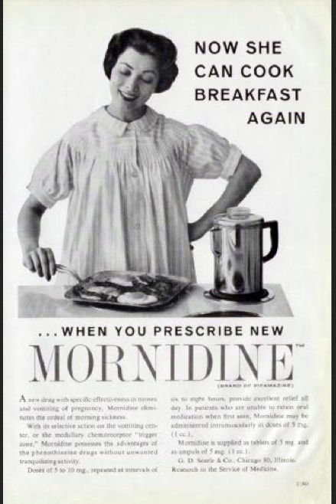
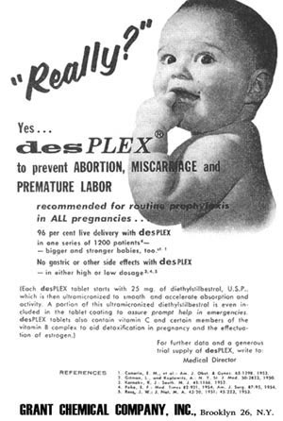
History

Slide 57
History

Slide 58
ACOG, 2018

Slide 59
N/V: Summary
No evidence that it helps
There are safer medications available
Ginger, Vitamin B6, acupuncture, wrist bands
Marijuana is not regulated
It may worsen nausea and vomiting
There are many other known harms

Slide 60
Mark, J Addict Med, 2017

Slide 61
Summary
Marijuana use is common in pregnancy and postpartum period
High rates of other comorbidities
Harms of marijuana in pregnancy
Crosses the placenta
Alters the development of baby’s brain
May increase adverse pregnancy outcomes, particularly when combined with cigarettes

Slide 62
Summary
Risks in postpartum period
Recommended against in breastfeeding
Not an absolute contraindication
Alters mothers’ cognition, reaction time and memory
Second-hand exposure to baby
Universal screening recommended
Screening should be used to improve maternal and fetal outcomes

Slide 63
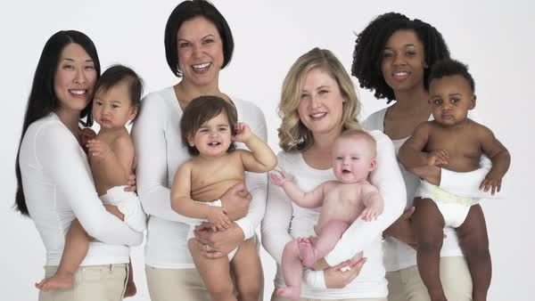

Slide 64
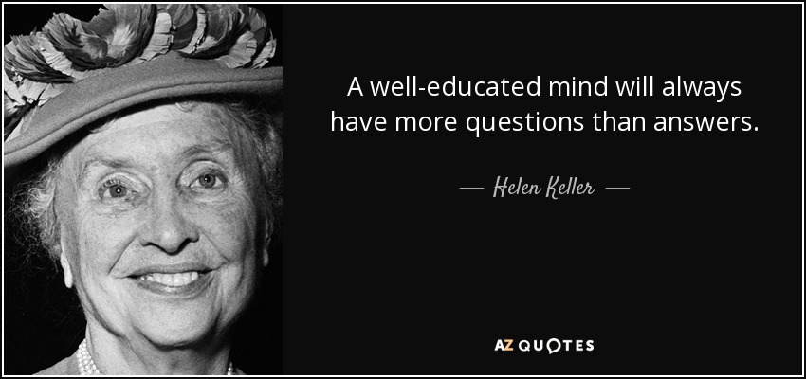

Slide 66
Perceptions of Harm
Pearson, Crim Just 2002

Slide 67
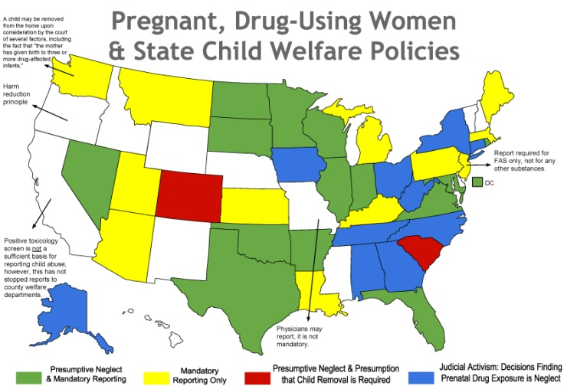
Laws
24 states and DC – consider substance use during pregnancy to be child abuse
3 states - grounds for civil commitment
23 states and DC require healthcare professionals to report suspected prenatal drug use
7 states require them to test for drug exposure if they suspect it
45 states have have prosecuted pregnant women for drug use
www.guttmacher.org

Slide 68
Access
19 states have created/funded drug treatment programs targeted to pregnant women
17 states + DC provide pregnant women with priority access to state funded programs
10 states prohibit publicly funded drug treatment programs from discriminating against pregnant women
www.guttmacher.org
Notes:
Many of these do not overlap – for example, South Dakota considers it child abuse and grounds for commitment, but there are no targeted programs, pregnant women are not given priority for treatment and are not safe from discrimination
So we are penalizing the act but not providing any alternative or assistance to aide women in becoming healthy.
As healthcare providers it is our responsibility to promote health and safety of our patients and their families. Putting women in jail for using drugs does not promote longterm positive outcomes for mother or baby.

Slide 69
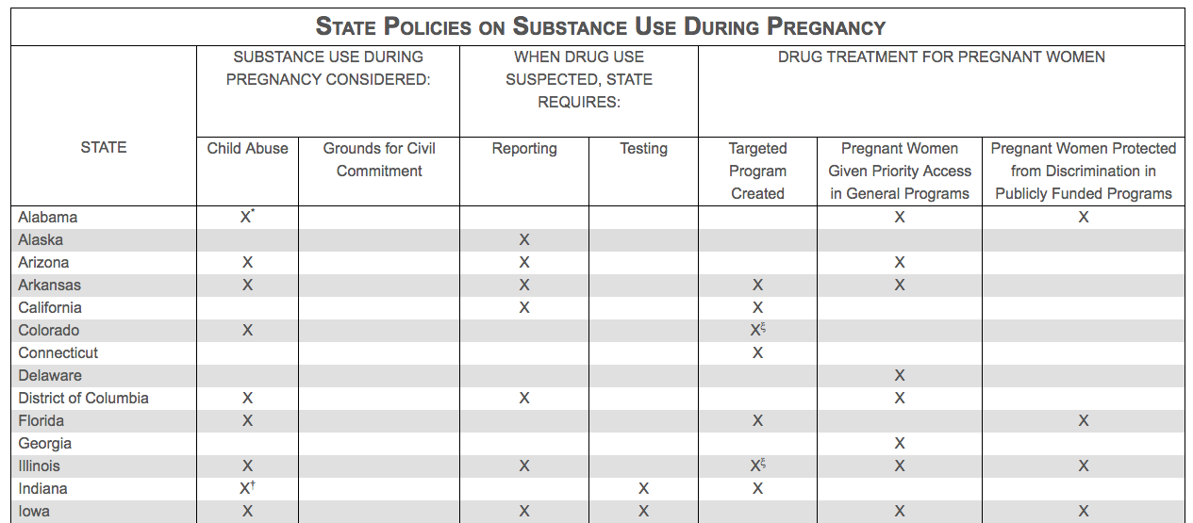
www.guttmacher.org

Slide 70
Evaluating Bias

Slide 71
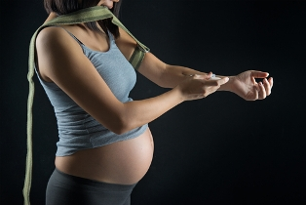
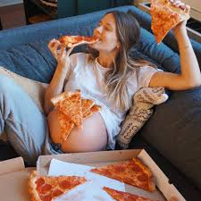

Slide 72
Notes:
Although I do applaud the idea of providing contraception to all women and particularly this population of women who typically have high unmet family planning needs, the idea of paying someone not to have a child is outrageous. I thought this seemed like an obvious fact, but you would be shocked by the responses I got when I showed this slide to some of the people I work with… many of them seemed to think this wasn’t a bad idea.
So…. At the risk of pointing out what seems quite obvious to me, I will explain my issues with this:
First, if someone is addicted to drugs, perhaps we should spend time and effort to help them break their own cycle of addiction rather than paying them not to get pregnant.
Second, this is again putting unfair burdens and judgment on mothers. Why is no one offering vasectomies to men who are addicted to drugs? Sure the man doesn’t carry the baby, but we know that a lot of the concerns regarding maternal substance use have to do with the environment in which the children will be raised, so why not keep men from bringing children into those same environments?
Also, just to point out, there is no such this as an “addicted newborn”.

Slide 73
Evaluating bias
45% of physicians believe child abuse
Notes:
Why do we not judge the father’s in the same way? Or other care givers? It is unfair to hold mother’s to a different standard. I see father’s show up to their baby’s delivery high frequently, but they are never reported. I also, unfortunately, see them not show up at all many times, and again no social services are contacted because the baby is the responsibility of the woman.
Perhaps even more analogous - Why do we not shame women who are non-compliant with medications or diabetic diets?

Slide 74
Addiction is a disease. This does not in any way excuse responsibility. Just as with every other disease, diagnosis requires adherence to a treatment plan. Designating addiction as a disease is not a free pass.
Sandy Swenson

