Slide 1
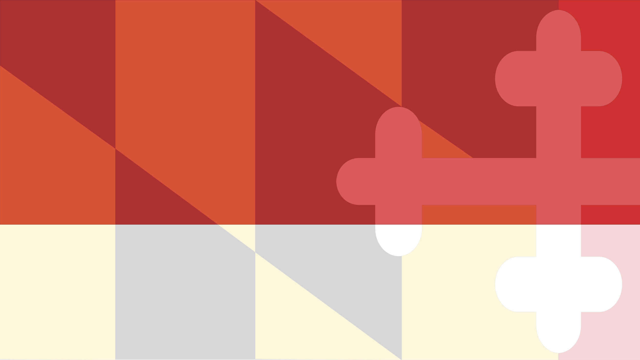
Implicit Bias Training
2018 MD MIECHV Conference
Maryland Department of Health
Office of Minority Health and Health Disparaties
Stephanie C. Slowly MSW, LCSW-C
September 20, 2018

Slide 2
MHHD Background
Statutory Base: The Office of Minority Health and Health Disparities (MHHD) was established in 2004 by statute, under the Maryland Health General Article, Section § 20-1001 to § 20-1007, to address minority health disparities in Maryland.
Mission: To address the social determinants of health and eliminate health disparities by leveraging the Department’s resources, providing health equity consultation, impacting external communications, guiding policy decisions and influencing strategic direction on behalf of the Secretary of Health.
Vision: To achieve health equity where all individuals and communities have the opportunity and access to achieve and maintain good health.

Slide 3
Objective of Today
Review key terms
Have discussion around Implicit Bias and Micro assaults
Review the Harmful Impact of Implicit Bias
Putting it together
Next Steps and Take away

Slide 4
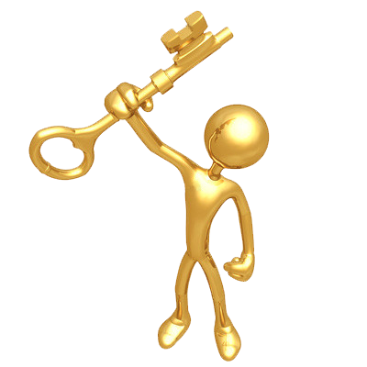
Key Terms
Bias: Is defined as a prejudice in favor of or against one thing, person or group compared with another usually in a way that’s considered to be unfair. (individual, group or institution)
Implicit (Unconscious) Bias: Attitudes towards people or associate stereotypes with them without our conscious knowledge.
Micro aggressions: a statement, action, or incident regarded as an instance of indirect, subtle, or unintentional discrimination against members of a marginalized group such as a racial or ethnic minority.
Micro-assaults: are explicit racial or derogatory actions that are intended to hurt.
Micro-insult: is an unconscious communication that demeans a person from a minority group.
Micro-Invalidation: is the minimizing or disregarding the thoughts, feeling or experience of a person of color.
Notes:
https://diversity.ucsf.edu/resources/unconscious-bias
http://kirwaninstitute.osu.edu/research/understanding-implicit-bias/
Sue, D., et.al. 2007. Racial Micro aggressions in Everyday Life. American Psychologist, 62(4): 271–286
Nadal, KL. 2012. Featured Commentary: Trayvon, Troy, Sean: When racial biases and microaggressions kill. Communiqué, American Psychological Association.
Gray J. nd. Identifying & Responding to Microaggressions (presentation).

Slide 5
Implicit Bias Characterstics
Implicit biases are pervasive. Everyone possesses them, even people with avowed commitments to impartiality such as judges.
Implicit and explicit biases are related but distinct mental constructs. They are not mutually exclusive and may even reinforce each other.
The implicit associations we hold do not necessarily align with our declared beliefs or even reflect stances we would explicitly endorse.
We generally tend to hold implicit biases that favor our own ingroup, though research has shown that we can still hold implicit biases against our in group.
Implicit biases are malleable. Our brains are incredibly complex, and the implicit associations that we have formed can be gradually unlearned through a variety of debasing techniques.
Notes:
https://diversity.ucsf.edu/resources/unconscious-bias
http://kirwaninstitute.osu.edu/research/understanding-implicit-bias/
Sue, D., et.al. 2007. Racial Microaggressions in Everyday Life. American Psychologist, 62(4): 271–286
Nadal, KL. 2012. Featured Commentary: Trayvon, Troy, Sean: When racial biases and microaggressions kill. Communiqué, American Psychological Association.
Gray J. nd. Identifying & Responding to Microaggressions (presentation).

Slide 6
Implicit Bias in Action
https://www.youtube.com/watch?v=xRgFkIMO-Js

Slide 7
Implict Bias Debunked
Implicit bias is nothing more than beliefs people choose not to tell others. They know how they feel; they just know they cannot or should not say those beliefs aloud, so they hide them.
Implicit bias is nothing more than stereotyping.
Having implicit biases makes me a bad person
I am not biased; I have diverse friends and I believe in equal treatment.
I’m Black; I can’t have bias against Black people. I’m also a woman, so it does not make sense that I would have implicit biases against my own sex.
Notes:
https://diversity.ucsf.edu/resources/unconscious-bias
http://kirwaninstitute.osu.edu/research/understanding-implicit-bias/
Sue, D., et.al. 2007. Racial Microaggressions in Everyday Life. American Psychologist, 62(4): 271–286
Nadal, KL. 2012. Featured Commentary: Trayvon, Troy, Sean: When racial biases and microaggressions kill. Communiqué, American Psychological Association.
Gray J. nd. Identifying & Responding to Microaggressions (presentation).

Slide 8
Implicit Bias- Debunked
If bias is natural, there is obviously nothing we can do about it.
It’s a waste of time to try to mitigate my implicit biases. They do not impact anyone anyways.

Slide 9
So Let’s Discuss
https://www.youtube.com/watch?v=DWynJkN5HbQ

Slide 10
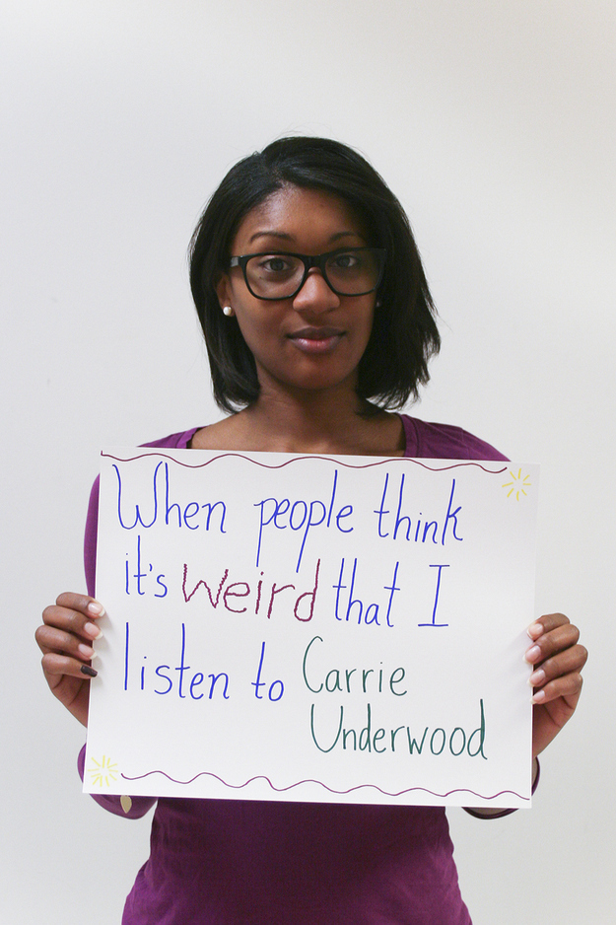
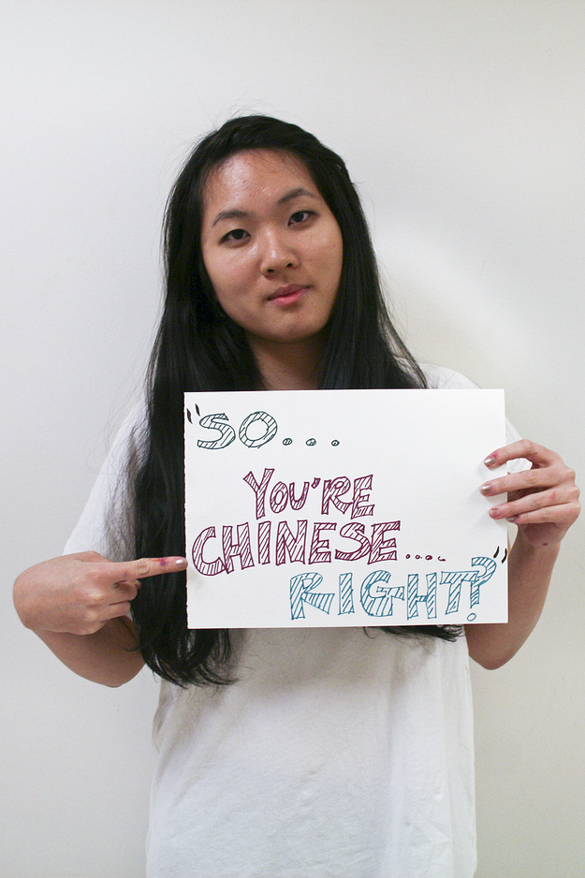
Micro aggression

Slide 11
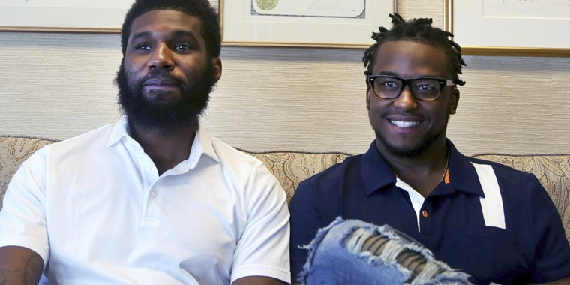
Micro-aggression in action

Slide 12
Micro-aggression in action

Slide 13
What do you think?
https://www.youtube.com/watch?v=hDd3bzA7450

Slide 14
The Harmful Impact
assail the mental health of recipients,
(b) create a hostile and invalidating work or campus climate,
(c) perpetuate stereotype threat,
(d) create physical health problems,
(e) saturate the broader society with cues that signal devaluation of social group identities,
(f) lower work productivity and problem solving abilities, and (g) be partially responsible for creating inequities in education, employment and health care.
Notes:
https://www.psychologytoday.com/us/blog/microaggressions-in-everyday-life/201010/racial-microaggressions-in-everyday-life

Slide 15
Putting it together
https://www.youtube.com/watch?v=zRwt25M5nGw
Notes:
https://www.psychologytoday.com/us/blog/microaggressions-in-everyday-life/201010/racial-microaggressions-in-everyday-life

Slide 16
What Next
WHAT CHALLENGED ME TODAY? | WHAT DID I LEARN TODAY?
WHAT WAS MY A HA MOMENT? | What will I do different tomorrow?
Notes:
https://www.psychologytoday.com/us/blog/microaggressions-in-everyday-life/201010/racial-microaggressions-in-everyday-life

Slide 17
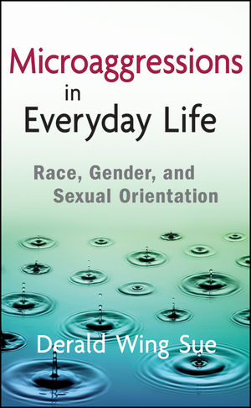
Resources
http://kirwaninstitute.osu.edu/
Kirwan Institute
https://implicit.harvard.edu/implicit/takeatest.html
Implicit Bias Test
https://www.psychologytoday.com/us/blog/microaggressions-in-everyday-life/201010/racial-microaggressions-in-everyday-life
Harmful impact of Implicit Bias
Notes:
https://www.psychologytoday.com/us/blog/microaggressions-in-everyday-life/201010/racial-microaggressions-in-everyday-life

Slide 18
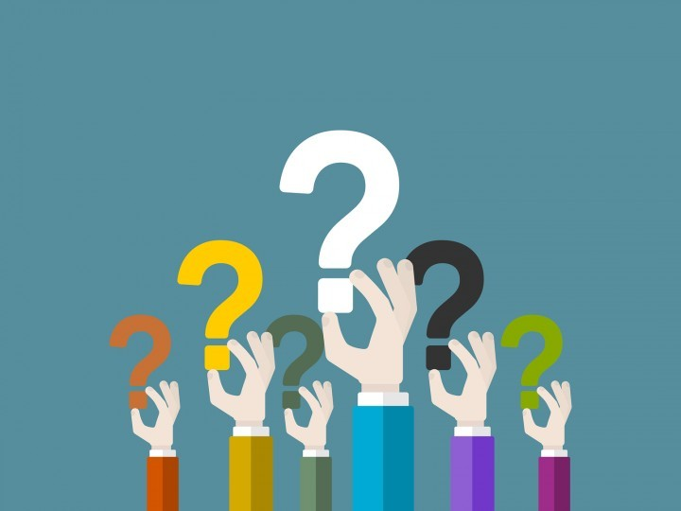
Questions????

Slide 19
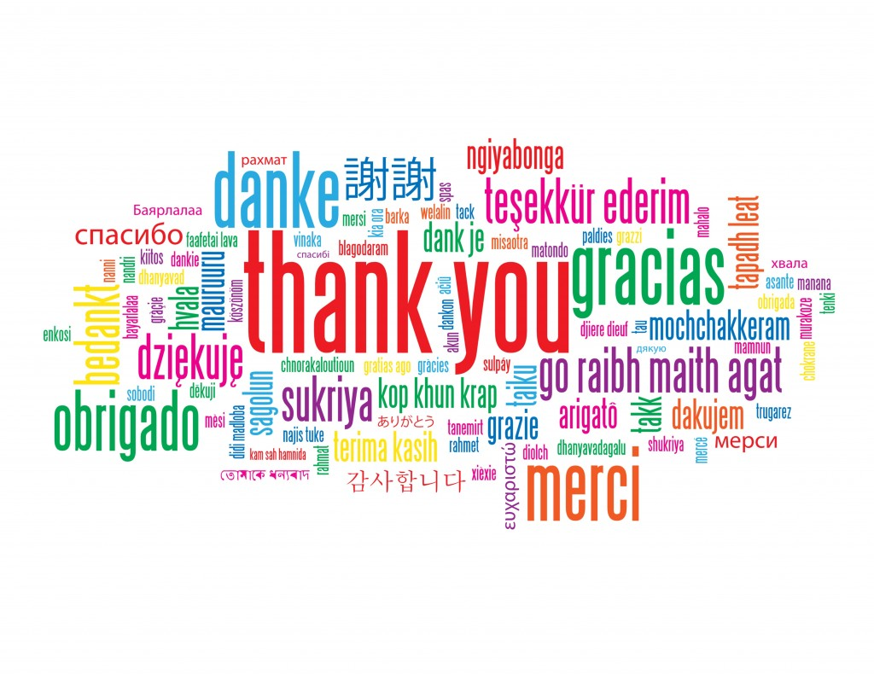

Slide 20
Contact Information
Stephanie C.Slowly MSW, LCSW-C
Deputy Director, Offfice of Minority Health and Health Dispariates
stephanie.slowly@maryland.gov
410-767-1052
https://health.maryland.gov/mhhd

