Slide 1
Child Passenger Safety: Ages and Stages Maryland Kids In Safety Seats

Slide 2
Goals of this Presentation
To learn how car seats and booster seats prevent and minimize injuries to children during crashes.
To understand the elements of correct selection and usage of a car or booster seat.
To review and understand the provisions of Maryland’s Child Passenger Safety Law.

Slide 3
What’s the Health Issue?
In 2016, of the 826 children
killed in passenger vehicle crashes,
restraint use was known for 751,
of whom 289 (39%) were unrestrained
(NHTSA Traffic Safety Facts 2016 Data)
Notes:
Many drivers think “I’m only going down the street – it should be OK this time” when they do not use a car seat or booster seat for short trips. Unfortunately, most crashes happen close to home, on familiar streets.

Slide 4
What are the Facts?
In 2016, regarding children 0-15 years old:
United States
1,132 child fatalities
178,000 injuries
Maryland (2016)
12 child fatalities
3,808 injuries
4
*2015 NHTSA’s National Center for Statistics and Analysis
Notes:
These numbers reflect children up to 15 years old.
The rate of serious injuries is much higher than the fatality rate, but still changes the lives of all involved.
The numbers of fatalities and injuries tend to increase for each age group. Does anyone know why this might happen? (less likely to buckle up older children, ride in front seat, children tell parents they don’t like to use car seats/seat belts, etc)

Slide 5
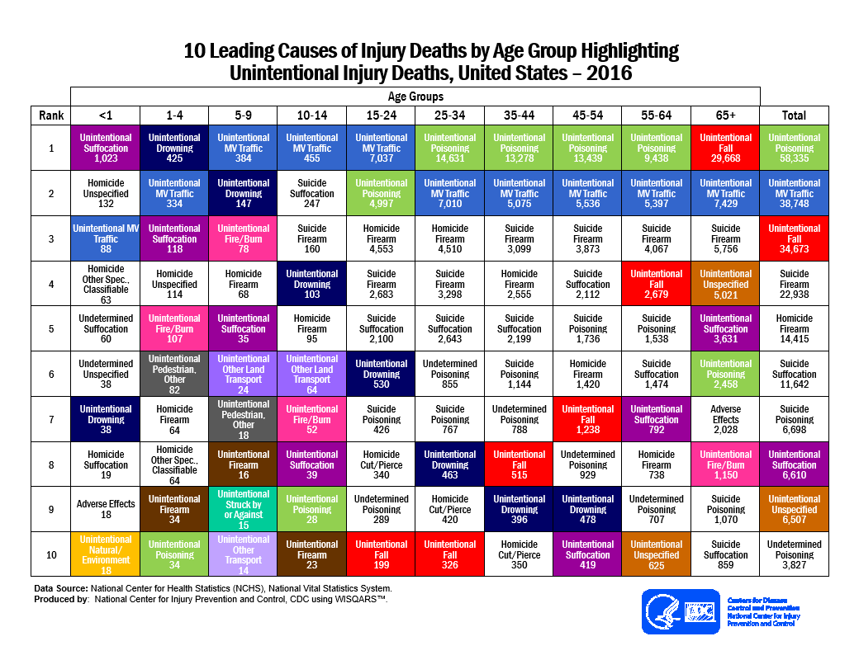

Slide 6
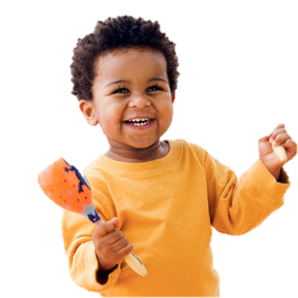
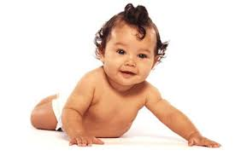
What is the Solution?
Car seats:
71% effective in reducing deaths of infants<1 year.
54% effective in reducing deaths of toddlers aged 1-4 years.
Booster seats:
45% effective in reducing risk of injury vs seat belt use alone.
45%
54%
71%
Notes:
As you can see, car seats do a great job of keeping children safe in vehicles.
Seats are slightly less effective for toddlers. Do you know why infants are better protected in cars? (they ride rear-facing and the seats protect them better that way; also, toddlers become more “opinionated” and can sometimes get out of car seats or harness straps)

Slide 7
Basic Crash Dynamics
An object in motion remains in motion at the original speed until acted upon by an outside force.
*You move towards the point of impact
* There is a lot of crash weight at that impact
Approximate:
Weight X Speed = Restraining Force.
Example: 30 lb. Child in a car going 40 mph has 1200 lbs of crash weight.
Notes:
This is a basic physics lesson. In the case of a car crash, all people and things in the car will move towards the point of impact until something “stops” them (Examples: harness straps, seat belts, other people or parts of the car (like the driver’s head or the windshield) or an object, the road or ground outside the vehicle)
“How many of you have ever been in a car crash?” “Could you tell us about it?”
What would you rather “hit”?
Do you think real car crashes are like the ones on TV? (stunt drivers use protective equipment and landing pads)

Slide 8
Notes:
This baby seems “safe” in the adult’s arms.
Look what happens when the car hits a solid barrier at 30 mph.
No one can hold a child during a severe crash.

Slide 9
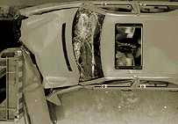
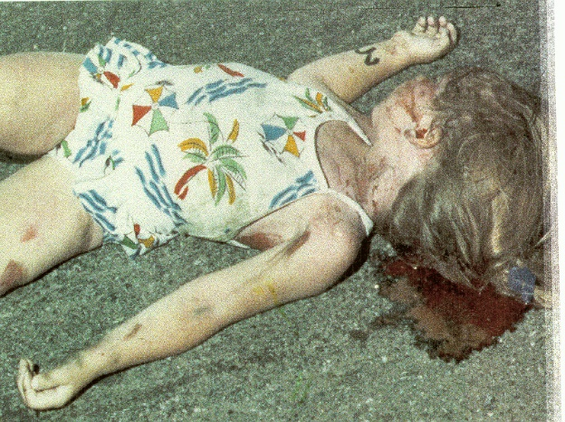
Three Collisions
Vehicle
Human
Internal
Notes:
Each time a car crashes, there are 3 collisions:
1st – the car hits an object or an object hits the car
2nd – the people in the car hit “something” (harness straps, seat belts, steering wheels, windshields or windows, or in this case, the pavement)
3rd – the person’s internal organs continue to move inside the body, especially the brain and internal organs

Slide 10
Notes:
Verbally describe the phases as the minivan, and then dummies crash around, then discuss the 3rd collision is the internal.

Slide 11
How Do Car Seats Prevent Injury?
Spread the crash force.
Concentrate the crash force on the strongest parts of the child’s body.
Allow the child to “ride down” the crash.
Provide protection for the child’s head, neck, and spinal column.
Protect the child from ejection or collision.
Notes:
Car seats are the only way to keep children safe in cars, because cars are made for adults.
The harness straps fit the child better to spread the forces. Try this: hold out your arm. Would you rather have your flat hand hit your arm (which would sting) or a “karate chop” to the bone (which could cause a break or tissue damage)?
Ride down means that the person will slow down at the same time as the car (it is dangerous to keep moving after the car has stopped).
Staying inside the vehicle is the safest place to be. If a person is ejected, their car or a passing car could run over them.
People not wearing a seat belt are 30 times more likely to be ejected from a vehicle during a crash. More than 3 out of 4 people who are ejected during a fatal crash die from their injuries.⁵

Slide 12
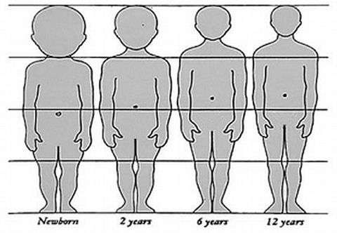
Children are more vulnerable
to injury in a crash
Large head-25% of body length.
Soft skull, immature brain.
Immature skeleton.
Weak and flexible neck/back muscles.
Flexible, narrow shoulders.
Small, round pelvis.
Notes:
Larger head-At birth the head is one-fourth the total body length, whereas in the adult it is one-seventh
higher center of gravity-
Soft skull bones- brains are jello-like and not fully snugged into skull cap
Vertibrae are made up a lot of cartilage at birth, babies are born with ~300 bones.
Spinal columns are flexible, bending up to 2 cm in either direction. But the spine cord cannot be pulled more than 5-6 mm before extensive injury
Rounded hip bones (prevents lap belt from staying low on hips)
Cars are designed to protect the ADULTS

Slide 13
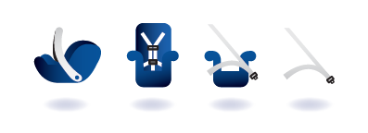
Intro: Ages and Stages
Step 1: Rear-Facing Car Seat
Step 2: Forward Facing Car Seat with Harness
Step 3: Booster Seat with Lap/Shoulder Belt
Step 4: Lap/Shoulder Belt
Notes:
We’ll discuss the 4 steps of different car seats children go through.

Slide 14
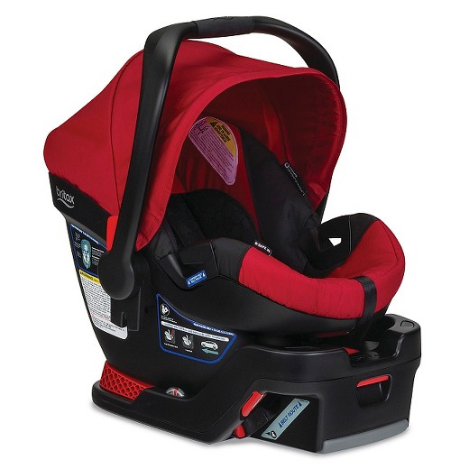
Why Rear-Facing Seats?
Supports the entire head, neck and back.
Cradles and moves with the child reducing stress to the neck and spinal cord.
Protects underdeveloped bones/ muscles.
Notes:
Think of it like a catcher’s glove which will support and move with your child’s head.

Slide 15
Notes:
https://youtu.be/h0Cx-39XRCY

Slide 16
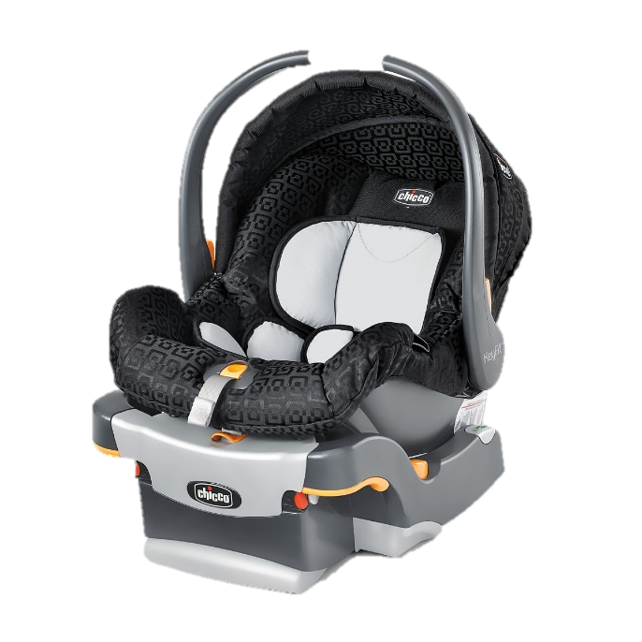
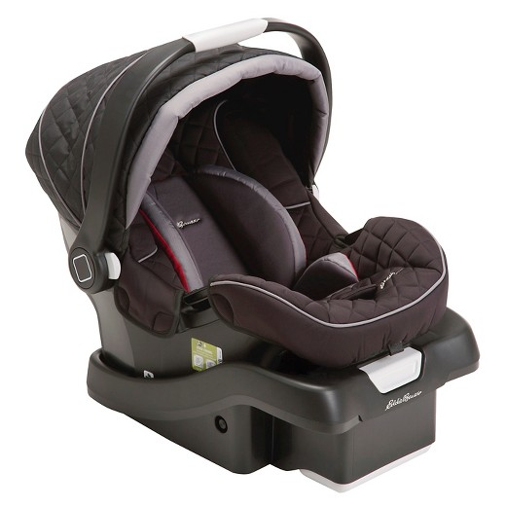
Rear-Facing Only Car Seat
Rear-facing ONLY.
4 or 5 pounds to 22/40 pounds or when head is 1” below top of shell.
Notes:
Most infant car seats have a maximum weight of 22 pounds. There are now several car seat carriers which have a 30 lb maximum weight. The Graco Snug Ride 32 has a 32 maximum weight.

Slide 17
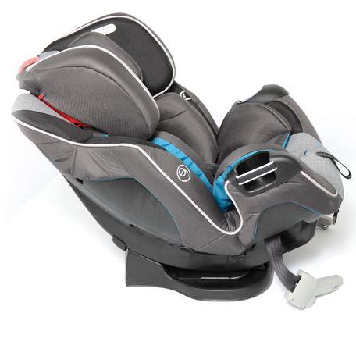
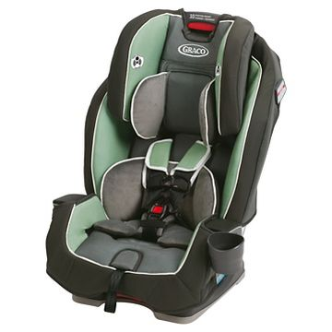
Rear-Facing Convertible
Rear-facing until 30/50 lbs or when head is
1” below top of seat.
5 Point Harness
Notes:
A convertible seat can be used rear-facing from 5 pounds until at least 30 lbs and then forward facing to at least 40 lbs. Some people use this seat instead of a carrier seat for infants. The car seat stays installed in the car (it doesn’t have a detachable carrier).
The 5-pt harness style seat can be adjusted better to a child’s body (and is better for a small child).

Slide 18
Rear-Facing Best Practice
American Academy of Pediatrics:
Children should stay rear-facing until the maximum weight or height of the rear-facing convertible seat
for OPTIMAL protection.
Notes:
Remember, no one wants the “minimum” when it comes to a child’s safety!

Slide 19
12-month old in Rear-Facing Seat
Notes:
This rear-facing convertible seat shows the movement of a frontal car crash hitting a barrier at 30 mph. The child’s entire body stays protected inside the shell of the car seat.

Slide 20
Forward-Facing Too Soon
Danger!
Increases the likelihood of serious injury or death to the child involved in a frontal collision.
Think “Shaken Baby Syndrome”
Spinal cord injuries
Traumatic brain injuries.
Notes:
When a child faces the front of the car, s/he will move forward and outside of the shell of the seat. A young child’s heavy head can put too much stress on the spinal cord and the brain can strike the skull with great force.
Think of the child’s head as a bowling ball and the spinal cord like a piece of cooked spaghetti. The weight and force of the head pulling forward is too much for the spinal cord to hold.

Slide 21
12-month old in Forward-Facing Seat
Notes:
Notice how far forward the child’s head moves in a crash. He would be safer if he was still rear-facing.

Slide 22
Why Forward-Facing Seats?
The harness system:
Dissipates crash forces over the stronger parts of the body.
Lessens the crash force on weaker bones/muscles of the child’s body.
Keeps them “in position.”
Car seats are “child-sized.”

Slide 23
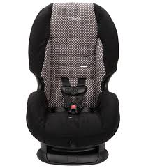
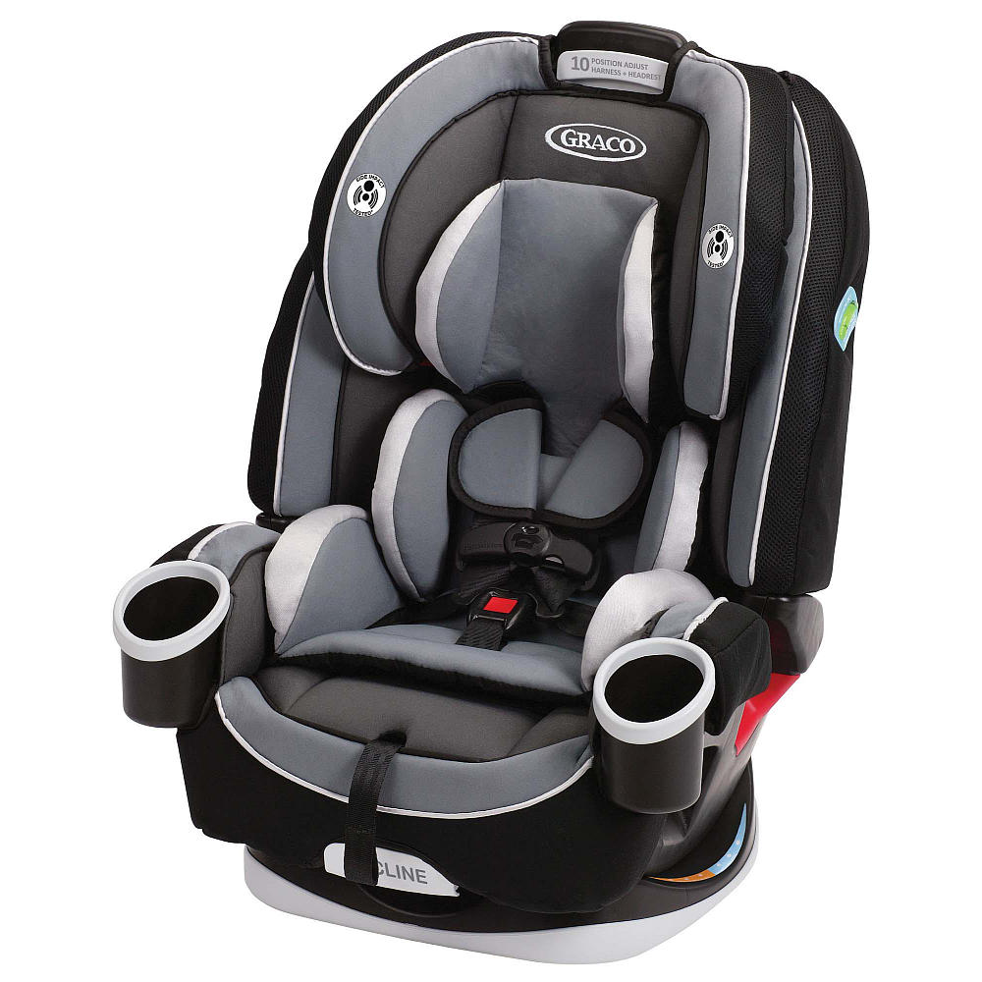
Forward-Facing Harness Seats
Combination – Harness/Booster
5 Point Harness
Notes:
Once a child reaches the rear-facing weight limit of a convertible seat, it can be turned forward and used to the forward-facing weight limit (or height limit).

Slide 24
Forward-Facing Best Practice
American Academy of Pediatrics:
Children should remain in a convertible, forward-facing, or combination seat with a full harness until they reach the top weight or height allowed by the seat for OPTIMAL protection.

Slide 25
Special Circumstances
Children who are:
Young but heavy.
Restrained by lap-only belt.
Need extra upper body support
Behaviorally “challenging”
Are ALL best protected by a full harness system.
Notes:
Some children should stay in a harnessed car seat longer.

Slide 26
Why Booster Seats?
Pre-crash positioners designed to help child fit the adult seat belt.
How?
Holds the lap portion of the belt low on the hips/upper thighs.
Pulls the shoulder belt off the neck to center of the child’s chest.
Notes:
The lap belt must fit low on the hips (where the legs bend) so that contact the bones instead of the soft belly area.
Children who use seat belts vs children who use a booster seat are at a higher risk of injury (59% higher).
Using a belt positioning booster reduces a child’s risk of injury by 45% (CDC, 2015)

Slide 27
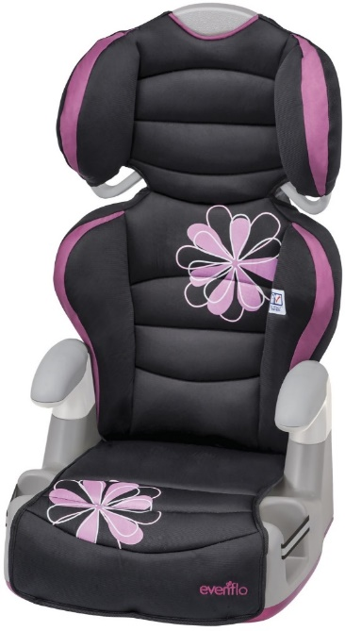
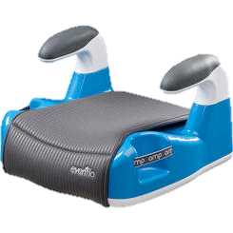
Types of Booster Seats
High back
provides head and neck support in vehicles that have no head restraints.
Backless
used in vehicles with high seat backs and/or head restraints.
Notes:
When a child is at least 40 lbs and is mature enough to stay in place in the car, a booster seat can be used. Booster seats are not attached to the car in any way. They can only be used with a lap and shoulder belt. Boosters sit on the vehicle seat and help make the seat belt fit the child properly.
Some high back seats have a removable back and can convert to a no-back booster. A high back booster might have an adjustable back which positions the shoulder belt and “grows” with the child.

Slide 28
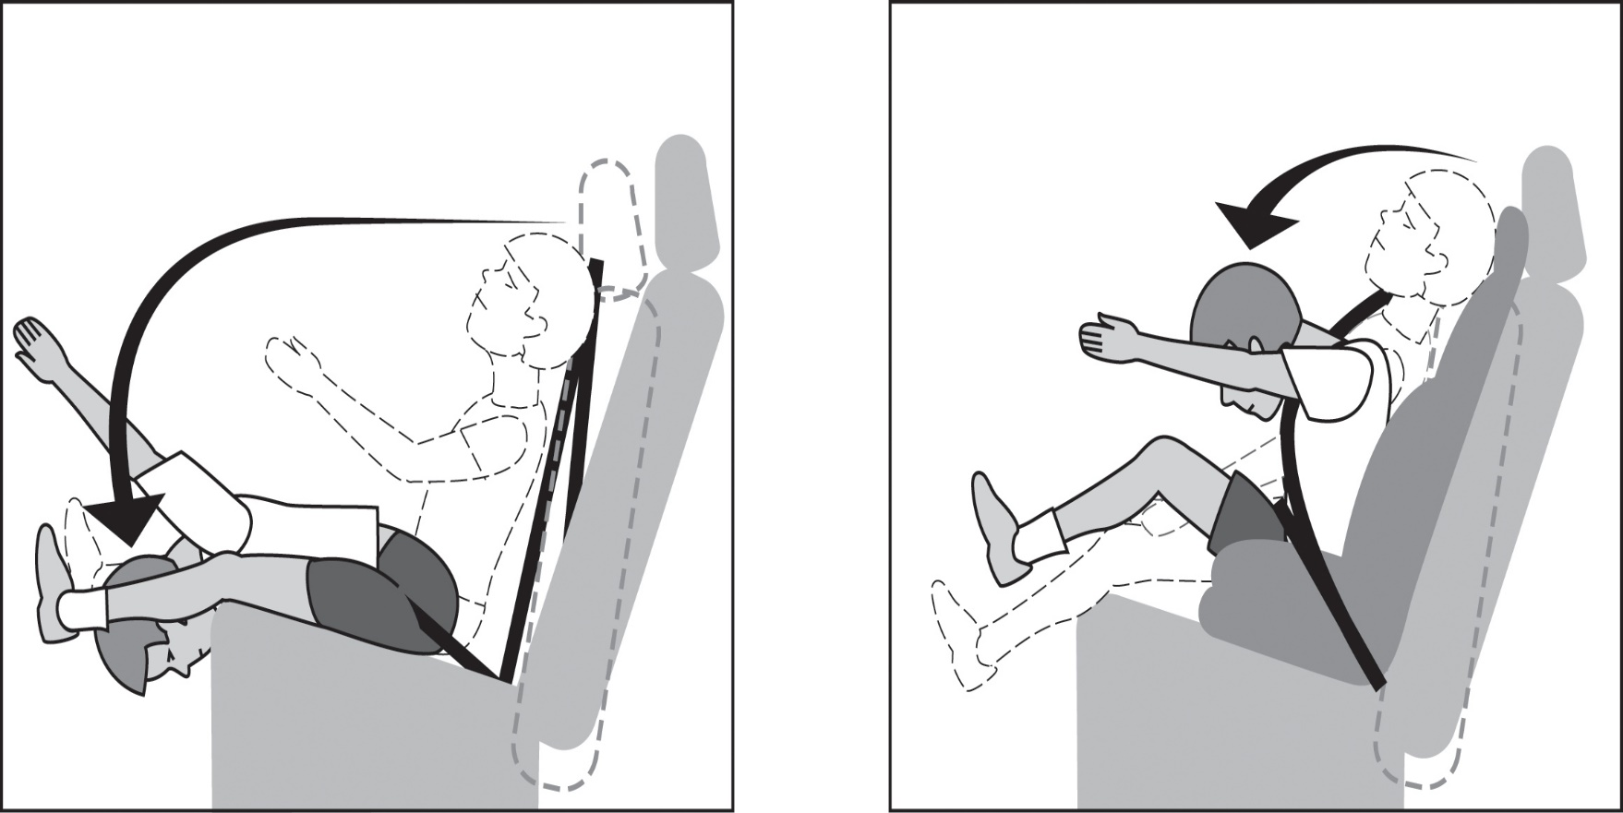
Seat Belt vs. Booster Seat
6 yr old
Notes:
The child on the left doesn’t fit the belt, so he placed the shoulder belt behind his back. Notice how far forward he pitches.
The child on the right is sitting on a booster seat and he doesn’t move as much because the belt fits him properly.

Slide 29
Booster Seat Best Practice
American Academy of Pediatrics:
Vehicle safety belts should not be used until:
the shoulder belt can be positioned across the chest with the lap belt low and snug across the thighs
the child should fit against the vehicle’s seat back with his or her feet hanging down when the legs are bent at the knees.

Slide 30
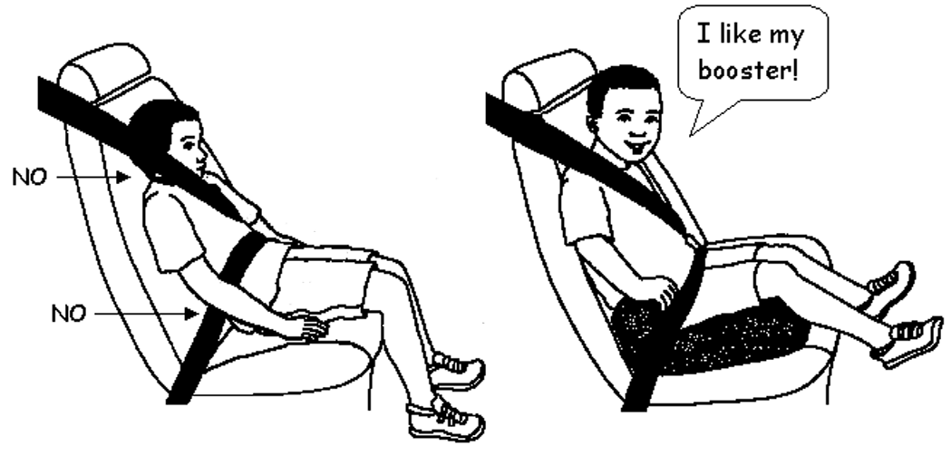
The Five-Step Test
Notes:
The Five Step Test should be “passed” before a child can graduate from a booster seat and use the seat belt.
Look at how the child on the left sits away from the vehicle seat and how the shoulder and lap belt fit poorly.

Slide 31
The Five-Step Test
Does the child sit all the way back against the auto seat?
Do the child’s knees bend comfortably at the edge of the auto seat?
Does the belt cross the shoulder between the neck and arm?
Is the lap belt as low as possible, touching the thighs?
Can the child stay seated like this for the whole trip?
If you answered “no” to any of these, the child needs a booster seat!
(Source for 5-Step Test: SafetyBeltSafe USA, a national advocacy group, with the support of the Allstate Foundation)

Slide 32
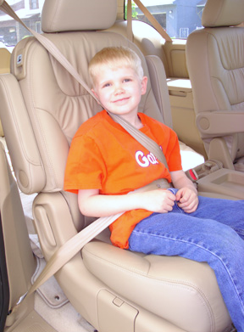
The Five-Step Test
This test should be done in every vehicle in which the child rides.
Notes:
The boy on the left shows very dangerous belt fit. Look where the lap belt is sitting on his body. It would cause severe internal injuries.
Children are all different, and so are cars. One 8 year old may fit the belt properly, but another 8 year old may not. This varies from child to child and from car to car.

Slide 33
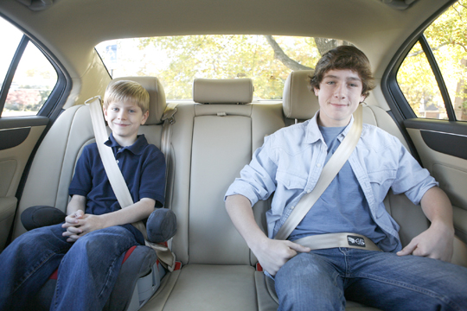
Lap/Shoulder Belt
Should be used by everyone once the 5-step test is passed.
Best protected by Lap/Shoulder Belt.

Slide 34
Notes:
Look how far forward this child pitches and bends because he is only using a lap belt (imagine he placed the shoulder belt behind his back because it didn’t fit right).

Slide 35
Car Seat Selection Practice
*Think best practice

Slide 36
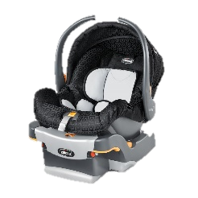
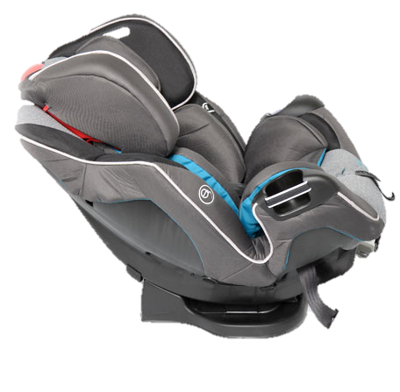
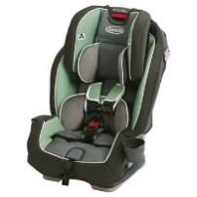
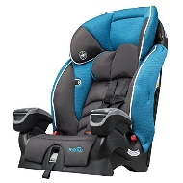
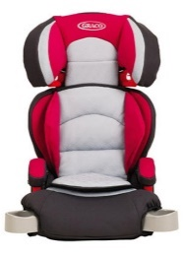
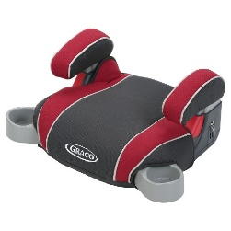
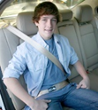
6 MO, 18 lb Child
A. Rear-facing
B. Forward Facing
C. Booster Seat
D. Seat belt
E. I cannot decide!

Slide 37
Notes:
Poll Title: 6 MO, 18 lb https://www.polleverywhere.com/multiple_choice_polls/OzZPOnl6sRtUNCP

Slide 38
4 YO, 47 lb Child
A. Rear-facing
B. Forward Facing
C. Booster Seat
D. Seat belt
E. I cannot decide!

Slide 39
Notes:
Poll Title: 4 YO, 47 lbs https://www.polleverywhere.com/multiple_choice_polls/DfgZ8pXCJyzTqoB

Slide 40
9 YO, 77 lb Child
A. Rear-facing
B. Forward Facing
C. Booster Seat
D. Seat belt
E. I cannot decide!

Slide 41
Notes:
Poll Title: 9 YO, 77 lb https://www.polleverywhere.com/multiple_choice_polls/CQVAPHFPL4nQarb

Slide 42
2 YO, 29 lb Child
A. Rear-facing
B. Forward Facing
C. Booster Seat
D. Seat belt
E. I cannot decide!

Slide 43
Notes:
Poll Title: 2 YO, 29 lb https://www.polleverywhere.com/multiple_choice_polls/CfEBLGvYlwTasx2

Slide 44
12 YO, 92 lb Child
A. Rear-facing
B. Forward Facing
C. Booster Seat
D. Seat belt
E. I cannot decide!

Slide 45
Notes:
Poll Title: 12 YO, 92 lb https://www.polleverywhere.com/multiple_choice_polls/5M1emA5fZogEpK8

Slide 46
Elements of Correct Installation
Correct Belt Path
Correct angle
Installation method

Slide 47
Choose the Correct Belt Path
Usually belt path closest to vehicle seat back
Rear-facing: near legs
Forward-facing: behind back
Always refer to the manufacturers instructions!
Notes:
Where should the seat be installed?
Lower anchors for LATCH usually use the same belt path as the seat belt.

Slide 48
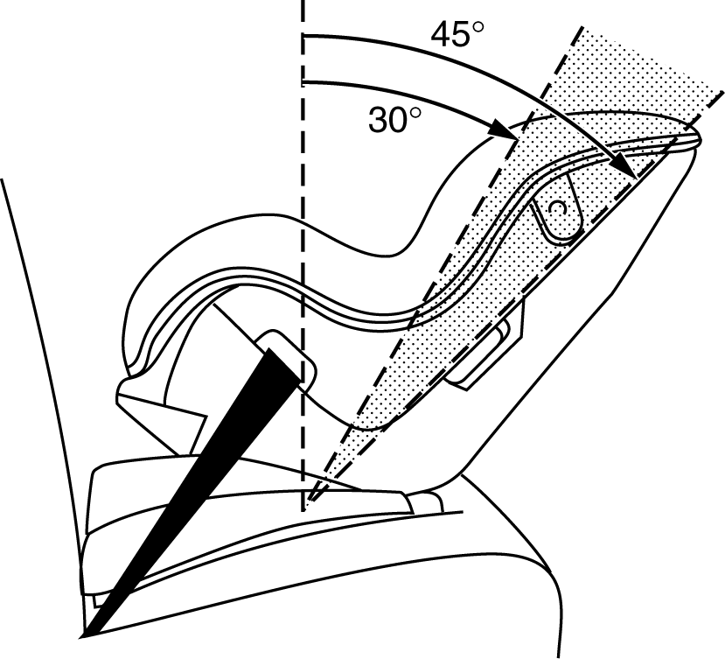
Rear-facing Recline
Vehicle seat slope may require ‘leveling’.
Use built-in recline adjuster.
May add rolled towel or noodle if permitted by manual.
Follow angle adjuster-may be single, double or even tri-mechanism.

Slide 49
Forward-Facing Recline
Generally, children should sit upright like adult occupants in vehicle.
Select car seats may permit installation in the semi-upright position, depending upon model.
That angle setting may be based on weight of child for seats with multiple angle settings.

Slide 50
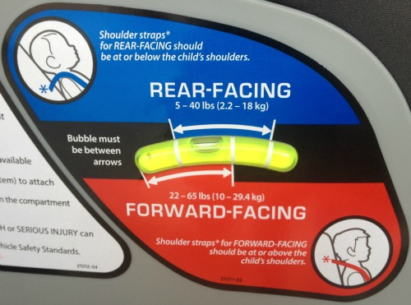
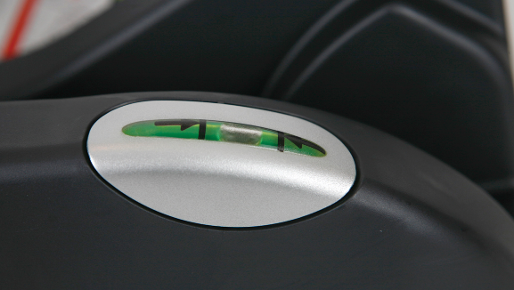
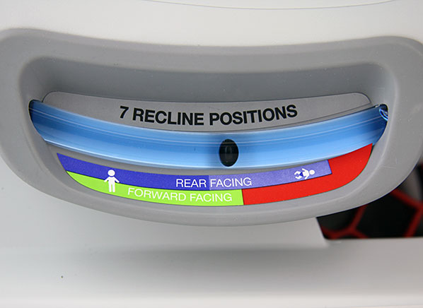
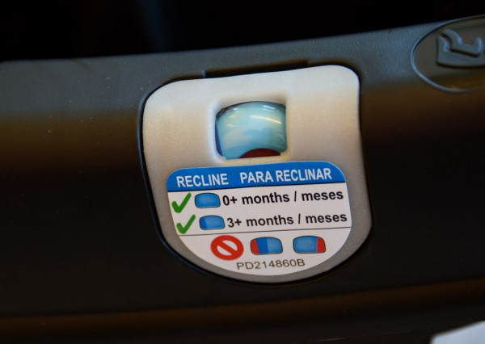
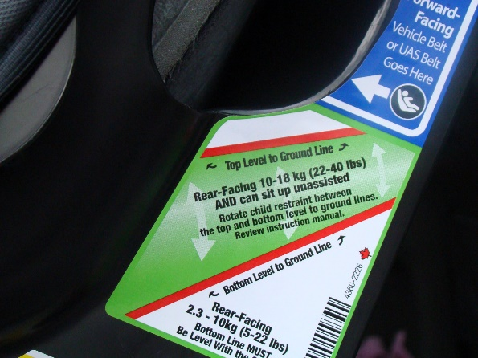
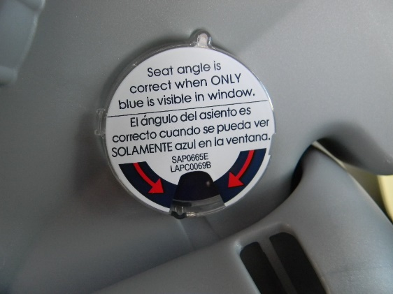
Angle Indicators
Notes:
Samples of built-in adjusters

Slide 51
Two Options for Installation
Seat Belt
LATCH system
Lap only belt
Lap shoulder belt
Tether on FF installation*
Lower Anchors
Tether Anchor on FF installation*

Slide 52
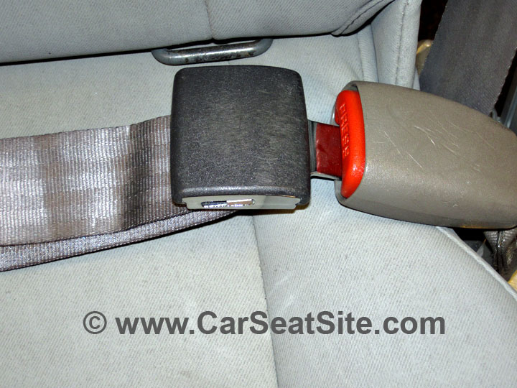
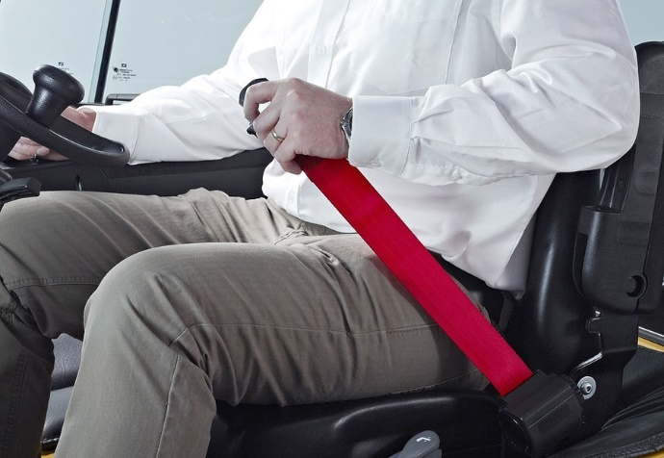
Locking the Seatbelt Lap Belt Only (usually in center pre-’08)
To Lock:
Buckle and pull belt “tail.”
Belt webbing should be in a straight line with the buckle.
To Lock:
Buckle in.
Let webbing roll back into retractor.

Slide 53
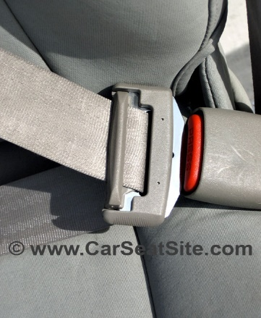
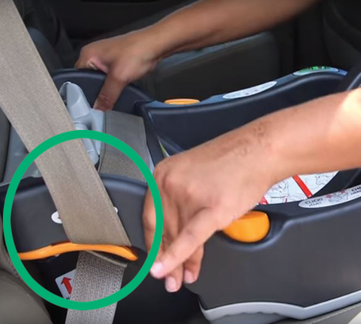
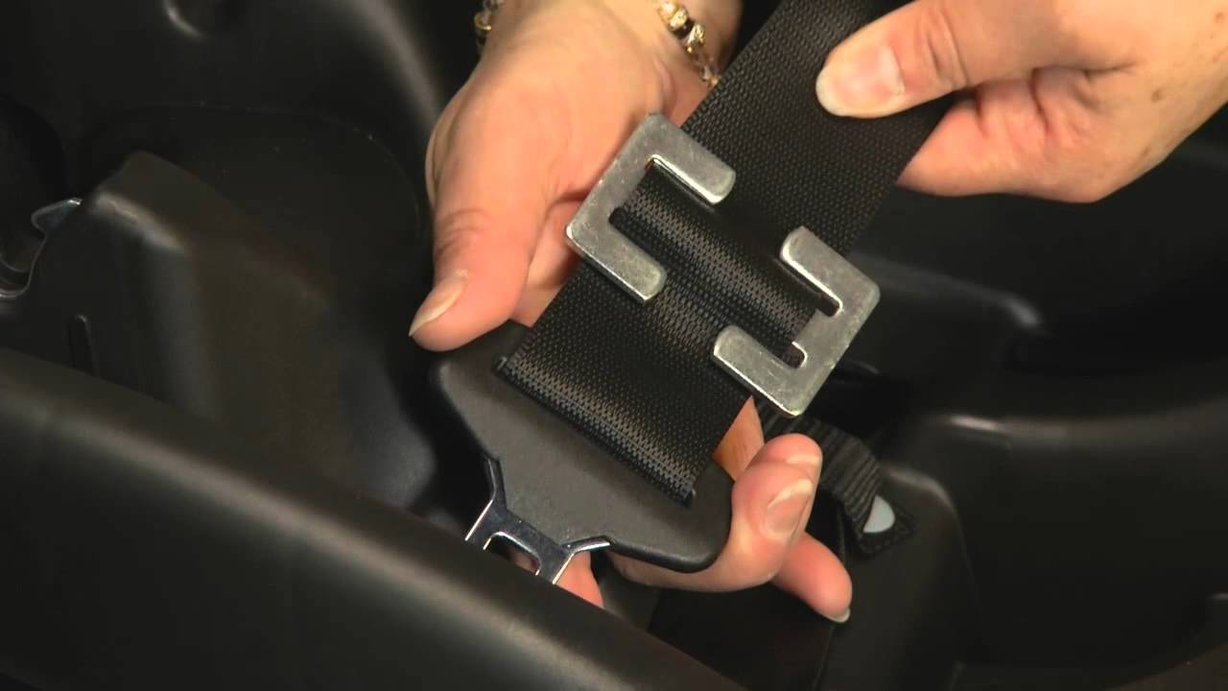
Locking the Seatbelt Lap/Shoulder Belt (next to doors/center ’08-current)
Will the belt lock if the shoulder belt is pulled out all the way out from the vehicle frame?
Will the vehicle latch plate lock?
Does the car seat have built-on lock-off?
Do you need to add a locking clip?

Slide 54
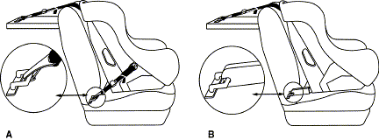
LATCH-Lower Anchors and Tethers for Children
Notes:
Confirm whether the vehicle has Lower Anchors, and the locations of the Lower Anchors (many vehicles do not have Lower Anchors in the center position).
Always use a top Tether if the car seat is forward-facing and the vehicle has top Tether anchors.

Slide 55
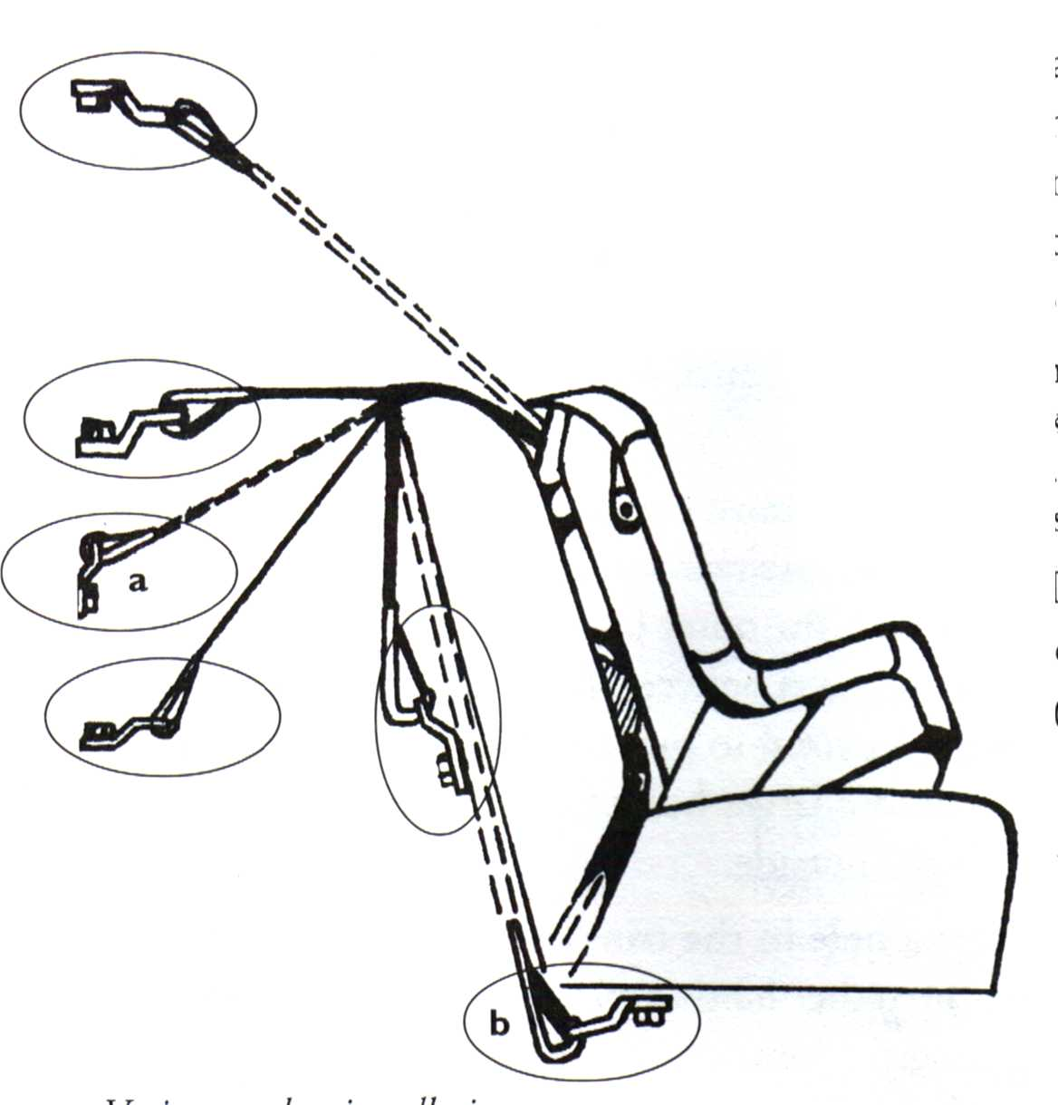
Tethers
Generally used on forward-facing seats.
Reduces forward movement of head.
May improve stability of installation.
Attaches to designated anchor point.

Slide 56
Installation Tips
No more than 1” of movement side-to-side or to the front of the vehicle at the belt path:
Install as tightly as possible with reasonable force.
Pull CRS at belt path with “weakest” hand.
*Always refer to car seat and vehicle manufacturer’s instructions!

Slide 57
Car Seat Installation Misuse

Slide 58
Installation Misuse

Slide 59
Installation Misuse

Slide 60
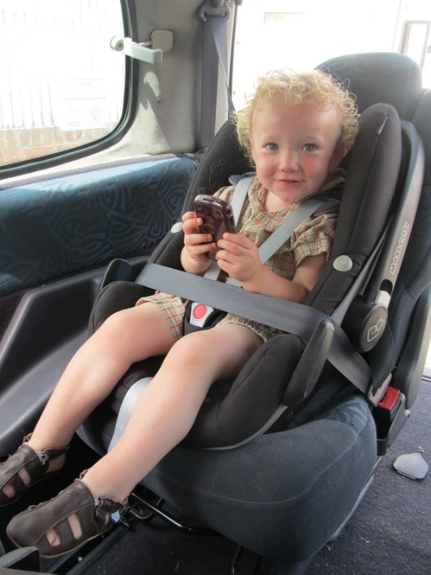
Installation Misuse

Slide 61
Installation Misuse

Slide 62
Installation Misuse

Slide 63
Location
All children 12 and under should ride in the back seat.
The center of the back seat is further from impact.*
When using LATCH system, follow vehicle instructions (LATCH anchors usually located in outboard seating positions).
Notes:
*discuss center considerations- seat belt vs LA, car seat shell sitting on top of seat belt buckles on side positions for adult riders, is it permitted per vehicle manual?

Slide 64
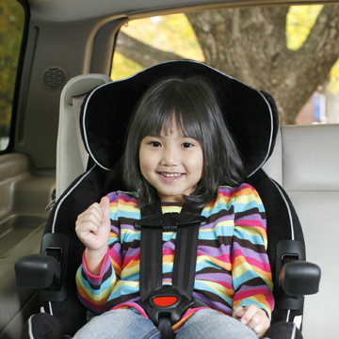
Placing the child in the seat
Child’s back and bottom flat against the car seat.
Nothing behind or underneath the child.
Buckle the harness.
Pull harness slack up starting at hips, continue through chest.
Place the harness clip at armpit level.
No snow suits/blankets/ shoulder pads around the child.

Slide 65
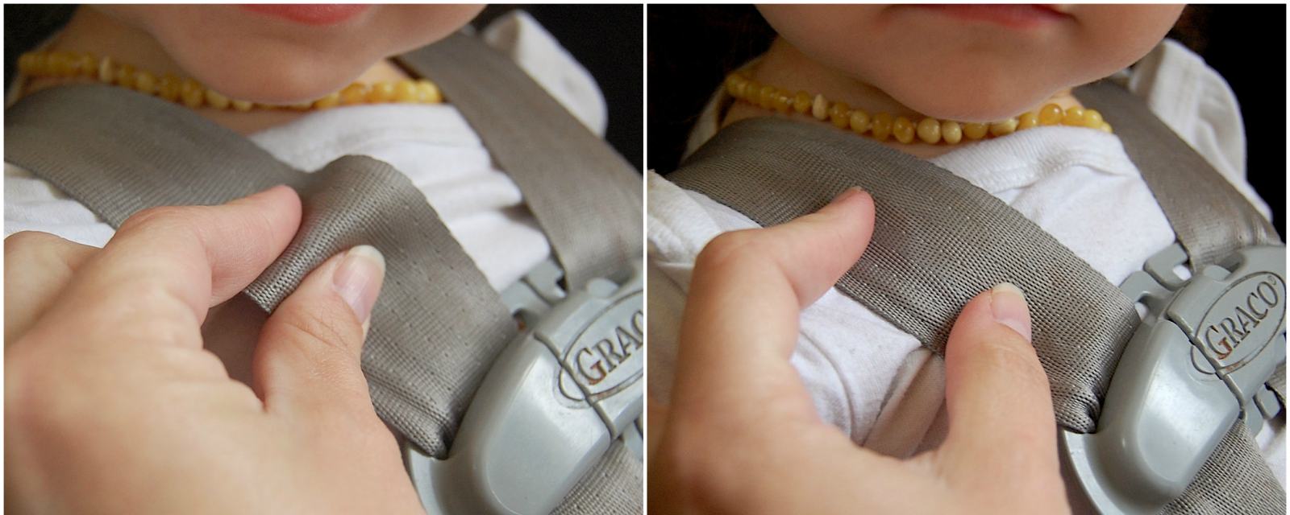
“Pinch Test”
Test at child’s collar bone.
Try to pinch webbing together.
Your fingers should slide off.

Slide 66
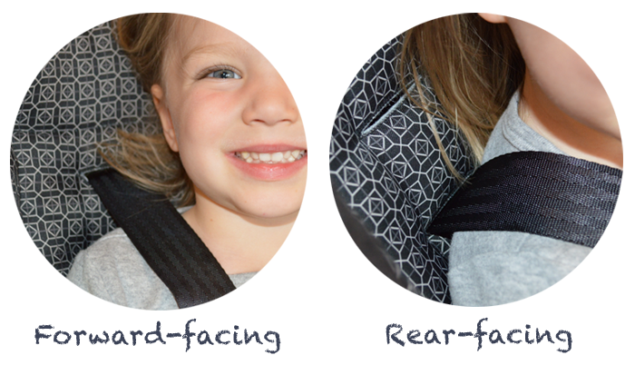
Shoulder Strap Level

Slide 67
Car Seat Harness Misuse

Slide 68
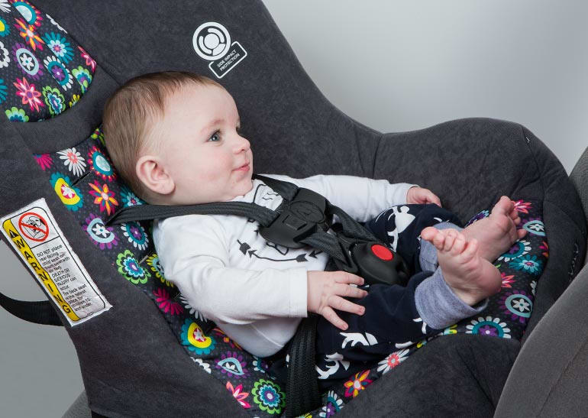
Harness Misuse

Slide 69
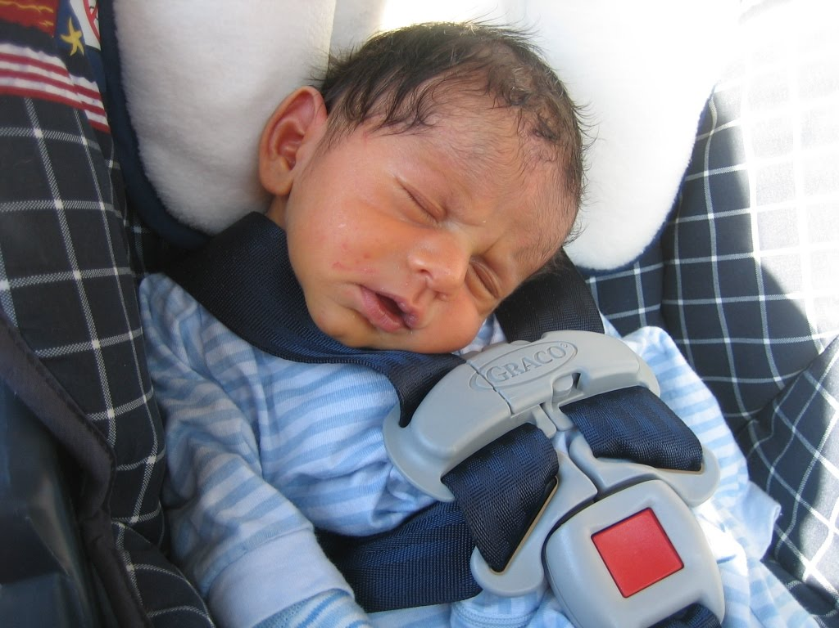
Harness Misuse
69

Slide 70
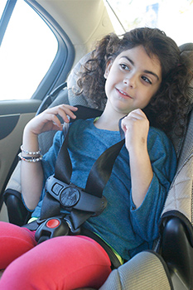
Harness Misuse

Slide 71
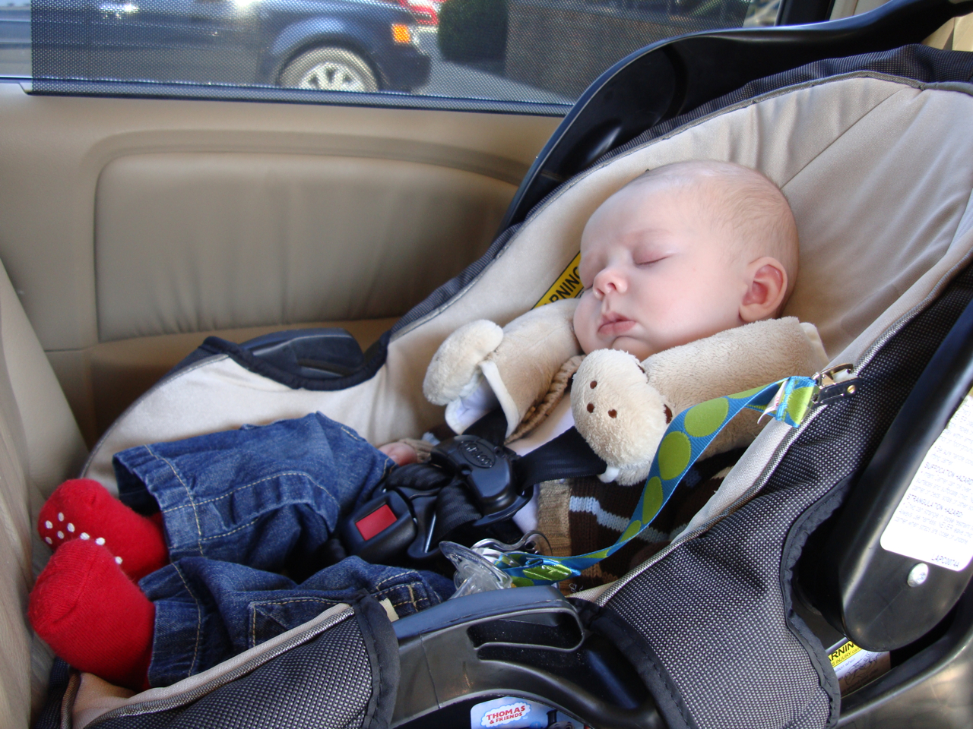
Harness Misuse

Slide 72
Harness Misuse

Slide 73
Maryland’s CPS Laws
**Effective October 1, 2013**
Every child under 8 years old must ride in a child safety seat or booster seat.*
*Unless the child is 4’9” or taller.
Notes:
Child restraint must be right for the child’s size, weight, and age
Applies to all passenger vehicles.

Slide 74
Maryland’s CPS Laws
Every child under 16 years of age must ride in a car seat, booster seat or seat belt, in EVERY seating position, in every vehicle.
A child younger than 16 years may not ride in an unenclosed cargo bed of a pick-up truck.
Notes:
This applies to all positions in the vehicle for all children under 16 riding in the car.

Slide 75
Info re: CPS Law
Law is not meant to be punitive.
If cited caregiver brings proof of restraint purchase to court date, citation and fine may be dismissed.
If unable to afford new seat, low cost purchase seats may be available in some areas of the State. (Call KISS)
If no program is available, low cost car seats we recommend caregivers purchase themselves are:
Cosco Scenara Next or Apt 50- convertible car seat
Evenflo Maestro- combination seat
Booster seats- pretty cheap

Slide 76
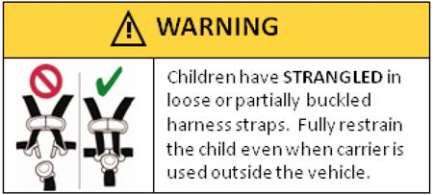
Miscellaneous Education
Remove child after transport.
Always keep child harnessed and snug if in car seat.
Remove heavy clothing as environment warms up.
Always double check the back seat for children. Develop a reminder system.

Slide 77
Miscellaneous Education
Follow the expiration dates determined by the manufacturer.
Crashed CSS? Follow instructions! Most manufacturers advise replacement.
Used CSS may have been in a crash, be too old, be recalled or may be missing parts.
Add-ons may interfere with CSS functioning or may injure child.
Notes:
Older car seats may not work as well in cars or may not be as easy to use correctly.
Call the manufacturer if you have been in a crash and want to know whether to replace the seat. Sometimes after a crash, insurance companies might pay to replace the seat.
Make sure you know a seat’s history (was it ever in a crash, how old is it, does it have all of its parts and instructions, was it recalled?) before using it or borrowing it.
Car seat inserts, strap covers, toys, and other devices or products sold in the stores should not be added to your car seat!

Slide 78
And one last thing…
Be a good role model for your child, and those you transport…
Always buckle up!

Slide 79
Resources
NHTSA Hotline 888-DASH-2DOT
NHTSA Website www.nhtsa.dot.gov
Maryland Kids In Safety Seats
800-370-SEAT
Mdh.kiss@Maryland.gov
www.mdkiss.org
Notes:
Thank you!

