Slide 1


Love in the Time of Corona:
A Homebound Self-Care Guide for Parents & Students

Slide 2
Homebound Because of CoVID?
First of all…
This is a scary time and let’s just take a moment
to FEEEEEEEEEEL that, because it is really hard.
*** Now, say the
Serenity Quote for all the stressors that we don’t have control
over. Repeat it weekly or even daily!
***
And last but not least, let’s dive into self-care, because we DO have control over how we take care of ourselves! And what’s more, we can make ourselves feel better, right alongside making our children feel better!
Grant me the serenity. To accept the things I cannot
change,
The courage to change the things I can, And the wisdom to know the difference.
(Niebuhr, 1932)

Slide 3
Why We Need Self-Care Today More Than Ever Before!
To combat all this CoVID chaos, we REALLY need to take excellent care of ourselves!!!
“The more you practice taking really good care of your body, the more it will reward you with good health, tons of clarity, energy, and the ability to experience all the good that life has to offer for years to come!” (Pan, 2015).

Slide 4

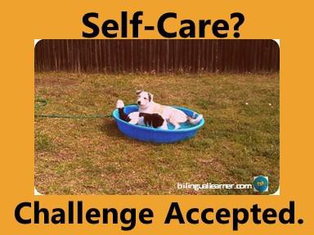
So Why is Self-Care Important?
Basically, self-care is important because it makes you feel better and extends your life! Self-care supports physical/mental health and it treats physical/mental health disorders (Harvard Health Publishing, 2017).

Slide 5
Homebound Self-Care
There are lots of things you can do at home to practice self-care. You can even involve kids in your self-care, which is really fun AND models healthy living habits for them at the same time. Let’s look at some self-care activities you can do with the whole family!

Slide 6

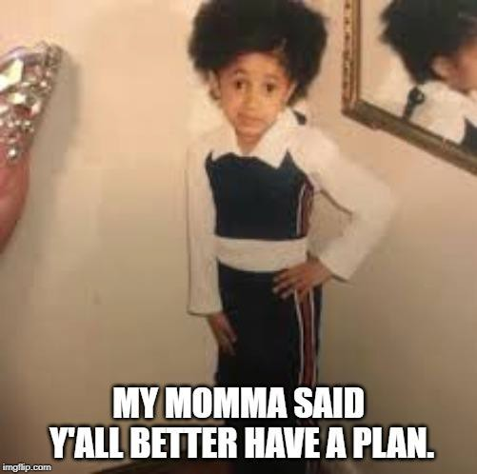
The Self-Care Activity Plan
This resource is full of various calming strategies that you can do in the home- either alone or with your kids.
You can arrange these different strategies to make a plan to relax and take your kiddos right along with you on the tranquility train!
Here we go…

Slide 7

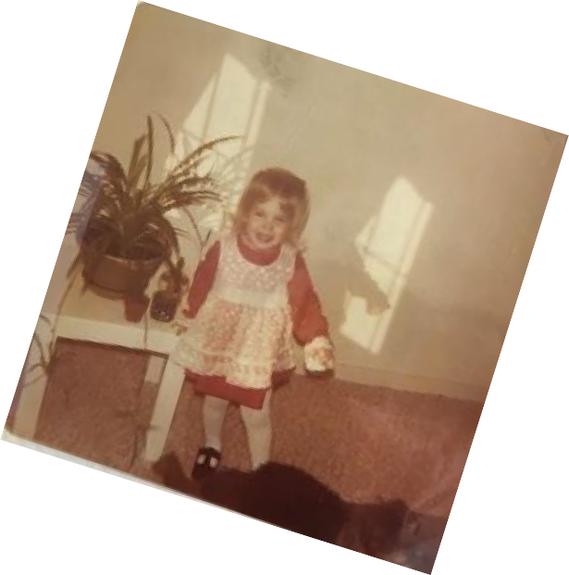
Homebound Self-Care with the Kids
Get the whole family reading the “classics” together. I still remember my dad reading Ramona and Beezus books to me. Here’s a link to a fab book list to work through with the family.
Share family stories- go through old photo albums to share stories about your family history!
Create and video a family or friend Tik Tok dance! Here’s a how-to link: Learn How to Dance the Git Up Dance Tik Tok.
Dance Party- Put on your favorite song and tell your kids that the best dancer gets a prize. Then play the song and enjoy the magic that is kids dancing for a prize!! Or jump in and dance right along with them.

Slide 8

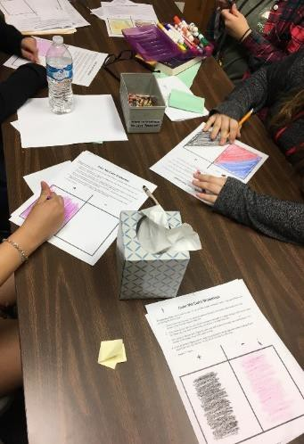
Homebound Self-Care with the Kids
Color Me Calm (Lerner, 2019) is an activity that you can do with your kids to calm everyone, yourself included!
Basic activity steps:
  Have everyone fold a paper in half and color one side their favorite color and the other side their least favorite color.
  Point to the favorite color and breathe in, imagining it filling you up.
  Point to the least favorite color and breathe out, imagining bad thoughts leaving your body in a cloud of the bad color.

Slide 9
Homebound Self-Care with the Kids
Muscle Makeover (Lerner, 2018) is an another soothing activity that you can do right alongside your kiddos. Here are the basic activity steps:
Sit upright in your chair.
Scrunch up your entire face like you just smelled something really bad.. Hold for 5 seconds and then let your entire face relax into a calm expression. Repeat four times.
Clench your fists as tight as you can and hold for 5 seconds, then release. Repeat four times.
Push your arms out at about a 35 degree angle from your body, stretching them as far as you can. Hold for 5 seconds and then release to let your arms fall gently at your sides. Repeat 4 times.
Push the soles of your feet into the floor as hard as you can, holding onto your chair or desk for
leverage. Hold for 5 seconds and release, relaxing your legs. Repeat four times.
Curl your toes inside your shoes as tight as you can, holding for 5 seconds. Then release your toes to lie flat in your shoes. Repeat four times.

Slide 10


Homebound Self-Care with the Kids
For those of you that love to read and share stories with others, bibliotherapy is the ultimate energizer!
Here are a few title suggestions for picture books that include themes of self-care that you can order right now on Amazon.
Katie Loves the Kittens by John Himmelman
The Wretched Stone by Chris Van Allsburg
A Flicker of Hope by Julia Cook
The Wonky Donkey by Craig Smith
Worry Says What by Allison Edwards
Seraphina Does Everything by Melissa Gratias

Slide 11
Homebound Self-Care with the Kids
Now let’s dive into some bibliotherapy techniques! Here is how to
make reading into self-care activity:
Tell your kids how much you love this particular book and how much it means to you- your enthusiasm will make them feel good!
Read the book, stopping along the way to work in some of the following fun, expressive activities:
  Make up a funny signal for everyone to show when you read a certain, repeating word in the story.
  Turn and Tell- what just happened in the story??
  Get silly and act out the story during the read aloud.
  At the end of the read aloud time, close eyes and imagine the next part of the story or sequel of the story. Share your ideas!

Slide 12


Bibliotherapy- Continued
3. Process the self-care themes in the book with the following discussion questions:
How does the character take care of her/himself?
How do people in your family take care of themselves to feel better?
What makes you feel better when you are having a rough day?
What did you like best and least about the story? Why?

Slide 13

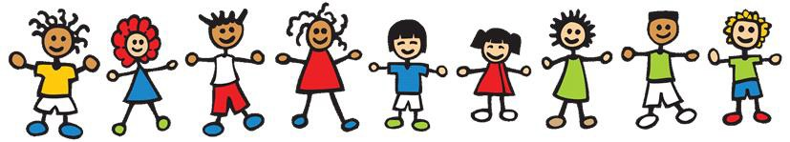
Thank You.
For all you are doing to be a calming influence and the voice of reason to everyone around you. It is hard.
Know that you are doing such great work and you are making an important and invaluable difference in the lives of everyone around you.
So much love.

Slide 14
Don’t Be a Stranger.
Contact me if I can help or offer support in any way!
Email- stephanie@schoolcounselorstephanie.com
  Instagram where you can see pics & videos (Tues Tips!) of my ideas in action- @schoolcounselorstephanie
  Website I maintain- schoolcounselorstephanie.com
PLUS!! Helpful Facebook resource groups for parents and counselors:
  The Mental Health Marketplace
  The Great State of Texas School Counselors

Slide 15
References for Self-Care
Brown, B. (2012). Daring greatly. New York: Penguin.
Butler, L. (2020). Developing your self-care plan. Retrieved from http://socialwork.buffalo.edu/content/dam/socialwork/home/self-care-kit/self-care-assessment.pdf
Dube, R. (2019) How to eat, sleep and live better, with Dr. Andrew Weil M.D. Forbes magazine. Retrieved from https://www.forbes.com/sites/robdube/2019/12/02/how-to-eat-sleep-and-live-better-with-dr-andrew-weil-md/#381e6ed2d0f2
Lerner, S. (2018). Get your group on volume 2: multi-topic small group counseling guides. South Carolina: Youthlight, Inc.
Lerner, S. (2019). Sending Students Soaring. Seattle, Washington: KDP.
Pan, J. (2015). What does self-care really mean? Retrieved from https://www.thefader.com/2015/08/11/what-does-self-care-
really-mean
Tello, M. (2017) Self-care: 4 ways to nourish body and soul. Harvard Health Publishing. Retrieved from https://www.health.harvard.edu/blog/self-care-4-ways-nourish-body-soul-2017111612736
World Health Organization. (1983). Retrieved from https://selfcarejournal.com/article/self-care-in-health-we-can-define-it-but-
should-we-also-measure-it/
Weil, A. (2011). Spontaneous happiness. New Your: Little, Brown and Company.

