Slide 1
Entering Data into Complication fields in the CDB
October 15, 2014
Maryland Department of Health and Mental Hygiene
Prevention and Health Promotion Administration
Maya King, MPH
Research Analyst
Center for Cancer Prevention and Control/
Surveillance and Evaluation Unit

Slide 2
Complications Defined
A Complication is an adverse event occurring in preparation of, during, after a procedure, or in relation to a procedure (including treatment) within 30 days of the procedure
Examples include, but are not limited to:
Colonic perforation
Bleeding or abdominal pain requiring hospitalization
Drug reaction that may require an ER visit
Stroke or myocardial infarction
Death
Notes:
The HO Memo # will change

Slide 3
Determining Complications
If a situation arises that is out of the ordinary, particularly if it leads to additional costs or provider visits, and/or you are uncertain as to whether it is a complication, consult the LHD practitioner providing medical oversight of the CPEST program and the appropriate Medical Case Manager(s) (i.e. obtain input from the clinical providers) for a determination. Contact CCPC clinical staff if you’re unable to make a determination or if further guidance is needed.

Slide 4
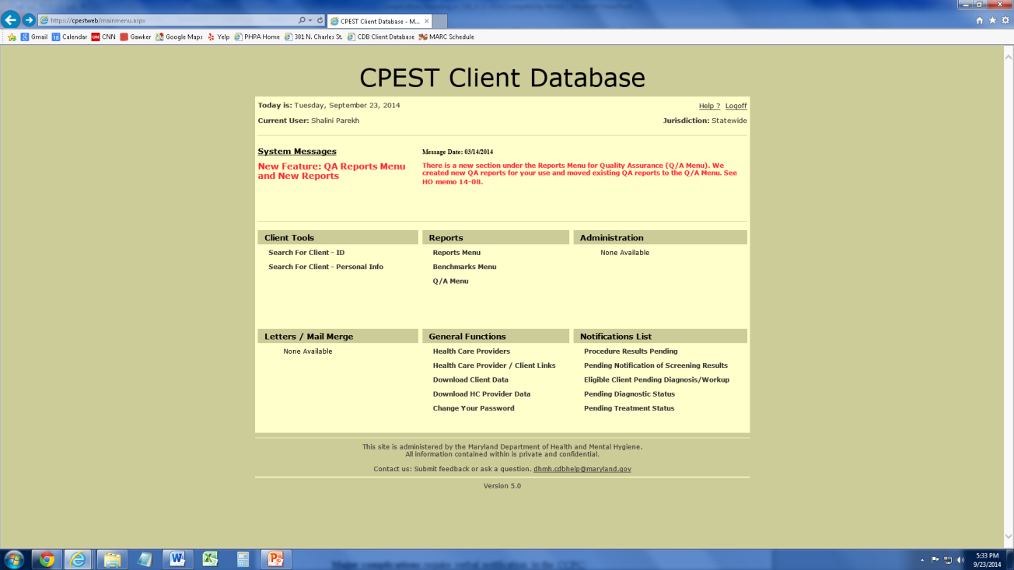
Client Database (CDB)
The Client Database, or CDB, is the online data collection system used by local CPEST staff to enter clinical data for clients receiving services paid for fully, or in part, by CRF funds through the CPEST program

Slide 5
Entering Data: What and Where
What: All client-specific complications data that meet the CPEST definition should be entered into the CDB
Where: Complications data should be entered in the complications fields for the procedure and/or treatment for which data is being entered
Notes:
HO Memo number must be updated

Slide 6
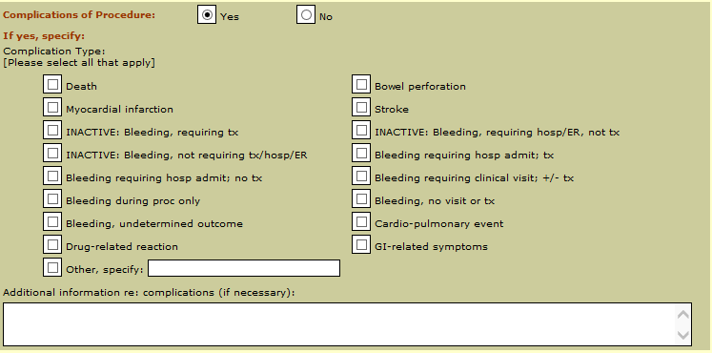
Location of Complication Fields
Most modules and/or ‘Additional Procedure’ pages have complication fields associated with it that now look like this:

Slide 7
Exception: Location of Complication Fields
Complications arising from prescreening exams and/or visits should be recorded in the Significant Findings section on page 3.

Slide 8
Complications Field
For Complications of Procedures, click the “Yes” radio button if the client has a complication(s)

Slide 9
Complications Field
For Complication Type, select all complications from the list provided that are applicable to the client

Slide 10
Complications Field
Please note that multiple complication types can be selected for one client
a
a

Slide 11
Complications Field
If “Other” is selected, please provide descriptive information for this complication in the adjacent text field
a
a
a

Slide 12
Complications Field
In the text field for Additional information re: complications, supplementary information about the complication can be provided, if necessary
a
a
a

Slide 13
Major Complications
A “major” complication is defined as a:
Perforation
Hospitalization
Bleeding that requires transfusion
Bleeding that requires unplanned endoscopic intervention
Surgery
Heart attack
Stroke or
Death
that occurs within 30 days following the procedure or treatment.

Slide 14
Major Complications
Local CPEST program staff should provide verbal notification of any major complication by telephone, fax, or e-mail to the Cigarette Restitution Fund (CRF) Programs Unit Nurse Consultant at DHMH/CCPC within 24 hours of being notified.
The CRF Program Manager may be contacted in the absence of the Nurse Consultant.
Local CPEST program staff should also inform the LHD practitioner providing medical oversight of the CPEST program for review of the case.

Slide 15
Major Complications
CCPC staff may call local CPEST program staff to collect additional information regarding major complications in your screening programs such as, procedures and costs of follow-up for complications

Slide 16
Questions?

Slide 17
Contact
Maya King, MPH
Maya.king@maryland.gov
(410-767-2033)

Slide 18
Prevention and Health Promotion Administration

