Slide 1
Community First Choice Provider Information Session
Provider Enrollment, Compliance and Claims Unit
Office of Long Term Services

Slide 2
Agenda
Payments
- Personal Assistance Agencies = ISAS/LTSS Provider Portal
- Environmental Assessments = LTSS Provider Portal
- Assisted Living = eMedicaid
Medicaid Programs: CFC, Community Options Waiver, Community Personal Assistance Services, Increased Community Services
Enrollment Process
- Providers (ePREP)
- Participants

Slide 3
NOTICE
Program does not enroll Provisional Licenses for any services
Residential Service Agencies (RSA)- Program does not enroll Level I RSA Licenses for Personal Assistance Services (CPAS, CFC, CO)
Level I Assisted Living License (ALF)- Program does not pay for Level One Services
ePREP: New Applications must be submitted through this Portal

Slide 4
ePREP
Visit the ePREP website at ePREP.health.maryland.gov!!
Addendums can be found at: https://mmcp.health.maryland.gov/Pages/Provider-Enrollment.aspx
Look for Provider Type Description: Community Options
For Personal Assistance & Other Services click on the X to the right of Community Options -Other
For Assisted Living click on the X to the right of Community Options-Assisted Living (ALF)
ePREP Call Center -- 1.844.4MD.PROV (1.844.463.7768) or email MDProviderRelations@automated-health.com

Slide 5
ePREP: Addendums
Provide information on documents to be upload with your application
Every service requires a license
Be sure to attach copies of any other requested items based on service you intend to provide:
- Including Staff credentials, certifications, background check
- Varies based on service
Don’t forget to sign the addendum and upload it under Practice Information
Note your Application # and check Portal frequently to see the status of application.

Slide 6
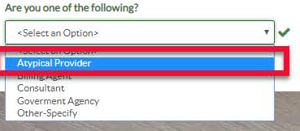
ePREP Application
New Applicant: Remember:

Slide 7
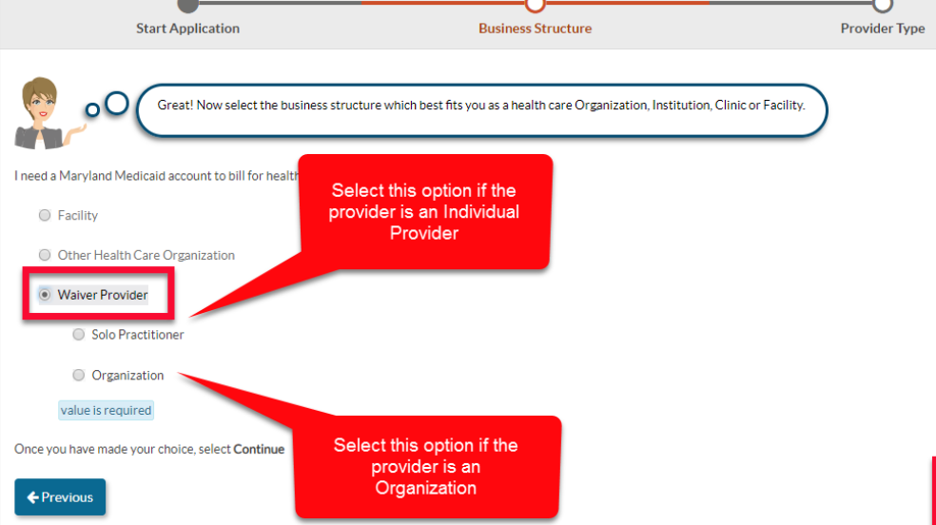
ePREP Application

Slide 8
Program Overview
The Community Options Division currently administers four Medicaid programs that serve individuals who need personal assistance services.
Community First Choice
Home and Community Based Options Waiver
Community Personal Assistance Services
Increased Community Services

Slide 9
Services Offered by Programs
 | CPAS | CFC | CO Waiver*
Personal Assistance Services | X | X | X
Supports Planning | X | X | X
Nurse Monitoring | X | X | X
Personal Emergency Back-up Systems |  | X | X
Transition Services |  | X | X
Consumer Training |  | X | X
Home Delivered Meals |  | X | X
Assistive Technology¹ |  | X | X
Accessibility Adaptations |  | X | X
Environmental Assessments |  | X | X
Medical Day Care |  |  | X
Nutritionist/Dietician |  |  | X
Family Training |  |  | X
Behavioral Consultation |  |  | X
Assisted Living |  |  | X
Senior Center Plus |  |  | X

Slide 10
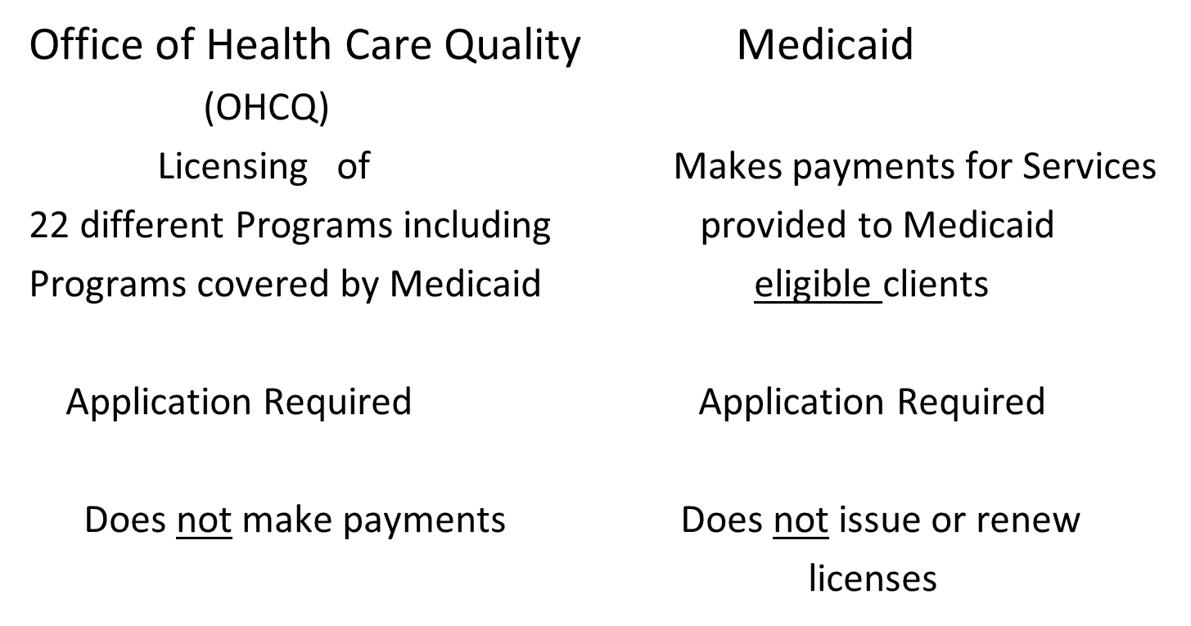
Maryland Department of Health

Slide 11
Provider Enrollment Basics
Must be licensed before you can apply!
Personal Assistance Services –Residential
Services Agency license (Office of Health
Care Quality) 410-402-8040 (Ambulatory Care)
Assisted Living-Assisted Living License
(Office of Health Care Quality) 410-402-
8217
OHCQ Website: https://health.maryland.gov/ohcq

Slide 12
Provider Enrollment Basics
Must submit a complete Medical Assistance Application
- Separate application for each Medicaid program
- Addendums vary based on the Medicaid program
- APPLY through ePREP Portal
The Provider Application for CPAS, CFC and CO Waiver is PT 76 –Community Options
Expect an Onsite Survey
Criminal Background Check documented
Licensure/other requirements current
Confirm Federal and State Tax Status

Slide 13
Provider Enrollment Basics
Providers are responsible for maintaining qualifications for licenses including the certifications and licenses of their staff
Providers are responsible for notifying the Department (OHCQ and Medicaid) of any:
- address changes
- name changes
- change in ownership
- change in Tax Id. Number

Slide 14
Provider Enrollment Basics
Providers are responsible for complying with MDH Code of Maryland Regulations
10.09.36 General Medical Assistance Provider Participation Criteria
10.09.20 Community Personal Assistance Services
10.09.54 Home and Community Based Options Waiver
10.09.81 Increased Community Services
10.09.84 Community First Choice
Any regulations specific to any other Medicaid Service provided: Home Health, Residential Services, Assisted Living, Medical Day Care, etc.
Participants have freedom of choice of providers

Slide 15
Regulation Changes: 10.09.84
Effective: 2/12/18
Settings Exclusions
Clarification on Client Representatives as Agency Employees
Clarification of items covered by Environmental Adaptations
Additions to Requirements Made of Home Delivered Meal providers

Slide 16
Provider Enrollment Basics
Provider Agreement Section of All Medicaid Applications including PT 76:
F. To check the Federal List of Excluded Individuals/Entities on the Health and Human Services (HHS) Office of Inspector General (OIG) website prior to hiring or contracting with individuals or entities and periodically check the OIG website to determine the participation/exclusion status of current employees and contractors. To check the Federal System for Award Management (SAM) prior to hiring or contracting with individuals or entities and periodically check the SAM website to determine the participation/exclusion status of current employees and contractors.

Slide 17
Provider Enrollment Basics
Provider Agreement Section of All Medicaid Applications including PT 76:
G. To check the Maryland Medicaid List of Excluded Providers and Entities prior to hiring or contracting with individuals or entities and periodically check the website to determine the participation/exclusion status of current employees and contractors. The Provider further agrees to not knowingly employ, or contract with a person, partnership, company, corporation or any other entity or individual that has been disqualified from providing or supplying services to Medical Assistance Recipients unless the Provider receives prior written approval from the Department;

Slide 18
Provider Enrollment Basics
Provider Addendum Section of PT 76 Community Options Applications PT 76:
Agree to cooperate with required inspections, reviews, and audits by authorized governmental representatives
Agree to maintain and have available written documentation of services, including dates and hours of services provided to participants for a period of 6 years, in a manner approved by the Department.
Record Retention

Slide 19
Provider Enrollment Basics
Under CFC and CPAS Regulations, an agency that provides personal assistance services shall:
Employ individuals to provide personal assistance services who meet the qualifications
Employ a registered nurse who may delegate nursing tasks
Allow participants to have a significant role in the selection and dismissal of the providers of their choice
Be licensed as a Residential Service Agency under COMAR 10.07.05

Slide 20
Provider Enrollment Basics
Know what your license permits: Residential Service Agency
Know which Medicaid Program will pay you for the service you provide. Are you enrolled with that program?
CPAS, CFC & CO require enrollment as a Community Options – Other PT Code 76.
Note: CPAS & CFC require Residential Services Agency Licenses: Level II - RN Supervision of Aides with medications administration; or
Level III - Complex Care provided by RN, LPN & RN Supervision of Aides
* CPAS & CFC do not enroll Level I Agencies

Slide 21
Provider Enrollment Basics
RSA License: Skilled Nursing, Occupational Therapy, Physical Therapy
May be eligible to apply for other Medicaid Programs
Cannot do Personal Assistance under CFC Programs
Can enroll to provide service such as Environmental
Assessment, Behavioral Consultation, Family and
Consumer Training

Slide 22
Provider Enrollment Basics
A Personal Assistance Agency licensed as a Residential Service Agency must
provide a Registered Nurse able to:
Participate in developing the client’s plan of care
Determine whether the client requires the services of a CNA & Med. Tech
Participate in training and retraining the individuals who will provide the care.
Oversee implementation of the care plan
Provide delegation, if needed *Requires class offered by MBON
Provide periodic on-site supervision of care (COMAR 10.07.05. 12)
\

Slide 23
Provider Enrollment Basics Nursing Responsibilities RSA vs. LHD
Personal Care Agency Responsibilities
Employ RN’s as Supervising Nurses to:
Develop Plan of Care (POC)
Train personal assistants (based on POC)
Supervise personal assistants by Registered Nurse
(Frequency determined by RN and COMAR
10.07.05)
Delegate nursing tasks, as necessary
Provide personal assistance according to the POC

Slide 24
Provider Enrollment Basics Nursing Responsibilities: RSA vs. LHD
Local Health Department Responsibilities
Quality monitoring
Complete subset of interRAI tool (confirm no significant changes)
Develop Nurse Monitoring visit frequency*
Report any significant findings via Reportable Events and OHCQ Complaint Form
*Minimum contact every 6 months

Slide 25
Provider Enrollment Basics-Assisted Living
Know what your license permits: Assisted Living (COMAR Regulation 10.07.14)
Know what the Medicaid Program expects (COMAR10.09.54)
Are you enrolled with this program?
Reminder: Program does not enroll Level I Assisted Living Facilities nor does it pay for services if the resident is Level I.

Slide 26
Provider Enrollment Basics
Personal Assistance Service-Criminal Background Checks
CPAS and CFC will only accept a State Criminal Record Check as performed by CJIS
Criminal Record Check must issued under Agency Name
Private Criminal Background Check are not accepted
Do not accept background check from other Agencies!

Slide 27
Provider Enrollment Basics
Assisted Living Service-Criminal Background Checks
Assisted Living Regulations 10.07.14.19 Other Staff
Qualifications:
B. (3) Have no criminal convictions or criminal history that indicates behavior that is potentially harmful to residents, as evidence through a criminal background check completed with 30 days before employment
Note: Community Options Waiver requires A State Criminal Record Check perform by CJIS

Slide 28
Participant Enrollment
Participant is Eligible for Medicaid
Assessed by Local Health Department
Applicant selects Supports Planner
Develops Plan of Service that identifies an MA enrolled provider
Department approves Plan of Service
Authorization to Participate approved; participant and provider receive a letter from MDH to confirm start date
Services may begin

Slide 29
Participant Enrollment
Participants must apply to the program and complete a multi-step process in order to enroll
Participants must meet medical, technical, and financial eligibility requirements
They must have a signed and approved Plan of Service (POS)
Participant and Providers must sign the POS
Department approves the plan to authorize services
No services can begin without an approved POS and the
participant being enrolled

Slide 30
Participant Enrollment
Supports Planners act as case managers for the participants
- Coordinate community services and supports for participants
- Develop and get signatures on the plan of service
- Complete the participant's enrollment process
- Communicate with providers about the plan of service
- Initiate and terminate services as necessary based on participant needs and interests

Slide 31
Participant Enrollment
Supports Planning Agencies:
The Bay Area Center for Independent Living (BACIL)
The Coordinating Center (TCC)
Medical Management and Rehabilitation Services (MMARS)
Beatrice Heart and Healthcare Agency
The Local Area Agencies on Aging (AAAs)
Independence Now, Inc.
Service Coordination, Inc.

Slide 32
Provider & Participant Interface
Make sure you have an approved POS and that participant is enrolled before rendering services!
Services rendered without complete approvals will not be paid:
participant enrolled
provider enrolled,
approved POS
Note: Because a person has Medicaid does not mean they have a Category of Medicaid that is eligible for services
Example: MA Eligibility Code SO3 and SO7 are not eligible
for CFC, COW, CPAS or ISAS

Slide 33
Provider & Participant Interface
Because a person has Medicaid does not mean they
have a Category of Medicaid that is eligible for services
and payment under CFC, CPAS or the Home and
Community Based Options Waiver!
Note: Participants with MA Eligibility Code SO3 and SO7 are
not eligible for CFC, COW, CPAS

Slide 34
Provider Enrollment
Direct Deposit
Agencies interested in direct deposit should register for Electronic Funds Transfer payments by downloading the gadx-10 form found on the website below:
http://comptroller.marylandtaxes.com/GovernmentServices/ State_Accounting_Information/Electronic_File_Transfer/
The form is also included with the PT 76 application you complete.

Slide 35
Contacts/Program Information
Need help with ISAS- Personal Assistance Billing:
Visit www.ltsstraining.org, or call 1-855-463-5877 or email: ISASHelpDesk@feisystems.com
Need information on eMedicaid billing:
https://encrypt.emdhealthchoice.org/emedicaid/
If you have any questions about this presentation, call 410-767-1065 or email: warren.sraver@maryland.gov
Office of Health Care Quality (OHCQ) : 410-402-8015
Information on Medicaid Programs: https://mmcp.mdh.maryland.gov/Pages/Home.aspx

