Slide 1
Carroll County
Local Health Improvement Coalition
LHIC Annual Conference
November 12, 2014

Slide 2

Connecting people. Inspiring action.
Strengthening community.

Slide 3
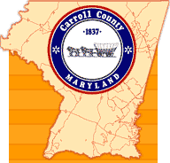


“To create and sustain a community
of wellness in Carroll County”
At Carroll Hospital Center,
we offer an uncompromising commitment
to the highest quality health care experience
for people in all stages of life.
We are the heart of health care
in our communities.
“Striving to build the capacity of individuals
and organizations to improve the health and
quality of life in Carroll County, Maryland”
Notes:
So the Health dept. and the hospital looked at their mission statements T
and created a new non profit agency to address the CHAP concerns
We have found a lot of value in being a-political/ neutral agency- not government, not hospital or health department
No baggage but getting to make use of the best those agencies have to offer

Slide 4
Local Health Improvement Coalition
The Partnership for a Healthier Carroll County Inc.
Board of Directors serves as Carroll County’s Local Health Improvement Coalition-LHIC.
Members represent: public and private schools, colleges, law enforcement, health department, hospital, physician health organization, libraries, businesses, city government, pharmacists and citizens.

Slide 5
Carroll County Local Health Improvement Coalition Priorities
(Prior to 2011)
Behavioral Health
Oral Health
Tobacco
Nutrition – Obesity and Salmonella
Heart Disease and Cancer
* Beginning with the 2011 CHNA- LHIC priorities and Hospital Community Benefit aligned with CHNA

Slide 6
Behavioral Health –
Outpatient Mental Health Clinic Model
2011:
Emergency Room visits diverted to OMHC.

Slide 7
Behavioral Health –
Community Benefit/Health Improvement Plan
Objective:
Ensure Carroll County residents have access to integrated, principle-driven mental health systems of care providing recovery/resiliency-oriented services. The availability of prescription drugs for potential misuse or illicit use will be reduced, the percentage of Carroll County adults who
smoke will be reduced.
Example Strategies:
1. Continue current programming:
a. Partner with the Maryland Department of Health and Mental Hygiene, Carroll County Youth Services Bureau and others to improve communication and resources for mental health.
b. Promote mental health provider education and outreach —radio talks on WTTR regarding depression and other top mental health issues.
c. Promote availability of The Partnership’s substance abuse and mental health resource directory for the community.

Slide 8
The Most Appropriate Setting
Initiatives:
Pain Management Contracts
Care Connect – Health Navigators
SBIRT
Care Plans
Peer Recovery Support Specialist

Slide 9
A Collaboration with Results

Slide 10
A Collaboration with Results
 | FY12 |  | FY13 |  | Reduction from previous year |  | FY14
High Utilizers* | 87 |  | 58 |  | 33%
 | FY12 |  | FY13 |  | Reduction from previous year |  | FY14
High Utilizers** | 83 |  | 49 |  | 41%
*(patients with 3 or more IP admissions)
** (patients with 10 or more ED encounters)

Slide 11
Behavioral Health
Carroll Hospital Center
Emergency Department visits and Hospital Admissions for Behavioral Health Diagnosis 2011 - 2013
DATA SOURCE: Carroll Hospital Center

Slide 12
Oral Health –
Access Carroll Dental Clinic
2000:
Pediatric dental clinic established at Carroll County Health Department to serve
Medicaid children.
2013:
Access Carroll services expanded to include dental services.

Slide 13


“To create and sustain a community
of wellness in Carroll County”
At Carroll Hospital Center,
we offer an uncompromising commitment
to the highest quality health care experience
for people in all stages of life.
We are the heart of health care
in our communities.
“Striving to build the capacity of individuals
and organizations to improve the health and
quality of life in Carroll County, Maryland”
“A Health Care Home for uninsured, low-income people”
Notes:
So the Health dept. and the hospital looked at their mission statements T
and created a new non profit agency to address the CHAP concerns
We have found a lot of value in being a-political/ neutral agency- not government, not hospital or health department
No baggage but getting to make use of the best those agencies have to offer

Slide 14
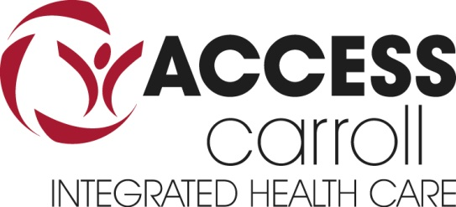
Serving the Low-Income of Carroll County, Maryland
An Integrated, Patient-Centered,
Medical Home

Slide 15

DENTAL CARE
Family Dental Care Services: Prevention, Diagnostics, Restorative, and Extractions
Opened full time July 2013 (part time in May 2013)
Monday thru Friday by Appointment
Sliding Fee Scale – based on family income
Soon: Accept Insurance with new ACA expansion
FY 2014 – First Full Year Operations
  2,201 Dental Encounters
  1,785 Extractions
  2,519 Exams/X-Rays
  128 Dentures

Slide 16
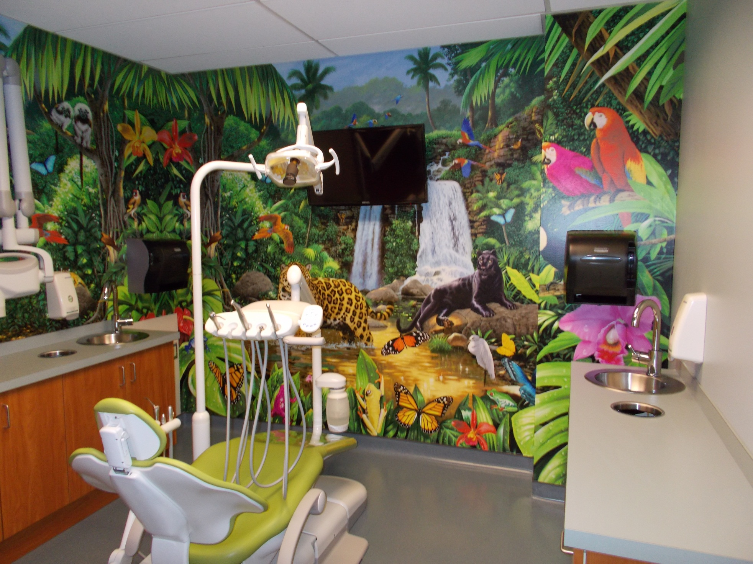

Slide 17
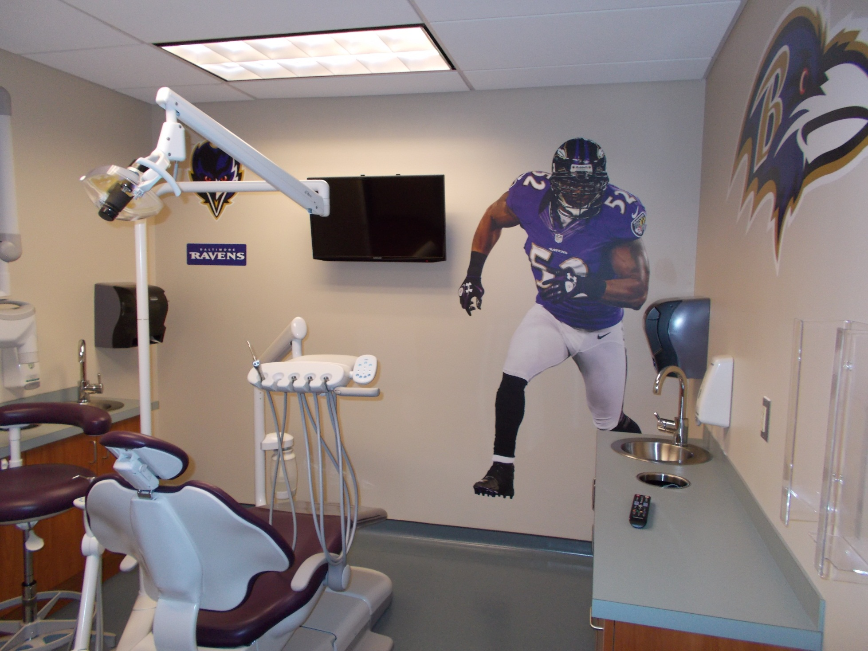

Slide 18
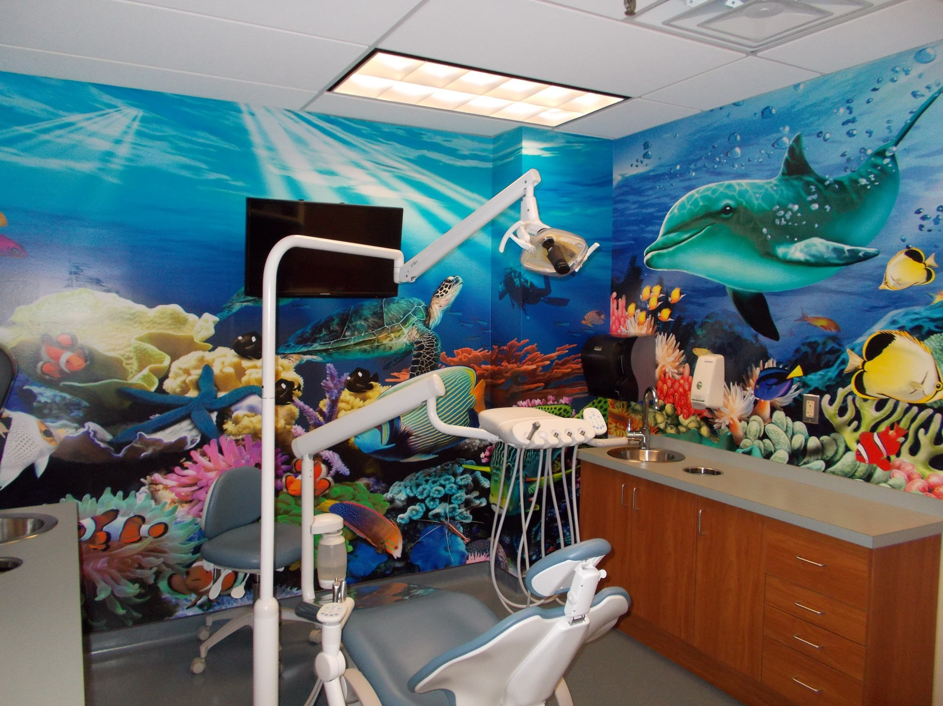

Slide 19
Obesity

Slide 20
Obesity – Community Benefit/Health Improvement
Objective:
Reduce the prevalence of overweight and obese adults in Carroll County; decrease the associated chronic and/or acute disease risks. Improve nutritional behaviors of children and families; inspire and empower individuals, including low income and minorities, to healthier eating behaviors
Example of Strategies:
1. Continue current programming:
a) Lose to Win Wellness Challenge – offer this 12-week program in partnership with Martin’s Food Market and area fitness centers. This comprehensive program promotes weight loss through nutrition, exercise and healthy lifestyles.
b) Nutritional screenings – offer screening sessions with a registered dietitian to assist people in improving nutritional health and well-being.
c) Cooking with the Doc – offer this nutrition program with a focus on the development of healthy lifestyles, a nutritious diet and exercising to reduce the risk
of developing health-related problems related to
weight.

Slide 21
Population Health Governance
Multi-agency coordination for Healthcare needs
Address duplication of efforts
Coordinate care needs based on health risk needs assessment
Design a conceptual framework for population health
Advise the LHIC and prioritize population health initiatives

Slide 22
Population Health Governance
Carroll County Health Department
Carroll Hospital Center
Carroll PHO/Carroll ACO
Access Carroll
The Partnership for a Healthier Carroll County
Carroll County Government (Citizen Services)

Slide 23
“To create and sustain a community
of wellness in Carroll County”
At Carroll Hospital Center,
we offer an uncompromising commitment
to the highest quality health care experience
for people in all stages of life.
We are the heart of health care
in our communities.
SHIP/LHIP
CHNA
CB
“Striving to build the capacity of individuals
and organizations to improve the health and
quality of life in Carroll County, Maryland”
PHGG
Notes:
So the Health dept. and the hospital looked at their mission statements T
and created a new non profit agency to address the CHAP concerns
We have found a lot of value in being a-political/ neutral agency- not government, not hospital or health department
No baggage but getting to make use of the best those agencies have to offer

