Slide 1
West Baltimore HEZ Year-in-Review 2013 to 2014

Slide 2
Why an HEZ in West Baltimore?
Cardiovascular disease three times higher than in other communities in Maryland
20% of families below poverty—compared to 6% in Maryland and 17% in Baltimore City
Life expectancy up to 12 years shorter than in other parts of Maryland
Designated a medically-underserved community
More than half of emergency room visits are avoidable

Slide 3
West Baltimore Primary Care Access Collaborative (WBPCAC)
Sixteen FQHCs, hospitals, community-based organizations, colleges and universities
Began forming in 2010
Oversee the HEZ project

Slide 4
WBPCAC Members
FQHCs
Baltimore Medical System
Park West Health System, Inc.
People’s Community Health Centers
Total Health Care, Inc.
Hospitals
Bon Secours Baltimore Health System
Maryland General Hospital
Saint Agnes Hospital
Sinai Hospital of Baltimore
University of Maryland Medical Center
Community-Based Organizations
Equity Matters
Light Health and Wellness Comprehensive Services, Inc.
Mosaic Community Services
National Council on Alcohol and Drug Dependence, Maryland
Academic Institutions
University of Maryland, Baltimore
Coppin State University
City and State
Senator Verna Jones-Rodwell
Baltimore City Health Department

Slide 5
Reducing Heart Disease
Targeting 86,000 West Baltimore residents in ZIP Codes 21216, 21217, 21223, and 21229 who are:
Overweight or obese
Cigarette Smokers
Have heart disease and are high utilizers of the emergency room

Slide 6
Categories of Activities
Strengthen patient
Strengthen community
Strengthen healthcare providers
Strengthen community partnerships

Slide 7
West Baltimore HEZ Accomplishments by the Numbers

Slide 8
Achievements in Increasing the Number of Health Care Providers
23 New healthcare providers recruited to the HEZ
11 New Community Health Workers deployed
352 Community members partnered with Community Health Workers

Slide 9
Achievements in Increasing Community Resources for Health
11 FREE weekly fitness classes
348 new “exercisers” (25% regularly attend)
14 people educated through Stanford Disease Management Course
14 Cooking Classes offered (120 attendees)
$15,000 grant from PNC Bank to support “Passport to Health” health & fitness rewards program
468 community members enrolled in Passport to Health

Slide 10
Achievements in Increasing Community Resources for Health (cont.)
$53,000 from Bon Secours Health System to support new nutrition program
Year-in-Review Event
Fitness demonstrations
Cooking demonstrations
>100 in attendance -- appx. 50% community members

Slide 11
Achievements in
Building Capacity in the Community
$70,000 grants awarded to seven community partners for CVD programming
89 community members trained through free Community Health Worker trainings
53 community partners trained through free workshops on:
Grant-Writing
Health Literacy and Written Products Development
Business Communications

Slide 12
Achievements in Building Capacity of Primary Care Professionals
Care Coordinators’ Operations Team monthly meetings
Patient-Centered Medical Home Retreat
Care Transitions Team

Slide 13
Year 1 Challenges
Staff recruitment and retention
Inability to identify appropriate vendor to provide “PCMH Culture” training and technical assistance
Delay in finalizing development of outreach and care coordination electronic tracking software
Resulted in $185,000 of unexpended funds

Slide 14
Remedies for Year 1 Challenges
Enlist Recruiter in search for project staff; expand number and type of publications in which positions are advertised
Strengthen partnership with Human Resources to secure consultation on identifying and retaining qualified staff
PCMH Culture Curriculum Development Workgroup is in progress
Outreach and care coordination software currently being tested

Slide 15
Proposed Use for Unexpended Funds
Carryover funds and increase budget for “PCMH Culture” curriculum development ($95,000)
Carryover funds to expand capabilities of outreach and care coordination tracking software; explore interoperability options ($40,000)
Carryover funds to continue to employ Project Officer for Community Partner Grants ($10,000)
Increase budget for “targeted interventions” to enhance nutrition programming ($25,000)
Associated indirect costs ($15,000)

Slide 16
Priorities for Year 2
Increased engagement of community in planning programs and delivery of care
Enhanced quality of care delivered to patients
Expanded Community Resources for Health
Enhanced nutrition programming
Enhanced efficiency in tracking outreach and care coordination efforts
Continued exploration of interoperability of partners’ IT systems

Slide 17
Planned New Activities for Year 2
July - Installation of Advisory Board
July – Implementation of outreach and care coordination tracking system
Sept - Implementation of electronic meal-planning tool to support patients’ nutrition goals
Sept – Implementation of customized “PCMH Culture” Training and TA Program
Quarterly – Entry-level health careers scholarships awarded ($80,000 annually)

Slide 19
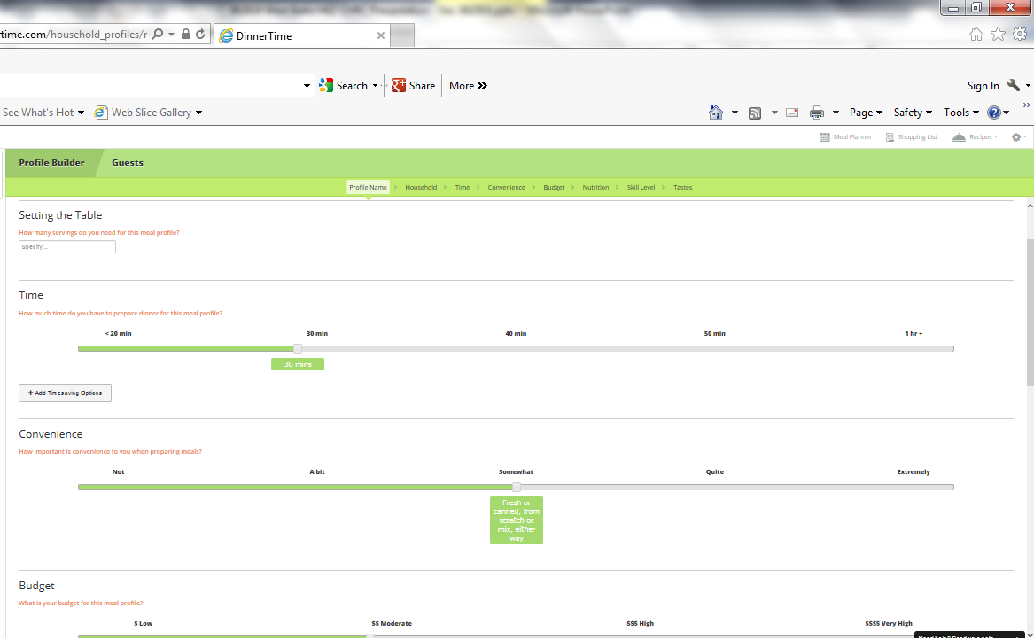

Slide 20
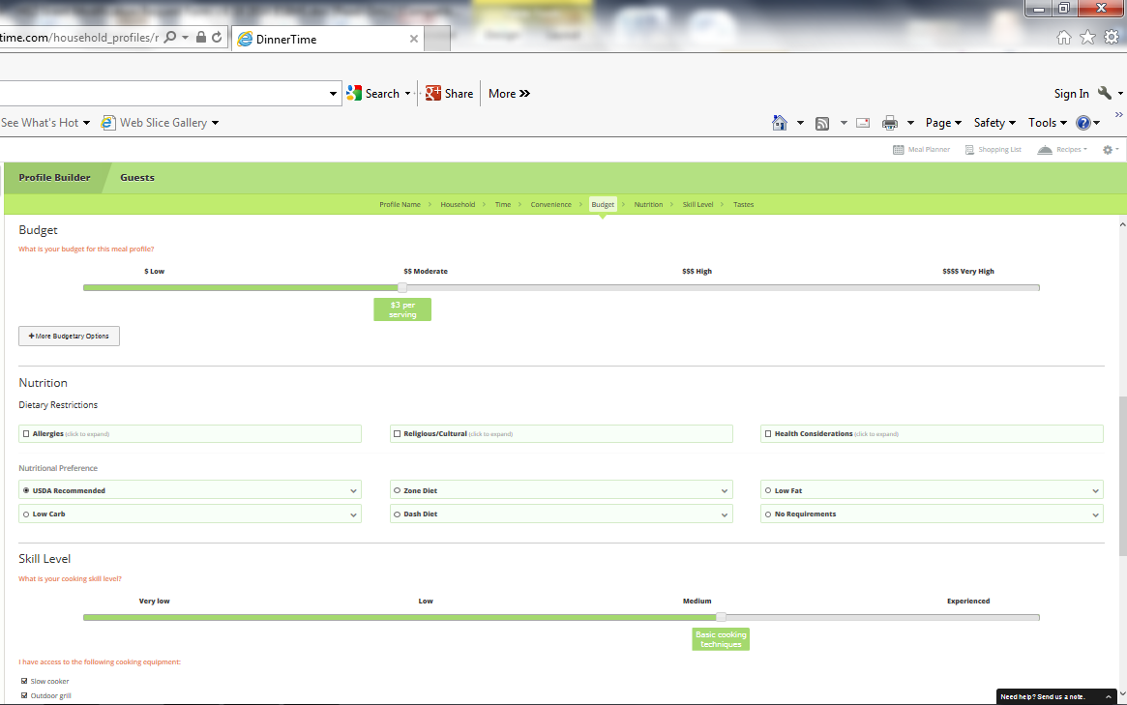

Slide 21
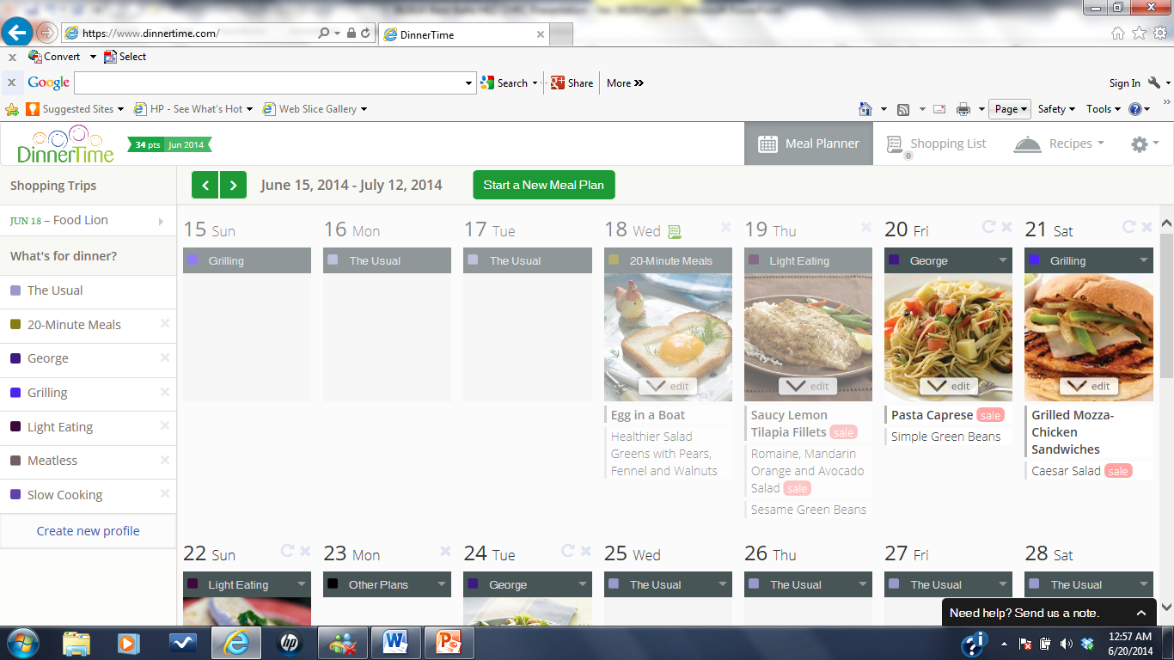

Slide 22
Continuing Activities for Year 2
Fitness Classes
Disease Management Classes
Cooking Classes
Capacity-Building Trainings
Pursuit of funding to enhance programming and assure sustainability

Slide 23
Questions?
Website: www.HealthyWestBaltimore.org
Facebook: www.Facebook.com/WestBaltimoreCare
Twitter: www.Twitter.com/HEZhero
Email: HEZ_Info@bshsi.org

