Slide 1
Greater Lexington Park Health Enterprise Zone (HEZ) Project

Slide 2
Vision
Establish accessible, integrated, culturally competent healthcare in the HEZ supported by clinical care coordination, prevention services, community outreach and education
Core Disease States
Diabetes, Asthma, Hypertension, Congestive Heart Failure, Chronic Obstructive Pulmonary Disease, Behavioral/Mental Health Diseases

Slide 3
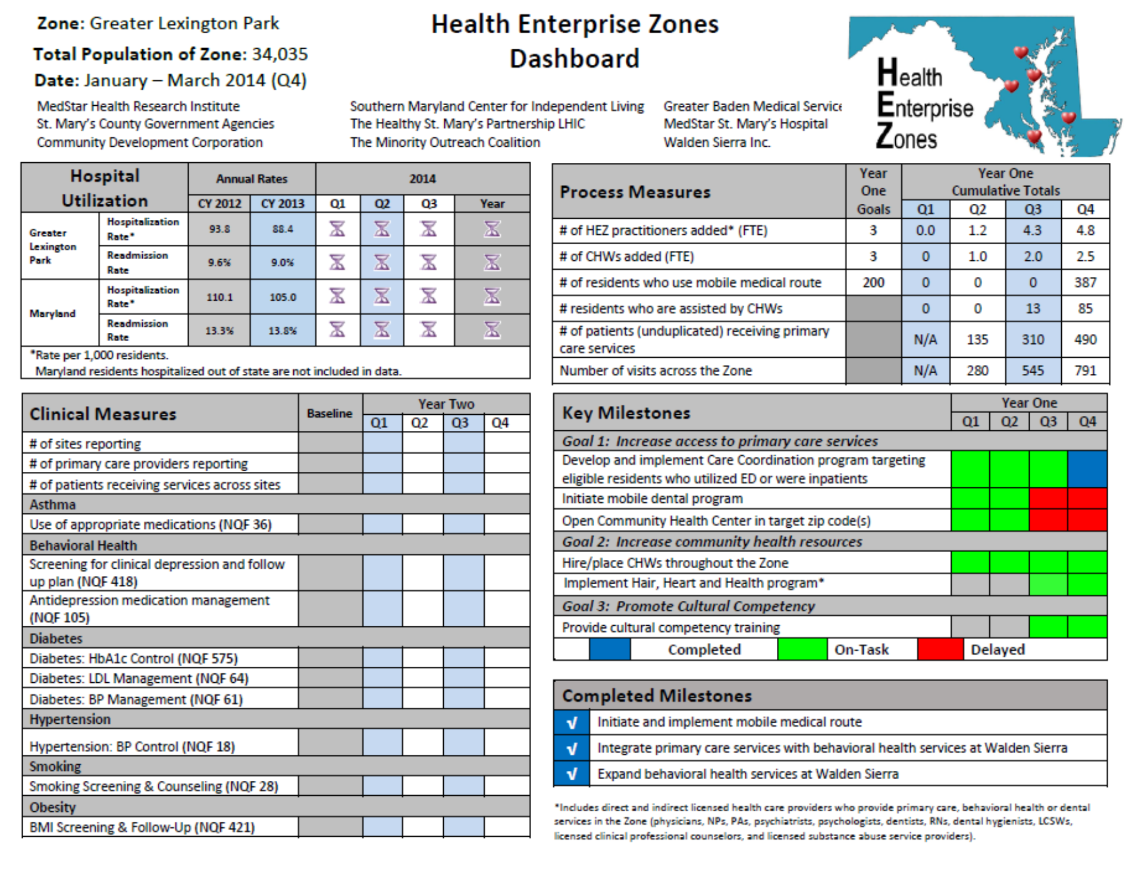

Slide 4
Status of Key Goals - Successes
Integrated Care with Walden and GCTH
Care Coordinators
Community Health Workers
Recruitment
Transportation Route
Logo Design

Slide 5
Status of Key Goals – Lessons Learned
Dental Van
Need for expert consultation
Health Center Timeline Shift
Teambuilding skills amongst partners
Provider Recruitment
Creativity when incentives did not meet providers requirements

Slide 6
Year 2 Goals
Open New Integrated Practice in 9/2014
Recruitment
Launch Dental Van
Increase Transportation Options
Expand Evidence Based CHW Programming
Expand Language Lines
Optimize Data Management

Slide 7
Year 1 Unexpended Funds
Total $184,780, includes the following:
MedStar Salaries/Fringe –$129,977
Equipment - $8,514
Supplies - $3,083
Training - $18,946
Contractual - $17,863
Other - $20,138
*Walden Year 1 overage – ($13,708)
Indirect Costs Year 1 overage – ($33)

Slide 8
Grant Modification Request
Reallocation Request for Year 2 (184,800):
MedStar Personnel Salaries and Fringe: $24,114
Equipment/Furniture: $31,000
Second vehicle
Language lines
Supplies: $10,000
Training: $6,600
Contractual: $3,000
Dental Providers
Provider Incentives : $35,000
Creative incentives.
HEZ Office Space in Lexington Park: $17,000
New Integrated Primary Care Practice: $58,066

Slide 9
QUESTIONS?

