Slide 1
Greater Lexington Park Health Enterprise Zone (HEZ) Project

Slide 2
Vision
Establish accessible, integrated, culturally competent healthcare in the HEZ supported by clinical care coordination, prevention services, community outreach and education
Core Disease States
Diabetes, Asthma, Hypertension, Congestive Heart Failure, Chronic Obstructive Pulmonary Disease, Behavioral/Mental Health Diseases

Slide 3
Logic Model
Input | Activities | Output | Outcomes (Short term) | Outcomes (Medium/Long term) | Impact
Resources Staff Funding Dental Van Transportation Data Collaboration Community partners DHMH Health Connections Hospital | Integrated Primary Care Increase number of providers serving patients in the zone Increase access to behavioral health Training of healthcare workforce Transportation Develop and run transport within and outside Zone Dental Van Outfit and run a dental van for HEZ residents Develop dental plan to make referral to appropriate provider(s) Care Coordination and Community Health Workers Stabilize medical needs Develop care plan to address social determinants Refer to appropriate partner organizations Evidenced based self management programs | Residents able to access primary care physician and behavioral health Patients able to access services, food and recreation Clients receive basic oral to reduce impact on chronic conditions Clients have a better understanding of their diagnosis Clients are connected to community services | Clients receiving therapy as specified by doctors Clients establishing routine of care and follow up Clients will keep primary care and specialist appointments as scheduled Clients will have access to fresh fruits and vegetables Clients will have access to physical activity/recreation Clients will be able to better take care of their teeth Clients will become efficient in making their own doctor’s appointments Clients will feel comfortable discussing their health concerns with doctor Improved self management of chronic condtions | Medium term Health Center and Primary Care office Clients are overall healthier because of therapies, recreations, nutrition, and social outlets Clients will learn how their daily behavior interacts with their overall health Long term Clients will be better equipped to take responsibility for their own health in the appropriate level of care Decrease non emergent ER use Reduction in ER use for dental issues | Improved health outcomes Reduced health disparities Reduction of health cost and hospital admissions and readmissions Reduction in unnecessary ER utilization Culturally competent healthcare workforce

Slide 4
HEZ Year 3
Build Practice Capacity
SMART Objectives:
– Primary care practitioners average 2-3 visits/hour 36 clinic hours/week during practice ramp-up (9 months) 788 patient visits to date
– Primary care practitioners will average 3-4 visits/hour
36 clinic hours/week minimum of 5184 appointments/year
Data track by practice manager via Centricity EMR and weekly productivity reports
Care Coordination
SMART Objective:
– Care Coordinators maintain current capacity of 60 active and
90 maintenance clients/RN
– CHW’s maintain current capacity of 20 clients/associate
Patient interactions tracked via templated reporting databases
Notes:
Opened in October 2015 with 1 provider
Nurse Practitioner added at end of December

Slide 5
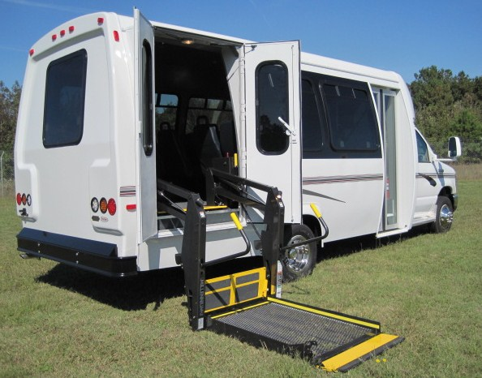
HEZ Year 3
Integrated Care/Behavioral Health
SMART Objectives
- Increase SBIRTS to 50/month from 30/month
- New Goal: 25 MSMH ED diversions/year to non-
hospital treatment
- Add 4 additional hours of Psychiatry/week
serving 20 patients/month (increase from
4-5 patients/month in Year 2)
Walden Sierra data tracked via EMR
Transportation
SMART Objectives
– Add 2 specialty route runs per day with 5 patients/run
– Increase shuttle ridership above current goal
of 1000/quarter
Transportation ridership and rider demographics tracked via driver tallies and applications for shuttle passes

Slide 6
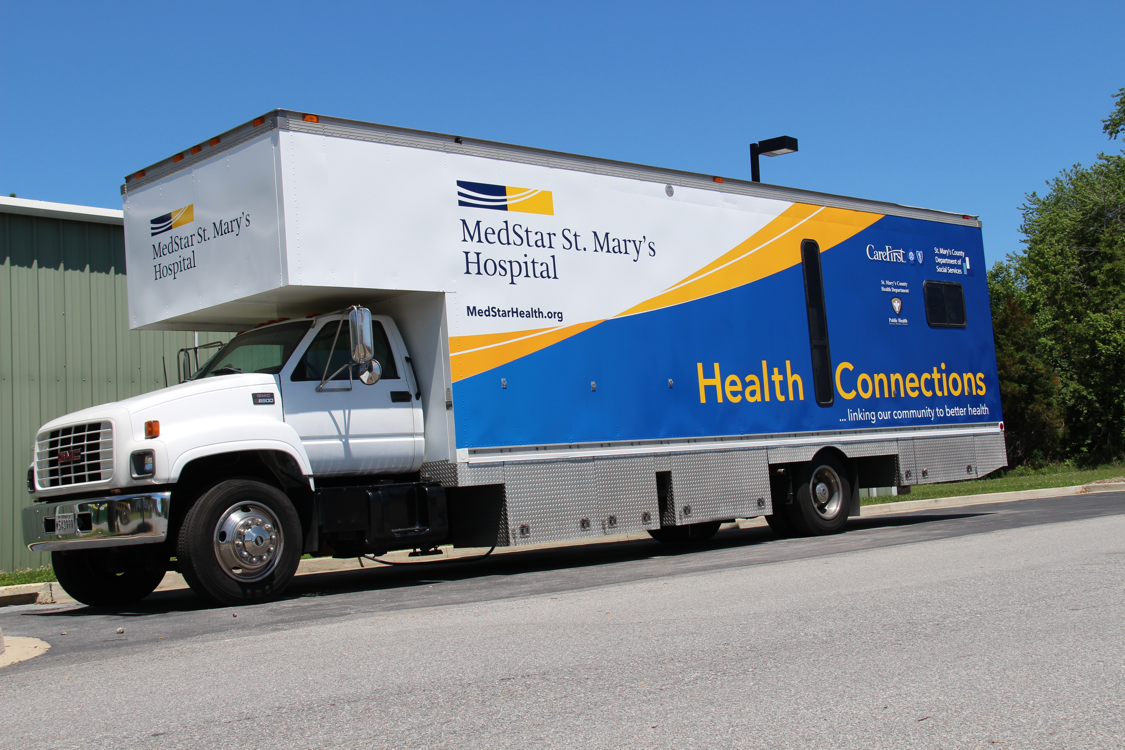
HEZ Year 3
Adult Dental
SMART Objective
Provide 6 hours of adult dental services/week (4-6 patients)
Visits and patient demographics tracked by HEZ program coordinator

Slide 7
Other Data Collection Methods
Readmissions and ER usage – hospital data, daily discharge reports, follow-up phone call scripts, CRISP and state provided sources
Utilization/Economic Impact - MHRI

Slide 8
Moving the Needle Quarter 1 FY2014- Quarter 3 FY2015

Slide 9
Moving the Needle Quarter 1 FY2014- Quarter 2 FY2015

Slide 11
St. Mary’s HEZ Hospital Resource Utilization
Randy Estes MIS/M, RN-BC, PMP, CPHIMS, CPEHR
Manager, Research Bioinformatics
Dept. of Biostatistics and Bioinformatics
MedStar Health Research Institute
randy.a.estes@medstar.net

Slide 12
St. Mary’s HEZ Readmission Rates

Slide 13
St. Mary’s HEZ Readmission Rates

Slide 14
St. Mary’s HEZ Returns to the ED

Slide 15
QUESTIONS?
Notes:
Last 10% of budget mostly indirect for MSMH and Evaluation costs

