Slide 1
Living with Prader-Willi Syndrome
Presented by Cindy L. Hay, MA
Sponsored by Eastern Maryland Developmental Disabilities Administration

Slide 2
Objectives
I. History and Genetics
II. Hypothalamus & Pituitary Involvement
III. Understanding Unique Characteristics of Adults with PWS
IV. Group Home Supports for those with PWS
V. Philosophy and Attributes of a Successful Caregiver
VI. Questions and Discussion

Slide 3
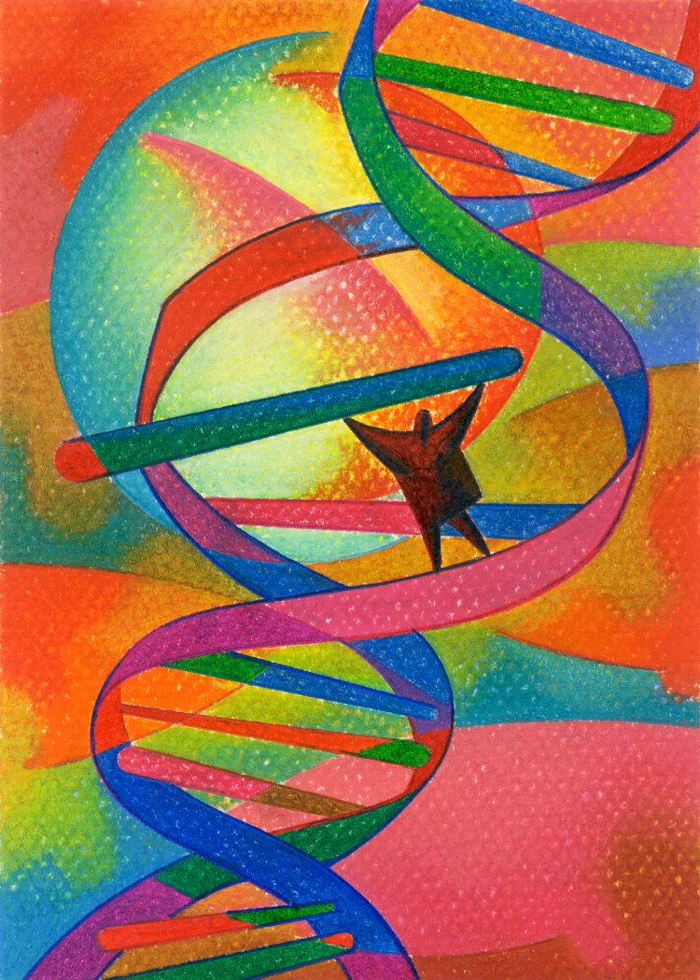
Section I-History and Genetic Factors

Slide 4
HISTORY AND GENETICS
Rare-1 in 12,000-15,000 live births
Non-inherited genetic abnormality related to missing coding on paternal side chromosome 15 (Maternal chromosome is “silent”)
A life threatening, life long medical condition
First described in 1956 by Andrea Prader and Heinrich Willi
Angelman Syndrome is genetically similar with missing coding on maternal side of chromosome 15

Slide 5
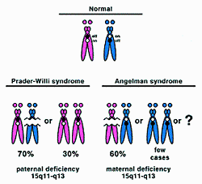

Slide 6
Areas impacted by PWS
Infancy and Child
Adults
Physical
Medical
Psychological and Behavioral aspects
Cognitive
Speech and Language
Physical
Medical
Psychological and Behavioral similarities
Cognitive/reasoning
Expressive and receptive language/reading
Psycho-social and sexual development

Slide 7
Physical feature-infants/children
Infants:
Hypotonia-Low muscle tone
Lethargy-excessive sleeping
Feeding difficulties/failure to thrive
Delayed milestone (physical and intellectual) Strabismus (eyes crossed)
Scoliosis
Hypothalamic disorder
Children:
  At about 2-4 years Hyperphagia begins (excessive eating)
  Sleeping disturbances increase
  Extreme weight gain
  Poor physical coordination
  Speech delays
  Extreme flexibility
  Short Stature
  Scoliosis
  Hypothalamic disorder

Slide 8
Common Characteristics
Physical
HYPERPHAGIA
Short stature
Abnormal (low) metabolic rate
Low muscle tone
Irregular body temperature-too hot/too cold
Lack of vomiting
Visual impairments
Easy bruising/skin problems
Hypo or Hyper sensitivity to pain
Easily fatigued
Undeveloped sexual organs
General
Near normal IQ
Concrete thinking
Anxiety associated with food
Determined
Inflexibility to change
Humor
Skilled at puzzles
Sociable
Good memory
Kind and caring
Good reading skill (not all)
Emotionally immature
Prone to temper tantrums (reduces with consistency)
Skin picking
Collectors (ranges from extreme tidiness to hoarding)

Slide 9
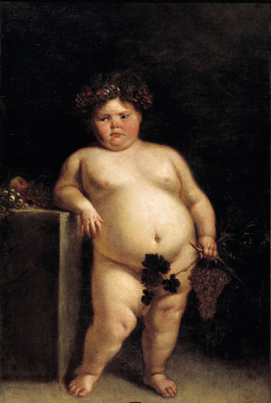
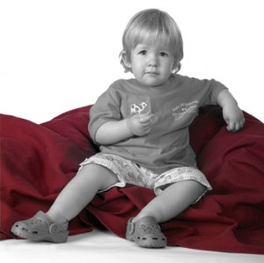
Left: A 1680 painting by of Eugenia Martínez Vallejo, a girl presumed to have PWS
Top: Poster child for PWSA 2012 detected early and treated with HGH (discussion later)

Slide 10
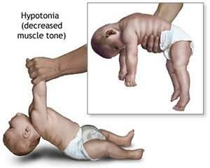

Slide 11
Developments in Early Diagnosis and Treatment
How is PWS diagnosed?
PWS should be considered when presented with a hypotonic newborn.
Only genetic testing can confirm PWS or other disorder
Early intervention can assist with growth hormone (GH) being used in some cases to assist physical development
This does not “reverse” the genetic disruption therefore the child will still need lifelong weight and dietary management
Early intervention for dietary, behavioral and educational supports

Slide 12
Section II-Hypothalamus and it’s affair the Pituitary Gland
A. Hypothalamus role in PWS (in layman’s terms)
B. Pituitary Gland-Master Gland and it’s relationship to the hypothalamus
C. Video to help “see” why the brain wiring impacts the person with PWS is DRIVEN by food

Slide 13
Understanding how the brain is affected by this genetic situation
Chromosomal impact of #15 has an impact on the hypothalamus and pituitary gland of all persons with Prader-Willi Syndrome
Early intervention can help increase skill acquisition, dietary needs, and emotional/behavioral support
There is no “cure” and PWS is a lifelong condition
Person’s with PWS will need constant supervision through their lives as even when optimal weight is reached the internal drive to eat excessive DOES NOT become controllable

Slide 14
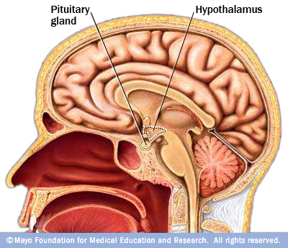

Slide 15
Hypothalamus and Pituitary Gland
Hypothalamus
Regulates appetite, metabolism, body temperature and mood
Genetic misfiring specifically impacts the hypothalamus
Hypothalamus is “disrupted” in the regulation of appetite, fullness, metabolism, body temperature and mood
Connects 2 key survival systems: nervous system and endocrine system (glands)
Pituitary Gland
Pituitary gland (master gland of the endocrine system) is directly attached to the hypothalamus.
Master gland that gets messages from hypothalamus signal other glands to release or not release hormones (growth hormone, sexual development hormones, etc)
The interaction between the hypothalamus and the pituitary gland is key in understanding some physical attributes, physiological and behavioral controls effecting everyone

Slide 16
Short Video on As the brain sees food
The Scanner: Dr Garfield
University of Cambridge

Slide 17
Section III Unique Characteristics of People with PWS
    Supporting Adults with Prader-Willi Syndrome in Residential Settings
    An Expert’s Recommendations
    By Barbara J. Goff, Ed.D
    This section of the training draws specifically from Dr. BJ Goff’s detailed work and experience of working with and designing optimal living environments for person’s living with Prader Willi Syndrome

Slide 18
Section III-Unique Characteristics
Generally high IQ
Hyerphagia-excessive appetite/eating
Lying and Stealing
Obsessive-Compulsive Behaviors
Self-Injurious Behavior
Under activity
Physical Appearance
Impulsivity and Aggression

Slide 19
A. Generally High IQ
Benefits
Concerns
Capable of academic success: High School and College
Often can obtain vocation and technical skills needed to get full time employment
May be able to navigate and use public transportation, handle layover and negotiate the delays
Caregiver “thinks” person with PWS understands and can control actions
High IQ not equal to emotional control (but may be able to better tell us what they felt)
Person with PWS with high IQ knows what they may never be able to gain (complete independence)
Susceptible to depression

Slide 20
B. Hyperphagia-what it may look like
Obsessed with food and general food seeking drive
Areas of caution
Always on my mind (food, how to get food)
Please keep temptation out of my way
Residents will always come up with ways to obtain food that you will never anticipate….
Appreciate the creativity, document/document and then change the environment to prevent it from easily happening again
Restitution may be natural consequence but I won’t “learn” to stop doing it
Food may be picked up from floor of buses, movie theatres, restaurants
Condiment packets are food
May go into trash cans for food
May eat pet food
Complain of sore throat, stomach ailment (cough drops, TUMS are food)
May hoard toothpaste, mouthwash and eat it in secret
May shoplift (usually very stealth-like) actual food or something to trade up later
May approach strangers with eloquent details of needing a snack or food
Extreme case may entail eating of feces/toilet paper, beads or other non-food item (rare, but does occur)

Slide 21
What can you do?
Get to know the individual
Monitor weight closely/frequently (details in video)
If person is on 1,000 calorie diet but is steadily gaining weight there is a food source SOMEWHERE
Investigate but don’t interrogate…..the source needs to be eliminated by careful planning
Look at day program, bus route, new friends or employees, new job detail (may go into dumpster, eat hamster food, have access to candy drawer, etc)
If a person in gaining weight despite all other controls there IS a source of calories……
Do not ask the obvious
Do state the obvious without emotional content

Slide 22
Creativity-just one of the amazing services I provide!!

Slide 23
Wow, now that’s genius!
Examples of lengths a person has gone to get what they crave
  Name change 101
  The Shopper
  “Ocean’s Three”

Slide 24
Create Safe Environment-food needs to be a “non-issue”
Inaccessibility to food and money except as prescribed
Meals strictly prepared (by staff)
Menus posted
If food portion is questioned, re-measure-
Staff eat the same meal with residence OR eat in private
Staff are not to bring in strong smelling foods-if you work in a de-tox clinic don’t show up drunk!
Nutritionist builds treats into menu AND helps plan for special occasions
Recreation and Social events should center around the activity not how and when we will eat
When food will be part of social event plan how to enjoy the food with dietary exchanges BEFORE going on event (food security)

Slide 25
One minute in my shoes
Final note: Let’s review your past 24 hours. In your head food is all consuming-how many places have you been that there is access to food or money that would tempt you IF you have uncontrollable drive for food?
Think of how many of these situations cannot be avoided----what if they each caused internal conflict?

Slide 26

Behavioral Management Strategies
Video:
Prader-Willi Syndrome Residential Staff Training
(Section 10)

Slide 27
C. Lying and Stealing
Understanding that lying and stealing is part of the syndrome (keep tough skin it is not personal)
Even if you have a close personal relationship with an individual does not mean they will not steal money or food from you (families and staff can be pulled apart by allegations)
It is your job to be vigilant in observing, be straight forward with fact if you see evidence and do expect the appropriate consequence to occur BUT do not expect long term change

Slide 28
B.J. Goff’s take on lying and stealing
Communication
Keeping logs
Keep open communication with all care givers
Do not put person with PWS in situation to lie (candy wrapper, food was eaten)
Denial is a river---don’t jump in
Write down property brought into, taken out of home
Of allegations of mistreatment, details of home visits, check all sources
Example of attempts to reason and length of “logical explanation” that will not work

Slide 29
Do Lying and Stealing always have to do with food?
Some individuals do hoard or acquire items without paying for them
It may be more about the collection (and wanting to save the money for food) than the “right or wrong” of the behavior
Person’s with PWS can usually tell you stealing and lying are wrong but the philosophy and implementation of behavior is not going to always translate

Slide 30
D. Obsessive-Compulsive Behavior
Obsession
Compulsion
On-going persistent thought, idea or impulse of images that are unwanted and cause STRESS and ANXIETY
Feeling that one must carry out the repetitive behavior (checking, ordering, washing, counting, or repeating words, praying)
Usually only feel temporary relief when carrying out the compulsion

Slide 31
D. Obsessive-Compulsive Behaviors
Orderliness-doing things in a precise manner
Arranging
Hoarding
Skin-picking
Cleanliness, symmetry and exactness
Consider: is it interfering with person’s life? Provide time to prepare, allow for routine as lack of life control is part of the syndrome

Slide 32
E. Self-Injurious Behavior
Skin-picking occurs in 81-84% of the population of person’s with PWS
Other Self-Injurious Behavior (SIB) includes nose picking, hand biting, head banging, trichotillomania (pulling hair out) and rectal picking
Often skin picking occurs on old sores, around cuticles, head and legs

Slide 33
SIB-theories why possible strategies
Part of the OCD symptoms
Picking or head banging releases endorphins (like runner’s high)
Given high threshold for pain the self-stimulatory activity may be anxiety reducing
  Suggested interventions:
  SSRI’s (Prozac, Zoloft, Paxil)
  Use daily skin checks (nonjudgmental)
  Gloves when not engaged in activity with hands
  Alternative activities to use hands and reinforce absence of skin picking (do not point out in front of others)
  Use code word or sign if person wants help reducing the behavior
  Daily skin-rubbing protocol (get an OT involved before considering this) has proven successful in some situations

Slide 34
F. Under activity
Hypertonia (weak muscle tone)with obesity lead to sluggishness
Lack of coordination makes exercise, walking, playing more difficult even embarrassing
Mix it up, be sure to enjoy the “activity” with the person AND create a goal for the success of routine which includes exercise time
Join in…..Ask the person…..Special Olympics is great for getting out and being active
Plan physical activity just before meal or snack
Park far away from the front door and sneak in the exercise

Slide 35
G. Physical appearance and effect on Self-esteem
Average man 5’ and 4’11” for woman with PWS
Low muscle tone to fat ratio
Incomplete puberty-males voice doesn’t deepen and lack of facial hair and underdeveloped genetalia
Females may not have a menstrual cycle, small hands and feet-clothes not made for “grown-ups”
I am an adult and wish to be treated as an adult (physically look and sound like child)
Staff job is to role model: in home, in public, in private conversation
  Side note-GH therapy will change person’s appearance-taller, more normalized muscle tone. Use of GH for adults is subject of much conversation in medical field. However, even with GH therapy in childhood, the underlying Hypothalamic situation is not reversed

Slide 36
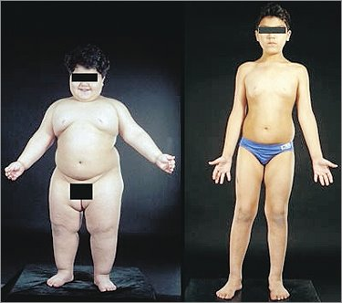
Child with PWS treated with HGH Human Growth Hormone prior to puberty

Slide 37
H. Impulsivity and Aggression
Only a small percentage engage in physical aggression toward others
Slightly higher percentage engage in property damage
No behavior occurs for “no reason” (unless it is a psychotic episode)
Might seem “out of the blue” but trigger is there

Slide 38
Impulsivity and Aggression
According to BJ Goff, “We have found that most outbursts can be traced back to an experience where the person was feeling he was some how being treated unfairly or a food issues” (pg. 19)
  Examples:
    Change from a movie to a dance
    Doctor’s appointment and the date

Slide 39
IV. Group Home Supports Specific for People with Prader-Willi Syndrome
Video:
Prader-Willi Syndrome Residential Staff Training
(Section 2)

Slide 40
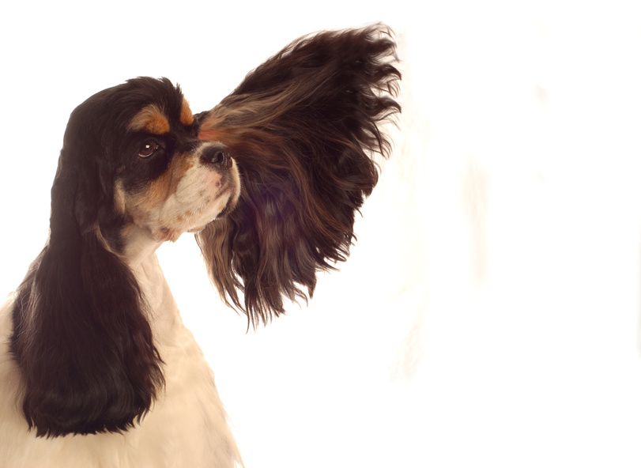
V. Philosophy and Attributes of Successful Caregivers: Listen
Keep your sense of humor
Be Loyal

Slide 41
Adults with PWS Advisory Board October 28-29, 2010
“What We Want You to Know About Us”
Prader-Willi syndrome comes in all sizes, shapes and colors.
If I am slim, it is due to a lot of effort by me, my parents, and care providers.
Don’t give me food or money without my parents or care provider’s permission.
Please keep food temptations away from me.
Prader-Willi syndrome is not the true shame, it is you bustin’ on me and you don’t even know my name (From the PWS rap song, “My Name’s not Willi!”)
Talk to me directly, not the person with me. Respect me as an adult.
Please understand that my muscle strength and energy are lower than yours.
I have hopes and dreams and goals – just like you

Slide 42
And now it time for a little Break down!!!!!!!
Turn up the volume cause I got something to say!
MY NAME'S NOT WILLY
This song goes out to all our bothers and sisters out there with Prader-Willi Syndrome. We wanted this song to:
Educate people about Prader-Willi Syndrome
Communicate the feelings you have to deal with having PWS
Stop the world from labeling you
Most importantly, get you to stop labeling yourself!
We want you and everybody else in the world to know that Prader-Willi Syndrome is what you have, not who you are. Your life is about so much more than just surviving. Your life has purpose! You have a destiny!

Slide 43
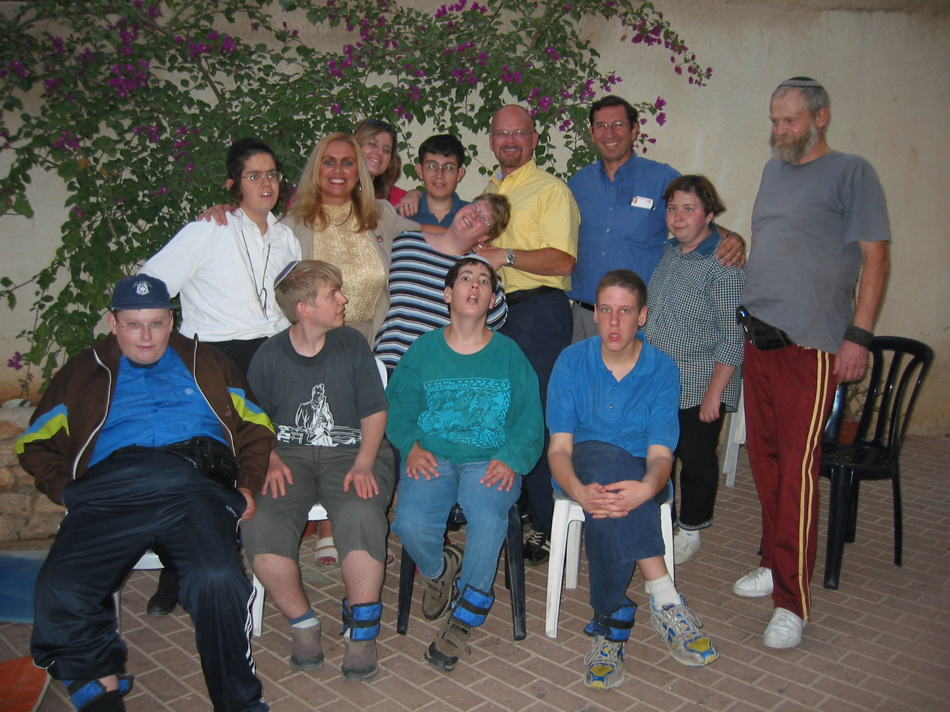
Group enjoying “post workout” at the PWSA Conference in Florida

Slide 44
Philosophy to soothe your care giver soul
Respect
Dignity
The fact that I am an adult
I may at times, emotionally lose control and “throw a tantrum” but I have adult experiences, feeling and dreams.
I am not comfortable with myself right now, but I am a 40 year old woman, talk to me, not about my behavior.
Acknowledgement of each person’s individual qualities
I am unique-my wires get a bit jumbled I do need your support not commands
Help work through the tough times please don’t push me. You gain my trust with consistent support

Slide 45
Philosophy to help not control
Understanding
Acknowledgement
All persons working with someone with Prader Willi must develop a GOOD understanding of the syndrome.
This will prevent many pitfalls
Will decrease the chance that the support inadvertently feeds into the less desirable qualities
“many of the characteristics of PWS are truly outside of the person’s ability to control.” B.J. Goff, Ed. D.
It is my job to be proactive not reactive.
I don’t know all the answers and things that work well today may not go smoothly tomorrow
Don’t lose your sense of humor when trying to figure out how to “lock up the Apple Tree!”

Slide 46
Empathy to foster Growth and Change
“Food, thoughts of food, fear of not getting food will ALWAYS be on my mind”
See Food Security for Person’s with PWS handout
Empathy not Sympathy
Person won’t gain long term behavior change from negative (natural or imposed) consequences…..just knowing that will help keep caregiver alert
Learn, live, enjoy and remember you are helping save my life and increasing my enjoyment on this earth!

Slide 47

VI Questions and Discussion

