Slide 1
Maryland Situation Update on Coronavirus Disease (COVID-19) for BHA
Maryland Department of Health
Infectious Disease Epidemiology and Outbreak Response Bureau
July 10, 2020

Slide 2
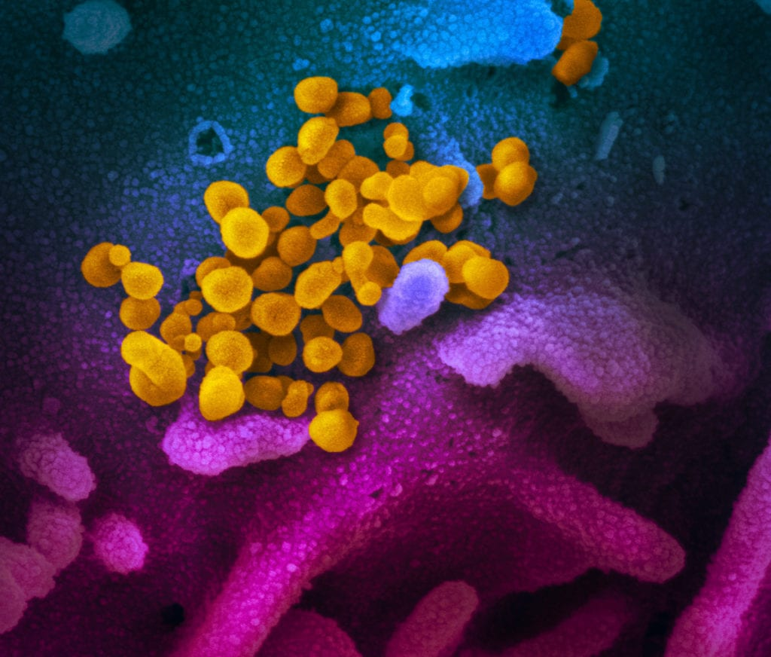
Call Agenda
Picture Courtesy of NIAID-RML
Review current situation of COVID-19
Vaccine Development
New Testing Technology
Questions and Answers

Slide 3
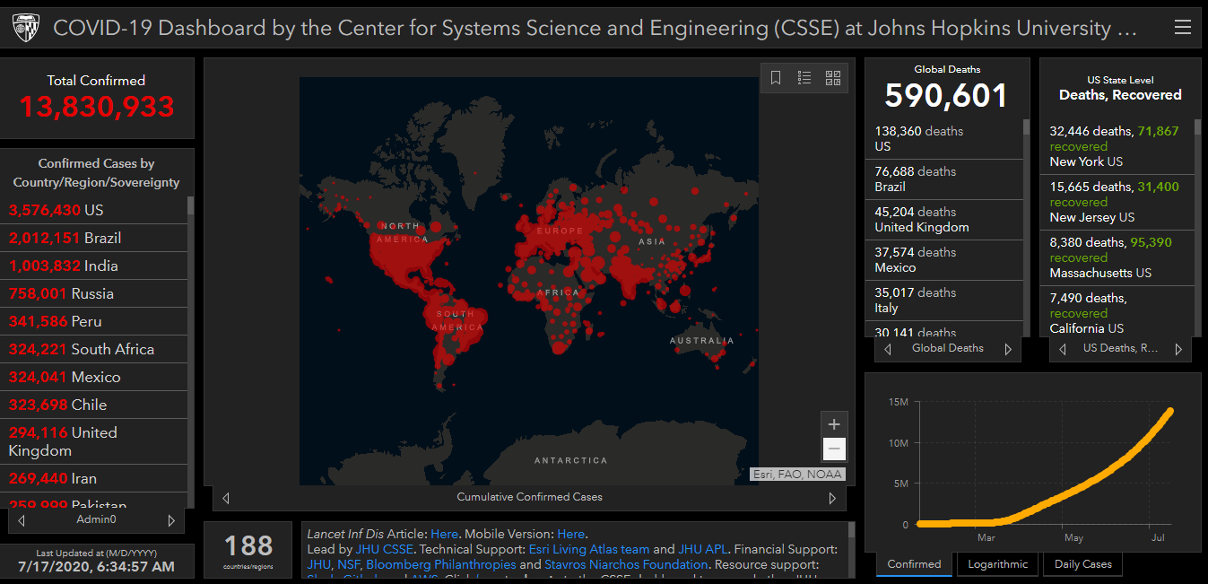
COVID-19 Global Situation Summary
Notes:
Over 1.5 million new cases this week

Slide 4
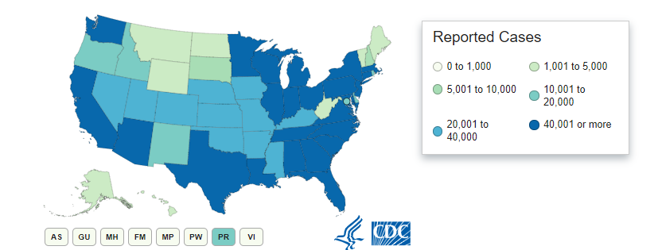
U.S.: COVID-19 Cases
3,483,832 Confirmed Cases
67,404 new
136,938 total deaths
947 new
US states and territories with no cases:
American Samoa
Marshall Islands
Micronesia
Palau
Notes:
2155572 last week

Slide 5
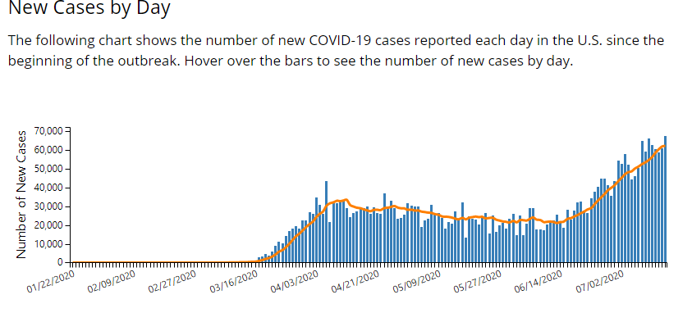

Slide 6
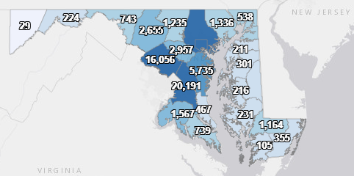
Maryland: COVID-19 Cases
http://health.maryland.gov/coronavirus
Data current as of 7/17/2020
Cases: 76,371
707 new
Deaths: 3,227
12 new
Hospitalizations: 10,725
42 new
Total tests 896,990

Slide 7
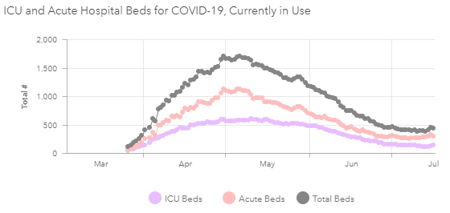

Slide 8
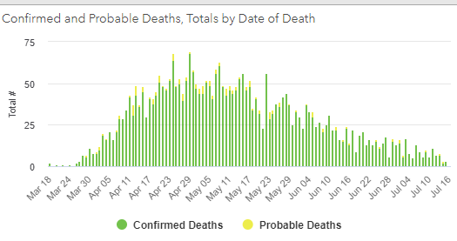

Slide 9
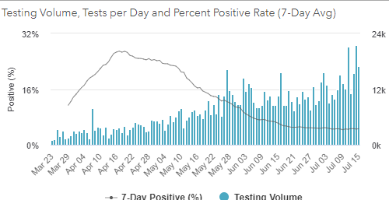
Testing Volume and % Positivity

Slide 10
Vaccine Development

Slide 11
COVID Vaccine Candidates
Currently 23 candidate vaccines in clinical evaluation (Global)
Phase 3: 2 candidates
Phase ½: 21 candidates
Pre-clinical: over 60 candidates
https://www.who.int/publications/m/item/draft-landscape-of-covid-19-candidate-vaccines

Slide 17
Sinovac
Inactivated virus
Adjuvant: inactivated alum
Phase III trial starting in Brazil
Phases 1 and 2 included:
743 healthy volunteers
143 phase 1
600 phase 2
Safe, no severe side effects
Induced immune response in 90% of test subjects
2 doses 14 days apart

Slide 18
University of Oxford/AstraZenenca
AZD1222
Non-replicating recombinant Adenovirus viral vector
Adenovirus with COVID proteins on it
Similar to a vaccine candidate for MERS-CoV
MERS vaccine can induce immunity for up to a year
Phase 1 and 2 trials
1000 healthy volunteers
Phase 3 trial starting in Brazil

Slide 19
Vaccine Prioritization
Bioethics, immunology, health administration, logistics
Tier 1: frontline healthcare workers
Almost everyone agrees on this one
About 12 million people in the US
Tiers 2 and 3
The rest of the HCWs, national security, essential workers
110 million people
Tiers 4&5
The rest of the population
206 million

Slide 20
Vaccine prioritization
Pregnant people: Higher or lower priority?
Older people: Higher or lower priority?
Should race/ethnicity be factored in?
Higher rates of disease and severe outcomes in Black and Latinx populations
Teachers?
People experiencing homelessness?
What about developing countries?
Does money matter? Political pull? Lobbying?

Slide 21
New Testing

Slide 22
Rapid Testing
2 different brands of machine have an emergency use authorization from FDA
Results can take 5 to 30 minutes
Specificity 100% (100% of positive tests are in patients who are positive)
Sensitivity 80% (80% of negative tests are in patients who are negative- which means that 20% of negative tests are actually in positive people)
Nasal swab- less invasive than nasopharyngeal
Tests for antigen (a protein on the surface) instead of RNA

Slide 23
Multiplex PCR
Real Time Reverse Transcriptase PCR test designed to detect 3 pathogens
COVID-19
Influenza A
Influenza B
Specimen will be a nasopharyngeal swab
FDA Emergency Use Authorization granted July 2
Will be distributed to state Public Health Labs

Slide 24
Resources
MDH Novel Coronavirus: http://health.maryland.gov/coronavirus
MDH Laboratory Coronavirus: https://health.maryland.gov/laboratories/Pages/Novel-Coronavirus.aspx
COVID-19 People at risk https://www.cdc.gov/coronavirus/2019-ncov/specific-groups/high-risk-complications.html
CDC Guidance for Infection Control https://www.cdc.gov/coronavirus/2019-nCoV/infection-control.html
Behavioral Health https://www.cdc.gov/coronavirus/2019-ncov/hcp/infection-control-faq.html?CDC_AA_refVal=https%3A%2F%2Fwww.cdc.gov%2Fcoronavirus%2F2019-ncov%2Finfection-control%2Finfection-prevention-control-faq.html
Memory Care https://www.cdc.gov/coronavirus/2019-ncov/hcp/memory-care.html

Slide 25
Questions?
Email : mdh.ipcovid@Maryland.gov

