Slide 1
Maryland Situation Update on Coronavirus Disease (COVID-19) for BHA
Maryland Department of Health
Infectious Disease Epidemiology and Outbreak Response Bureau
May 29, 2020

Slide 2
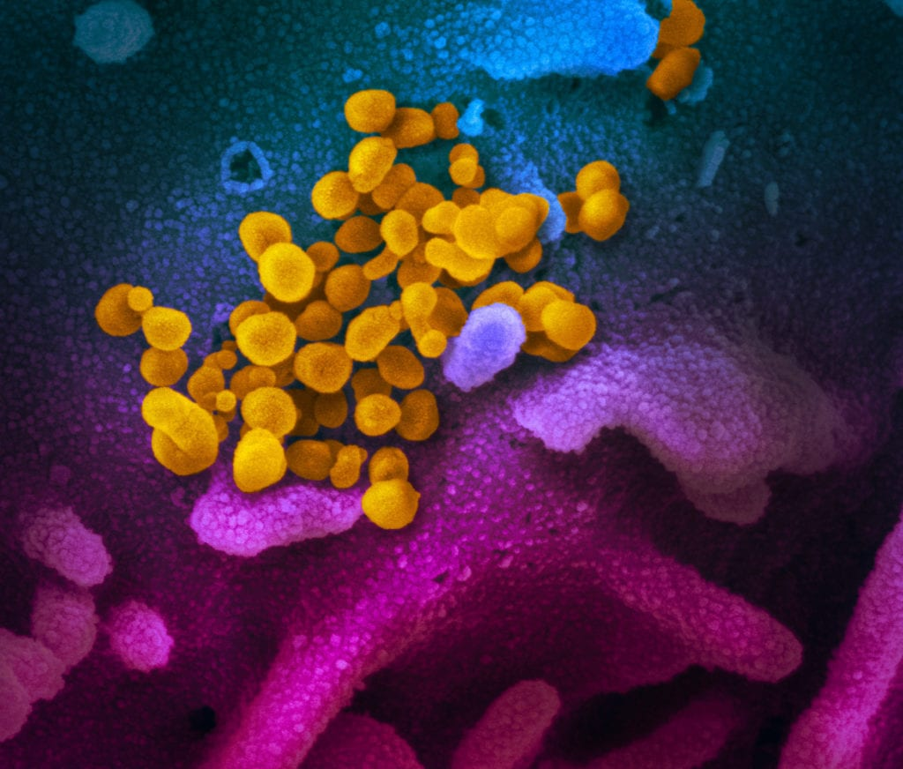
Call Agenda
Picture Courtesy of NIAID-RML
Review current situation of COVID-19
CDC Updates
Re-opening
Questions and Answers

Slide 3
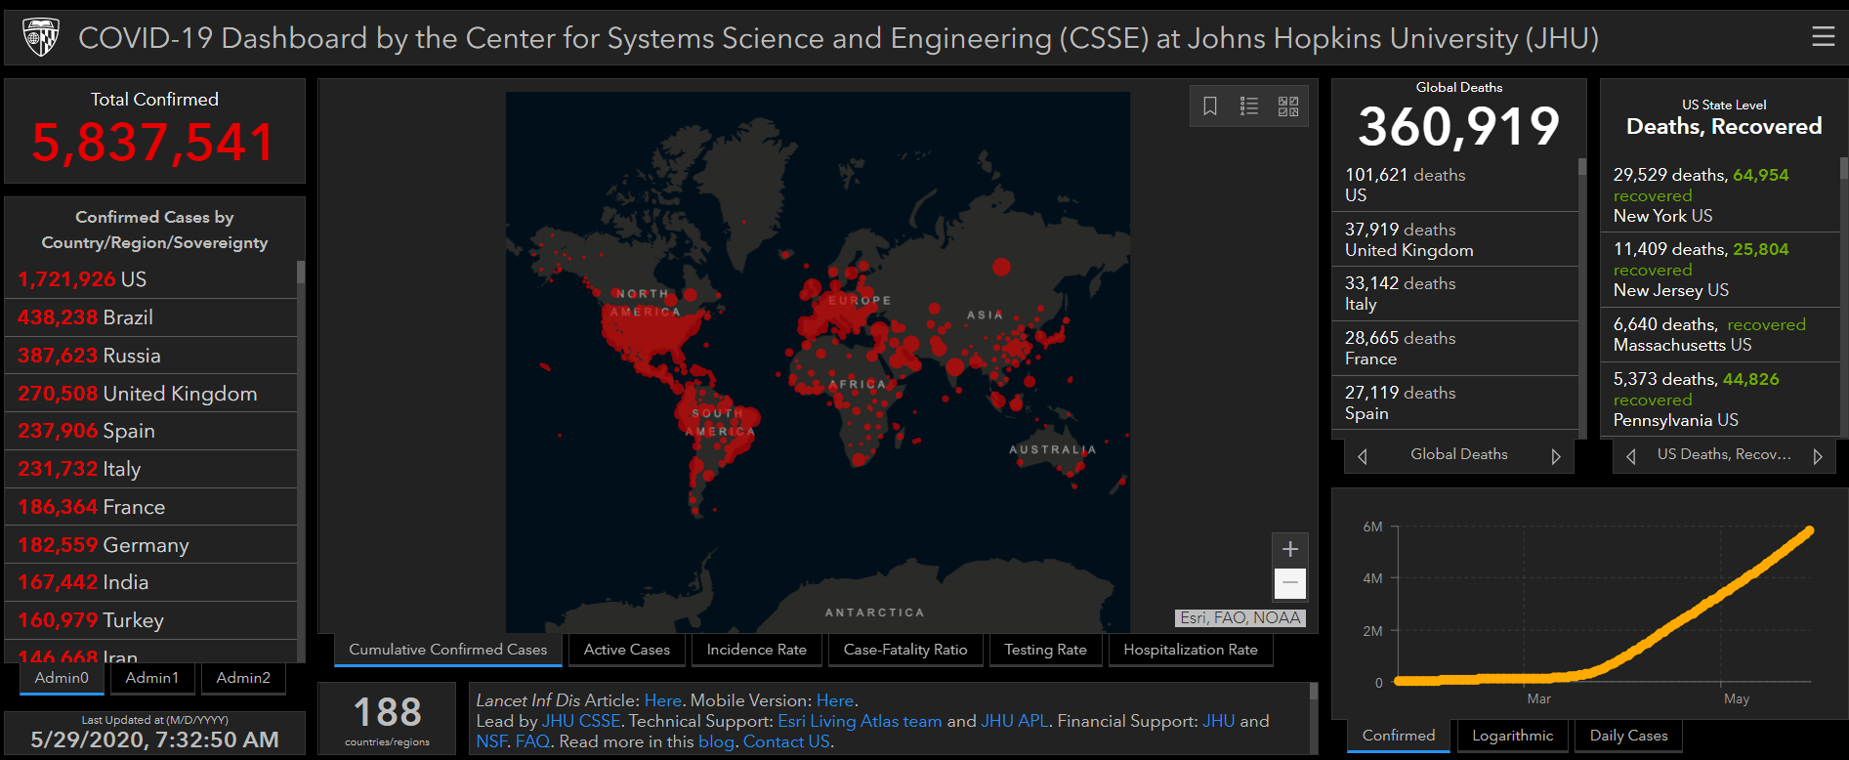
COVID-19 Global Situation Summary

Slide 4
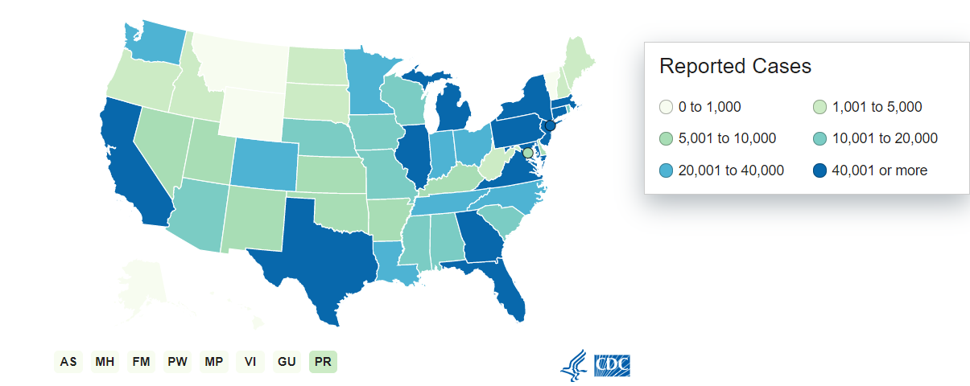
U.S.: COVID-19 Cases
1,698,523 Confirmed Cases
19,680 new
100,446 total deaths
1,415 new
55 states and territories reporting
Source: www.cdc.gov, accessed May 29, 2020

Slide 5
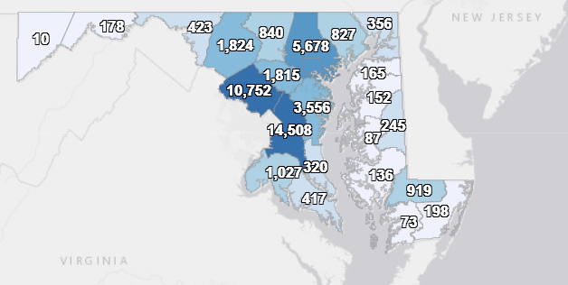
Maryland: COVID-19 Cases
http://health.maryland.gov/coronavirus
Data current as of 5/29/2020
Cases: 50,988
1,279 new
Deaths: 2,348
41 new
Hospitalizations: 8,479
87 new
Negative tests 233,530

Slide 6
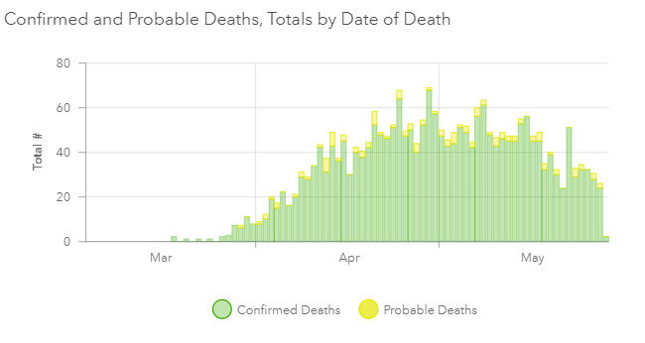

Slide 7
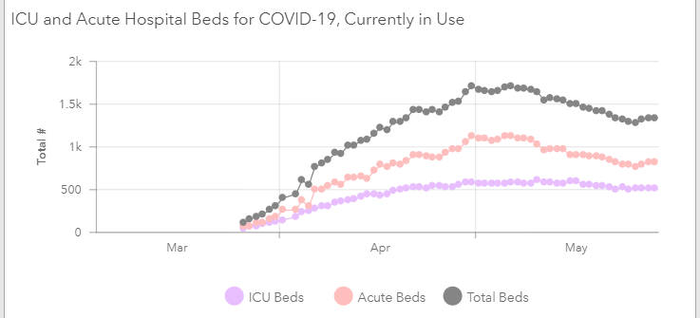

Slide 8
CDC Updates

Slide 9
Guidance for Disaster Shelters
Preference for dorm or hotel style shelters over large congregate settings
Masking for shelter staff and evacuees
Provide masks if needed
Check residents daily for fever and symptoms
Access to safe shelter from disasters is critical even during community spread of COVID-19. Disaster shelters should not exclude as residents people who are having symptoms or test positive for COVID-19.
Separate sick residents; designate an isolation area where people can be kept in separate rooms, or at least 6 feet apart
Refer those who need immediate medical attention to emergency services
https://www.cdc.gov/coronavirus/2019-ncov/downloads/Guidance-for-Gen-Pop-Disaster-Shelters-COVID19.pdf

Slide 10
Guidance for Group Homes
Special considerations for people with limited mobility, trouble understanding information, who require close contact with a care giver, have difficulties with changes in routine
Reminders and redirection for physical distancing, hand washing, use of respiratory etiquette
https://www.cdc.gov/coronavirus/2019-ncov/hcp/developmental-behavioral-disorders.html

Slide 11
Guidance for Homeless Shelters
Screen clients upon arrival
Take temperatures
Ask about symptoms
Provide a cloth face mask for clients
Clients who report fever or symptoms, should be directed to designated isolation room
Shelter healthcare providers should be notified whenever a client screens positive for symptoms
https://www.cdc.gov/coronavirus/2019-ncov/community/homeless-shelters/screening-clients-respiratory-infection-symptoms.html

Slide 12
This is not over yet…
As things start to re-open

Slide 13
“Lower risk” is not “no risk”
Continue to physically distance
Avoid large groups of people
Keep track of who you hang out with (in case you get a contact tracing call)
Masks are still important as source control

Slide 14
Screening staff and clients
HCP and clients who had previously been staying home will now be leaving the house and doing some activities
This increases risk of exposure to asymptomatic but infectious contacts
DO NOT WORK OR GO OUT IF YOU ARE SICK
Continue to screen everyone for symptoms and fever upon arrival to the workplace, clinic, residential treatment center, etc
Refer people with ANY symptoms for testing
Exclude until test comes back (if negative), or 10 days after test (if positive)

Slide 15
When to get tested
If you have symptoms
Even mild symptoms
Even “just allergies”
If you were in close contact with someone tested positive
Don’t go immediately- wait 10-14 days after contact
If your healthcare provider recommends it
May be prior to elective procedures and surgery
If you really enjoy getting things stuck up your nose

Slide 16
When facilities start to re-open
Encourage physical distancing
Limit the number of people in a waiting area- have people wait outside or in their cars and call them when it is time for their appointment
Create one way pedestrian traffic flow
Provide additional hand hygiene opportunities
Hand sanitizer or sinks with soap and water
Require masks in all public spaces
Put up physical barriers between staff and clients
At the check in desk, payment, pharmacy, or medication distribution

Slide 17
Resources
MDH Novel Coronavirus: http://health.maryland.gov/coronavirus
MDH Laboratory Coronavirus: https://health.maryland.gov/laboratories/Pages/Novel-Coronavirus.aspx
COVID-19 People at risk https://www.cdc.gov/coronavirus/2019-ncov/specific-groups/high-risk-complications.html
CDC Guidance for Infection Control https://www.cdc.gov/coronavirus/2019-nCoV/infection-control.html
Behavioral Health https://www.cdc.gov/coronavirus/2019-ncov/hcp/infection-control-faq.html?CDC_AA_refVal=https%3A%2F%2Fwww.cdc.gov%2Fcoronavirus%2F2019-ncov%2Finfection-control%2Finfection-prevention-control-faq.html
Memory Care https://www.cdc.gov/coronavirus/2019-ncov/hcp/memory-care.html

Slide 18
Questions?
Email : mdh.ipcovid@Maryland.gov

