Slide 1
Maryland Situation Update on Coronavirus Disease (COVID-19) for BHA
Maryland Department of Health
Infectious Disease Epidemiology and Outbreak Response Bureau
January 29, 2021

Slide 2
Call Agenda
Picture Courtesy of NIAID-RML
Review current situation of COVID-19
Influenza Updates
Article of Relevance: Association of Psychiatric Disorders With Mortality Among Patients With COVID-19
Q and A

Slide 3
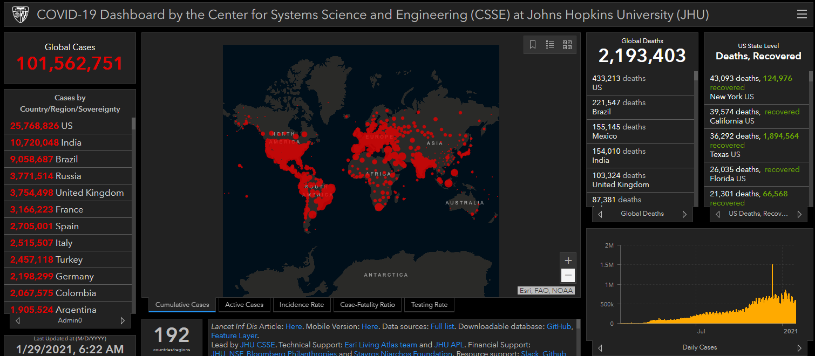
COVID-19 Global Situation Summary
https://gisanddata.maps.arcgis.com/apps/opsdashboard/index.html#/bda7594740fd40299423467b48e9ecf6

Slide 4
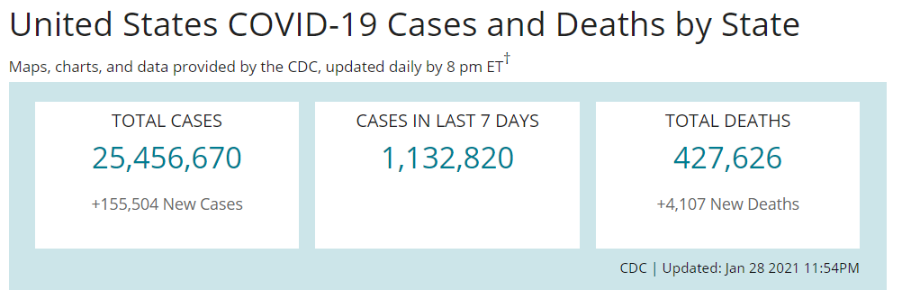
US Case Counts and Rates
https://www.cdc.gov/coronavirus/2019-ncov/cases-updates/cases-in-us.html Accessed 1/29/2021

Slide 5
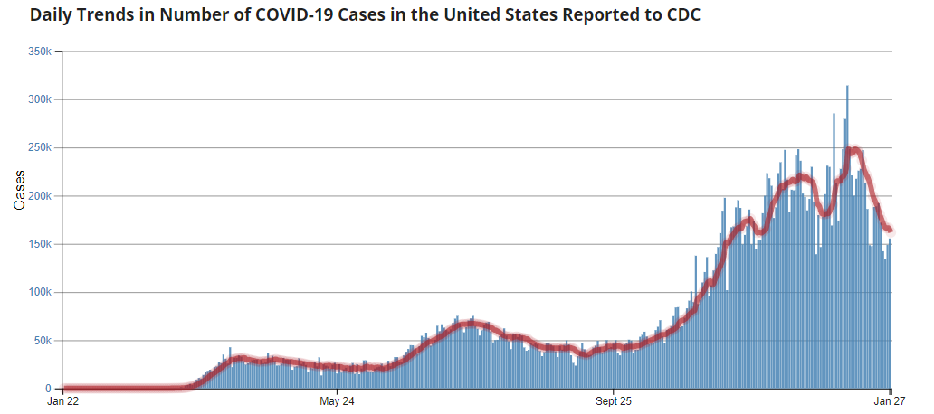
Number of Cases Reported in the USA, by Day
https://covid.cdc.gov/covid-data-tracker/#trends_dailytrendscases
Updated 1/22/2021

Slide 6
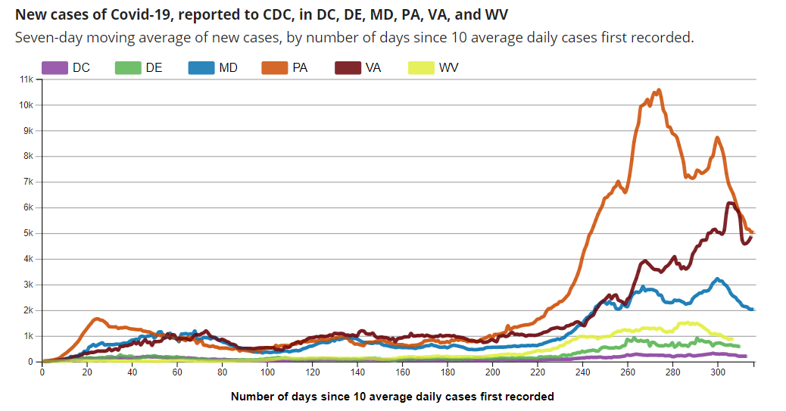
Regional Trends
https://covid.cdc.gov/covid-data-tracker/#compare-trends_newcases 1/29/2021

Slide 7
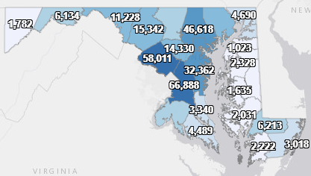
Maryland: COVID-19 Cases
http://health.maryland.gov/coronavirus
Data current as of 1/29/2021
Cases: 350,629
1,880 new
Deaths: 6,900
39 new
Hospitalizations: 31,759
Current: 1,616 ( down 20)
Total tests performed: 6,918,308
Case rate: 32.4 per 100,000

Slide 8
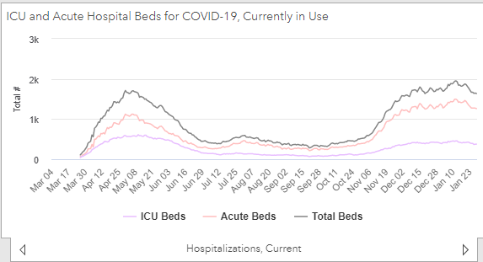
https://coronavirus.maryland.gov/ 1/29/2021

Slide 9
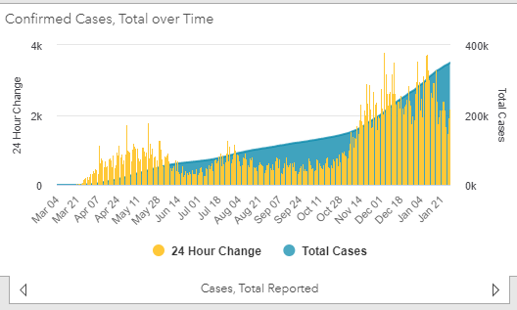
https://coronavirus.maryland.gov/ 1/29/2021

Slide 10
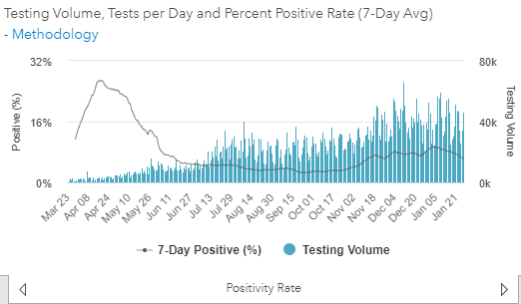
Testing Volume and % Positivity

Slide 11
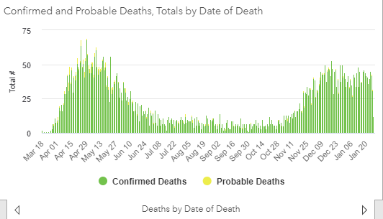

Slide 12
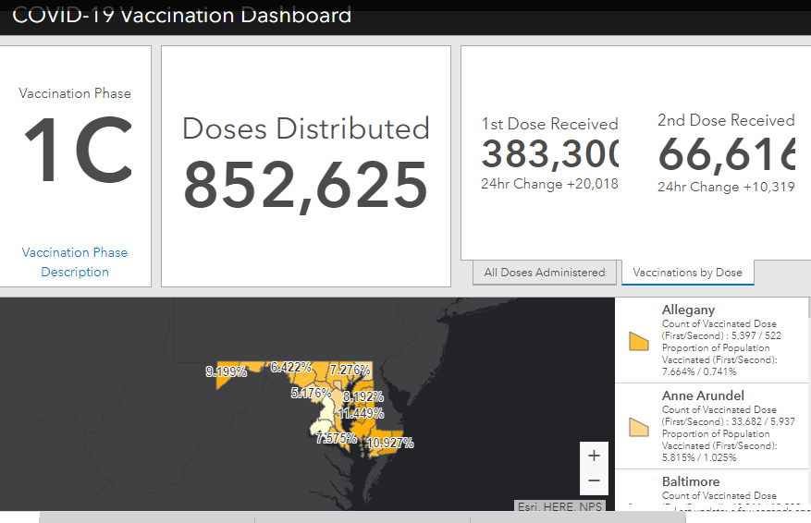
Maryland Vaccine Dashboard
https://coronavirus.maryland.gov/#Vaccine accessed January 29, 2021

Slide 13
Maryland Influenza Epi Update
Week Ending January 16nd, 2021
Influenza-like illness (ILI) activity in Maryland was minimal

Slide 14
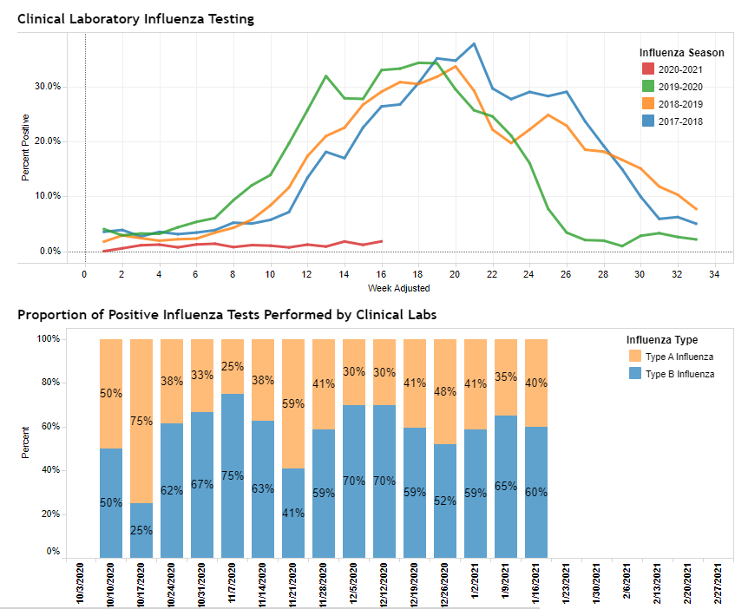
https://phpa.health.maryland.gov/influenza/Pages/flu-dashboard.aspx

Slide 15
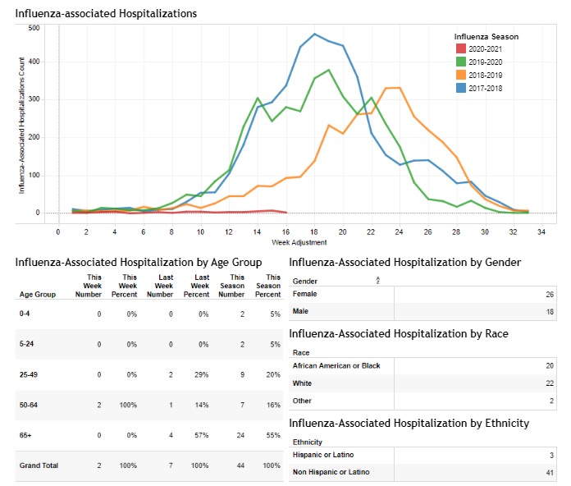
https://phpa.health.maryland.gov/influenza/Pages/flu-dashboard.aspx

Slide 16
Association of Psychiatric Disorders With Mortality Among Patients With COVID-19
https://jamanetwork.com/journals/jamapsychiatry/fullarticle/2775179

Slide 18
Key Points
Question Is a diagnosis of schizophrenia spectrum, mood, or anxiety disorders associated with increased risk of mortality in patients with coronavirus disease 2019 (COVID-19)?
Findings In this cohort study of 7348 adults with laboratory-confirmed COVID-19 in a New York health system, a schizophrenia spectrum diagnosis was associated with an increased risk of death after adjusting for demographic and medical risk factors. Mood and anxiety disorders were not associated with increased risk of mortality.
Meaning A diagnosis of a schizophrenia spectrum disorder may be a risk factor for mortality in patients with COVID-19.
https://jamanetwork.com/journals/jamapsychiatry/fullarticle/2775179

Slide 19
Study Design
Design, Setting, and Participants This retrospective cohort study assessed 7348 consecutive adult patients for 45 days following laboratory-confirmed COVID-19 between March 3 and May 31, 2020, in a large academic medical system in New York. The final date of follow-up was July 15, 2020. Patients without available medical records before testing were excluded.
Exposures Patients were categorized based on the following International Statistical Classification of Diseases, Tenth Revision, Clinical Modification diagnoses before their testing date: (1) schizophrenia spectrum disorders, (2) mood disorders, and (3) anxiety disorders. Patients with these diagnoses were compared with a reference group without psychiatric disorders.
Main Outcomes and Measures Mortality, defined as death or discharge to hospice within 45 days following a positive severe acute respiratory syndrome coronavirus 2 (SARS-CoV-2) test result.

Slide 20
Results
Results Of the 26 540 patients tested, 7348 tested positive for SARS-CoV-2 (mean [SD] age, 54 [18.6] years; 3891 [53.0%] women). Of eligible patients with positive test results, 75 patients (1.0%) had a history of a schizophrenia spectrum illness, 564 (7.7%) had a history of a mood disorder, and 360 (4.9%) had a history of an anxiety disorder. After adjusting for demographic and medical risk factors, a premorbid diagnosis of a schizophrenia spectrum disorder was significantly associated with mortality (odds ratio [OR], 2.67; 95% CI, 1.48-4.80). Diagnoses of mood disorders (OR, 1.14; 95% CI, 0.87-1.49) and anxiety disorders (OR, 0.96; 95% CI, 0.65-1.41) were not associated with mortality after adjustment. In comparison with other risk factors, a diagnosis of schizophrenia ranked behind only age in strength of an association with mortality.
Conclusions and Relevance In this cohort study of adults with SARS-CoV-2–positive test results in a large New York medical system, adults with a schizophrenia spectrum disorder diagnosis were associated with an increased risk for mortality, but those with mood and anxiety disorders were not associated with a risk of mortality. These results suggest that schizophrenia spectrum disorders may be a risk factor for mortality in patients with COVID-19.

Slide 21
But why?
It is possible that unmeasured medical comorbidities contributed to this finding, although the risk remained significantly increased after adjustment for multiple established risk factors. Delays in treatment seeking or reduced access to care may have contributed to worse outcomes.
Beyond systemic barriers to care and delayed treatment, adults with schizophrenia spectrum diagnoses may be more susceptible to COVID-19 mortality due to biological factors related to their psychiatric illness or treatment.

Slide 22
Questions?
Email : mdh.ipcovid@Maryland.gov

