Slide 1
MDH Electronic Information Systems
An Introduction to Required IT Security and Privacy Policies
Office of Enterprise Technology

Slide 2
Key IT Security Points
What is your role as an end-user?
Do you work with Protected Health Information (PHI)?
Are you a Custodian of Records, DBA, or a Network/IT Services employee?
Privacy and Security policies govern your actions
When in doubt, ask your supervisor!

Slide 3
Orientation Required by Policy
Employees:
Are required to read, sign and adhere to the IT and Data Privacy policies
Must sign the Combined Acknowledgement Form
Must comply with requirements
When in doubt, ask your supervisor!

Slide 4
MDH Office of Enterprise Technology (OET)
OIT manages MDH IT enterprise services for more than 50 sites and direct user support for select MDH business units. Other business units maintain their own local IT user support staffs.
Some of the services offered by MDH OET include:
Enterprise network services (MDH Wide Area Network, Internet and SwGI services)
Enterprise network security
Helpdesk, hardware and software end-user support (for some MDH business units)
Information Technology Asset Management services for software licensing
MDH liaison to Maryland State Department of Information Technology
Security requirements analysis for new system development and upgrades
Information Security training for users, developers and managers (online and in-person)
Assistance to access vendor-based IT systems security consulting services

Slide 5
MDH Electronic Resource Use Principles
Adherence to software licensing end-user agreements
Protection of non-public data
Hardware, software and network are state property made available to employees to conduct state business
Use may be monitored by MDH OET and DoIT (Department of Information Technology)
Use records and electronic correspondence may be public record
No right or expectation of privacy while using state resources
Use of personal devices must be approved by your manager
Personnel actions/legal ramifications for violation of principles, policies and laws

Slide 6
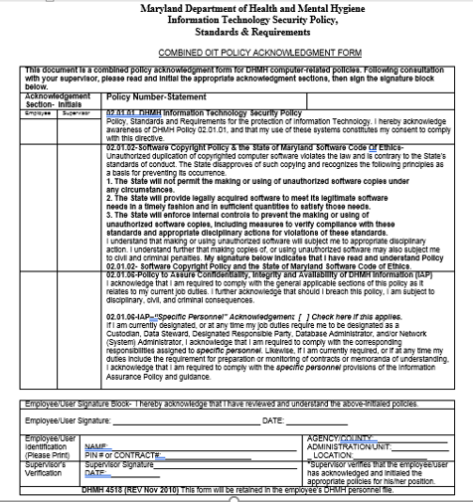
Appropriate Use of Electronic Resources
Important Policy Topics
02.01.01 Information Technology Security Policy
02.01.02 Software Copyright Policy & Code of Ethics
02.01.06 Assure Confidentiality, Integrity and Availability of MDF Information (IAP)
Review and signature required every year.

Slide 7
Policies and Required Acknowledgement Form
Agency Information Technology Technical Security Policy, Standards and Requirements
Information Assurance Policy (IAP) 02.01.06
Policy for Prevention of Software Copyright Infringement

Slide 8
What is Software Copyright Infringement?
It’s the making and using of unauthorized copies of computer software
Copying software is illegal!
Federal copyright laws protect companies from users “stealing” their products
Law is straight forward…illegal to copy software for any reason other than as a backup, unless expressly permitted by the copyright holder
Purchasing doesn’t give you ownership…only the right to use according to the licensing agreement
Policy written, MDH Policy 02.01.02

Slide 9
General Rules!
DO NOT COPY SOFTWARE, comply with the license
DO NOT BRING IN YOUR OWN SOFTWARE/HARDWARE/PERIPHERAL
DO NOT COPY MDH SOFTWARE for use at home
All unauthorized software found on your pc will be removed immediately and you will be subject to disciplinary action
Games are not allowed on any MDH Workstations
No personal screen savers or backgrounds, use only those supplied by Windows

Slide 10
Reminders
Your computer, the software on it, and the network it’s attached to are all STATE PROPERTY
Supplied to you to do your job
Keep in mind that any action you take with this state property can be and is monitored
If the contents of these are found to be in violation of MDH policy, you may be subject to disciplinary actions
You are ultimately responsible for what’s on your computer

Slide 11
Maryland.gov
Google Apps for Government used by State of Maryland executive branch agencies
Gmail, Google Drive, Google Docs, Sheets and Slides
Email between Maryland.gov accounts is considered secure
Email sent to any user outside of Maryland.gov system is not secure
Email sent outside of Maryland.gov system containing Personally Identifiable Information (PII), Protected Health Information (PHI) or any non-public data must be encrypted using the State approved encryption solution (Virtru)
Password protection of email attachments provides additional level of security

Slide 12
Virtru Email Encryption
Use for sending and/or viewing encrypted messages from within your Maryland.gov account
Runs as an extension within Chrome or Firefox web browser
Available for mobile devices
MDH users must be approved and provisioned for Virtru before use
If approved for your use, supervisor or manager must submit request on your behalf to your local IT support staff or contact the MDH OET Service Desk directly (if your unit is directly supported by OET)
Reading and replying to received, encrypted emails is possible even without being provisioned as a Virtru user

Slide 13
Infosec Training
State of Maryland security awareness training for state employees
Monthly online security lessons
Email notice alerts users to new lesson
If you do not receive email alerts for lessons, notify your local IT support staff to verify that your enrollment

Slide 14
MDH and OET Websites
MDH Employee Information
http://health.maryland.gov/Pages/empcentral.aspx
Contains information, policies and forms
MDH Self Service Center
https://selfservice.health.maryland.gov
Users can unlock and/or change their own network passwords and enter work contact information that will be visible in the Maryland.gov Google directory
OIT Service Desk
Web: https://mdhhelpdesk.health.Maryland.gov or http://helpdesk.health.maryland.gov (access on MDH network only)
Phone: 410.767.6534
Email: MDH.Helpdesk@Maryland.gov

Slide 15
Please Remember…
Always follow applicable policies, procedures and laws!
Always protect MDH/State of Maryland data; when in doubt err on the side of caution!
Always protect MDH/State of Maryland hardware and software resources!
Report any suspected or confirmed security breach immediately!
Ask your supervisor or local IT support any questions about the proper, permissible and/or secure use of MDH/State resources!
It is your responsibility to learn and keep UpToDate with the software used to perform your duties!

