Slide 1
HIPAA
MARYLAND DEPARTMENT OF HEALTH
OFFICE OF INTERNAL CONTROLS, AUDIT COMPLIANCE & INFORMATION SECURITY

Slide 2
HIPAA TERMS
What is HIPAA?
What is a covered entity?
What is a hybrid entity?
What is a business associate?
What is a breach?
What is PHI?

Slide 3
WHAT IS PHI?
What is Individually Identifiable Health Information (IIHI) anyway?
Any information that relates to the past, present, or future physical or mental health or condition of an individual, or provision of health care to an individual, Addresses past, present, or future payment for health care services provided to individuals; and
Any information created or received by a health care provider, health plan, health care clearinghouse, public health authority, employer, life insurer, school or university; and
Identifies or could be used to identify the individual; and
If the information is transmitted or maintained in any form or medium by a covered entity or business associate, it is known as “Protected Health Information” (PHI)

Slide 4
What makes PHI “identifiable”: HIPAA Identifiers
1. Names;
2. Addresses (you can leave in State and some parts of some zip codes)
3. All elements of dates (except year) for dates directly related to an individual, including
birth date, admission date, discharge date, date of death; and all ages over 89 and all
elements of dates (including year) indicative of such age, except that such ages and elements may be aggregated into a single category of age 90 or older;
4. Phone numbers;
5. Fax numbers ;
6. Electronic mail addresses;
7. Social Security numbers;
8. Medical record numbers;
9. Health plan beneficiary numbers;
10. Account numbers;
11. Certificate/license numbers;

Slide 5
HIPAA PHI Identifiers
12. Vehicle identifiers and serial numbers, including license plate numbers;
13. Device identifiers and serial numbers;
14. Web Universal Resource Locators (URLs);
15. Internet Protocol (IP) address numbers;
16. Biometric identifiers , including finger and voice prints;
17. Full face photographic images and any comparable images; and
18. Any other unique identifying number, characteristic, or code (note this does not mean the unique code assigned by the investigator to code the data)
*NOTE - a record is “identifiable” if it contains any of these identifiers for the subject of the records, their family, the people they share a house with and/or their employer

Slide 6
Main Rules:
Security Rule
Privacy Rule
Enforcement Rule
Breach Notification Rule
Transaction and Code Set Rules

Slide 7
HIPAA Minimum Necessary Standard
Part of the Privacy Rule
Limits unnecessary and inappropriate access to or disclosure of PHI
Access should be limited to only that which the user needs to perform their job
Disclosures should be limited to only the information necessary to to satisfy the reason for the disclosure
Exceptions include disclosures to the individual or with their authorization or for treatment purposes
Minimum Necessary violations could be a breach

Slide 8
What is a breach under the HIPAA Breach Notification Rule?
An unauthorized acquisition, access, use, or disclosure of PHI is presumed to be a breach unless the covered entity or business associate, as applicable, demonstrates that there is a low probability that the PHI has been compromised based on a risk assessment of at least the following factors:
The nature and extent of the PHI involved, including the types of identifiers and the likelihood of re-identification;
The unauthorized person who used the PHI or to whom the disclosure was made;
Whether the PHI was actually acquired or viewed; and
The extent to which the risk to the PHI has been mitigated.

Slide 9
Exceptions to the Breach Notification Rule
Unintentional acquisition
Inadvertent disclosure between 2 authorized agents
Good faith belief that the information was not retained

Slide 10
Breach Notification
Notice to affected individuals must occur within 60 days of discovery by the Covered Entity
by first class mail
HIPAA regulations lay out what information must be in letter
Notification to HHS must be
within 60 days of discovery of 500 or more affected individuals
within 60 days of the beginning of the next calendar year if under 500 affected individuals
Notification to area media required when 500 or more affected individuals

Slide 11
Covered Entities may only use or disclose PHI in the following manner:
To the individual who is subject of the PHI
For treatment, payment or health care operations
Incident to a use or disclosure permitted by the Privacy Rule
Pursuant to a valid authorization from the individual or their personal representative
Directories
For certain fundraising activities
In connection with a limited data set (research)
For certain underwriting and insurance purposes

Slide 12
No authorization required:
Public health activities;
Victims of abuse, neglect or domestic violence;
Health oversight purposes;
Judicial and administrative proceedings;
Law enforcement purposes;
Decedents (coroners and medical examiners, funeral directors);
Cadaveric organ, eye, or tissue donation purposes;
Averting a serious threat to health or safety;
Specialized government functions;
Workers compensation;
As otherwise required by law.

Slide 13
Areas of Concern:
Laptops;
Flash drives;
Paper files;
Communications;
Disposal;
Cell phones;
Fax machines;
PCs;
Emails;
Disclosures;
Mailings; and
Social media.

Slide 14
Preventing Breaches:
Policies;
Training;
Monitoring;
Risk Assessments; and
Follow up

Slide 15
HIPAA Civil Penalties:
Violation Category | Each Violation | All Such Violations of an Identical Provision in a Calendar Year
Did Not Know | $100 - $50,000 | $1,500,000
Reasonable Cause | $1,000 - $50,000 | $1,500,000
Willful Neglect-Corrected | $10,000 - $50,000 | $1,500,000
Willful Neglect-Not Corrected | $50,000 | $1,500,000

Slide 16
HIPAA Criminal Penalties:
Violation Category | Each Violation
Knowingly obtain/disclose or with reasonable cause | Up to a 1-year period of incarceration and $50,000 fine
Under false pretenses | Up to a 5-year period of incarceration and $100,000 fine
For personal gain or malicious reasons | Up to a 10-year period of incarceration and $250,000 fine

Slide 17
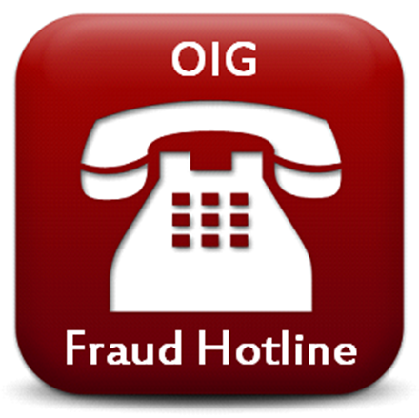
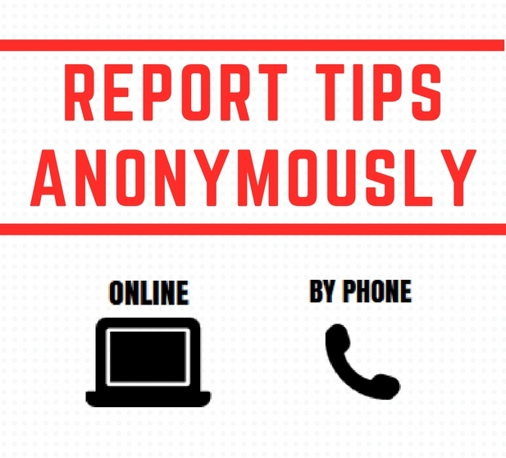
1-866-770-7175
health.maryland.gov/iac/Pages/Home.aspx
mdh.iac@Maryland.gov

Slide 18
Office of Internal Controls, Audit Compliance & Security
For more information on the Maryland Department of Office of Internal Controls, Audit Compliance & Security or to make a report of fraud, waste, abuse, or misconduct please contact:
Lauren Boyce, Privacy Officer, lauren.boyce1@maryland.gov, 410-767-5411

