Slide 1
MARYLAND TEACHERS AND STATE EMPLOYEES SUPPLEMENTAL RETIREMENT PLANS
The Basics
457(b) Roth 457(b)
401(k)
Roth 401(k)
403(b)
NRM-7778MD-MD12

Slide 2
Maryland Supplemental Retirement Plans (MSRP)
Plan overview video: https://www.marylanddc.com/iApp/tcm/marylanddc/learning/videos/msrp_overview_18.jsp
To schedule an enrollment phone call please make an appointment by going to: www.savannahrath.timetap.com
You can reach me by email at raths5@nationwide.com
I work with employees in West Baltimore City / County. If you work elsewhere, I can still help you to get started. Once enrolled, you will work with the representative for your specific area. The representative map can be found here: https://www.marylanddc.com/iApp/tcm/marylanddc/support/contact/meet_your_retirement_specialists.jsp
Nationwide is the administrator for MSRP. Nationwide Investment Services Corporation (member, FINRA), an affiliate of NRS, provides educational and enrollment services on behalf of MSRP. Financial & Realty Services, LLC may provide education and marketing support services on behalf of Nationwide. Its Retirement Consultants are registered representatives of FSC Securities Corporation (FSC), member FINRA, SIPC. FSC and Financial & Realty Services, LLC are not affiliated with MSRP, Nationwide or NISC.
2 |  |  |  |  | MARYLAND TEACHERS AND STATE EMPLOYEES SUPPLEMENTAL RETIREMENT PLANS

Slide 3
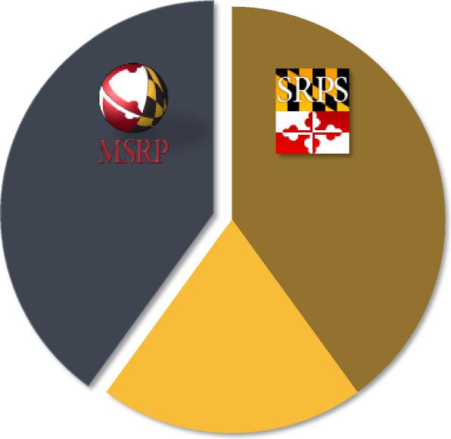
Sources of retirement income
MSRP can help fill the gap
between what you’ll have
and what you’ll need for
retirement.
Membership is open to:
Maryland State Employees
Contractual Employees
Employees of State Higher Education Institutions
Gap? Pension
Social
Security
$135 Average MSRP bi-weekly deferral (as of Dec 2018)
3 |  |  |  |  | MARYLAND TEACHERS AND STATE EMPLOYEES SUPPLEMENTAL RETIREMENT PLANS

Slide 4
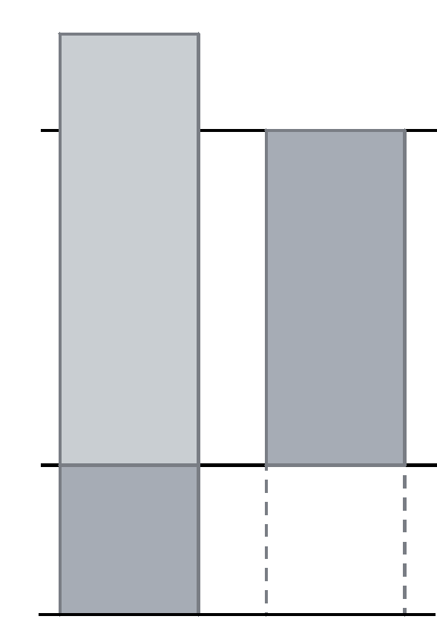
It pays to start early
$281,632
Compounding only
Both Roz and Deanne began working in 1979.
Roz began contributing $3,510 annually but stopped in 1989
Deanne waited 10 years until 1989 and contributed $3,510 per year until she retired at age 65 in 2014
Because Roz’s money had more time to grow, her account balance was higher than Deanne’s even though Deanne contributed more for a longer period of time.
This hypothetical illustration assumes an average annual return of 7%. No taxes or fees are reflected which would lower the amount shown. This illustration is intended to demonstrate time and compounding. It is not intended to serve as a projection or prediction of the investment results of any specific investment. Depending on underlying investments, actual returns may be higher or lower. Investing involves risk, including possible loss of principal.
$237,544
2014
$3,510 per year
($87,750)
1989
YEAR
$3,510 per year
($35,100)
Missed opportunity
1979
Roz Deanne
5 |  |  |  |  | MARYLAND TEACHERS AND STATE EMPLOYEES SUPPLEMENTAL RETIREMENT PLANS

Slide 5
Let’s get started filling that gap.
First, select your plan
457(b) Deferred Compensation Plan
– pre-tax (tax-deferred) employee contribution option
– after-tax Roth employee contribution option
401(k) Savings and Investment Plan
– pre-tax (tax-deferred) employee contribution option
– after-tax Roth employee contribution option
403(b) Tax-Deferred Annuity Plan
– for employees in educational institutions
– Pre-tax employee contribution
401(a) Match Plan – Automatically Enrolled – Pre-tax employer contribution
– Note: The amount of the match may change from year to year or be suspended through legislative action, and is suspended for the fiscal year ending 6/30/2015.
Neither Nationwide Retirement Solutions nor its representatives provide legal or tax
advice.
6 |  |  |  |  | MARYLAND TEACHERS AND STATE EMPLOYEES SUPPLEMENTAL RETIREMENT PLANS

Slide 6
Decide how to invest
Do-it-yourself One and done Go Pro
Your own strategy Target Date Funds ProAccount
Define your investment strategy, select & manage your own investments | ✓
Choices guided by personal risk tolerance | ✓ |  | ✓
Want professional asset allocation |  | ✓ | ✓
Automatic re-balancing service | ✓ | ✓ | ✓
Want professional investment management to select and manage your funds for you. |  | ✓ | ✓
Professional monitoring and periodic adjustments |  | ✓ | ✓
Target Maturity Funds are designed for people who plan to retire or need income during or near a specific year. These funds use a strategy that reallocates equity exposure to a higher percentage of fixed investments over time. As a result, the funds become more conservative over time as you approach retirement. It’s important to remember that no strategy can assure a profit or loss in a declining market. Please note that choice of this fund does not assure you will reach your desired retirement plan goal.
Investment advice for Nationwide ProAccount is provided to plan participants by Nationwide Investment Advisors, LLC (NIA), a SEC-registered investment advisory. NIA has retained Wilshire Associates Incorporated as the Independent Financial Expert for Nationwide ProAccount. Wilshire Associates Incorporated is not an affiliate of NIA or Nationwide.
7 |  |  |  |  | MARYLAND TEACHERS AND STATE EMPLOYEES SUPPLEMENTAL RETIREMENT PLANS

Slide 7
Finally, choose a Roth or Tax-deferred option
Tax Deferred 457(b), 401(k), 403(b)
Roth* 401(k), Roth 457(b)
Pay taxes
now Pay taxes
later
For example, a $50 contribution to your For example, a $50 contribution to your
account reduces your take-home pay by $50 account reduces your take-home pay by $37.50 (in a 25% tax bracket)
*Earnings are not taxable in the year distributed assuming all contributions have been held in the Roth account for five years after the first Roth contribution was made AND the distribution is made after age 59¹/₂ (and separation from State service for a Roth 457(b)); or for death or disability.
11 |  |  |  |  | MARYLAND TEACHERS AND STATE EMPLOYEES SUPPLEMENTAL RETIREMENT PLANS

Slide 8
How much can I contribute
 | Maximum Contribution Limit | Contribution limit plus Age 50 Catch-up | Special 457 Catch-up Contribution Limit
This calendar year | If you’re less than age 50 this year, you may contribute as much as... | If you’re at least age 50 this year, you may contribute as much as... | If you have three years prior to the year you reach your normal retirement age, you may contribute as much as...
457(b) Roth 457(b) | $19,500 | $26,000 | $39,000
401(k) Roth 401(k) 403(b) | $19,500 | $26,000 | $26,000 (use Age 50 catch-up)
TOTAL | $39,000 | $52,000 | $65,000
For participants with both a 401(k) and 403(b) plan account, combined annual contributions to the plans may not
exceed $19,500
You may start, stop, increase or decrease your deferral amount
Minimum deferral — $5 per bi-weekly pay
Increase every time you get a pay increase or pay off major bills
12 |  |  |  |  | MARYLAND TEACHERS AND STATE EMPLOYEES SUPPLEMENTAL RETIREMENT PLANS

Slide 9
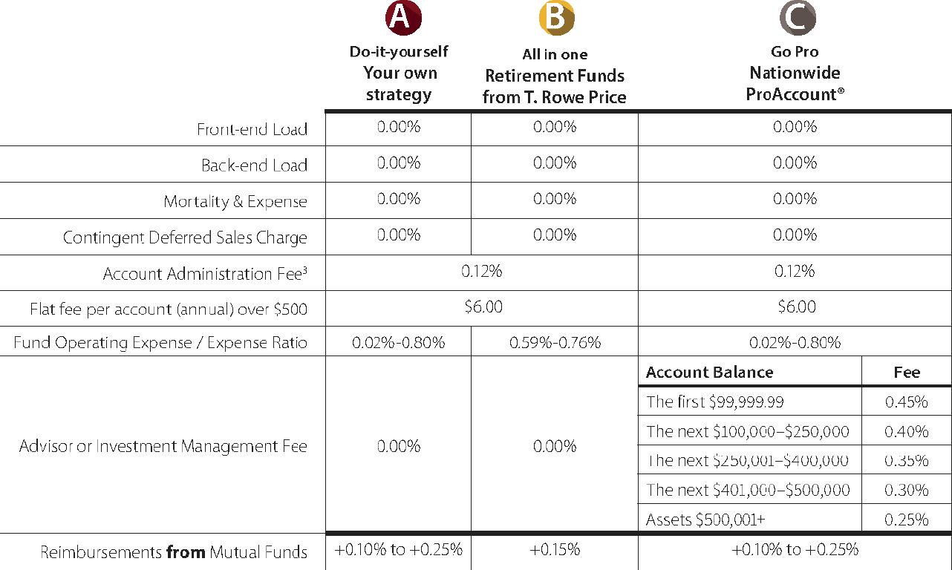
Competitive fees
Admin Fees effective 10.2019 13
 | MARYLAND TEACHERS AND STATE EMPLOYEES SUPPLEMENTAL RETIREMENT PLANS

Slide 10
Rollovers & MSRP
It’s important to understand retirement account differences and similarities, such as fees, services, investment options, etc., before making any rollover decisions.
This material is not a recommendation to buy, sell, hold or roll over any asset, adopt an investment strategy, retain a specific investment manager or use a particular account type. It does not take into account the specific investment objectives, tax and financial condition or particular needs of any specific person. Investors should work with their financial professional to discuss their specific situation.
Investing involves risk, including possible loss of principal.
Qualified retirement plans, deferred compensation plans and individual retirement accounts are all different, including fees and when you can access funds. Assets rolled over from your account(s) may be subject to surrender charges, other fees and/or a 10% early withdrawal tax if withdrawn before age 59¹/₂.
Diversification does not guarantee profits or insulate you from potential losses.
Rollover to MSRP
 | 457(b) | Roth 457(b) | 403(b) | 401(k) | Roth 401(k)
457(b) | Yes | Yes* | Yes | Yes | No
Roth 457(b) | No | Yes | No | No | Yes
403(b) | Yes | No | Yes | Yes | No
401(k) | Yes | No | Yes | Yes | Yes*
Roth 401(k) | No | Yes | No | No | Yes
Roth 403(b) | No | Yes | No | No | Yes
IRA | Yes | No | Yes | Yes | No
Roth IRA | No | No | No | No | No
Simple IRA | Yes** | No | Yes** | Yes** | No
SEP IRA | Yes | No | Yes | Yes | No
Pension | Yes | No | Yes | Yes | No
Thrift Savings Plan | Yes | No | Yes | Yes | No
Rollover from
*Ignores Roth conversion. In other words, the money rolled over remains taxable at distribution. **After 2 years, only one rollover in any 12-month period.
14 |  |  |  |  | MARYLAND TEACHERS AND STATE EMPLOYEES SUPPLEMENTAL RETIREMENT PLANS

Slide 11
Borrowing from your account
Participant loans are available; pay yourself back principal and interest
Five-year repayment, principal residence repayment — 15 years
Consider the effect it may have on your retirement goals
18 |  |  |  |  | MARYLAND TEACHERS AND STATE EMPLOYEES SUPPLEMENTAL RETIREMENT PLANS

Slide 12
How do I enroll?
Online: www.marylanddc.com
Schedule a meeting to get your questions answered and then enroll via DocuSign when you are ready www.savannahrath.timetap.com
By phone: 800-545-4730
By form: enrollment forms will be sent out as a PDF after orientation. If you do not have access to a printer/ scanner, you can also email me and I can send you a DocuSign to enroll: raths5@nationwide.com

Slide 13
Contacts
Maryland Supplemental Retirement Plans
800-545-4730
or
800-543-5605
MarylandDC.com
or
MSRP.maryland.gov
For comments or requests
for educational seminars
at your workplace
Enroll online now
23
MARYLAND TEACHERS AND STATE EMPLOYEES SUPPLEMENTAL R E T I R E M E T A

