Slide 1
Public Health Emergencies
Queen Anne’s County Department of Health

Slide 2
Cornerstone of Emergency Preparedness = PERSONAL Preparedness
“It’s Not Luck!”
Do you have a plan for your Family in the event of an emergency?
If your family is prepared, you are better able to respond to an emergency and help the community.
Know your risk for the area where you live and work.
Make a plan to lessen the impact of those risks.
Build a kit to be ready for disasters and emergencies.
Visit www.ready.gov for checklists and helpful tips on being prepared for a disaster.

Slide 3
County Emergency Notifications
Everbridge is the emergency alert notification system used by Queen Anne’s County.
To receive alerts about emergencies and other important community events in QAC, visit the Department of Emergency Services website at
https://www.qac.org/325/Emergency-Services

Slide 4
Types of Emergencies
What kind of public health emergencies does QACDOH plan for or respond to?
Naturally Occurring Events – Severe Weather (snow storms, hurricanes, extreme heat), Pandemics or Epidemics/Outbreaks (influenza, measles, smallpox)
Technological Events – Power Failures, Supply Chain Interruptions
Human-related Events – Bioterrorism (anthrax), Active Shooter, Mass Casualty/Fatality
Chemical/Radiological Events – Hazardous Materials Spill, Radiological/Nuclear Dispersal

Slide 5
Who Responds?
Most emergency responses require only a few people, typically the Health Officer, Directors, and PHEP.
Sometimes limited DOH staff are asked to help staff a Shelter.
All LHD staff may be asked to assist in a large response such as a mass medication distribution at a Point of Dispensing clinic.
Other duties: Call Center, Surveillance, Clerical or Logistical Support.

Slide 6
Points of Dispensing
In an emergency requiring the Health Department medicate the population in a fixed amount of time, we activate large clinics called Points of Dispensing or PODs.
There are two types of PODs:
Medical Model (like a Flu Clinic)
Limited number of people
Sufficient time to treat/dispense
Medical screening conducted
Sufficient medical and non-medical personnel
Non-medical Model
Large numbers of the population affected
Limited timeframe to dispense
Rapid throughput
Head of Household conducts Self-screening for all
Requires less medical staff to run

Slide 7
Cities Readiness Initiative (CRI)
Queen Anne’s County is a CRI county due to its proximity to Washington, D.C. and is part of the Baltimore Metropolitan Statistical Area (MSA).
CRI started after the Anthrax incidents of 2001 and requires jurisdictions have a plan to rapidly deploy medical countermeasures to the population within 48 hours of notification.
We use the non-medical model to dispense the medicine to our 50,000+ citizens!

Slide 8
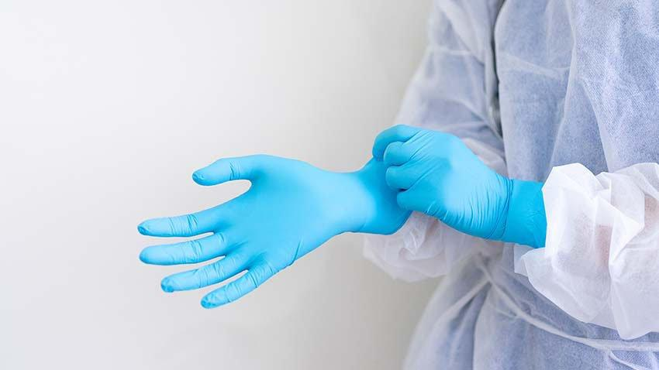
Strategic National Stockpile (SNS)
Where does all the medicine come from to medicate 50,000+ people in 48 hours? The SNS.
The Strategic National Stockpile is a national repository, administered by the Assistant Secretary for Preparedness & Response (ASPR), to supplement federal, state, and local public health agencies stockpiles of:
Antibiotics
Chemical antidotes
Vaccines
Antitoxins
Antivirals
Other PPE and equipment
SNS supplies can be sent anywhere in the US within 12 hours.

Slide 9
What can you do?
Be Informed. Make a Plan. Build a Kit. Get Involved.
Pay attention to emergency alerts and know how to prepared for the hazards that affect our area.
Where will you go if an emergency affects your home?
Prepare for 3 days on your own.
Consider becoming a volunteer for public health or your community.

