Slide 1
Self-Directed Data Dump Technical Design (draft)

Slide 2
High Level Architecture

Slide 3
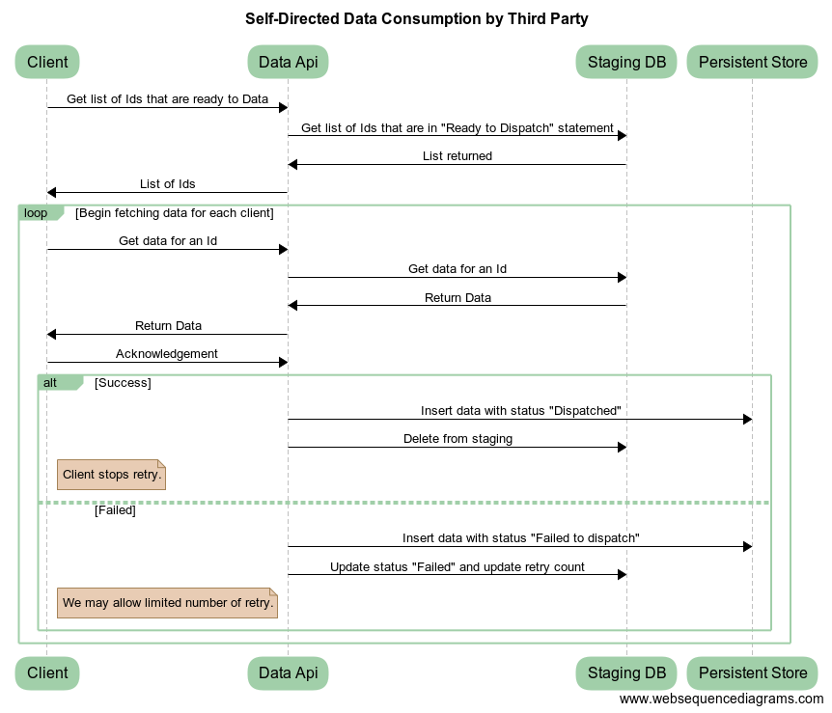
Data Consumption Sequence Diagram

Slide 4
Data Api
A Data Api will be exposed for the third party to consume data over HTTP.
Data Api will expose 3 end points
  Get list of Ids that were changed
  Get data for a single Id (client will invoke data api in loop)
  Acknowledgment for data processed successfully for the Id.
Data Api will support different format such as JSON, XML, Protobuf
Data Api can be extended further to enhance data security when more than one client is consuming data.

