Slide 1
USE OF NUCLEIC ACID AMPLIFICATION TESTS FOR DETERMINING RISK OF TUBERCULOSIS TRANSMISSION
Yingda L. Xie^{1*}, Wendy A. Cronin², Jonathan E. Golub³, Lisa Paulos², Richard Oatis², Jafar H. Razeq², Silvia Cohn³, Ray Y. Chen¹, Clifton E Barry¹, and Susan E. Dorman³
1. Tuberculosis Research Section, Laboratory of Clinical Infectious Diseases, NIAID, NIH, Bethesda, Maryland, USA
2. Maryland Dept. of Health and Mental Hygiene, Baltimore, Maryland, USA
3. Johns Hopkins University School of Medicine, Baltimore, Maryland, USA
Notes:
I’ve been working on under the close co-mentorship of Susan on this study and in collaboration with Jonathan and Silvia among others looking at how NAAT can help us determine a patient’s risk of transmitting TB.

Slide 2
Background
Public health management of TB patients based heavily on sputum smear microscopy
However, smear-negative patients contribute considerably to TB transmission
  Behr et al, Lancet 1999;353:444
Emergence of nucleic acid amplification tests (NAATs) more sensitive for detecting TB
  Enhanced Amplified Mycobacterium Tuberculosis Direct Test (‘MTD’, Gen-Probe, CA)
  Xpert MTB/RIF (Cepheid, CA; FDA-cleared, being rolled out globally)
POOR
SENSITIVITY
X
X
X
PERFECT
SENSITIVITY
Smear
~10,000 cfu/ml
NAATs
~100 cfu/ml
Culture
10 to 50 cfu/ml
For pulmonary TB patients in the state of Maryland from Jan 2004 to Sept 2009 (when MTD and genotyping was routinely performed on TB isolates)…
We can compare the infective potential of sputum NAAT-negative vs. sputum
NAAT-positive patients, using Mtb genotyping as a proxy for transmission
Notes:
Up to now, public health management of pulmonary TB patients has been based heavily on sputum smear status, typically prioritizing resources for respiratory isolation and extensive contact investigations away from smear-negative TB patients. However, studies such as the one performed by Marcel Behr et al in San Francisco in the 1990s have shown that smear-negative patients contribute substantially to TB transmission.
Since that time, we’ve had the emergence of a new generation of rapid TB diagnostics based on nucleic acid amplification, that offer a lower, more favorable limit of detection compared to smear microscopy. Examples include the enhanced Amplified Mycobacterium tuberculosis Direct Test which picks up a portion of16s rRNA, and was used by some US public health TB programs prior to being supplanted by Xpert MTB/RIF which is now being rolled out globally.
*click*
So inaturally we were interested in understanding if nucleic acid amplification tests could refine our assessment of infective potential for each TB patient. It just so happens that since 2003, the state of Maryland made heavy use of MTD testing and routinely performed M.tb genotyping for each pulmonary TB patients. Using this dataset, we could compare and …

Slide 3
Study Objectives
Primary Objectives:
  To compare the infective potential of sputum NAAT-negative vs. sputum NAAT-positive patients, using Mtb genotyping as a proxy for transmission
  To compare the infective potential of sputum NAAT-negative/smear-negative vs. sputum NAAT-positive/smear-negative patients, using Mtb genotyping as a proxy for transmission
Secondary Objective: To compare the infective potential of sputum NAAT-negative vs. sputum NAAT-positive patients, using proportion of infected contacts as a proxy for transmission

Slide 4
Design/Methods
Definitions/Assumptions
  NAAT negative: at least 2 neg NAAT (MTD) results at time of 1st culture-pos specimen (if any positive MTD or if smear positive = NAAT positive)
  Smear negative: at least 3 neg smear microscopy results at time of 1st culture positive specimen (if any positive smear= smear positive)
Notes:
So for our primary analysis looking at cases within genotypic clusters, we needed to define how we determine SM and MTD status.
As well as Relative rate of transmission from MTD negative patients with TB , which divides transmission events into a denominator of total secondary cases who are MTD (-) vs MTD (+)
To be NAAT negative…
…if they had any positive MTD result or were smear positive they were determined to be MTD (+)
To be smear negative….
It didn’t happen often, but if their smear or MTD specimens came after 2 days of treatment, they were not considered in the analysis. This is because the error of misclassifying them seemed greater than that of possibly not including them in the analysis.

Slide 5
How to approximate transmission?
Transmission events within genotypic clusters
2. Proportion of contacts infected for each PTB case
Clustered:
Index cases
Clustered: Secondary cases
Singletons: not assigned to genotype clusters
Latent TB Infection
Notes:
First we can look at transmission events among the TB cases that had the same TB genotype. This is defined as our primary analysis.
Second, we could look at contacts for each PTB case and estimate transmissibility for each case based on how many of their contacts became infected, either with latent or active TB.

Slide 6
Design/Methods
Primary Analysis: Transmission approximated by genotypic links
Cases with Mtb isolates having the same fingerprint (spoligo + MIRU 12-loci) assigned to clusters.
Cases ordered chronologically by date of 1st culture-positive sputum.
Cluster categorized according to index case (1st case in the cluster)
Clusters excluded from respective analysis if index case smear or NAAT unknown
Measurements of transmission risk:
Risk of starting a cluster (being an index case)
Risk of transmitting TB (as a clustered case )
Assumption 1: Cases following MTD+ cases attributed to NAAT+ transmission
Assumption 2: Cases following only MTD- case (no MTD+ cases earlier in cluster) attributed to NAAT- transmission
b
c
d
Index Case (a)
e
  Relative transmission risk (RR_{T}) estimated as:
NAAT-negative transmission events / Total NAAT-negative PTB patients
NAAT-positive transmission events / Total NAAT-positive PTB patients
Notes:
Before delving into our analysis design, it’s worth mentioning that we defined:
NAA-negative: at least 2 neg NAAT (MTD) results at time of 1st culture-pos specimen (if any positive MTD = NAAT positive). If they didn’t have enough tests to meet either criteria, then they were NAAT indeterminate.
We used the same classification method for Smear status, except at least 3 neg smear microscopy results were required to be smear negative.
We took cases with Mtb isolates having the same genotype (combination of looking at spacer oligonucleotide sequences and VNTR in 12 specific loci of the TB genome) and assigned them to transmission clusters. Cases were then ordered chronologically based on the date of their 1st culture positive specimen.
Clusters were categorized according to the index case, so if the index case was MTD negative, this was a MTD neg cluster. Clusters with an index case of indeterminate test outcome were excluded from the analysis.
*Click*
We took 2 primary approaches to approximate transmission risk: The first, the risk of being an index case, assumes if you started a cluster, you probably transmitted TB to at least one other person. This is a rough approximation as being an index case is only measured as one transmission event independent of the cluster size.
The second measurement approximates transmission for the entire cluster, including both the index and secondary cases. The assumptions are that cases following the higher burden MTD+ cases likely got their TB from the MTD + case and that cases only following MTD (-) cases in the cluster came from MTD (-) transmission. From this, we calculate a relative risk of transmission for MTD (-) versus MTD (+) pulmonary TB cases.
These analyses were also performed to determine transmission risk based on smear status.

Slide 7
Using contact investigation data for each active case (available for study cases after 2007), we looked at proportion of contacts evaluated who were found to have a) active b) latent c) active or latent TB infection
Relative Risk of transmission (RR_{T}) calculated as:
# NAAT (-) contacts infected/total # NAAT (-) contacts evaluated
# NAAT (+) contacts infected/total # NAAT (+) contacts evaluated
**Calculation of RR_{T} also performed based on smear status
Design/Methods
Secondary Analyses: Transmission approximated by infected contacts

Slide 8
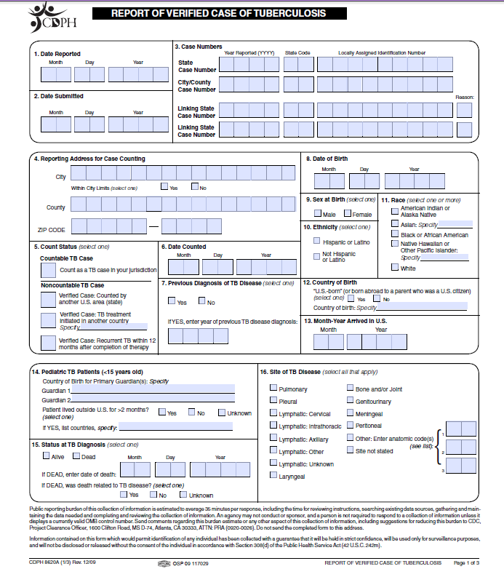
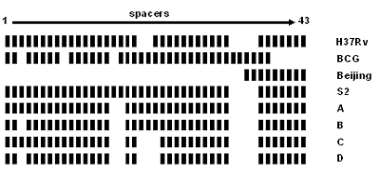
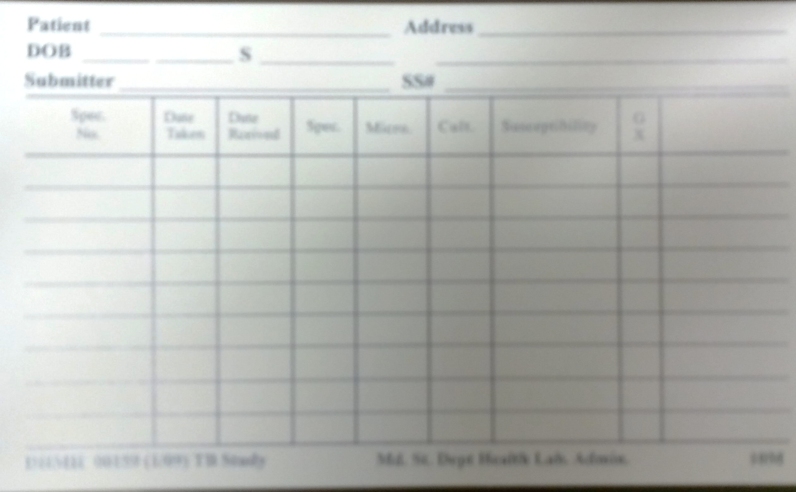
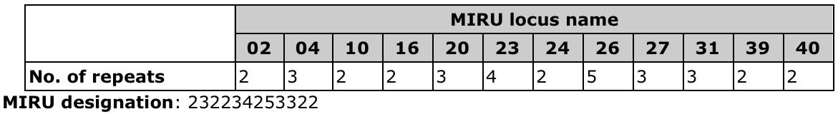
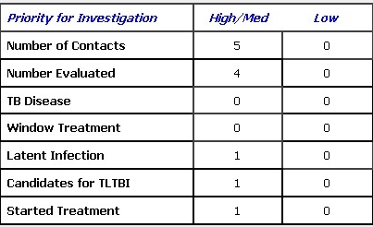
Source documents
1. RVCT
3. Genotyping
2. Laboratory
MTD/Smear/Culture: Dates when first specimen for culture/smear used to determine chronology
Epidemiologic Linking
To approximate transmission clusters
(12-loci MIRU VNTR + spoligotyping)
Descriptive:
Examine characteristics (homeless, HIV, imaging data, occupation, etc) of participants that were included AND excluded from analysis due to missing data
4. Contact Investigation Records
Notes:
RVCT which is CDC-based case report forms used nationwide to profile characteristics of active cases… This will be important in understanding other factors related to transmissibility of both the population that we are able to analyze and the population that we cannot analyze.
Laboratory information which was stored on cards in the Maryland state lab. This included the culture, smear and MTD data results for specimens processed at the state lab.
Genotyping which were done on the vast majority of culture proven active cases. The genotyping designation that was applied to our cases was a combination of spoligotyping, looking at spacer oligonucleotide sequences in the direct repeat region of the TB genome and MIRU-VNTR which distinguishes TB strains by looks at Variable number of tandem repeats at 12 specific loci of the TB genome. After 2009, they started looking at tandem repeats on 24 loci, which added for higher discriminatory power, but we kept with the 12-loci MIRU to keep consistent discriminatory power since most of our data is before 2009.
Contact investigation done for culture pos pulmonary cases and gave us a different approach to looking at transmission events for each pulmonary TB case.
Linking these datasets so that we could have complete information for each case, ended up being more complex and messy which is a different story.

Slide 9

Compiling the Data
Retrieved laboratory data (initial cultures/smear/MTD data)
  From alphabetized cards in state lab in Baltimore → Excel database
Merged databases via SAS
  Merged RVCT components
  RVCTs with my MTD database (x3)
  Set the 3 different RVCT + MTD database
  Merge RVCT + MTD with Genotyping database
  Manually added the contact investigation data to this (stored on paper forms)
Sputum culture-positive cases with genotyping and RVCT data
Culture positive cases with genotyping + MTD information
N ~ 2000
N = 782
N~590
Notes:
It had to be in this order due to security restrictions on taking data, which required patient identifiers to link with the laboratory database, outside of the TB control office at the time.
Acquired the relevant RVCT and Genotyping entries (already in electronic database format, thank goodness) for culture-positive TB
Merging: I think I’d still be stuck on this step were it not for Silvia Cohn at the JH center for TB research who volunteered to travel up to the TB control office, where we had to keep the information, and execute these merges in SAS. The merge took several steps because the RVCT data was in bits and pieces and the database before and after 2008 had different entries and formats. Also there were a lot of time spent correcting and reformatting the databases so they could merge correctly. For example, I realized that names were often different by a letter among different databases, which was a problem since the name was needed to link them. So after fixing all this, we finally got a master database.
Within the master database, about 730 fell into genotypic clusters with more than one case and although close to all of them had smear data, about half of those had complete MTD information.

Slide 10
RESULTS:
796 pulmonary TB patients
Jan 2004-Sep 2009
782 with genotyping results
468
not clustered
314
clustered
(83 clusters)
10.2
NAAT NEG | NAAT POS | NAAT UNK |  | SM NEG | SM POS | SM UNK
N=39 | N=551 | N=192 |  | N=171 | N=483 | N=128
39 | 42 | 49 | Age | 41 | 42 | 50
79% | 71% | 65% | Born outside USA | 80% | 70% | 61%
5% | 12% | 12% | HIV pos | 11% | 11% | 19%
15% | 50% | 14% | CXR cavitation | 12% | 55% | 19%
13.5 | 2.3 | 13.4 | Days to Rx start | 15.7 | 2.2 | 10.2
Notes:
Of the 796 pulmonary TB patients in Maryland during the study period, 782 had genotyping results of their TB isolates. 468 of these patients's isolates had a unique fingerprint whereas 313 of these patients could be grouped in a cluster of matching TB fingerprints. When we compare characteristics of MTD neg vs pos vs unknown status due to inaequate results, we find a longer treatment duration for MTD negative and MTD unknown and higher prevalence of HIV and cavitary disease in MTD positive patients which will weigh into their infectivity risk. We find a similar pattern for smear comparison minus the difference in HIV positivity.
*click*
Finally we come to out outcomes. As a point of reference, Peter Small and Marcel Behr, who followed a very similar analysis derived a RR of transmission risk of smear-negative patients of 0.22, with 17% of secondary cases attributed to smear-negative transmission.
In Maryland, we found a similar relative smear negative transmission risk of 0.28 with 9% of secondary cases attributed to smear negative transmission. We also found that smear negative patients were 23% less likely to start a cluster.
In our outcome of interest, we derived relative MTD-negative transmission risk of 0.08 with 0.6% of secondary cases attributed to MTD negative transmission.
Finally, we asked ourselves how MTD status might further stratify TB transmission risk among smear negative patients. We found that among smear negative TB patients, relative MTD-negative to MTD-positive transmission risk was 0.25,
Although this didn’t achieve statistical significance, it seems to makes sense if one compares the relative risks of transmission based on smear versus MTD. And finally you’ll see that MTD- accounted for around 4% of transmission events among SM- secondary cases.
We also looked at contact investigation data, approximating transmission by number of contacts infected with active or active and latent TB and found was not able to identify a single contact of an MTD negative case who developed active TB.
Finally we also identified several biases in our assumptions such as chronologically misclassifying patients and not accounting for missing cases outside of the study period or who left Maryland before they could be identified. We are currently working to censor the data so as to either propogate or dampen these potential biases and see if they affect the results. So far we’ve found that censoring cases that presented within 6 months of each other don’t affect outcomes, suggesting that chronological misclassification is an unlikely source of bias.

Slide 11
RESULTS: Primary Analysis
 | RR of starting a cluster | RR of transmitting as a cluster case | Interpretation
Behr et al, 1999 SMEAR (-) vs. (+) |  | 0.22 (95% CI: 0.16-0.32) | SM(-) 78% less likely to transmit TB than SM(+)
SMEAR (-) vs. (+) | 0.77 (95% CI: 0.43-1.36) | 0.27 (95% CI: 0.17-0.44) | SM(-) 73% less likely to transmit TB than SM(+)
NAAT (-) vs. (+) | 0.24 (95% CI: 0.01-1.44) | 0.08 (95% CI: 0-0.47) | NAAT(-) 92% less likely to transmit TB than NAAT(+)
Among smear neg: NAAT (-) vs. (+) | 0.38 (95% CI: 0.02-3.95) | 0.25 (95% CI: 0.01-2.26) | NAAT(-)/SM(-) maybe less likely to transmit TB than NAAT(+)/SM(-)
Notes:
We also looked at how MTD (-) status could differentiate transmissibility among SM negative cases.

Slide 12
What if instead of requiring 2 negative NAAT tests…
 | RR of starting a cluster | RR of transmitting as a cluster case | Interpretation
NAAT (-) vs. (+) | 0.24 (95% CI:0.01-1.44) | 0.08 (0-0.47) | NAAT(-) 92% less likely to transmit TB than NAAT(+)
Among smear neg: NAAT (-) vs. (+) | 0.37 (0.02-3.95) | 0.28 (0.01-2.26) | NAAT(-)/SM(-) maybe less likely to transmit TB than NAAT(+)/SM(-)
We just require 1 negative NAAT test?....
 | RR of starting a cluster | RR of transmitting as a cluster case | Interpretation
NAAT (-) vs. (+) | 0.32 (95% CI: 0.08-0.98) | 0.12 (0.03-0.32) | NAAT(-) 88% less likely to transmit TB than NAAT(+)
Among smear neg: NAAT (-) vs. (+) | 0.63 (0.06-5.57) | 0.39 (0.02-3.89) | NAAT(-)/SM(-) maybe less likely to transmit TB than NAAT(+)/SM(-)
Notes:
We just require 1 negative NAAT test?....this means that among the first 3 specimens they collect, only one has to be NAAT negative / culture positive, even if another was NAAT positive

Slide 13
Sensitivity Analysis: Relative transmission risk recalculated

Slide 14
Secondary Analysis: RR_{T} from Contact Investigation
 | RR_{T} Active TB | RR_{T} Latent TB I | RR_{T} ALL
SM-/SM+ | 0.35 (95% CI 0.02-2.46) | 1.43 | 1.41
NAAT (-) X1 vs. (+) | 0.00 (95% CI 0.00-12.20) | 1.19 | 1.15
NAAT (-) X2 vs. (+) | 0.00 (95% CI 0.00-3.86) | 1.42 | 1.38
Relative risk of active disease in contacts of Smear (-) vs Smear (+) in other developed countries:
  Saskatchewan: 0.28 (Gryzbowski et al. Bull Int Union Tuberc 1975; 50: 90-106)
  Spain: 0.47 (Vidal R et al, med clin barc 1997; 108: 361-365)
Notes:
Another approach to measuring transmissibility that is PTB case-centric. Unfortunately, only data for individual contacts (outside of Baltimore City) after 2007 were available at Maryland TB Control
Looking at around a total of 5300 contacts evaluated. Of note, it would make sense that a more thorough contact investigation was done for the highest risk/higher burden TB cases. It turns out that around 82% of smear + and 81% of MTD+ contacts were evaluated, 72% of smear negative were evaluated, and only 64% of MTD negative contacts were evaluated.

Slide 15
CONCLUSIONS
Transmission risk from sputum NAAT (-) pulmonary TB patients substantially less (88% if 1 negative NAAT test, 92% if 2 negative NAAT tests) than that from sputum NAAT (+) pulmonary TB patients.
Relative order of transmission risk likely: smear (+)/ NAAT (+) > smear (-)/NAAT (+) > smear (-)/NAAT (-)
Transmission risk approximated from proportion of actively infected contacts may suggest similar findings but statistically inconclusive.
Limitations of this study include:
  a) Potential bias due to geographic or temporal undersampling→ additional sensitivity analyses
  Small number of NAAT (-) patients
Findings likely applicable to GeneXpert MTB/RIF, which has similar sensitivity as MTD for TB detection⁵ and has widely supplanted use of MTD in its global rollout.
NAATs may be important public health tools in guiding infection control decisions
Notes:
We are hoping that these results introduce a possibility that NAATs are useful in making public health decisions about isolation and contact investigations for TB patients.

Slide 16
REFERENCES
**Behr M, et al. Lancet 1999;353:444
Gryzbowski S, et al. Bull Int Union Tuberc 1975; 50: 90-106
Vidal R, et al. Med Clin Barc 1997; 108: 361-365
Coll PI, et al. Int J Tuberc Lung Dis. 2003 Sep;7(9):886-91.
Boehme CC, et al. N Engl J Med. 2010 Sep 9;363(11):1005-15.

Slide 17



Special Thanks
MDHMH, TB Control:
Wendy Cronin
Andrea Palmer
Lisa Paolos
Maryland Public Health TB Laboratory:
Rich Oatis
Jafar Razeq
JHU Bloomberg School of Public Health
Silvia Cohn
Jonathan Golub
Project Mentor:
  Susan Dorman, MD
  JHU Professor of Medicine
NIH, TB Research Center:
Clifton Barry III, PhD
Ray Y. Chen

