Slide 1
What’s New With Your Maryland State Lab.
Richard Oatis
Supervisor, Mycobacteriology
State of Maryland
Department of Health and Mental Hygiene
Labs Administration
1770 Ashland Ave
Baltimore, MD 21205
(443)681-3944
richard.oatis@maryland.gov

Slide 2
In case you plan on falling asleep…
Lab move to the new facility.
Specimen quality assurance.
GeneXpert testing for smear-negative specimens.
Quantiferon testing: what we do now and what’s next.

Slide 3
Contact info:
Lab results (Val): (443)681-3942
Weird questions (Rich): (443)681-3944
Fax: (443)681-4506
Website: http://dhmh.maryland.gov/laboratories/Pages/Tuberculosis-(TB)-Laboratory.aspx

Slide 4
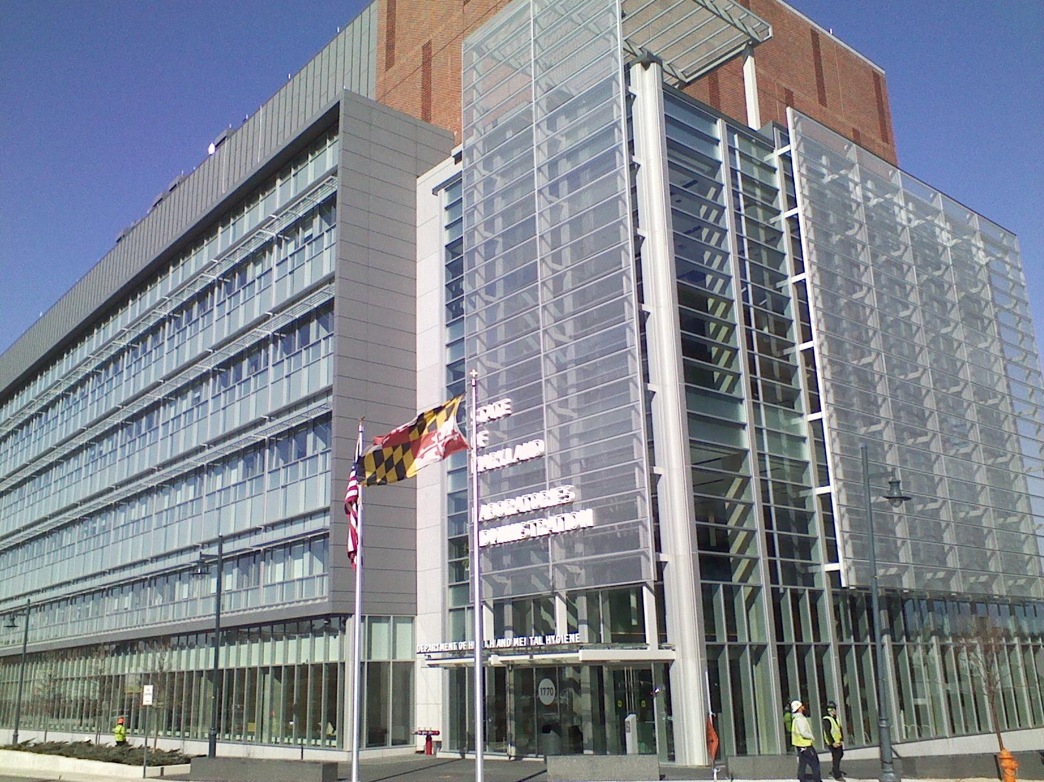
The new building:

Slide 5

Main lobby:

Slide 6
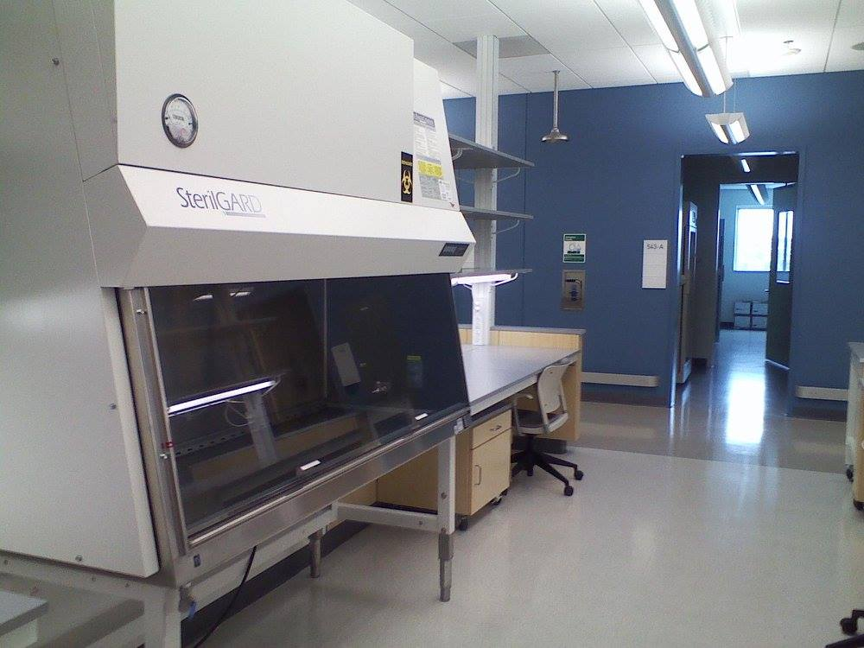
BSL-2 space:

Slide 7
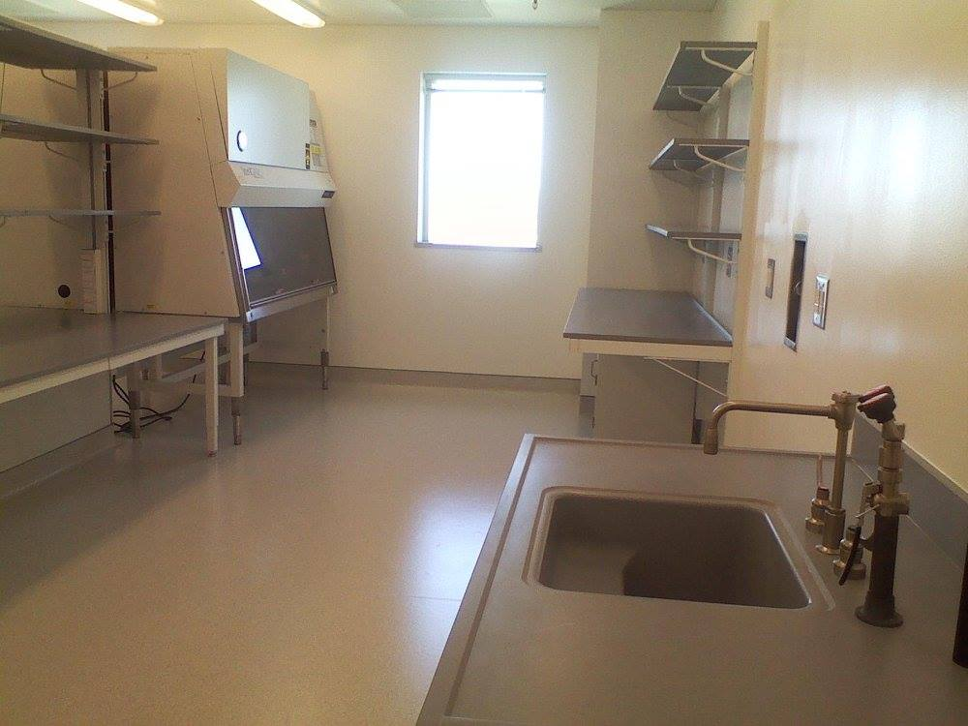
BSL-3 space:

Slide 8
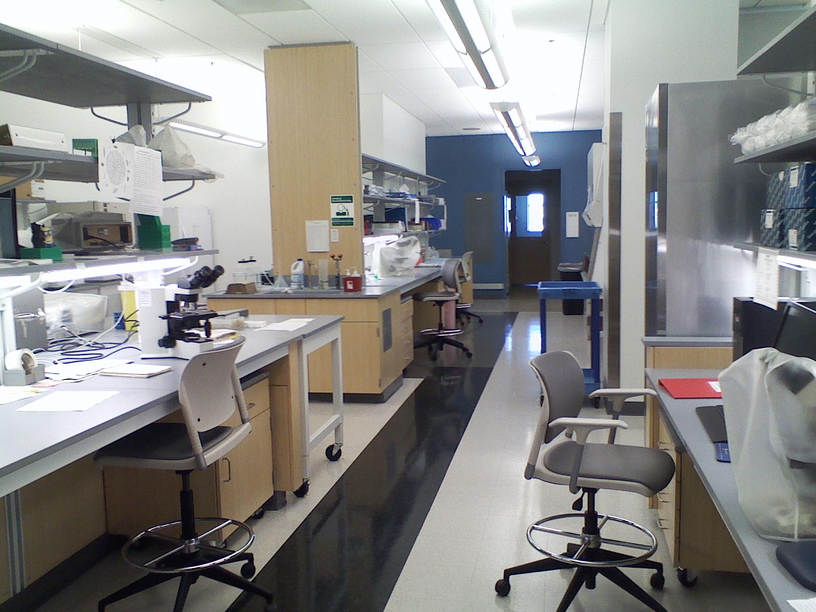
Today:

Slide 9

Our view:

Slide 10
Growing pains…
Move begins 04/16/15, but small cracks in HEPA filter housing prevent work at 1770 until 04/26/15.
Drain pipe leak in penthouse shuts down main processing lab in September 2015. Repairs continue…

Slide 11
Our new BSL-3
Separate suite of labs isolated from the rest of the lab space.
Designed with additional features to enhance biological containment.
Restricted access – a code is required to get in.
Employees working in BSL-3 must sign in/out and notify security upon entrance/exit.

Slide 12
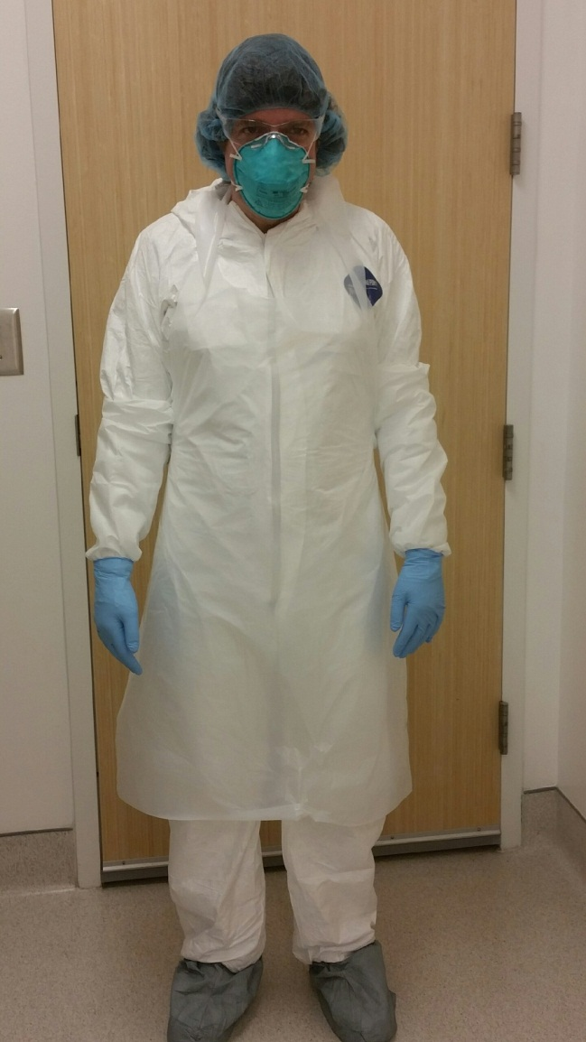
BSL-3 PPE

Slide 13
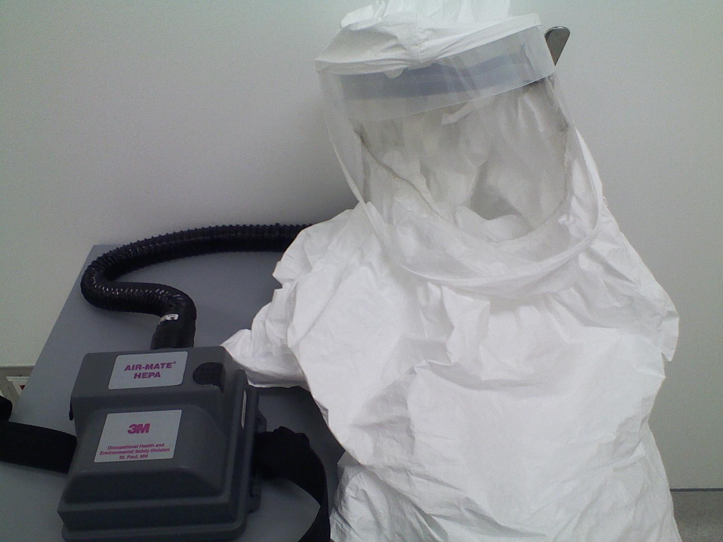
Powered Air Purifying Respirator (PAPR):

Slide 14


Slide 15
Quality specimens
Our results can only be as good as the specimen we receive.
We hope to assist all TB cases managers and physicians in providing the best possible TB specimens.

Slide 16
Sputum specimens
First morning specimens are often best.
5 mL is the optimum volume.
Watery specimens may not yield good results!

Slide 17
Other specimen collection considerations:
Check that tube is closed tightly and properly as much as possible!
Check that biohazard “ziplock” bag is sealed properly.
Refrigerate specimens as much as possible during storage/transport.
Submit to lab ASAP – do not batch!

Slide 18
Our goal for time to specimen receipt in lab is 24 hours!
Expedite lab testing.
Disallow for the growth of contaminating organisms.

Slide 19
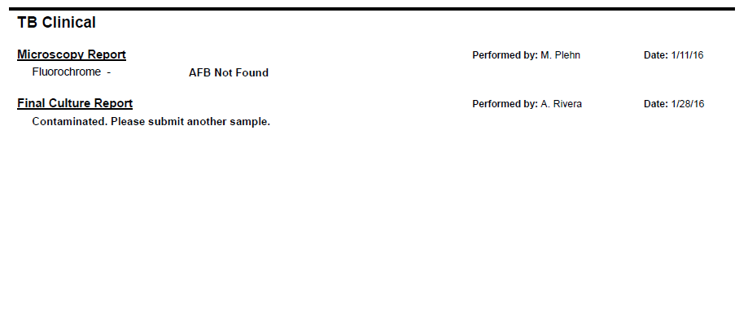
Contaminated cultures:

Slide 20
Current turnaround times:
CY2015 | CY2014 | Description of turnaround times (TAT) for initial diagnostic specimens
 |  | 1. Promote rapid delivery of specimens. (TAT goal: Specimens should be received in the laboratory within 24 hours of specimen collection.) Report the percent of specimens received within 1, 2, and 3 calendar days.
14 | 28 | % of specimens received within 1 calendar day.
39 | 54 | % of specimens received within 2 calendar days.
59 | 69 | % of specimens received within 3 calendar days.

Slide 21
How can we work together to solve this?
Identify changes to practices or workflow to expedite specimen submission.
Notify the lab of any ways we may be to assist – would adjustments to courier schedule help?

Slide 22
GeneXpert
Nucleic acid amplification (NAA) assay for direct detection of M. tb complex.
Only can be performed on respiratory (sputum, bronch wash, etc.) and tissue specimens.
Also detects mutations associate with Rifampin resistance.

Slide 23
GeneXpert – when should it be done?
All smear-positive specimens with no recent history of AFB + culture.
Specimen should be within 3 days of start of treatment.
Performed within 7 days of being processed in lab.
Can be performed on smear-negative specimens upon phone request.

Slide 24
CDC recommends:
“NAA testing should be performed on at least one respiratory specimen from each patient with signs and symptoms of pulmonary TB for whom a diagnosis of TB is being considered but has not yet been established, and for whom the test result would alter case management or TB control activities.”
http://www.cdc.gov/mmwr/preview/mmwrhtml/mm5801a3.htm

Slide 25
At our lab:
316 patients tested with GX in 2015, up from 223 in 2014.
Of the 316 tested, 142 were requested on smear-negative specimens (45%).
Of these 142 requested, only 4 were GeneXpert positive (3%).

Slide 26
Concerns of these results:
Money/lab time spent.
Negative results can be misleading – GX should not be used to rule out TB!

Slide 27
Negative GeneXpert result:
In 2015, there were 5 patients with negative GeneXpert results but positive cultures.
Another 5 cases were only positive upon testing a second specimen.
These concerns increase with smear-negative specimens – too few TB bacilli to detect!

Slide 28
What we can do as a result:
All GeneXpert results should be interpreted in light of patient history/clinical presentation.
Be mindful of specimen quality.
Call the lab and request additional tests be run if there are concerns with negative results.

Slide 29
GeneXpert to remove patients from respiratory isolation:
First announced February 2015.
“One or two” negative GeneXpert results is sufficient for removing TB suspects from isolation.
NOT intended for patients with confirmed active TB - not a good test of cure.
http://ir.cepheid.com/releasedetail.cfm?releaseid=896300

Slide 30
Take home messages:
All TB suspects should have a GeneXpert requested.
GeneXpert should not be used to “rule out” TB – culture results still important!
Specimen quality, patient history, and clinical presentation all need to be considered when interpreting GeneXpert results.

Slide 31
Quantiferon
An interferon-gamma release assay whereby whole blood is exposed to proteins specific to M. tb. complex (but not BCG) to test for latent TB infection.
The test requires three specialized collection tubes: a blank (Nil) tube, the test (Antigen) tube, and a positive (Mitogen) tube.
Only known to cross-react with three fairly uncommon Mycobacterial infections: M. kansasii, M. marinum, M. szulgai.

Slide 32
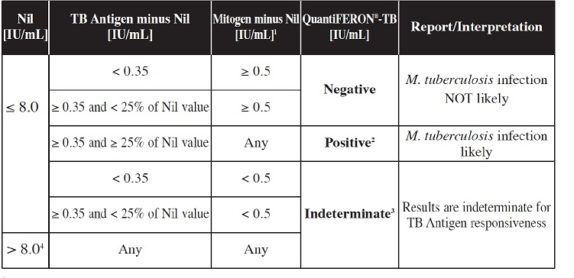
Quantiferon: how do we interpret results?

Slide 33
The controversy:
No equivocal zone around cut point lends to “flip flopping” upon repeat testing.
Some research suggests a higher cutoff point (.70) may yield results with better correlation to other testing methods.

Slide 34
Why must our lab use 0.35?
FDA approved the test with this cut point.
Must interpret the test as described in package insert by Federal regulation.

Slide 35
Why isn’t the cutoff being changed?
No gold standard for latent TB infection.
Balancing sensitivity (rate of false negatives) vs. specificity (rate of false positives).
$$$$

Slide 36
What do the numbers mean?
Amount of CD4 cells in specimen.
How well blood tubes were shaken during collection.
How long blood tubes were incubated.
Variations in preparation of reagents in lab.
Room temperature of lab.
Time between blood collection and testing.

Slide 37
What this means for you:
Interpretation on lab report (positive, negative, indeterminate) is more important than the numbers.
Still must be interpreted in light of patient history.

Slide 38
How does the lab assure the quality of QFT results?
Positive and negative controls run daily as well as kit standards.
All positive results repeated to demonstrate precision.
Discordant results repeated until an consensus reached.
Testing can be repeated on same specimen up to a week from receipt if there are concerns.

Slide 39
What’s next for QFT?
Quantiferon-TB Gold Plus.
May receive FDA approval some time this year.
Already seeing use overseas.

Slide 40
The good:
Designed to stimulate CD8 as well as CD4 blood cells.
May better capture recent exposures, active TB disease, HIV + patients, and young children.
Mostly no change to specimen collection, processing, and testing procedure.

Slide 41
The bad: 4 tubes instead of 3!
2 separate antigen tubes: one targeting CD4 cells, one targeting CD8 cells.
More time to collect, more discomfort for patients.
More time to test in lab.

Slide 42
The ugly: $$$$!
One would expect tubes to cost more per test since 1 additional tube required.
Less tests will fit on each ELISA plate, which may add cost.
But what about additional savings?

Slide 43
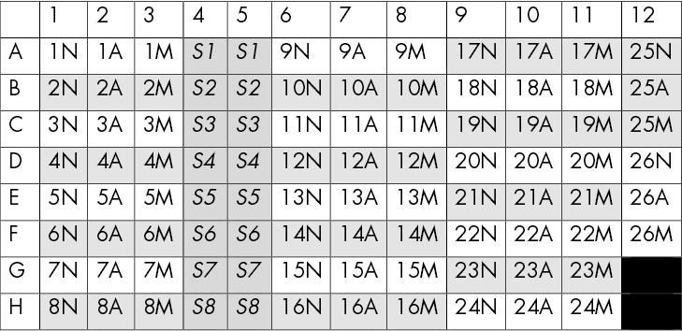
Current QFT plate layout:

Slide 44
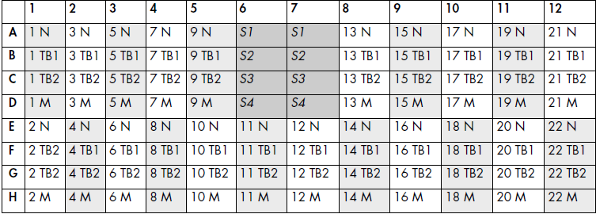
Possible QFT-Plus plate layout:

Slide 45
What will it take to get us there?
FDA approval…???
Training…should be minimal.
Lab validation of assay – may present challenges.
Updating our LIMS to accommodate extra tube result.

Slide 46
Questions?

