Slide 1
XDR-TB: Evolving Role of Public Health in Tuberculosis
Jayne McGunigale, RN
Supervisor, Refugee Health and TB Control
Howard County Health Department
Columbia, Maryland
March 22, 2016

Slide 2
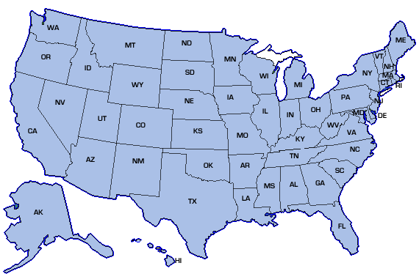
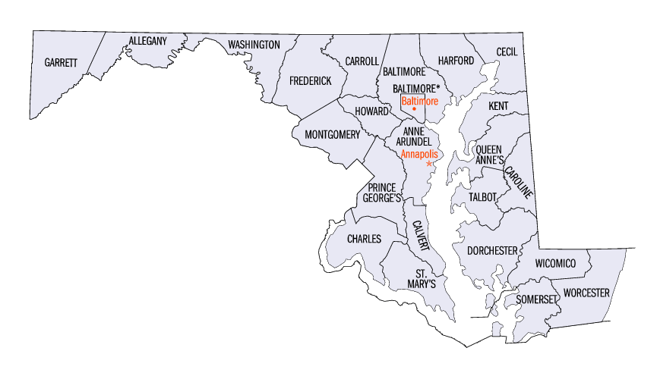
Howard County, Maryland
Maryland
References: United State Census Map, 2015
Notes:
HC is located b/t Baltimore and D.C.
XDR case located in the western part of the county – least populated area of the county.

Slide 3
Howard County Demographics
Howard County is one of the wealthiest counties in the United States.
Population of 304,000: 1 out of 6 residents is foreign born.
95 % are High School graduates
60 % are College/Professional graduates
Notes:
Highly educated population with many professionals that work in the Baltimore/D.C. corridor.

Slide 4
Howard County TB cases
Year | Angola | China | Ethiopia | India | Iran | Korea | Malaysia | Mexico | Myanmar | Nigeria | Russia | Thailand | US | Vietnam | Total
2013 | 0 | 0 | 0 | 3 | 0 | 1 | 1 | 0 | 0 | 0 | 0 | 0 | 4 | 0 | 9
2014 | 1 | 2 | 0 | 2 | 0 | 0 | 0 | 0 | 1 | 0 | 1 | 0 | 2 | 0 | 9
2015 | 0 | 1 | 2 | 2 | 1 | 1 | 0 | 1 | 1 | 1 | 0 | 1 | 0 | 1 | 12
Notes:
From 2013 – 2015 HCHD received 30 TB cases
Last three years 6 cases were U.S. born including our XDR case – 24 cases were Foreign-born
TB cases from 14 countries
2013 – our XDR case plus a 12 year old with Milliary TB/TB Meningitis who received DOT 7 days a week, 2 times per day.

Slide 5
MDR-TB in the U.S.
Notes:
MDR TB represents 1% of those with TB Disease in the U.S. Fewer than 100 individuals with MDR-TB DX in U.S. each year.
Overall the proportion of MDR cases in the U.S. are from the foreign-born population.
Even though MDR cases have decreased in the U.S., the proportion of MDR TB cases among foreign born persons increased from 31% in 1993 to 88% in 2014
Overall the % of MDR TB cases decreased slightly from 1.4% (96 cases)in 2013 to 1.3% (91 cases) in 2014.
The proportion occurring among foreign-born persons increased from 31% in 1993 to 88% (80 of 91) in 2014.
The proportion occurring among foreign-born persons increased from 31% in 1993 to 88% (80 of 91) in 2014.

Slide 6
XDR-TB in the U.S.
Notes:
- 5 cases of XDR including our XDR
- 2 cases reported 1993 – 10 cases reported
1993

Slide 7
Pediatric XDR – TB Case Background
Healthy U.S. born two-year-old of foreign-born parents
Parents are healthcare professionals experienced with TB
Traveled to India from 5/31/13 – 8/20/13
Healthy household members: mother, father, five-year-old sibling
U.S. daycare attendee before and after India trip
Notes:
While in India:
* 2 weeks after arrival the child was given BCG vaccination and TST was read negative
* The child was placed on preventive anti-malarial treatment
* Three weeks after arrival the child entered a daycare program 5 days/week, 2 hours/day
Three weeks after arrival child entered a daycare program - 5 days / week, 2 hours / day
Mid-August toddler became ill with fever, loss of appetite, and decreased activity

Slide 8
Pediatric XDR-TB Timeline
8/13
Sx onset
(India)
8/26
Hospital Adm
CXR abnl
Chest CT abnl
Gastric asp x 4
10/8
LHD
Notified of MTB
12/4
Hickman cath placed
New drug regimen
started
9/30
Rx tolerated
New daycare enrollment
11/27
XDR-TB
confirmed
8/23
PCP eval
8/20
Returned to USA home
8/30
4 TB-drugs Rx begins
10/3
Cx + for MTB
(1 of 4 gastric asp)
Hospital notified parent
12/2
Hosp Adm
11/14
Notified of drug resistance, Home isolation begins
8/26
QFT(+)
9/4
Hospital DC
LHD begins DOT
Notes:
Seen by physician in India and diagnosed with viral illness.

Slide 9
Pediatric XDR-TB Case
XDR-TB Drug Resistance Profile
First-line drugs Fluoroquinolone Second-line drugs
Isoniazid Moxifloxacin Amikacin
Rifampin Kanamycin
Pyrazinamide Capreomycin
Ethambutol
Notes:
resistant to isoniazid and rifampin among first-line drugs, resistant to any fluoroquinolone and at least one second-line injectable drug. Treatment options are very limited and outcomes are often worse.

Slide 10
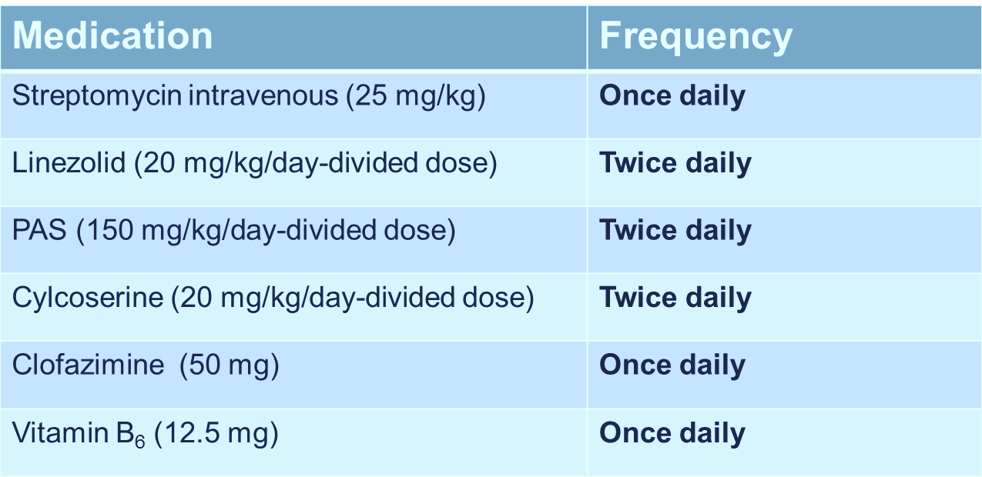
Pediatric XDR-TB Regimen
l
Regimen changed during course of treatment based upon patient weight, drug levels, and ongoing consultations
Total treatment period was 21 months
Notes:
1. Streptomycin given via eclipse ball – 1 hour for infusion.
2. PAS was given 30 minutes after Cycloserine.
3. In the home for approximately 1.5 hours every visit.
4. Meds were given 2 times per day – Staff in home for approximately 3 hours/day – think of the impact on the family routine.
5. Private provider created a XDR-TB treatment plan – listed dosing, how it comes and how to give, side effects
6. Regimen changed during course of tretment based upon patient weight, drug levels, and ongoing medical consultation.
7. Total treatment period was 21 months

Slide 11
Pediatric XDR-TB LHD Challenges
Care Coordination
Family
Private provider
Local and state health departments and the CDC
Other academic faculty working in TB clinical practice and research
Public Health Responsibilities
Consultations with local, state, federal, and international TB experts
DOT
Contact/Source case investigations
Notes:
Care Coordination involved many people - The effort from all involved helped to facilitate the appropriate delivery of health care

Slide 12
Pediatric XDR-TB DOT Challenge
Small LHD TB Program
Special order medications
Lack of DOT awareness and acceptance
Multiple DOT visits
Morning visits 90 minutes
Evening visits 30-45 minutes
Residence 45 minutes from the LHD
Notes:
Staff at time of treatment consisted of:
1 TB Control nurse who worked 4 days/ week
1 Fulltime LPN
1 Supervisor
1 Director of CD
Special order medications:
Urgently needed medications to treat toddler
. Special release of medication from CDC
. CTBCP worked with vendor to
obtain other medications
Lack of DOT awareness from parents and provider – Parents were both highly educated and not understanding of DOT process. Reluctant to accept the need for DOT . This is a common reaction among TB Patient’s. Providing education to both the family and provider was critical to providing care.
DOT visits: Twice daily DOT was a buden to LHD. We provided coverage for evenings, weekends, and holidays.

Slide 13
Pediatric XDR-TB Investigation Challenge
Notes:
-Long and challenging because it was both extensive and international
Focus was home and daycare in Maryland – opposing opinions regarding need to conduct contact investigation at local daycare. Notification letter to daycare drafted.
Family reluctant to provide contact information.

Slide 14
Strengths
Federal, state, local agencies and private provider worked efficiently, collaboratively, and compassionately as a team
Customized medications were facilitated
Patient had private health insurance
Hospital pediatric pharmacy prepared unit dosing and provided
guidance for administering meds and for monitoring possible side
effects
LHD provided DOT twice daily 7 days a week
LHD funds used to hire agency nurse for evening and weekend DOT
Child responded favorably to treatment
Notes:
Agency nurse: Funds to hire agency nurse from 1/2014 – 7/2015: Approximate cost $36,000

Slide 15
Weaknesses
Multiple conference calls
Up to 24 people on initial calls
Numerous private and public health experts
Varying and conflicting opinions expressed by experts
Example:
Experts stated that child was not infectious
LHD was not using respiratory precautions BUT…
Airborne isolation was in place while patient was in the hospital, AND
Respiratory precautions ordered for pediatric home health team
Funding was not readily available for specialized medications or staff overtime – private insurance and HO approved county funds to assist
Notes:
Mix of roles within each sector
Hospital did not do bronch, due to risk to staff.

Slide 16
Opportunities
Positive culture allowing for susceptibility testing
Family had health insurance
Allowed for purchase / preparation of medications
Paid for appointments including labs, vision, audiology and vestibular assessments, and consultations with specialists
Private provider was open and willing to collaborate with LHD
Medications were tolerated
Minimal side effects
Notes:
Hospital lab scientist said they very rarely get growth from gastric aspirates.
Health insurance – Think of th eimpact on the family and LHD if this family did not have health insurance.
Clofazimine – caused skin discoloration – Bronze tone.
PAS – cause Hypothyroidism

Slide 17
Threats
Toddler with XDR-TB
Multiple Voices
Notoriety of diagnosis
Family priorities versus public health priorities
DOT
Missed DOT doses extended treatment
Identifying funding for extensive DOT coverage
Notes:
XDR – TB is new territory – even for the experts
First XDR – TB case in a U.S. born child below age of 5
Hurdles- family priorities vs. public health
Separate medical decisions vs. HD role
Health Department makes infection/DOT/contact Investigation decisions
Identify who is making medical/treatment decisions

Slide 18
Lessons Learned
Collaboration is the key to treatment success
Consider effects of long-term intense treatment on child and family
Length of treatment
DOT Schedule:
Initial twice daily visits
Length of home visits due to IV therapy and spacing of medications
Consider DOT team – initially, various LHD nurses provided DOT
Adjust work schedules to provide DOT into evening hours and weekends
Staff Awareness:
Resource packets
HD provided respiratory training for additional staff
Cultural Competency
Navigating the experts
Notes:
“ THINK OUTSIDE THE BOX” - Quote from Elizabeth at the beginning
Length of treatment : 18 months – 2 years
TB cases are primarily in foreign born populations
TB innovation allows for collaboration with private providers, CDC, State control program and gives us the opportunity to work with our peers.
Navigating the Experts
Identify your team with guidance from CTBCP – consider limiting number of participants
In-person meetings and conference calls to keep everyone informed
Keep all need-to-know parties informed with regular updates and be prepared for differences of opinions
Educate the private provider/all parties involved on public health policy

Slide 19
Update on child with XDR
Seen by private provider in October, 2015
No symptoms of TB
Bronze skin color from Clofazimine slightly improved – expect complete resolution to take several years
TSH and free T4 is normal – off Synthroid
Child is enjoying kindergarten, and gaining weight appropriately
Next follow up in March, 2016

Slide 20
Acknowledgements
Maryland Department of Health and Mental Hygiene – Center for Tuberculosis Control Program (CTBCP)
Nancy Baruch RN, MBA, Maryland TB Controller
Maureen Donovan RN, MGA, Nurse Consultant
Lisa Paulos RN, MPH, Epidemiologist
Howard County Health Department
Maura Rossman, M.D., Health Officer
Bernard Farrell, M.D., TB Clinician
Elizabeth Menachery, M.D., Medical Director
Andrea Raid, RN, Director of Communicable Disease
Dorothy Bauman, RN, Staff TB Control Nurse
Sandra Nicholas, LPN
Tial Zawkhai, LPN
Susan Bauhaus, RN
Wendy Kensie, RN, JPS
Fiori Tesfamariam, LPN
Marilyn Birkner, Clerical
Zakariya Kmir, HCPSS Gifted & Talented Program Student Intern
Notes:
Additionally, we’d like to thank Dr. Sanjay Jain, the local Pediatric Infectious Disease doctor that was instrumental in the positive outcome of the child.

Slide 21
Moving Forward

Slide 22
Questions?

