Slide 1
Maryland Epidemiology and Genotyping Update
Wendy Cronin, PhD, Epidemiologist
Center for TB Control & Prevention
Maryland Department of Health & Mental Hygiene
TB Annual Meeting
March 22, 2016

Slide 2
Presentation Outline
Global TB Epidemiology (2014)
Maryland TB Epidemiology (2015)
  TB case numbers and trends
  Demographics
  Drug resistance
  Comorbidities
  Genotyping
TBESC Update
Notes:
I will be reviewing some key epidemiologic characteristics of our TB cases for 2014.

Slide 3
Global TB epidemiology - 2014
No. 1 infectious disease cause of death
No. 5 all-cause of death
No. 3 all-cause of death in women of child-bearing age
>9 million estimated incident “new” cases
56% cases in Southeast Asia, Western Pacific Regions (35% China and India); 25% in Africa)
80,000 TB deaths among HIV-negative children
Notes:
MDR 1.5 million, XDR 40,000, HIV 13%

Slide 4
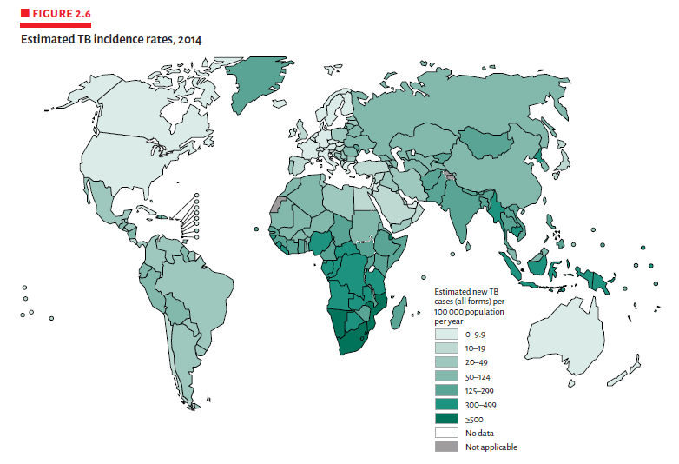
WHO Estimates of TB incidence, 2014
Global Tuberculosis Report 2015. World Health Organization.

Slide 5
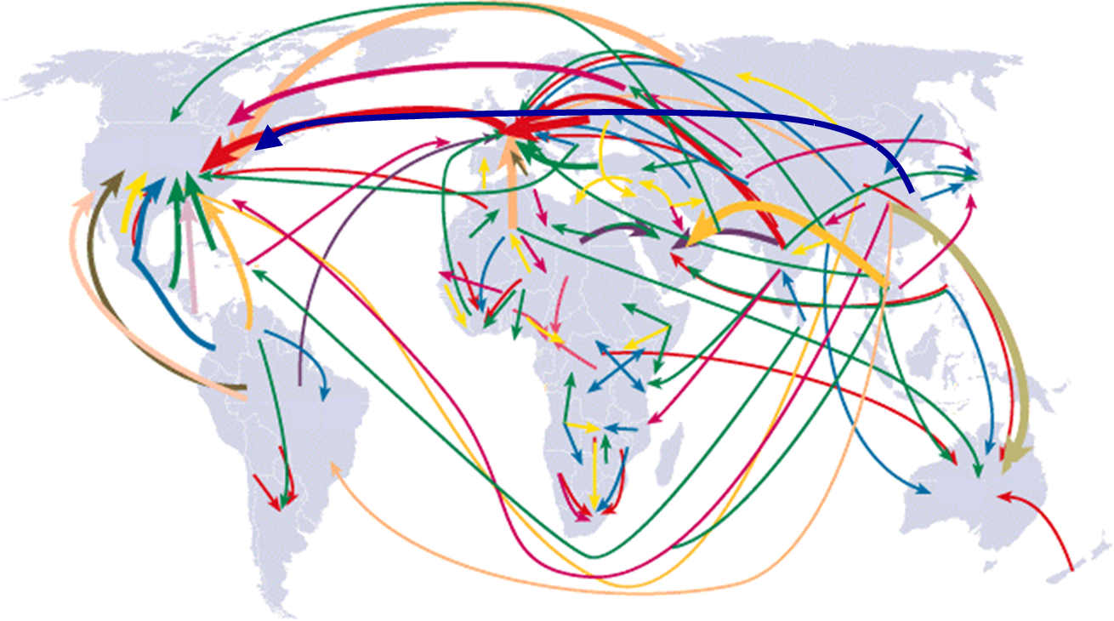
Have germs, will travel…
Migrating populations
Source: Population Action International
Notes:
This map show the travel has increased 4 fold from the 60s and 70s and note the heaviest arrows – most frequent paths have US as destination.
BUT … stable intensity of global 5-year migration flows at ~0.6% of world population since 1995. We estimate the largest movements to occur between South and West Asia, from Latin to North America, and within Africa.
USING CALIF. AS THE EXAMPLE
Population (2014): 39 million
~10 million Californians are foreign-born
~400 million crossing US-Mexico border each year
~3.5 million visitors to CA
~2 million undocumented enter CA
~250,000 new entrants with permanent residence visa
~100,000 new entrants with student visa
There is major flow from Asia to Oceania,
SE Asia & the Middle East
Europe & the Americas & all points on the globe
The even travel to & within Africa has increased
In fact the volume of migration has increased 4 times as compared with 20 to 40 years ago

Slide 6
Maryland TB, 2008-2015
176 cases
Rate: 2.9
Notes:
2015: 176 new TB cases, the case rate is 2.9 (12% decrease in case number and rate) vs 195 cases, 3.3 rate 2014
Still lower than 2010-2012 for both case count and case rate.
Bars represent case numbers,
blue line = case rates,
dotted black line = trend

Slide 7
TB Case Rates per 100,000, United States, 2015
D.C.
Case no. 9,563
(2% increase)
< 2.98 (provisional national average)
> 2.98
CDC, 3/16/2015
Notes:
Map = MD 2015; US 2015 provisional

Slide 8
State TB Case Rates per 100,000 Population, by Jurisdiction, 2015
>2.9 /100,000
<2.9/100,000
No reported cases
Notes:
Red = 8 Counties at or above MD rate of 2.9: Balto Co, Caroline, Frederick, Howard, Montgomery, Prince Georges, Somerset, Wicomico
Green = 5 Jurisdictions below MD rate of 2.9: Baltimore City, Harford, Anne Arundel, Calvert, St. Mary’s
White = 11 counties with no reported cases (lowest N so far!)

Slide 9

Baltimore City
Rate: 2.2!
3/17/2016

Slide 10
TB Rates among US and Foreign Born, Maryland vs. US, 2015
Notes:
Foreign-born accounted for 76% of cases, versus 81% for last year
Foreign-born accounted for 66% of cases in the US
US-born 2015 goal was 0.7 – actual MD = 0.8
US-born 0.8 vs. 1.1 in US
Foreign-born goal is 14.0
MD-FB down from 18.5 to 15.0 versus US 15.0

Slide 11
6 Top Countries of Origin-MD, 2015
Notes:
2013 US – Mexico 21%, Philippines 14%, India, Vietnam, China (~150 countries)
In 2015, MD=36 countries (last year 42);
Generally far more African countries of origin Last year Phil, China
Philippines is different for us
Nearly two-thirds of Filipinos had arrived in the US >5 years ago and 37% were ­>55 years old.

Slide 12
Foreign-born TB Case Numbers, by Time from U.S. Arrival to Diagnosis, 2013-2015
Notes:
Prevalent cases – 3 months to 6 months to 9 months
Purple = 10 year +
Green = 5-10 years
Red = 4 mo to 5 years
Blue=0-4 mo = prevalent cases (may be up to 1 year)
<=5 years – proportion has decreased
Most cases >5 years, and many >10 years in US (43%)

Slide 13
TB Cases by Race and Origin, 2015
Notes:
U.S. born = n=42
Black/African American: in the past = majority in Baltimore City and Prince George’s County.
Now just >1/3 Baltimore City, rest = Balto Co, Calvert Mont, PG, Wicomico
Foreign born
Asian: Most in Montgomery and Baltimore Counties.
Hispanic: Most seen in Prince George’s followed by Mont county.
Black: Mont PG, high percent = many patients come from countries in Africa.

Slide 14
Cases by Age Group Maryland, 2013-2015
Notes:
MEDIAN FOR fb=41, FOR usb=43 (BUT MORE AT EACH END OF SPECTRUM)
Shape is changing – decline in 25-44 yo = not sure of importance; many elderly are now foreign-born, not necessarily US-born
¼ of US-born were 65+

Slide 15
The Canary in the Coal Mine
Children under 5 years old
  At high risk for TB meningitis, disseminated TB
  Disease can progress quickly
  Important to find source case
    Stop further transmission
  Can represent undiagnosed adult cases
Notes:
Children under 5 years old are vulnerable to developing TB after infection and are considered a high risk group.
The mean time for development of TB disease in children after infection is 150 days. However, children can develop TB disease, including primary TB, TB meningitis and disseminated TB, very soon (< 8 weeks) after infection, and we have seen this in Maryland.
Over the past 5 years, 1/3; 2014=1/4 had a known source case

Slide 16
Case Rates per 100,000 in Children <5 Years of Age; Maryland vs. US,
2011-2015
1.3
0.5
0.4
Notes:
The national average has been decreasing slightly over the years and is 1.3 for 2014.
Green line: The 2015 CDC goal for case rates in children under 5 is 0.4 cases/100,000 persons.
2 cases in 2015
2 US-born – 2 FB parents

Slide 17
Maryland Drug Resistance, 2015
176 cases total
128 (73%) cases: susceptibility results
11 (9%) cases: any resistance
1 (<1%) MDR
Notes:
There were 176 cases in Maryland in 2015
Of those 176, 73% cases had DST results
Of those 176, 9% had resistance to 1 or more drugs
Of the 176, 1 case was MDR (<1%)

Slide 18

With Fewer Cases Why Are We Still Working So Hard?
Risk factors
  TB HIV co-infection
  Co-morbidities (DM, COPD)
  Pregnancy
  Substance abuse
They are more complex!
Notes:
Cancer HTN pregnancy
Won’t present homeless LTC, substance abuse etc – we remain low and routinely lower than the US averages

Slide 19
TB HIV Co-Infection Rate Trends, 2011-2015
Notes:
Bars are percent of cases
Most of the cases are among the foreign born, consistent over last 2 years.
Upward trend is likely due to increased number of HIV among foreign born cases.
2015
16 cases HIV (+) = 10.1 % of those with known results
9 (56%) Foreign born

Slide 20
Numbers of TB HIV Co-Infection, Origin of Birth, 2012-2015
Notes:
Maryland screens 95% of cases, which is about 10% above the national average.
2015 Of those tested, 10.1% positive
Rates of HIV infection DIFFERED each US and foreign- born (2015: 31% vs 7%)
However, numbers are in the foreign-born, who often get their first HIV diagnosis when they are being screened in our TB programs
Issues around diagnosing HIV in the foreign born are many – finding appropriate care centers, case management care, paying for care

Slide 21
TB and Diabetes
No.
%
Notes:
Gradually increasing concern in Maryland, DM ranges between 11 and 15.3% of cases in Maryland.
Many often have multiple risk factors ESRD, other immuno-suppressive disorders
DM increasing worldwide, as poorer countries develop, often in TB endemic places
New MD standard: Screen for DM by blood glucose or preferably HgbA1c.
Important screen for DM early on, to improve Tx outcomes
Richard Brroks – data since these recommendation came out
Increased risk of dying during treatment
Slower to convert cultures
Often need treatment >6 months.
May lead to RIF resistance

Slide 22
TB-DM project (2014-2016)
Richard Brooks, MD, MPH, EIS officer
“Quick and dirty” findings for 1.5 years of NEDSS data:
Compared to TB patients without diabetes, TB-DM were:
Two times more likely to be sputum smear positive
2.4 times more likely to be cavitary
Four times more likely to:
  a. have an indeterminate IGRA
  b. die during TB treatment

Slide 23

TB-DM project (2014-2016)
Richard Brooks, MD, MPH, EIS officer
A couple of anecdotes:
Among TB patients/ suspects:
YOU have diagnosed previously unknown DM-TB
HgbA1c as high as 14.4!
3. TDM among TB-DM patients:
YOU identified low RIF absorption in some patients, and increased RIF doses to therapeutic levels
Notes:
Since the expert panel recommendations to screen all cases for DM, and use TDM for those with uncontrolled DM

Slide 24



Mtb Genotype Clustering
Local Health Department calls CTBCP
Provider or ICP calls CTBCP
CTBCP gets routine genotyping report from CDC (TB-GIMS) and calls LHD
CDC (TB-GIMS) sends an “Alert”
Laboratory calls CTBCP
Notes:
How do we find out about epi links or clusters?
Person – named, ~ risk char; Place location where exposed, and Time during infect period
We try to avoid workman’s comp issues (HCW, etc.)

Slide 25
TBESC Update: Protocol Part B
TB Prevention Cascade
 | TB case rate (active TB) | # cases of active TB
Current U.S. (2014) | 30 cases/million | 9412
TB ‘pre-elimination’ | < 10 cases/million | < 3200
TB ‘elimination’ | < 1 case/million | < 320
Notes:
Sent out to the group for review on September 8 – hope you have been able to take some time to review. The Part B group has been very active and done a lot of work to get the protocol and Appx A timeline (action plan) in shape.
Focus for Part B is to gather information to work toward TB Elimination – if we are serious about Elimination as a goal
2013 – 9582 (down by 1.8% in 2014) and no change in case rate.

Slide 26
Reaching TB Pre-elimination and Elimination
Nadir in TB case numbers and transmission in U.S.
New tests (IGRAs) for diagnosing M. tuberculosis infection
Shorter treatments for LTBI, with high completion rates
Combined strategies needed to hasten time to TB elimination:
  Reduce foreign born new arrivers with TB and untreated LTBI
  Among individuals with LTBI, increase the proportion that are treated (treatment as prevention)
A.N. Hill et al, Epidemiol Infect 2012;140:1862
Notes:
The time is right, but we need combined strategies

Slide 27
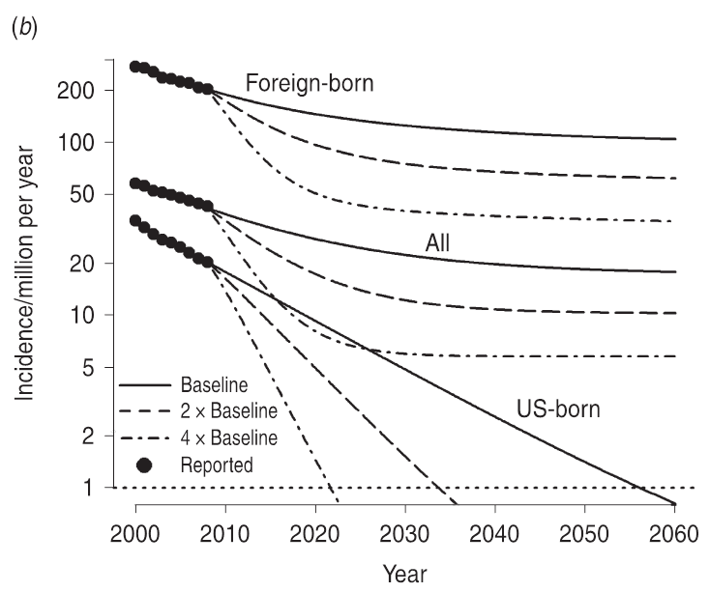
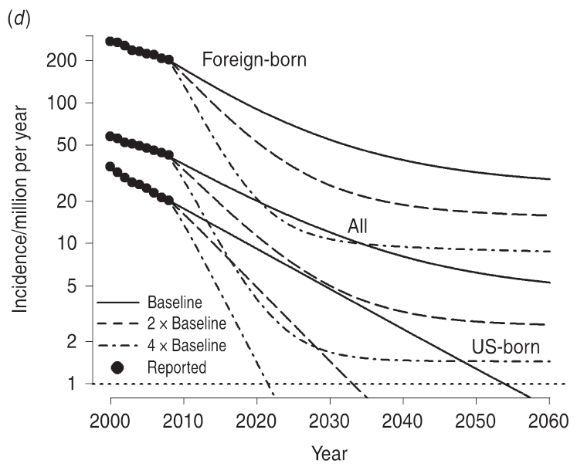
A.N. Hill et al, Epidemiol Infect 2012;140:1862
*
*
Pre-elimination target (<10/mill) met by ≈ 2025 IF
Treatment rate for chronic LTBI is quadrupled starting 2008.
Approaching elimination (<1/mill ) after 2030 IF
Treatment rate for LTBI
is quadrupled starting 2008.
Assumes prevalence of chronic LTBI in FB arrivals is reduced to 25% of baseline.
Notes:
Hill et al, a number of years ago modeled TB prevention services and outcomes. Strongly encourage you to review this publication
Primary infections – develop disease within 2 years
Chronic LTBI = progress to disease at a much slower rate
Fit to surveillance data 2000-2008, parameters from TB literature
IF Current control efforts maintained:
US-born SOLID LINE: TB elimination can be achieved in the US-born before the end of this century.
All: not on track, due to influence of FB
Foreign-born SOLID LINE: Not on track in this timeframe; even with higher rates of targeted testing and treatment for LTBI
b) * BLUE PRE-ELIMINATION ALL (<10/mill): Incidence projections assuming treatment rate of chronic LTBI is doubled or quadrupled in 2008
d) * RED APPROACH ELIMINATION ALL (<1/mill): Incidence projections assumes prevalence of FB arrivals with LTBI reduced to 25% of baseline; treatment rate of chronic LTBI quadrupled in 2008

Slide 28
TB Prevention Cascade (“Treatment as Prevention”)
% of Population
Notes:
Dark bars = outcome measurements
Light bars = operational measurements
High risk for LTBI and for progression to active TB = FB, HIV, DM, contacts, B-waivers, etc …

Slide 29
TB Prevention Gaps in Care
% of Population
Notes:
What are the gaps? Dark red = actual known gaps; pink – unknown – missing
Dark red = obvious gaps between bars
Light red = what are we missing overall for at-risk individuals

Slide 30

Theme for TBESC Part B!

Slide 31
% of Population
LTBI services-Health Dept TB Clinics |  | X | X | X | X | X | X
LTBI services – Other Clinics |  | X | X | X | X | X | X
Modeling existing data (census, ACS, BRFSS, TBESC, etc.) | X | X | X | X | X | X | X
Notes:
RIGHT SIDE: Health Department TB Clinics: Existing individual data obtained for routine clinical care
MIDDLE TO RIGHT SIDE: Other TB Care Service Providers; data collection feasibility, acceptance …
LEFT SIDE: Publicly Available Data Sources: census, NHANES, GIS mapping, community surveys, immigration data, TB surveillance data, billing, …

Slide 32

Low Hanging Fruit - Collecting Data from Health Department TB Clinics
We can do better but can’t get us to TB Elimination!
Funding cuts = fewer populations served by HD
Notes:
Cheap and expedient , but …. also Extremely Simplistic!!!!!!!!
Simple number –
Single versus intersecting – this can easily be done, and depends on individual site and TBESC goals for hot spots
High Gap – concerning gap --- what is it, and does it have a confidence interval?
Not a true risk ratio or relative risk: not risk driven as in local population specific incidence of LTBI versus population specific TB incidence, or at-risk population in the site
Systematic approach = we plan to have a Workgroup to consider these issues and come up with best approach, given funding, time, and non-research protocol
Want to get at fruit that is higher up and ones that may be HIDDEN in the branches…

Slide 33
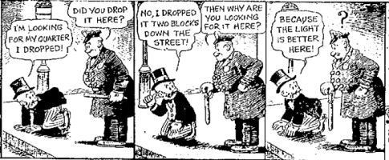
Then there’s the old Mutt and Jeff story …

Slide 34
Challenges to TB Elimination
We don’t know much about the ‘at risk’ populations – WHO, WHERE, HOW MANY?
We don’t know who IS and IS NOT, receiving TB services outside the health department
We don’t know WHICH and WHERE FOR non-health department providers that serve ‘at-risk’ populations of interest
Notes:
High risk populations of interest result in our cases

Slide 35

Potential non-HD Providers
  Other public health clinics
  Other government agencies (corrections)
  FQHCs, Community Health Centers
  Other community-based organizations
  Private providers (Kaiser, universities, etc.)
?
?
?
?
?
?
?

Slide 36
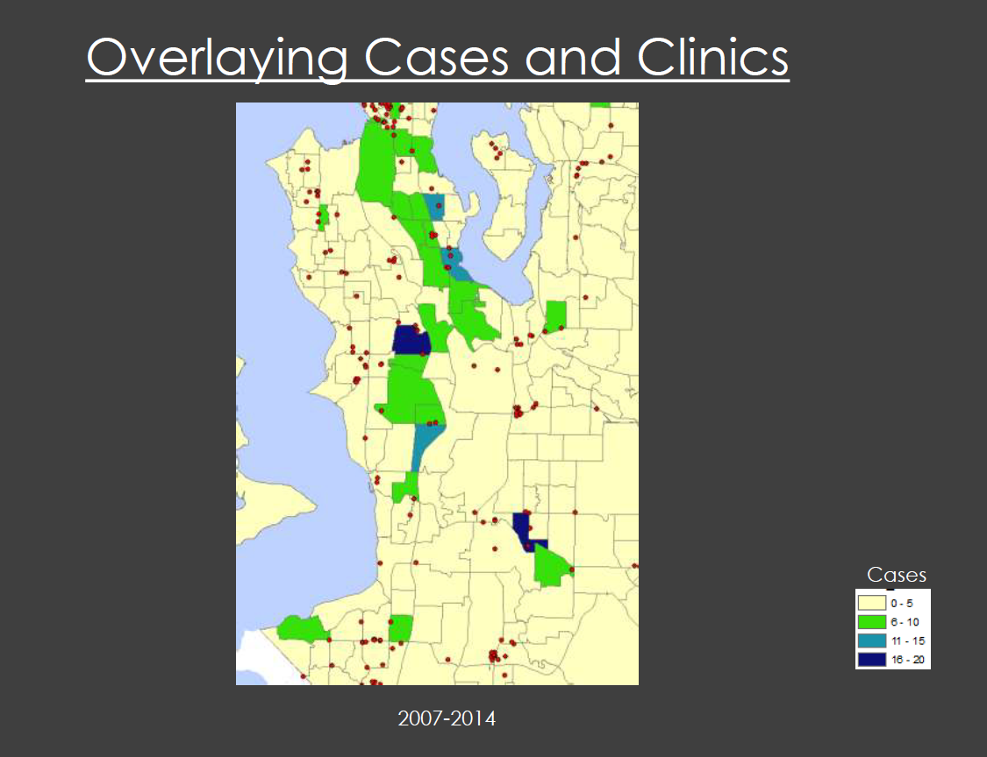
Seattle – Locating High Risk Populations and Their Providers
Notes:
Andrea Palmer and Matt Folley DHMH – Baltimore City and Baltimore County
Geo-code to map the high risk populations of TB cases:
Geographical clustering?
Common areas serviced by medical facilities or community organizations?
Estimate size of each high risk population, using community census data, hospital discharge data, death certificate information, and other local sources of data
Estimate local rate of progression to disease, by risk:
Number of TB cases with risk factor(s)
Number (%) of identified LTBI+ in the served community, projected to an LTBI prevalence rate in the estimated risk population in the site catchment area

Slide 37
Questions?

