Slide 1
The Intergenerational Experience and Your Role as Ambassadors ………
Dr. Errol S. Bolden
Universal Inspirations, LLC.
Universalinspirations.com

Slide 3
The focus of “The Sparrow and the Mustard Seed”
The Beauty of healthy relationships
The value of secure attachments
Demystifying and normalizing grief and loss
The value of being heard

Slide 4
Your Thoughts What are some behaviors/attitudes that grandparents more typically display than parents, particularly younger ones?

Slide 5
Storytelling Problem solving Patience Resilience Giving Display of emotions Forgiveness Saying I’m Sorry

Slide 6
The Essence of Intergenerational Relationships
Cultivating caring relationships across generations
Intergenerational Caring Conversations
Intergenerational Community Building
Intergenerational Relationships in Existing Programs
Intergenerational Storytelling
Intergenerational Relationships through Mentoring

Slide 7
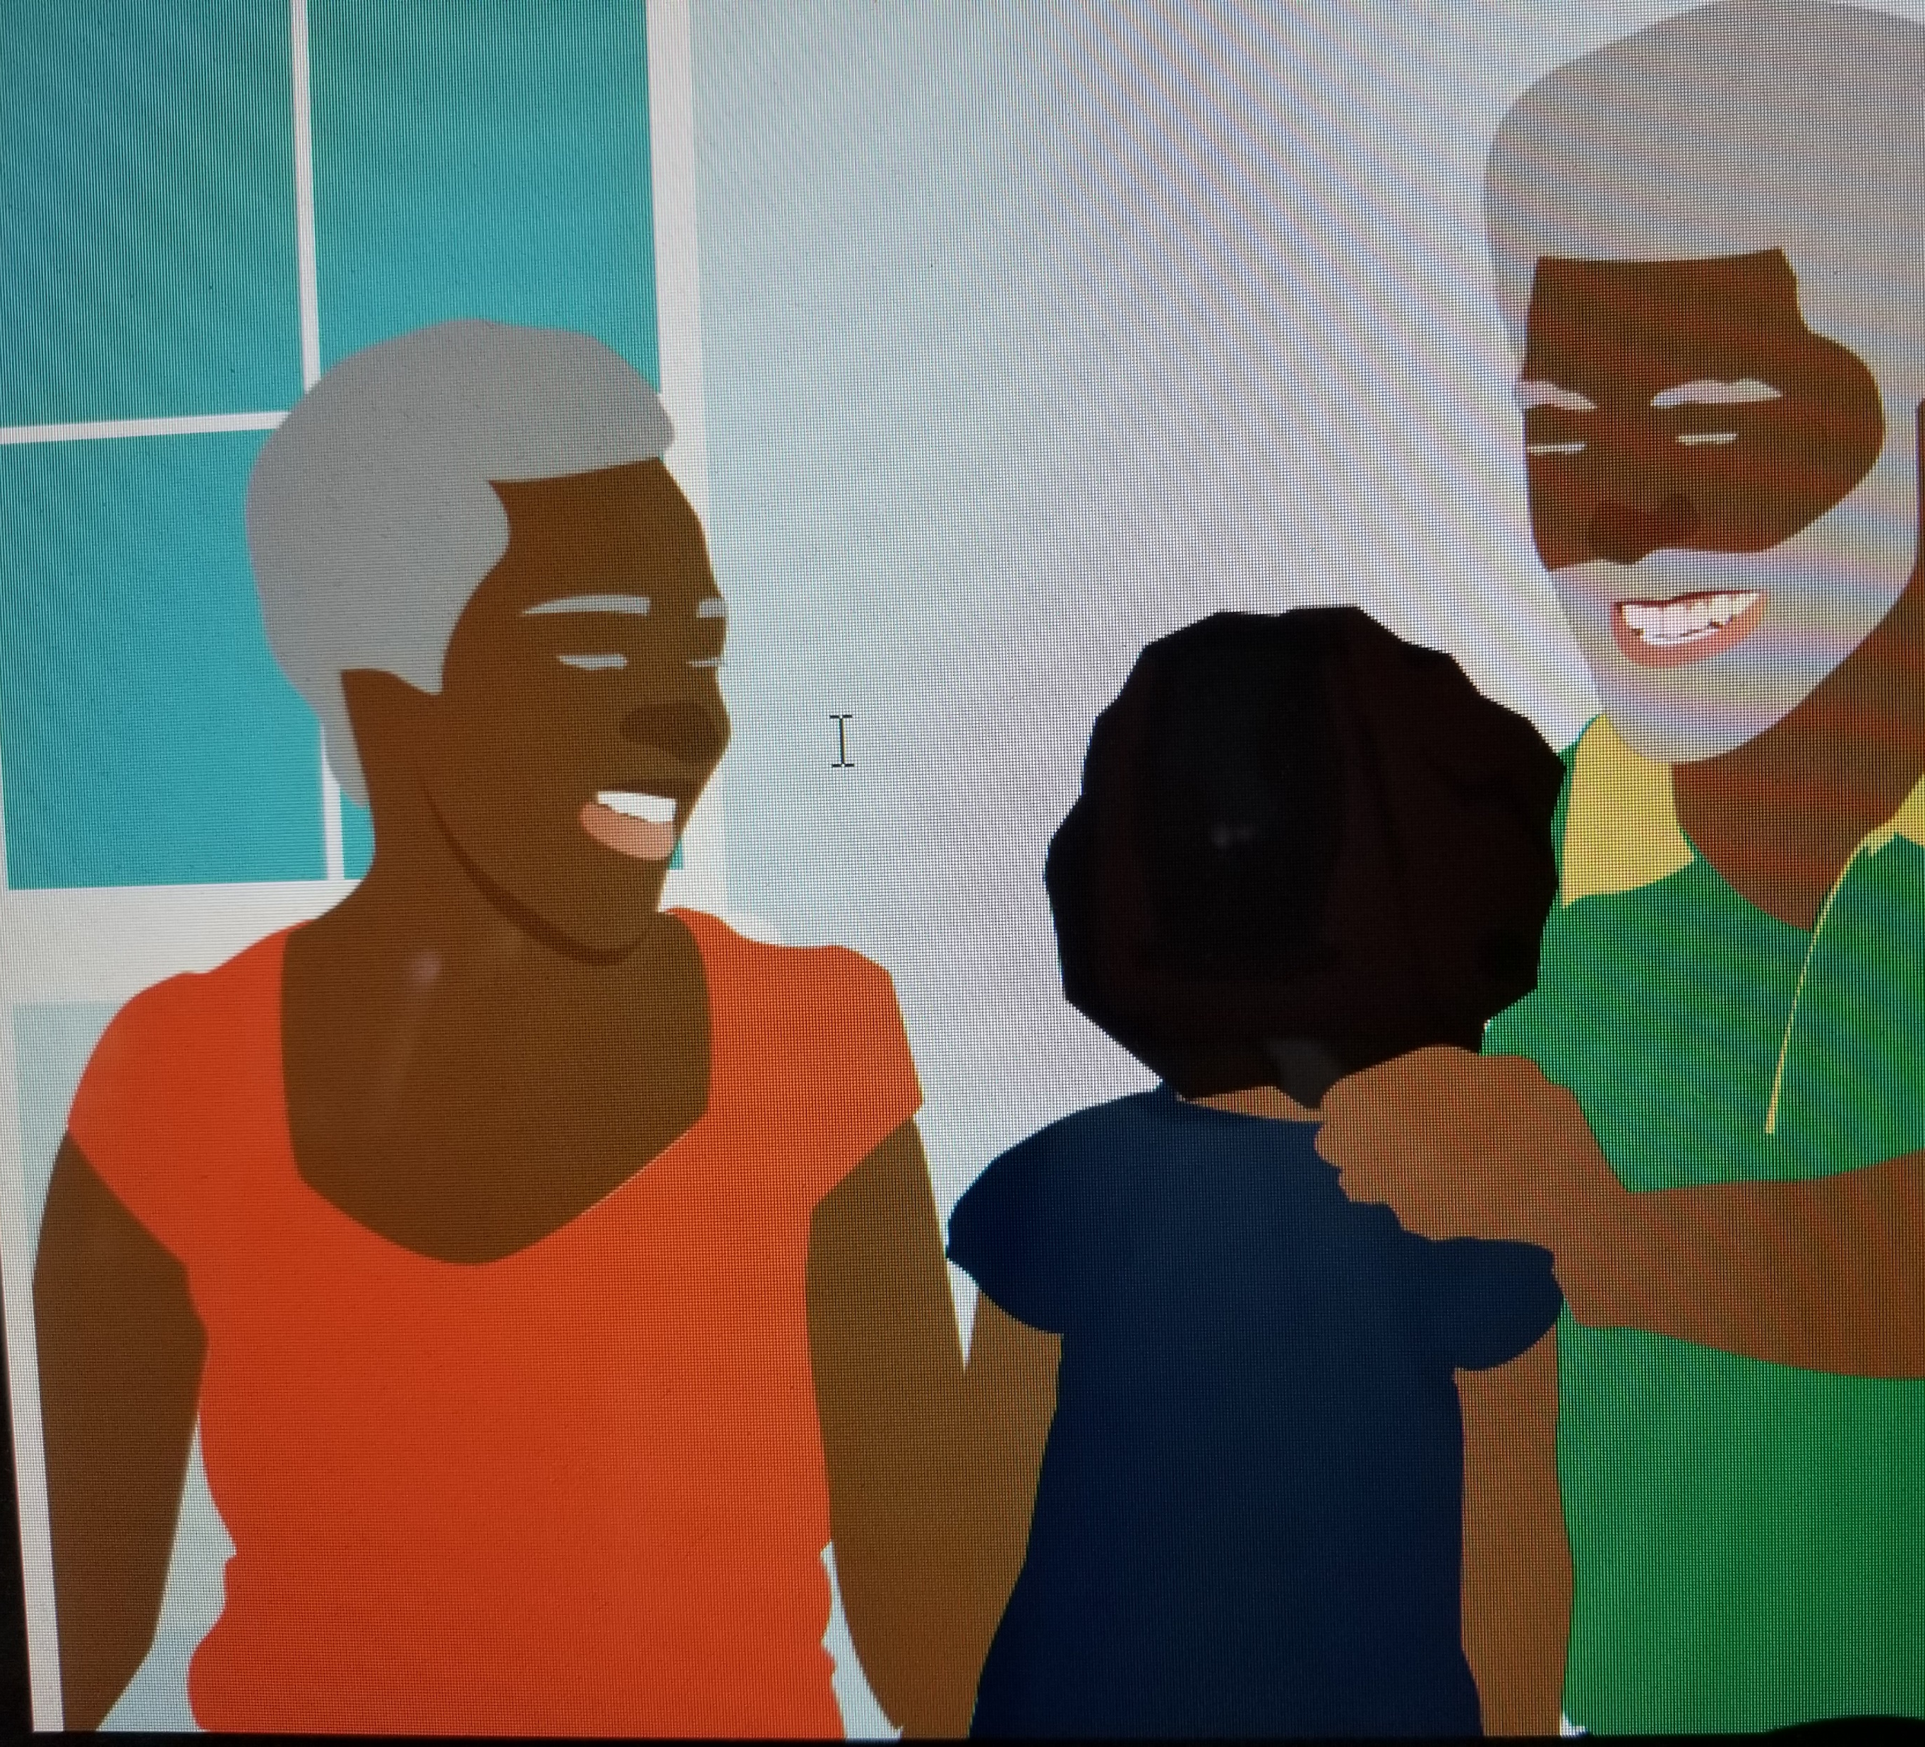
Crystal and Her Grandparents
Grandparents are special. This is a lesson that Crystal learned very early in her life. She was her grandparents pride and joy.

Slide 8
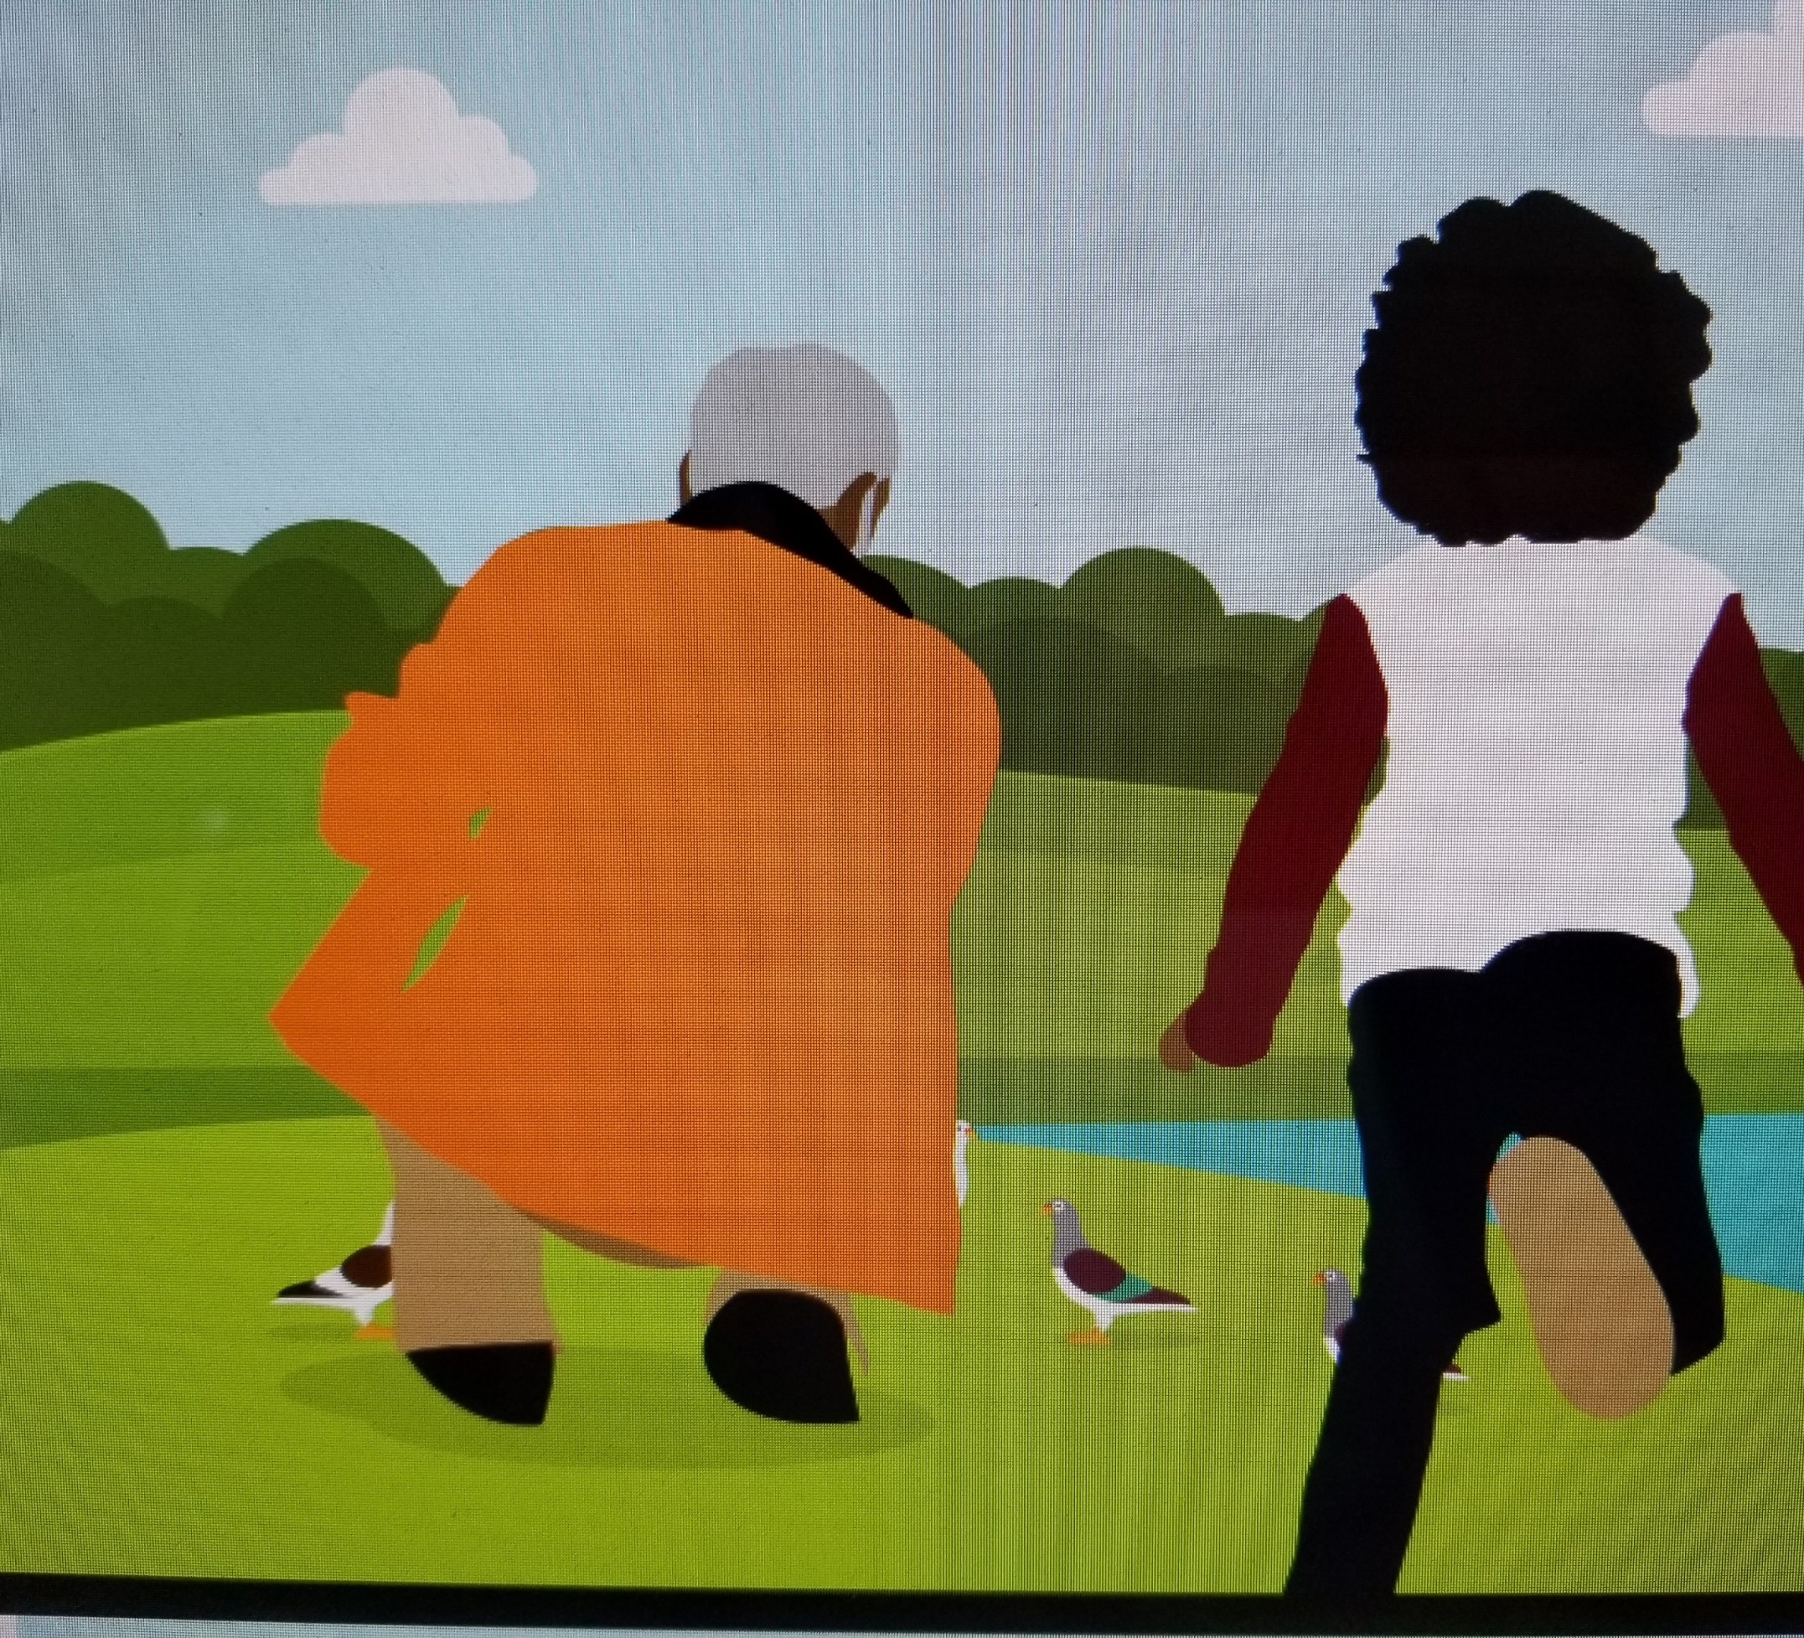
Crystal enjoys playing with her grandfather
Her grandfather loved to carry her on his shoulders and loved to tickle her with his beard.
He would also take her to the park to play and feed the pigeons.

Slide 10
Tools that are often used

Slide 12
The Vicious Cycle

Slide 13
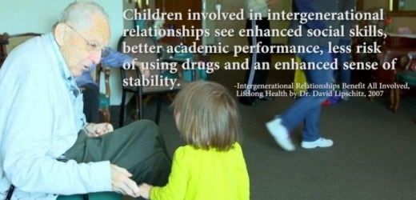

Slide 14
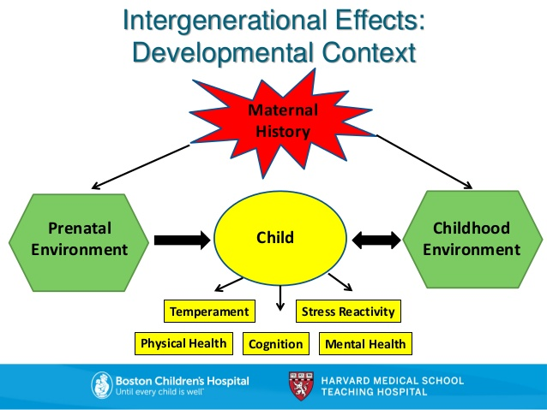

Slide 15
Crystal is feeling sad!

Slide 16
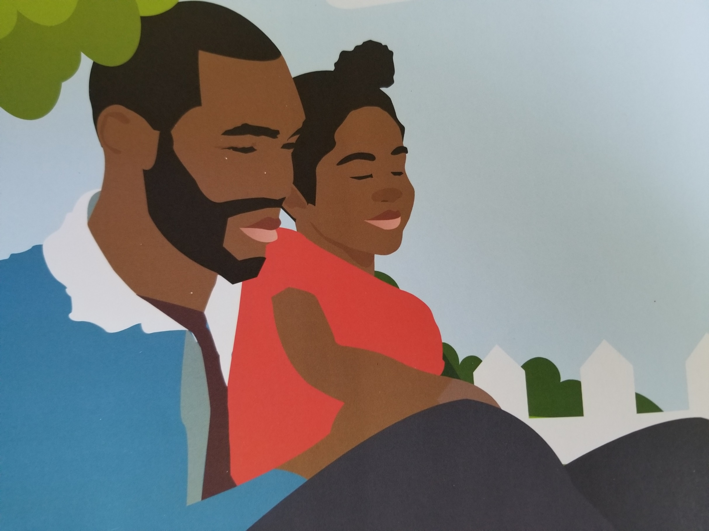
Crystal and her dad
He spent time talking to her about the loss of her grandfather and how they could work through the first significant loss in her life.
"We found that today's dads spend more time, provide more care and are more loving toward their kids than ever before," said Kevin Shafer, BYU sociology professor and a co-author of the study. "Most dads see themselves as playing an equally important role in helping their children as mothers do.
"The most important finding, in my opinion, is a growing mentality that fathers should be engaged and nurturing and expressive." He notes that dads generally see the change as "good and necessary" and they are spending more time with their children.
“Today's dads are moving away from 'toxic' aspects of manliness so they can become better fathers”. BYU and Ball State University researchers

Slide 19
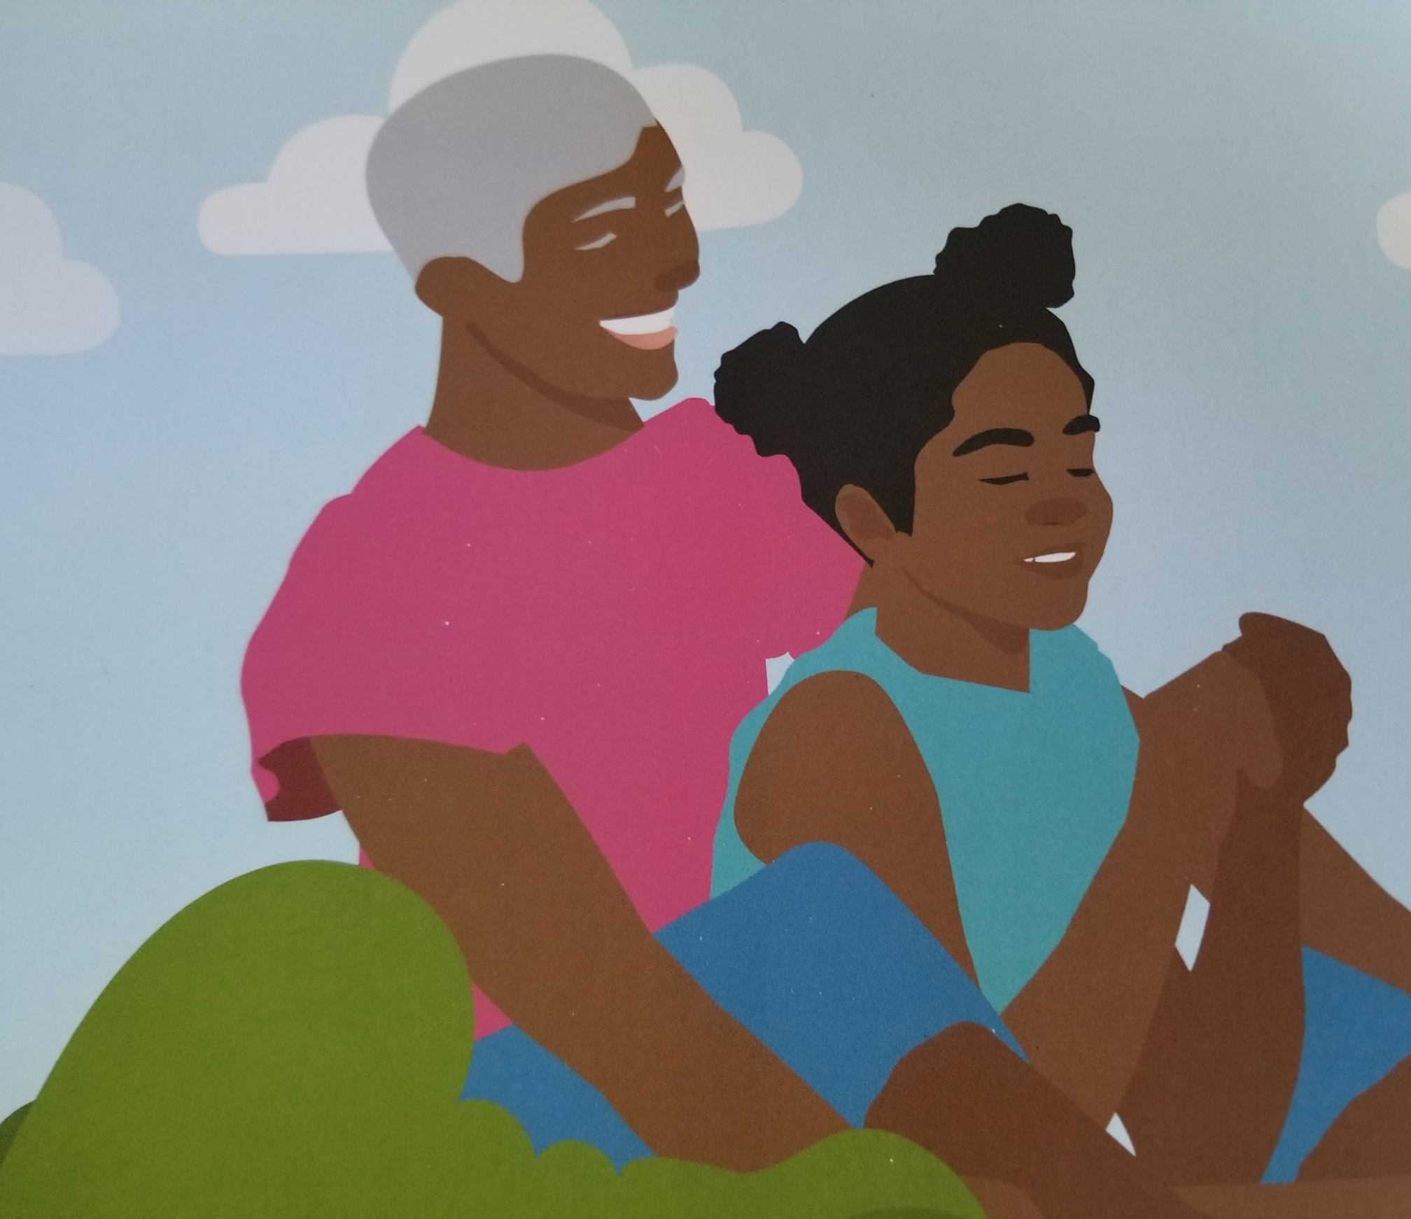
Crystal and her grandmother
One day when Crystal’s grandmother was feeling sad, she shared in her own child-like manner, her understanding of the Sparrow and the Mustard Seed. This was her attempt to cheer up her grandma. It worked!

Slide 20
Key Reminders

Slide 21
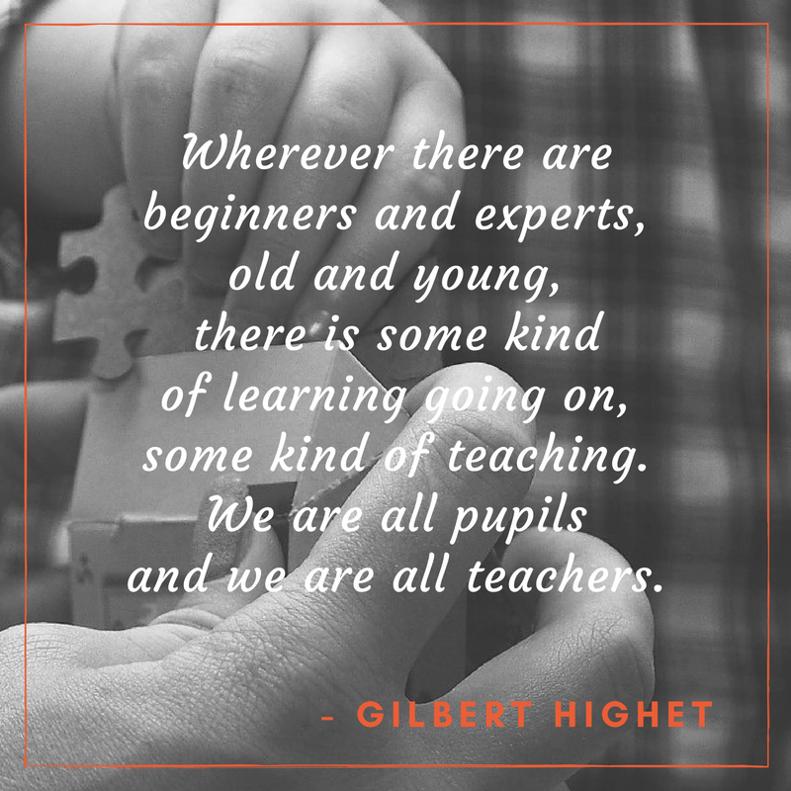

Slide 22
Strength in Asking
I grew up thinking that asking for help
Was a sign of weakness and ignorance that others would exploit.
So I would remain silent and struggle and mess up at times
When asking for help would have dealt with my problem. Now that I’m grown, I still struggle with asking
Even for a service that I know I am in need of.
Ego—maybe -- or protection of self;
Or a false sense of a strength even though I’m cheating myself.
Understand then that my asking is still hard for me.
Please be patient and know that to ask is still difficult
But I’m working on accepting that there is strength in my asking.
Universal Inspirations
©2018

Slide 23
The Home Visitor
I am:
A Light when things seem dark and dismal.
I am:
A Voice for the Voiceless when they need to be heard.
I am:
A Scale to help others weigh options they face.
I am:
An Advocate when others struggle to stand up.
I am:
An Oxygen tank for those who struggle to breathe.
I am:
A Compendium of Knowledge where ignorance exists.
I am:
All of the above, and so much more.
Universal Inspirations
©2018

Slide 24
Which one do you think is more important in the work that you do with families?
Working with the family to address helplessness.
Working with the family to address hopelessness.

Slide 25
In an environment where hopelessness is sometimes the prevailing response
You are An Ambassador of Hope

Slide 26
Our ultimate goal!!!!!

