Slide 1

Co-Creating a MD Home Visiting Research and Evaluation Agenda
Allison West & Kelly Bower
MD MIECHV Conference
Ocean City, MD
2018

Slide 2
Welcome!
Evaluation is like ______________________ because…

Slide 3
Objectives
Explore understandings about the purpose of evaluation
Brainstorm potential research and evaluation questions
Describe ways for stakeholders to be involved in a partnership process for research and evaluation process in MD home visiting

Slide 4
Resources for Research and Evaluation
Funding opportunities vary…
  Call for proposals vs. investigator initiated
  Specific vs general topic areas
  % of funds for direct service vs. evaluation
Examples:
  MIECHV formula funds
  MIECHV Innovations funds
  Investigator- and/or community-initiated grants

Slide 5
Evaluation Promotes Learning
An opportunity to learn…
  What you do (processes and activities)
  Impacts of your work on families (outcomes)
  WHY and HOW desired outcomes are achieved
  WHAT works for WHOM?
Can also help…
  REFINE program goals
  IMPROVE service quality
  Meet standards and requirements for accountability

Slide 6
Evaluation is a Process
Assess strengths & needs
Identify priority issues and questions
Design and conduct research & evaluation
Interpret findings
Use findings to improve practice

Slide 7
Evaluation is a Partnership
Assess strengths & needs
Identify priority issues and questions
Design and conduct research & evaluation
Interpret findings
Use findings to improve practice
Partnerships among stakeholders in all phases of the process yield the most useful results!
Partnership

Slide 8
Evaluation is a Partnership
Assess strengths & needs
Identify priority issues and questions
Design and conduct research & evaluation
Interpret findings
Use findings to improve practice
Stakeholders include:
HV staff
Families
Evaluators
Administrators
Others?
Partnership

Slide 9

You are a part of something bigger!!
National MIECHV learning agenda aims to continually improve program performance by…
Applying existing evidence about what works,
Generating new knowledge, and
Using experimentation and innovation to test new approaches to program delivery.

Slide 10
What can we evaluate?
Context
Community resources and needs
HV program policies, resources, and needs
Family strengths, needs, motivations, and resources
Long-term Child & Family Outcomes
Maternal & child health
School readiness
Family economic self-sufficiency
Goal achievement
Program Strategies
Strategies to recruit, enroll and serve families
Strategies to recruit, train and support staff
Short-term Outcomes
Family enrollment
Family participation in visits
Homework completion
Satisfaction with program
Family retention

Slide 11
Types of Evaluation Questions
Questions about long-term child and family outcomes….examples:
  Are families enrolled in home visiting more likely than families who are not enrolled in HV to have recommended immunizations?
  How effective is home visiting in promoting safe sleep?

Slide 12
Types of Evaluation Questions
Questions about short-term outcomes….examples:
  How do families experience the process of enrollment?
  Does motivational communication improve family engagement in visits?
  How satisfied are families with home visiting services?

Slide 13
Types of Evaluation Questions
Questions about program strategies…
  What are programs doing to address unstable housing?
  Does training in reflective supervision improve family retention?
  When added to HV services as usual, do depression support groups improve maternal mental health?

Slide 14
Types of Evaluation Questions
Questions about local, organizational, and family context…
  Are adequate mental health services available in our community for families who screen positive for depression?
  How confident are staff in their ability to work with families with substance exposed newborns?
  Of all families currently enrolled in MD HV, how many have unstable housing?

Slide 15
Activity!!

Slide 16

Brainstorming Evaluation Questions
1. On your own, brainstorm questions YOU have about:
    Short- and long-term outcomes
    Service delivery strategies
    The communities and families you serve
    Anything that you think may improve family outcomes!
Write each idea on an index card, in question form
2. In groups of 2-3, share your ideas
3. Select 2 ideas from your small group to share with the large group

Slide 17

Be Sure to Consider Feasibility

Slide 18
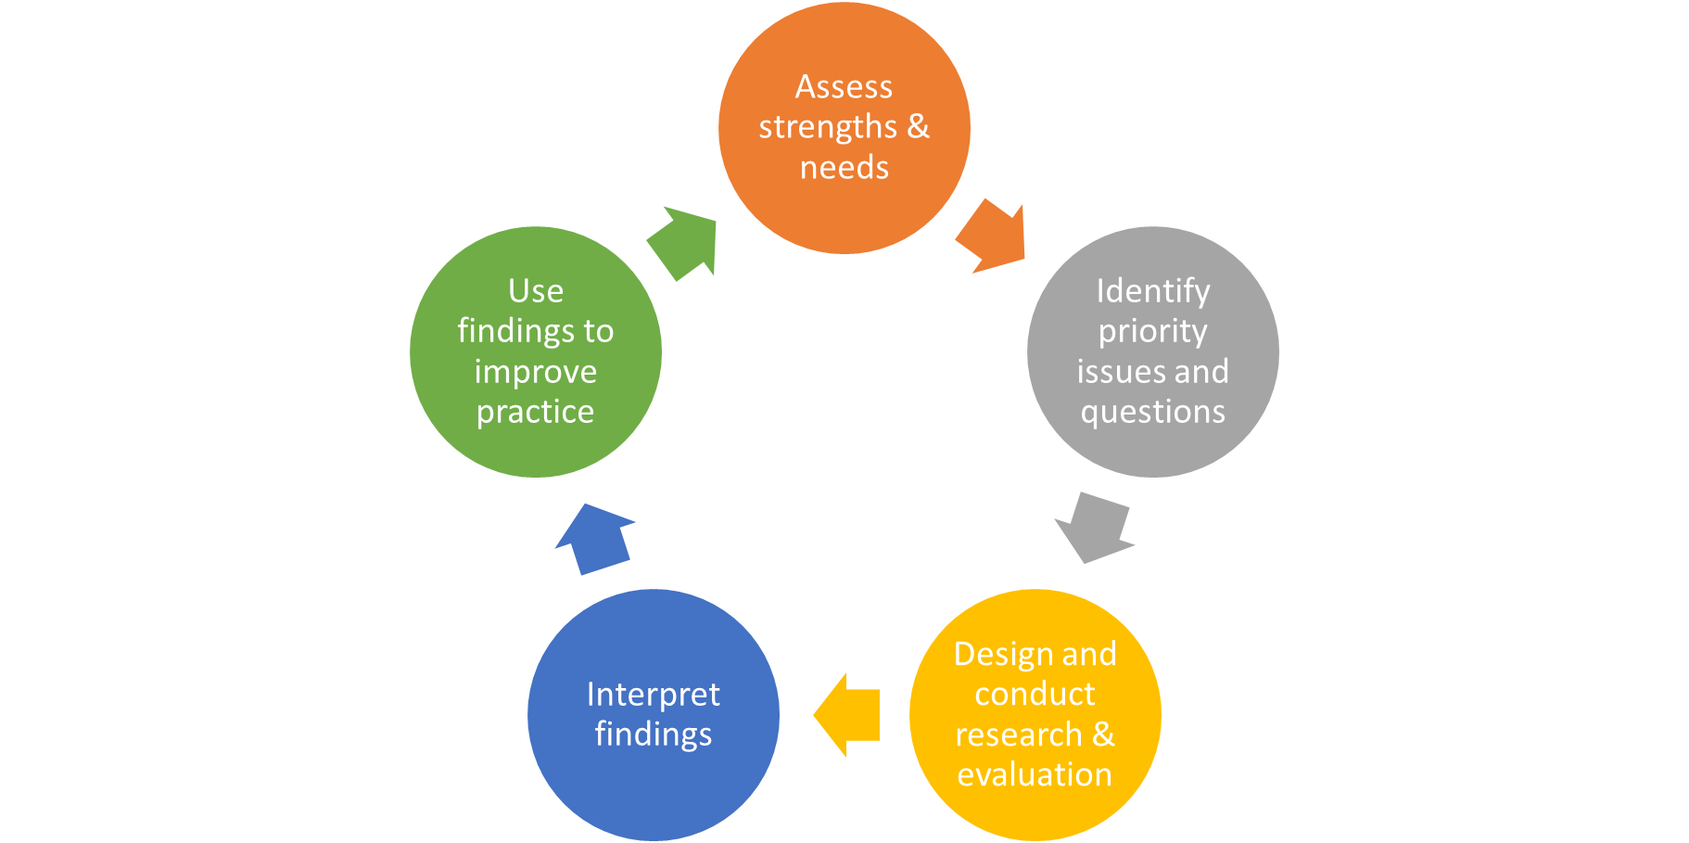
Developing a Partnership Process for
Research & Evaluation in Maryland
In what ways do YOU want to be involved in home visiting research and evaluation?
  Where in the process?
  How? Consider mode, format, communication, etc.
How can we best achieve state-wide representation in the evaluation process?
How and to whom should evaluation findings be communicated?
Partnership

Slide 19
Final Thoughts?

Slide 20
Feel Free to Contact Us
Allison West, PhD
Assistant Professor
Johns Hopkins Bloomberg School of Public Health
awest25@jhu.edu
P: 443-287-6317
Kelly Bower, PhD, RN
Assistant Professor
Johns Hopkins School of Nursing
kbower1@jhu.edu
P: 410-502-0654

