Slide 1

Resources and Strategies for Mental Health Providers During COVID-19 Outbreak
Center of excellence for infant and early childhood mental health,
Division of Child and Adolescent Psychiatry,
University of Maryland School of Medicine

Slide 2

Caring for yourself and your family: Are you wearing your life jacket?
Your health and well-being is essential
Be kind to yourself
Establish routines and ways of working that set you up for success
Reach out for help
Explore the resources to help you perform your role
Join our Facebook Community and get access to resources for you and your family and the community you serve:
https://www.facebook.com/iECMHMaryland/

Slide 3

Be Informed
Stay up-to-date:
Maryland Department of Health: https://coronavirus.maryland.gov/
Deaf and Hard of Hearing: https://odhh.maryland.gov/coronavirus/
Center for Disease Control: https://www.cdc.gov/coronavirus/2019-ncov/index.html

Slide 4
Essential Personnel Only
If you are an essential employee and need child care call Locate Child Care:
877-261-0060

Slide 5

Safety first
Explore families’ concerns about physical safety (housing, domestic violence) and basic needs (food, etc.)
Problem solve how to meet those safety needs.
Resources: Maryland 211

Slide 6

Food
Call school or go on the website below to locate food distribution for youth during the closure:
https://state.nokidhungry.org/maryland/2020/03/13/school-districts-serving-meals-during-school-closures/
https://mars.msde.maryland.gov/mars_sitesearch/
You can visit mdsummermeals.org Currently, the state is providing 3 meals a day and a snack to students who need it during the school closure.

Slide 7
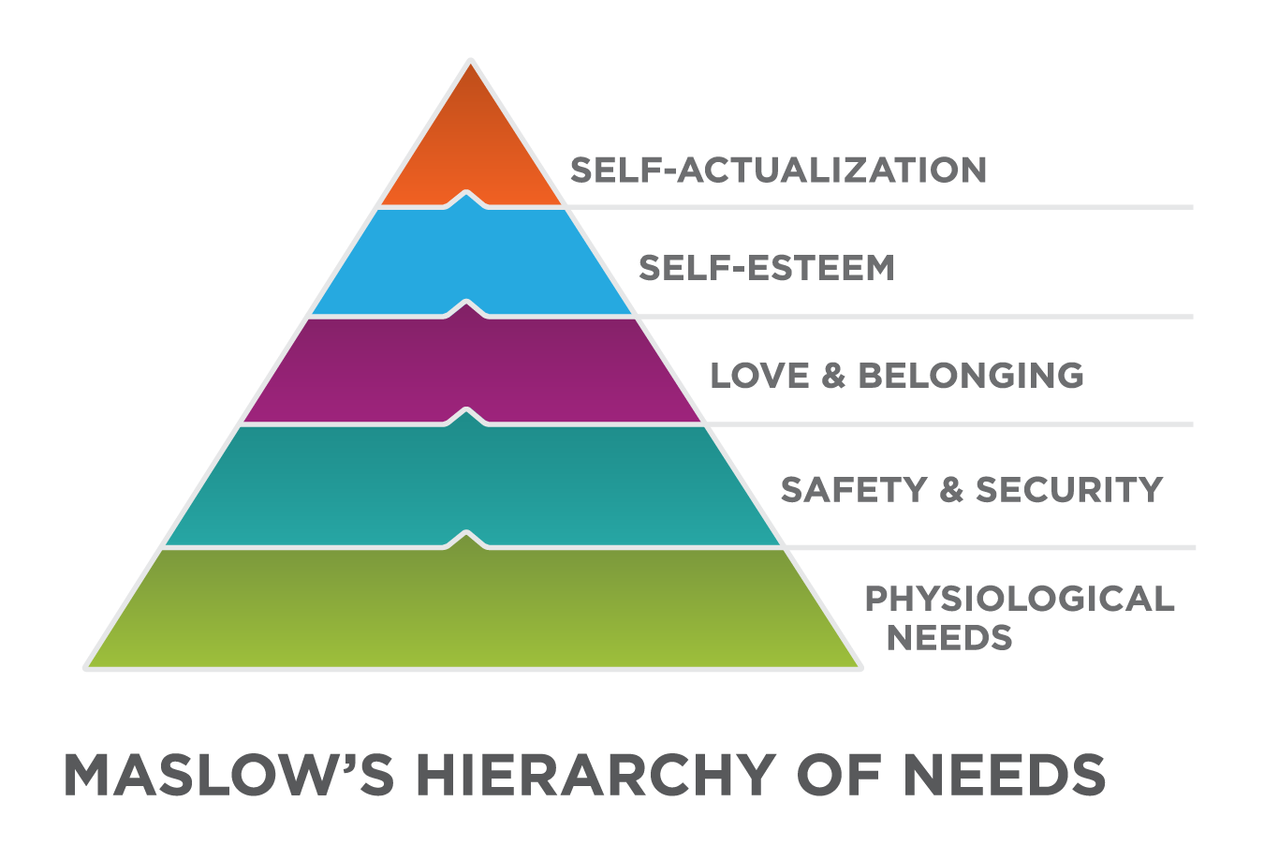
Emotional Safety
Explore emotional safety to support wellness and reduce risks of family conflict, violence and suicide.
If concerns regarding domestic abuse or suicide arise consider the following evidence based assessments and safety plans

Slide 8

Free Evidence Based Training: Skills for Psychological Recovery Online Available Now on the NCTSN Learning Center
This 5-hour interactive online course designed for providers to help survivors gain skills to manage distress and cope with post-disaster stress and adversity.
This course is for individuals who want to learn about using SPR, learning the goals and rationale of each core skill, delivering SPR, and supporting survivors in the aftermath of a disaster or traumatic event.
https://learn.nctsn.org/course/view.php?id=535

Slide 9

Domestic Violence Resources: Evidence base resources
Evidence based Danger Assessment (Johns Hopkins Resource):
https://nursing.jhu.edu/news-events/news/archives/2005/domestic_violence_risk_tool.html
https://www.dangerassessment.org/
Evidence based MyPlan App (collaboration with Johns Hopkins and One Love): myPlan is a tool to help with safety decisions if you, or someone you care about, is experiencing abuse in their intimate relationship.
Download myPlan for free: https://www.myplanapp.org/about
NATIONAL DOMESTIC VIOLENCE HOTLINE
1-800-799-7233
Maryland Network Against Domestic Violence
6911 Laurel Bowie Road, Suite 309
Bowie, MD 20715
TOLL-FREE: 800-MD-HELPS
Phone: 301-352-4574
http://www.mnadv.org
House of Ruth: 410-889-7884 (RUTH)
http://www.hruth.org

Slide 10
Suicide Assessment and Safety Plan: Evidence based Resources
ASQ: Ask Suicide Screening Questions:
https://www.nimh.nih.gov/research/research-conducted-at-nimh/asq-toolkit-materials/index.shtml
Brown Stanley Safety Plan:
https://suicidepreventionlifeline.org/wp-content/uploads/2016/08/Brown_StanleySafetyPlanTemplate.pdf
24/7 National Suicide Prevention Lifeline 1-800-273-TALK (8255) En Español: 1-888-628-9454 or 24/7 Crisis Text Line: Text “HOME” to 741-741
Maryland Youth Crisis Hotline 800-422-0009
Baltimore Crisis Response 410-752-2272
First Call for Help 410-685-0525

Slide 11

State Hotlines
For Life Threatening Emergencies DIAL 9-1-1
Maryland Crisis Hotline/ DIAL 211 (and press option 1) or text 898211
Maryland Suicide Prevention Program or visit 211md.org
2-1-1 MARYLAND 24 hours a Day to connect Maryland residents to health and human service resources DIAL 2-1-1 or visit online at https://211md.org

Slide 12
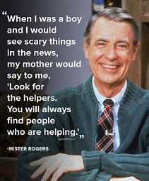
Coping
“If it is mentionable it is manageable” -Fred Rogers
When we can talk about the situation we are better able to manage our feelings, process our thoughts and put plans to stay safe into place and cope with difficult times.
Talk with children and explain why things are different. Be sure not to scare and let them know that many people are helping out and that they can be helpers, too, by washing their hands, adhering to social distancing rules and following all the health and safety rules.

Slide 13

Evidence based resources to help parents talk with children about COVID-19 Outbreak
NATIONAL CHILD TRAUMATIC STRESS NETWORK
https://www.nctsn.org/resources/parent-caregiver-guide-to-helping-families-cope-with-the-coronavirus-disease-2019
ZERO TO THREE
https://www.zerotothree.org/resources/3210-tips-for-families-coronavirus

Slide 14

Coping
Help parents see for signs of stress in themselves and in their children. Emphasis that is essential for parents to take care of yourself so that you can be there for your family.
Routines can help everyone stay in touch and reduce stress. If the ones you have in place are working, stick to them, if not create new ones for this special time.
Trauma informed Parenting during the ‘staycation’ https://www.attachmenttraumanetwork.org/wp-content/uploads/social-distancing-infographic-final.pdf

Slide 15
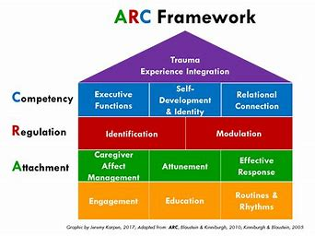
FREE Evidence based training on the ARC model from the Center for Trauma Training – ARC (Attachment, Regulation, Competency)
Each video will provide a brief overview of a core ARC concept. These videos are not a replacement for full ARC training, but you can get familiar with ARC concepts: To learn more Go to https://arcframework.org/ or directly to the free online trainings https://arcframework.org/what-is-arc/arc-at-a-glance/

Slide 16
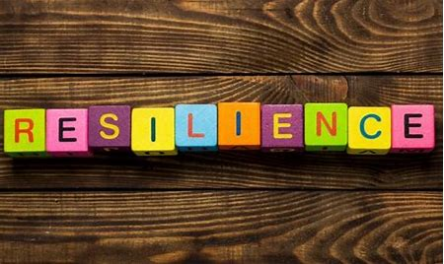
Resilience: Adapt and Move Forward
Remind yourself and others that the crisis is temporary.
Tap into memories, experiences and stories that illustrate you and your families’ strengths and ability to get through hard times.
Check out Behavioral Health Administration’s Resilience website for
resources and activities:
https://www.mindresilience.org/

Slide 17
Maryland Resources
Children’s Mental Health Matters has an excellent webpage to support families and childrens: https://www.childrensmentalhealthmatters.org/resources/coronavirus/
Join our Infant and Early Childhood Mental Health Facebook Community and get access to Tuesday Teaching, Wellness Wednesdays and Family Friday resources for you and your family and the community you serve:
https://www.facebook.com/iECMHMaryland/
Stay up to do date with child care announcements and resources https://earlychildhood.marylandpublicschools.org/
Check out the resources available through Maryland Pyramid Model- Social Emotional Early Learning Community: Go to MD Pyramid: www.mdpyramidmodelsefel.org

Slide 18
Center of Excellence for Infant and Early Childhood Mental Health
We are stronger together (even at a distance)
Please contact Kay Connors at kconnors@som.umaryland.edu if you need resources or would like to share resources with our community
Be Well!

