Slide 1
Behavioral Risk Factor Factor Surveillance System Communication and Marketing 2025
Brittany Wilson, BRFSS Coordinator, Harriet Smith
Prevention and Health Promotion Administration
Center for Chronic Disease Prevention and Control
January 15, 2025
Notes:
Good afternoon, [introduce self]. Today we will be going through the communication strategy for brfss 2025.

Slide 2
BRFSS Program Updates

Slide 3
Behavioral Risk Factor Surveillance System (BRFSS) Overview
What is BRFSS?
• BRFSS is the largest, continuously conducted health survey system in the world.
• Conducted by the Maryland Department of Health in partnership with the CDC.
• Collects data on health-related risk behaviors, chronic health conditions, and preventive services.
• Helps design programs and services for a healthier Maryland
Notes:
Leveraging data for Local Health Decision Making: "The Behavioral Risk Factor Surveillnace System BRFSS is the largest continuously conducted health survey in the United States. It collects data on health-related behaviors, chronic health conditions, and use of preventive services."
"In Maryland, the BRFSS has been conducted annually since 1984 and provides valuable state- and county-level data to address public health priorities."
Slide 3: Why BRFSS Data Matters to You
"BRFSS data can help identify health trends and disparities in your community."
"It supports the development of targeted interventions and the allocation of resources."
"The data informs grant applications, strategic planning, and progress reporting for public health programs."
Slide 4: Key Features of BRFSS Data
"Data is available for demographics, chronic diseases (e.g., diabetes, hypertension), risk behaviors (e.g., smoking, alcohol use), and preventive health measures (e.g., cancer screenings)."
"Data can be disaggregated by geography, age, race, gender, and more to identify disparities."
"Local-level estimates are available for many indicators to guide your health department's efforts."
Slide 5: How to Access BRFSS Data
"Maryland BRFSS data is available through the IBIS platform, which provides interactive dashboards and downloadable datasets."
Provide live demonstration or screenshots of IBIS platform:
"Search for specific health indicators."
"Customize data views by year or demographic group."
"Download tables or charts for presentations and reports."
Thank you for your commitment to improving community health. Together, we can use BRFSS data to make informed decisions and create impactful programs for Maryland residents."

Slide 4
The Role of Marketing in BRFSS
Increase awareness about the survey to improve participation rates.
Build trust among Maryland residents to reduce misconceptions (e.g., “It’s not spam!”).
Ensure representation of diverse populations for accurate health data.
Educate communities on the impact of their responses.

Slide 5
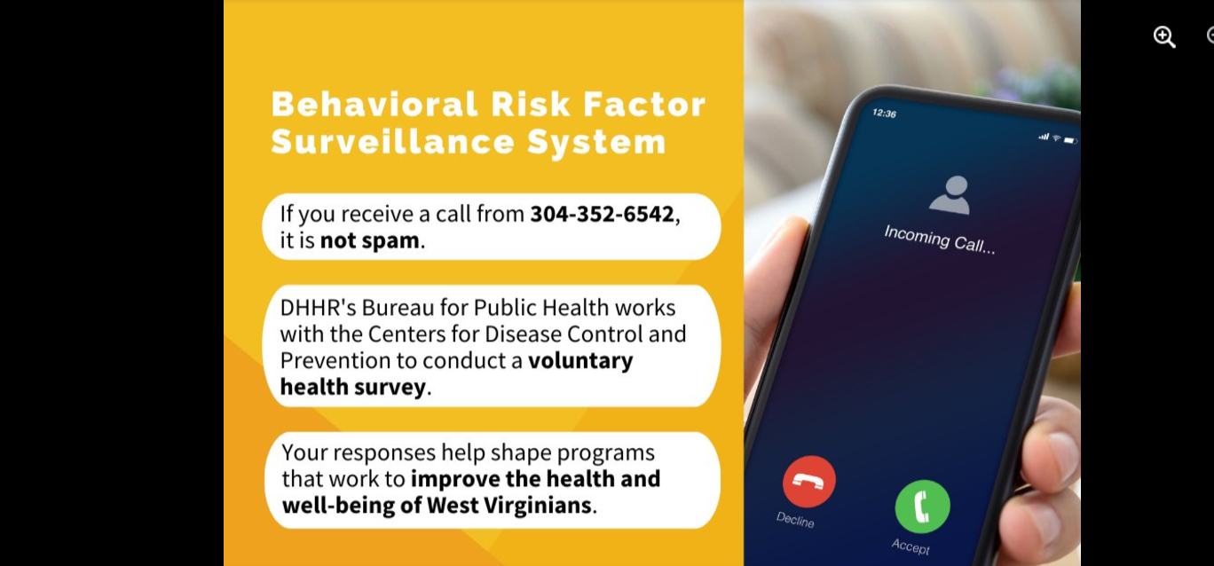
BRFSS Phone Survey Marketing Campaign
Headline: “Who’s calling? It’s not spam. It’s the State!”
The Maryland Department of Health conducts a voluntary health survey with the U.S. Centers for Disease Control and Prevention. Your participation helps design programs that improve health in Maryland. If you’re 18 or older, answer the call.

Slide 6
Marketing Objectives for BRFSS
1. Increase survey participation in the next year.
2. Improve public understanding of BRFSS and its value to Maryland’s health.
3. Foster diverse representation in survey responses.
4. Strengthen partnerships with local organizations to amplify outreach efforts.

Slide 7
Engaging Communities Through Coffee Listening Sessions
• Informal virtual gatherings to discuss BRFSS and its importance to local health departments and health organizatons.
• Create a comfortable space for health professionals to ask questions and share concerns.
• Gain insights into marketing strategies that resonate with different populations.
• Build trust and encourage participation through personal interaction.

Slide 8
Implementation Plan
1. Finalize marketing materials (flyers, digital ads, radio spots).
2. Schedule Coffee Listening Sessions in priority communities.
3. Launch social media campaign to promote awareness.
4. Collaborate with local leaders to advocate for participation.

Slide 9
Thank you!

Slide 10
Prevention and Health Promotion Administration
For Questions: Please Contact Brittany.Wilson2@maryland.gov

