Slide 1
EDB TRAINING 7/27/16 Maria-Theresa C. Okafor, PhD, MCG Program Manager, Surveillance and Evaluation Unit Center for Cancer Prevention and Control Maryland Department of Health and Mental Hygiene

Slide 2
Meet the Trainer
Maria-Theresa C. Okafor
Program Manager, Surveillance and Evaluation Unit Cancer Center for Prevention and Control

Slide 3
Training Objective
Provide an overview of updates to the EDB
EDB sections updated
Preview of updates
Impact on local programs

Slide 4
Education Database (EDB)
Non-confidential internet-based relational database
Used by local CPEST staff
Previously: Enter cancer education and outreach activities across four EDB forms
Now: Enter cancer education and outreach activities in one EDB form

Slide 5
Why update the EDB?
You spoke we listened! ☺
Improve data quality
Streamline data entry process
User friendly
Reduce data entry time
Generate informative performance measures data
Anticipate future needs

Slide 6
What’s New in the EDB?
System Message Expiration Feature
Main Menu Layout
EDB Form
Accessing New and Old EDB Data:
Copy Feature
Archive Feature

Slide 7
UPDATE 1: SYSTEM MESSAGES
Expiration Feature

Slide 8
System Messages: Expiration Feature
Previously:
System message would remain on Main Menu screen until new message posted
Now:
System messages will be set to expire on a given date
Only new messages will display on Main Menu screen

Slide 9
UPDATE 2: MAIN MENU
Main Menu Layout (Old vs. New)

Slide 10
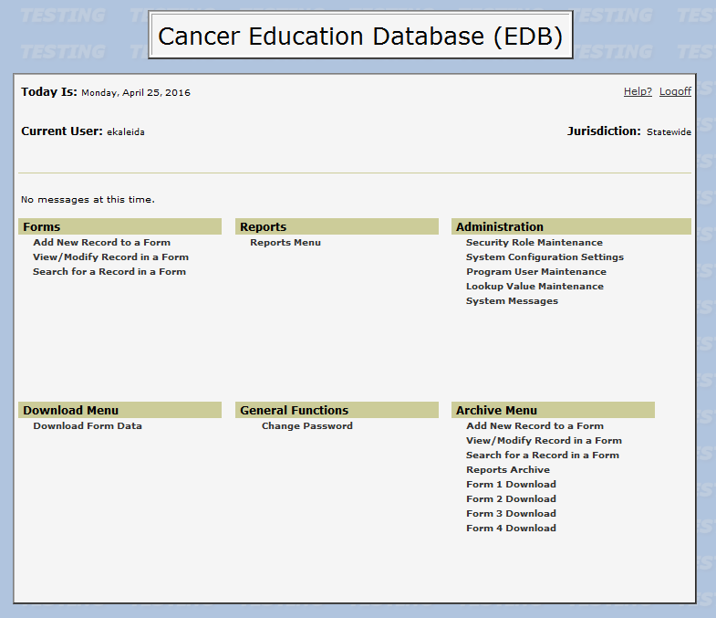
Main Menu: Old Layout
Add/View/Modify/Download data

Slide 11
Main Menu: New Layout
Access new EDB data here
Access old EDB data here

Slide 12
UPDATE 3: EDB Form Changes
Overview
EDB Form 2 Revisions
Final EDB Form

Slide 13
EDB Form Changes: Overview
What Changed?
Total Number of EDB Forms:
EDB Forms 1, 3, and 4 deleted
EDB Form 2 revised:
Includes select fields from other EDB forms
Aligns with new FY17 Education and Outreach performance measures:
# of public education and targeted outreach activities implemented, for all cancers combined
# of new individuals screened, for all cancers combined, regardless of funding source

Slide 14
How was EDB Form 2 Revised?
EDB FORM 2 SECTION | UPDATED (Y/N) | LOCATION OF UPDATE
PROGRAM USE ONLY | N | N/A
ACTIVITY INFORMATION | Y | TOPIC/DESCRIPTION TYPE OF ACTIVITY/RESOURCE IMPLEMENTED PLACE OF ACTIVITY LENGTH OF TIME TO IMPLEMENT ACTIVITY LEAD EDUCATOR FIELDS
PARTICIPANTS TARGETED/REACHED | Y | ENTIRE SECTION
COMMENTS SUGGESTIONS | N | N/A
FOR LOCAL PROGRAM USE ONLY | N | N/A

Slide 15
How was EDB Form 2 Revised?
Topic Description field deleted
Type of Activity field deleted
Length of Time to Implement Activity deleted
All Lead Educator fields deleted:
Lead Educator First and last name
Lead Educator Affiliation
Category of Lead Educator’s Affiliation
Type of Activity/Resource Implemented options added:
Brief Interaction
Group Presentation
Individual Session

Slide 16
DELETED
DELETED

Slide 17
How was EDB Form 2 Revised?
Type of Activity/Resource Implemented options added:
ADDED

Slide 18
How was EDB Form 2 Revised?
Participants Targeted/Reached section revised:
Previously:
Revised:
New
fields

Slide 20
UPDATE 4: ACCESSING EDB DATA
Accessing New EDB Data
Accessing Old EDB Data

Slide 21
Accessing New EDB Data: Add New Record
How do you add a new record?
Option 1:
Click add new record
Enter data in EDB form
New Clear feature added
Clears any data entered in form
Must confirm that you want to clear data entered

Slide 22
Accessing New EDB Data: Add New Record
How to clear data when adding new record
Option 1 (continued)

Slide 23
Accessing New EDB Data: Add New Record
Confirmation pop-up when clearing data entered
Option 1 (continued):

Slide 24
Accessing New EDB Data: Add New Record
How do you add a new record?
Option 2:
Copy information from existing record into new record:
Step 1: Find existing record using Search for Record or Form Search features
Step 2: Click Copy and confirm you want to copy:
Entire record copied, except EDB ID and date of activity
EDB ID field should show: (system generated)
Step 3: Enter in Date of Activity and any other data and click Save; confirmation screen will appear, with assigned EDB ID

Slide 25
Accessing New EDB Data: Add New Record using Copy Feature
Step 1: Find existing record to copy, using Search feature(s)

Slide 26
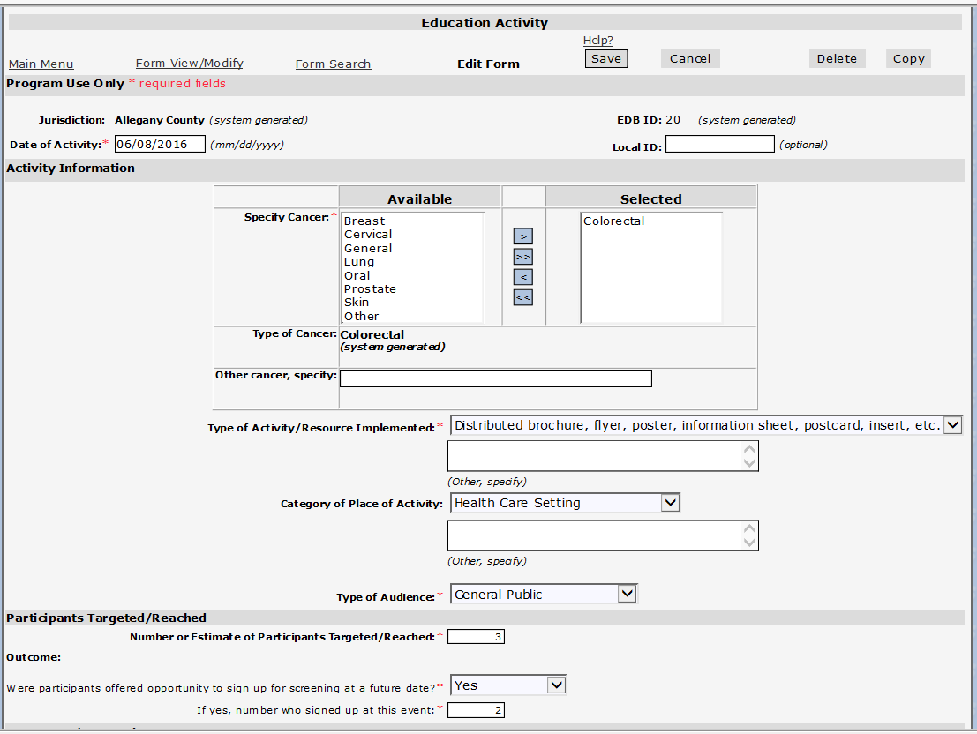

Slide 27
Accessing New EDB Data: Add New Record using Copy Feature
Step 2: Click Copy and confirm you want to copy

Slide 28
Accessing New EDB Data: Add New Record using Copy Feature
Step 2 (continued): Click Copy and confirm you want to copy

Slide 29
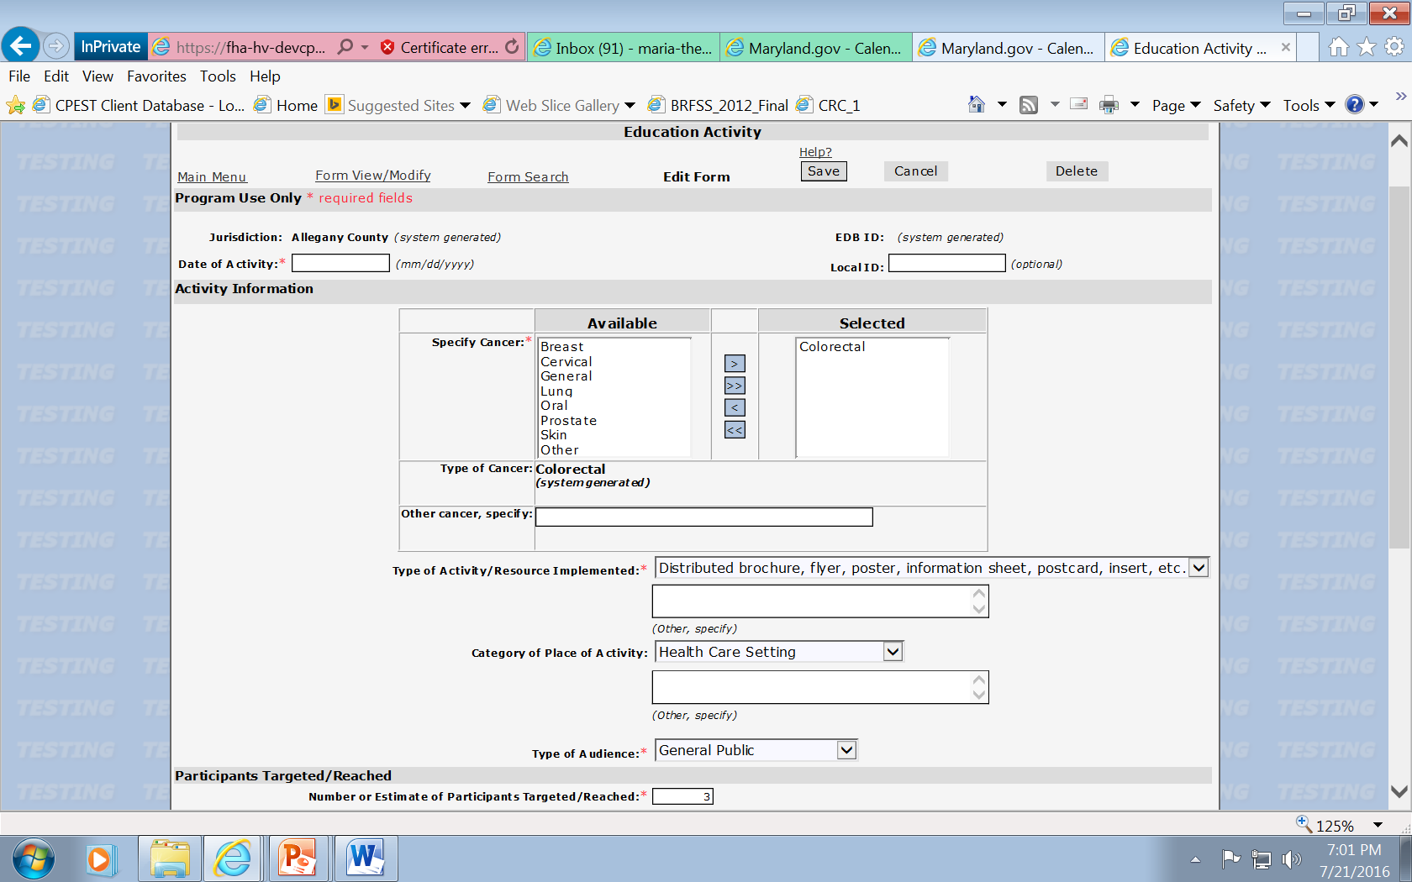
Accessing New EDB Data: Add New Record using Copy Feature
Step 3: Enter in Date of Activity and any other data and click Save
Save
Enter Date of Activity

Slide 30
Accessing New EDB Data: Add New Record using Copy Feature
Step 3 (continued): Confirmation screen appears after saving
New EDB ID

Slide 31
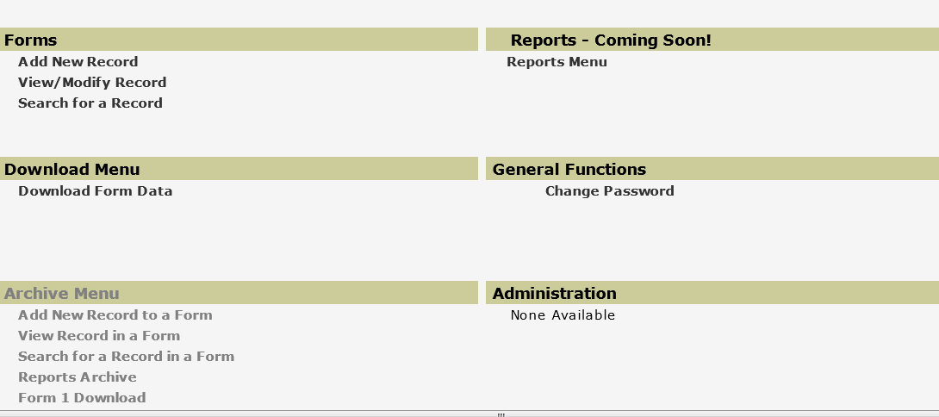
Accessing New EDB Data: Reports
How do you run reports using the new EDB Data?
Go to EDB Main Menu
Go to Reports Section and click on Reports Menu
EDB Reports are currently under development:

Slide 32
Accessing Old EDB Data: Archive Menu
Archive Menu Overview
Includes features/data from old EDB
Add/view/modify/search features are the same
Cut off for FY16 data entry/modification is 12/31/16
1/1/17 onward will be view only access
Old Reports Menu renamed Reports Archive
Links to old EDB reports
Old EDB reports can be run at anytime
Forms 1, 2, 3, and 4 Download feature are the same
Old EDB data can be downloaded at anytime

Slide 33
Accessing Old EDB Data: Archive Menu

Slide 34
What’s Next?
EDB Rollout Date
July 27, 2016 (evening)
Technical Assistance
Forthcoming Updates
Reports
Training Materials
Guidance Documents

Slide 35
Questions? dhmh.edbhelp@maryland.gov

