Slide 1
The Importance of Influenza Vaccination
Maryland Department of Health and Mental Hygiene

Slide 2
Influenza (Flu) Is Serious and Preventable
  Each year about 1,000 people die from flu-related illness
  Approximately 226,000 Americans are hospitalized and more than 36,000 die from influenza and influenza-related complications annually
  In fact, influenza—a vaccine-preventable disease—is the sixth leading cause of death in the United States

Slide 3
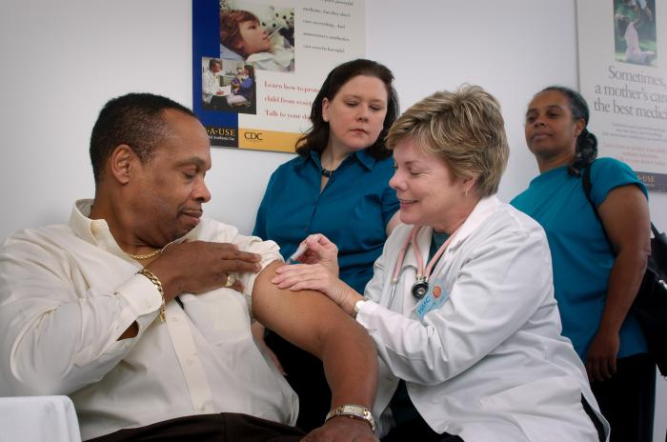
How Flu Vaccination Benefits Everyone
Getting a yearly flu vaccination
is the single best way to
prevent the flu
Vaccination protects you, your patients and co-
workers, your family and the entire community

Slide 4
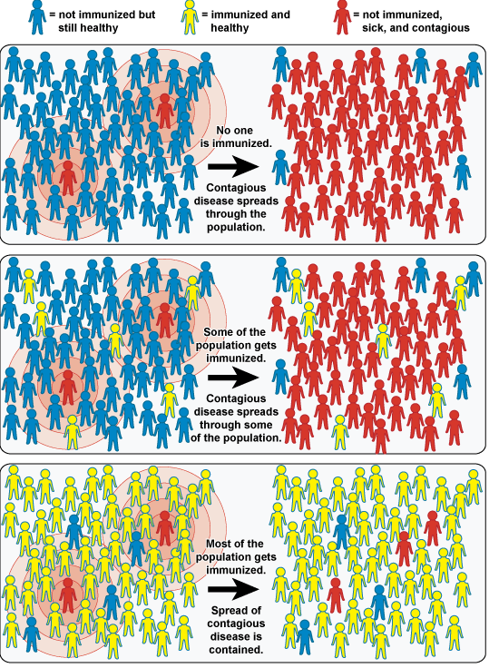
How Flu Vaccination Benefits Your Community
When most of the population is vaccinated the spread of the Flu is contained.
Containing the spread of the Flu helps protect people in your community and/or work environment who are unable to be vaccinated, such as:
    Young Babies
    People with a severe allergy to Flu vaccine
    People who are severely immune-compromised
    People with a history of Guillain–Barré Syndrome
Graphics - National Institute of Allergy and Infectious Disease

Slide 5
Personnel working in healthcare settings have a Special Obligation…
All personnel who may care for or share the air with patients while working in clinical buildings have a responsibility to protect them by making sure we are immunized against influenza each year
Healthcare personnel (HCP) and other covered employees can be the source of influenza outbreaks in institutional and clinical settings

Slide 6
Common Flu Myths and Facts
MYTH: I don’t need the Flu vaccine because I am healthy. I never get influenza
FACT: You may become infected and experience mild or no symptoms, but still pass the virus to vulnerable patients and members of your family

Slide 7
Even employees who think they are healthy can spread the flu
In one study of HCP conducted after a mild influenza season:
  23% of HCP had antibody evidence of influenza infection in their blood
    59% of those could not recall having influenza
    28% could not recall any respiratory infection
  This suggests that many people have flu without
  feeling sick

Slide 8
The benefits of employee vaccination in clinical settings
Over a period of 12 years in one hospital, vaccination coverage increased from 4% to 67%
  Laboratory-confirmed influenza cases among HCP decreased from 42% to 9%
  Health care acquired cases among hospitalized patients decreased 32% to 0 (p<0.0001)

Slide 9
Healthcare Personnel Vaccination
CDC. (2012) Influenza Vaccination Coverage among Health Care Personnel--United States, 2012-2013. http://www.cdc.gov/mmwr/preview/mmwrhtml/mm6238a2.htm
The Centers for Disease Control and Prevention (CDC) recommends annual influenza immunization for all healthcare personnel.

Slide 10
Common Flu Myths and Facts
MYTH: I don’t want to get the Flu from the vaccine.
FACT: It is impossible to contract the flu from the vaccine, which contains inactivated (killed) virus or attenuated (weakened) virus
Sometimes people who have been vaccinated are exposed to flu before the vaccine has time to work (1 to 2 weeks after vaccination) and may think that the vaccine caused their illness

Slide 11
Vaccine Safety
Flu vaccine is very safe and is recommended even for people with medical conditions like heart and lung disease and diabetes
The most common side effects of the flu shot include soreness, redness, or swelling at the site of the injection. These reactions are temporary and occur in 15%–20% of recipients
Less than 1% of vaccine recipients develop symptoms such as fever, chills, and muscle aches for 1 to 2 days following the vaccination

Slide 12
Vaccine Safety (Cont.)
These symptoms are more likely to occur in a person who has never been exposed to the flu virus or vaccine
Experiencing these mild side effects does not mean that you are getting the Flu
Flu vaccine CANNOT give you the Flu

Slide 13
Common Flu Myths and Facts
MYTH: I’m pregnant and concerned about harm to my unborn baby from the influenza vaccine, especially if it contains the preservative thimerosal.
FACT: Influenza infection during pregnancy increases the risk of serious medical complications for the mother. Therefore, pregnant women are among the Centers for Disease Control and Prevention top priority groups for influenza immunization. Influenza vaccines that contain thimerosal are safe for use in pregnant women based on a study of influenza vaccination in more than 2000 pregnant women in which there was no harm to the baby. Women, who are still concerned, can request thimerosal free vaccine from their doctors. Talk to your doctor if you have questions.

Slide 14
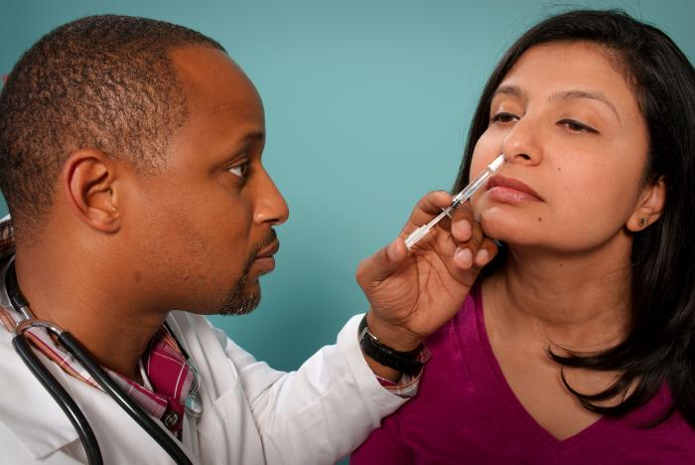
Other benefits of vaccination
If everyone is vaccinated we
will reduce the impact of flu
and decrease healthcare costs
In another study, HCP who got flu vaccine had 28% fewer documented lost work days due to respiratory infections
Your co-workers need you to be healthy and able to cover your shift

Slide 15
Take these everyday steps to prevent influenza transmission:
Cover your nose and mouth with a tissue when you cough or sneeze. Throw the tissue in the trash after you use it
If you don’t have a tissue, cough or sneeze into your upper sleeve or elbow, not your hands
Wash your hands often with soap and water, especially after you cough or sneeze or touch surfaces that many others may have also touched. You can also use an alcohol-based hand cleaner
Avoid touching your eyes, nose or mouth
Stay home if you are sick until at least 24 hours after you no longer have a fever (100°F or 37.8°C) or signs of a fever (without the use of a fever-reducing medicine, such as Tylenol®)
While sick, limit contact with others as much as possible to keep from infecting them

Slide 16
Flu Vaccination Protects Everyone
By getting vaccinated against the flu you help create a safer atmosphere not just here at work but everywhere you go
You getting vaccinated against the flu helps protect us ALL
Patients
Co-workers
Visitors
Family
Friends
Community

Slide 17
More Information on HCP Flu Vaccination
Immunization of Health-Care Personnel
http://www.cdc.gov/mmwr/preview/mmwrhtml/rr6007a1.htm
Influenza Vaccination Information for Health Care Workers
http://www.cdc.gov/flu/professionals/index.htm
Prevent Influenza - Information for Healthcare Professionals
http://www.preventinfluenza.org/professionals.asp
Ask the Experts - Influenza vaccination issues for healthcare workers
http://www.immunize.org/askexperts/experts_inf.asp

