Slide 1
Naloxone Training
Last updated May 7, 2025

Slide 2
Overview
Maryland Overdose Data
What Is An Opioid?
Recognizing An Opioid Overdose
Signs and symptoms
Responding To An Opioid Overdose
Using naloxone
Rescue breathing
Contacting EMS
Care of individual after naloxone administration
Resources

Slide 3
Maryland Overdose Data

Slide 4
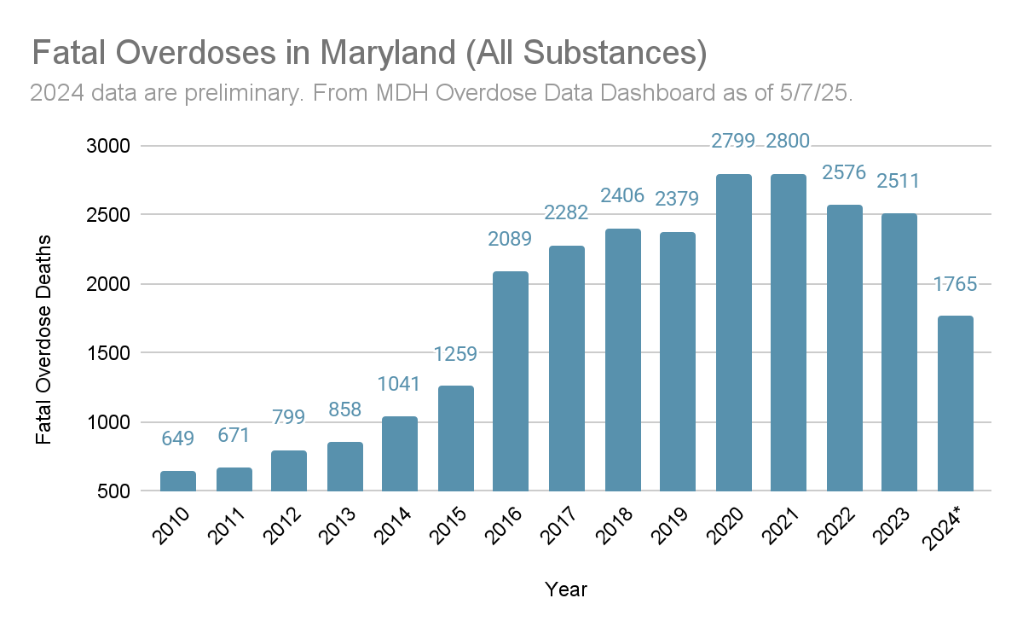
Notes:
Fatal Overdose Deaths in Maryland (All Substances)

Slide 5
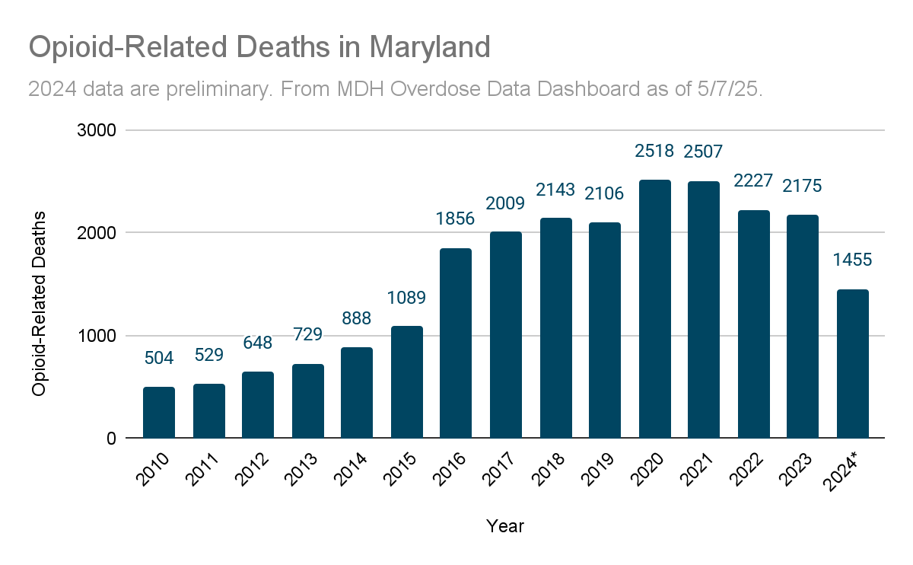
Notes:
Opioid-Related Deaths in Maryland

Slide 6
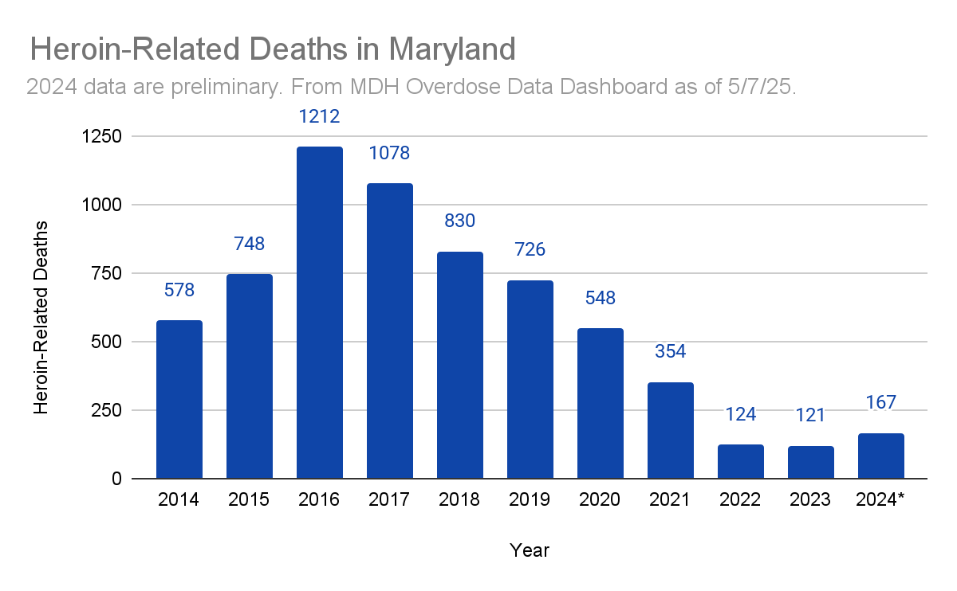
Notes:
Heroin-Related Deaths in Maryland

Slide 7
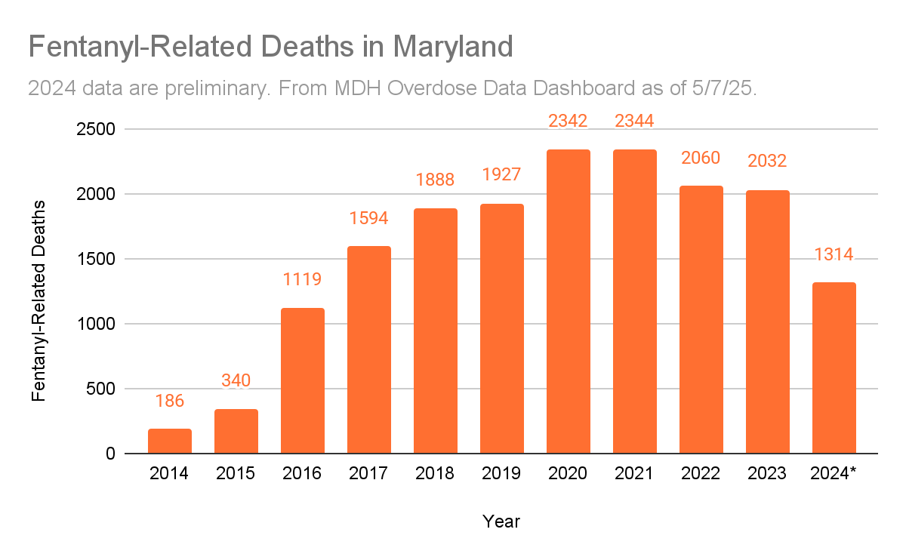
Notes:
Fentanyl-Related Deaths in Maryland

Slide 8
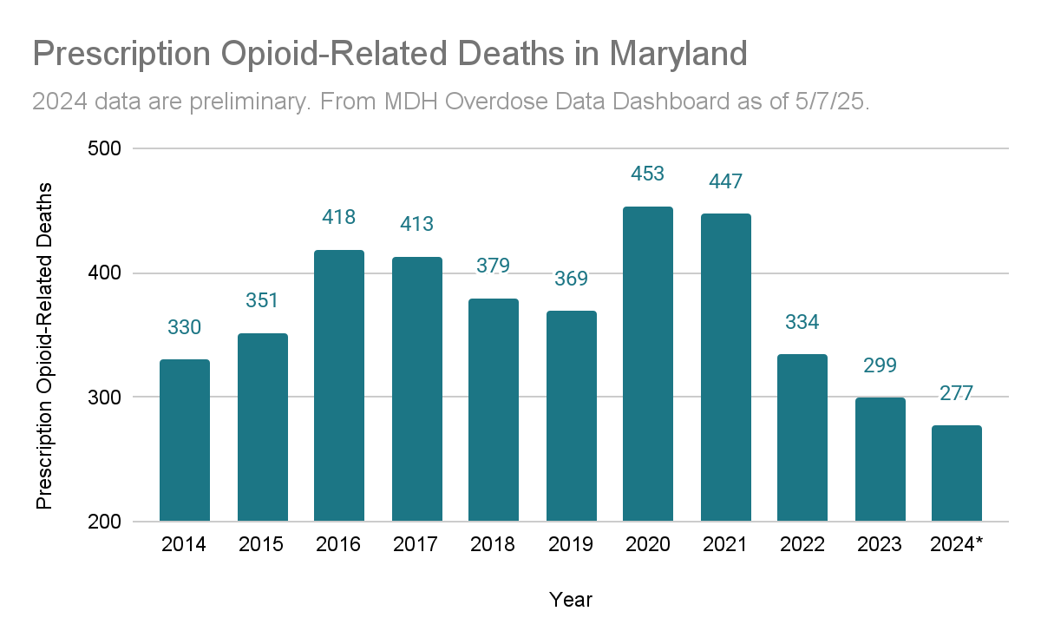
Notes:
Prescription Opioid-Related Deaths in Maryland

Slide 9
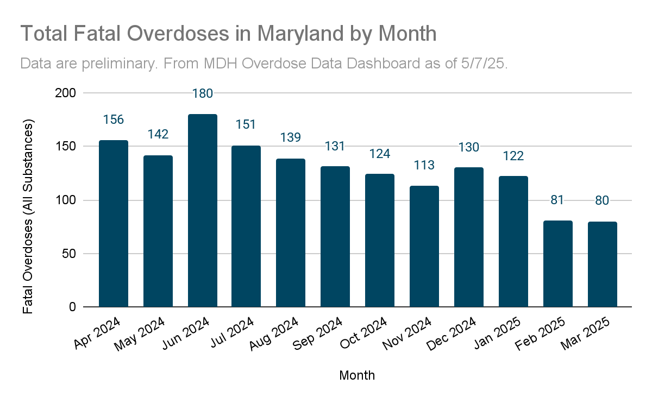
Notes:
Fatal Overdoses (All Substances)

Slide 10
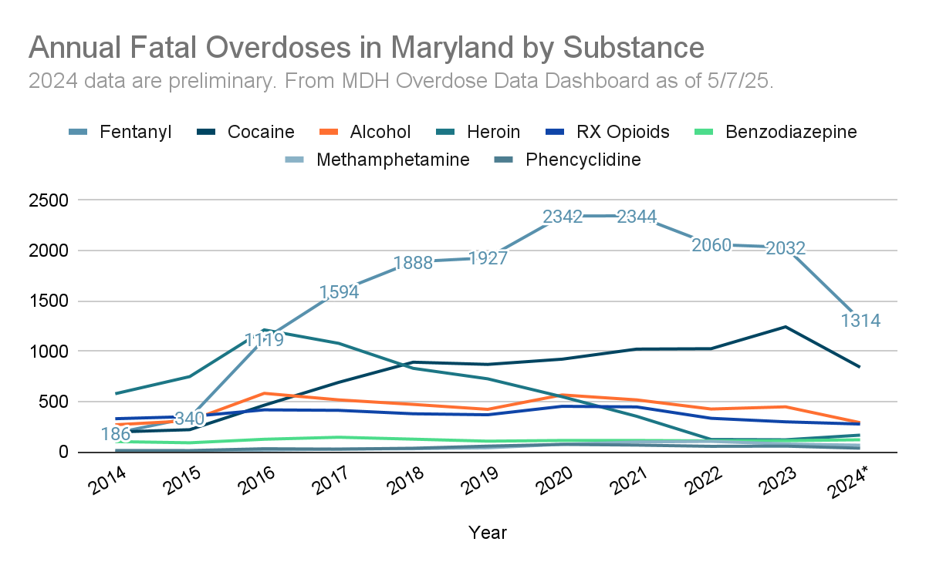
Notes:
Historical Fatal Overdose Trends by Substance (Annual Totals)

Slide 11
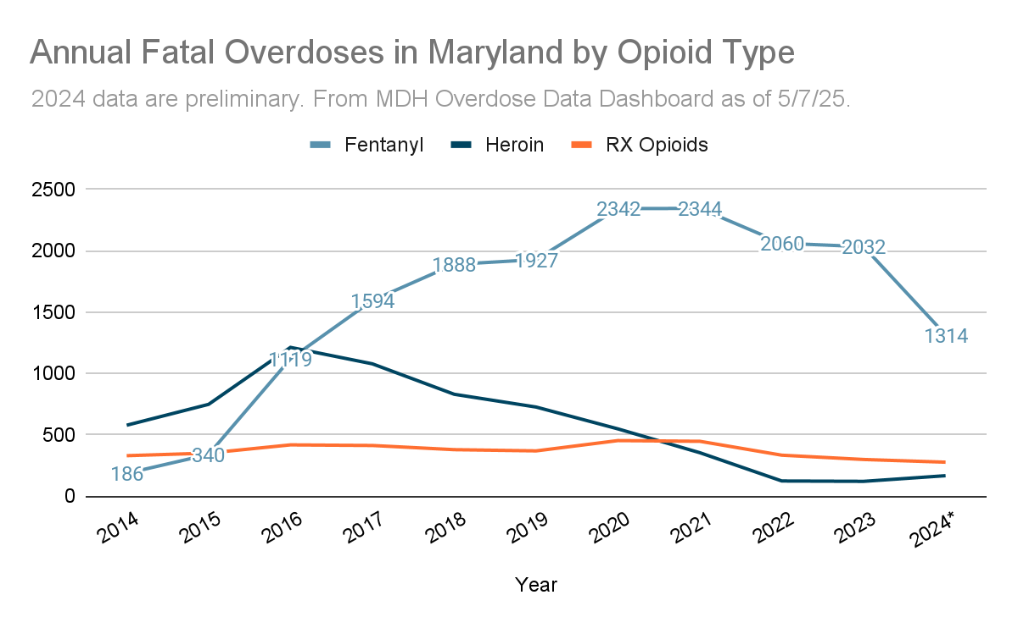
Notes:
Fatal Overdose Trends by Opioid Type

Slide 12
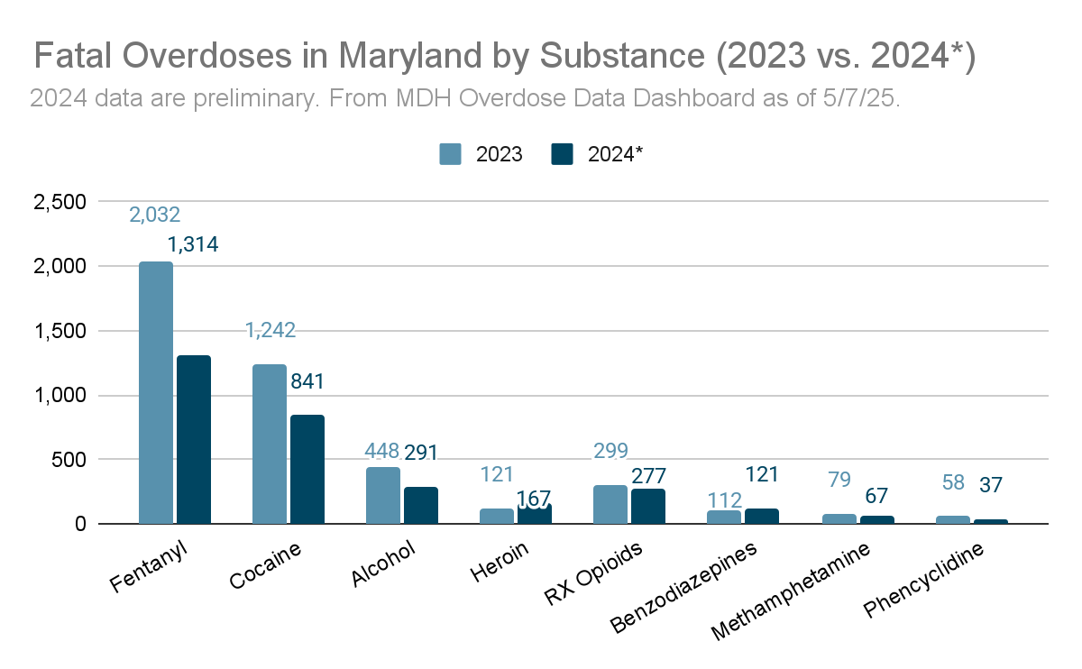
Notes:
Overdose Deaths by Substance (12 Months Ending in…)

Slide 13
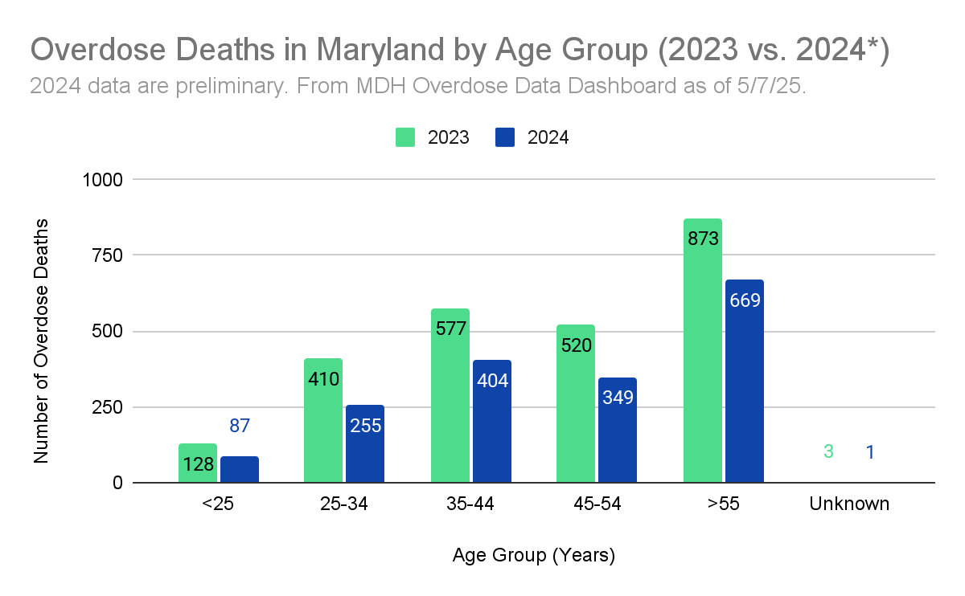
Notes:
Opioid-Related Fatal Overdoses by Age

Slide 14
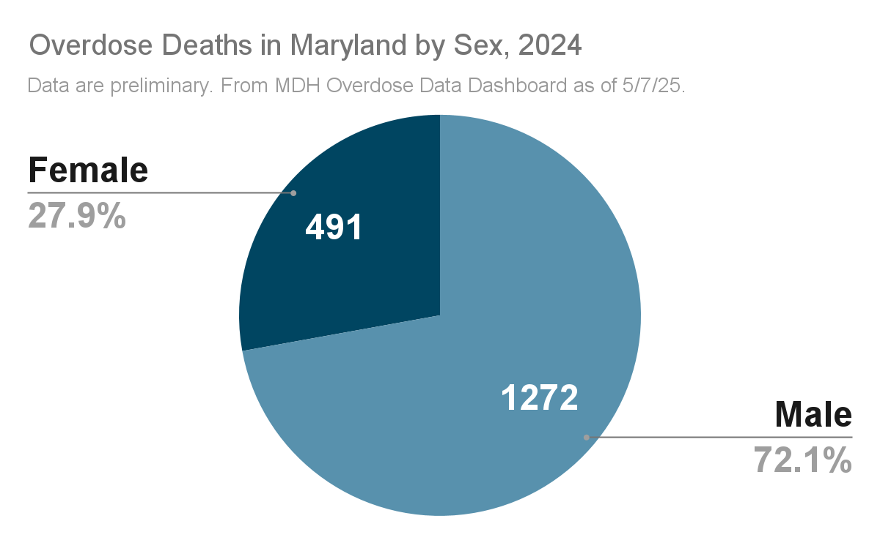
Notes:
Opioid-Related Fatal Overdoses by Gender
Opioid-related deaths involving males vastly outnumbered those involving females, consistent with long-standing trends.

Slide 15
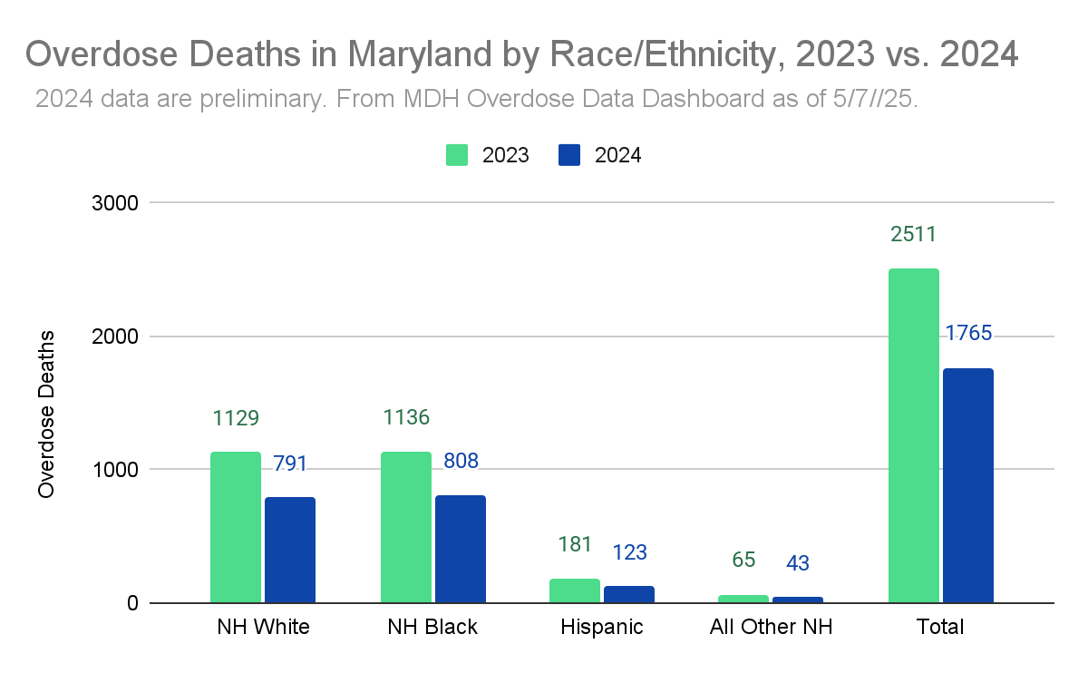
Notes:
Opioid-Related Fatal Overdoses by Race/Ethnicity

Slide 16
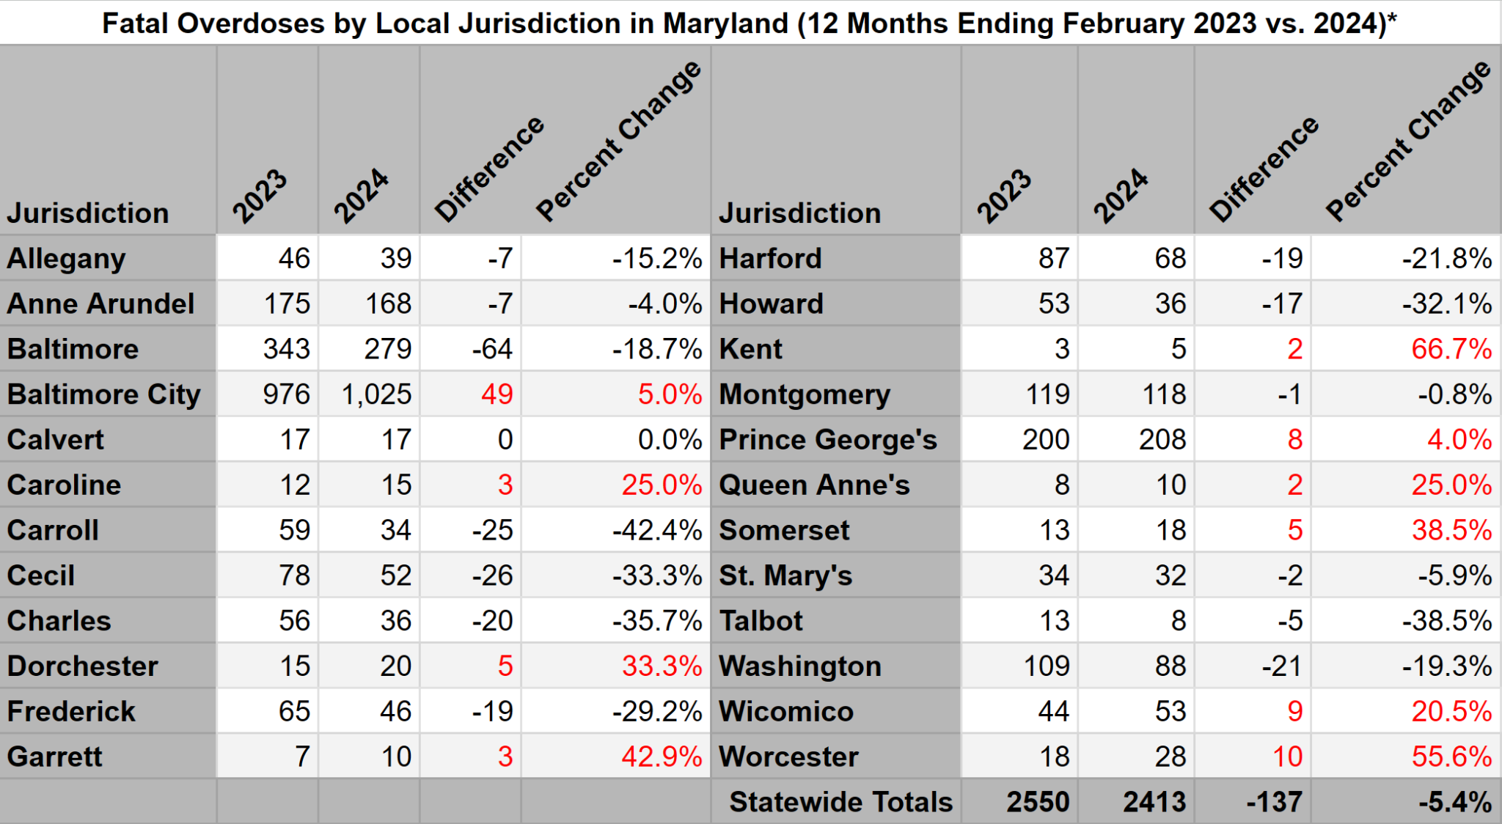
Fatal Overdoses by County
2023 vs. 2024
As of 6/10/24. Data are preliminary. Source: MOOR Data Dashboard

Slide 17
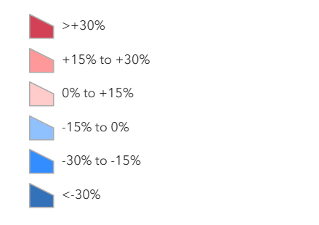
Percent Change in Fatal Overdoses
2023 vs. 2024
As of 6/1/24. Data are preliminary. Source: MOOR Data Dashboard

Slide 18
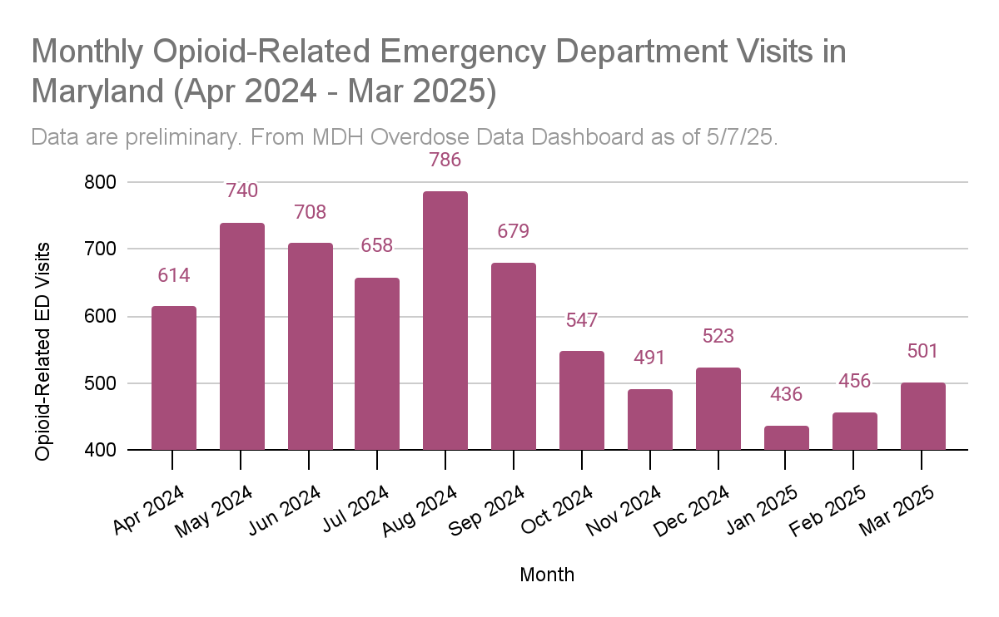

Slide 19
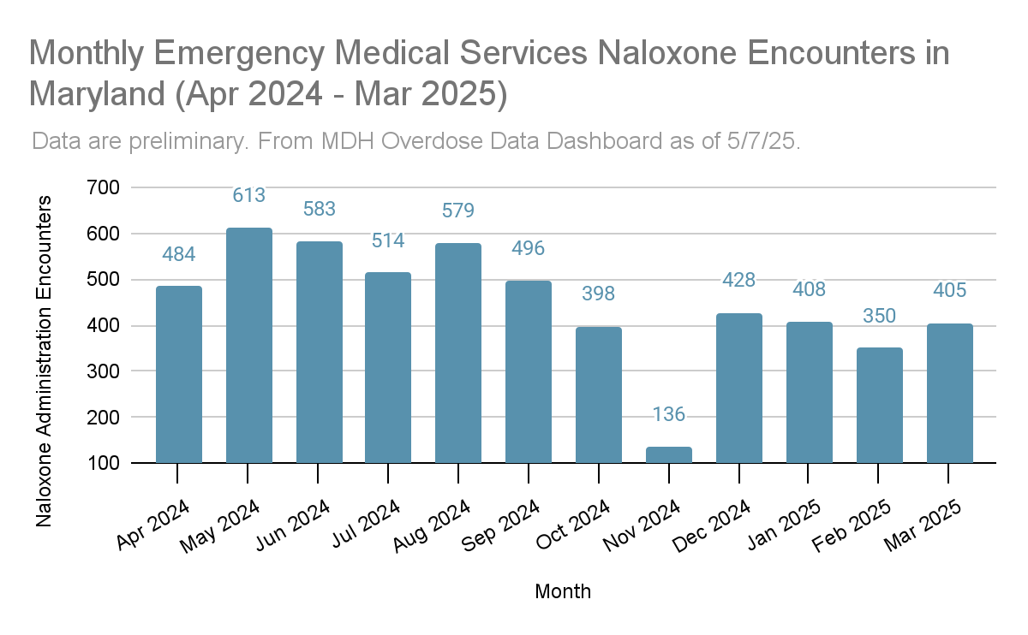

Slide 20
What is an Opioid?

Slide 21
What is an Opioid?
A type of drug used to reduce pain
Examples of opioids include heroin, fentanyl, and morphine
Includes opium-derived and man-made drugs
Effects may include pain relief, euphoria, drowsiness, respiratory depression

Slide 22
Fentanyl
Non-pharmaceutical fentanyl
Illicitly produced, synthetic drug
Pill form packaged to look like prescription medications
Powder form looks like heroin
Fentanyl + heroin can be a deadly combination.
Fentanyl may be hundreds of times more potent than heroin.

Slide 23
Fentanyl
Fentanyl continues to be the primary driver of overdose mortality in Maryland.
Fentanyl was involved in 80.9% of all Maryland fatal overdoses in 2023 versus only 6.8% in 2013.*
Fentanyl may be sold with heroin.
People may or may not realize that there is fentanyl mixed with their heroin or other drugs.
* Data as of 5/1/24. Sources: MOOR Data Dashboard, MDH VSA 2013 Annual Report
Notes:
In calendar year 2023, fentanyl was involved in 2026 out of 2503 fatal overdoses (80.9%).
In calendar year 2013, fentanyl was involved in 58 out of 858 fatal overdoses (6.8%).

Slide 24
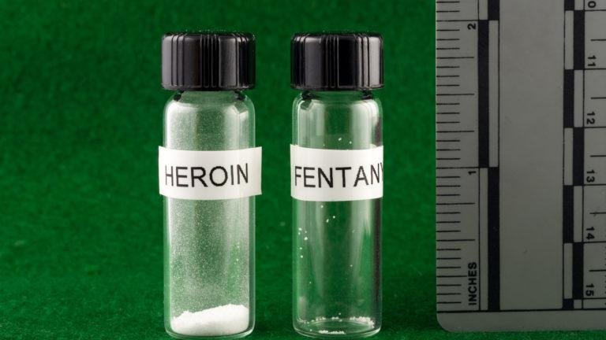
Notes:
Fentanyl may be hundreds of times more potent than heroin.
On the left is a potentially-lethal dose of heroin.
On the right is a potentially-lethal dose of fentanyl.

Slide 25
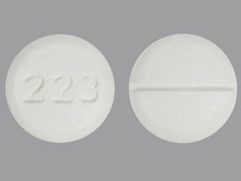
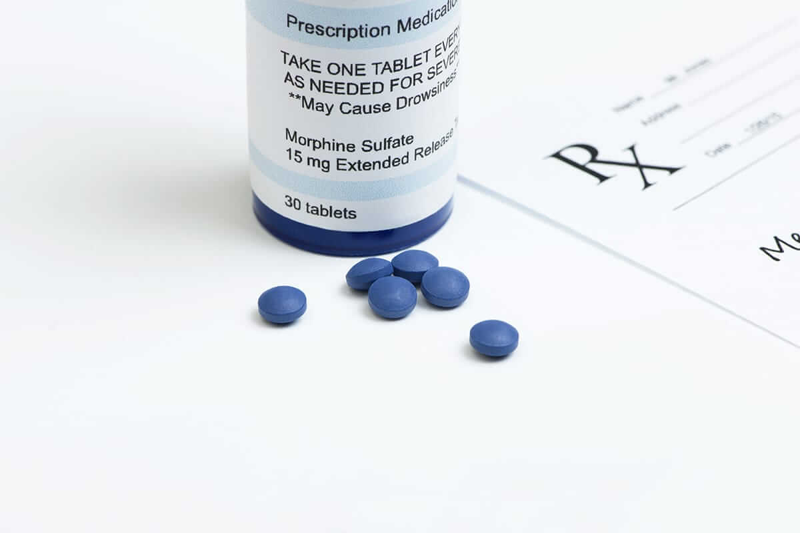
Prescription Opioids
Oxycodone (Oxycontin, Percocet)
Hydrocodone (Vicodin)
Hydromorphone (Dilaudid)
Morphine
Demerol (Meperidene)
Codeine
Buprenorphine
Methadone
Fentanyl
Notes:
Oxycodone: Oxycontin, Percocet, Roxicodone
Oxymorphone: Opana
Hydrocodone: Vicodin, Lorcet, Zohydro, Zortab
Hydromorphone: Dilaudid
Morphine: Arymo ER, Kadian, MorphaBond ER, MS Contin
Meperidine: Demerol
Codeine: Tylenol 3 & 4
Buprenorphine: Suboxone, Subutex, Zubsolv
Methadone: Dolophine, Methadose
Fentanyl: Duragesic

Slide 26
Recognizing an Opioid Overdose

Slide 27
What is an Opioid Overdose?
Opioid overdose happens when a toxic amount of an opioid—alone or mixed with other opioid(s), drugs and/or substances— overwhelms the body’s ability to handle it.
Many opioid-related overdoses result from mixing prescription painkillers or heroin with benzodiazepines (benzos), cocaine and/or alcohol.

Slide 28
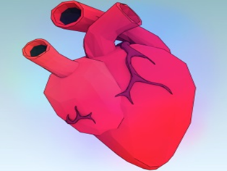
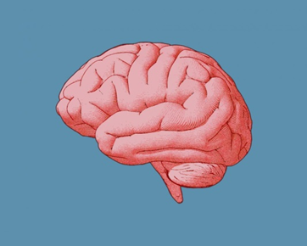
What Leads to Overdose Death?
Respiratory failure
↓
Lack of oxygen in the blood
↓
Vital organs like heart and brain start to fail
↓
Unconsciousness, coma, death

Slide 29
Signs & Symptoms of Opioid Overdose
Slow, shallow, or no breathing
Unresponsive
Unconscious
Loud snoring or gurgling noises
Limp body
Lips/fingertips turn blue or gray
Skin pale/gray, clammy
Pulse slow or erratic

Slide 30
Responding to an Opioid Overdose

Slide 31
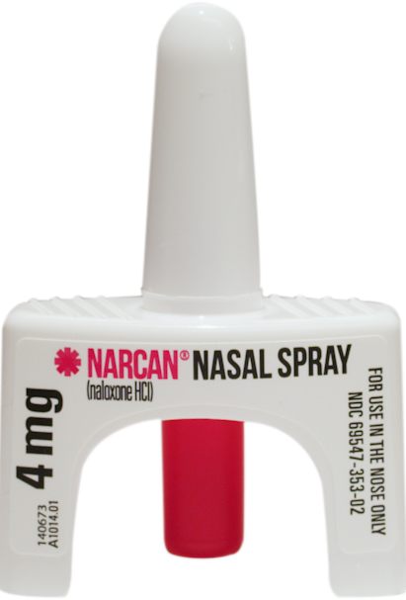
What is Naloxone?
Naloxone is a medicine that reverses opioid overdose by restoring breathing.
Wears off in 30 minutes to 2 hours
Safe for children and pregnant women
Delivery: intramuscular, intranasal or intravenous
Intramuscular: in the muscle
Intranasal: in the nose
Intravenous: in the vein
Image source: Emergent Biosolutions, https://www.emergentbiosolutions.com/narcan-nasal-spray/

Slide 32
What is Naloxone?
No potential for misuse
No effect on someone who hasn’t taken opioids
Side effects are minimal and rare
Naloxone is only effective in reversing overdoses involving opioids
Image source: Emergent Biosolutions, https://www.emergentbiosolutions.com/narcan-nasal-spray/

Slide 33
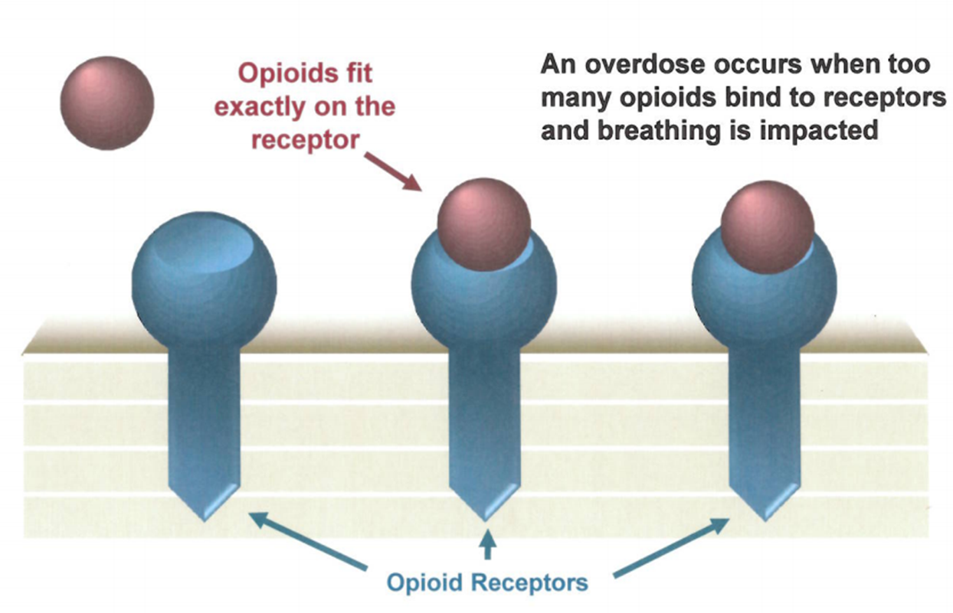
Simulation of an overdose

Slide 34
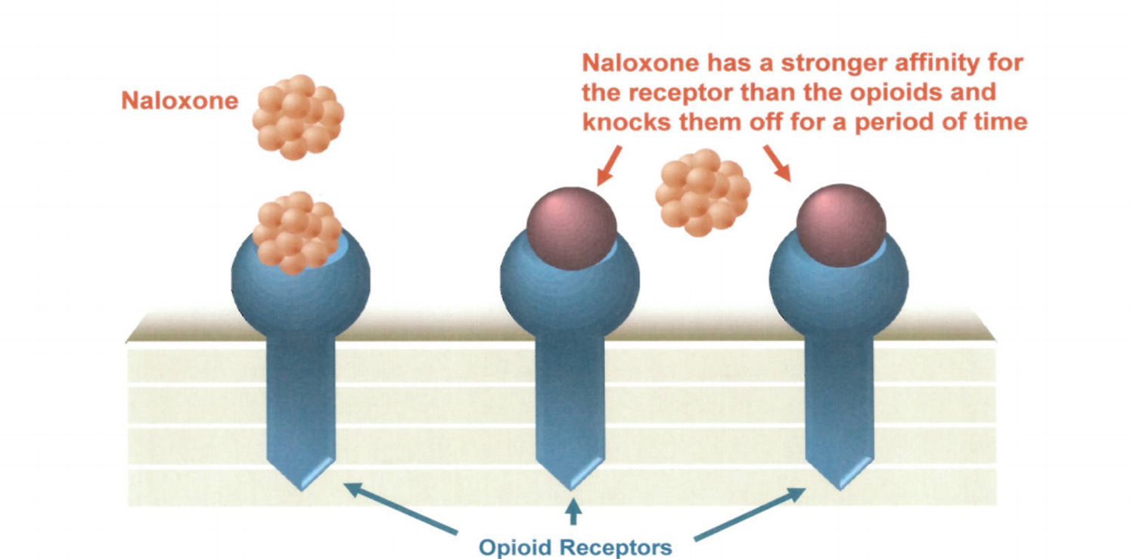
Naloxone Reversing an Opioid Overdose

Slide 35
Respond to an Opioid Overdose
Rouse & stimulate
Call 911
Give naloxone
Rescue breathing
Care for the person

Slide 36
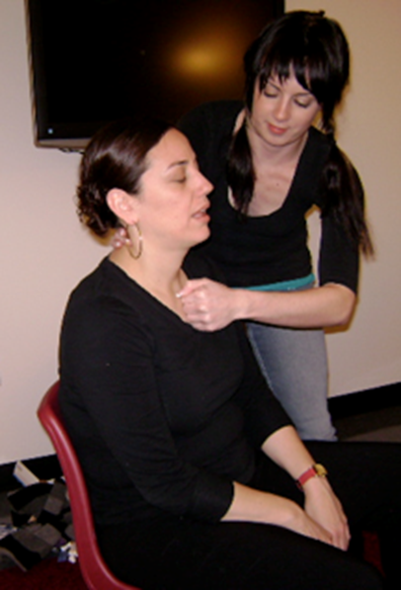
Step 1: Rouse & Stimulate
Noise – Shake person’s shoulders and yell:
“[Name!] Are you alright? Wake up!”
Pain – If no answer, do a sternum rub:
Make a fist & rub your knuckles firmly up and down the breastbone
Photo: N.O.M.A.D (Not One More Anonymous Death)

Slide 37
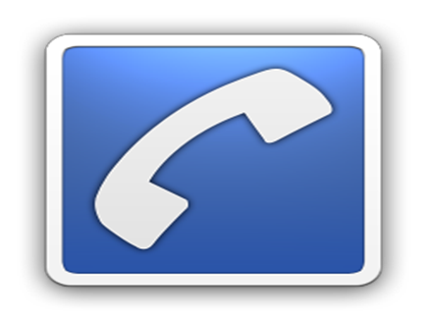
Step 2: Call 911
Why?
Naloxone is only temporary.
Person may:
have complications or other health problems
need more naloxone
May be a non-opioid overdose.
Get emergency medical help for someone experiencing an overdose!

Slide 38
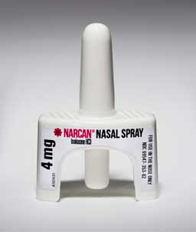
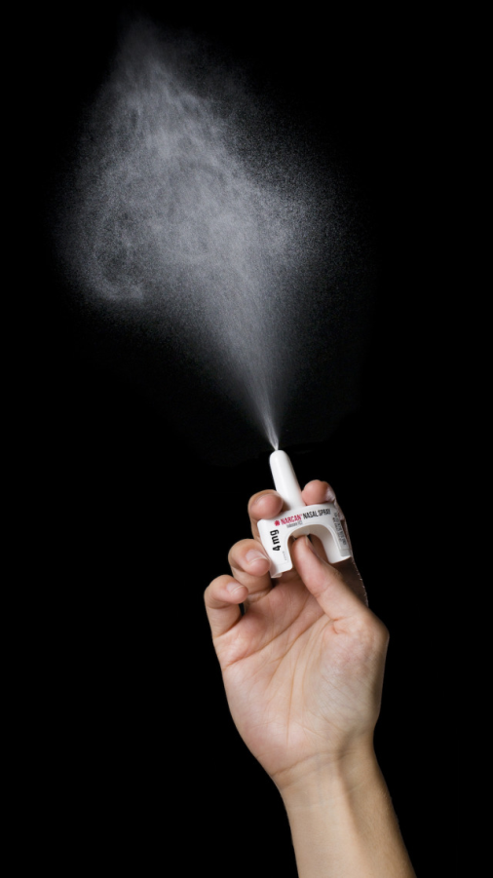
Step 3: Give Naloxone

Slide 39
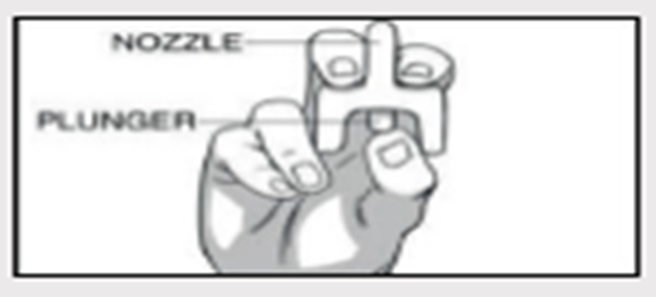
Nasal Spray
Remove naloxone nasal spray from box. Peel back tab with circle to open.
Hold nasal spray with your thumb on the bottom of the plunger and your first & middle fingers on either side of the nozzle.

Slide 40
Nasal Spray
Tilt head back & support person under neck. Gently insert tip of nozzle into nostril, until your fingers on either side of the nozzle are against the bottom of the nose.
Press plunger firmly to administer.

Slide 41
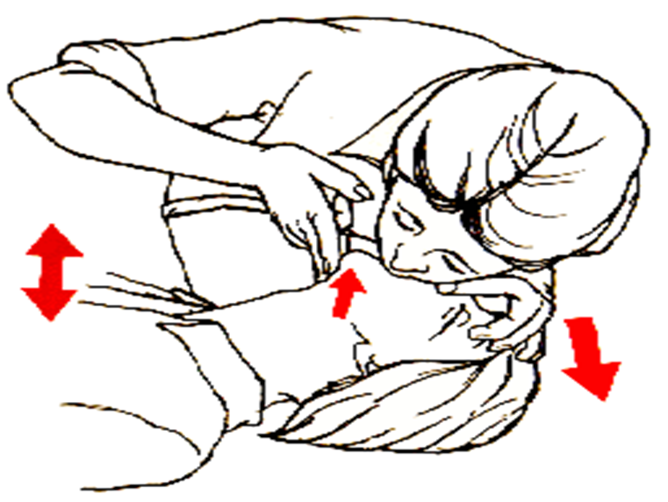
Step 4: Rescue Breathing
Lay the person face-up on a flat surface.
Lift the chin and tilt the head to open the airway.
Check to see if anything is in the mouth, blocking the airway. If so, remove it.

Slide 42
Step 4: Rescue Breathing
Pinch the nose shut.
Make a complete seal over the person’s mouth with your mouth. Blow two regular breaths, then give one breath every five seconds.
If chest does not rise, re-tilt the head and give another rescue breath.

Slide 43
Step 5: Care for the Person
Stay with the person until medical help arrives.
If person cannot sit up, put him/her in recovery position.
Keep person calm.
Encourage person not to take more opioids.
If overdose happens again, give another dose of naloxone.

Slide 44
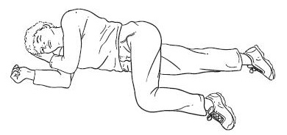
Recovery Position
If you have to leave the person (even briefly) put them into the recovery position.
This keeps the airway clear and prevents choking or aspiration if vomiting occurs.

Slide 45
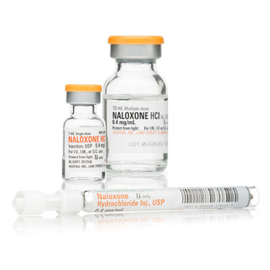
Instructions: Injectable Naloxone
Pop off the flip-top from naloxone vial.
Insert needle into vial & draw up 1 cc of naloxone into syringe.
Use alcohol wipe to clean injection site: shoulder, thigh, or buttocks.

Slide 46
Instructions: Injectable Naloxone
Inject needle straight into muscle (through clothes, if necessary), then push in plunger.
Do not inject naloxone into the person’s heart, chest, or back.

Slide 47
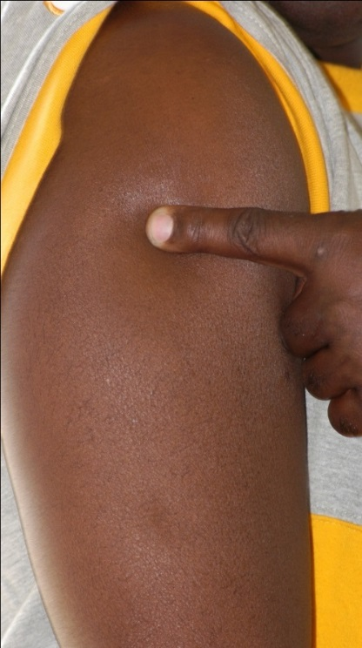
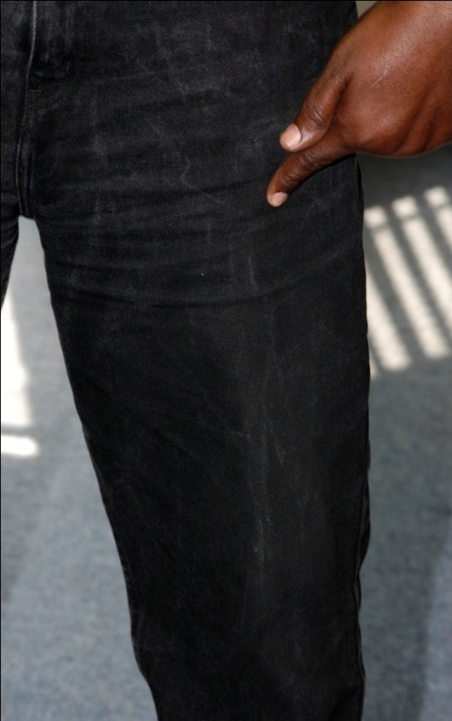
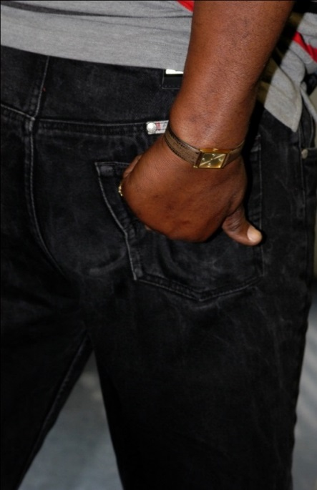
Instructions: Injectable Naloxone
Where to inject naloxone:
Shoulder
Thigh
(upper, outer)
Buttocks

Slide 48
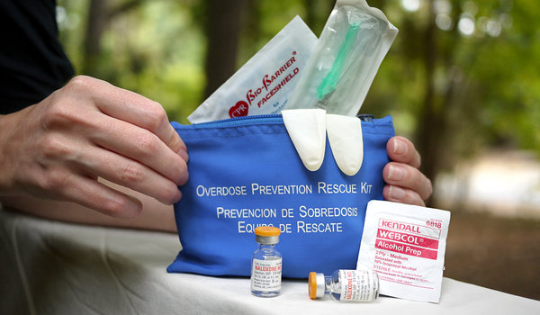
IM Naloxone Kits
Vial(s) of naloxone
Syringes (one syringe per 1ml injection)
Any option is okay as long as the point is 1 inch long to reach the muscle.
Intramuscular syringes are larger gauges than insulin syringes.
Alcohol pads
Rescue breathing masks
Gloves
Educational inserts (i.e., informational flyers)
Notes:
Note: What goes in your kits should be determined by the ORP staff and the prescriber; it should also be specified in your standing order and/or dispensing protocols.

Slide 49
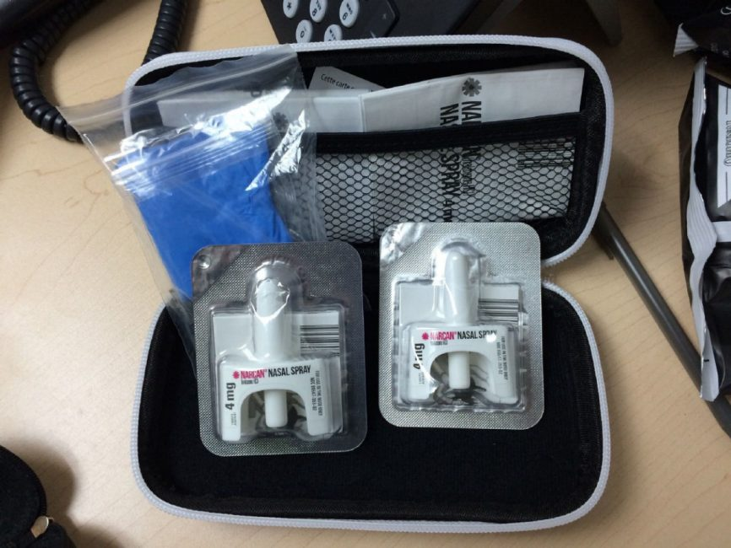
Nasal Naloxone Kits
2 doses of nasal naloxone
Rescue breathing mask
Educational inserts (i.e., informational flyers)
Gloves
Notes:
Note: What goes in your kits should be determined by the ORP staff and the prescriber; it should also be specified in your standing order and/or dispensing protocols.

Slide 50
If You Administer Naloxone…
Let us know! Tell the Maryland Department of Health Center for Harm Reduction Services using the Naloxone Use Report (bit.ly/naloxoneusereport)
Anyone can use this link
Or call the Poison Center: 1-800-222-1222

Slide 51
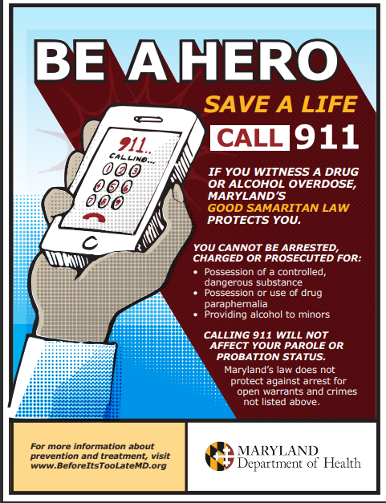
Good Samaritan Law in Maryland

Slide 52
Good Samaritan Law in Maryland
Who does it protect?
This law protects these individuals from arrest and prosecution for certain crimes:
Individuals assisting in an emergency overdose situation
Individuals who are experiencing an overdose
The law does not protect people witnessing the medical emergency if they’re not helping.
Good Samaritan Law Fact Sheet | Good Samaritan Law Poster

Slide 53
Good Samaritan Law in Maryland
What does it protect you from?
Protects from criminal arrest, charge or prosecution for the following misdemeanors
§5-601: Possessing or Administering controlled dangerous substance
§5-619: Drug Paraphernalia
§5-620: Controlled Paraphernalia
§10-114: Underage Possession of Alcohol
§10-116: Obtaining Alcohol for Underage Consumption
§10-117: Furnishing for or allowing underage consumption of alcohol
Protects from violation of a condition of pretrial release, probation, or parole
These protections only apply if the evidence was obtained solely because of the act of seeking medical assistance.

Slide 54
Good Samaritan Law in Maryland
What does it NOT protect you from?
Open warrants
Immigration status
University regulations
Drug felonies
Other crimes not specifically listed
It does not prevent law enforcement from conducting an investigation and gathering evidence.
The law does not protect persons witnessing the medical emergency if they’re not helping with the medical emergency.

Slide 55
Resources and Information

Slide 56
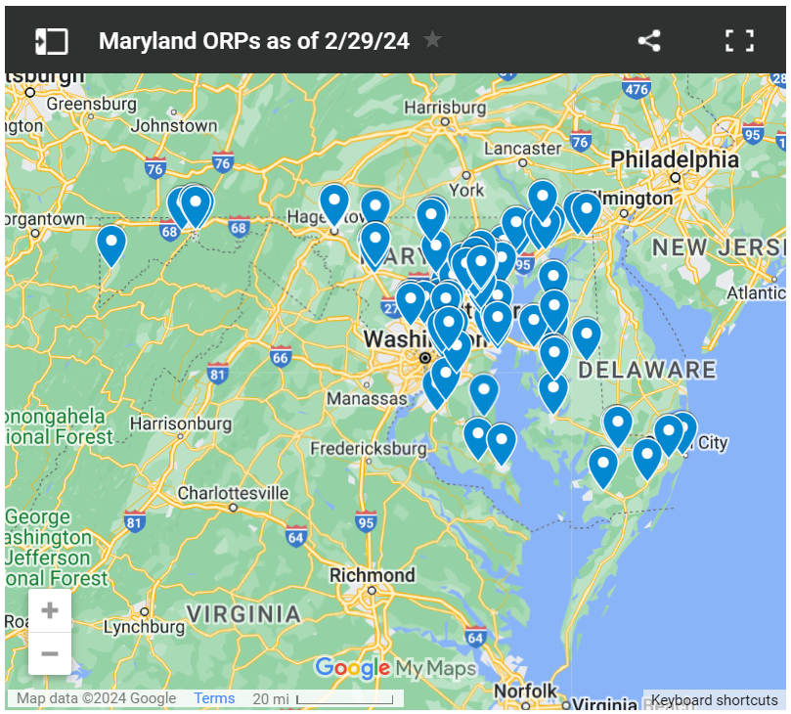
Get Free Naloxone and Test Strips
View Map of Overdose Response Programs (ORPs)
View List of ORPs
Contact mdh.naloxone@maryland.gov

Slide 57
Get Naloxone from a Pharmacy
You can request naloxone at participating pharmacies throughout Maryland under the statewide standing order.
The pharmacy can bill your insurance, even when using the statewide standing order.
You do not need a prescription; you do not need to prove you were trained.
If you have difficulty accessing naloxone at a pharmacy, let MDH know by contacting mdh.naloxone@maryland.gov.

Slide 58
Naloxone Saves Lives
Thank you!

