Slide 1


ePREP For Waiver/Resource Providers
Brenda Logan (AHS)
Charles Choh (AHS)
Notes:
Hello and thank you for logging into this webinar. I’ll be walking you through ePREP basics information and explaining the initial steps for setting up your User Profile and Business Profile and how to navigate through the ePREP Portal. For those of you who are familiar with the portal, I’ll be sure to point out some changes. Okay…lets get started

Slide 2
Welcome to ePREP!
ePREP stands for electronic Provider Revalidation and Enrollment Portal.
Here are some of the Benefits of using ePREP:
Applications can be filled out electronically instead of by paper
Easier/Quicker to fill out
Only the necessary fields for the type of application are generated
Shorter processing times
Access to your Maryland Medicaid information (now called an Account in ePREP)
You can see the status of your account (Active, Suspended or Inactive)
You can see your affiliations
You can see all of your demographic information
Notes:
Some of you may already be familiar with ePREP but for some of you this may be new information and a new process.
ePREP stands for electronic Provider Revalidation and Enrollment Portal. All applications will now be completed electronically including changes and updates. Only those fields required for the specific change you’re making will be generated. This will make the process faster than making changes through the previous paper application process. It will also make the processing time shorter. And in ePREP , you can access and verify your Maryland Medicaid account information, and see if your account is active , suspended or inactive . You can also see all your affiliations and view all your demographics

Slide 3
Helpful Resources
There are resources you can use to learn all about ePREP and how to use it. Maryland Medicaid has created a website with documents, checklists and webinars that will help you with ePREP.
health.maryland.gov/eprep
Notes:
Maryland Medicaid has provided some great resources on the ePREP website. This link is the path to get to the ePREP website and when you do, you’ll find various documents, checklists and webinars to help you with your ePREP enrollment. There is also on the website a link to “Getting Started” which is a walk thru document you can follow to set up the User Profile and Business Profile. There are also checklists that help you know what documents you’ll need to upload on your computer prior to starting your application so you can upload them easily into the ePREP portal when you are completing your application. There are many other great resources so please look at them before you start your application

Slide 4



Helpful Resources Cont.
Resources within ePREP
Lucy – Your enrollment buddy and guide appears on most pages to give you helpful information.
Lucy Hover Help – When you click on or hover over an action item (textbox, drop down, Radio button), Lucy will pop up again with more information on what and how to enter information
In Context Tutorials – If you see a filmstrip icon you can click on it to view a short 3 to 5 minute video explaining what needs to be done .
Notes:
Lucy will appear on may pages and pop up when you hover over some textboxes, drop downs and radio buttons. Make sure you read what she has in her conversation bubble. In can save you time and keep you from making a mistake. There are also these In Context Tutorials…they are short 3 to 5 minute videos to help you through the ePREP process. Just click on the filmstrip and then you’ll see the video to open . I really recommend these. They will often explain where you are in the application or what you are supposed to be doing in a particular section

Slide 5
ePREP Terminology – Profiles, Roles, and Accounts
User Profile: Your individual username, used to log in to ePREP.
Business Profile: A centralized environment that houses your enrolled Medicaid entity accounts and applications. A user may have access to one or more business profiles.
Account: ePREP record for an enrolled provider, associated with a single NPI, provider type, practice location, and entity Medicaid (MA) number.
Linking: Connecting your Business Profile to an existing account so that you can view and manage it.
Notes:
Just like everything else in business, ePREP has some of it’s own special terminology. Let’s look at some of it.
User Profile – this is your own individual username that you, and only you, will use to log into ePREP.
The Business Profile – this is the location where all your enrolled Medicaid accounts and applications will be housed. A user may have access to more than one Business Profile.
The “Account” in ePREP is ePREPs record for an enrolled provider, it is associated with one NPI #, one provider type, and practice location and one Medicaid or MA #
The term “Linking” often gets confused with affiliation…don’t get it confused…what linking in ePREP is referring to is connecting your Business Profile to that information held by Maryland Medicaid so you can view and manage it.

Slide 6
Linking providers to groups
It is very important to note that when setting up accounts, you should NEVER link a rendering provider’s NPI to the same Business profile as the group or facility.
Each rendering provider should have a separate email address, User Profile, and Business Profile.
Notes:
It is very important to note that when setting up accounts, you should NEVER link a rendering provider’s NPI to the same Business profile as the group or facility.
Each rendering provider should always have a separate email address, a User Profile, and a Business Profile.

Slide 7
ePREP Application Types
Application Types
New Application: Application to enroll new facility to Maryland Medicaid.
Supplemental: A change in a provider’s account information or required documenting, such as correspondence address or an updated professional license.
Change of Ownership (CHOW): Application to add a new Tax Identification Number (TIN) or Employment Identification Number (EIN) to Business Information form.
Notes:
New Facility: Application to enroll an new facility into eprep for Maryland Medicaid that is not currently enrolled with MD Medicaid
Supplemental – this one is used to change the providers account information such as updating a license or a mailing address
Change of Ownership (CHOW): Application to add a new Tax Identification Number (TIN) or Employment Identification Number (EIN) to Business Information form.

Slide 8
ePREP Application Types Cont.
Revalidation
Application to renew your Medicaid enrollment every 5 years
Scheduled automatically in ePREP when they are due. You may only submit a reval when you receive a notification that it is time to do so.
You will receive a printed reval notification in the mail for your initial notification. After your ePREP account is set up, you will receive electronic reval notifications.
Notes:
And ..the “Revalidation Application” –
This is the application used to renew your Maryland Medicaid enrollment every 5 years
It is scheduled automatically through ePREP when it is due
You can only submit a revalidation application after you have been notified that it is due
You can only submit a revalidation application after you have been notified that it is due
Prior to setting up your User Profile and Business Profile , the revalidation notification will be sent by the mail
After you have set up your User Profile and Business Profile , the notifications will come electronically

Slide 9
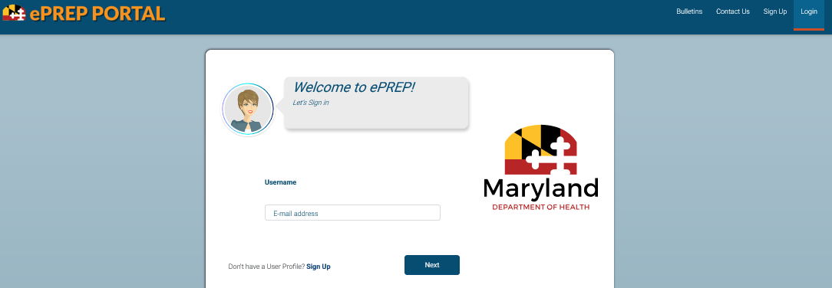

Signing Up
Notes:
The Sign Up option is for new and first time users of ePREP who have not had a User Profile established previously. Already existing user can enter the email you used for your User Profile and click next to proceed.

Slide 10
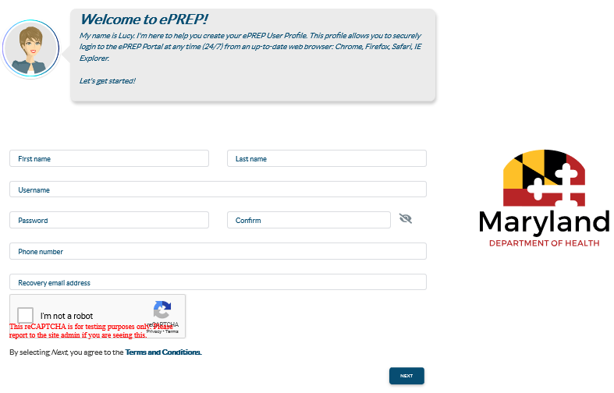

Sign Up (User Profile)
Notes:
This screen will pop up for the new users. Once you fill out all the password information, you can unmask the information to verify that what you have entered is correct. You can do that by clicking on the oval next to confirm box.. and remember to check that you are not a robot, then hit “next”

Slide 11
Verification Code
Once you enter your User Profile information and select the method of verification, ePREP sends a six digit verification via email, text, or a phone call if selected to ensure a secure and safe login.
If you select the email verification method, please check your inbox for an email from ePREP-MDH@dharbor.com with a subject of ePREP Verification Code
You may have to check your Spam, Junk, Trash or Clutter folder to find the six digit verification code.
Notes:
Once you enter your User Profile information you will be given the choice of three options to use for verification, select the method of verification you want and ePREP will send a six digit verification by email, text, or a phone call
If you selected email, you will want to look for an email that comes from ePREP-MDH@dharbor.com . The subject line will say ”ePREP Verification Code”. If you don’t see it in your inbox, look in your Spam, Junk, Trash or Clutter folder

Slide 12
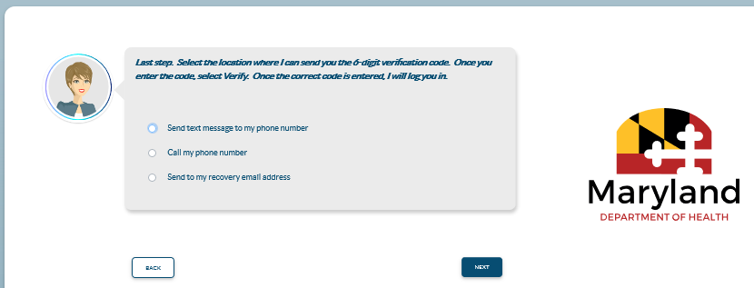

Sign up verification
From the verification options provided, the top two options will require a phone number, which will be used to send out a text message or phone call with the area code: 1(850).
Notes:
This is where you choose the option for ePREP to send you the six digit code. By phone, you have these two options at the top, you can have them send you the verification 6 digit code by text or by receiving a phone call with the verification code. The area code where the call will be coming from is the 850 Florida area.

Slide 13
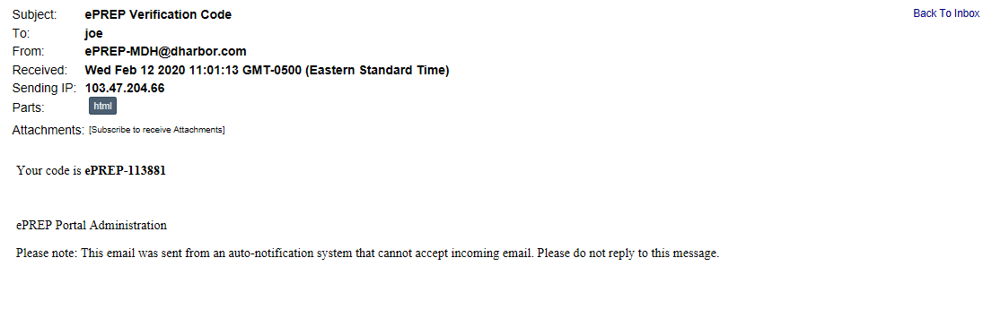
Email Verification
Notes:
This is what the email verification code email will look like

Slide 14
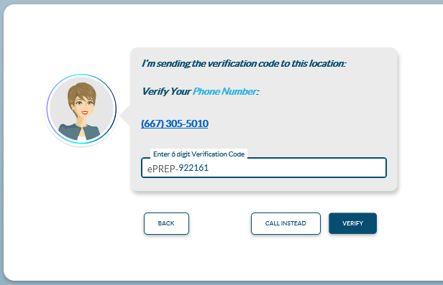

Verification Code
Once the six digits verification code is received and entered, Clicking on “VERIFY” completes the sign up process.
Notes:
Once you receive your six digit code, you’ll enter it in ePREP and click “Verify”

Slide 15
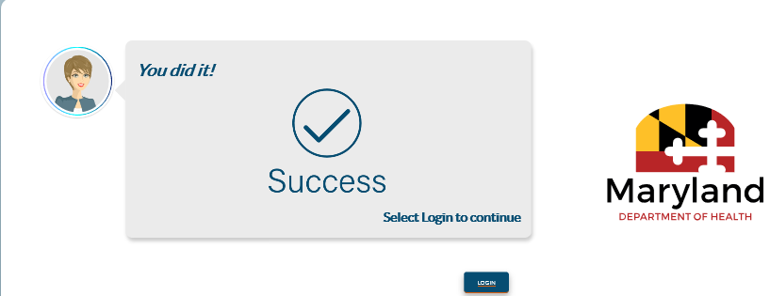
Sign Up Complete
Notes:
Once you successfully verify, you will see this screen message and then you can proceed by clicking on “Login

Slide 16
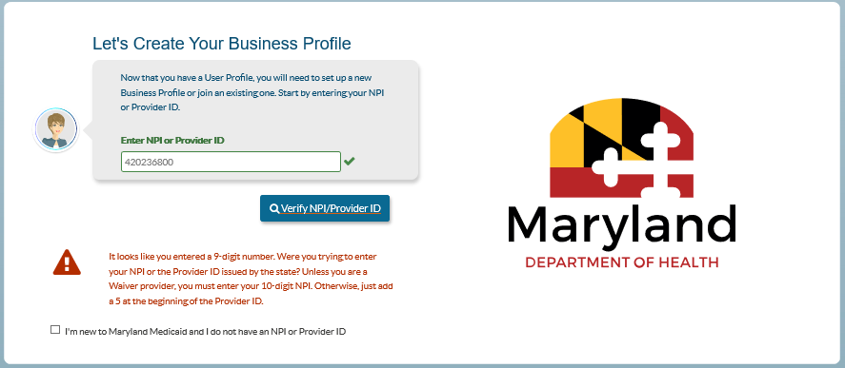
Verify NPI to Link Account to Business Profile (BP)
Enter NPI
Notes:
If you already have an NPI you would enter it here. If you don’t have an NPI but only have you 6-digit Maryland Medicaid number you can enter that here with a number 5 in front. If you enter the MA number without the 5 in front you will get this message that tells you what to do. Once you enter either number click verify

Slide 17
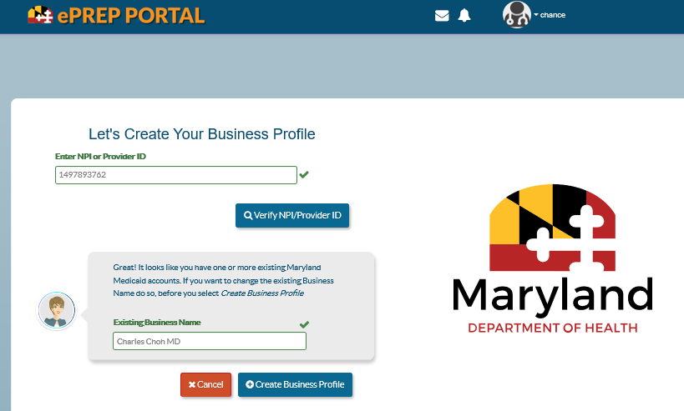
Creating Business Profile (NPI verification)
As first time users on ePREP, once the sign up process is complete, and you successfully login to the accounts, verifying the NPI numbers and existing business names is required to proceed with creating the business profile.
Notes:
When the sign up process is complete, and you successfully login to the accounts, verifying the NPI numbers and existing business names is required to proceed with creating the business profile. So here you’ll enter your NPI click Verify and enter the Business Name down below and click Create Business Profile

Slide 18
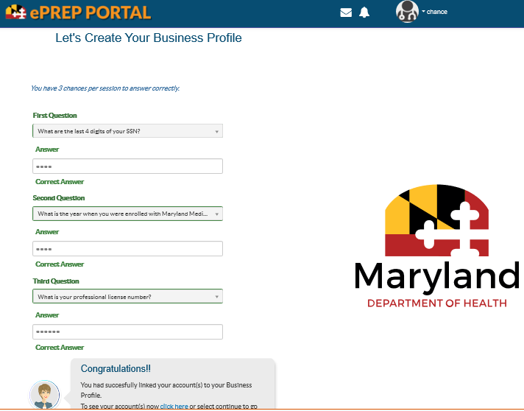
Verifying Existing Business Profile
Notes:
To verify an existing business profile, You’ll be asked to answer 3 business questions that apply to the individual or business directly? If you have problems answering the questions, feel free to reach out to the call center for assistance. 1-844-4MD-PROV (1-844-463-7768)​​
Once you answer the questions successfully , you’ll see Lucy pop up again !! and say CONGRATULATIONS … you have successfully created the Business Profile……Click continue and it will bring you to the home page in ePREP

Slide 19
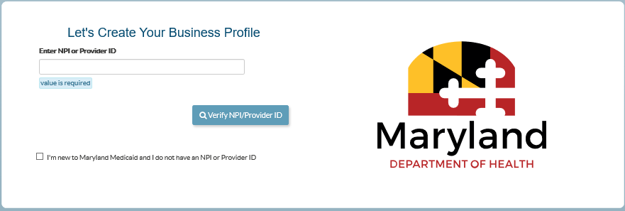
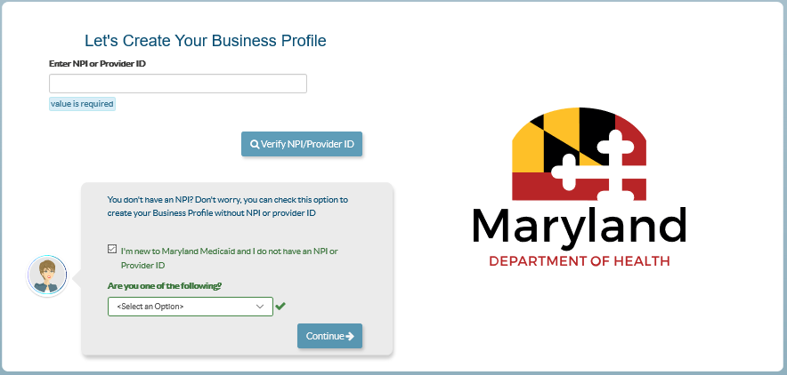
Providers without NPI/MA Numbers.
Atypical providers without NPI/MA numbers, are required to check the box, as shown above which says “I’m new to Maryland Medicaid and I do not have an NPI or Provider ID” in order to select the category they fall under, and proceed with accessing the business profile.
Notes:
Atypical providers without NPI/MA numbers, are required to check the box, as shown above which says “I’m new to Maryland Medicaid and I do not have an NPI or Provider ID” in order to select the category they fall under, and proceed with accessing the business profile

Slide 20
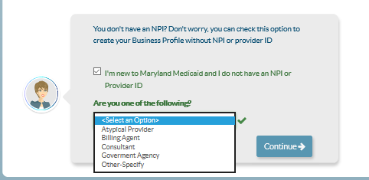
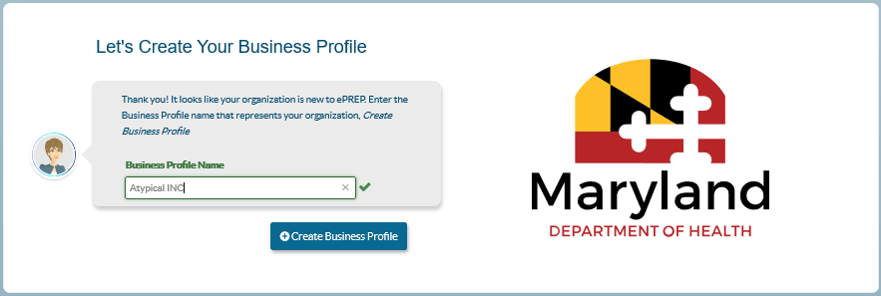
Providers without NPI Numbers Cont.
Once the option that applies is selected, as seen on the first image, the next step is typing in the business profile name that applies to the practice, as shown below. The “Create Business Profile” option can be clicked on to access the business profile.
Notes:
Once the option that applies is selected, as seen on the first image, the next step is typing in the business profile name that applies to the practice, as shown below. The “Create Business Profile” option can be clicked on to access the business profile.

Slide 21
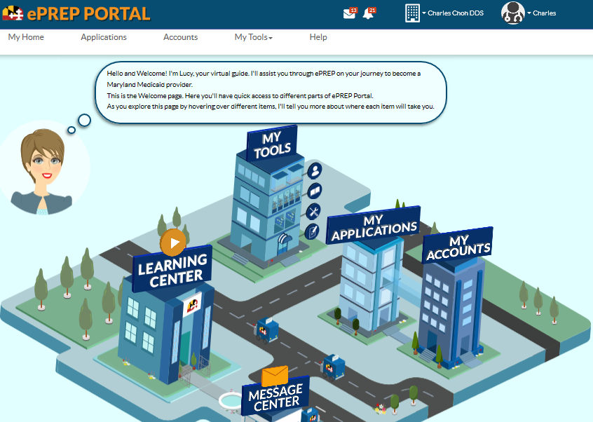
Home Page
This is your Business Profile
This is your User Profile
Notes:
This is the home screen and where you can locate your applications, accounts and my tools sections in ePREP. Your User Profile displays at the top right and should always show your name. The Business Profile displays to the left of that. If you are working with more than one Business Profile you can click the little drop down triangle next to the building or calculator whatever you chose to call that icon,,,and it will display all the Business Profiles in alphabetical order.

Slide 22
Waiver Providers
Notes:
Let’s look at some features specific to Waiver Providers

Slide 23
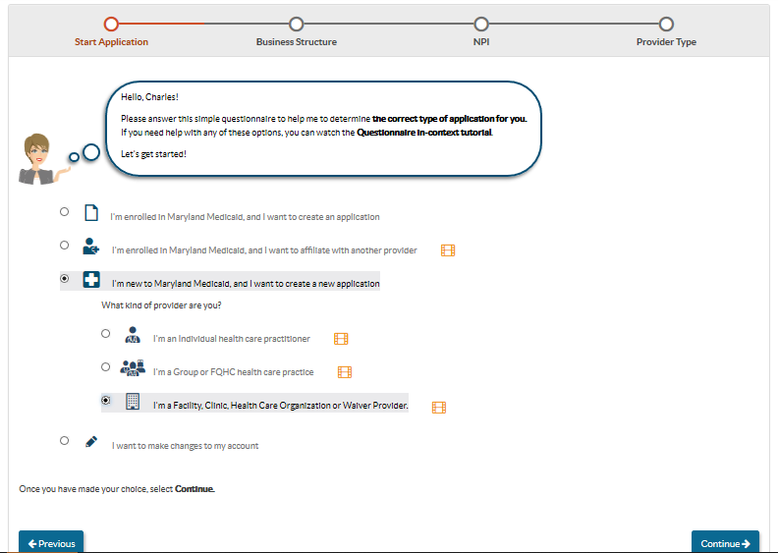
New Application Option
Notes:
To start your application. You’ll chose the third option, I am new to Maryland Medicaid and I want to create a new application. And then you’ll get the drop down with the next three options. Again choose the third option “I am a facility, Clinic , Health Care Organization or Waiver Provider

Slide 24
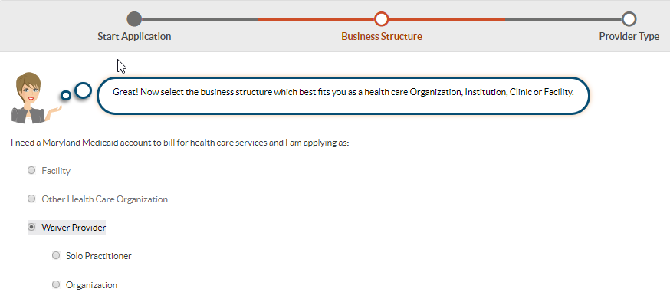
Applications For New Waiver Provider
Waiver providers must select the correct application and provider type to ensure that Medicaid can reimburse for their services.
Notes:
It will then ask you to specify which of those you are and of course you will select, Waiver Provider

Slide 25
Provider Addendum
Almost all provider types will need an Addendum.
If providers cannot find their Provider Type specific Addendum, or are not sure if they need to complete one, ePREP directs them to the State’s website.
health.maryland.gov/providerinfo
The provider will need to navigate to the Enrollment page. This is where the provider can then find their Provider Type (PT) and click on the “X” to retrieve that PT’s Addendum.
Notes:
Almost all provider types will need to complete and attach an addendum. If you can’t find your Provider-Type-specific addendum or if your not even sure if you need to complete one, you can go the Maryland Medicaid ePrep site. ePREP will actually direct you there while you’re doing the application. I’ll show you how to navigate that a little further in the presentation

Slide 26
Waiver/Resource Providers
Facilities that CAN create New Applications
  Autism Waiver = 40
  EPSDT Therapeutic Behavioral Services (TBS) = 51
  Community Options =76
  Brain Injury Waiver = 86 is excluded from enrolling as a Solo Practitioner *
  Developmental Disabilities Association (DDA) Service Providers = 90
Notes:
These are the facility types that can create new applications
Autism Waiver = 40
EPSDT Therapeutic Behavioral Services (TBS) = 51
Community Options =76
Brain Injury Waiver = 86 is excluded from enrolling as a Solo Practitioner *
Developmental Disabilities Association (DDA) Service Providers = 90

Slide 27
Waiver/Resource Providers
Facilities that can NOT create New Applications
Medical Day Care – Children = 43
Local Health Department/ Nurse Monitors = 47
HMO/PACE = 70
HealthChoice Managed Care Organizations = 72 (MCO Insurers)
Case Management - Model Waiver = 81
Notes:
These facilities cannot create new applications;
Medical Day Care – Children = 43
Local Health Department/ Nurse Monitors = 47
HMO/PACE = 70
HealthChoice Managed Care Organizations = 72 (MCO Insurers)
Case Management - Model Waiver = 81

Slide 28
Resource Providers
DMS/DME, Pharmacy, Medical Transportation and Home Health Agency
Notes:
Now let’s look at some features specific to Resource Providers

Slide 29
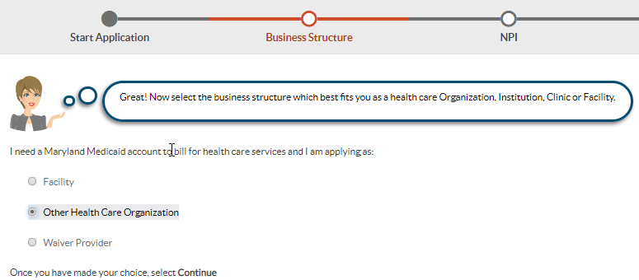
Resource or Other Health Care Organization (OHCO)
Providers must select the correct application and provider type to ensure that Medicaid can reimburse for their services
Notes:
On this page instead of selecting Waiver Provider, you will select Other Health Care Organization

Slide 30
Provider Addendum
Many of the Resource provider types must attach an Addendum to their application.
Each Addendum is available on the Maryland Medicaid website. ePREP will direct providers to the link below to find the correct Addendum for each provider type.
health.maryland.gov/providerinfo
The provider will need to navigate to the Enrollment page. This is where the provider can then find their Provider Type (PT) and click on the “X” to retrieve that PT’s Addendum.
Notes:
Many of the resource provider types will need to complete and attach an addendum. You can click on this link in the slide or when you are in the application there is another way. And I’ll show you that in just a .minute

Slide 31
Waiver/Resource Providers
Facilities/Clinics Who Can Create New Applications
  Laboratory = PT 10
  Home Health Agency = PT 41
  Portable X-Ray = PT 59
  Diagnostic Services, Other = PT 60
  Dialysis Facilities = PT 61
  Durable Medical Supplies (DMS)/Durable Medical Equipment (DME) Provider = PT 62
  Mental Health Case Management Provider = PT CM
  Pharmacy = PT RX
  Ambulance Company = PT T1
  HIV Case Management = PT VC
Notes:
Here is a list of the facilities and clinics that can create a new application

Slide 32
Waiver/Resource Providers
Facility/Clinic Who Cannot Create New Applications
Rare and Expensive Case Management (REM) Provider = PT 87
Tape Intermediary = 96 (Supplemental Only)
Notes:
These are the two who can’t create new applications in ePREP.

Slide 33
Completing Applications on ePrep
Notes:
Now we will give you some guidelines on how to create the application in ePREP

Slide 34
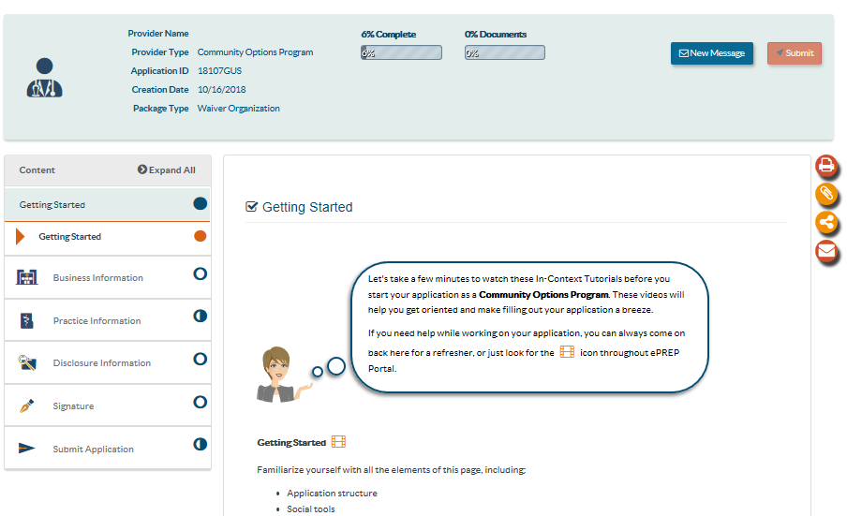
Completing the Application
Filled circles indicate the section is completed.
Half circles mean the section is not completed.
Empty circles indicate sections not started.
Keep an eye on the completion prompts to guide you.
Make sure all the circles are filled in
Notes:
Once you start the application there are some things to be aware of…. on the left side under the Content section, you will see circles next to the different sections of the application. If you keep an eye on these circles as you proceed through the application process, you will be able to see what sections are complete and which ones are missing some information or documents. When they fill up completely, the section is complete. Know that you can proceed to another section without the section your working on being complete and the circle being filled out. You just have to go back and complete what needs done and the circles all have to be filled in before the application can be signed. An example would be if they ask for your DEA information and you don’t’ have the document, you can put yes and skip to the next session and then go back later to upload the information and the document. Remember…you won’t forget to do it because that circle will not be filled out and you won’t be able to sign the application without uploading the required documents.
Just another note…when the circle is in orange, it indicates that you are currently working in that section.
Also notice Lucy is on the slide giving some helpful information. Here she is telling you of the value of the imbedded video.

Slide 35
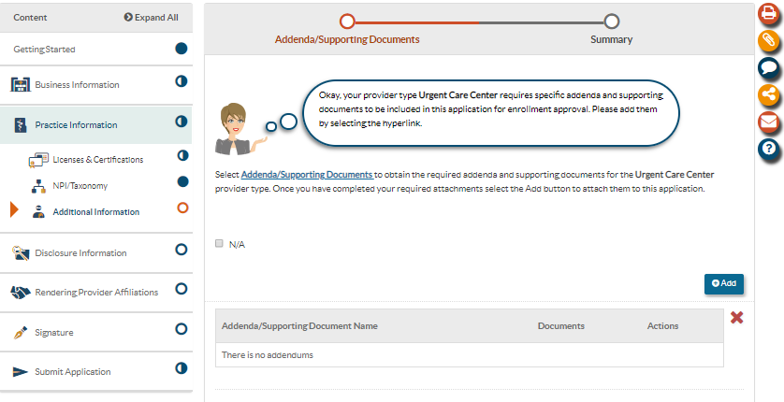
Provider Addendum Cont.
The addendum is a requirement to complete the application. It can be obtained directly from the Maryland web page by clicking on the link “Addenda/Supporting Documents” in blue, as indicated. Once the addendum is saved and completed, Clicking on “Add” enables us to add the completed document to the application.
Notes:
The addendum is required to complete the application. You also need to complete and attach documents requested in the addendum in order for the application to move forward in the review process. You can easily access the addendum while in the process of doing the application by clicking on the link under Practice Information and sub section Additional information. Once you click on this link , it will take you to the section in the Maryland Medicaid website where you can locate your addendum then download it to your computer. Once all the information is completed on the addendum, you can click the add button and add that addendum to your application and any documents required by the addendum.

Slide 36
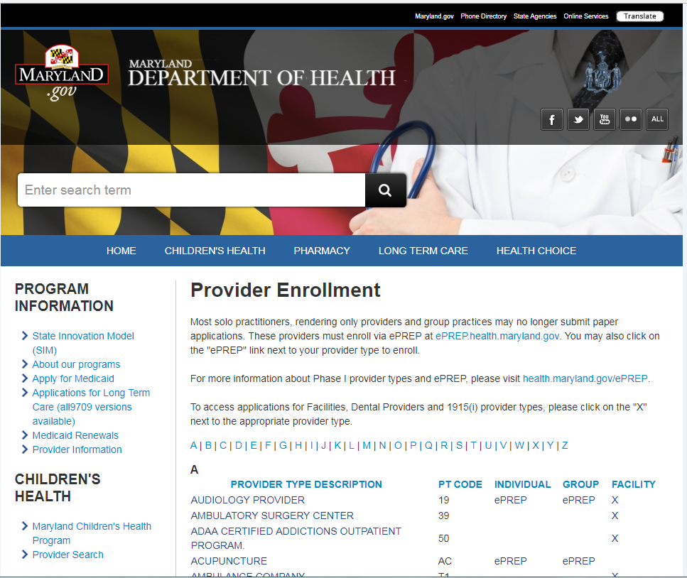
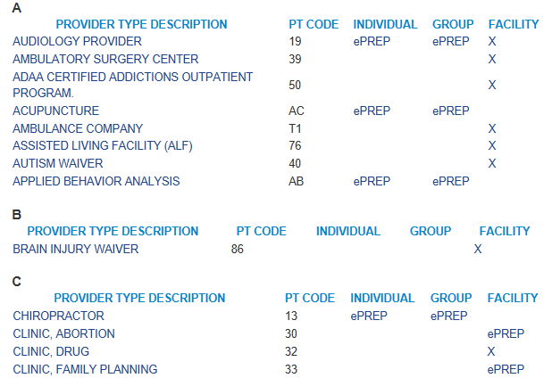
Where To Find Addenda on MDH Website
Notes:
This is where that link will take you…to the Maryland Medicaid website and it looks this. When you get to the Maryland web page…you click on Provider Information all the way to the left, it then takes you to the Provider Enrollment page, find your provider type and then go over and click on the X. That will bring up the required addendum for your provider type. You can then down load and save that to your computer, fill it out and then upload it to your application. Include in your upload any documents required in the addendum

Slide 37
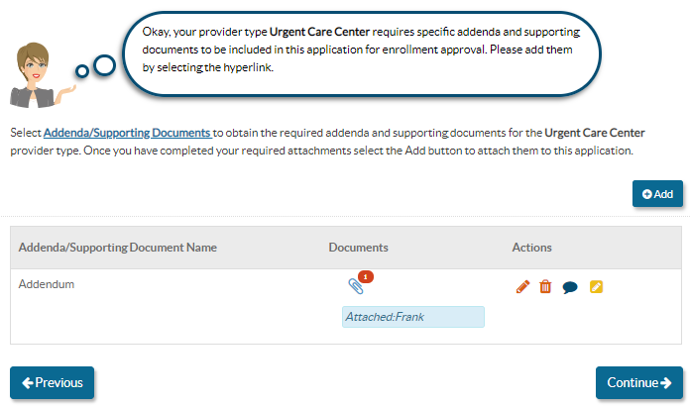
Uploaded file will be indicated by number next to the paper clip
Notes:
Once you upload using that add button, you will see the X next to the paper clip change to a number 1. If you see an X beside a paper clip it means a document is required and HAS NOT been uploaded. So if you think you uploaded a document and a number 1 does not appear next to the paper clip, try uploading again until you see that #1 appear.

Slide 38
Disclosure of Ownership
MOCA = Managing employees, Owners and Controlling interest Agents.
  These will always be updated in the Disclosure Information section of an ePREP application.
  MOCA information can be updated without a need to complete a CHOW application
Notes:
MOCA are Managing employees, Owners and those agents who have controlling interest
If needed…The Change of Ownership can be done in the application you are working on..….and they can also be done with a supplemental application.
In Maryland, you only do a Change of Ownership

Slide 39
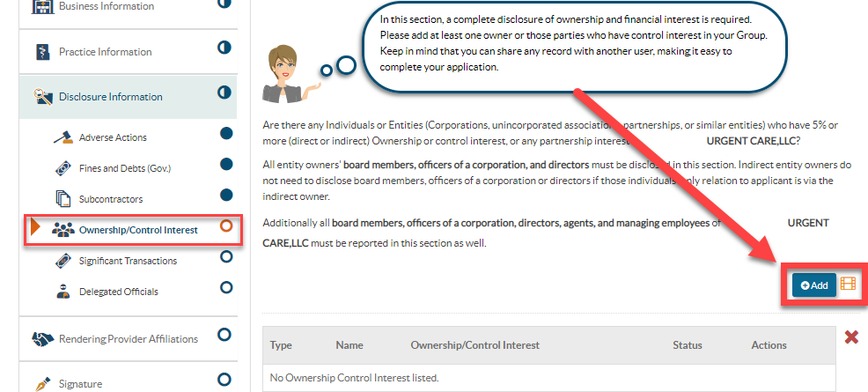
Disclosure of Ownership Cont.
  Add new MOCAs to Disclosure Information form and this determines who can sign the application.
Notes:
If you have new MOCAs ,this is important to you because it indicates more individuals and the authorized individuals who can sign the application.

Slide 40
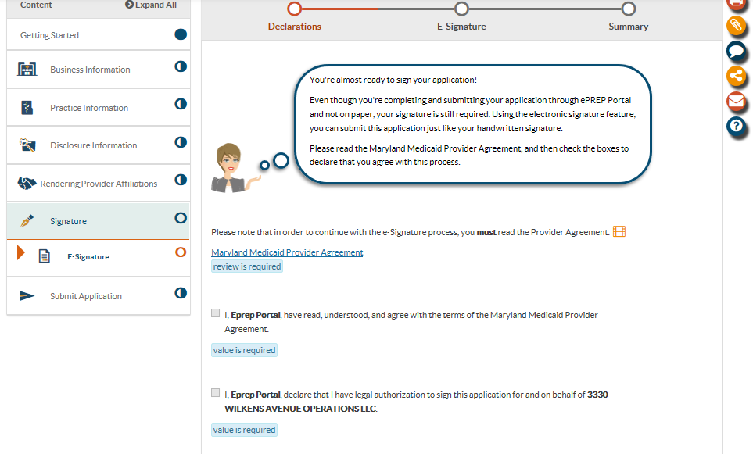
Electronic Signature
Notes:
in order to sign…all the circles must be filled in except the signature and submit circles. On this page to be able to go further to signature, you MUST click on the Maryland Medicaid Provider Agreement Link…If you don’t…you won’t be able to sign it….then click the box that you read , understood and agree to the Agreement. And last box that you have authority to sign the application

Slide 41
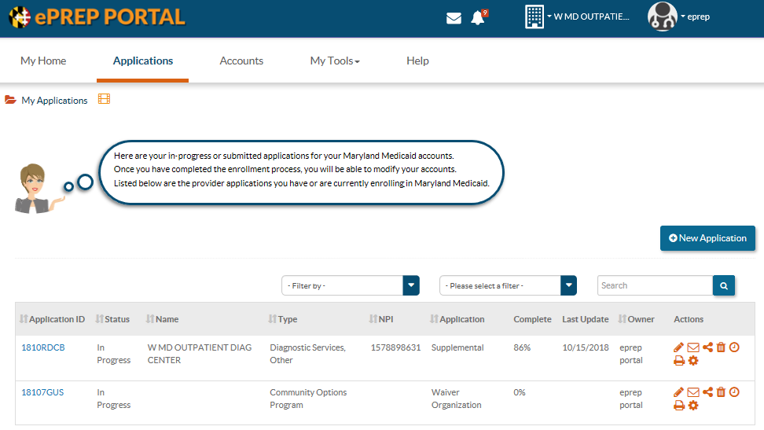
Applications
Your list of submitted and in progress apps.
The Status of your apps.
Additional Status Information.
Notes:
Once you submit, go back to your application page to make sure the status on your application has changed from “In Progress” to “Submitted” When you click on the clock icon all the way to the right in a few days , you can check the progression of your application review.

Slide 42
Questions & Contacts
ePREP Portal: eprep.health.maryland.gov
Resources and frequently asked questions: health.maryland.gov/eprep
ePREP Call Center: 1-844-4MD-PROV (1-844-463-7768)​​
Monday – Friday 9AM- 5PM​
***Closed on State holidays***
Notes:
Here is the link to the portal, the link to the resources and the FAQ on the Maryland Medicaid ePREP website and the call center information.
Thank you and I hope this has been helpful

