Slide 1
MHHD Social Determinants of Health (SDOH) and Obesity Grant Program
Pre-Application Webinar for
FY 2026 SDOH Grant Program Awards
Office of Minority Health and Health Disparities
Maryland Department of Health
April 18, 2025

Slide 2

Introductions
Camille Blake Fall, MHHD Director
Saroje Portious, SDOH Grant Program Administrator
David Mann, SDOH Grant Epidemiologist
Shirlene Carr, Fiscal Administrator
Office of Minority Health and Health Disparities

Slide 3
Webinar Specifics for Participants
This Training session will be recorded and uploaded on the MHHD website no later than Friday, April 25, 2025.
Although other browsers should be viable options to view this Training, we have been advised by MDH IT staff that the webinar may work best in Chrome.
The chat function is on and will be utilized as a “parking lot” for questions. Please type all questions in the chat at the end of the slide presentation and staff will respond to each at the close of this presentation during the question-and-answer session.
We will make every attempt to answer all questions, however, those that were missed due to time constraints will be answered individually.
Office of Minority Health and Health Disparities

Slide 4
Webinar Specifics for Participants
We prefer questions to be entered into the chat to help us with sequencing and documenting the questions. If time permits, we may be able to open it up for audio questions (for those joining by phone only).
Today we are only discussing the RFA process for SDOH for fiscal year 2026.
Any questions or issues about the current year will be handled offline by email to the appropriate MHHD staff.
Office of Minority Health and Health Disparities

Slide 5
Agenda
Overview
  Introductions
  Opening Remarks Camille Blake Fall
  Purpose and Application Components Saroje Portious
  Performance Measures and Data David Mann
  Budget and Fiscal Activities Shirlene Carr
  Q&A All
  Closing Camille Blake Fall
Office of Minority Health and Health Disparities

Slide 6
Opening Remarks
MHHD Director: Camille Blake Fall
Office of Minority Health & Health Disparities (MHHD)
Vision: To achieve health equity where all individuals and communities have the opportunity and access to achieve and maintain good health.
Office of Minority Health and Health Disparities

Slide 7
Opening Remarks (continued)
MHHD Director: Camille Blake Fall
  Mission: To address social determinants of health, reduce health disparities, and promote health equity by:
  leveraging the resources of the Maryland Department of Health (MDH) to support community health and well-being;
  collecting, compiling, and analyzing race and ethnicity data to improve health outcomes;
  fostering robust community public/private partnerships to advance advocacy and education;
  guiding policy, practice, and program decisions within MDH; and
  influencing the overall strategic direction of the department on behalf of the Secretary of Health."
Office of Minority Health and Health Disparities

Slide 8
Purpose and Application Components
Saroje Portious
SDOH Program Administrator
Office of Minority Health and Health Disparities

Slide 9
Purpose
The Maryland Department of Health (MDH or the Department), Office of Minority Health and Health Disparities (MHHD) is issuing this Request for Applications (RFA):
    To provide community-based interventions to address social determinants of health and obesity in Maryland to reduce health inequity.
Office of Minority Health and Health Disparities

Slide 10
Awards; Questions; Submission
We intend to make 15 to 25 awards of $50,000 to $200,000 each based on this RFA. Proposal budgets should not exceed $200,000.
Written questions from prospective Applicants will be accepted by the Contract Officer and Grant Monitor. Questions shall be submitted via e-mail mdh.healthdisparitiesRFAapplications@maryland.gov Please include in the subject line the Solicitation Number, SDOH FY2026 and the applicant organization name.
Submit applications via eMaryland Marketplace Advantage (eMMA)
Solicitation Number: BPM050317
Closing Date and Time: Monday. May 5, 2025, at 5:00 p.m.
Confirm that you see the submission portal in eMMA well in advance of the deadline! We are unable to accept applications after the eMMA deadline.
Office of Minority Health and Health Disparities

Slide 11
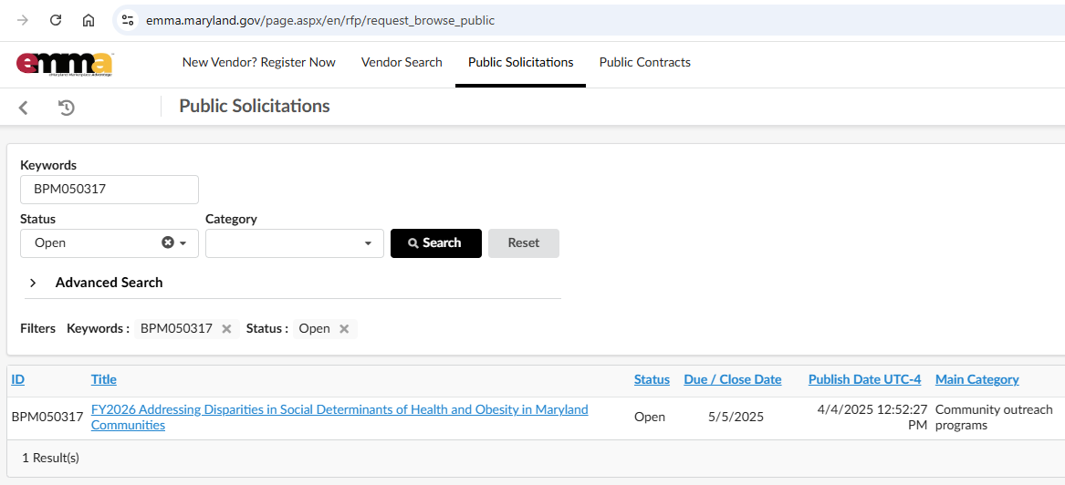
Finding the RFA in eMMA https://emma.maryland.gov/page.aspx/en/rfp/request_browse_public
Go to the “Public Solicitations” part of eMMA
Enter our Solicitation Number (no spaces), then click search
You will get this:
Click on the title to open the solicitation

Slide 12
Submission
You will only see one document upload window in eMMA.
You will upload both Volumes (Technical and Budget) in the one upload window (see next slide).
The fillable forms downloaded from our website may be uploaded individually in their native format. https://health.maryland.gov/mhhd/Pages/MHHD-Grant-Documents.aspx
Office of Minority Health and Health Disparities

Slide 13
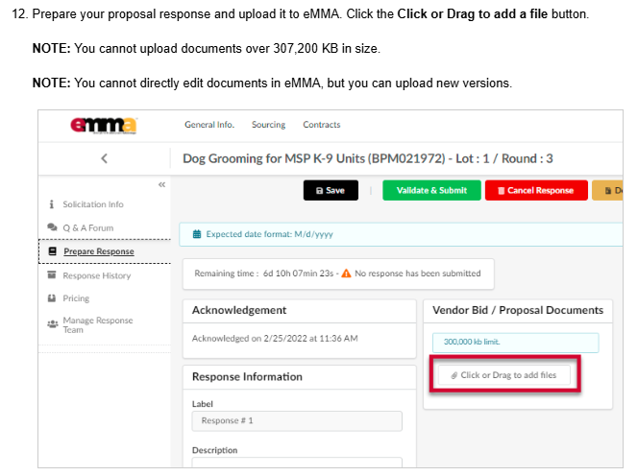
eMMA Quick Reference Guide to Submitting:
https://mdprocurement.freshdesk.com/support/solutions/articles/70000592965-responding-to-solicitations-ifb-vendor-
Ignore the Pricing tab above.
It only applies to commodity
purchases with a price per
unit approach. (It is discussed
as item 9 in the quick reference guide)
Your budget documents, as well as narrative, go here.
Upload Documents Here
Office of Minority Health and Health Disparities

Slide 14
Applicant Requirements
The Applicant must provide proof with its Application that the following Mandatory Requirements have been met:
2.1.1 The Applicant shall be a Social organization as defined per Section 7-402 of the State Finance and Procurement Article of the Annotated Code of Maryland or a local, state government agency, public college or state university.
2.1.2 For social organization Applicants (not local, state government agency, public college, or state university), the Applicant must be a nonprofit organization, classified by the IRS as tax-exempt under section 501(c)(3) of the Internal Revenue Code. Applications must include attachments of the following documentation from the applicant:
Documentation of tax-exempt status of the Applicant or the Applicant’s fiscal sponsor (i.e. IRS tax exempt status determination letter)
Office of Minority Health and Health Disparities

Slide 15
Applicant Requirements
The Applicant must provide proof with its Application that the following Mandatory Requirements have been met:
2.1.3 Applicants must have a certificate of good standing issued by the Maryland State Government.
Applicants must maintain an operational office within Maryland. All official records must be maintained at this location and accessible for site visits and audits.
Applicants must be registered on eMMA (see https://procurement.maryland.gov/ for more information). Applicants must have access to relevant data sources, the capacity to deliver planned services, the ability to track performance, and be prepared to submit progress reports on time. Applicants must be able to implement the proposed program/service workplan on the grant Agreement start date. Workplans that deliver client services closer to the start date will score higher in proposal evaluation.
Office of Minority Health and Health Disparities

Slide 16
Scope of Work
Grantees funded through this RFA will provide community-based services to Maryland's racial and ethnic minorities and other disadvantaged populations to address social determinants of health (SDOH) or obesity to reduce health inequity.
Services will be provided in Maryland jurisdictions.
Office of Minority Health and Health Disparities

Slide 17
Scope of Work
All Applicants are required to provide enrollment, client needs assessment regarding SDOH, referral to SDOH services, and follow-up assessments (referral completion and results) for the SDOH factors that an applicant organization addresses related to its mission.
The applicant has the option of additionally proposing to provide a solution service (not just a referral) in one or more of the following social determinants of health (SDOH): housing instability, food and nutrition deficiencies, transportation, access to primary care services, education, job opportunities, violence reduction; or direct services in obesity.

Slide 18
Scope of Work
Each proposal must include the program description for the required elements listed above,
and if applicable the solution service provision in the one or more chosen focal service areas.
The proposal must identify the funding allocation between the required components and the solution services as applicable.

Slide 19
Scope of Work (Cont’d)
The applicant shall provide the required screening, referral and follow-up assessment services described above. Additionally, the Applicant may provide direct services focusing on one or more of the following social determinants of health (SDOH):
housing instability,
food and nutrition deficiencies,
transportation,
access to primary care services,
job opportunities,
education,
violence reduction: or
obesity.
Office of Minority Health and Health Disparities

Slide 20
Scope of Work (Cont’d)
The services will reduce inequities in SDOH and reduce health inequities among racial and/or ethnic minorities and other disadvantaged populations in Maryland.
"Specific population" will be identified by the Applicant as specific racial or ethnic groups or other disadvantaged populations within Maryland.
"Geographic area" will be identified by the Applicant as a specific jurisdiction, zip code, or census tract within Maryland.
"Service" is defined as practice, clinical service, social services, education, training, care management, referrals, community program, or other work appropriate to the goal of reducing SDOH disparities.
Office of Minority Health and Health Disparities

Slide 21
Submission Components
Applicants shall submit Proposals in separate volumes:
  Volume I – Technical Proposal (Project Narrative)
  Volume II – Budget Proposal (Narrative & Spreadsheets)
  Note: No pricing information is to be included in the Technical Proposal (Volume 1). Pricing information is to be included only in the Budget Proposal (Volume II).
Office of Minority Health and Health Disparities

Slide 22
Transmittal Letter
4.3.1 The Technical Proposal shall include the following documents and information in the order specified as follows:
4.3.1.1 Transmittal Letter:
1. Applicant
2. Solicitation Title and Solicitation Number that the Proposal is in response to;
3. Signature, typed name, and title of an individual authorized to commit the Applicant to its Proposal
4. Federal Employer Identification Number (FEIN) of the Applicant, or if a single individual, that individual's Social Security Number (SSN);
5. Applicant's eMMA number
6. Applicant's MBE certification number (if applicable)
7. Applicant's SBR number (if applicable) – please contact eMMA at 410-767-1492 if you don't know your number. (Small Business Reserve – see https://gomdsmallbiz.maryland.gov/Pages/SBR-Registration.aspx)
8. Applicant’s email address
9. Completed RFA document checklist (Attachment B)
Office of Minority Health and Health Disparities

Slide 23
Project Narrative
The Project Narrative shall include the Scope of Work, including the Work Plan.
The Project Narrative will be no more than 10 pages (standard letter size).
The Application will be 12 pt. font, Times New Roman or Calibri, 1-inch margins, double-spaced, and each page numbered sequentially. Information in tables may be 11 pt. font.
Required sections (see RFA)
Executive Summary
Problem Statement
Geographic Area(s)
Target population
Proposed program
Work plan overview
Organizational capacity
Program management
Partnerships
Performance Measures – (Refer to and include RFA Attachments E and F)
Dissemination
Item i. on page 16 of the RFA has a typo
and refers to these as D and E;
E and F is correct.
Office of Minority Health and Health Disparities

Slide 24
Other Technical Proposal Documents
4.3.2 The Application will include the following attachments:
  Workplan Table (Attachment C)
  Workplan Gantt Chart (Attachment D)
  Letters of Commitment - from identified partners, if applicable (see 4.3.1.2 2 (h) in RFA). Combine the letters into one (1) PDF.
  References - At least two (2) references. See details on page 17 of the RFA.
  Completed Attachments E and F
  Applicant shall acknowledge they have read the American with Disabilities Act Statement in Section 3.2 and will meet all requirements.
  Include signed W-9 with Contact Person Names and Phone Number
      4.3.1.3 Mandatory Requirements Documentation
IRS Determination Letter of 501(c)(3) status (per RFA section 2.1.2)
    Maryland Comptroller Certificate of Good Standing (per RFA section 2.1.3)
Office of Minority Health and Health Disparities

Slide 25
Work Plan
Office of Minority Health and Health Disparities

Slide 26
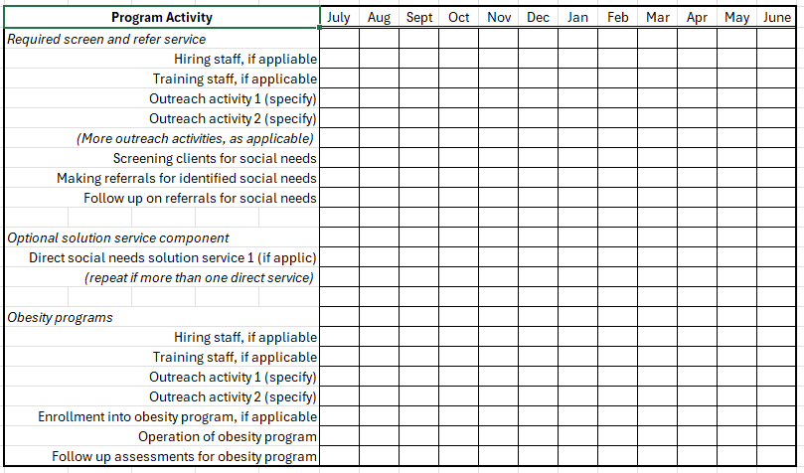
Program Workplan Gantt Chart
These are generic activities as an example. Replace with
the specific activities of your workplan. Fill in the monthly
boxes that the activity is planned to occur.

Slide 27
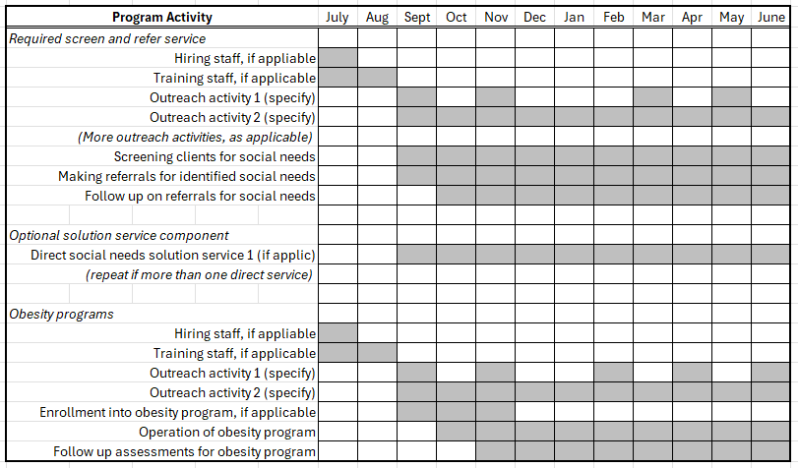
Program Workplan Gantt Chart
An example of what a completed chart might look like. The
monthly distribution of the activities should correspond to the
monthly distribution of performance measures on Attachment F

Slide 28
Event Calendar (not part of application)
Sunday | Monday | Tuesday | Wednesday | Thursday | Friday | Saturday
 |  |  |  |  |  | 1
2 | 3 | 4 | 5 | 6 | 7 | 8
DPP cohort 1 mtg 1 1 PM to 3PM XYZ Church |  |  | DPP cohort 2 mtg 1 7 PM to 9PM QRS Library |  |  | Healthy Pregnancy 10 AM to Noon Hospital mtg room
9 | 10 | 11 | 12 | 13 | 14 | 15
DPP cohort 1 mtg 2 1 PM to 3PM XYZ Church |  |  | DPP cohort 2 mtg 2 7 PM to 9PM QRS Library
16 | 17 | 18 | 19 | 20 | 21 | 22
DPP cohort 1 mtg 3 1 PM to 3PM XYZ Church |  |  | DPP cohort 2 mtg 3 7 PM to 9PM QRS Library
23 | 24 | 25 | 26 | 27 | 28 | 29
DPP cohort 1 mtg 4 1 PM to 3PM XYZ Church |  |  | DPP cohort 2 mtg 4 7 PM to 9PM QRS Library |  | LHIC Meeting 6 PM to 8 PM Local Health Dept
30 | 31
DPP cohort 1 mtg 5 1 PM to 3PM XYZ Church |  | NOTES:
(Provided with Monthly Progress Reporting)
Office of Minority Health and Health Disparities

Slide 29
Application Document Checklist
Transmittal Letter and completed project and budget checklists
Project Narrative
Work Plan Table (see RFA Attachment C for the template)
Work Plan Gantt Chart (see RFA Attachment D for the template)
Letters of Commitment (if applicable)
References
Performance measures tables (see RFA Attachments E and F)
IRS determination letter of non-profit status (per RFA section 2.1.2)
Maryland Comptroller Certificate of Good Standing (per RFA section 2.1.3)
W-9 Form (per RFA section 4.3.1.4)

Slide 30
Application Document Checklist
Budget Narrative Checklist:
Budget Forms
MDH 432A
MDH 432B
MDH 432C
MDH 432D
MDH 432E
MDH 432 F
MDH 432G
MDH 432H
Budget Narrative (See Exhibit C – Budget Narrative)

Slide 31
Evaluation of Applications
Evaluation of Applications will be performed by a committee established for that purpose and based on the evaluation criteria set forth in the RFA.
The Evaluation Committee will review Applications and provide input to the Grant Officer and Program Administrator.
The Department reserves the right to utilize the services of individuals outside of the established Evaluation Committee for advice and assistance, as deemed appropriate.
All Applications will be graded on a point system. If any of the requirements have not been met or documents included, points will be deducted from each application.
Office of Minority Health and Health Disparities
Notes:
This is a very competitive process, and the evaluation process will be stringent so please be certain that you pay close attention to the listed requirements in the RFA

Slide 32
Performance Measures and Data
David Mann
SDOH Program EPIDEMIOLOGIST
Office of Minority Health and Health Disparities

Slide 33
Grant Program Design Overview
Budget $$$
Inputs
Staff and Supplies
ACTIVITIES
Outputs
(Milestones
Performance
Measures,
Deliverables)
VALUE:
Optimal BENEFITS per Dollar
Attendees and Enrollees (REACH)
Measurable BENEFITS to those Reached

Slide 34
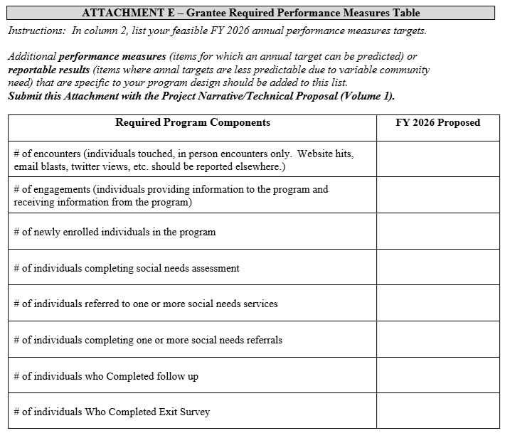
Required Performance Measures:

Slide 35
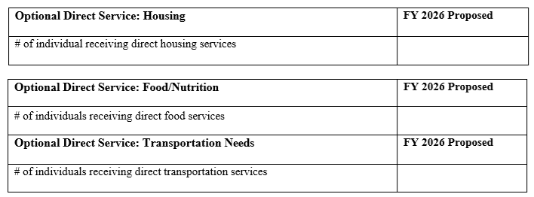
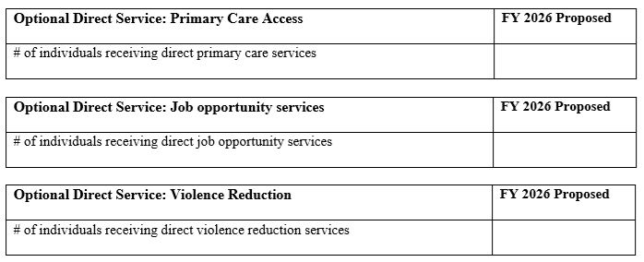
Required Performance Measures:

Slide 36
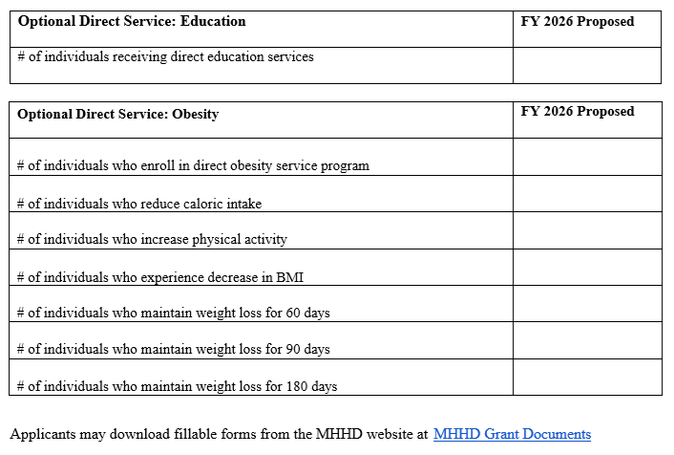
Required Performance Measures:

Slide 37
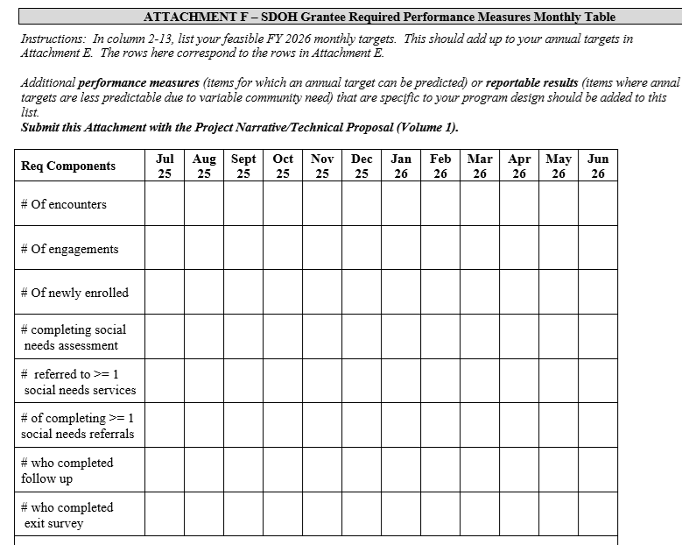
Monthly Performance Measures:

Slide 38
Program Workplan Gantt Chart
An example of what a completed chart might look like. The
monthly distribution of the activities should correspond to the
monthly distribution of performance measures on Attachment F

Slide 39
Additional Performance Measures
In addition to these required and standardized performance measure categories your unique program should have some unique performance measures to describe your productivity. For example, the number of various types of events, and the attendance at those events.
Such measures will be specific to the design of your program.
Office of Minority Health and Health Disparities

Slide 40
Reportable Results
Performance measures are measures for which a yearly estimate of performance can be made. For example, the number of people screened for some need.
  Not all the important measures to describe your program permit a reliable prediction of annual targets. For example, the number of the people that you screen who may need a particular service.
  So, the number referred to any service is a reportable result: reported, but not predicted at the time of application.
Office of Minority Health and Health Disparities

Slide 41
Budget and Fiscal Activities
Finance & Operations Manager: Shirlene Carr
Budget and fiscal activities will be conducted in compliance with laws, regulations, and policies as instituted by the state of Maryland.
Budget and fiscal compliance is a key component of success for each grantee. Therefore, we are committed to providing grantees with the necessary technical assistance and guidance to help ensure success with this grant partnership.
41

Slide 42
Budget and Fiscal Key Points
No advance payments to provide start-up funding can be made with this award. All payments must be a reimbursement of invoiced expenses.
Therefore, grantees will be expected to support from their own funds the first three months (plus invoice processing time) of program activities. Quarterly invoices are due 15 days after the end of a quarter, and invoice processing will take place within 30 days of receipt.
All receipts must be categorized to align with the invoice.
42

Slide 43
Budget and Fiscal Key Points
COMPTROLLER OF MARYLAND GENERAL ACCOUNTING DIVISION (p.33) states: Since the State of Maryland is exempt from all forms of taxes, except excise tax on air flights, tax items should not be included in any invoice payments.
Comptroller of Maryland Accounting Procedures Manual
All awardees are strongly encouraged to obtain ACH/Direct Deposit.
You can access the links to the General Accounting Division (GAD) for applying for ACH/Direct Deposit transactions and researching your payments using the links below.
State of Maryland ACH/Direct Deposit Authorization for Vendor Payments
State of Maryland ACH/Direct Deposit Authorization for Vendor Payments
GAD's Online Service Center
43

Slide 44
Invoice Requirements
Ensure that you or your representative forward the documents noted below to the MHHD Fiscal email mdh.mhhdfiscal@maryland.gov while copying the Program Administrator
MDH 437 and MDH 438 Forms (completed in their entirety)
Invoice on organization's letterhead to include an Invoice Number and Date, as well as the Tax ID number and Purchase Order (PO) Number (submitted in PDF format).
Ensure that the invoice aligns line for line with your supporting receipts
Ensure that included on the invoice is the PO#/BPO (whichever applies to your grant)
If you are submitting for payroll reimbursements, please submit corroborating paystubs or payroll documentation
If the award is paying a portion of the receipt, please circle and initial the amount being charged to the grant.

Slide 45
Project Budget and Fiscal Forms
Submit completed MDH Forms – located on the MHHD Website – MHHD Grant Documents
  MDH 432 A –H (eight tabs in an excel worksheet)
Using the example in Exhibit C of the RFA, prepare and submit detailed Budget Justification Narrative.
  Budget Modifications not accepted beyond December 15th
Provide correct contact information, including
  Name
  Address
  Federal ID Number
Office of Minority Health and Health Disparities

Slide 46
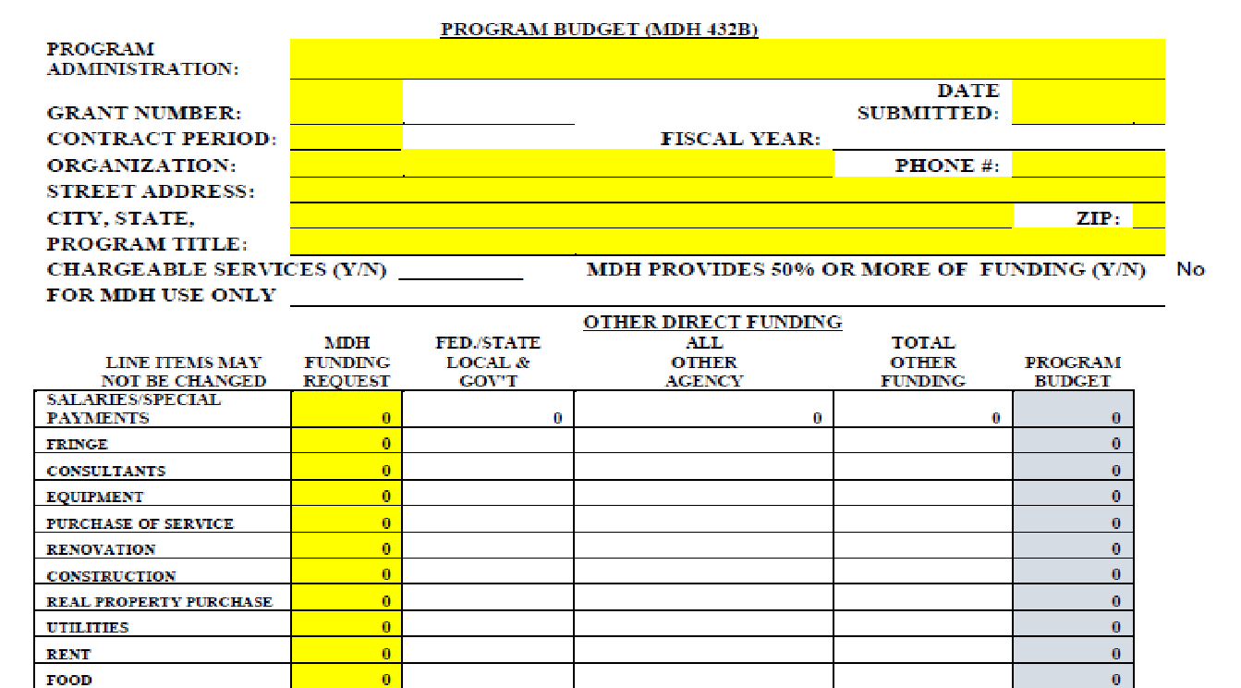
MDH 432B
Office of Minority Health and Health Disparities

Slide 47
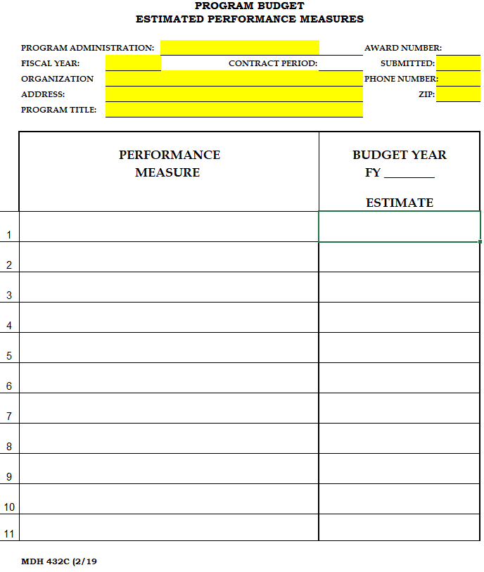
MDH 432C
In column 1, enter the name of the
Performance measure being reported.
In column 2, enter the proposed amount
of that performance measure to be
accomplished over the 1-year grant.
In most cases, the entry is column 2 will
be the number of people receiving the
service or accomplishing the goal that
is stated in column 1.
Note that column 2 is NOT filled in with an
amount of money, unlike most other
432 series forms.
Office of Minority Health and Health Disparities

Slide 48
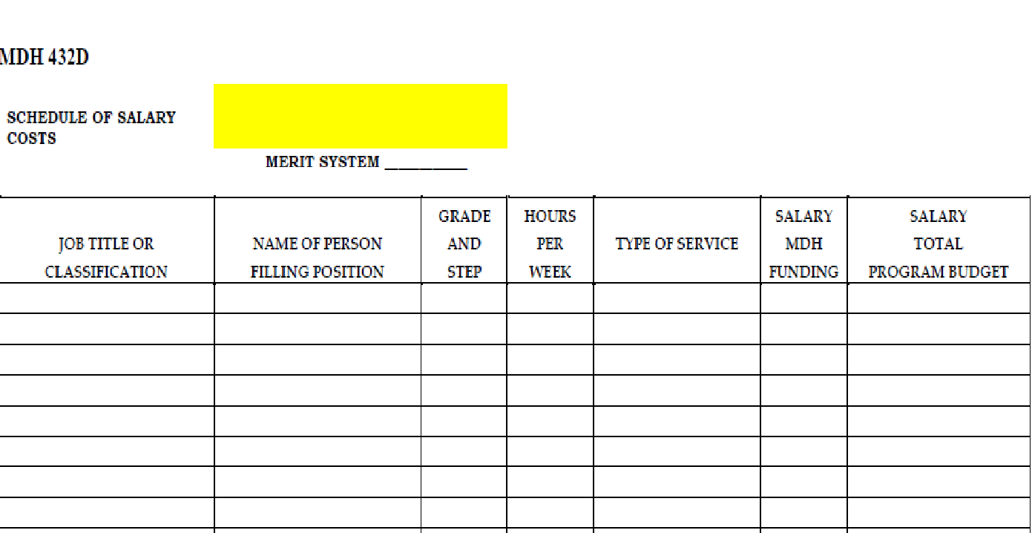
MDH 432D
Office of Minority Health and Health Disparities

Slide 49
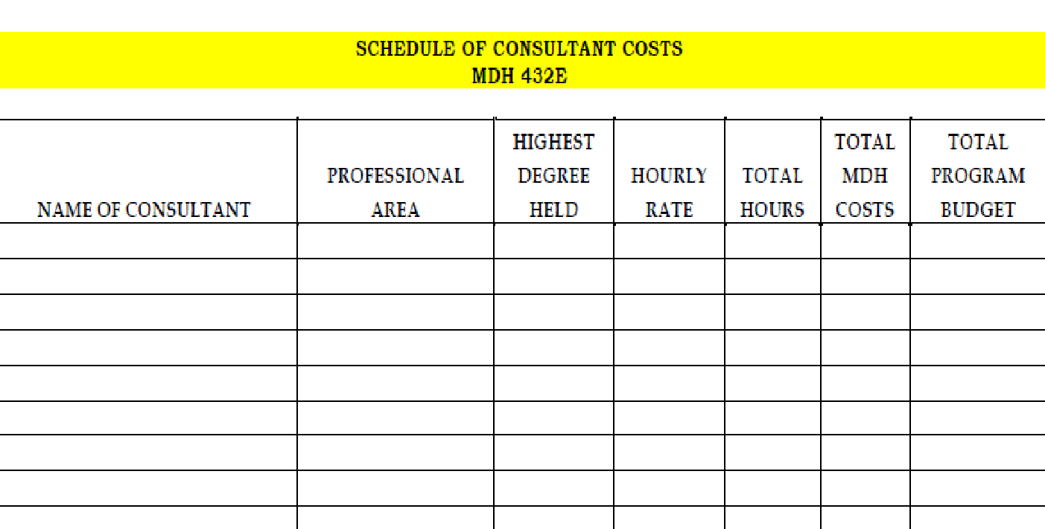
MDH 432E
Office of Minority Health and Health Disparities

Slide 50
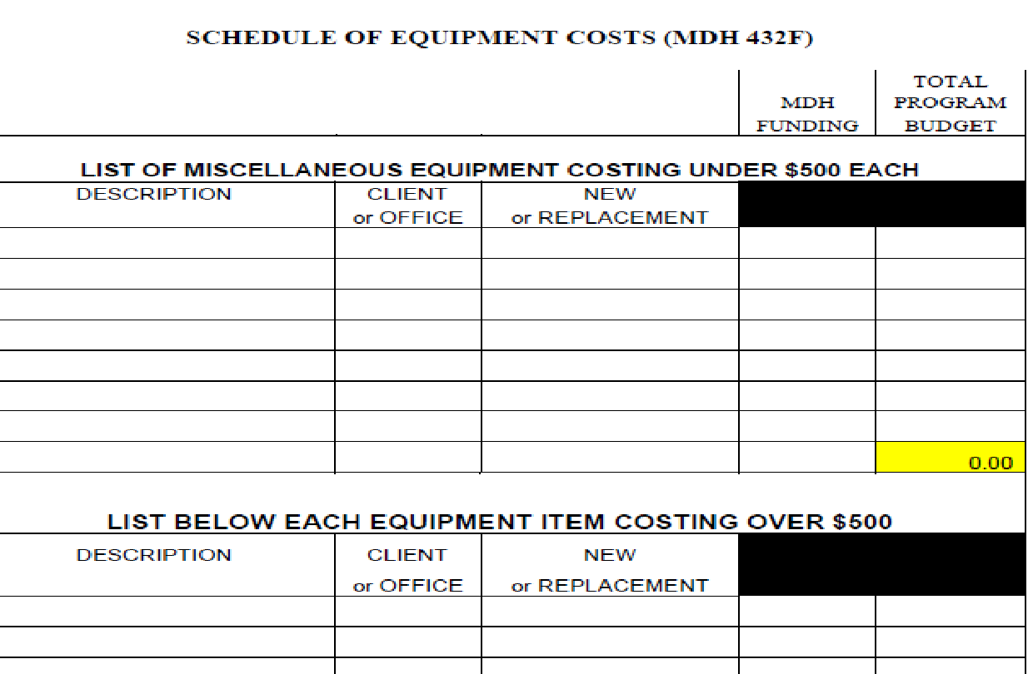
MDH 432F
Office of Minority Health and Health Disparities

Slide 51
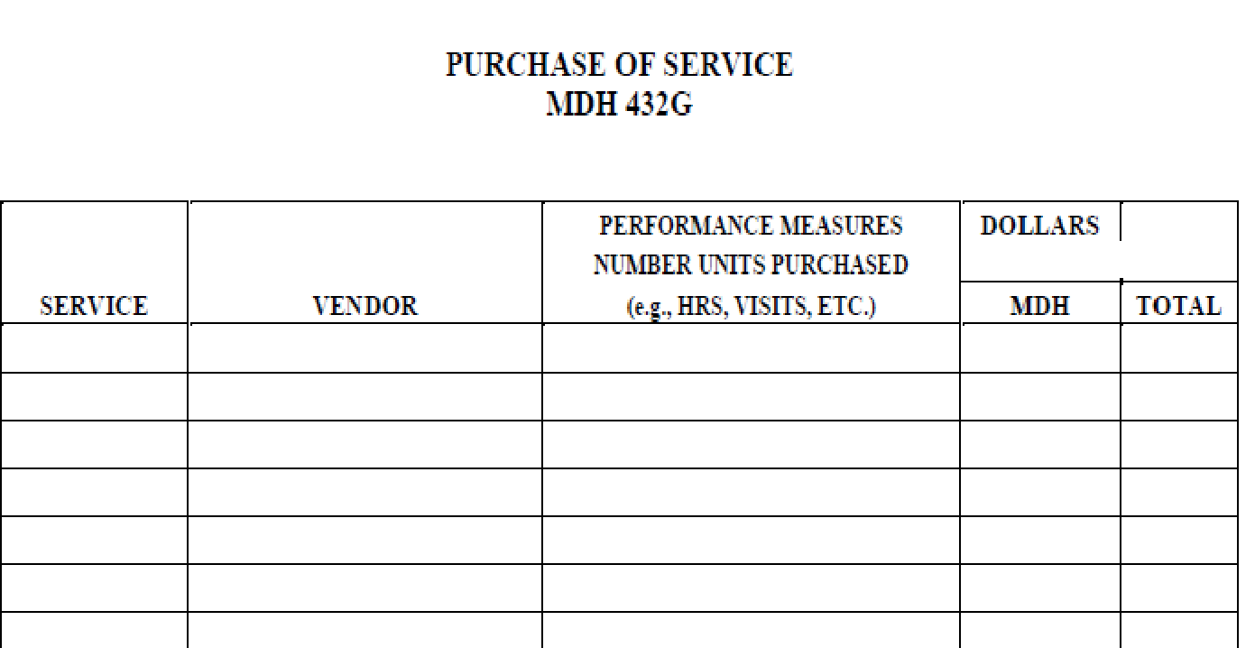
MDH 432G
Office of Minority Health and Health Disparities

Slide 52
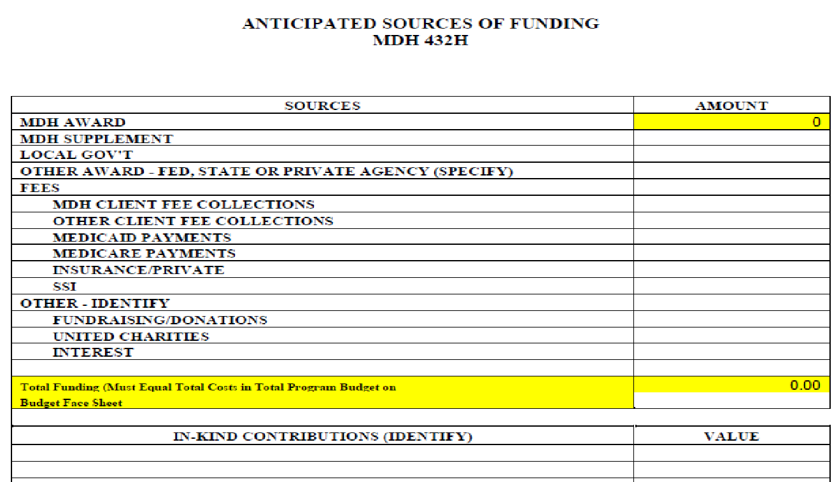
MDH 432H
Office of Minority Health and Health Disparities

Slide 53
Question and Answer Session Start
Office of Minority Health and Health Disparities

Slide 54
Question and Answer Session End
Office of Minority Health and Health Disparities

Slide 55
Closing Remarks
MHHD Director: Camille Blake Fall
Office of Minority Health & Health Disparities (MHHD)
Our promise to you is that we will work to provide exceptional customer service at every opportunity to every person.
Your success is our success and the success of the health and well-being of all Marylanders.
Thank you for your time and commitment. It’s a pleasure to partner with you to continue the fight to reduce health disparities and to promote health equity
Office of Minority Health and Health Disparities

Slide 56
Pre-Application Webinar End
Thank You
We are available to answer all questions, please send us an email to mdh.healthdisparitiesRFAapplications@maryland.gov
Please include your organization’s name, the Solicitation Number and FY26SDOH in the subject line.
Office of Minority Health and Health Disparities

