Slide 1
COVID-19 Update for Ambulatory Providers and Staff
Maryland Department of Health
Maryland Primary Care Program
Program Management Office
16 September 2020

Slide 2
Play Video

Slide 3
Focus
Gates and Buffett have become mega-wealthy BFFs. As told in the documentary, Gates's father once asked them both to write down a single word to describe their success. They both wrote the same word: focus.
https://youtu.be/ju20hzifwAo?t=16

Slide 4
Agenda
Maryland Morbidity and Mortality Data
National Status and Projections
Focus
Vaccinate
Test
Primary Care ongoing
The Five Things to Do as Primary Care Providers
Guest Speaker – Sneha Jadhav, MD
Helping children cope with COVID and Anxiety
Q & A
Resources Appendix

Slide 5
Morbidity and Mortality Update
 | United States | Maryland
New Daily Cases (7-day rolling average) | 36,731 | 538
Cumulative Cases | 6.5 million+ | 117,245
New Daily Deaths (7-day rolling average) | 760 | 5
Cumulative Deaths | 194,397 | 3,706
Cases
Deaths
Updated 9/15
Source: MDH, CDC, New York Times

Slide 6
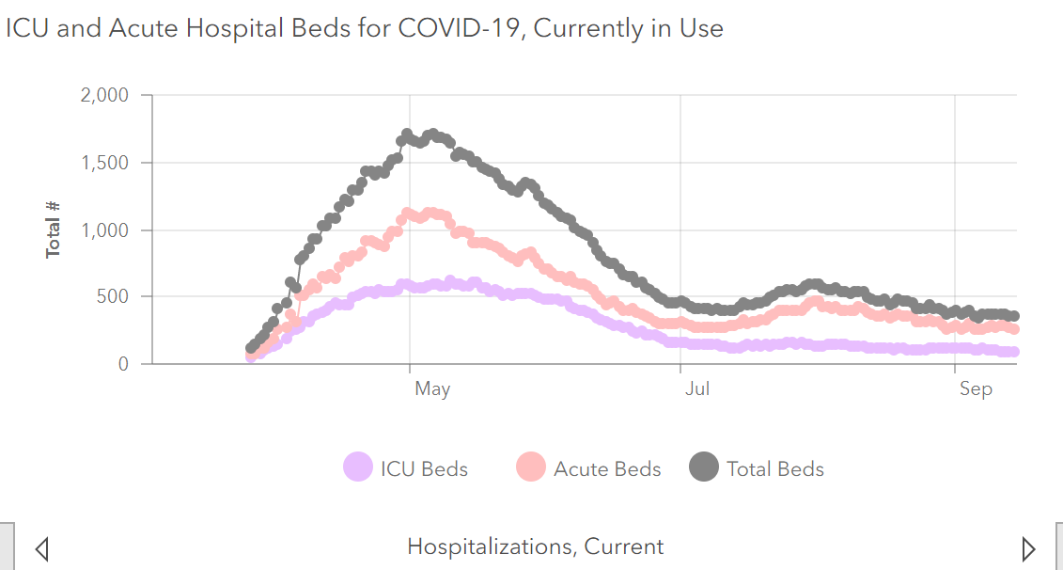
Hospital and ICU Beds in Use
Source: MDH https://coronavirus.maryland.gov/
Updated 9/14

Slide 7
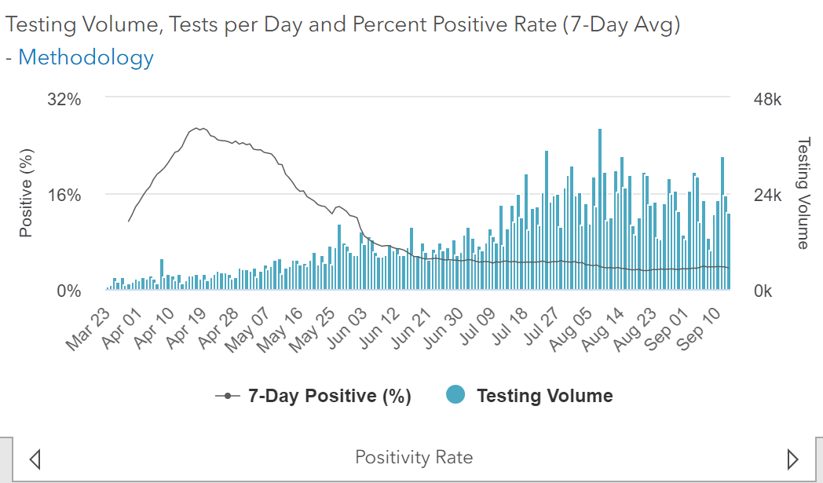
7-day average percent positive rate and testing volume
Source: MDH https://coronavirus.maryland.gov/
Updated 9/14

Slide 8
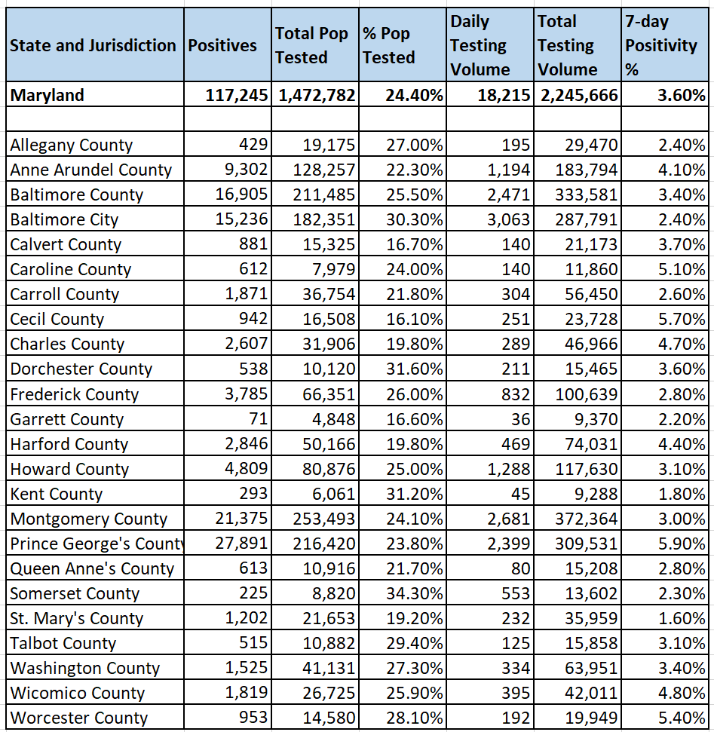
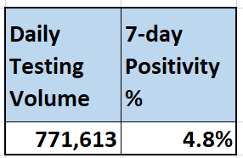
Maryland Testing and Positivity by County
USA
Source: MDH; Johns Hopkins
Updated 9/15

Slide 9
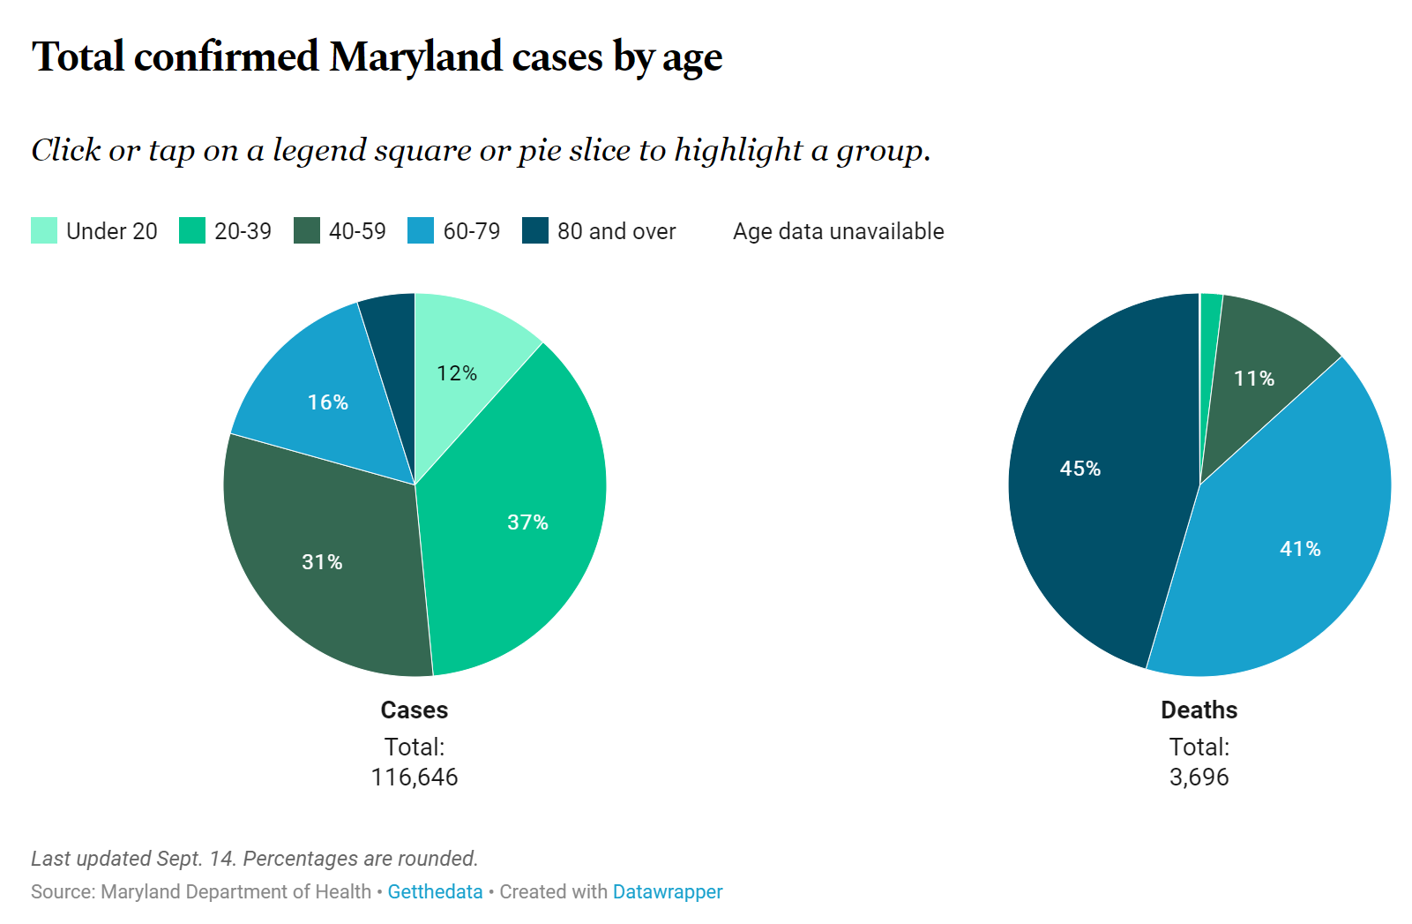
Cases and deaths by age in Maryland
Source: https://www.baltimoresun.com/coronavirus/bs-md-coronavirus-cases-statewide-maryland-20200726-rk7n7qam4fd33ka7zvrxv3xybe-htmlstory.html
Updated 9/14

Slide 10
Maryland’s Overall COVID-19 Status in Context
Testing widely available: 18,000 per day
Getting better at managing patients with Covid-19; daily deaths going down
Statewide contact tracing program
Covid-19 fatigue settling in
Preparing for eventual vaccination plan

Slide 11
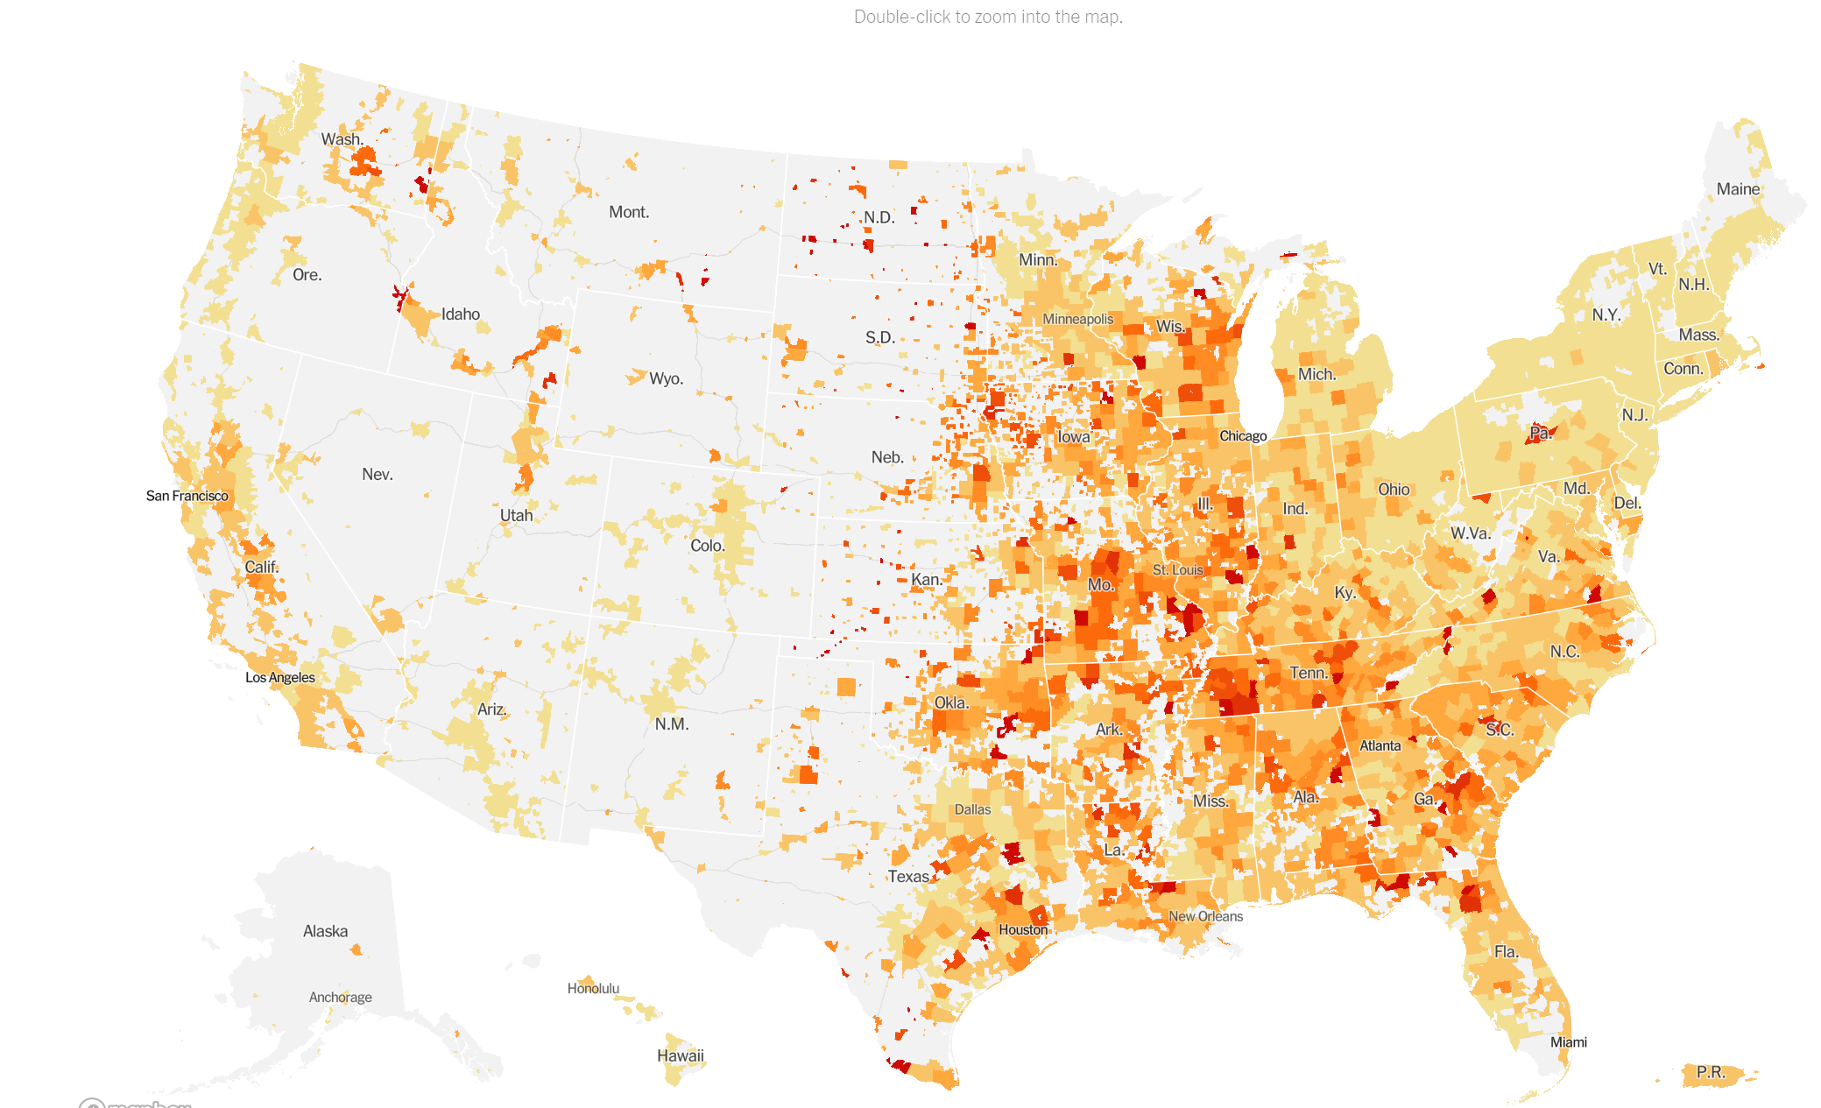
COVID-19 Outbreak US Hotspots
Source: New York Times
Updated 9/15

Slide 12
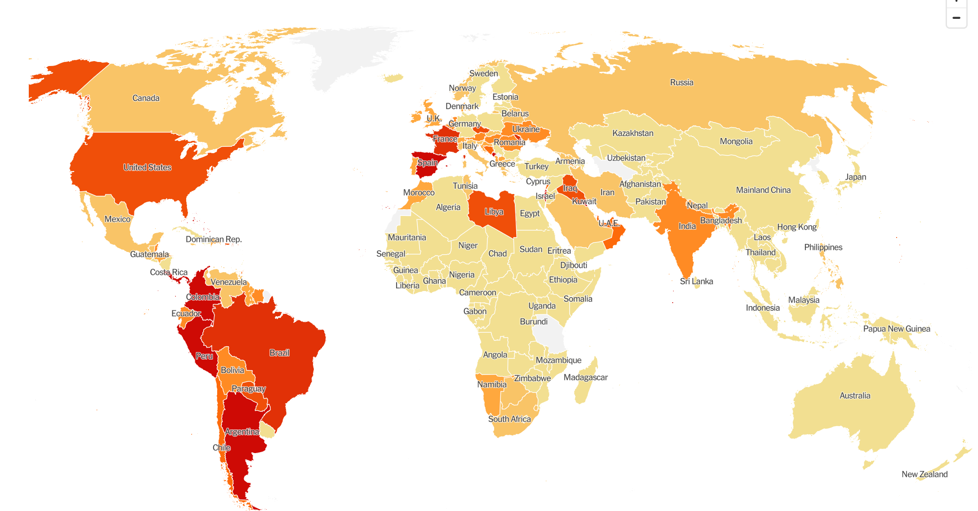
Global Pandemic Hotspots
September 14: World Health Organization reports highest one-day new case increase of the pandemic (307,930 new cases)
Source: New York Times; https://www.bbc.com/news/world-54142502
Updated 9/15

Slide 13
Covid Vaccination

Slide 14
Vaccines in development
Types
mRNA- earliest to be released, novel type
Live attenuated
Protein fragments
Separate virus carrying antigenic material
Unique features
Temperature sensitivity
Dosing
Prioritization
Trial phases - ongoing

Slide 15
CDC - FDA Checklist for States’ Vaccine Preparedness
Determine organizational structure and partner involvement
Identify gaps in preparedness
Review requirements and assess capacity of immunization information system (IIS) or other reporting system
Identify critical populations
Prepare for covid vaccine administration
Plan for expansion of Covid-19 vaccination provider
Outreach and enrollment
Determine covid vaccine allocations
Develop communications plan

Slide 16
Draft Covid Immunization plan Early Information
States Informed to have a plan for late October, early November
Vaccine type A store at -20C, two doses, Moderna, mRNA
Vaccine type B store at -70C, two doses. Pfizer, mRNA
Have broad infrastructure
Prioritize in 4 phases
Notes:
next week - talk through what herd immunity is

Slide 17
Vaccine Phases
Phase 1- Highest risk- limited volume of vaccines
Hospital Health Care workers
SNF workers and maybe residents (depends)
First responders and others
Phase 2 – High risk, other
High risk vulnerable populations
Critical infrastructure workers
Phase 3- Moderate risk
Moderate risk vulnerable populations
Phase 4- anyone- excess amount of vaccine

Slide 18
Vaccine Administrators
Primary Care
Pharmacists
HealthCare Facilities
Health Departments - vaccine clinics
Paramedics
Others

Slide 19
Supply Chain and Data Management
First phase requires super cold storage, not typically available to primary care
Ordering vaccine through Immunet program
https://phpa.health.maryland.gov/OIDEOR/IMMUN/Pages/immunet.aspx
If you are not already registered in Immunet, register now
Record keeping through PrepMod- patient scheduling and record keeping system
Primary Care should be registered and trained

Slide 20
Vaccine Hesitancy
Pre-existing group of anti-vaccine people
Current political push for a vaccine before the election
Warp Speed connotation of cutting corners
Inconsistent messaging
Novel types of vaccines
Requires consistent accurate and timely messaging from trusted sources (Primary Care Providers)

Slide 21
Flu Vaccine
As flu season approaches, flu vaccines will be especially important this year:
Keeps people out of the hospital, ED, and ICU
Respiratory illness like the flu can be mistaken for COVID-19, can strain testing capacity
CDC guidance on flu vaccines during COVID
Flu vaccine recommended for all >6 months old without contraindications, emphasis on high risk groups
Timing: Aim for September – October
Patient FAQ Link
The good news: COVID-19 precautions (distancing, hand hygiene, masks) also prevent spread of the flu
Flu vaccines are more critical this year. Encourage your patients to get a flu vaccine.
Source: https://www.cdc.gov/flu/professionals/acip/summary/summary-recommendations.htm; https://www.baltimoresun.com/coronavirus/bs-hs-flu-coronavirus-20200825-hba46ik7xragzm2zajmmkljoam-story.html; https://www.cdc.gov/flu/season/faq-flu-season-2020-2021.htm
Notes:
next week - talk through what herd immunity is

Slide 22
Covid Testing

Slide 23
Testing Marylanders in Primary Care
Testing in offices serves patients and normalizes the process
Testing or referring patients for testing is key to keep the State safe
Testing in office or sending patients for a test at another site
Specimen collection continues to evolve from nasopharyngeal sampling to the current simplified nasal sampling
Testing will continue to evolve with Point of Care tests and saliva tests

Slide 24
Point of Care Testing
Any healthcare provider or healthcare facility, subject to the following terms and conditions, may perform COVID-19 point of care (POC) test analysis pursuant to Executive Order 20-03-23-02 (initiating a process for authorization of laboratories in Maryland to develop and perform COVID-19 testing).
Testing takes 15 minutes
May require (reflex) RT-PCR test
Test results must be reported through CRISP https://ulp.crisphealth.org/.

Slide 25
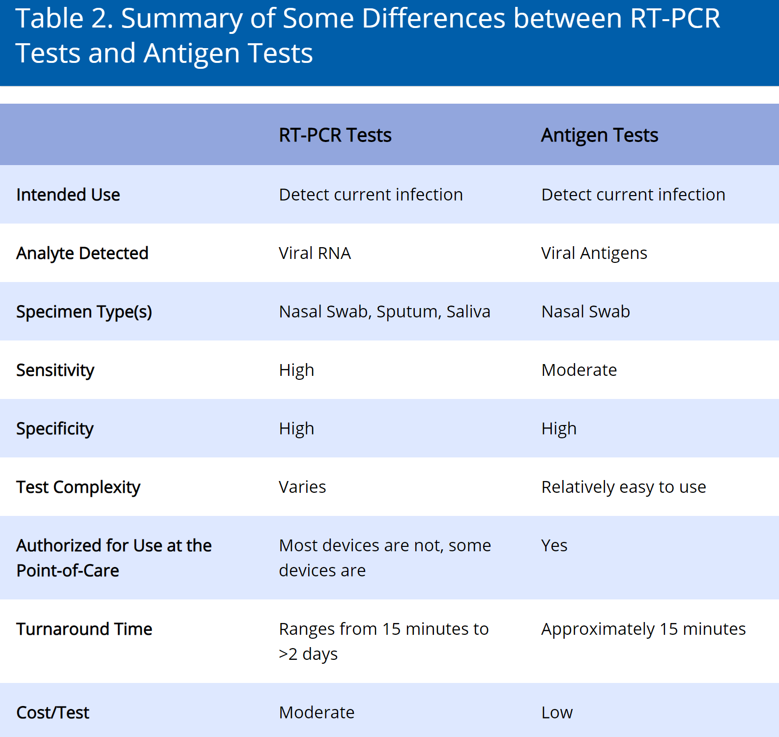
CDC POC Testing Guidance
New CDC Guidance on Rapid Antigen Tests
Must be Clinical Laboratory Improvement Amendments (CLIA) certified to perform diagnostic testing
Sensitivity/specificity of FDA-approved rapid tests vary - check your specific test
You must report results to local health department

Slide 26
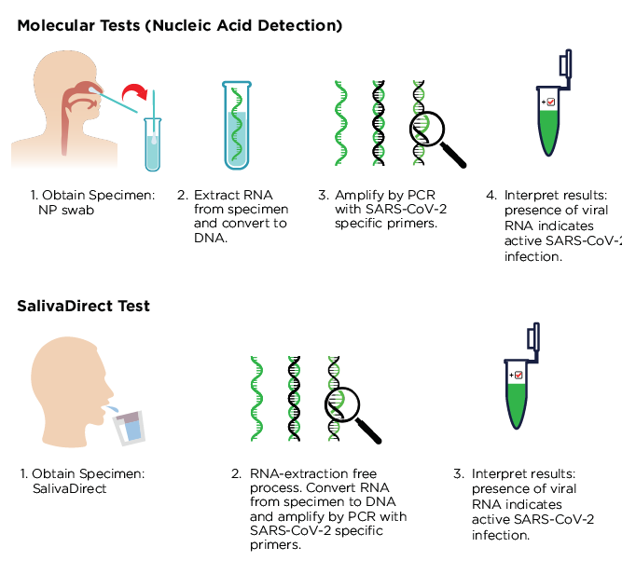
Saliva Covid Testing
Commercial kits available
More sensitive in early Covid ?
Easy sampling
Less expensive
Tricky for lab techs
Source:https://www.journalofinfection.com/article/S0163-4453(20)30349-2/abstract

Slide 27
Gov. Hogan Announces POC Test Purchasing
Tests will be deployed to: Nursing Homes, Assisted-Living Facilities, Correctional and Juvenile Detention Centers
Part of a compact between 10 states and the Rockefeller Foundation to scale up testing
Sources: https://www.baltimoresun.com/coronavirus/bs-md-testing-hogan-20200910-xmgzcfvoafd3znyv7bzj77apju-story.html; https://governor.maryland.gov/2020/09/10/governor-hogan-announces-acquisition-of-250000-rapid-antigen-tests-from-becton-dickinson-through-bipartisan-interstate-compact-with-rockefeller-foundation/

Slide 29
Five things you can do as Primary Care providers
1. Identify all your high-risk patients—use the COVID Vulnerability Index (CVI) in CRISP, your EHR, and your intuition
2. Reach out to every patient on those lists
3. Provide vulnerable patients with expanded care through telemedicine and special accommodations if they need face-to-face care
4. Offer testing for all patients, every visit
5. Stay current, stay safe—stay current by keeping up-to-date with CDC guidelines and case rates in your area. For up-to-date information, visit CDC, MDH, and MDPCP sites. Stay safe by taking all necessary infection control precautions when seeing patients

Slide 30
CME Accreditation and Designation
This activity has been planned and implemented in accordance with the Essential Areas and policies of the Accreditation Council for Continuing Medical Education (ACCME) through the joint providership of MedChi, The Maryland State Medical Society, and The Maryland Department of Health. MedChi is accredited by the ACCME to provide continuing medical education for physicians.
MedChi designates this live webinar educational activity for a maximum of 1 AMA PRA Category 1 Credits™. Physicians should claim only the credit commensurate with the extent of their participation in the activity. Contact Frank Berry at fberry@medchi.org

Slide 31
CME Disclosures and Evaluation
Presenters and Planners: Howard Haft, MD, has reported no relevant financial relationships to disclose.
MedChi CME Reviewers: The reviewers from the MedChi Committee On Scientific Activities (COSA) for this activity have reported no relevant financial relationships to disclose.
Please complete an evaluation at: COVID-19 Update Evaluation

Slide 32
Announcements
Learn from our Frequently Asked Questions page
Future Webinars
Today - Sneha Jadhav, MD
Helping Children Cope with COVID and Anxiety
Child Psychiatrist, Kennedy Krieger
Next Week - Michelle LaRue, MD Senior Manager Health and Social Services, CASA

Slide 33
Helping children cope with COVID and Anxiety
Sneha Jadhav, MD
Child and Adolescent Psychiatrist
Consultant for BHIPP
Kennedy Krieger Institute
Johns Hopkins Medical Institutions

Slide 34
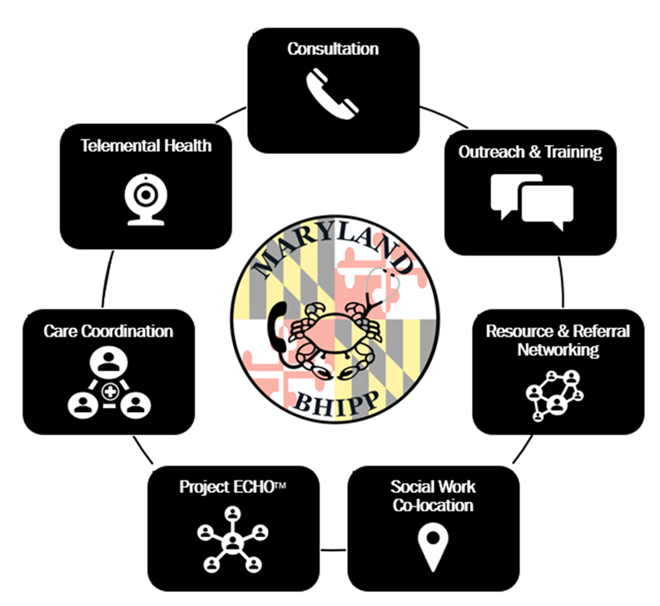
Who We Are – Maryland BHIPP
Offering support to pediatric primary care providers through free:
Telephone consultation (855-MD-BHIPP)
Resource & referral support
Training & education
Regionally specific social work co-location (Salisbury University and Morgan State University)
Project ECHO®
Coming soon!
Direct Telepsychiatry & Telecounseling Services
Care coordination
Notes:
Maryland Behavioral Health Integration in Pediatric Primary Care or BHIPP is a Child Psychiatry Access Program that supports the capacity of primary care providers in Maryland to manage pediatric mental health concerns. We do this, currently, in a number of ways: 1. We offer a free behavioral health telephone consultation service, including resource and referral support, 2. education and training, 3. Through our partnership with Salisbury and Morgan State University, we offer co-location of social work interns at select primary care sites, 4. Web-based longitudinal learning through Project ECHO similar to today’s event, 5. Direct telepsychiatry and telecounseling services (coming soon) , 6. Care Coordination (coming soon)

Slide 35
Partners & Funding
BHIPP is supported by funding from the Maryland Department of Health, Behavioral Health Administration and operates as a collaboration between the University of Maryland School of Medicine, the Johns Hopkins University School of Medicine, Salisbury University and Morgan State University.
This program is supported by the Health Resources and Services Administration (HRSA) of the U.S. Department of Health and Human Services (HHS) as part of an award totaling $433,296 with approximately 20% financed by non-governmental sources. The contents of this presentation are those of the author(s) and do not necessarily represent the official views of, nor an endorsement, by HRSA, HHS or the U.S. Government. For more information, visit www.hrsa.gov.

Slide 36
Objectives
Recognize developmentally normal v/s excessive anxiety
Identify strategies to promote resilience and normalize anxious thoughts during the pandemic
Discuss treatment options for anxiety when treatment becomes necessary

Slide 37
What are Children dealing with?
A Disaster: The WHO describes disaster as, “a severe ecological and psychosocial disruption which greatly exceeds a community’s ability to cope.”
How long will this affect them?
Degree of exposure (active and passive) 🡨---🡪 prevalence of anxiety/depression
27 months after the September 11 attacks:
Emotional reactions in children were sadness, tearfulness, anger, irritability, sleep disturbance, intrusive thoughts and images.

Slide 38
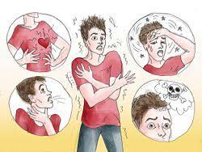
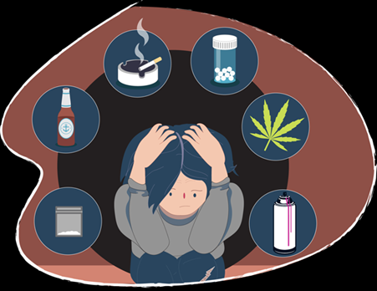
Anxiety in children

Slide 39
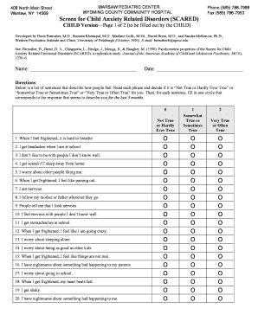
Anxiety Assessment
Clinical Assessment
Trauma screen
Anxiety Scales
Family history
Medical workup
GAD 7 scale
SCARED scale

Slide 40
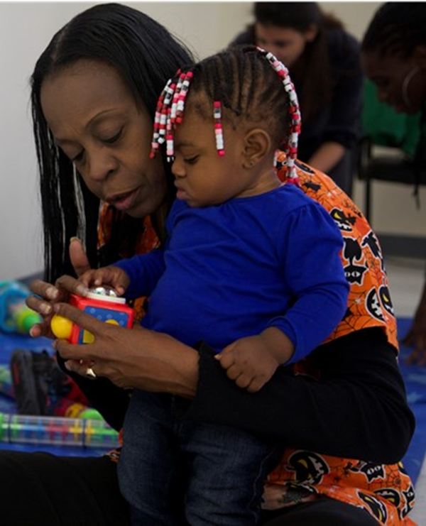
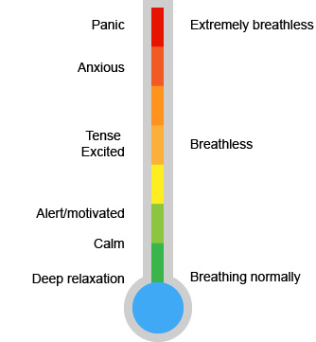
How to manage anxiety?
Normalize
Routine
Self care/sleep
Social bonds
Parental Anxiety
Monitor/ limit exposure
Child directed activity
Relaxation/Breathing
Daily check in

Slide 41
When to treat anxiety?
Know the baseline/ change from baseline
How many issues/ how bad? (spectrum of symptoms)
How long? (duration)
How does it affect their day? (dysfunction)
Has anything helped?
What is effective for these symptoms? (evidence based treatment)

Slide 42
Treatment
Prevention
Therapy
Medication
Minimize indirect exposure
Provide facts
Keep a routine
Self care
Calming/ breathing exercises
Anxious children often have anxious parents
Therapy
Psychotherapy- CBT, play therapy, supportive therapy
Response to CBT: 55-80%
SSRIs (best evidence)
SNRIs (limited data)
Hydroxyzine
Anticholinergics
Buspar
Benzos- probably not!

Slide 43
More about Meds
SSRI (FDA approval) | Start (mg) | Maximum (mg) | Increments (mg)
Sertraline (6 and up) | 6-12yo: 25 (12.5) 13-17 yo: 50 | 200 200 | 12.5-25
Fluoxetine (7 and up) | 5-10 (2.5) | 60 | 5-10
Escitalopram (12 and up) | 5-10 (2.5) | 20 | 5
SNRI | Start (mg) | Maximum (mg) | Increments (mg)
Duloxetine (7 and up) | 30 (15) | 60 | 15-30

Slide 44
Treatment- Side Effects
GI pain, nausea, diarrhea
Headache
Sexual (decreased libido, orgasm)
Activation
hypomania
Suicidality/ Black Box warning
Serotonin syndrome
Discontinuation syndrome
All effects (good and bad) seem ‘bigger’ to anxious children.

Slide 45
Summary
Developmentally normal v/s pathological anxiety
Use a variety of assessment tools
Include parents in treatment
Treatment plan- Environment+ Therapy+ Meds
Thank you for your attention!

Slide 46
BHIPP is Available to Provide Support to Pediatric PCPs
Ways to Connect:
Visit our COVID-19 Resource Page:
www.mdbhipp.org
Sign up for our newsletter:
https://mdbhipp.org/contact.html
Follow us on Facebook:
https://www.facebook.com/MDBHIPP/
Follow us on Twitter:
https://twitter.com/MDBHIPP

Slide 47
Thank you!

Slide 48
Appendix
Resources and Links

Slide 49
Scheduling In-Office Appointments
Patient calls in for an appointment
Reception screens patient on the phone using the pre-visit screening template
Schedule in-office visits for different groups: At-risk and vulnerable patients on certain days, healthier patients on other days
Schedule telehealth and non-office-based care for other patients including follow-ups and patients uncomfortable with office visits
Check In
Practice remote check in and limited front-desk contact
Consider using a triage zone outside of office or main area;
Or use a barrier at the front desk
Design your office to accommodate patients who come in specifically for COVID testing and triage, separate from patients who arrive for non-COVID related and elective procedures
Ensure patients and staff do not cross between COVID and non-COVID areas
Set aside a specific area for patients who come in for testing to wait and be triaged

Slide 50
Scheduling In-Office Appointments
Checking out
Practice remote check out, limit front desk exposure;
Or use a barrier at the front desk
If patient is paying co-pays, etc., set up credit card reader outside of the barrier

Slide 51
Governor Hogan Directive – Elective & Non-Urgent Medical Procedures may resume May 7, 2020
These measures must be in effect:
Licensed healthcare providers will use their judgment to determine what appointments and procedures are appropriate
Facilities and providers must have at least one week’s supply of personal protective equipment (PPE) for themselves, staff, and as appropriate, for patients
PPE requests to any State or local health or emergency management agency will be denied for elective and non-urgent medical procedures
The healthcare facility or healthcare provider must be able to procure all necessary PPE for its desired services via standard supply chains
For hospitals with COVID-19 patients, MDH will determine a daily PPE per patient use rate for PPE requests
Social distancing must be maintained in all waiting areas
All healthcare workers, patients, and others must be screened for COVID-19 symptoms upon arrival for shift or visit. Staff must stay home if they are showing COVID-19 symptoms.
All healthcare facilities and healthcare providers must implement enhanced workplace infection control measures > CDC guidelines: https://www.cdc.gov/coronavirus/2019-ncov/hcp/infection-control.html
All healthcare providers and staff shall wear appropriate face coverings, to include cloth face coverings, surgical face masks or N-95 masks, respirators, and/or face shields
Patients should wear a face covering whenever possible
Any healthcare facility or provider unable to provide PPE for themselves, staff, and patients where appropriate must immediately restrict operations to urgent and non-elective procedures and appointments

Slide 52
Maryland Companies Producing Personal Protective Equipment in Response to COVID-19
Grant Recipient | County | Typical Production | COVID-19 Production
Awesome Ninja Labs | Baltimore City | Medical devices | Face shields
CoastTec | Carroll | Battery back-ups for computers | Battery packs for Vyaire ventilators
CR Daniels | Howard | Textile, plastics, and metal manufacturing | Face masks and gowns
DiPole Materials | Baltimore City | Custom nanofiber manufacturing | Filters for medical masks and respirators
DVF Corporation | Washington | Metal and plastic fabrications | Plastic components of respirators
Fashions Unlimited | Baltimore City | Apparel manufacturing | Surgical masks and protective gowns
Fabrication Events | Howard | Special event decor | Face masks, head coverings, and other PPE
Harbor Designs | Baltimore City | Manufacturing design and engineering | Ventilators
Hardwire, LLC | Worcester | Bulletproof body armor and equipment for law enforcement and the military | Face shields
K&W Finishing | Baltimore City | Traditional die cutting, coating, and other bindery services | Face shields
Grant Recipient | County | Typical Production | COVID-19 Production
Key Technologies | Baltimore City | Medical devices | Blower units for positive air pressure respirators
LAI International | Carroll | Components for aerospace and defense, medical devices and infrastructure systems | Face shields
Manta BioFuels | Baltimore County | Energy technology | Face shields
Marty’s Bag Works | Anne Arundel | Canvas boating products, cushions, laser printing, and bags | Surgical masks, face shields, and lightweight gowns
Nations Photo Lab | Baltimore County | Full-service photo printing | Face shields
NRL & Associates | Queen Anne’s | Ultra-precision machining, fabrication, and assembly | Ventilators
Potomac Photonics | Baltimore County | Biotech and medical devices | PPE visors
Rankin Upholstery | Montgomery | Auto, marine, aircraft and custom upholstery | Masks, gowns, and other PPE
Strouse | Carroll | Adhesive solutions | N-95 masks
X-Laser | Howard | Laser light show systems | Face shields

Slide 53
Personal Protective Equipment (PPE) Sources and Requests
Routed through Local Health Departments
Priority as previously stated - may change over time
Maryland PPE Manufacturers List – next slide
National and International PPE Supplier List
PPE request forms and local contacts

Slide 54
State Launches Maryland PPE Network Supplier Portal
Increasing Maryland’s supply of PPE – one of the 4 building blocks on the Road to Recovery
Maryland has launched the Maryland Manufacturing Network Supplier Portal, an online platform that helps connect Maryland suppliers with buyers in need of critical resources
Large daily deliveries come into the state’s warehouses
For additional business resources during COVID-19, visit businessexpress.maryland.gov/coronavirus

Slide 55
Help your patients get health coverage
Maryland Health Connection, the state’s health insurance marketplace, has a Coronavirus Emergency Special Enrollment Period until June 15 for uninsured Marylanders. All plans on Maryland Health Connection cover testing and treatment of COVID-19.
How to enroll
Enroll online at MarylandHealthConnection.gov
Call 1-855-642-8572. Deaf and hard of hearing use Relay service. Help is available in 200 languages.
Download the free “Enroll MHC” mobile app to enroll on a phone/tablet.
Navigators throughout the state can answer questions and enroll consumers by phone.

Slide 56
Considerations when Reusing N95 Respirators (CDC)
There is no way of determining the maximum possible number of safe reuses for an N95 respirator as a generic number to be applied in all cases.
Safe N95 reuse is affected by a number of variables that impact respirator function and contamination over time.
Manufacturers of N95 respirators may have specific guidance regarding reuse of their product.
CDC guidelines advise to discard N95 respirators before they become a significant risk for contact transmission or their functionality is reduced
Administrative controls (e.g. staff training, reminders, and posters)
Minimize unnecessary contact with the respirator surface
Strict adherence to hand hygiene practices
Proper PPE donning and doffing technique, including physical inspection and performing a user seal check
Engineering controls (e.g. use of barriers to prevent droplet spray contamination)
Source

Slide 57
CDC Guidelines - N95 Respirators and Infection Control
Clean hands with soap and water or an alcohol-based hand sanitizer before and after touching or adjusting the respirator (if necessary for comfort or to maintain fit).
Avoid touching the inside of the respirator. If inadvertent contact is made with the inside of the respirator, discard the respirator and perform hand hygiene as described above.
Use a pair of clean (non-sterile) gloves when donning a used N95 respirator and performing a user seal check. Discard gloves after the N95 respirator is donned and any adjustments are made to ensure the respirator is sitting comfortably on your face with a good seal.
Follow the manufacturer’s user instructions, including conducting a user seal check.
Discard any respirator that is obviously damaged or becomes hard to breathe through.
Pack or store respirators between uses so that they do not become damaged or deformed.

Slide 58
CDC Guidelines - Reusing N95 Respirators
N95 respirator must only used by a single wearer (Label N95 respirator on the straps with person’s name)
Consider use of a cleanable face shield (preferred) over an N95 respirator and/or other steps (e.g., masking patients, use of engineering controls), when feasible to reduce surface contamination of the respirator.
Hang used respirators in a designated storage area or keep them in a clean, breathable container such as a paper bag between uses.
To minimize potential cross-contamination, store respirators so that they do not touch each other and the person using the respirator is clearly identified (including date).
Storage containers should be disposed of or cleaned regularly.
Follow the employer’s maximum number of donnings (or up to five if the manufacturer does not provide a recommendation) and recommended inspection procedures.

Slide 59
CDC Guidelines - When to Discard N95 Respirators
Discard N95 respirators following use during aerosol generating procedures
Discard N95 respirators contaminated with blood, respiratory or nasal secretions, or other bodily fluids from patients
Discard N95 respirators following close contact with any patient co-infected with an infectious disease requiring contact precautions

Slide 60
COVID-19 Testing Site Information
Patients require a provider order for referral to testing sites
Providers contact your local hospital or use the link below
Sites are subject to host location restrictions and availability
MD is also piloting drive-thru testing at several Vehicle Emissions Inspections Program (VEIP) locations – FAQs available here.
Current list of testing sites, please click here

Slide 61
CDC Guidelines for COVID Patient Management
Healthy people can be monitored, self-isolated at home
People at higher risk should contact healthcare providers early, even if illness is mild
Older adults and people with severe underlying chronic medical conditions are at higher risk, need closer contact
Emergency Department and Hospitals only when needed - not for screening or low risk/minimal disease
Guidelines are important and powerful tools, but remember providers’ clinical experience and judgment are key to care

Slide 62
Billing for End-of-Life Planning
Billable event with AWV or Separate Encounter
99497 - Advance care planning including the explanation and discussion of advance directives such as standard forms (with completion of such forms, when performed), by the physician or other qualified healthcare professional; first 30 minutes, face-to-face with the patient, family member(s), and/or surrogate
99498 - Advance care planning including the explanation and discussion of advance directives such as standard forms (with completion of such forms, when performed), by the physician or other qualified healthcare professional; each additional 30 minutes (List separately in addition to code for primary procedure)

Slide 63
Support for Patients at Home
Food
Meals on Wheels
Caregivers
Visiting nurses and caregivers
Emotional support
Support from family
Phone calls and videochat to fight loneliness
MD Department of Aging Senior Call Check Program

Slide 64
Caregiver Services Corps (CSC)
OPEN for primary care providers STATEWIDE throughout Maryland’s reopening!
The CSC call center (800-337-8958), staffed with specialists 7 days a week, matches volunteers for urgent and temporary assistance to people over 65 years old in their homes to help with:
Self-administration of medications
Ambulation and transferring
Bathing and completing personal hygiene routines
Meal preparation and grocery or prepared meals delivery
Teaching how to use video technologies to connect with loved ones and/or healthcare providers for telemedicine
Healthcare providers should alert their patients they are being referred
Seniors, their families and friends may call 211 to seek help and referrals to the elderly in need

Slide 65
Hospital Surge Preparedness
Convention Center needs medical staff – Visit https://www.linkedin.com/jobs/view/1788387174
Tents and Modular Units - including ICUs
Expansion within facilities
Professional student staffing
Employment opportunities for healthcare professional and support staff: www.MarylandMedNow.com

Slide 66
Opportunities to Volunteer and Serve
Volunteer staffing opportunities - Maryland Responds Medical Reserve Corps (MRMRC)
https://mdresponds.health.maryland.gov/
Complete Road to Readiness

Slide 67
Staying Current - Sources
General Guidelines
CDC
MDH COVID-19 information page
MDPCP COVID-19 webpage
Local Health Departments
CONNECT
Clinician Letters
Multiple Resource Links in Appendix

Slide 68
MedChi/CareFirst/Backline Grant
CareFirst BlueCross BlueShield (CareFirst) and the Maryland State Medical Society (MedChi) launched a grant program that will equip additional Maryland physicians with the technology they need to provide needed virtual care during the COVID-19 pandemic and beyond
Eligibility Requirements
The medical practice and medical license are in Maryland
The medical practice is a private, independent group of five or fewer physicians
The practice enrolls in Backline after March 1, 2020 as the result of the COVID-19 crisis
MedChi has confirmed the practice’s enrollment with DrFirst
Enrollment in Backline occurs before December 31, 2020
Application Steps
Can be completed in less than 5 minutes
Complete the application linked here
Email completed application to amullin@medchi.org
For questions, email or call Andrea Mullin at amullin@medchi.org or 800-492-1056 x3340
Grant Amount
$300 per eligible physician

Slide 69
Federal Emergency Funds for Small Business
Disaster Loan Assistance (from Small Business Administration)
Low-interest financial disaster loans for working capital in small businesses suffering substantial economic injury due to COVID-19
FAQs
CARES Act (pending federal legislation)
Sets up a $350 billion loan program for small businesses
Small businesses can apply for low-interest loans that cover up to 2.5 months of expenses
Maximum loan amount is $10 million
Loans can cover payroll, rent, utilities, or existing debt obligations
Interest rates cannot exceed 4%
If employer continues to pay workers through June, the amount of the loans that went toward eligible costs would be forgiven
Loans will be available through the Small Business Administration and Treasury-approved banks, credit unions, and some nonbank lenders

Slide 70
State Emergency Funds for Small Business
COVID-19 Layoff Aversion Fund (from Maryland Governor Larry Hogan and Maryland Dept. of Labor)
Designed to support businesses undergoing economic stresses due to the pandemic by minimizing the duration of unemployment resulting from layoffs
Award of up to $50,000 per applicant
Will be quick deployable benefit and customizable to specific business needs
View the One-Pager
COVID-19 Layoff Aversion Fund Policy
COVID-19 Layoff Aversion Fund Application (Excel)
Submit your completed application to: LaborCOVID19.layoffaversion@maryland.gov.

Slide 71
Food Resources
Nutrition: Inform patients that children can receive three free meals/day at sites listed on:
Maryland Summer Meals Howard County
Montgomery County Anne Arundel County
Prince Georges County St. Mary's County
Charles County Harford County
Frederick County Calvert County
Free meals available from 42 rec centers in Baltimore
Call 311 for locations and to schedule pickup time

Slide 72
Resources for Specific Groups
Resources
Community- and Faith-Based Organizations (https://www.cdc.gov/coronavirus/2019-ncov/community/guidance-community-faith-organizations.html)
Mass Gatherings and Large Community Events (https://www.cdc.gov/coronavirus/2019-ncov/community/mass-gatherings-ready-for-covid-19.html)
Non-Pharmaceutical Interventions for Specific Groups (https://www.cdc.gov/nonpharmaceutical-interventions/index.html)

Slide 73
Resources and References
Resources
Maryland Department of Health Coronavirus Website (https://coronavirus.maryland.gov)
CDC Coronavirus Website (https://www.cdc.gov/coronavirus/2019-nCoV/index.html)
CDC National data on COVID-19 infection and mortality (https://www.cdc.gov/coronavirus/2019-ncov/cases-updates/cases-in-us.html)
CDC Interim Guidance for Homes and Communities (https://www.cdc.gov/coronavirus/2019-ncov/hcp/guidance-prevent-spread.html)
CDC Interim Guidance for Businesses (https://www.cdc.gov/coronavirus/2019-ncov/specific-groups/guidance-business-response.html)
CDC Interim Guidance for Childcare and Schools (https://www.cdc.gov/coronavirus/2019-ncov/specific-groups/guidance-for-schools.html)
CDC Travel Website (https://wwwnc.cdc.gov/travel/)

Slide 74
State Emergency Funds for Small Business
Maryland Small Business COVID-19 Emergency Relief Loan Fund
$75 million loan fund (to be paid to for-profit business only)
Loans are up to $50,000
No interest or principal payments due for the first 12 months
Thereafter converts to 36-month term loan of principal and interest payments, with interest rate of 2% per annum
Maryland Small Business COVID-19 Emergency Relief Grant Fund
$50 million grant program for businesses and non-profits
Grant amounts of up to $10,000
Grant amounts not to exceed three months of demonstrated cash operating expenses for Q1 2020
Emergency Relief Fund FAQ
Questions or concerns email fpaaworkflowcoordinator.commerce@maryland.gov.

