Slide 1

Community Health Resources Commission January 20, 2016
The Hon. John A. Hurson Chairman, Maryland Community
Health Resources Commission
Mark Luckner Executive Director, Maryland Community Health Resources Commission

Slide 2
BACKGROUND ON THE CHRC
The Community Health Resources Commission (CHRC) was created by the Maryland General Assembly in 2005 to expand access for low-income Marylanders and underserved communities.
Statutory responsibilities include:
Increase access to primary and specialty care through community health resources
Promote community-hospital partnerships and emergency department diversion programs to prevent avoidable hospital utilization
Facilitate the adoption of health information technology
Promote long-term sustainability of community health resources as Maryland implements health care reform

Slide 3








BACKGROUND ON THE CHRC
The CHRC grants have focused on the following public health priorities:
Reducing infant mortality
Integrating behavioral health
Promoting ED diversion programs
Investing in health information technology
Expanding primary care access
Addressing childhood obesity
Increasing access to dental care
Building safety net capacity

Slide 4
BACKGROUND ON THE CHRC
Eleven Commissioners of the CHRC are appointed by the Governor.
Below is a listing of the CHRC Commissioners (one vacancy).
John A. Hurson, Chairman
Nelson Sabatini, Vice Chairman
Elizabeth Chung, Executive Director, Asian American Center of Frederick
Charlene Dukes, President, Prince George’s County Community College
Maritha R. Gay, Executive Director of Community Benefit and External Affairs, Kaiser Foundation Health Plan of the Mid-Atlantic States Region
William Jaquis, M.D., Chief, Department of Emergency Medicine, Sinai Hospital
Sue Kullen, Southern Maryland Field Representative, U.S. Senator Ben Cardin
Paula McLellan, CEO, Family Health Centers of Baltimore
Barry Ronan, President and CEO, Western Maryland Health System
Maria Harris-Tildon, Senior Vice President for Public Policy and Community Affairs, CareFirst BlueCross BlueShield

Slide 5
IMPACT OF CHRC GRANTS
Since 2007, CHRC has awarded 154 grants totaling $52.3 million. Most grants are for multiple program years.
CHRC has supported programs in all 24 jurisdictions.
These programs have collectively served approximately 200,000 Marylanders.
Most grants are awarded to community based safety net providers, including federally qualified health centers (FQHCs), local health departments, free clinics, and outpatient behavioral health providers.

Slide 6
IMPACT OF CHRC GRANTS
Encourage programs to be sustainable after initial “seed” grant funding is expended.
Utilize CHRC grant funding to leverage additional federal and private/non-profit funding.
$52.3M awarded to grantees
$18.8M in additional resources
$14.9M in private, nonprofit, or local resources
Weinberg Foundation
$250,000 to West Cecil Community Health Center
CareFirst $447,612 to Access to Wholistic. & Prod. Living
$3.8M in federal resources
HRSA New Access Point $425,874 to Mobile Med

Slide 7
CHRC GRANTS IN LARGER CONTEXT
Assist ongoing health care reform efforts
Build capacity of safety net providers to serve newly insured
Assist safety net providers in IT, data collection, business planning
Promote long-term financial sustainability of providers of last resort
Support All-Payer Hospital Model and health system transformation
Provide initial seed funding for community-hospital partnerships
Fund community-based intervention strategies that help achieve reductions in avoidable hospital utilization
Issued white paper, “Sustaining Community-Hospital Partnerships to Improve Population Health” (authored by Frances B. Phillips)
Support population health improvement activities
Align with State Health Improvement Process (SHIP) goals
Build infrastructure of Local Health Improvement Coalitions

Slide 8

CHRC REAUTHORIZATION
The Maryland General Assembly approved legislation (Chapter 328) in 2014 to re-authorize the CHRC until 2025. This vote was unanimous.
CHRC has a demonstrated track record in distributing and managing public funds efficiently and holding grantees accountable for performance
47 grants, totaling $10 million, under implementation
Monitored by CHRC staff of four PINS
Agency overhead is 7% of its $8 million budget

Slide 9
COMMUNITY HEALTH RESOURCES ARE IMPORTANT IN ONGOING HEALTH REFORM
Health insurance does not always mean access
FQHCs and other community health resources may be the best option for newly insured because many non-safety net providers do not accept new patients or have long wait times
Historical mission of serving low-income individuals who are impacted by social determinants and have special health and social service needs
Health literacy - critical role of safety net providers
Demand for health services by the newly insured dramatically outpaces the supply of providers
81% of FQHCs nationally have seen an increase in patients in the last 3 years

Slide 10
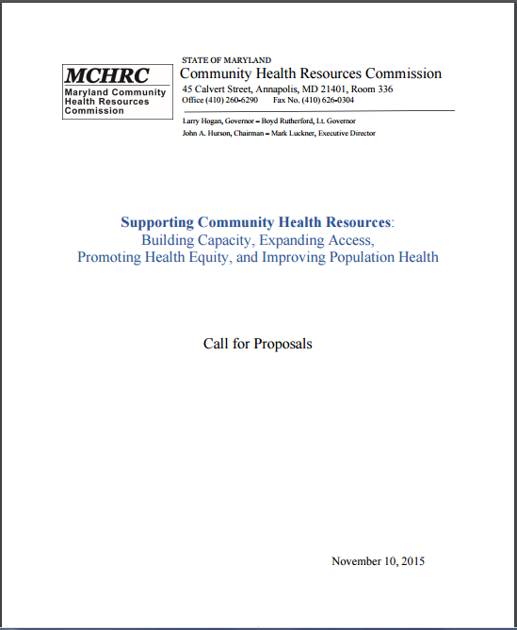
FY 2016 CALL FOR PROPOSALS
Key Dates:
November 10, 2015 – Release of Call for Proposals
January 11, 2016 – Applications due
January/February – Grant Review Period
Mid-March – Presentations and Award Decisions
Three strategic priorities:
Expand capacity;
Reduce health disparities; and
Support efforts to reduce avoidable hospital utilization.

Slide 11
FY 2016 CALL FOR PROPOSALS
Generated 71 proposals totaling $14.8 million in year one funding (FY 2016 budget - $1 million is available)
Most proposals seek funding for multiple years. Total requested this year was $31.3 million.
RFP includes 4 types of projects:
Women’s health/infant mortality - 4 proposals, $1.7M
Dental care - 12 proposals, $2.8M
Behavioral health/heroin and opioid epidemic - 20 proposals, $9.8M
Primary care and chronic disease management -
35 proposals, $17.0M

Slide 12
FY 2016 CALL FOR PROPOSALS
Review Criteria (100 point scale)
(1) Addresses strategic priorities (1a) Build capacity and support implementation of the Affordable Care Act (1b) Address health disparities (1c) Reduce avoidable hospital admissions and readmissions
(2) Community need | (3) Project impact and prospects for success
(4) Program monitoring, evaluation, and capacity to collect/report data | (5) Sustainability/matching funds
(6) Participation of stakeholders and partners | (7) Organizational commitment and financial viability

Slide 13
CHRC BUDGET AND DEMAND BY COMMUNITY HEALTH RESOURCES
Demand for grant funding exceeds CHRC’s budget
The Commission has funded approximately 19% of requests ($276.2M requested; $52.3M awarded)
Total requests for funding
$276.2M
Applications received
593
Total of grants awarded
$52.3M
Total grants awarded
154

Slide 14
CHRC GRANTEE PRESENTATIONS
Traci Kodeck, Health Care Access Maryland (HCAM) David Baker, LifeBridge Sinai Hospital
Access Health, ED diversion program and community-hospital partnership
Targets high utilizers and offers care coordination and linkage to care
Tammy Black, Access Carroll
Access to care for low-income residents providing primary care, dental, and behavioral health services
Promote long-term financial sustainability by leveraging other grants (CareFirst and Weinberg) and billing third party payers (Medicaid and commercial)
Dr. Larry Polsky, Calvert County Health Department
“Healthy Beginnings” program for substance using women of reproductive age
Program provides counseling, prenatal care, training, and linkage to community resources
Colenthia Malloy, Greater Baden Medical Services
Open new health center site in Charles County; FQHC operates multiple sites in Prince George’s, Charles, and St. Mary’s Counties
Services include: primary care, management of chronic disease, and behavioral health

Slide 15


Maryland Community Health Resources Commission: Access Health
Traci Kodeck, MPH
Interim-CEO, HealthCare Access Maryland
And
David R. Baker, DrPH, MBA
Director, Ambulatory Quality, LifeBridge Health

Slide 16

ED Frequent User Reduction
“Access Health” – Partnership with HCAM
Launched in June 2014
Embedded Care Coordinators in Sinai ED
Engage patients returning with
Unmanaged chronic conditions (somatic, behav, subst abuse)
Ambulatory-sensitive conditions
Intensive Care Coordination
3 months
Home visits
Address social barriers
HealthCare Access Maryland (HCAM):
Baltimore-based nonprofit that specializes in connecting vulnerable Maryland residents to needed social services and health-promoting resources

Slide 17
Our Model
Assess
Identify
Refer
Follow up
Develop Care Plan

Slide 18
Impact To-Date
434 clients enrolled (Jan 11 2016)
(51% of referred patients)
Client profile:
4% High-risk/super-utilizer
37% At-risk*
29% Low-risk
30% Insurance only
Insurance sign-up: 120 clients
Obtain a primary care provider: 222 clients
Primary care appointments kept: 73%

Slide 19
Impact To-Date (cont.)
Comparing 4 months pre-enrollment with 4 months post case closed
At-Risk Clients with Cases Closed through 9/10/15
78% have 0 visits in the first month post case closed
65% have 0-1 visit 4 months post case closed
Estimated Avoided Utilization To-Date
Sinai Hospital | % Reduction | Avoided Visits | Average Charge/Visit | Est. Avoided Charges
ED Visits | 64% | 157 | $1,181 | $185,417
Inpt Stays | 80% | 45 | $9,935 | $447,075
Total | 67% |  |  | $632,492

Slide 20
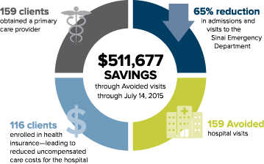
Lessons Learned
Hospital Champion
Embedded within ED
Access to EMR system/Flagging System
Shared Data
CRISP ENS alerts
Delineation by Risk Stratification

Slide 21
Sample Client Story #1
In a five-day period in July, a 54-year-old man had come to the Sinai ED three times. He was referred to an Access Health Care Coordinator. The Coordinator learned that, in addition to having a hernia, the client lacked health insurance and frequently went hungry.
The Coordinator worked with the client for 6 weeks—including three home visits. She connected him to Medicaid, a primary care provider, and food stamp benefits. She also helped the patient schedule hernia surgery.
Since working with the Care Coordinator, the client has not visited the ED.

Slide 22
Sample Client Story #2
The client is a 56 year old woman who often came to the ED for non-emergency reasons, such as a stomach ache. Prior to enrollment, the client visited Sinai’s ED 14 times within a 4-month period. The Coordinator met with her in the ED and the client agreed to program services.
The Coordinator established a relationship with the client and arranged a new PCP, medication support, and a therapist. HCAM is in the process of obtaining a home aide. The client has followed through on her appointments to-date.
Since development of her care plan, the client has returned to the ED only once.

Slide 23
Traci Kodeck, MPH Interim-CEO HealthCare Access Maryland TKodeck@HCAMaryland.org David R. Baker, DrPH, MBA Director, Ambulatory Quality LifeBridge Health CMS Innovation Advisor DBaker@LifeBridgeHealth.org

Slide 24
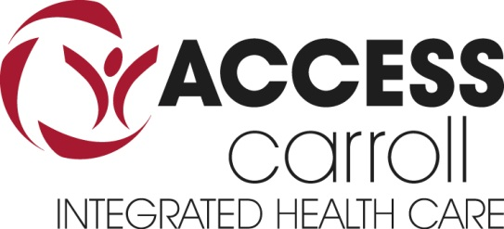
An Integrated, Patient-Centered,
Medical Home

Slide 25
Who We Are
Private, nonprofit – 501(c)(3)
Established 2005 – 10 years old
Private and Public Health Partnership
Strategic partners with Carroll Hospital & CCHD & Partnership for a Healthier Carroll County
Provide integrated medical, dental, and behavioral health
Target low-income, at-risk residents – high rate of chronic disease
Community-based - Volunteer driven
Centrally located
Addressing local health access – only full-time safety-net

Slide 26
Community Health Resources Commission (HCRC)
Three MCHRC Grants for improving access to health care since 2007:
1. Access to Care – Care Coordination – 2007
Award: $100K/2 years = $479,078 leveraged cash
2. Access to Dental Care – 2011
Award: $300K/3 Years = $611,767 leveraged cash
3. Capacity Expansion – 2014
Award: $125K/2 Years = $184,125 leveraged cash

Slide 27
Leveraging Power
Total MCHRC Awards: $525,000
Total Leveraging thru December 31,2015
Cash: $1,274,970
In-Kind: $5 million conservatively– providers, supplies, diagnostics, staffing, facility space

Slide 28
Access Coordination
Established first RN Care Coordinator in county for at-risk residents (Access Coordinator – hired March 2007)
Model of Coordination for aligning community resources – diagnostics, specialty care, medications, providers/staff
Focused on Social Determinants of Health since 2007 – shelter, food, clothing, phones, transportation, public assistance
Overall patients served: 6,703 individuals
Intensive Case Management: Average 65 monthly - 1 FTE
IMPACT: Model of training and replicating Care Coordination within community and intensive case management: efficient, cost-effective, high patient satisfaction, high provider retention, reduction of disease exacerbations, reduction ED utilization & readmissions, reduction of recidivism, and healthy community
International Recognition: China visited in 2014

Slide 29
Access to Dental Care
Funding in response to a proposed capital expansion project
2011-2012 Initially extractions only – 1 day/month – capital delays
2013 – Opened New Dental Clinic – full time
Preventive, Diagnostic, Restorative, Emergency
Funding supported full time dentist and essential dental staff
IMPACT:
Only full-time family dental clinic in CC offering reduced cost dental care for all ages – sliding fee $40 at 138% of FPL
Will be only clinic accepting Medicaid for all ages
Serving high number Medicaid and elderly Medicare
New relationship with University of MD Dental and Hygiene School
Served: 802 Individual Patients with 4,672 encounters
Highest need: Extractions and Dentures
Since Opening clinic 07/2013: Extractions: 4,361 Dentures: 1,147
People don’t hire people who don’t have teeth! Giving smiles!!

Slide 30
Capacity Expansion
With imminent need to expand, three core goals:
1. Transition from solely grant and donation based revenue to accepting of insurance, targeting Medicaid recipients.
Barriers: Malpractice, Volunteerism Success: MA Provider Status
2. Develop an integrated business and sustainability plan with public health partners.
3. Develop platform for FQHC application when eligible to apply as an integrated private and public hybrid model.
IMPACT: Establish as premier community health safety-net provider – integrated medical, dental, and behavioral health
Expand as Medicaid and safety-net provider
Directly address population health and local health improvement plans
Achieve high quality, affordable, accessible, and collaborative health services for at-risk residents with emphasis on prevention and wellness.
Model drivers: Person-centered care, social determinants of health, chronic disease management, and community health navigation

Slide 31
Thank You!
On behalf of the patients we serve, we thank the MCHRC for being a VISIONARY PARTNER since 2007!
Visionary Partners provide philanthropic support to address community health issues through innovative and pioneering concepts. Through the generosity of our Visionary Partners, Access Carroll is a trailblazer of improved access to medical, dental, and behavioral health services for those most in need in Carroll County, Maryland.

Slide 32
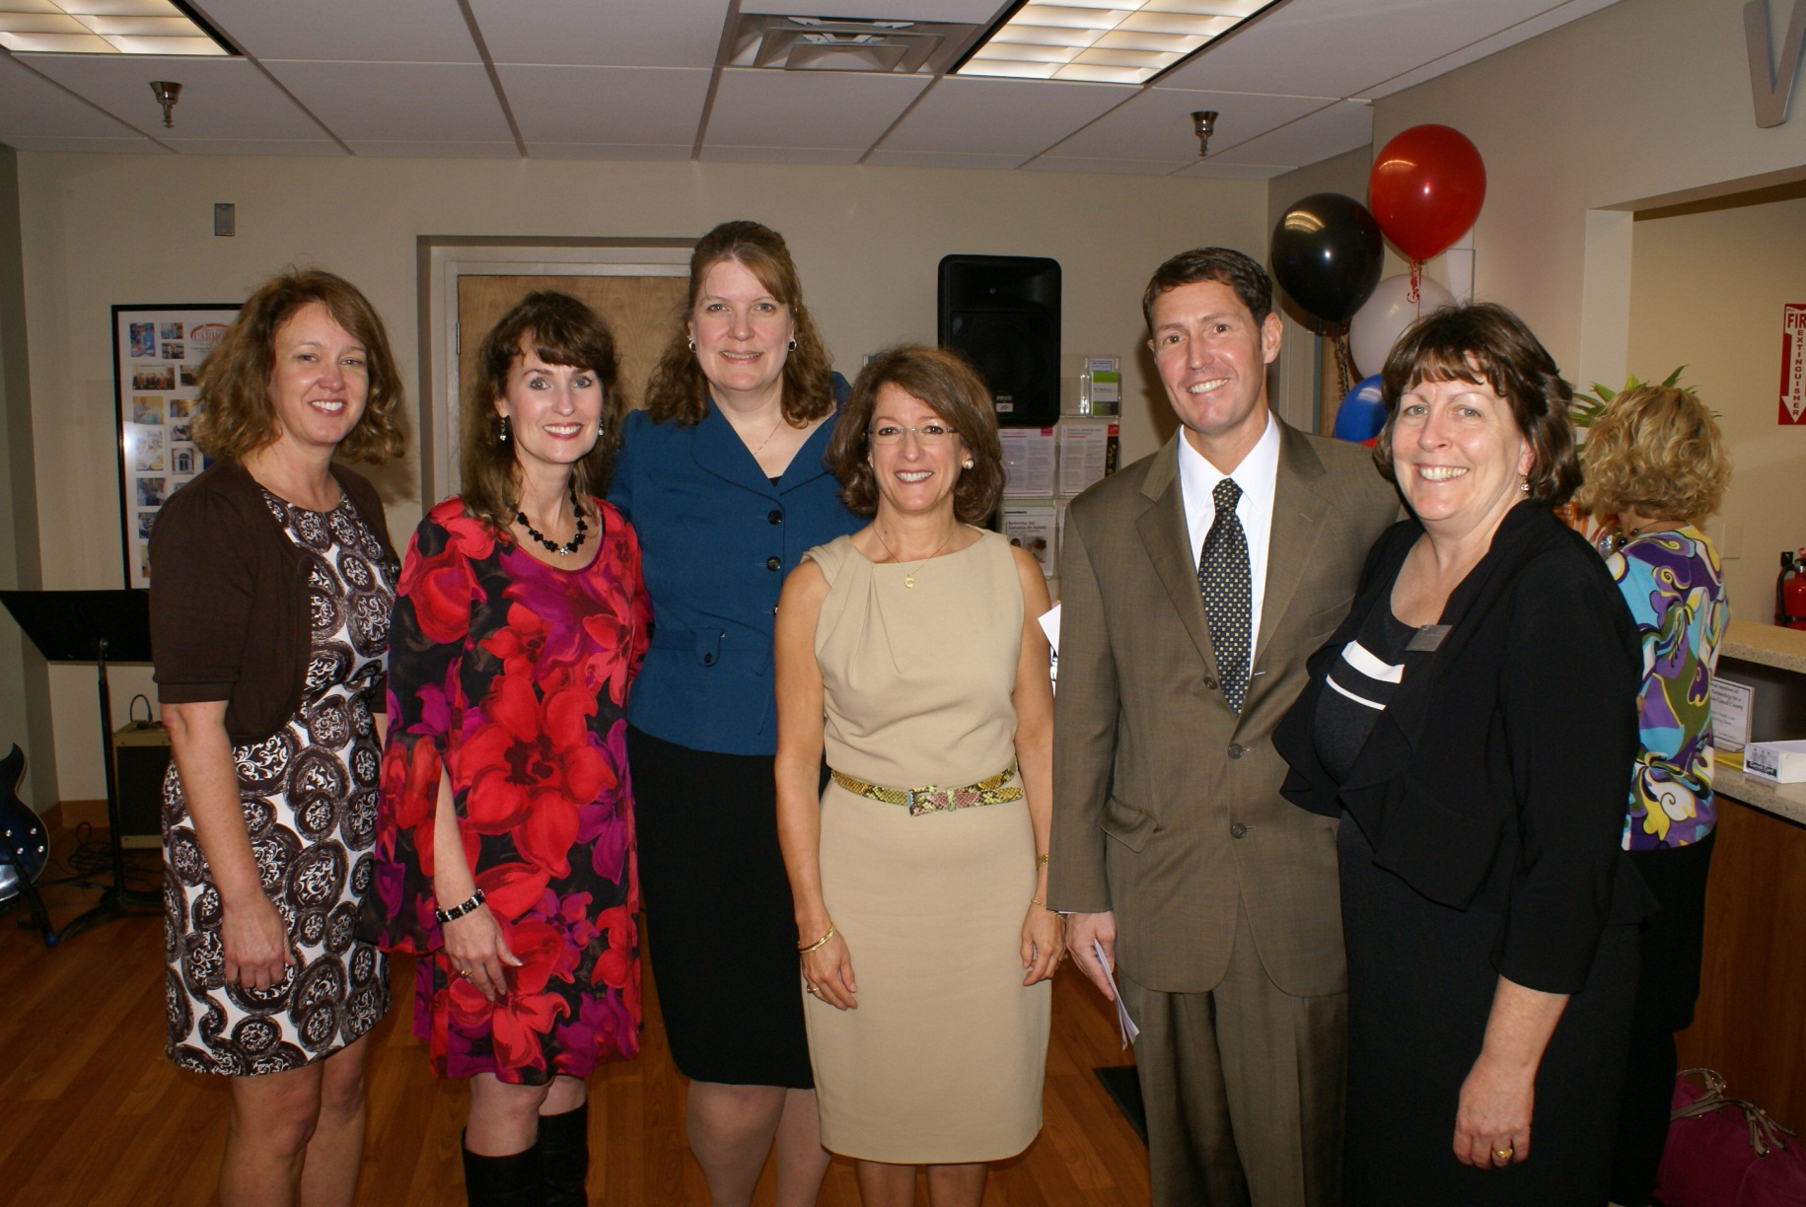
10 Year Anniversary 2005-2015

Slide 33
Contact Information
Main Patient Line: 410-871-1478
Fax: 410-871-3219
Email: info@accesscarroll.org
Web: www.accesscarroll.org
Facebook – Access Carroll
Executive Director: Tammy Black
tblack@carrollhospitalcenter.org

Slide 34



Healthy Beginnings: Maternal-Behavioral Health Intervention

Slide 35


Healthy Beginnings Grant and Bridge to Health Grant
Healthy Beginnings grant provides one-stop coordination of care for pregnant women in need of behavioral health services and payment for underfunded services
In the first 1 ½ years, 31 pregnant women have been case managed
77.4% have 7 or more prenatal visits
87.1% born >2500 grams
90.3% of babies have not required NICU care
77.4% have received contraception after delivery
>450 outreach patients
Notes:
81% TDAP, 77% pregnant pts given flu vaccine, 32 outreach patients identified with Hep C, 13 pregnancies diagnosed, 106 LARC placed

Slide 36


The average 7-10 day NICU admission for a baby near full term costs approximately $50,000.
Cost for a baby born at 28 weeks is >$250,000.
“Public health is public wealth.” B. Franklin

Slide 37

Project Phoenix Case Management
Case Management
Shift to Outpatient Treatment
Decrease Treatment Failures
Increase LARC Usage
Referrals from Calvert Memorial Hospital
Sustainability: Increase CCHD patient visits
Cost Savings under All Payer Model
Assistance with insurance enrollment
Establish care with Behavioral Health provider
Transportation needs
Coordinating Behavioral Health with Primary Care
Link to Social Services

Slide 38

Project Phoenix
GOALS over 3 Years
190 Case Manager contacts for behavioral health patients
Reduce ER visits by 120
Reduce hospital readmissions by 60
RESULTS in 1st 5 Months
96 Contacts with 85 patients case managed
63.2% without return visits to ER
75.4% without hospital readmission
Notes:
89% of patients contacted have agreed to case management. 39% Sub abuse, 36% mental health, 26% co-occurring.

