Slide 1
Personal Supports’
Recoupment
Methodology
DDA Administrative Services
September 28, 2022

Slide 2
Agenda
Opening Remarks: Welcome/Introductions
PS Recoupment Calculation
Invoice Overview: PCIS2 Invoice/Details
Remitting Payment
Key Dates
Questions
Notes:
Speaker - Robert? (Welcome them, say why we are gathered, what we hope to accomplish, etc.)
Any Introductions??
Good afternoon, thank you for joining us today. I am Robert White, Director of Administrative Services for the DDA. The Maryland Department of Health (MDH) Developmental Disabilities Administration is holding this webinar for Personal Supports’ Providers to explain the recoupment process for those who have transitioned all of their Personal Supports’ services fully into LTSS and/or recoupment from other services for providers that are still receiving payment for services in PCIS2.
The intent of the reconciliation process is to make DDA and Providers whole after the PCIS2 reconciliation recoupment. The intent of today is to show you the methodology used in arriving at the recoupment invoice amount. We will walk through an invoice example and how the adjustments are applied. The goal of today is to provide clarity. We will allow time at the end for any questions you may have.
On the panel today we have:
Peter deFries, Director of Operations
Elizabeth Peters, Deputy Director of Administrative Services
Our Presenters today are:
Paulinus Nwosu, Interim Director of Fiscal
Seung Kim, Database Specialist Manager
Please type your questions in the “questions” section of the pane, and we will get to as many as we can during the Q&A session.
I would now like to turn things over to Seung Kim who will start us off by walking you through the invoice details.

Slide 3
PS Recoupment Calculation & Definitions
Quarterly Advances - Quarterly Advance Takeback - Unpaid certified Attendance +/ - Other adjustments = Total Recoupment $
1. Quarterly Advances = “Advance Payment” in the Quarterly Invoice 2. Quarterly Advance Takeback = “Previous advances taken back in the quarterly invoice”
3. Unpaid Attendance = Certified PS attendance in PCIS2 on LTSS transition date that has not been paid a quarterly invoice to the provider.
4. Other Adjustments = Recoupments and Other Payments that increases or decreases invoice amount.
Notes:
Speaker - Paulinus Nwosu
This is the formula used in the previous invoice.

Slide 4
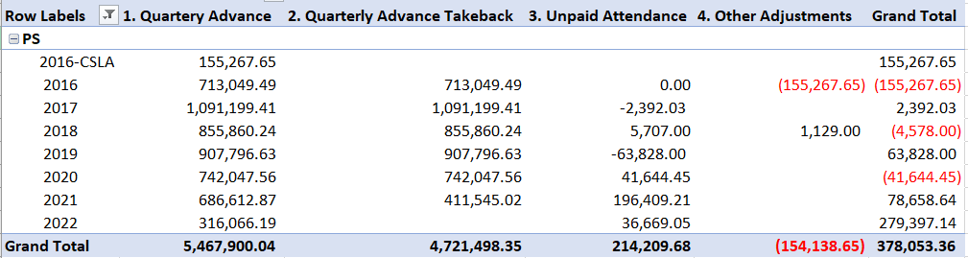
Recoupment Calculations Continues
Notes:
Speaker - Paulinus Nwosu
This is the detail for the PS recoupment.
the first column “Quarterly Advance” is the sum of “Advance Payment” in the Quarterly Invoices.
the second column “Quarterly Advance takeback” is the sum of Estimated Payment taken-back in the Quarterly invoices.
the third column “Unpaid Attendance” is Certified PS attendance in PCIS2 on LTSS transition date that has not been paid a quarterly invoice to the provider.
the last column “Other Adjustments” include the Adjustments not related to Personal support.

Slide 5
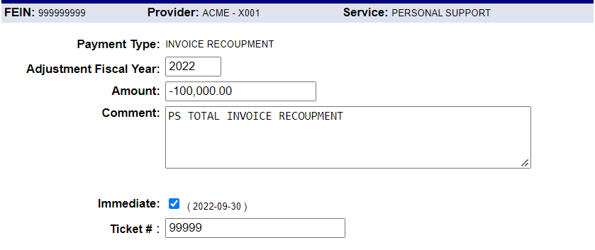
PCIS2 Invoice
Notes:
Speaker - Seung Kim
This is an example of PCIS2 Payment record for the PS recoupment.
And on this, you can see….

Slide 6
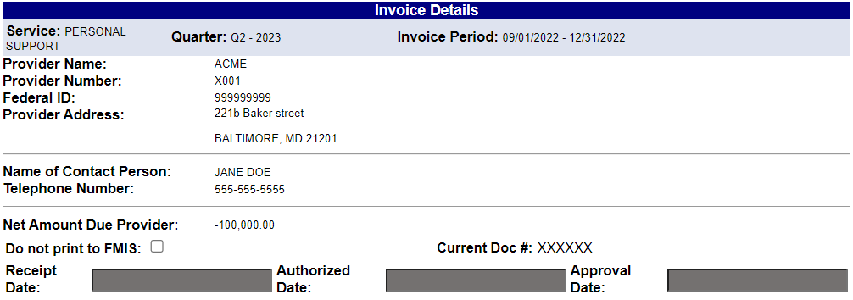
PCIS2 Invoice
Notes:
Speaker - Seung Kim
This is the PCIS2 invoice for the PS recoupment in PCIS2.
And on this, you can see….

Slide 7
LTSS Billing Exception Form
LTSS billing exceptions are excluded from PCIS2 recoupment.
Submit unpaid LTSS billings using “LTSSMaryland Billing Claims Summary- Exceptions _effective 070122v2.”
Notes:
Speaker - Seung Kim
LTSS billing exceptions are NOT included in the PCIS2 recoupment….They are EXCLUDED.
If you cannot submit LTSS billings using the LTSS system, please submit those using “LTSSMaryland Billing Claims Summary- Exceptions _effective 070122v2” .
I would now like to introduce Paulinus Nwoso, Deputy Chief Financial Officer, to talk about the Payment process.

Slide 8
Remit Payment
Fedex
MDH/DDA 4th Floor
201 West Preston Street
Baltimore MD 21201
ATTN: Acting DDA Fiscal Director
Bank Wire
Email a blank wire authorization form from your bank to
thaddaeus.hubbard@maryland.gov, and copy Pnwosu@maryland.gov.
We will complete banking information and return to you to process
Notes:
Speaker - Paulinus
Thank you again for joining us today. Again, the intent of the reconciliation process is to make both DDA and Providers whole. As such, here is the address where you can remit payment. Or, you may remit payment by bank wire if preferred.

Slide 9
Key Dates
Invoices available in PCIS2 on Friday, September 30, 2022
Invoices along with details will be emailed to contact information listed in PCIS2 (Executive Director and Finance Contact)
Payments will be due no later than Monday, October 31, 2022
Notes:
Speaker - Robert
Invoices will be made available in PCIS2 on Friday, September 30, 2022.
Invoices, along with details, will be emailed to contact information listed in PCIS2 (Executive Director and Finance Contact)
and payments will be due no later than Monday, October 31, 2022

Slide 10
What if I Can’t Pay in Full?
Will be handled on a case-by-case basis
Reach out to Paulinus Nwosu at pnwosu@maryland.gov
Notes:
Speaker - Robert

Slide 11

Questions
Notes:
Speaker - Robert
Any questions?

