Slide 1
Developmental Disabilities Administration (DDA)
Person-Centered Plans Services Considerations and Flexibility
Support Services, Residential Supports,
State Funding, and Self-Direction
Rachel White, Eastern Shore Regional Office Deputy Director
Linda Yale, Western Maryland Regional Office Deputy Director
March 4, 2022
Notes:
DONNA -- open webinar and introduce the panelist
Panel include:
Rachel While, Eastern Shore Regional Office Deputy Director
Linda Yale, Western Maryland Regional Office Deputy Director
Karen Lee, SEEC Executive Director
Jennifer Mettrick, Penn-Mar Chief Strategy Officer
Allan Sheahen, Abilities Network Chief Programs Officer
Jane Raddar, MMARS, Inc. Senior Coordinator of Community Services
Rhonda Workman, Director of Federal Programs and Integrity
Patricia Sastoque, Director of DDA Services

Slide 2
Purpose
Ensure comprehensive and flexible person-centered plans
Provider business model and infrastructure strategies
Support provider transition to fee-for-service billing
Review processes and share service reminders
Share strategies and lessons learned from Early Adopters and Coordinators of Community Services
Notes:
Rhonda
Thank you for joining us today. My name is Rhonda Workman and I am the DDA Director of Federal Programs and Integrity.
This is the second DDA training related to person centered planning service considerations and flexibilities.
The DDA conducted a webinar on February 24th related to Meaningful Day service considerations and flexibilities that is posted on our website. We have also included the links on the resource slides at the end of this presentation.
Today’s training/discussion will focus on support services and residential supports flexibilities within the LTSSMaryland system for service delivery and billing once transitioned.
Every person’s plan should reflect all assessed services and supports in their current person centered plan even if the provider transition to LTSS fee for service billing will not occur until the future.
We will also touch on State Funded services and guidance related to self-direction.
We are excited about having another opportunity to share and discussion how to operationalize the various flexible services and strategies available to CCSs and providers to create individualized person-centered plans.
Our purpose is to:
Ensure comprehensive and flexible person-centered plans
Provider business model and infrastructure strategies
Support provider transition to fee-for-service billing
Review processes and share service reminders
Share strategies and lessons learned from some Early Adopters and a Coordinators of Community Services
We appreciate you taking the time to join us today and value your time.
We know everyone is busy and we again hope that you will be able to close emails and move from distractions so you can actively listen and share questions in the question box. Questions from last weeks webinar and todays will be reviewed for inclusion in the DDA’s frequently asked questions that is posted on the website.
Next slide

Slide 3
Agenda
Trajectory
Day in the Life - Service Considerations and Flexibility
  Support Services
  Residential Supports
  State Funding
  Self-Direction
Coordinator of Community Services Advice
Early Adopter Advice
Questions
Notes:
Rhonda
Our agenda for today’s discussion will include the following:
We will briefly touch on some of the Trajectory information we shared last week
We will share Service Considerations and Flexibility
Support Services
Residential Supports
State Funding
Self-Direction
Jane will share some Coordinator of Community Services Advice
Karen, Jennifer and Allan will share some provider Advice
We will conclude with answering Questions
Next slide

Slide 4
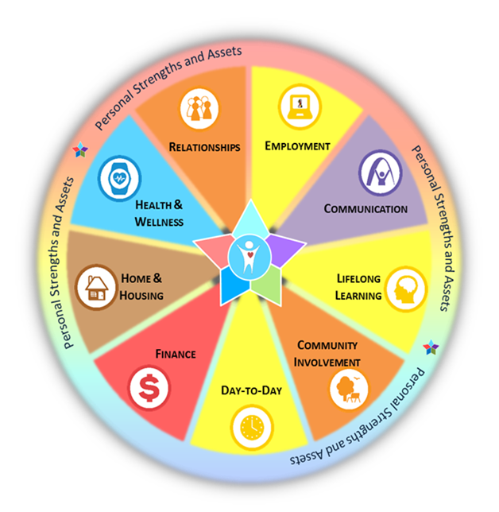
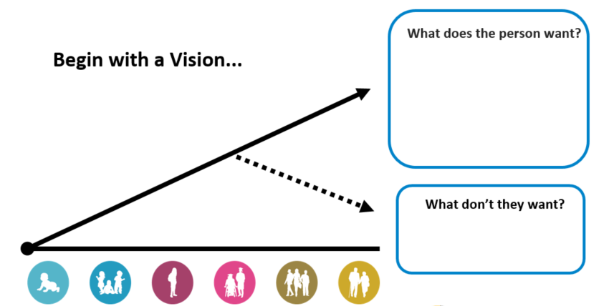
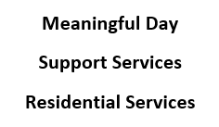
Trajectory
Preplanning and team meetings
Discovery including Focus Area Exploration
Outcomes/Goals
Identify unmet needs and explore service considerations/options
Notes:
Rachel
My name is Rachel White and I am the DDA Eastern Shore Regional Office Deputy Director.
As shared during our February 24th webinar, People are the center of planning a vision for their personally-defined good life. This is done through Person-Centered Planning.
As per our community of practice, before considering services, it is important for Coordinators of Community Services and Providers, working in partnerships with the person and their team members, to engage in preplanning and team meetings to share updates, progress toward outcomes, current or new needs, challenges, and risk.
As noted in our PCP Development and Authorization Guidance and webinars, there are several person-centered planning tools and strategies that may be used in helping each participant to consider their personal strengths, assets, gifts, and wishes across the Life Domains and over the lifespan.
Person-centered planning is a continual process of listening and learning (e.g., exploration and discovery) to create a meaningful and relevant plan that may be adjusted according to life circumstances.
This includes discovery actions such as discussing focus areas as identified by the participant and included in the PCP as well as outcomes the participant wants to accomplish initially and throughout the PCP year.
After the participant’s vision has been identified, the PCP team should utilize the HRST and other tools/discussions to assess support need(s), including any that have changed or have not been met and identify health care needs, risks, and mitigation strategies.
Next slide

Slide 5
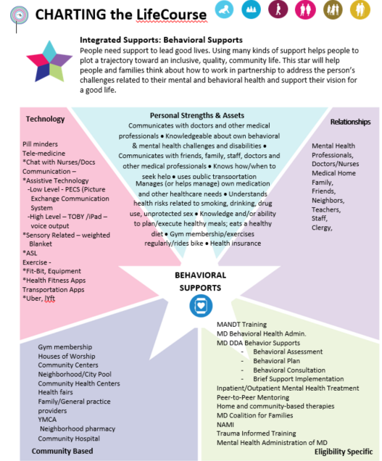

Trajectory using the Integrated Supports Star
Personal Strengths and Assets
Relationships
Technology
Community Resources
Eligibility Specific
Notes:
Rachel
All people need supports to lead good lives. Using a combination of different kinds of supports helps to map out a trajectory towards an inclusive, quality community life. Utilizing the Integrated Support Star in planning helps people and their families to think about how to work in partnerships- in order to support a person’s vision for their good life. Considering Technology, Personal Strengths, Relationships, Community Resources and Eligibility Specific Services lead to a different way of thinking and planning. These types of conversations encourage higher expectations and integrate lots of different kinds of supports- not just eligibility specific supports like the DDA operated Medicaid Waiver programs.
After exploration of generic, natural, community, local, and other resources, the PCP team should determine if any remaining unmet support needed can only be met with a Waiver or Medicaid service.
This slide has an example of the behavioral supports Integrated Support Star
Next slide

Slide 6
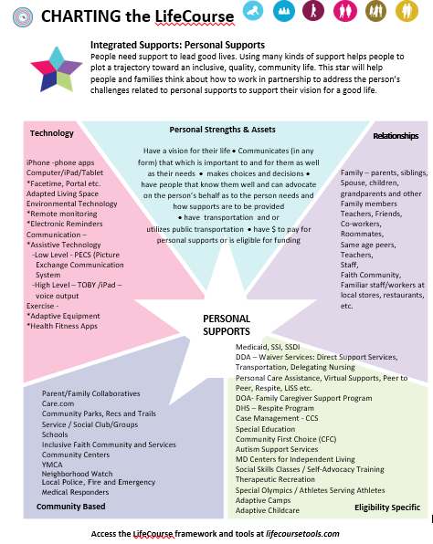
Trajectory using the Integrated Supports Star
Personal Strengths and Assets
Relationships
Technology
Community Resources
Eligibility Specific
Notes:
Rachel
This is an example of the personal supports Integrated Support Star
Next slide

Slide 7
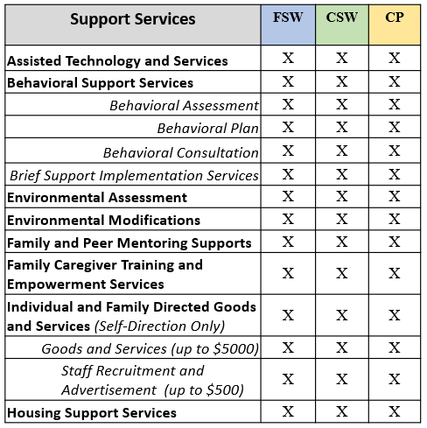
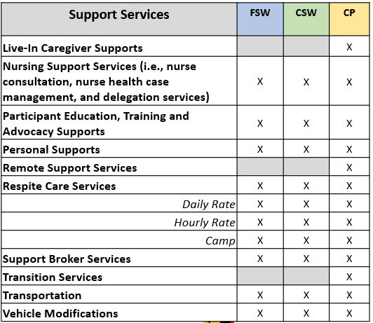
Day in the Life - Support Services
FSW - Family Supports Waiver CSW - Community Supports Waiver CPW - Community Pathways Waiver
Notes:
Rachel
The DDA operated Medicaid Waiver programs includes various flexible services to support full active participation and membership of one’s community.
This slide show the various variety of support services to support independent living and community engagement.
Next slide

Slide 8
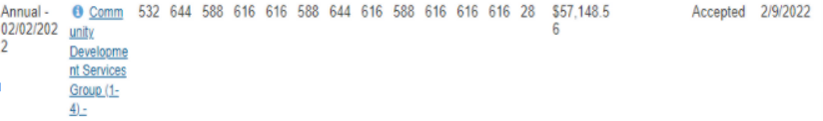
Day in the Life - Support Services
Notes:
Rachel
This slide gives you an example of a PCP detailed service authorization section with multiple services to support independence and community Integration including:
Assistive Technology and Services
Transportation
Respite, and
Personal Supports
To support service flexibility:
Some services are based on 15 minute units
Some have an upper pay limit like camp and transportation that can be reflected with an annual service cost and check marks in each month
Next slide

Slide 9
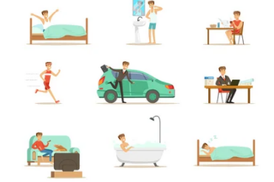
Day in the Life - Support Services
Coordinator of Community Services - Lesson Learned/Advice
Early Adopter - Lesson Learned/Advice
Notes:
Patricia- will facilitate the discussion by asking the following questions:
Jane- Can you share how you worked with the person and their team in understanding the various support service options available that can help support the person’s vision, independence, community engagement and as applicable address risks? What is your main role in facilitating this process?
Allan- How do you start having a conversion with the team when discussing support services?
Staff to be clear on trajectory for services (what’s your organization’s purpose) and need to look at all aspects of s a person’s life to make this happen and build independence. Start with full independence and work backward to identify needed services.
Allan- To give example of a person we support - broader approach to support independence (AT, transportation, personal support). Setting up reminders on phone, connections in the community and to available resources.
Karen - please share how the SEEC service graphic you shared with us last week is used related to support services
Jennifer - can you share the details about the tools and strategies your agency uses (see slide 11)
Next slide

Slide 10
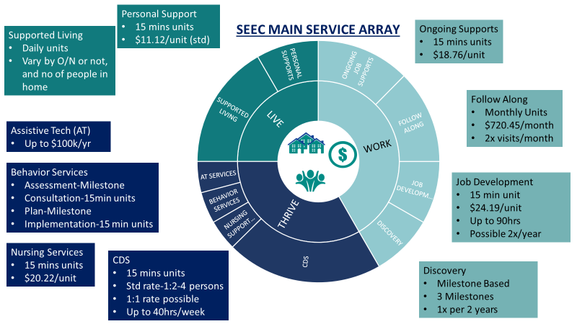
Notes:
Karen
SEEC's graphic Service Guide- This is a format we share with the people we support, families, CCS’s and others who need to know which service we are licensed to do and they can choose. We also make sure people know we can do virtual or in person for many of these services.
**You can also reference last week’s ppt and the importance of:
Preplanning and team meetings
Infrastructure
Finance and Program Teams
When Karen finish talking Patricia will ask Jennifer and go to Slide 11
Jennifer - can you share the details about the tools and strategies your agency uses?
Next slide

Slide 11
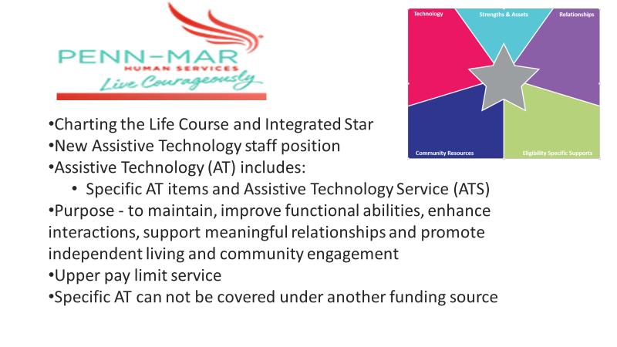
Notes:
Jennifer-
At Penn-Mar we are starting to incorporate the Charting the Life Course tools as part of our PCP preparation process with each person we support. The Integrated Star tool is particularly helpful in understanding a person’s strengths, relationships, existing services, community activities and places they frequent and the technology they utilize. This also helps to discuss any gaps or challenges, that support services can address. This in combination with their life trajectory helps the person think about new services that can be added to the PCP to help them reach short and long term goals/outcomes. Specific example - A person who was able to have a more comprehensive set of supports that used to only receive personal supports (now receives, Supported Living, CDS, etc..)
One component of the Integrated star is Technology.
Currently Penn-Mar is creating a process where Assistive Technology needs are more prominently addressed in everyone’s person centered planning process. This is a process under development as we have seen the value of AT becoming a part of the service array we offer.
Penn-Mar has created a new Assistive Technology position to assist people to assess their needs, connect with AT that makes sense for them and ensure their PCP includes AT and ATS as needed. The AT position will be certified and be able to support the person and their support staff in ensuring their AT goals are met.
Next slide

Slide 12
Day in the Life - Personal Supports
Personal Supports provide habilitative services to assist participants who live in their own or family homes with acquiring, building, or maintaining the skills necessary to maximize their personal independence. These services include
  In home skills development
  Community integration and engagement skills development
Available:
  Before and after school;
  Any time when school is not in session;
  During the day when meaningful day services are not provided; and
  On nights and weekends
Notes:
Linda
My name is Linda Yale. I am the Western Maryland Regional Office Deputy Director
As you are aware, Personal Supports services provide habilitative services to assist participants who live in their own or family homes with acquiring, building, or maintaining the skills necessary to maximize their personal independence.
These services include
In home skills development
Community integration and engagement skills development
Personal Supports are available:
Before and after school;
Any time when school is not in session;
During the day when meaningful day services are not provided; and
On nights and weekends
Next slide

Slide 13
Day in the Life - Personal Supports
Personal Supports include both in person and virtual support delivery models
Direct Support Professional services may be provided in an acute care hospital for the purposes of supporting the participant’s personal, behavioral and communication supports not otherwise provided in that setting. Services may not be duplicative of hospital or short-term institutional services
Services provided during an acute care hospital stay or virtual must be documented in the provider’s Service Implementation Plan
Notes:
Linda
The DDA has also shared as part of the last waiver amendments that:
Personal Supports include both in person and virtual support delivery models
Direct Support Professional services may be provided in an acute care hospital for the purposes of supporting the participant’s personal, behavioral and communication supports not otherwise provided in that setting. Services may not be duplicative of hospital or short-term institutional services
Services provided during an acute care hospital stay or virtual must be documented in the provider’s Service Implementation Plan
Next slide

Slide 14
Day in the Life - Personal Supports
Effective March 1, 2022, the provision of overnight supports will be a component of personal supports in all three DDA Waivers to:
  Promote participant personal independence;
  Enhance access to person-specific safeguards and skills that are foundational to ensuring a person’s health and safety; and
  Further promote the vital role that families serve in supporting their loved ones
Waiver participants’ assessed needs must demonstrate there is a behavioral or medical risk that requires overnight supports, and this information must be documented in the participant’s current person-centered plan and approved Nursing Care Plan and/or Behavior Plan
Notes:
Linda
Today the Department issued a Personal Supports - Overnight Support Policy Memo.
It noted:
Effective March 1, 2022, the provision of overnight supports will be a component of personal supports in all three DDA Waivers to:
Promote participant personal independence;
Enhance access to person-specific safeguards and skills that are foundational to ensuring a person’s health and safety; and
Further promote the vital role that families serve in supporting their loved ones
Waiver participants’ assessed needs must demonstrate there is a behavioral or medical risk that requires overnight supports, and this information must be documented in the participant’s current person-centered plan and approved Nursing Care Plan and/or Behavior Plan.
The personal supports services policy reflected in PolicyStat has been updated to reflect this decision.
The DDA will also update other guidance as applicable.
Next slide

Slide 15
Day in the Life - Personal Supports
To support assessed needs and service flexibility:
  Teams can consider daily and weekly needs and schedules
  Some people may need additional supports during school breaks and summer months
  The detailed service authorization tool, along with other supporting documents, is used to help document the types, amount, and duration of services a person needs to be supported to achieve their goals and stay healthy and safe
CCS can enter units into the PCP as daily units, weekly units, and for specific days. Some CCS have shared their view of the PCP to help clarify the service noted
Notes:
Linda
To support assessed needs and service flexibility:
Teams can consider daily and weekly needs and schedules
Some people may need additional supports during school breaks and summer months
The detailed service authorization tool, along with other supporting documents, is used to help document the types, amount, and duration of services a person needs to be supported to achieve their goals and stay healthy and safe
CCS can enter units into the PCP as daily units, weekly units, and for specific days. Some CCS have shared their view of the PCP to help clarify the service noted.
It is important to note that regardless of how the units are noted in the CCS planning screen such as daily or specific days of the week, authorized services units can be access at any time during the month.
The annual PCP process should be used to reassess service needs unless there is a health and safety assessed needs.
Next slide

Slide 16
Day in the Life - Personal Supports
Reminders
Personal Supports provide habilitative services to assist participants who live in their own or family homes with acquiring, building, or maintaining the skills necessary to maximize their personal independence. These services include
  In home skills development
  Community integration and engagement skills development
  Overnight supports based on assessed medical and/or behavioral need
Teams can consider daily and weekly needs and schedules
Notes:
Linda (read slide)

Slide 17
Day in the Life - Personal Supports
Coordinator of Community Services - Lesson Learned/Advice
Early Adopter - Lesson Learned/Advice
Notes:
Patricia
Jane
Can you shared how you went about supporting the person and their team in discussing personal support needs and entering proposed services in the DSA?
Allan - Can you share how you have projected needs for personal supports and also considered evening and weekends to meet the needs of the person? and can you give us some examples?
Services provided in increments. Could provide at beginning of day to support people prep for the day/work (in-person and virtual); provide different during the day and PS in evening for meal prep, etc…
Prep (PS (prep for day virtual))->pickup and drive to work, support at work->PS (take to bank, meal prep, etc…)
Karen- can you talk about how you are supporting people and determining whether the service needed is personal supports versus Supported Living?
And Jennifer what about Personal Supports vs CDS?
Jennifer - When people would like to be supported to connect in their communities with their friends but need assistance doing so, we typically offer them the choice of utilizing community development services as that service can be provided during weekdays, evenings and weekends vs personal supports. We utilize personal supports when someone does not choose to utilize meaningful day services or when the primary focus of their supports is building skills towards independence within their homes.

Slide 18
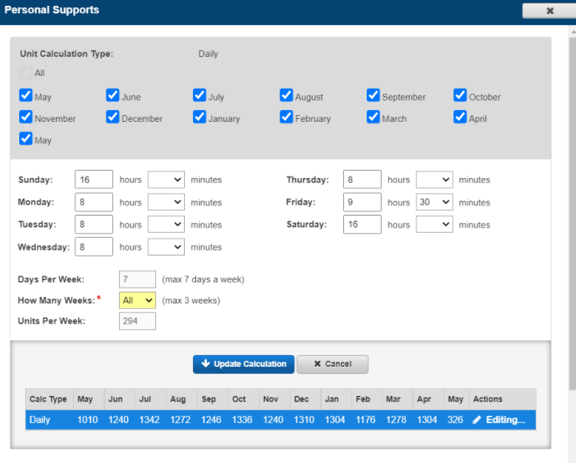
Day in the Life - Personal Supports
Notes:
Jane
This is a view of the CCS view of the detail service authorization section. As Linda shared, CCS can enter in the request services units proposed by the provider in the DSAT in different ways.
To address questions about the proposed units, CCS have shared their screens with providers to support communication and coordination.
After Jane finishes then
Patricia
Allan/Jennifer - Can you share how you have projected needs for personal supports and also considered evening and weekends to meet the needs of the person? and can you give us some examples?
Karen- can you talk about how you are supporting people and determining whether the service needed is personal supports versus CDS or Supported Living?
Next slide

Slide 19
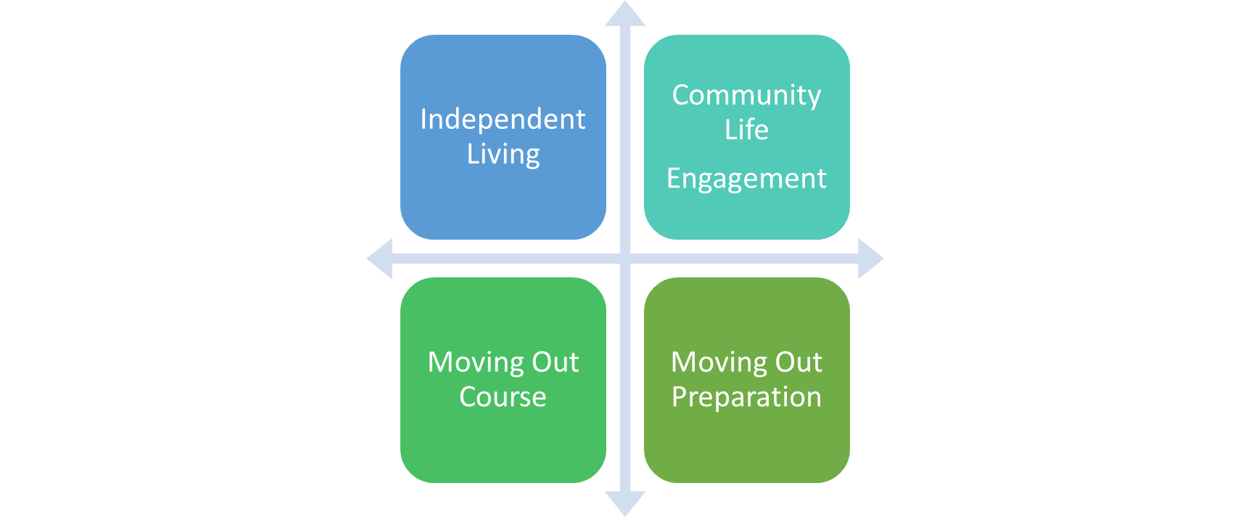

SEEC - Personal Supports
Notes:
Karen

Slide 20
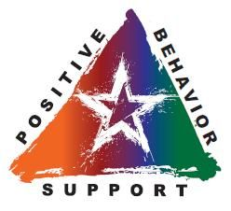
Day in the Life - Behavioral Supports
BSS-Behavioral Assessment (BA) and BSS-Behavioral Plan (BPS) milestone services can be checked for each month to support the flexibility in service delivery and the provider’s ability to bill in the actual month that the service was provided
BSS-Brief Support Implementation Services (BSIS) and BSS- Behavioral Consultation (BC) services 15-minute units can be projected across the entire plan year to support the participant’s needs and service flexibility
Notes:
Rachel
Now let's talk about behavioral supports
Behavioral strategies are based on a multi-tiered approach:
Tier 1 includes providing positive interactions, choice making, and predictable and proactive settings or environments.
Tier 2 focuses on: (i) social, communication, emotional, and physiological intervention or therapies; (ii) mobile crisis teams; and (iii) behavioral respite based on trauma-informed care.
Tier 3 is the use of restrictive techniques based on a functional behavioral assessment and approved strategies developed in the Behavior Plan.
“Brief Support Implementation Services” are time-limited provision of direct assistance, modeling, and training to individuals supporting the participant (e.g., families, direct support professionals, and paid and unpaid caregivers) so they can implement the participant’s Behavior Plan independently.
BSS-Behavioral Assessment (BA) and BSS-Behavioral Plan (BPS) milestone services can be checked for each month to support the flexibility in service delivery and the provider’s ability to bill in the actual month that the service was provided
BSS-Brief Support Implementation and BSS- Behavioral Consultation services 15-minute units can be projected across the entire plan year to support the participant’s needs and service flexibility
Next slide

Slide 21
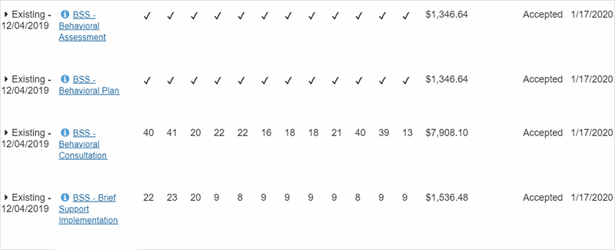
Day in the Life - Behavioral Supports
Behavioral Support Services
  It is important to consider potential monthly consultation units needed in addition to scheduled reviews, in the case of an emergency or off cycle review
  Remember more units are used when annual plan is updated
  Some individuals have holiday triggers and may require more consultation
Notes:
Rachel
It is important to consider potential monthly consultation units needed in addition to scheduled reviews, in the case of an emergency or off cycle review
Remember more units are used when annual plan is updated
Some individuals have holiday triggers and may require more consultation
This is an example of a DSA with each month marked for behavioral assessment and behavioral plan to support service delivery flexibility and projected behavioral consultation and BSIS per month.
Next slide

Slide 22
Day in the Life - Behavioral Supports
Reminders
To support BA and BP flexibility each month can be checked for each month to support the flexibility in service delivery and the provider’s ability to bill in the actual month that the service was provided
BSIS are time-limited provision of direct assistance, modeling, and training to individuals supporting the participant (e.g., families, direct support professionals, and paid and unpaid caregivers) so they can implement the participant’s Behavior Plan independently
BSIS and BC services 15-minute units can be projected across the entire plan year (for people in the traditional service delivery model only) to support the participant’s needs and provider service flexibility
Notes:
Rachel- read slide
Next slide

Slide 23

Day in the Life - Behavioral Supports
Coordinator of Community Services - Lesson Learned/Advice
Early Adopter - Lesson Learned/Advice
Notes:
Jane
Can you shared how you went about supporting the person and their team in discussing behavioral support needs?
Jane - Yes, it’s important to understand the person’s risks, behaviors, restrictions and the type of incidents they have had to have a really good team discussion and see if a behavior plan and supports are needed or if they have a plan is it working. It’s also very important to explore what the person is communicating with their behavior and if there’s an underlying or unmet need we have not explored that behavior supports services can assist and improve the quality of life of the person.
Jennifer - can you share how your agencies support people with who may be exhibiting challenging behaviors?
Penn-Mar uses some BSS but also uses other resources/supports to address behaviors
Penn-Mar first considers:
What are the they trying to achieve
What is the beh communicating to us
What are the unmet needs.
Other supports and resources could be put in place to address the unmet needs instead of restrictive measures
Use Mandt training strategies
Ways to communicate with people
Mandt as the foundation
Karen - please share SEEC’s considerations and strategies
Next slide

Slide 24

Day in the Life - Behavioral Supports
Notes:
Karen
Can you share how you have projected needs for Brief Support Implementation Services to train caregivers or staff and behavioral consultations? and give examples?
Next slide

Slide 25

Day in the Life - Nursing Supports Services
HRST is a screening tool to identify those participants at high risk for health complications and destabilization early.
  22 rating items
  Health Care Level (HCL) between 1 and 6. 1 = low risk 6 = highest risk
  Training considerations and Service considerations used during planning for consideration of resources for health needs and staff training needs
  Documentation of risks and mitigation efforts should be noted in the PCP
HRST must be updated and clinically reviewed within 90 days of PCP
Notes:
Linda
As part of our Waiver assurances DDA must look at the health and welfare of individuals and meet their assessed need. DDA uses the Health Risk Screening Tool to meet this assurance
This tool does a great job of identifying training needs, risk and mitigations efforts that should be noted in the PCP
Next slide

Slide 26
Day in the Life - Nursing Supports Services
Provides a registered nurse to perform Nursing Consultation, Health Case Management, and/or Delegation services, based on the participant’s assessed need.
The nurse will:
Perform an initial nursing assessment reviewing health needs, health records, physician orders etc.
HRST clinical review if the score is 3 or higher, and
Medication Administration Screening Tool
Notes:
Linda
The HRST can help the team determine the level of nursing supports that may be needed and allows for a registered nurse to meet health needs
Next slide

Slide 27
Day in the Life - Nursing Supports Services
Initial nursing assessment allows the Nurse to:
Evaluate whether health needs require performance of nursing tasks (including medication administration) and
  Whether those tasks can be delegated in accordance with MBON regulations or
  If tasks are exempt from delegation in accordance with MBON regulations
Based on a participant’s assessed need and programs used to support them, nursing support services will vary:
Consultation: make recommendations for community health resources, develop health care protocols/emergency protocols, review communication systems between individual, family, support staff, and healthcare providers
Health Case Management: Develop Nursing care plans to meet participants health needs and train staff, recommend how best to meet health needs in the community to provider/direct support staff
Notes:
Linda
read slide
Next slide

Slide 28
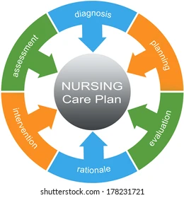
Day in the Life - Nursing Supports Services
Health Case Management with Delegation: Develop Nursing care plans to meet participants health needs and train staff to include training on delegated nursing tasks, recommend how best to meet health needs in the community to provider/direct support staff, monitor the direct support staff’s competency in delegated tasks, continually monitor participants health status with an assessment and review of records, ensure nurse availability as need arises to participant/direct support staff
Notes:
Linda
read slide
Next slide

Slide 29

Day in the Life - Nursing Supports Services
Initial nursing assessment allows the Nurse to:
Evaluate whether health needs require performance of nursing tasks (including medication administration) and
  Whether those tasks can be delegated in accordance with Maryland Board of Nursing (MBON) regulations or
  If tasks are exempt from delegation in accordance with MBON regulations
Notes:
Linda
Read slide
Next slide

Slide 30
Day in the Life - Nursing Supports Services
Reminders
Meaningful day and residential services have nursing support services as part of the service and rate
If staff give medications a nursing support service is needed
In SDS plans HRSTs of 3 or higher need nursing support included in the plan for the annual nursing review
Paid staff can not clock in and out to administer medication
Notes:
Linda
read slide
Next slide

Slide 31
Day in the Life - Nursing Supports Services
Coordinator of Community Services - Lesson Learned/Advice
Early Adopter - Lesson Learned/Advice
Notes:
Jane
Can you shared how you went about supporting the person and their team in discussing nursing support needs?
Just a reminder that just because a person needs nursing delegation does not mean the team needs to request 1:1 services unless they are specific health care needs.
Karen or Jennifer
Can you share how you have projected needs for nursing supports to meet the needs of the person? and can you give us some examples?
Jen - Particularly for those we support through personal supports who require support with delegatable tasks we work closely with our Nursing agency Dimensional Health care to determine the number of units needed to be able to do case management oversight, training ,etc.
Karen- Infrastructure discussion and has forced us to have our nursed as part of the planning team.
Next Slide

Slide 32

Day in the Life - Respite
Respite
  Options include:
    Daily respite is provided in a DDA-licensed residential site
    Respite Hourly (15 minute units)
    Camp
  Person and family needs may vary by time of the year
    Example #1: Family enjoys skiing and utilizes respite during weekend trips. Under the traditional model, to provide flexibility for weekends when trips are coordinated, the PCP could reflect four (4) days for each month December through March
    Example #2: Respite needed during summer when school is not in session. Under the traditional model, the PCP could note higher units for June, July, and August to provide flexibility
Notes:
Rachel
Respite is short-term care intended to provide both the family or the primary caregiver and the participant with a break from their daily routines. Respite relieves families or the primary caregivers from their daily caregiving responsibilities.
Respite includes:
services in a DDA licensed residential site noted as daily units
services based on 15 minutes units (titled Respite Hourly in LTSS DSA), and
camp

Slide 33
Day in the Life - Respite
Notes:
Rachel
This is an example of a DSA illustrating that a person can utilize different types of respite services.
To support access and flexibility for respite, under the traditional model, for a participant’s respite daily and hourly services combined can be requested and authorized by the DDA, above the 720 hours limit within each PCP.
Similar to the meaningful day service flexibility, participants cannot receive and providers will not be paid for more than the limit for respite daily and hourly services combined services.
Next slide

Slide 34
Day in the Life - Respite
Reminders
To support respite care services flexibility under the traditional service model, hourly (15 minute units) and daily total hours combined can be requested and authorized by the DDA, above the 720 hours limit within each PCP
However, similar to the meaningful day service flexibility, participants cannot receive and providers will not be paid for more than the limit for respite daily and hourly services combined
The total cost for camp cannot exceed $7,248 within each plan year
Notes:
Rachel- read slide
Next slide

Slide 35
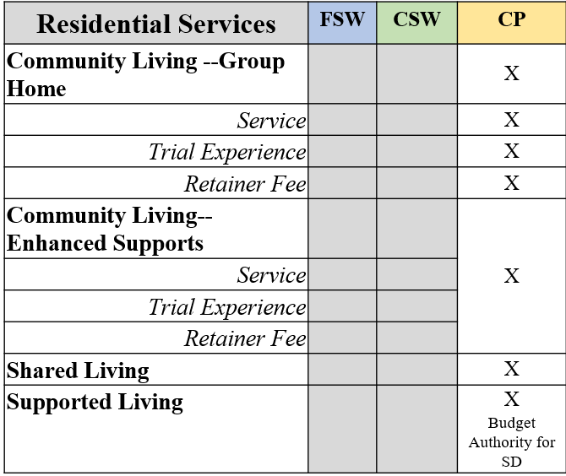

Day in the Life - Residential Services
Notes:
Linda
This slide gives you an overview of the Residential Services such as:
Community Living- Group Home and Community Living - Enhanced Supports that are provided in a provider owned and/or operated site
Shared Living is based on an adult foster care model and the use of host home supports
Supported Living is provided in the person’s own home and people in self direction have budget authority for this service
Please note that these services are not available in the FSW & CSW
Next slide

Slide 36
Day in the Life - Residential Services
The transition from PCIS to LTSS provides more flexible shared hours and more individualized supports
Teams should focus on individualized needs and schedules vs provider staffing model
Notes:
Linda
The transition from PCIS to LTSS provides more flexible shared hours and more individualized supports.
Instead of PCIS2, matrix and add on supports, residential services (with the exception of Shared Living) include flexible shared hours in addition to dedicated supports
Agencies are utilizing these flexibilities in many different ways to demonstrate the flexibility for the person and the agency staff and business model
Teams should focus on individualized needs and schedule vs provider staffing model or backing into the legacy matrix process
Next slide

Slide 37
Day in the Life - Residential Services
Current guidance reflects:
  Shared flexible base hours:
    1-3 person home = 128, 4 - 5 person home = 196, 6 - 8 person home =272
  Assumes a 40 hour meaningful day week
  Assumes 56 hours of shared overnight supports
Adjustment to flexible shared base hours to include:
  1 person home = 138 hours
  Increased flexible base hours as the home size increases by one person
  Assume a 30 hour meaningful day week
  Supports individuals schedules and community integration
  Decreased need to request dedicated supports
  Feedback from stakeholders and preliminary FIAT review
Notes:
Linda
Current guidance reflects:
Shared flexible base hours based on the size of the home such as:
1-3 person home = 128, 4 - 5 person home = 196, 6 - 8 person home =272
It assumes a 40 hour meaningful day week and
Assumes 56 hours of shared overnight supports
The DDA is making adjustment to flexible shared base hours to include:
1 person home = 138 hours
Increased flexible base hours as the home size increases by one person
Assumption of a 30 hour meaningful day week
Adjustment are being made to:
Further supports individuals schedules and community integration,
Decreased need to request dedicated supports, and
Incorporate feedback from stakeholders and preliminary FIAT review
PCP revision related to dedicated supports will not be required and can be adjusted during the annual planning process or next assessed need for a Revised PCP.
Providers would only bill based on actual services delivered
Next slide

Slide 38
Day in the Life - Residential Dedicated Supports
Residential dedicated supports
  If the participant’s needs cannot be met through residential services flexible base services hours or overnight supervision (as applicable based on the provider’s business model), then a request for dedicated staff hours may be requested inconsideration of:
    Flexible base shared support hours
    Overnight supports
    1:1 or 2:1 dedicated supports
    Community Integration/Activity Schedules Difference
Notes:
Linda
If the participant’s needs cannot be met through residential services flexible base services hours or overnight supervision (as applicable based on the provider’s business model), then a request for dedicated staff hours may be requested
The person-centered planning process should include a discussion of:
a) The participant’s support needs including any dedicated hours needed to maintain health and safety, if applicable;
b) Existing dedicated support hours;
c) Number of shared hours available in the home; and
d) Availability of overnight supervision.
The Provider’s assessed need for dedicated hours will be based on:
a) Participant’s assessed need (i.e., medical, behavioral, community);
b) Number of people in the home supported by shared hours;
c) Provider’s business model (i.e., overnight supervision staff vs no overnight supervision staff) and
d) Provider staffing model (e.g., use overnight supervision staff vs hiring dedicated staff)
Based on these considerations, a request for dedicated supports for any additional hours that the participant will need can be made
People with higher intense needs reflected in a Behavior Plan and/or Nursing Care Plan that indicate the assessed need for 1:1 and 2:1 dedicated supports to support health and safety can be noted in addition to above the base residential services
DDA’s Residential Services: Use of Dedicated Supports During Meaningful Day Hours policy are primarily intended to provide 1:1 staff-to-participant supervision for a participant, there are circumstances in which housemates may share staff.
For example, two housemates who are retired participants may share support if this would meet both participants’ assessed needs and is reflected in their respective person-centered plans. In this instance, Residential Dedicated Supports could be authorized for one or both participants, but the DDA provider would only bill against one of those authorizations, per unit.
Please refer the policy noted on this slide for additional information, options, and requirements
Finally, as noted in the DDA’s Guideline for Service Authorization and Provider Billing Documentation, additional dedicated hours can be requested to support community integration for individualized schedules.
As you can see there are several flexible options. It is important to consider the person’s needs including ADL assistance, behavioral plan/NCR as applicable, and accessing their community for social activities, recreational, and individualize activities.
Next slide

Slide 39
Day in the Life - Residential Dedicated Supports
If an individual has a bowling club that they go to once a week and it takes about 4 hours to support this community activity and base shared hour are not available the team should consider this individual have these direct support hours in his PCP
If an individual needs direct supports during their ADLs and this takes approximately 2 hours a day 7 days a week and base shared hour are not available the team should consider 14 direct support hours in the PCP
If an individual can not go to day program during the 100 degree weather or the icy weather in the winter and base shared hour are not available the team should consider 30 hours of direct support in the plan so the provider can bill for the service provided on the day it is provided
If the room mate is also home during these times we would see these shared support hours noted in the SIP and the outcome section of the PCP as shared hours
Notes:
Linda
If an individual has a bowling club that they go to once a week and it takes about 4 hours to support this community activity and base shared hour are not available the team should consider this individual have these direct support hours in his PCP.
If an individual needs direct supports during their ADLs and this takes approximately 2 hours a day 7 days a week and base shared hour are not available the team should consider 14 direct support hours in the PCP.
If an individual can not go to day program during the 100 degree weather or the icy weather in the winter and base shared hour are not available the team should consider 30 hours of direct support in the plan so the provider can bill for the service provided on the day it is provided.
Individual has a really hard time during May every year due to a past trauma in their life so the team should consider 1:1 direct support during the month of May so that the individual can get their needs met.
If the room mate is also home during these times we would see these shared support hours noted in the SIP and the outcome section of the PCP as shared hours.
Next slide

Slide 40
Day in the Life - Residential Dedicated Supports
Reminders
If the participant’s needs cannot be met through residential services base services hours or overnight supervision (as applicable based on the provider’s business model), then a request for dedicated staff hours may be requested
Overnight support are provided unless advised otherwise
Dedicated hours are not limited to services provided inside the home and can support the participant with community engagement
Notes:
Linda
read slide
Next slide

Slide 41
Day in the Life - Residential Dedicated Supports
Coordinator of Community Services - Lesson Learned/Advice
Early Adopter - Lesson Learned/Advice
Notes:
Patricia
So we just talk about residential services and dedicated supports
Jane can you talk about how you facilitate the discussion of residential supports and dedicated hours with the person and their team?
Karen and Jennifer- Can you share some lessons learned and advice on how you went about identifying dedicated supports?
Next slide

Slide 42
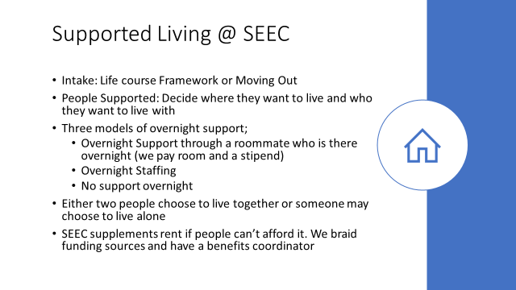
Day in the Life - Residential Dedicated Supports
Notes:
Karen
Next slide

Slide 43
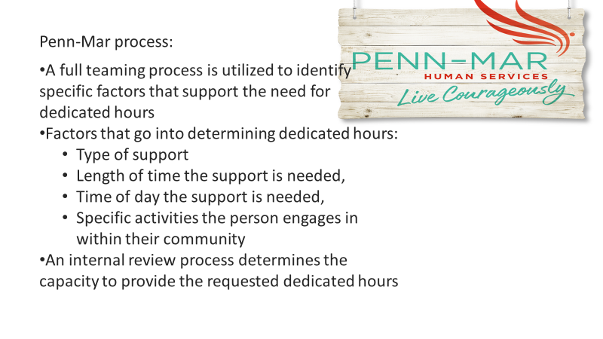
Day in the Life - Residential Dedicated Supports
Notes:
Jennifer
Next slide

Slide 44
Unbundle State Funded to Waiver Service
In the past, some participants received State-funded services through programs such as Family and Individual Support Services (F/ISS), in which one or more services are “bundled” and provided to the participant by a provider
The bundled services may include services that align directly with waiver services as well as those that do not
Services that align directly with waiver services shall be unbundled during the next Revised or Annual PCP process (whichever occurs first)
Services that directly align with a waiver service should be indicated in the DSA with the Service Title that corresponds to the matching waiver service
Notes:
Linda-
In the past, some participants received State-funded services through programs such as Family and Individual Support Services (F/ISS), in which one or more services are “bundled” and provided to the participant by a provider
The bundled services may include services that align directly with waiver services as well as those that do not
Services that align directly with waiver services shall be unbundled during the next Revised or Annual PCP process (whichever occurs first)
Services that directly align with a waiver service should be indicated in the DSA with the Service Title that corresponds to the matching waiver service
Next slide

Slide 45
State Funding
“DDA State Funded Program” vs “State Only Funded”
If a person was authorized “State Only Funded” service, the specific services shall be noted in the DSA as:
  Camp - Non-Respite (State Only Funded)
  Nursing - Skilled Nursing Services (State Only Funded)
  Rent - Individual Support (State Only Funded)
  Other (State Only Funded)
Notes:
Linda
Let's talk about State Funding.
Participants that are support only eligible or loose CPW eligibility are noted as being in the DDA’s State Funded Program. For these individuals, services that directly align with a waiver service should be indicated in the
DSA with the Service Title that corresponds to the matching waiver service. If an individual has fallen out of the waiver they need to reapply ASAP
Some waiver participants are authorized State Only Funding for a specific service or item. These are services paid that are not in our DDA waivers but have been previously authorized by the DDA.
If a person was authorized DDA State Funded services, the specific services shall be noted in the DSA
Camp - Non-Respite (State Only Funded) is used when the camp is not on the approved list or an out-of -state camp due to unique circumstances and authorized by the DDA.
Nursing - Skilled Nursing Services (State Only Funded) - is only available to participants that were previously authorized by the DDA.
Rent - Individual Support (State Only Funded) -is used when State-funded rent support were authorized by the DDA.
Other (State Only Funded) - is used for all other items DDA authorized State funded services.
Next slide

Slide 46
State Funding
DDA State Funded program and State Only Funded services are only available to participants that were previously authorized by the DDA
  The service must match the DDA authorized service and service amount
  It must also be included in the Outcome Summary and include a short summary of the service
  Service should not be over authorized and must not exceed the current budget authorization
Notes:
Linda
read slide
Next slide

Slide 47


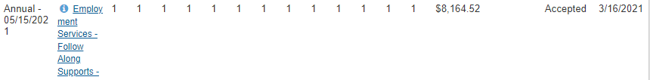
DDA State Funded Program - DSA
Notes:
Linda-
This is an example of a DDA State Funded Program DSA for a person who is not in a DDA Waiver program
People who are SO eligible including some people classified under Forensic
SO eligible individuals are not able to put in the “flexibilities”
The DSA service options will look the same as a person in a waiver program
Therefore the CCS will select the Service Title that corresponds to the matching waiver service. This example is showing Personal Supports, Respite, and Employment Services
Next slide

Slide 48
State Only Funded - DSA
Notes:
Linda-
This is an example of a DSA that includes a State Only Funded service in the DSA
The DSA service options will specifically note (State Only Funded) in the service title
State Only Funded services are only available to participants that were previously authorized by the DDA.
The service must be included in the Outcome Summary and include a short summary of the service
Next slide

Slide 49
State Funded
Reminder
The State does not receive any federal funding for people in DDA State funded program or receiving State Only Funded services
CCSs need to support people who are currently using state funds in their path to waiver eligibility
For some people that due not meet the financial eligibility requirements (income and asset limits) this should include exploring ABLE accounts and trust
Notes:
Linda-
Read slide
Next slide

Slide 50

Self-Directed Service Guidance
Self-directed budget allocations are based on service and units listed in the PCP detailed service authorization (DSA) using the same fully load rates that provider’s receive
People self-directing service have employer and budget authorities over their staff and self-directed budget funding
This means once authorized, they have the flexibility to schedule services at anytime during the year and authorize payment regardless of the month noted in the PCP DSA
To prevent over authorization of funding, it is important to reflect the actual assessed need for units and not exceed service limits
Notes:
Linda
Self-directed budget allocations are based on service and units listed in the PCP detailed service authorization (DSA) using the same fully load rates that provider’s receive
People self-directing service have employer and budget authorities over their staff and self-directed budget funding
This means once authorized, they have the flexibility to schedule services at anytime during the year and authorize payment regardless of the month noted in the PCP DSA
To prevent over authorization of funding, it is important to reflect the actual assessed need for units and not exceed service limits
Next slide

Slide 51
Self-Directed Service Guidance
Meaningful Day Services
  Combined meaningful day service (including Employment Services, Community Development Services, and Day Habilitation Services) total should not exceed 40 hours
Behavioral Support Services
  BSS-Brief Support Implementation Services (BSIS) and BSS- Behavioral Consultation (BC) services 15-minute units projected actual annual need should be noted
Respite
  Hourly (15 minute units) and daily total hours combined can not exceed the 720 hours limit
Notes:
Linda
To prevent over authorization of funding for people SDS:
Meaningful Day Services
Combined meaningful day service (including Employment Services, Community Development Services, and Day Habilitation Services) total should not exceed 40 hours
Behavioral Support Services
BSS-Brief Support Implementation Services (BSIS) and BSS- Behavioral Consultation (BC) services 15-minute units projected actual annual need should be noted
Respite
Hourly (15 minute units) and daily total hours combined can not exceed the 720 hours limit
Next slide

Slide 52
Self-Directed Service Guidance
Personal Supports
  The detailed service authorization should reflect but not exceed the assessed hours needed per week
  As per the DDA’s guidance, the scope section should reflect
    “Services and supports based on the approved waiver service scope and requirements as outlined in the service implementation plan, behavior plan, and nursing care plan (as applicable)” unless otherwise noted in policy or guidance
    We are seeing plans with staff schedules, pay rates, benefits amounts, staff hours per week, taxes, and back-up vendor information which should not be noted in the scope section
  Back up staff and vendors would replace the primary staff and therefore additional hours should not be requested as it will over authorize the budget
Notes:
Linda
Read slide
Next slide

Slide 53
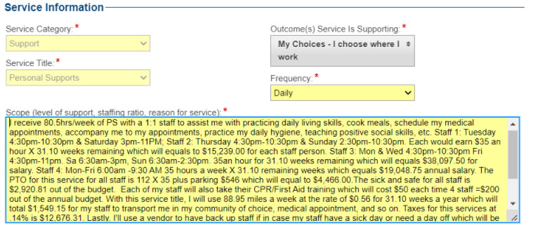
Self-Directed Service Guidance
Notes:
Linda
This is an example of a SDS plan scope section that contains staff schedules, pay rates, benefits amounts, staff hours per week, taxes, and back-up vendor information
Next slide

Slide 54
Resources and Tools
DDA Webinar -PCP and Services - Meaningful Day Services Webinar - February 24, 2022​
  DDA Webinar -PCP and Services - Meaningful Day Services Presentation – February 24, 2022
Notes:
Rachel
These are links to last weeks webinar where we shared person centered planning service considerations and flexibilities related to meaningful day services and community integration.
Next slide

Slide 55
Resources and Tools
Person-Centered Plan Checklist
  DDA CCS PCP Checklist - Revised March 28, 2021​
  CCS Alert—Person-Centered Planning Checklist - Revised March 28, 2021
Detailed Service Authorization Tool (DSAT) Form-Revised June 1, 2021 v2
Service Implementation Plan (SIP) (Previously known as Provider Implementation Plan) - Revised June 1, 2021 ​
Competitive Integrated Employment Checklist
Person-Centered Plan Development and Authorization - Revised Feb 11, 2022​​
Guidelines for Service Authorization and Provider Billing Documentation - Revised Feb 5, 2021​​​​
Guidance for Operating in PCIS2 and LTSSMaryland
PolicyStat
Notes:
Rachel
The DDA person centered planning web page includes a variety of resources and tools to assist teams with developing a robust PCP.
The PCP checklists includes the some of the necessary information to support both Federal and State requirements, demonstrate assessed need for requested DDA
service(s), and support the participant’s health and safety needs in order to be processed efficiently.
The “PCP Review Checklist” tool is not an exhaustive list, but is required to be used in conjunction with existing DDA Service Authorization and Provider Billing Documentation guidance
for the DDA programs, policies, procedure and guidance to ensure consistent and efficient processing of PCPs.
If a CCS agency is using their own checklist it must include all of the DDA required elements
Please also review DDA service and topic specific policies in PolicyStat including requirements associated with the SIP.
If an agency has created or using a software vendors version of the SIP, it needs to mirror the DDA form
Next slide

Slide 56

Questions

