Slide 1
Tony Hillery
Founder & CEO
Notes:
MTK events
Saturday programming publicity
Virtual cooking lessons
Ps 139 studio
Virtual gardening event how to put together a container garden… basic produce on patio

Slide 2
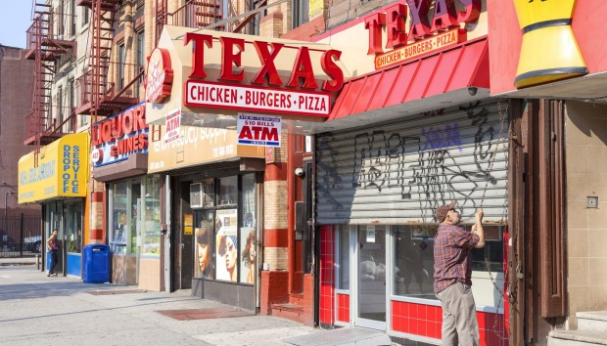
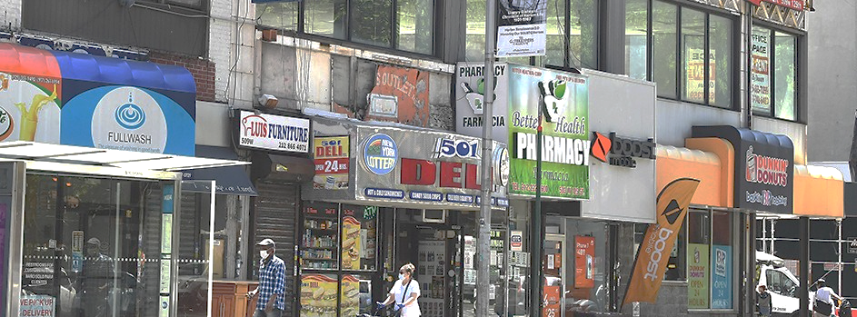

Slide 3
Harlem Grown’s mission is to inspire youth to lead healthy and ambitious lives through mentorship and hands-on education in urban farming, sustainability, and nutrition.

Slide 4
Learning Objectives
Understand how addressing hunger and nutrition have a direct impact on youth health and resilience
Learn how community gardens can increase developmental assets like adult role models, positive peer influences, service to others, and structured community that help youth grow up healthy and resilient
Learn why mentorship from caring adults and opportunities for civic engagement that give children a sense of hope and belonging are effective substance use prevention

Slide 5
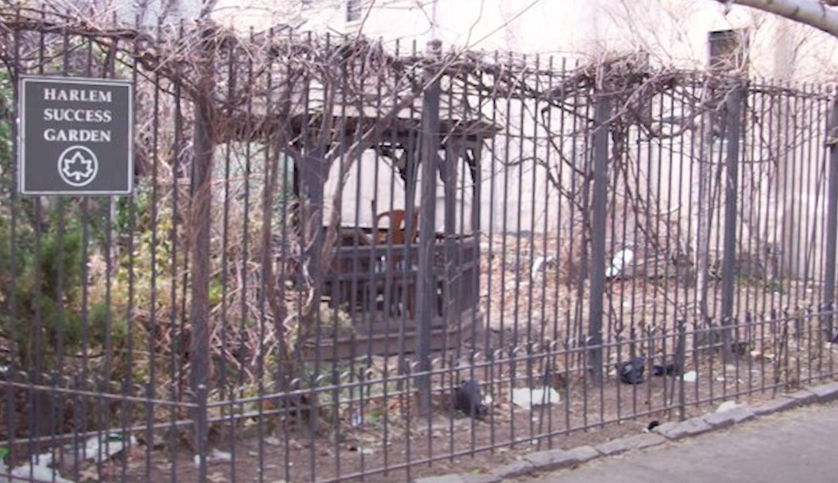

Slide 6
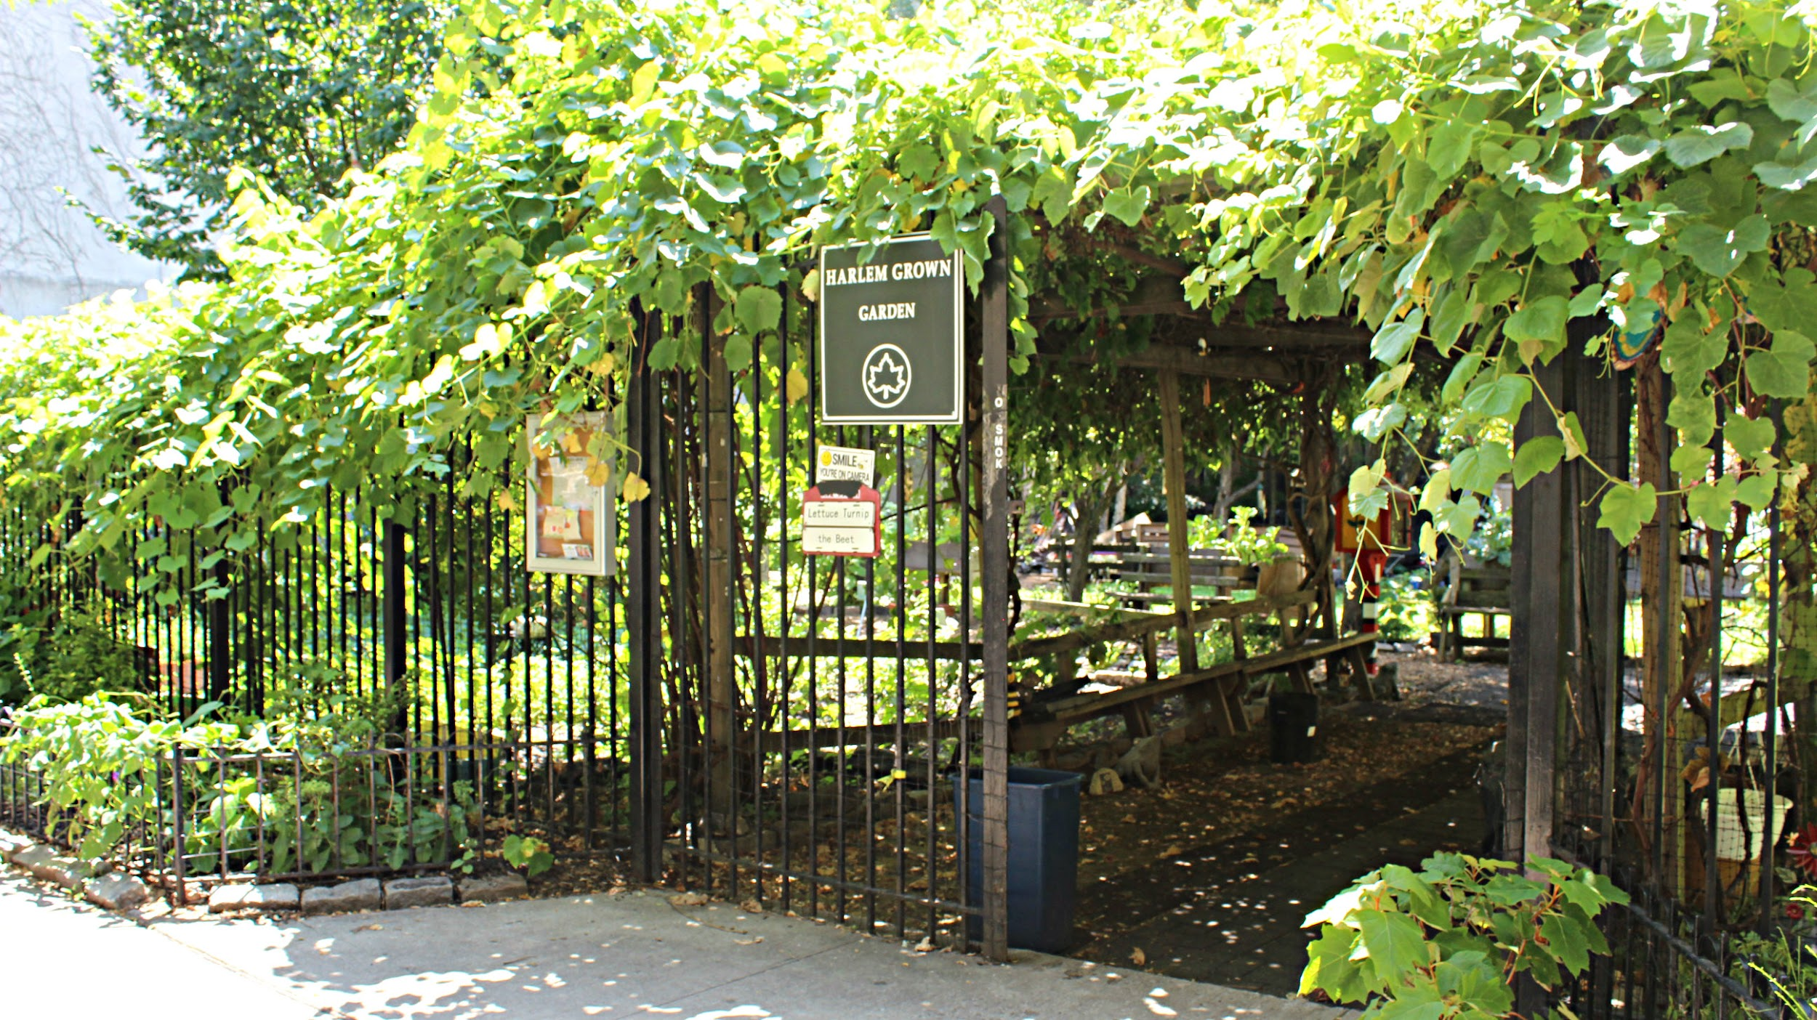

Slide 7
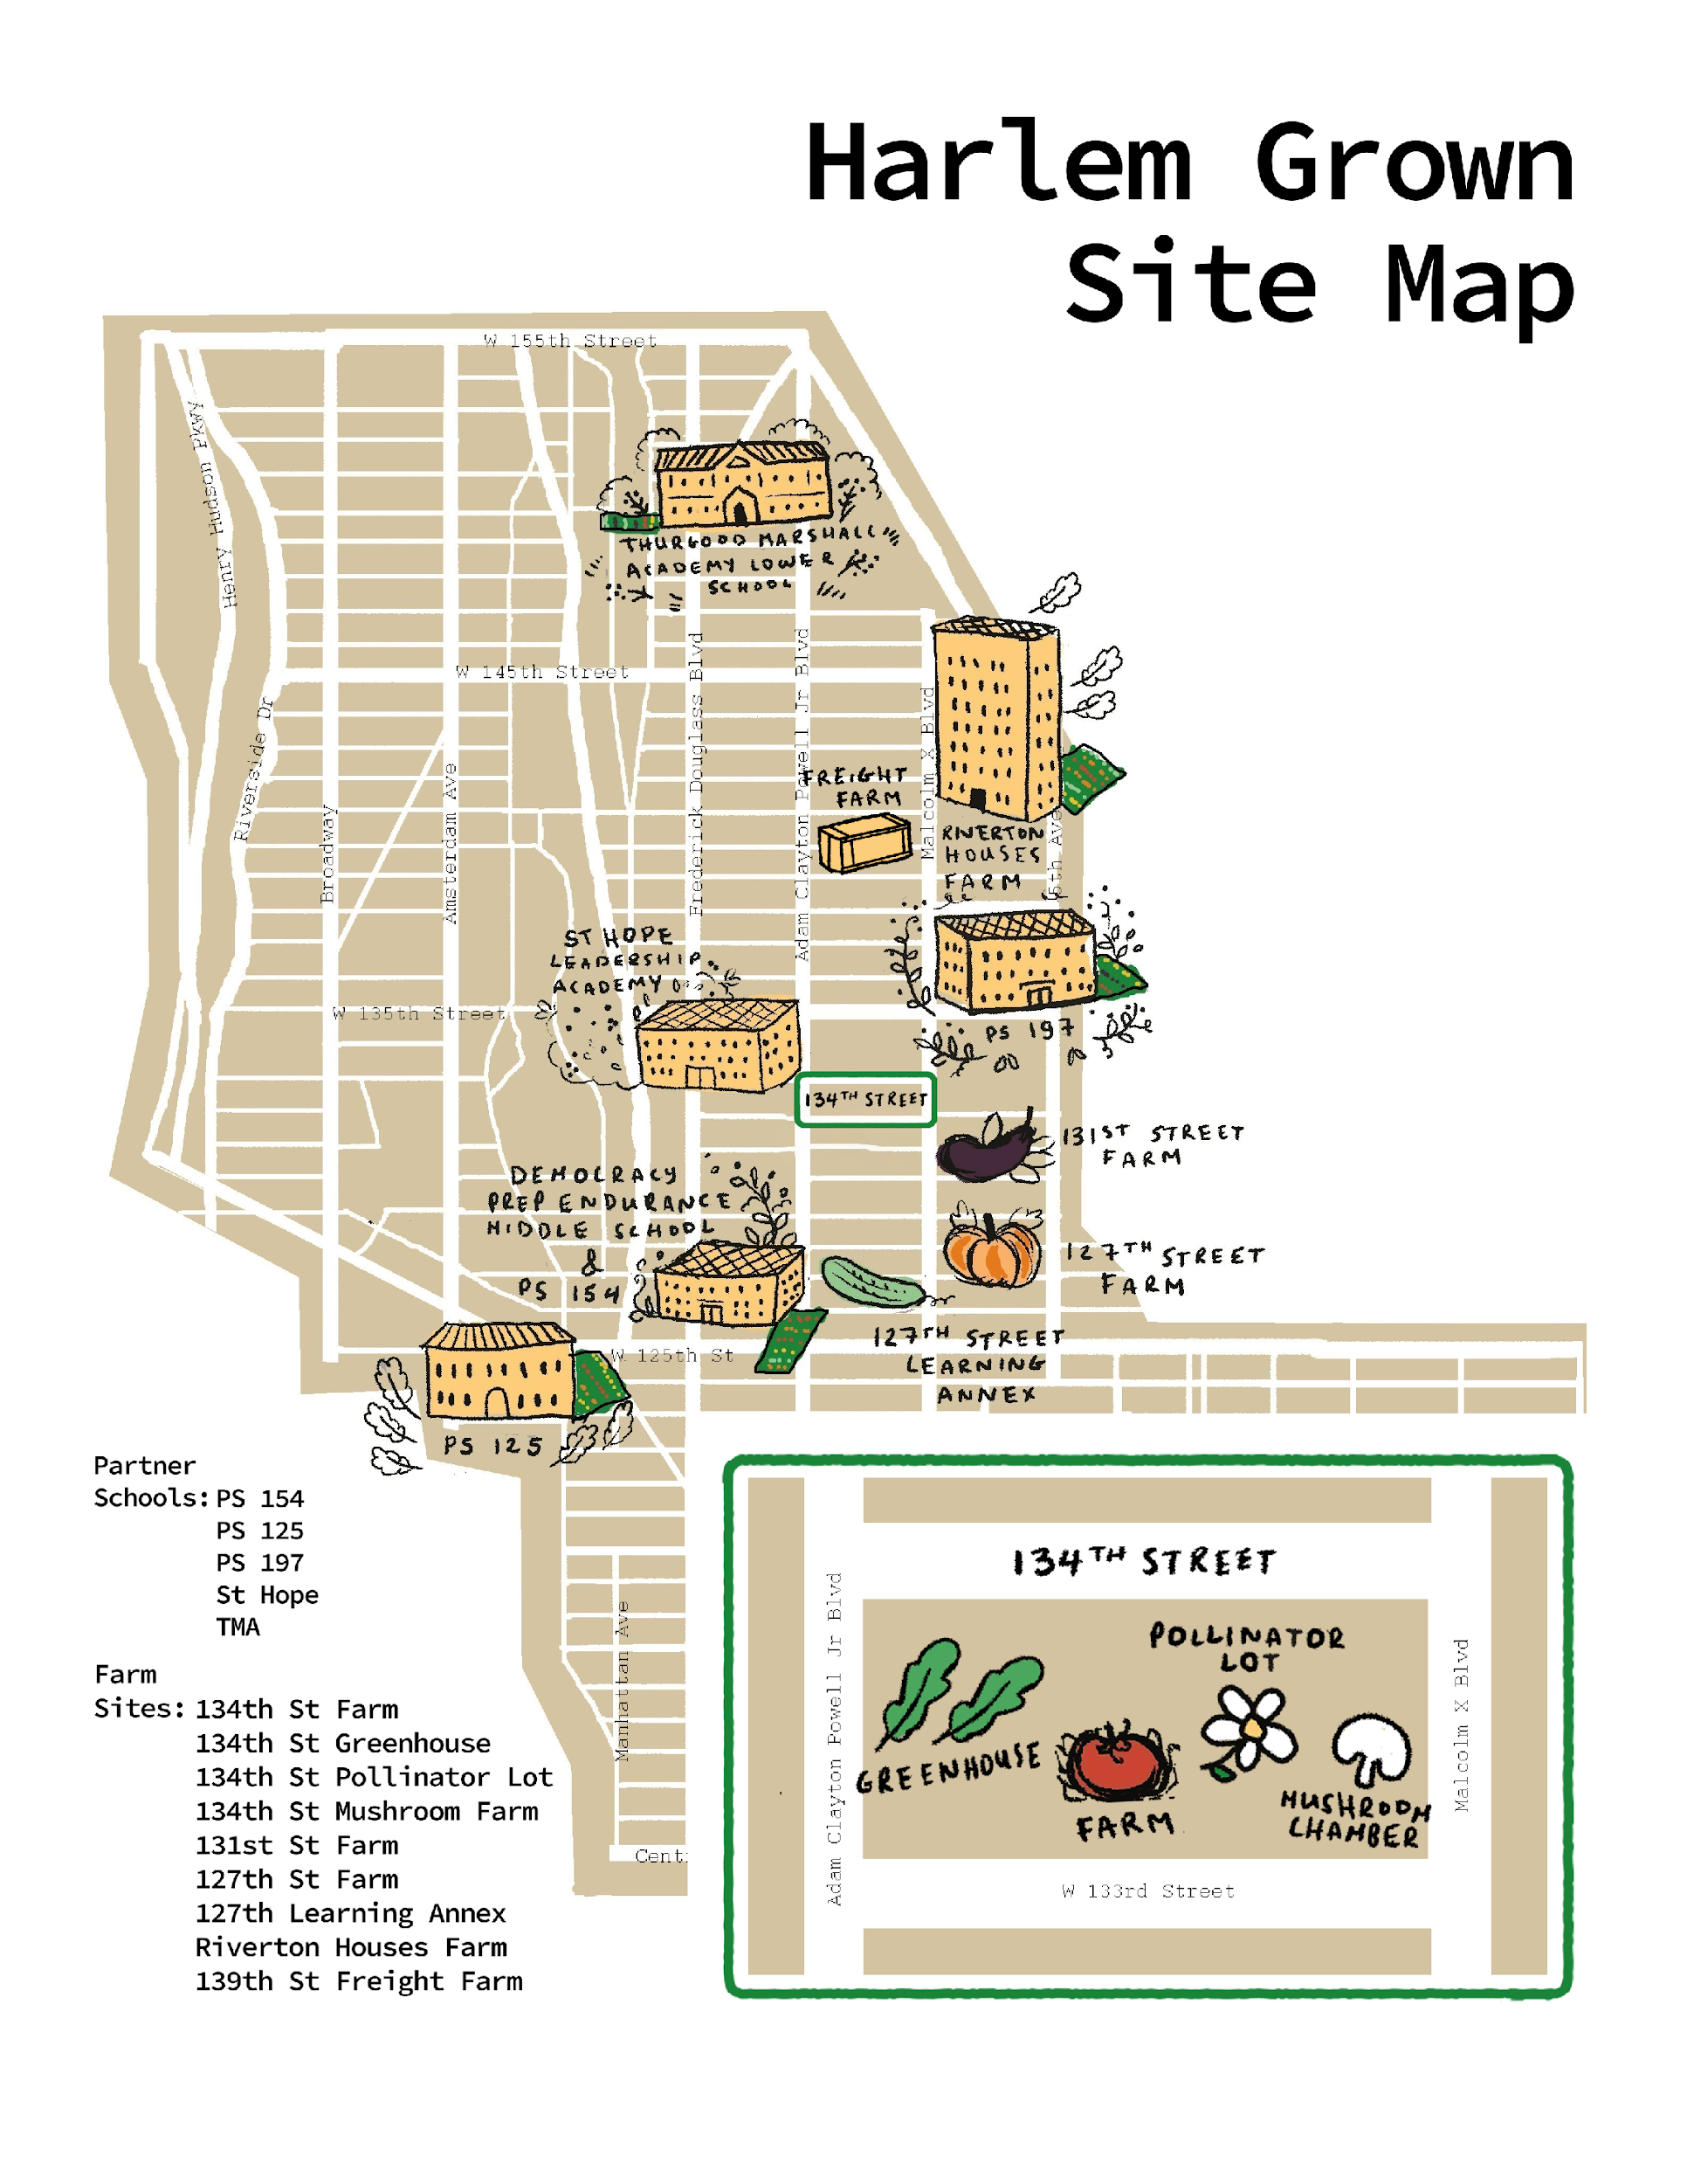
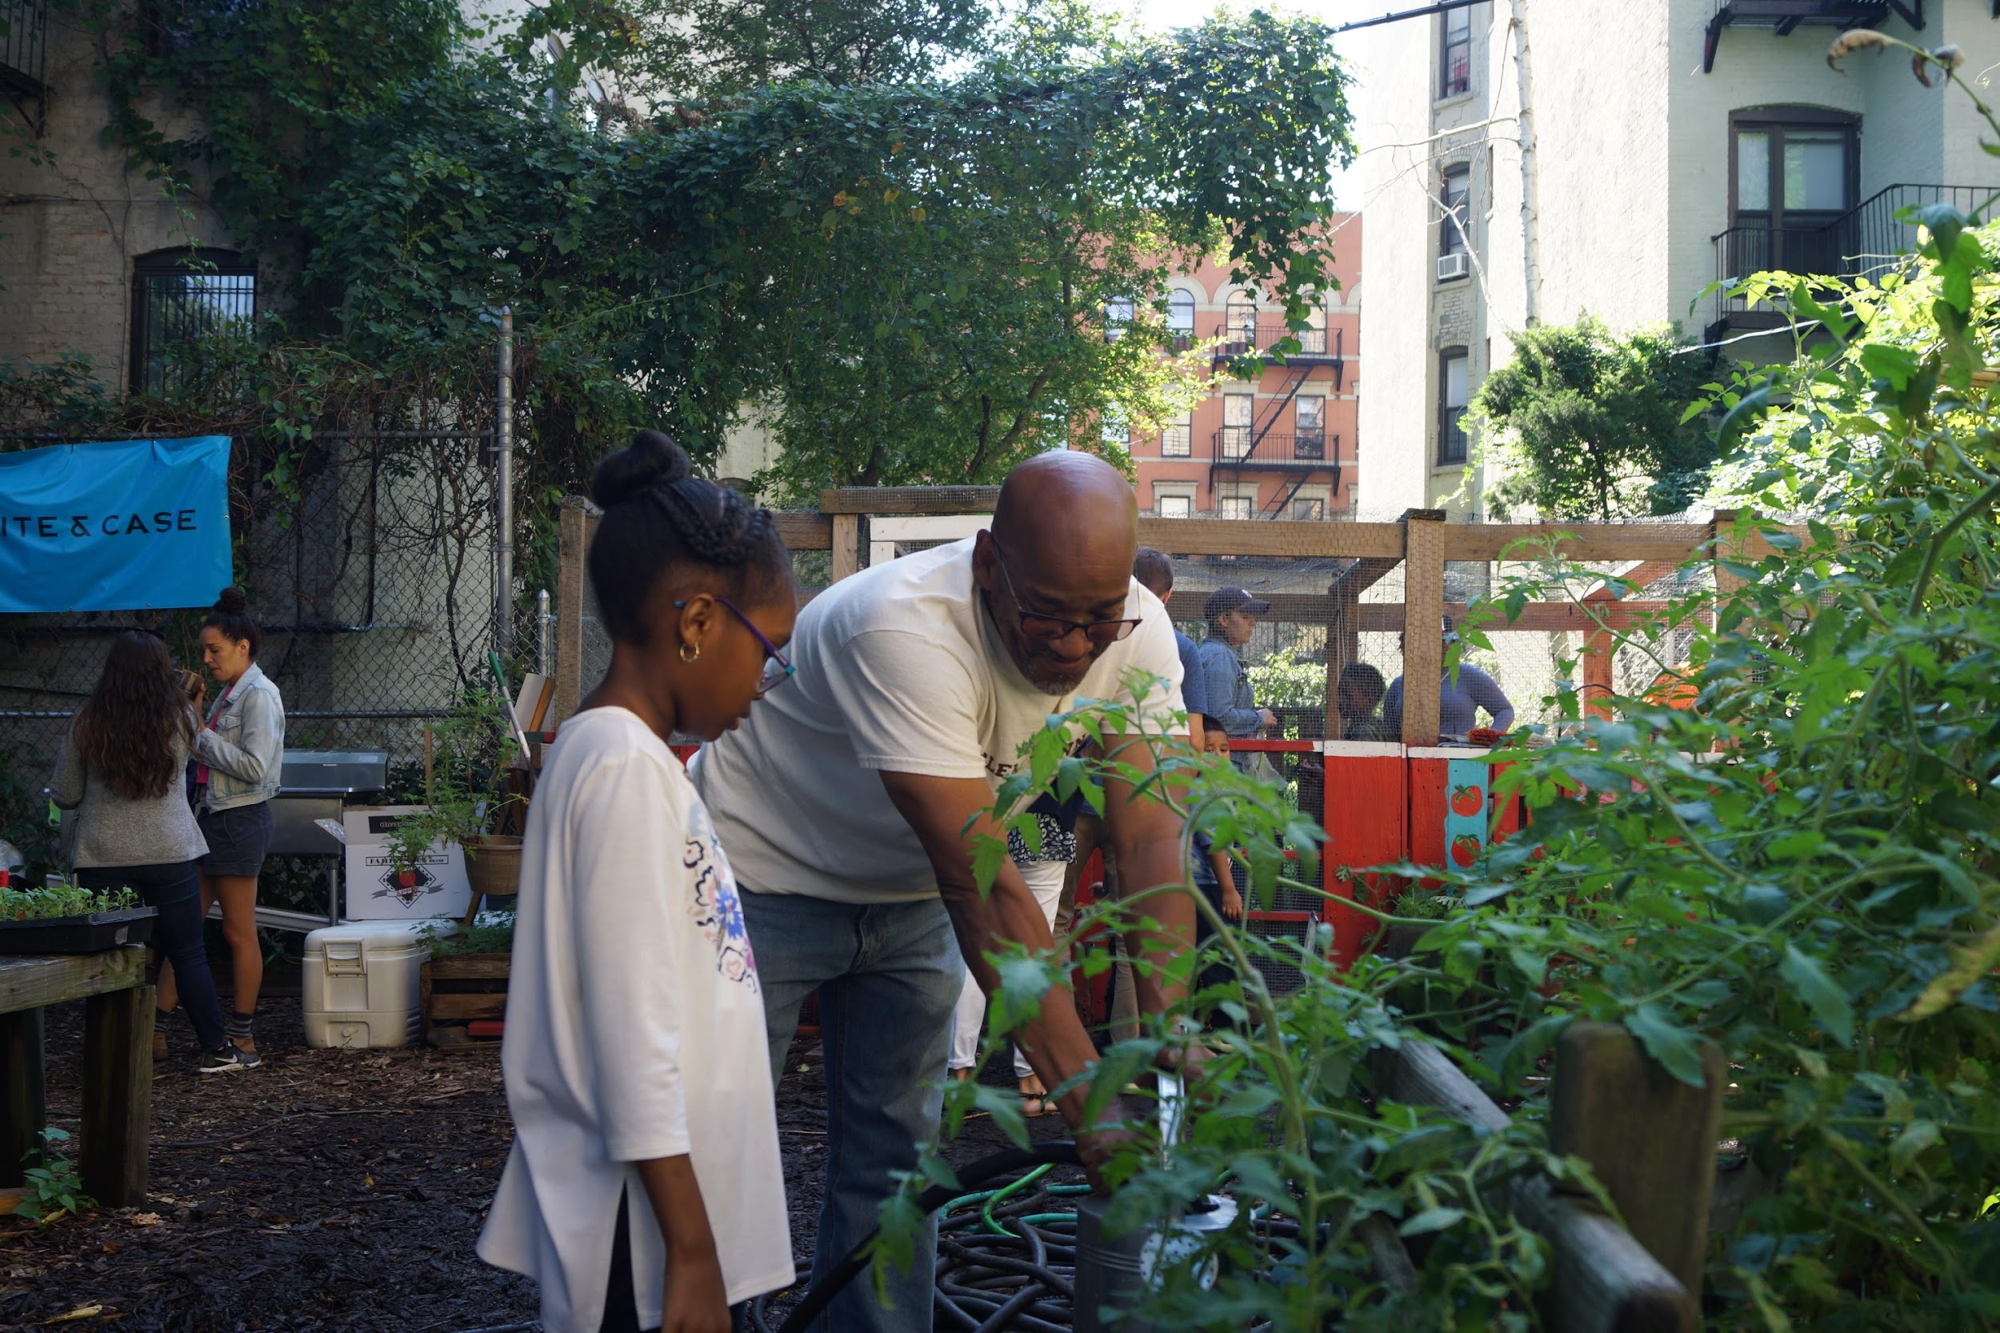
Notes:
As we propel into the next decade of Harlem Grown, it is our youth and their families that shape the work we do. We collaborate with our community members and partners to create programming that is going to amplify their aspirations and close the gap on the stark inequities that they experience. Our after school program is a direct response to a call to action from our parents and school partners as we address the need for out of school programming across our community.

Slide 8
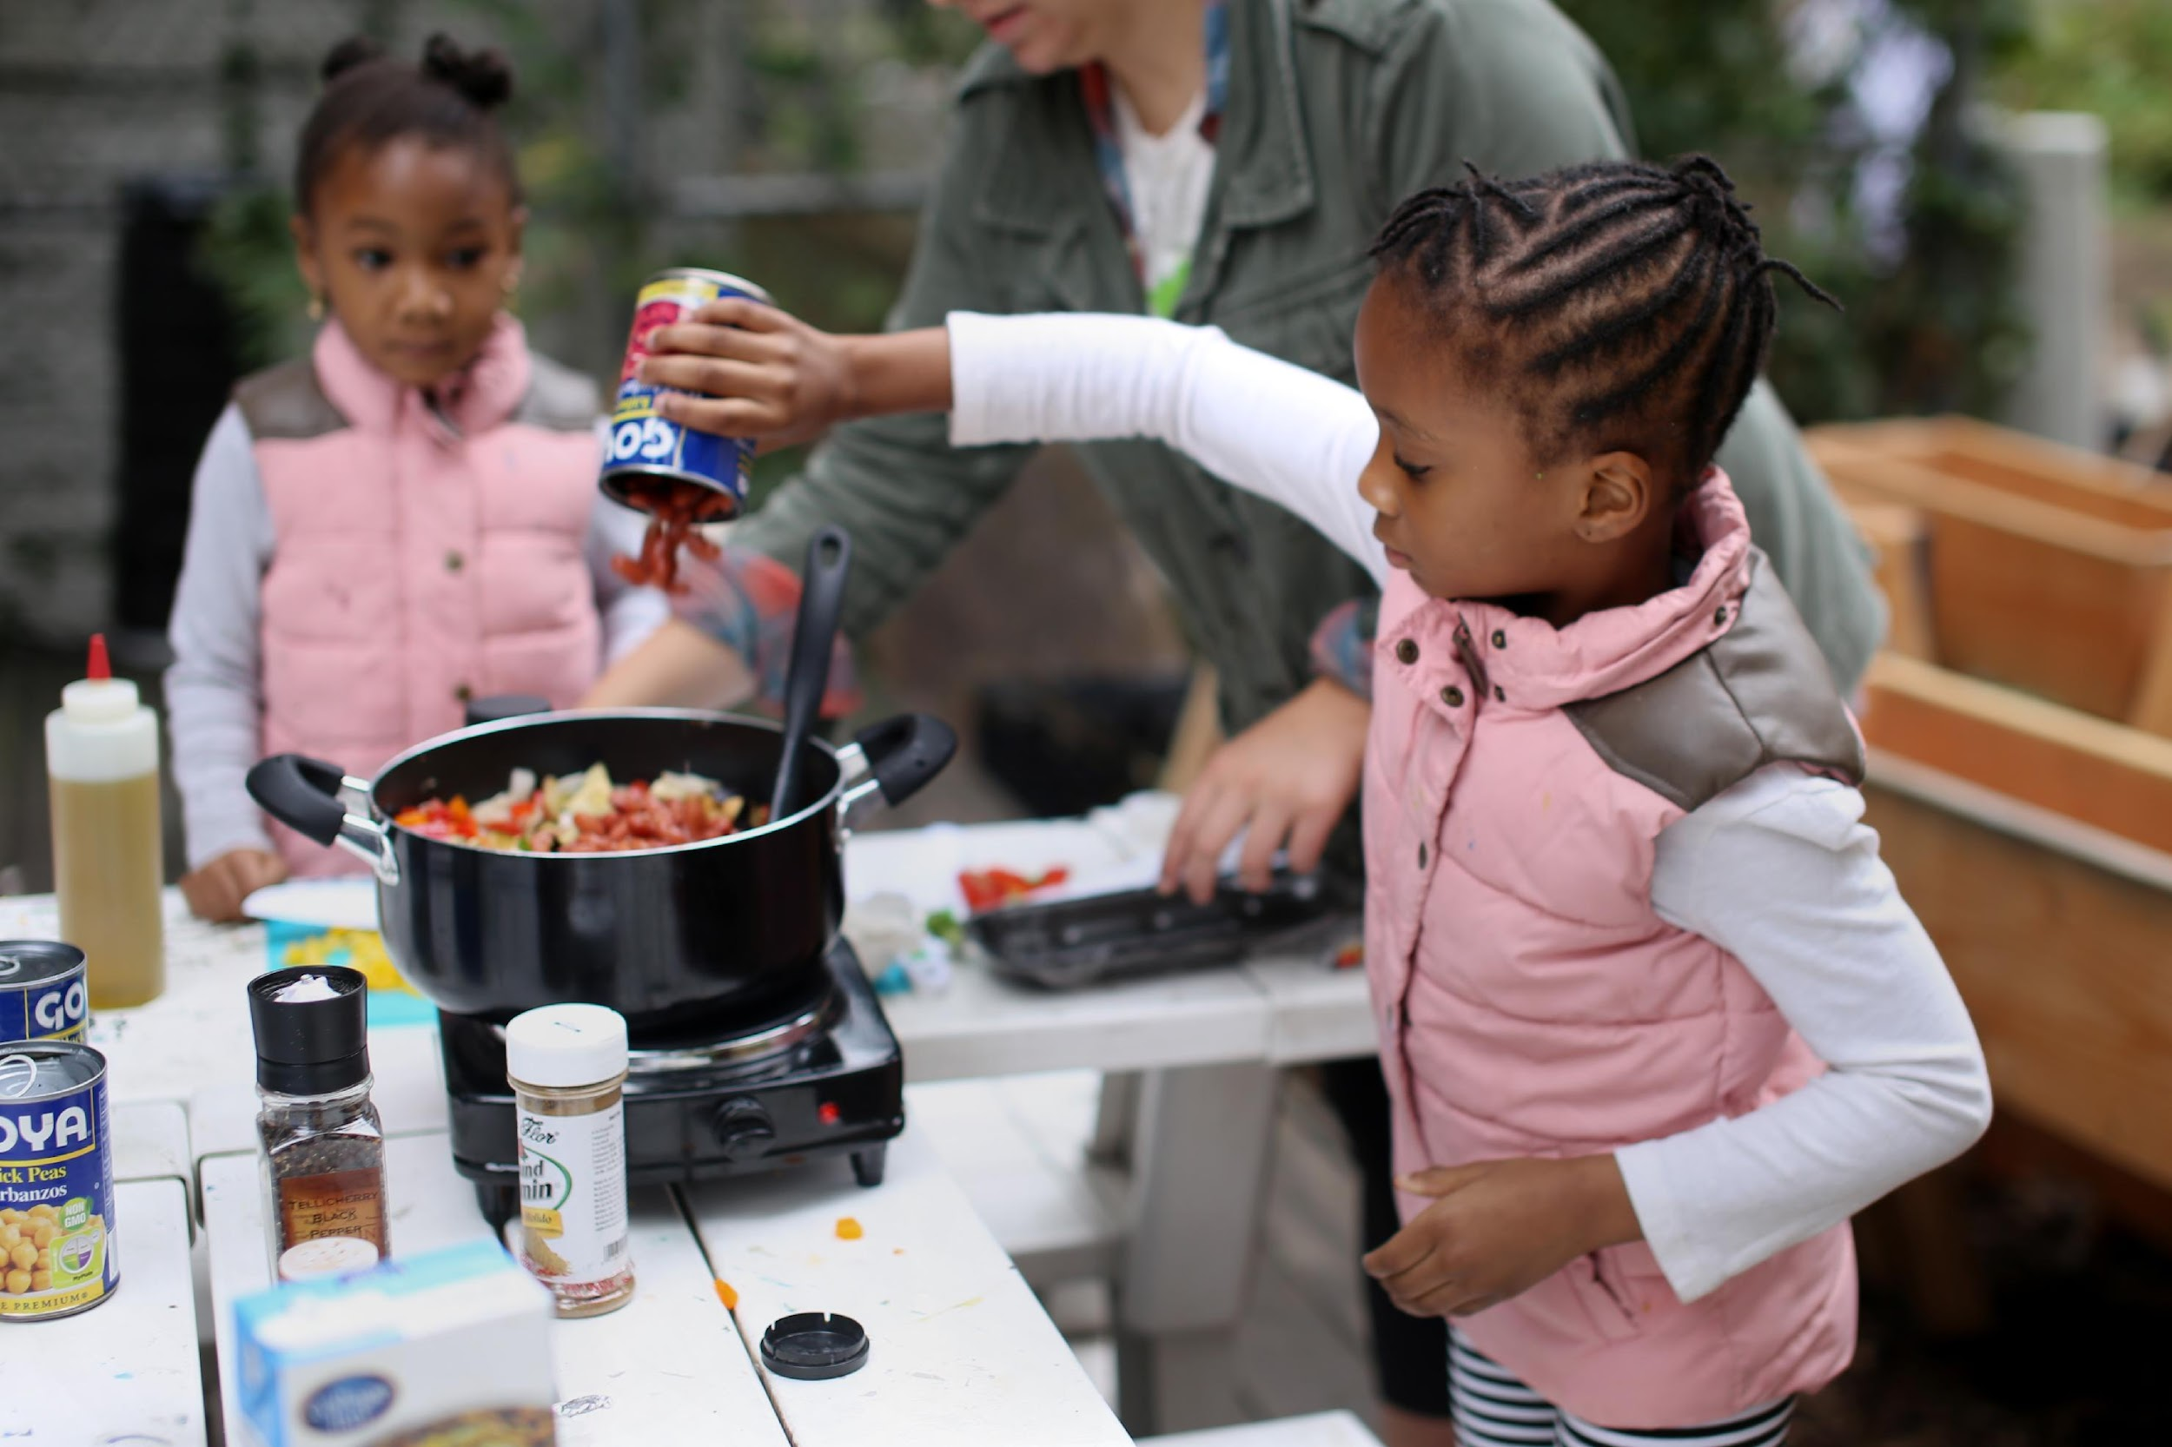

Slide 9
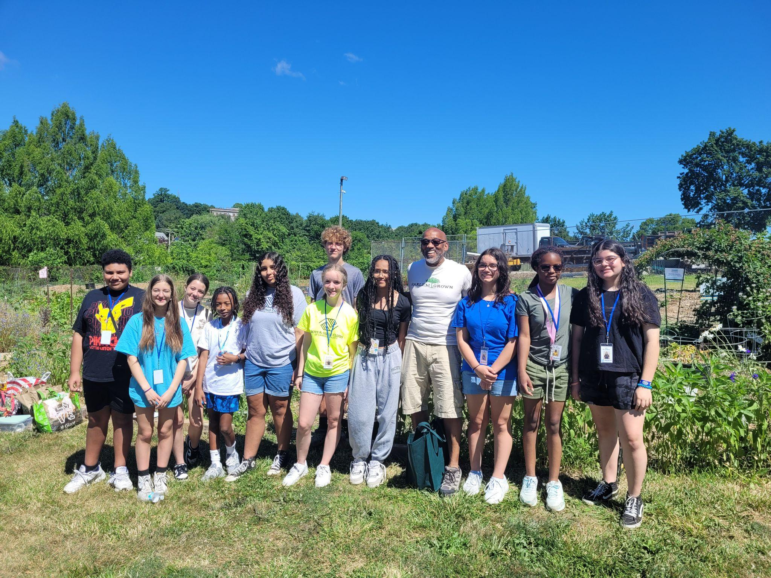
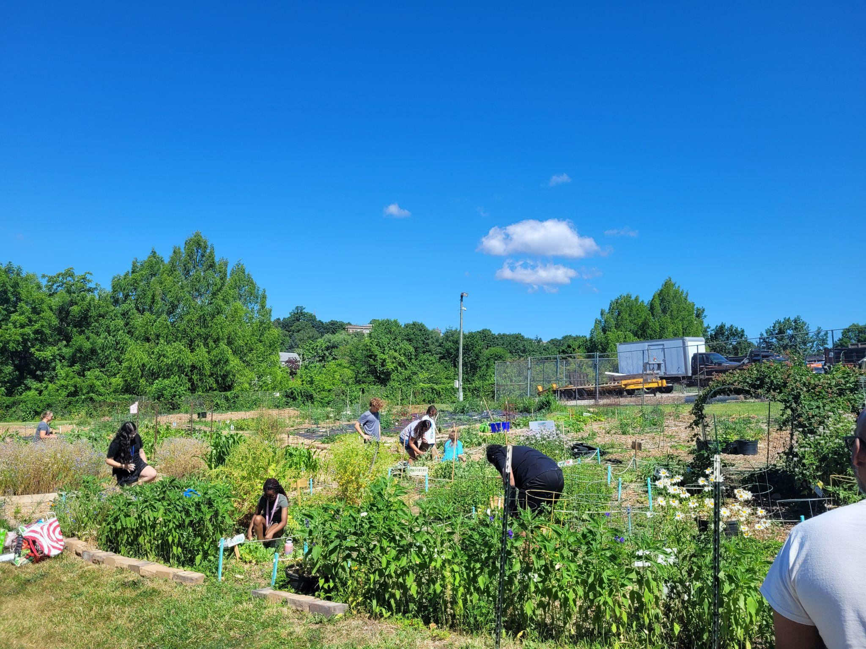
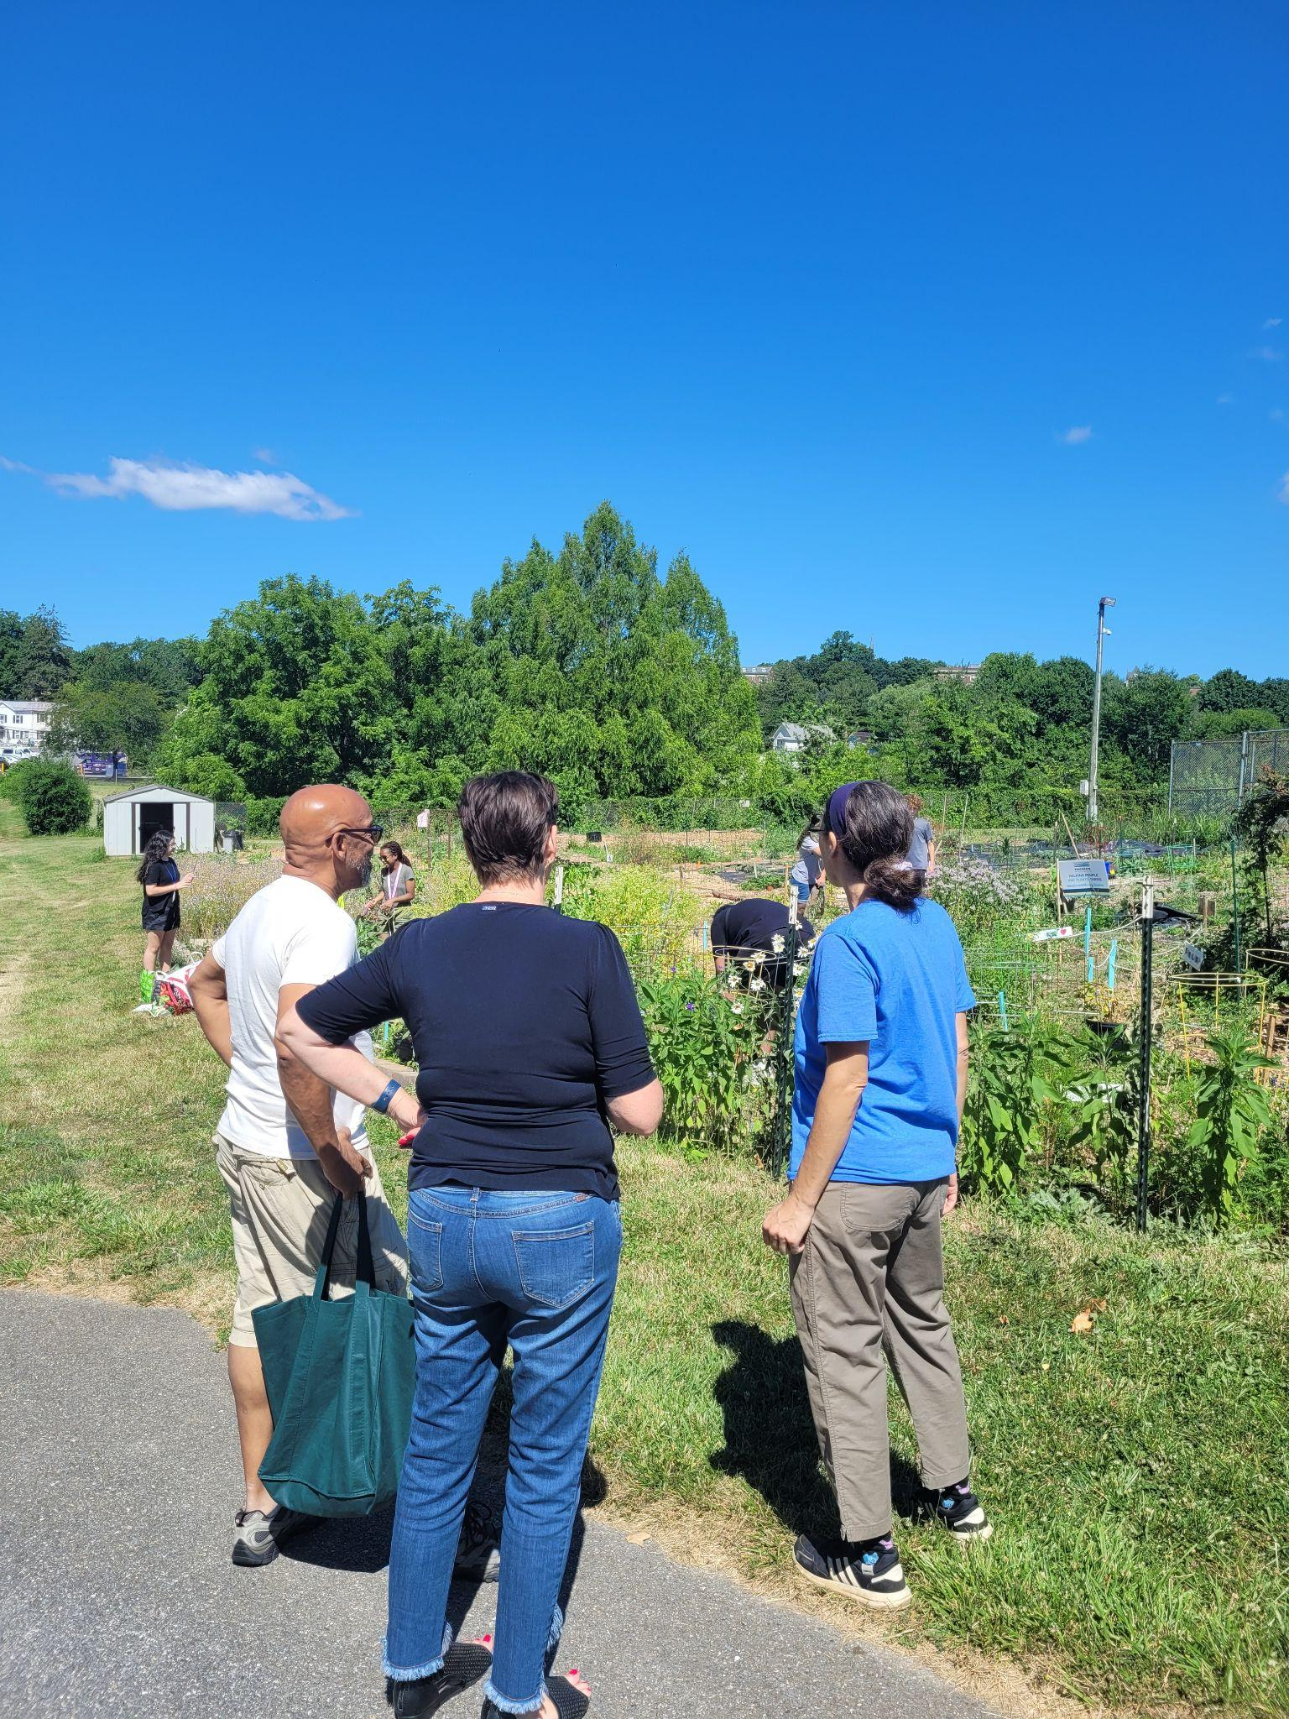
Tony’s Visit with Boys & Girls Club of Carroll County

Slide 10
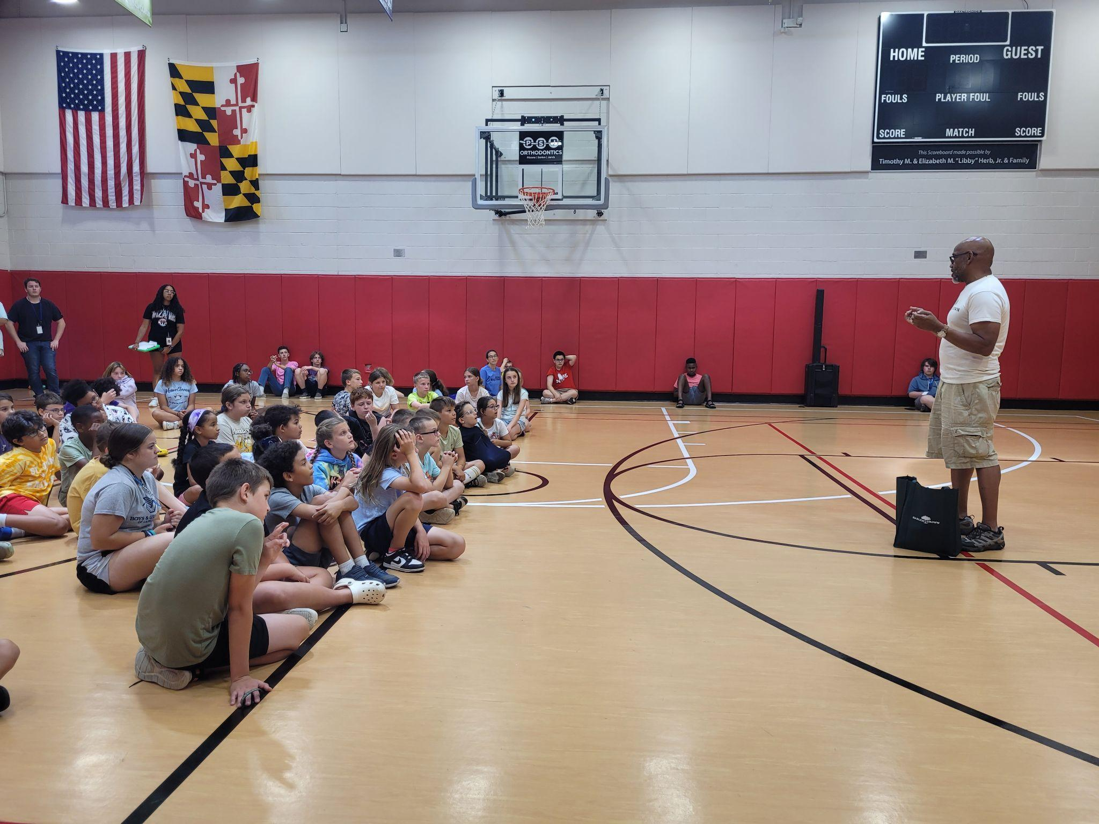
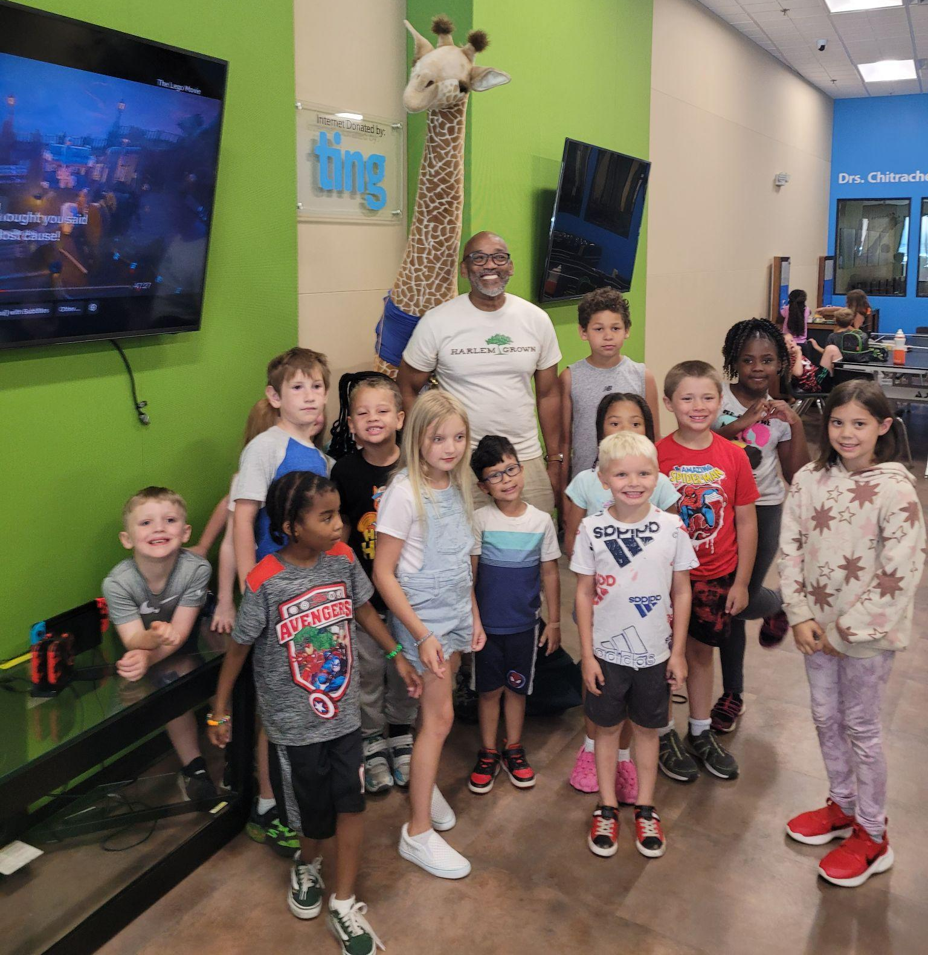
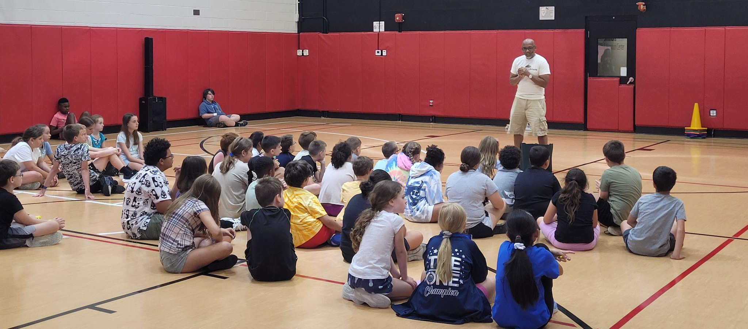
Sharing his story of Harlem Grown to the kids at BGC Westminster.

Slide 11
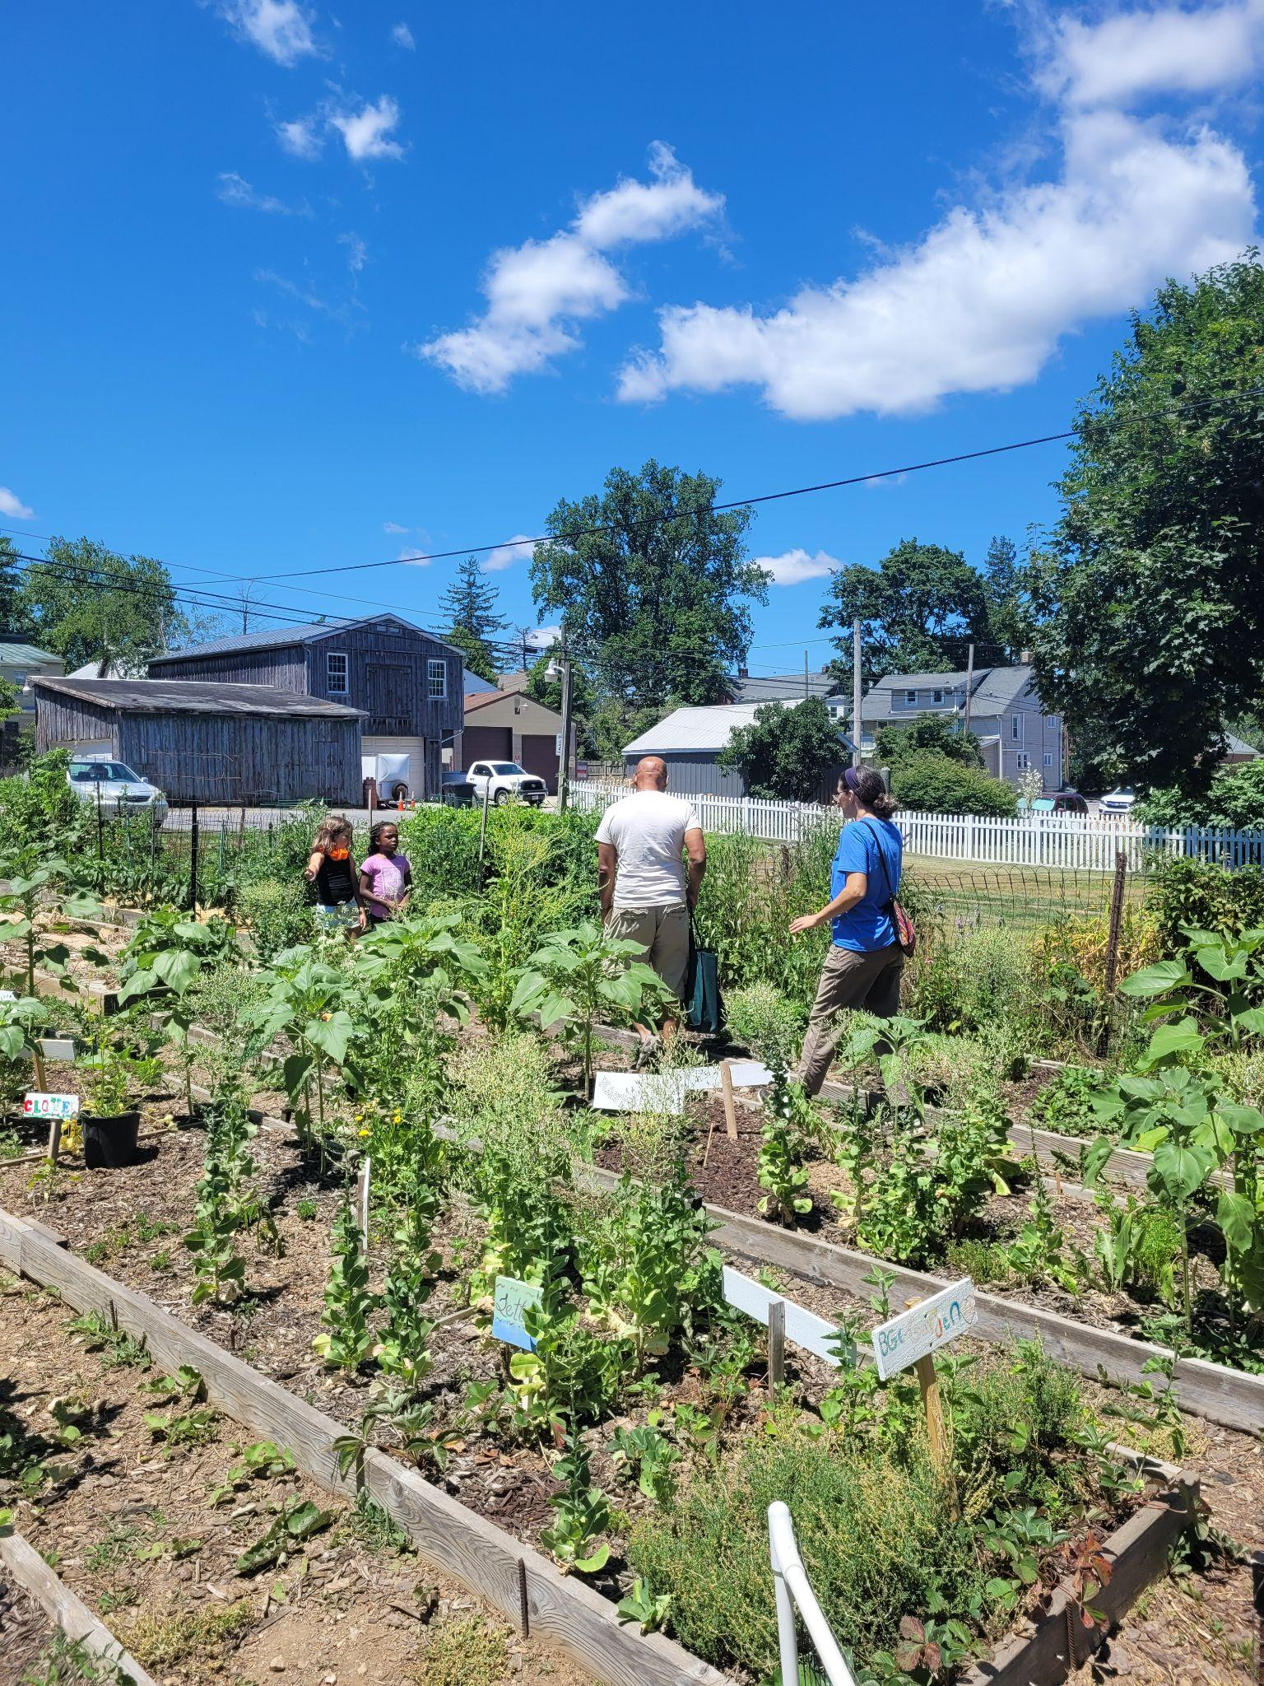
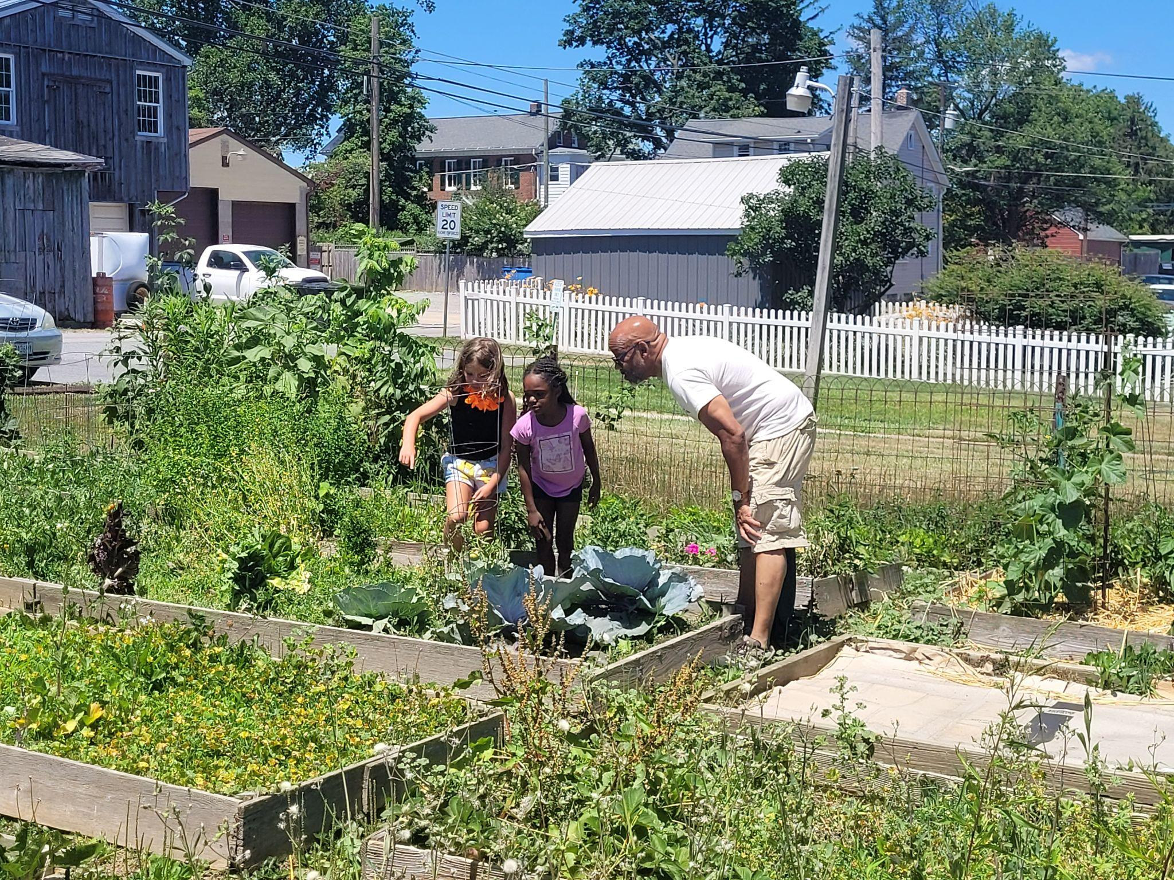
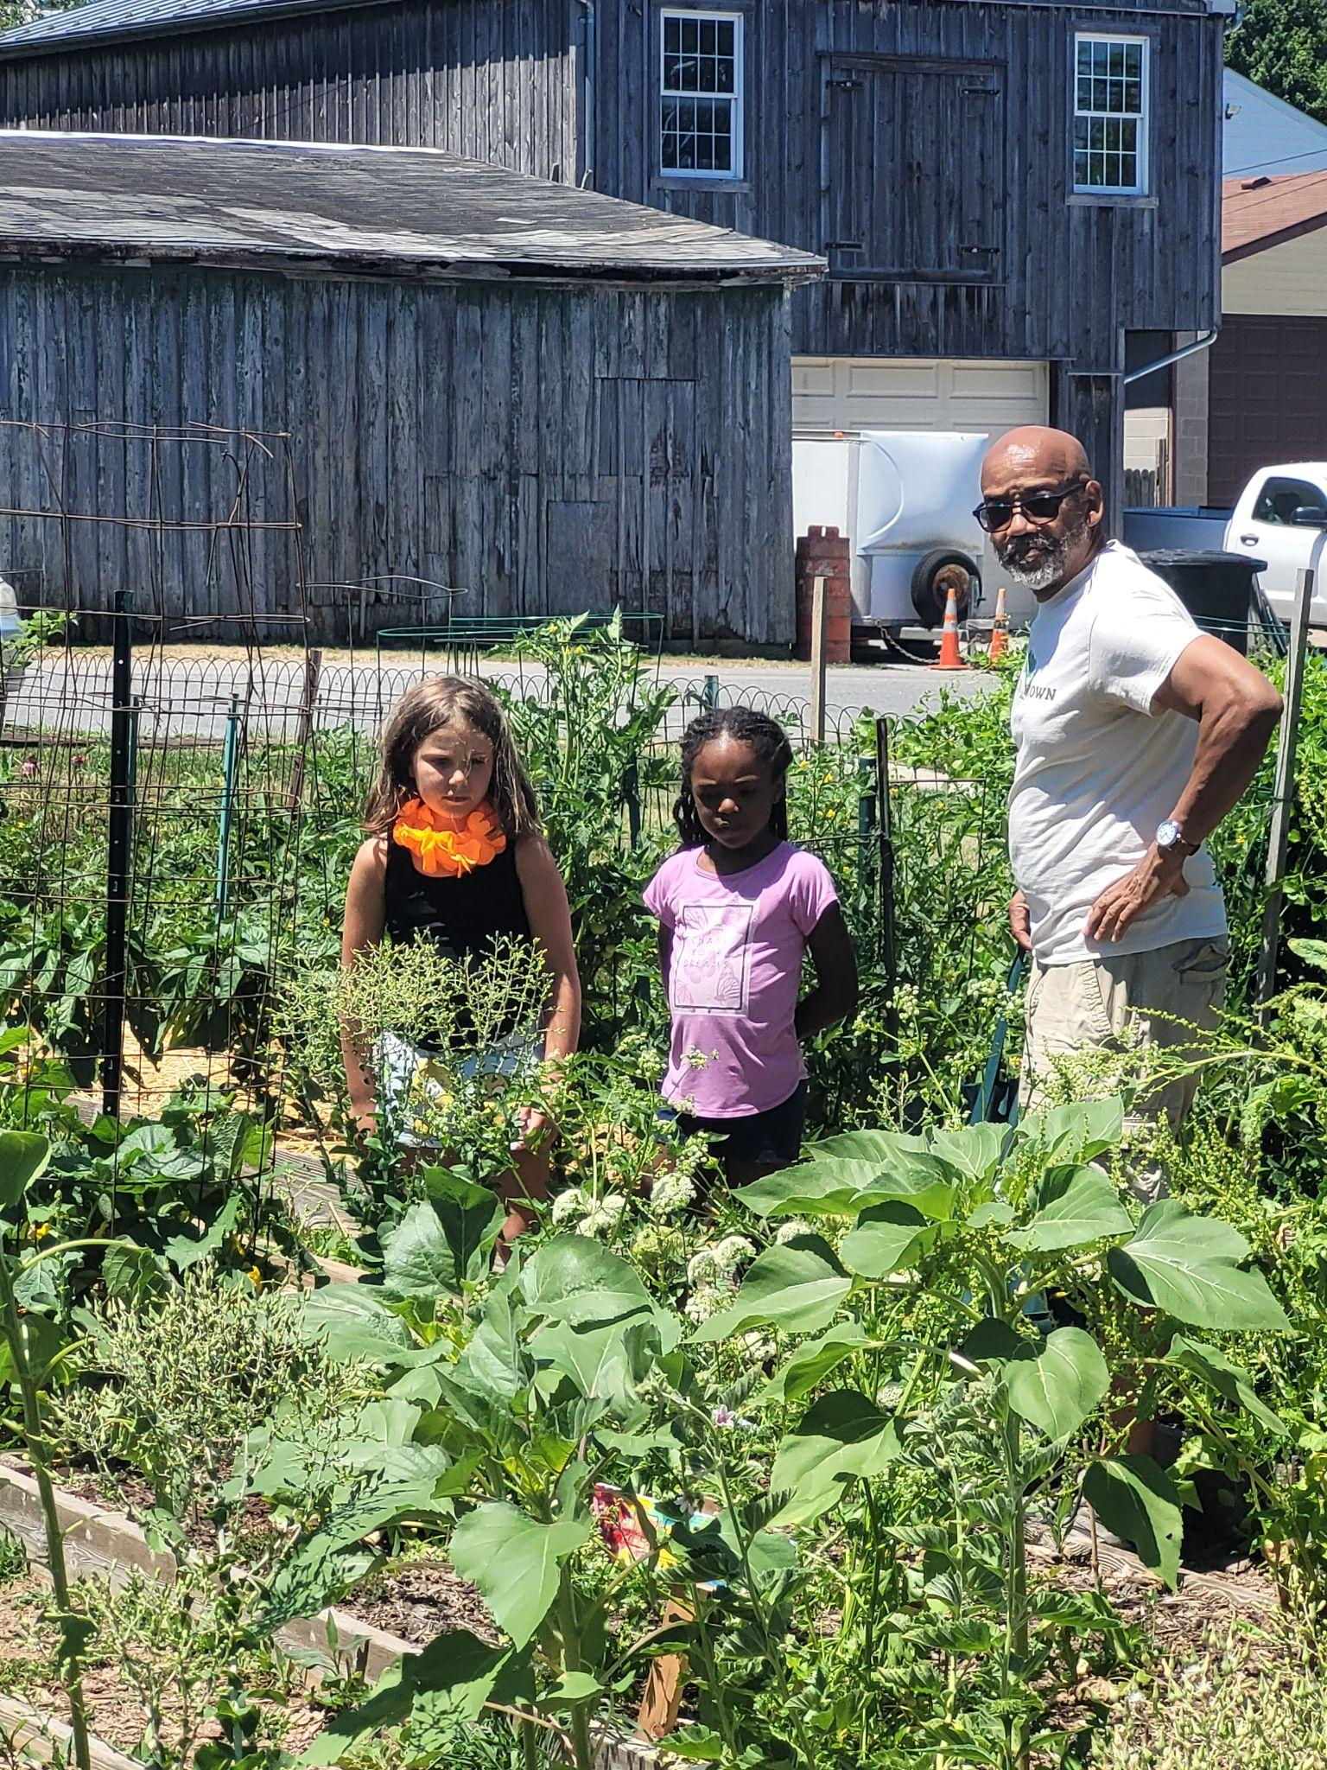

Slide 12
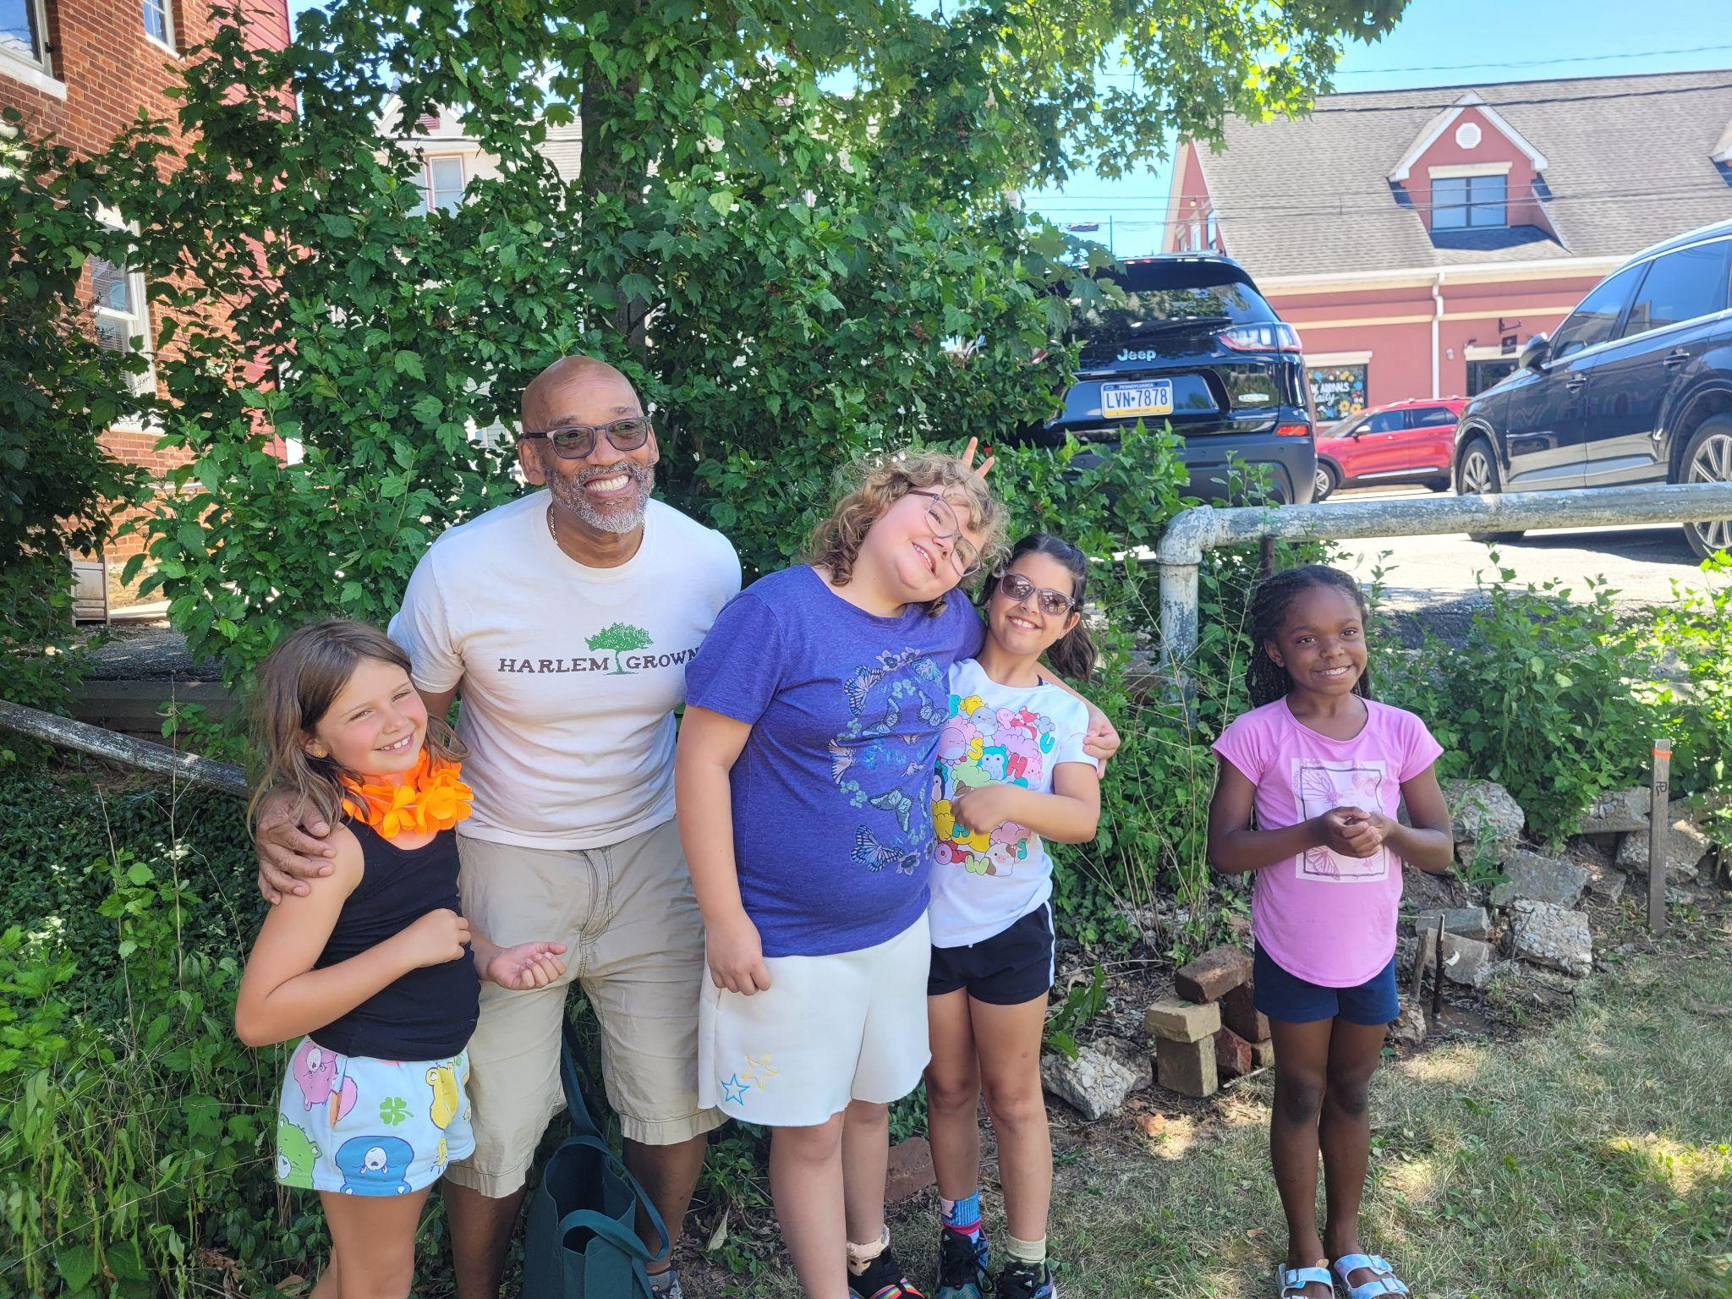
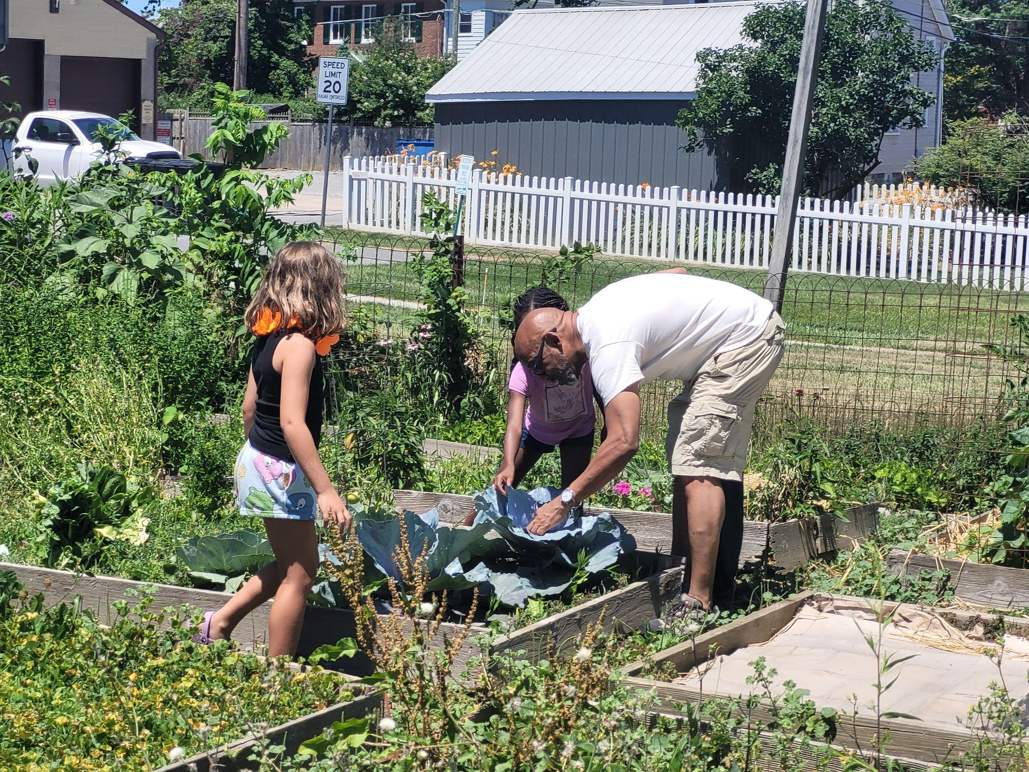

Slide 13
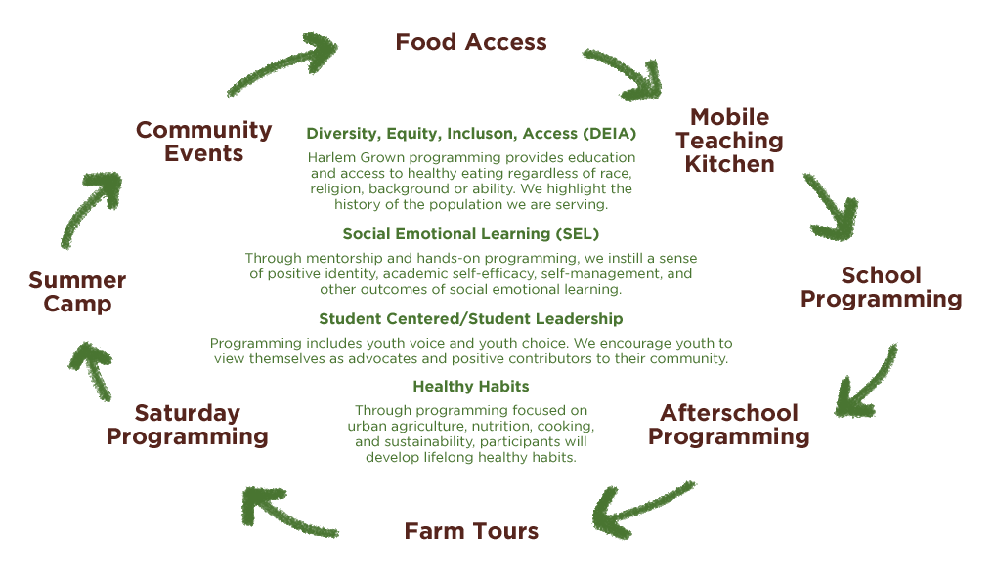
Program Objectives & Participant Journey

Slide 14
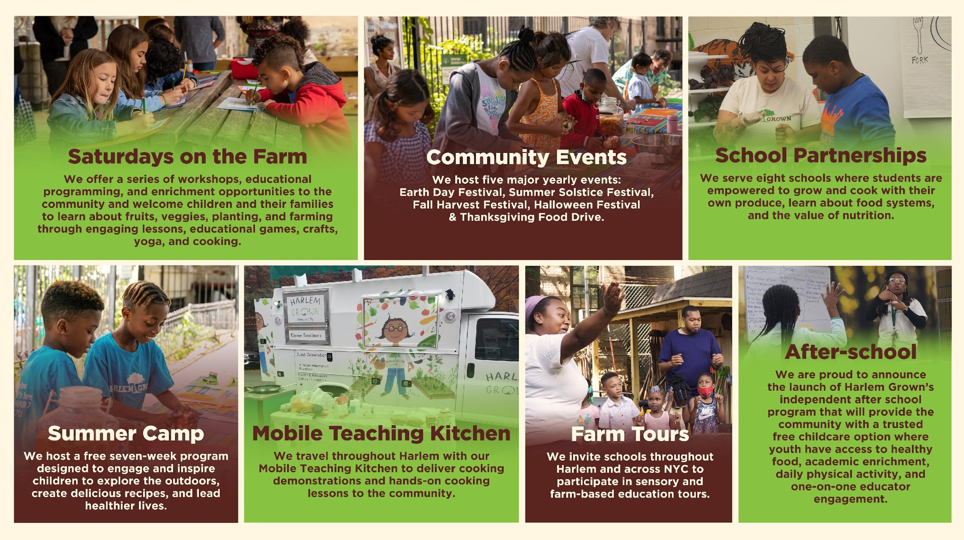
Notes:
Habits start at an early age, so we target youth to instill a life-long knowledge of healthy food choices in the community. We realize our mission through our seven streams of programming including eight intensive school partnerships, weekly Saturday programming from April to October, a free 7-week intensive Summer Camp, farm-based education tours, monthly community events, and our Mobile Teaching Kitchen. For 11 years Harlem Grown has worked and will continue to work alongside the community to support and empower them to lead healthy lives.

