Slide 1

Advancing Substance Use Prevention to Meet the Moment
Christopher M. Jones, PharmD, DrPH, MPH
CAPT, US Public Health Service
Director, Center for Substance Abuse Prevention
Substance Abuse and Mental Health Services Administration
U.S. Department of Health and Human Services
Notes:
‹#›

Slide 2
Learning Objectives
Characterize the current landscape of substance use in the nation.
Describe the importance of prevention in the context of today's drug threats and its role within the continuum of care.
Examine how established and emerging prevention strategies can be utilized to address the ever-changing drug landscape.
Present a rationale for a comprehensive prevention strategy.

Slide 3
Epidemiology Update

Slide 4
Historically High Overdose Deaths in the U.S.
Source: CDC

Slide 5
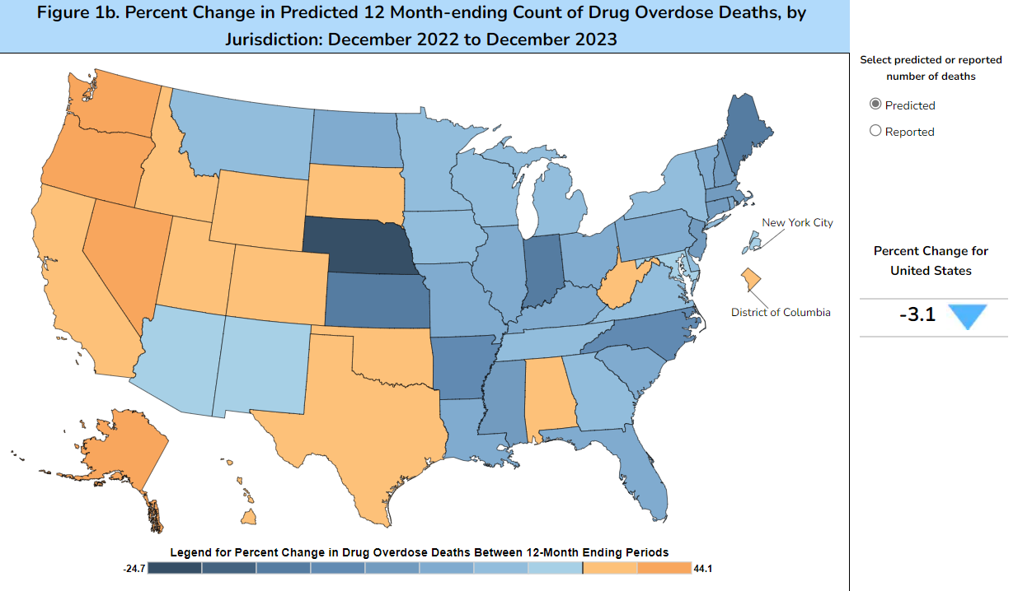
Latest Provisional Data
Products - Vital Statistics Rapid Release - Provisional Drug Overdose Data (cdc.gov)

Slide 6
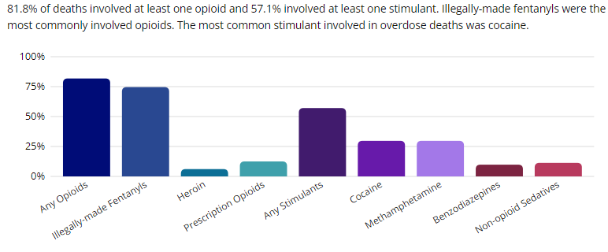
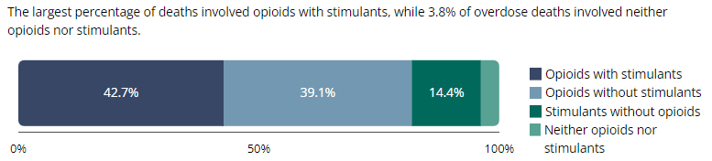
Deaths Driven by Illicit Synthetic Opioids and Stimulants
SUDORS Dashboard: Fatal Overdose Data | Drug Overdose | CDC Injury Center

Slide 7
Changing Epidemiology of Substance Use & Overdose
Source: CDC NCHS. NVSS/WONDER, 2024.

Slide 8
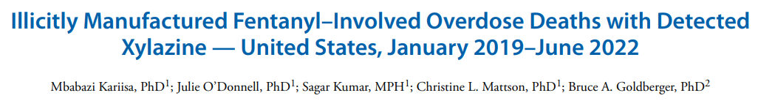
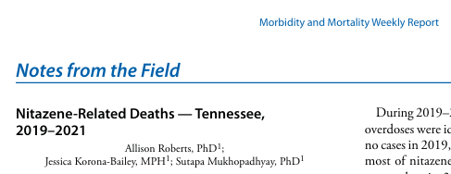
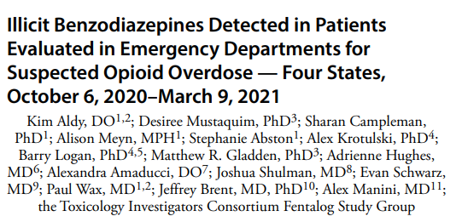
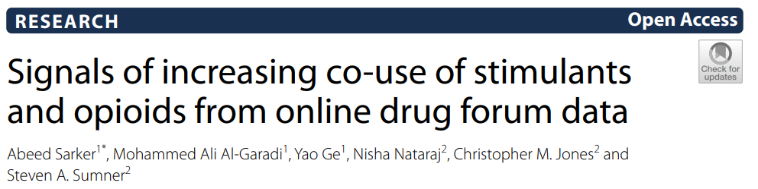
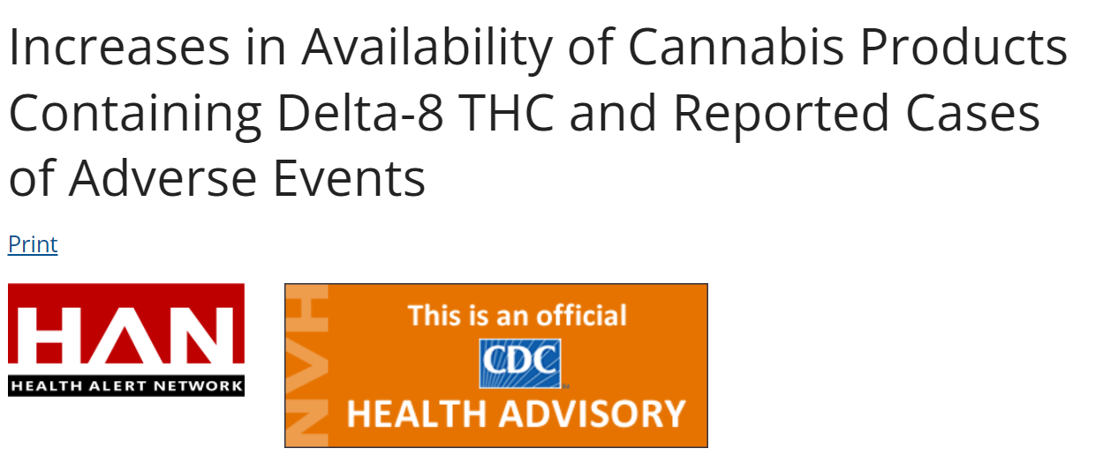
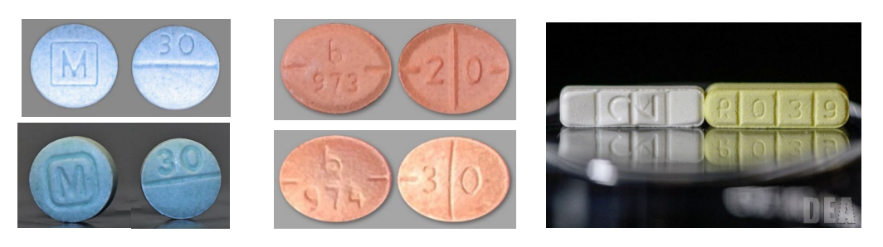
The Substance Use Landscape Is Changing and Has Never Been Riskier

Slide 9
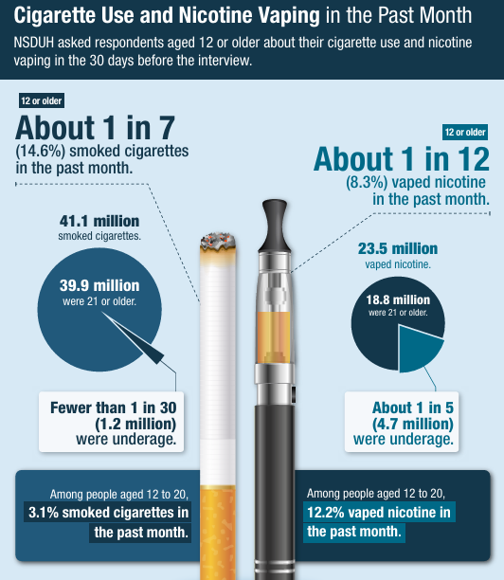
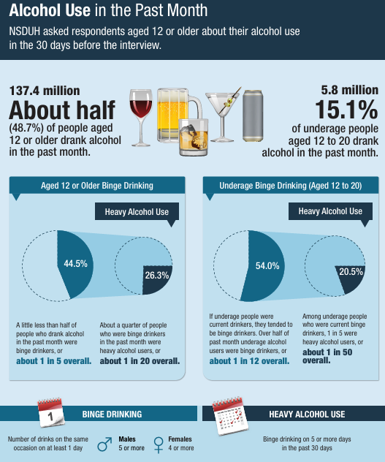
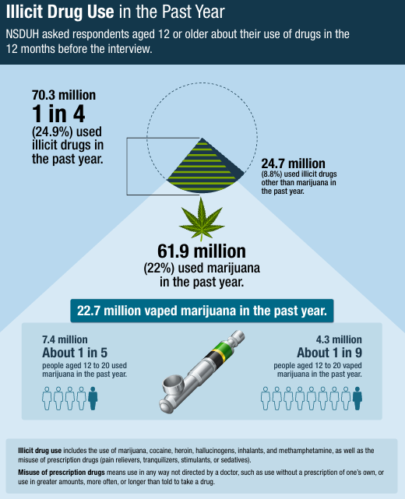
Usual Suspects are Ever-Present and Evolving

Slide 10
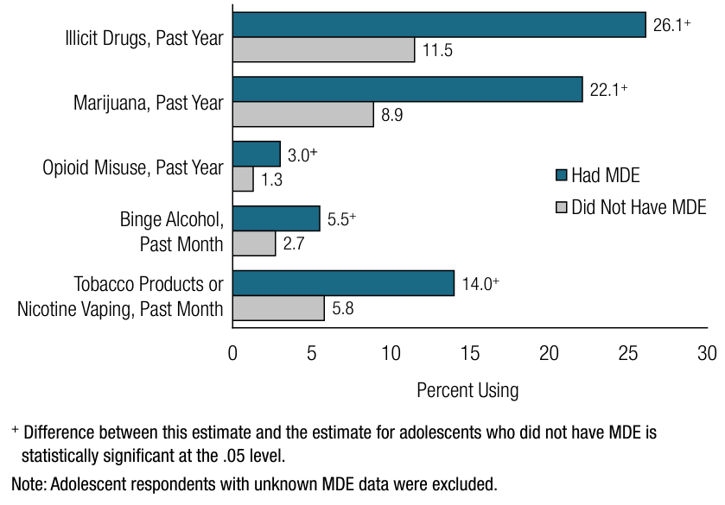
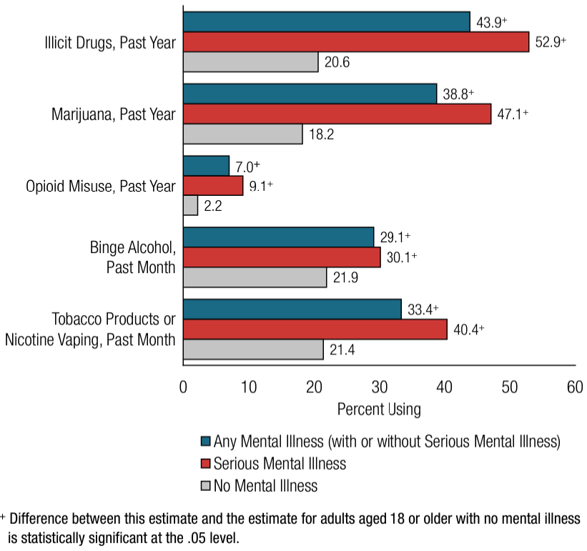
Substance Use and Mental Health are Intimately Linked
Past Year or Past Month Substance Use: Among Adolescents Aged 12 to 17; by Past Year Major Depressive Episode (MDE) Status, 2022
Past Year or Past Month Substance Use: Among Adults Aged 18 or Older; by Past Year Mental Illness Status, 2022
Data Source: Substance Abuse and Mental Health Services Administration. (2023). Key substance use and mental health indicators in the United States: Results from the 2022 National Survey on Drug Use and Health (HHS Publication No. PEP23-07-01-006, NSDUH Series H-58). Center for Behavioral Health Statistics and Quality, Substance Abuse and Mental Health Services Administration. https://www.samhsa.gov/data/report/2022-nsduh-annual-national-report

Slide 11
Percent of All Deaths by Age Group Due to Drug Overdose in 2022
1 in 3
1 in 4
1 in 5
1 in 8
1 in 12
1 in 20
1 in 100
Source: CDC NCHS. NVSS/WONDER, 2024

Slide 12
Holistic Approach to Substance Use & Overdose

Slide 13
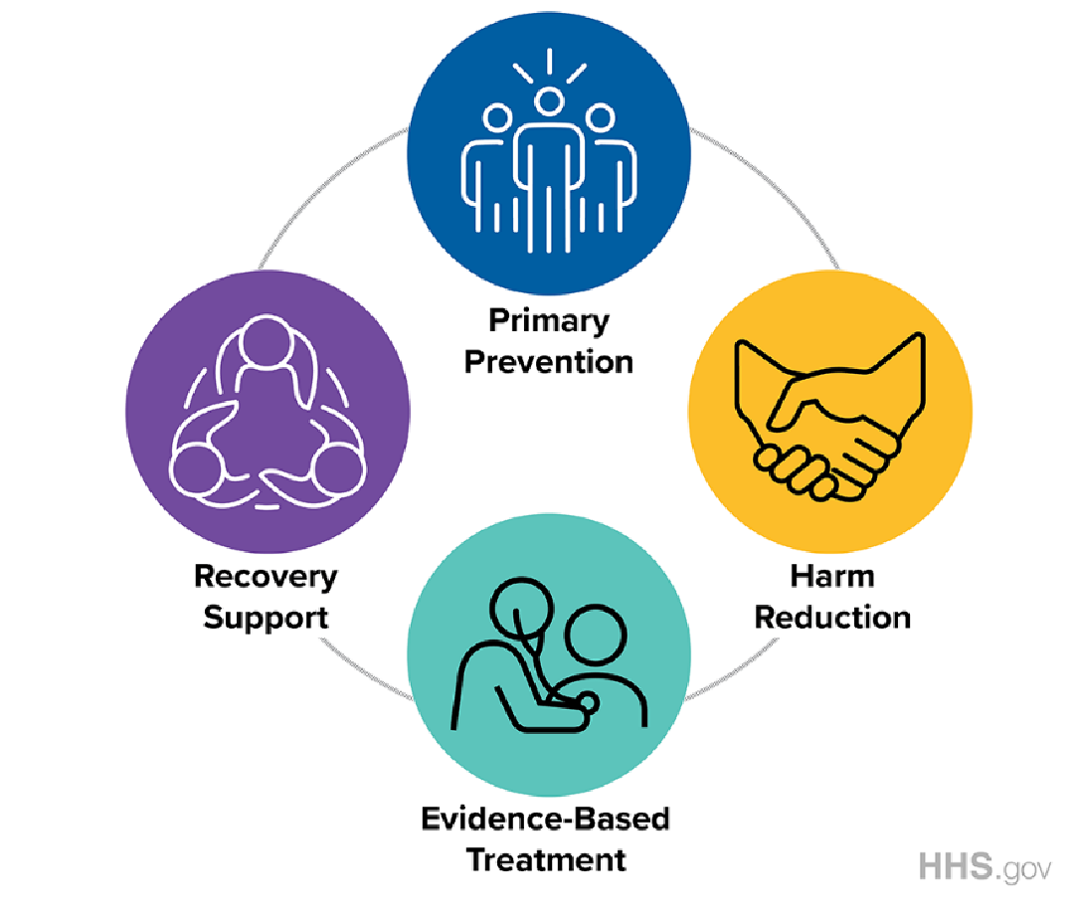
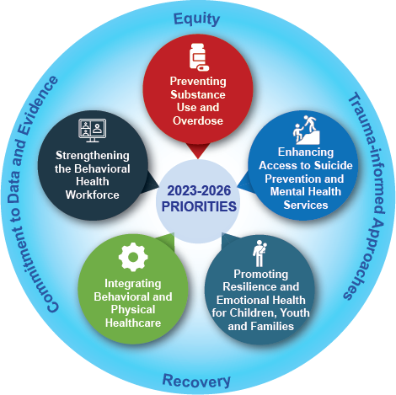
Guiding Frameworks for SAMHSA's Whole Person Approach

Slide 14

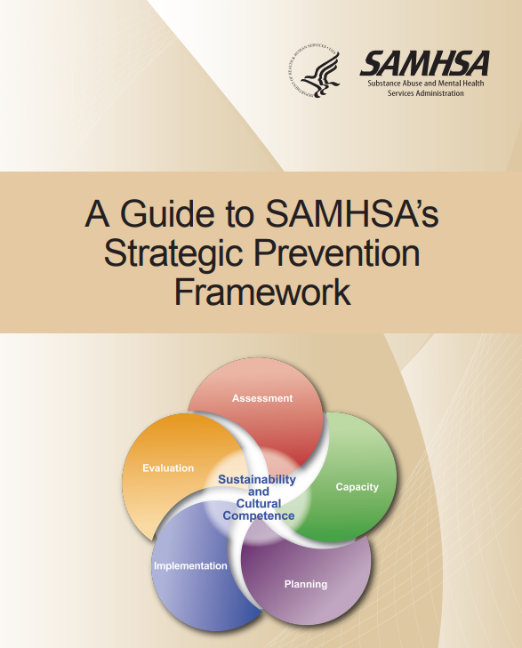

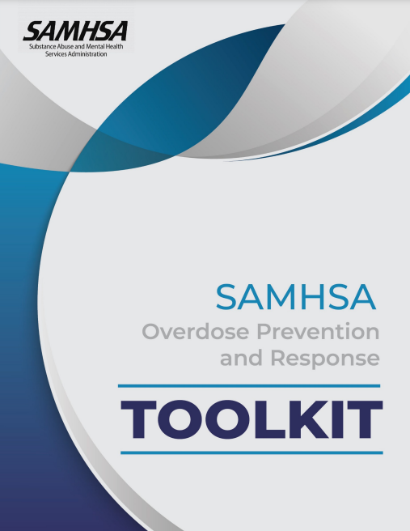


The Future We Envision
CSAP’s Vision
  A future where individuals, families, and communities are healthy and thriving
CSAP’s Mission
  Provides leadership and collaborates across sectors to advance prevention across the lifespan.
  We aim to:
    Prevent substance use initiation
    Prevent progression of substance use
    Prevent and reduce harms associated with substance use
How We Do It
  Through use of data, prevention science, communication, collaboration and strategic program investments

Slide 15
CSAP Strategic Priorities and Guiding Principles
Analyzing and Disseminating Information on the Latest Data, Trends, and What Works in Prevention
Building Prevention Capacity at the National, State, Tribal, Territorial, and Local Levels
Guiding Principles
Data-Driven
Innovative
Community Informed
Grounded in Cultural Humility
Focused on Health Equity
Inclusive of Social Determinants of Health
Raising Awareness and Catalyzing Prevention Action
Advancing Prevention through Strategic Collaborations and Partnerships

Slide 16
Substance Use Among Youth – Setting the Stage
Youth substance use rates heading in right direction
Yet, overdose deaths among youth continue to go up – driven by proliferation of fake pills and toxic, unpredictable illicit drug market
  1 in 12 deaths among 12-17 year-olds
  1 in 5 deaths among 18-24 year-olds
Disparities in patterns of use and harms depending on sociodemographics
Need a holistic approach to address range of risk and protective factors long-term while also addressing acute issues of increasing overdose risk
Alcohol – down 44% since 2004; down 16% since 2019
Any illicit drug – down 26% since 2004; down 27% since 2019
Cannabis – down 24% since 2004; down 29% since 2019
Any illicit drug other than cannabis – down 59% since 2004; down 38% since 2019

Slide 17
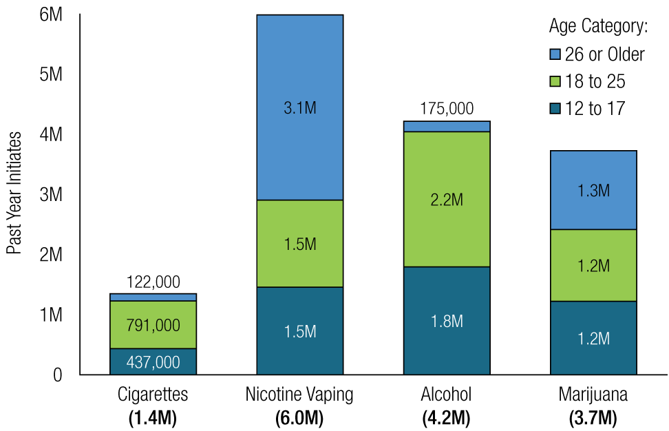
Prevention Isn’t Just for Youth
Initiation Age
SOURCES: 2022 NSDUH

Slide 18
Prevention Opportunities Across the Spectrum
Foundational Prevention Programming
Acute Overdose Prevention
SOURCES: 2022 NSDUH ; SUDORS Dashboard: Fatal Overdose Data | Drug Overdose | CDC Injury Center

Slide 19
Substance Use Risk Factors – Socioecological Model
Individual
Relationship
Community
Societal
Genetic factors
Initiating substance use early
Low risk perception of use
Peers who use substances
Perception that use of substances among peers is high
Emotional distress or aggressiveness that starts early and is persistent
Mental health challenges
Substance use in the family and home
Parental mental health challenges
Family conflict, abuse, or neglect
Parents who favorably view or approve of substance use
Lack of family connectedness
Lack of community connectedness and supports
Community norms favorable toward alcohol and drugs
Violence in schools or community
Availability and costs of drugs and alcohol
Poverty
Lack of economic and educational opportunities
Inadequate housing
Disinvestment
Discrimination
Social norms
Laws and policy environment

Slide 20
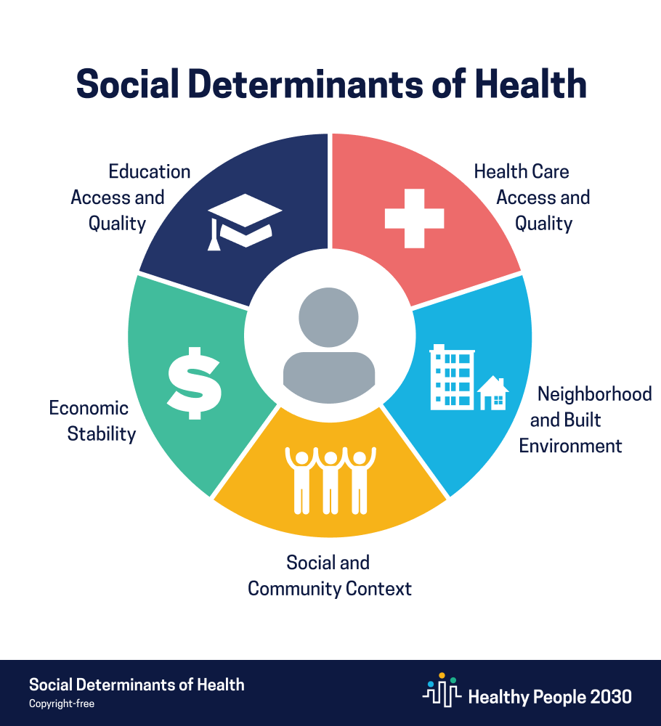
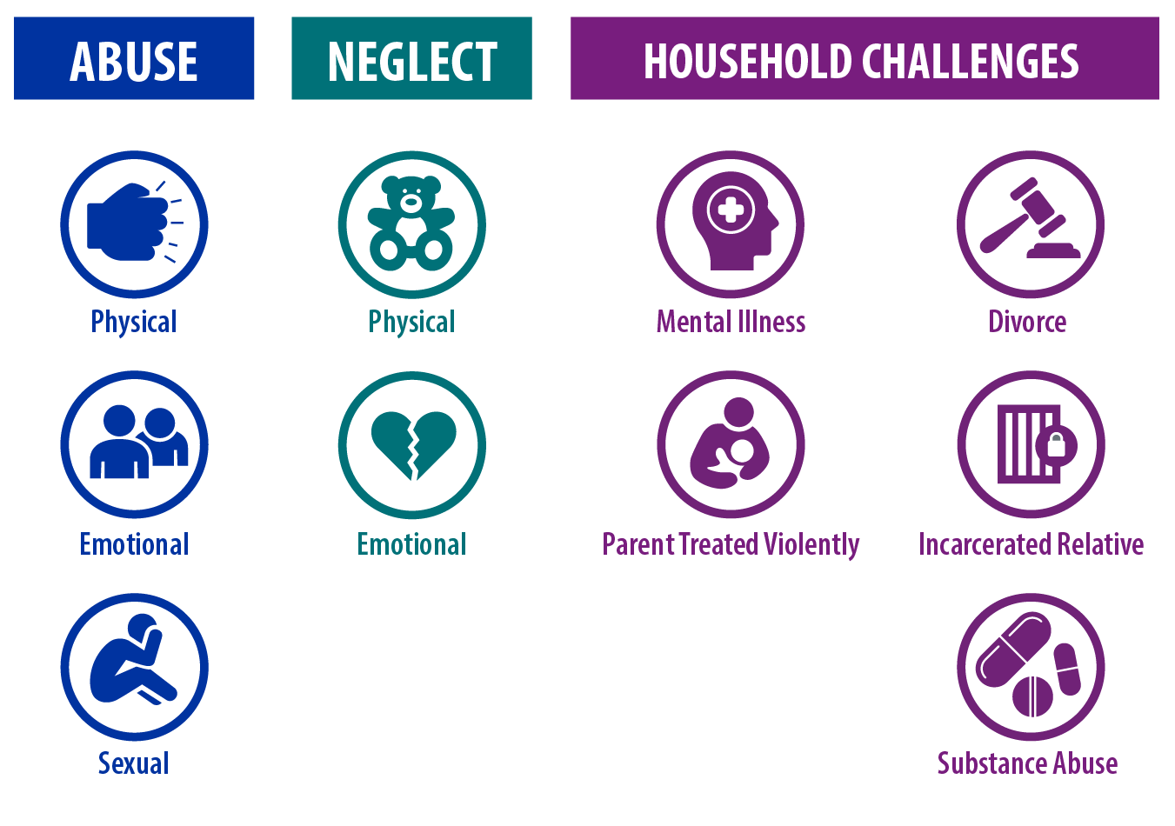
Moving Upstream to Get Ahead of Substance Use Challenges
Adverse Childhood Experiences
Social-Ecological Model
Individual
Relationship
School/Community
Society
Notes:
Chris

Slide 21
ACEs and Risk for Substance Use
Number of Categories of ACEs
Research shows ACEs increase risk for:
        Rx opioid misuse, illicit opioid use, opioid use disorder, opioid injection
        Cocaine and amphetamine use and use disorder
        Earlier age of initiation of substances
Source: Felitti, Vincent J., et al. American journal of preventive medicine 14.4 (1998): 245-258.
Notes:
Chris

Slide 22
ACEs and Poor Mental Health
Source: Anderson et al., MMWR, 2022
Notes:
Chris

Slide 23
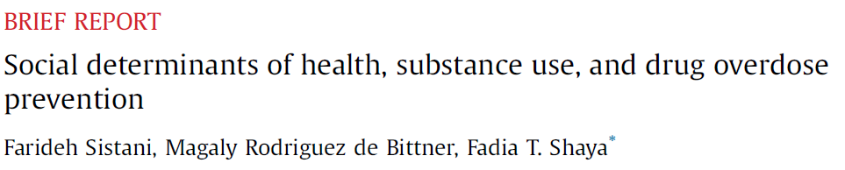
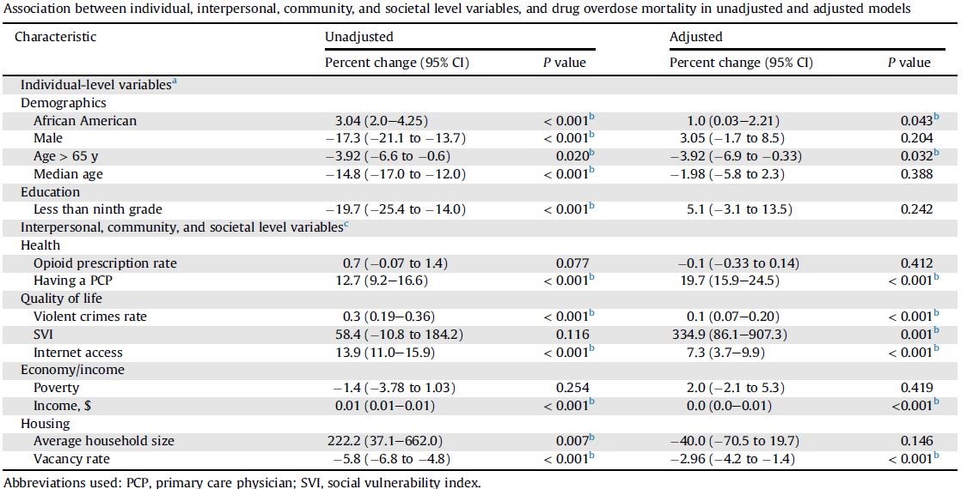
Social Determinants of Health and Substance Use
SDOHs have been directly associated with an increased risk of substance use and others are associated with increased rates of stress and anxiety, which can increase the likelihood of substance use
Greater community-level social vulnerability, violent crime, per capita income, access to health care, and access to the Internet were all associated with increased risk for drug overdose
Having a lower housing vacancy rate was associated with lower risk for drug overdose

Slide 24
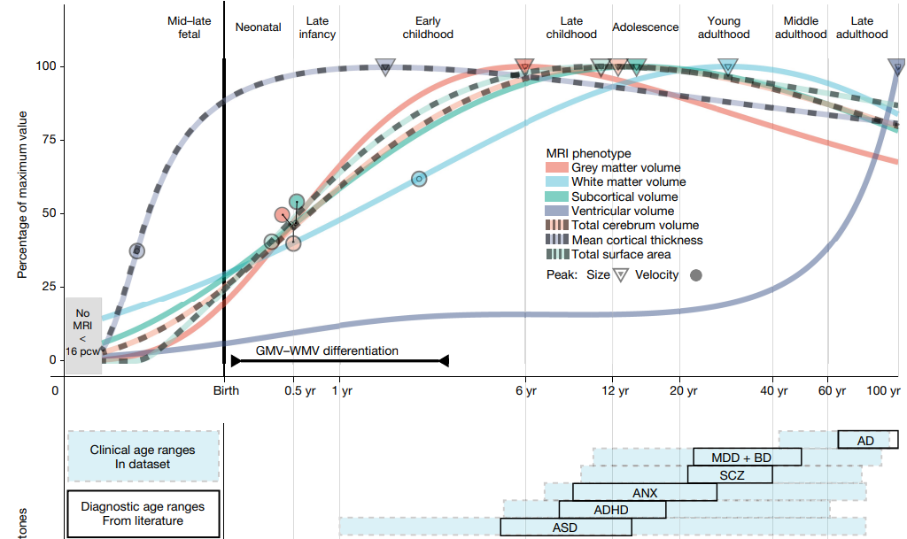
Neurodevelopment: Overlap in Trajectories
SUD
Bethlehem RAI et al., (2022) Brain charts for the human lifespan. Nature. 604(7906):525-533.

Slide 25
Prevention Policies, Programs, & Practices

Slide 26
Individual-Level Strategies
Risk Factors
Genetic factors
Initiating substance use early
Low risk perception of use
Peers who use substances
Perception that use of substances among peers is high
Early and persistent problem behavior
Mental health challenges
Prevention Strategies
Life-skills development
Problem solving skills
Conflict resolution
Strengthening resiliency and self-efficacy
Treatment for health and behavioral health conditions
Empowerment opportunities
Exposing youth to positive adult role models
Raising awareness about risks associated with substance use

Slide 27
Universal Skills-Based Prevention Program
28 public school districts randomized to intervention or control
Family focused intervention in 6th grade (SFP 10-14)
School-based intervention in 7th grade (Life Skills Training)
Examined changes in outcomes at age 19
Source: Spoth et al., 2017, Psychological Medicine

Slide 28
Relationship-Level Strategies
Risk Factors
Substance use in family or home
Parental mental health challenges
Family conflict, abuse, or neglect
Parents who favorably view or approve of substance use
Lack of family connectedness
Prevention Strategies
Healthy relationship skills programs
Creating opportunities for positive social involvement with family
Positive parenting skills programs
Strengthening parent-child relationship and communication
Addressing household challenges that contribute to stress and other risk factors
Treatment for parental/caregiver substance use, mental health challenges

Slide 29
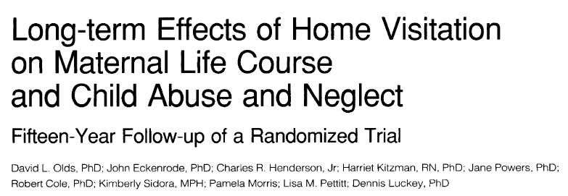
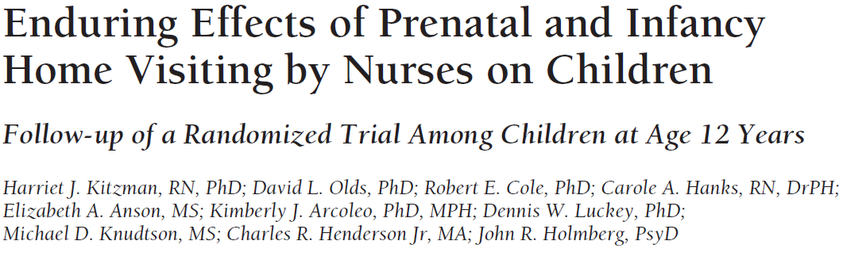
Long-term Impacts of Home Visitation Program
During the 15-year period after index birth, women in the program had reduced rates of verified reports of child abuse
Among women from low-SES households, exposure to the program resulted in fewer subsequent childbirths, months receiving government assistance, behavioral impairments from substance use, arrests, convictions, and number of days jailed.
Among children of women exposed to the program, at the age of 12 years this group reported fewer days of cigarette, alcohol and marijuana use, and were less likely to have internalizing disorders
Academic outcomes were also improved.

Slide 30
School and Community-Level Strategies
Risk Factors
Lack of school, community connectedness and supports
Community norms favorable towards alcohol and drugs
Violence in schools or community
Availability and costs of drugs and alcohol
Lack of commitment to school
Poverty
Prevention Strategies
Creating opportunities for positive social involvement with school and community
Creating positive and supportive school environments
Supporting community norms about substance use risk
Raising awareness at the community level about substance use and impacts on communities
Promoting help-seeking
Combatting stigma
Environmental design and built environment
Clinical practice and access to healthcare

Slide 31
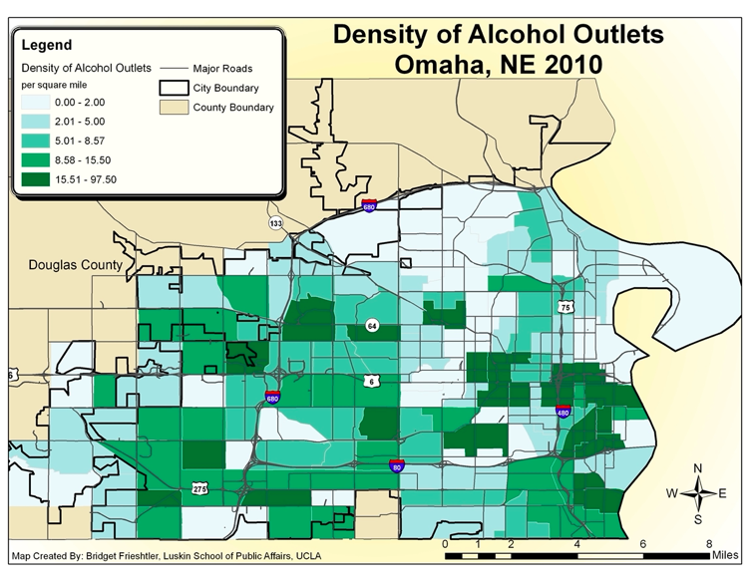
Regulating Alcohol Outlet Density
        Refers to the concentration of retail alcohol outlets within an area
        Higher alcohol outlet density is associated with increased alcohol consumption and related harms (e.g., violent crime)
        Examples: monitoring liquor licenses granted in challenged areas of community; working with local leaders to encourage safe and healthy operational standards for outlets

Slide 32
Society-level Strategies
Risk Factors
Lack of economic and educational opportunities
Inadequate housing
Disinvestment
Discrimination
High rates of transition or instability
Prevention Strategies
Economic, education, and housing policies
Improving access to education, including early childcare to ensure a strong start for kids
Policy environment, including access and availability of substances
Environmental strategies

Slide 33
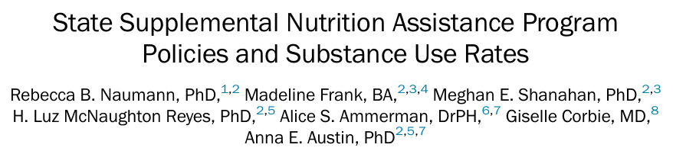
SNAP Benefits and Substance Use
https://www.ajpmonline.org/action/showPdf?pii=S0749-3797%2823%2900435-X
Results showed that state adoption of policies that expanded Supplemental Nutrition Assistance Program (SNAP) eligibility were associated with lower rates of Alcohol Use Disorder, Opioid Misuse, Illicit Drug Use Disorder, and Substance Use Disorder overall
Rates were lower in states that both opted out of the federal felony drug disqualification and adopted at least one broad-based categorical eligibility (BBCE) policy compared to states that did not expand SNAP eligibility through either policy option.

Slide 34
CSAP Prevention Programs & Resources

Slide 35
SAMHSA’s Prevention Grant Programs
State formula funding for Prevention
Substance Use Prevention, Treatment, and Recovery Services (SUPTRS) Block Grant.
Synar Program (youth tobacco use prevention)
Opioid Prevention discretionary programs
Strategic Prevention Framework for Prescription Drugs (SPF-Rx)
Grants to Prevent Prescription Drug/Opioid Overdose Related Deaths
First Responders (FR-CARA)
Improving Access to Overdose Treatment (OD-Tx)
State & community discretionary primary prevention programs
Strategic Prevention Framework – Partnerships for Success (PFS)
STOP Act Program (Sober Truth on Preventing Underage Drinking)
Harm Reduction Grant Program
HIV discretionary program
HIV Prevention Navigator Program for Racial and Ethnic Minorities (MAI)
Tribal discretionary funding
Tribal Behavioral Health (Native Connections)

Slide 36
SAMHSA’s Prevention Technical Assistance Capacity
Prevention Technology Transfer Centers: Provides accessible technical assistance to the prevention field; coordinates with the ATTCs
Strategic Prevention Technical Assistance Center: Provides direct technical assistance to CSAP grantees (SUPTRS BG, PFS, STOP Act, SPF Rx, FR CARA, PDO, ODTA)
Tribal Technical Assistance Center: Provides TA to tribal entities
Native Connections Technical Assistance Center: Provides TA to Native Connections Grantees

Slide 37

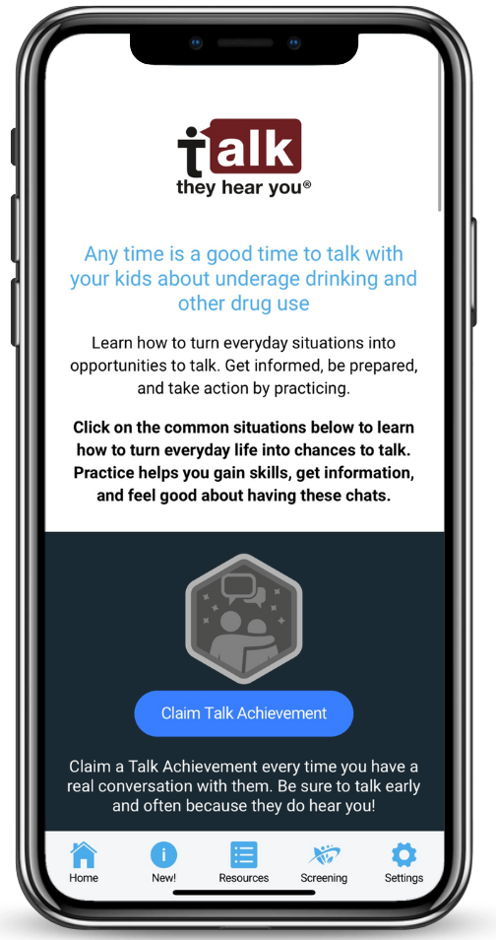
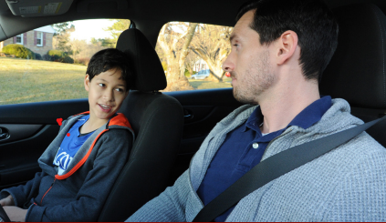






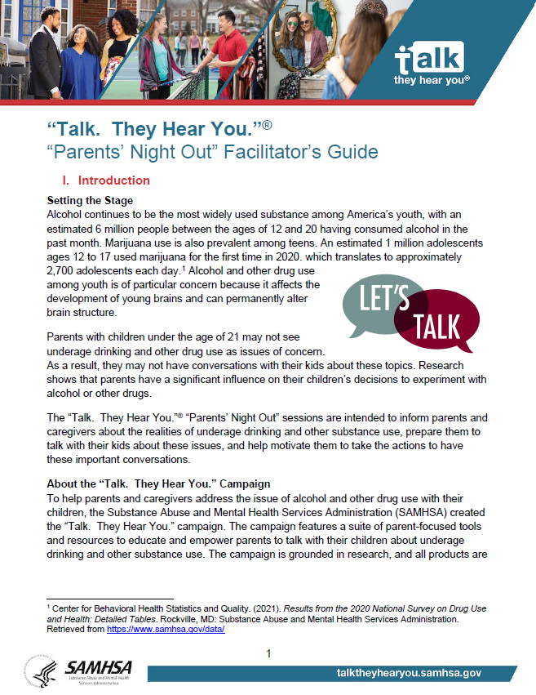
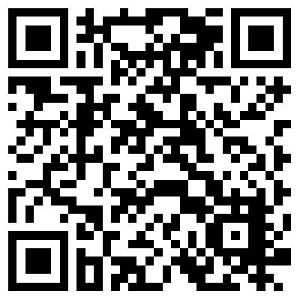
TALK. THEY HEAR YOU. CAMPAIGN UPDATES
National Adult Oriented Campaign
GET INFORMED. BE PREPARED. TAKE ACTION.
TTHY 10TH ANNIVERSARY
DISCUSSION STARTER VIDEOS
"This Life for Us" Product Suite
“COMMUNITIES THAT CARE”
MOBILE APP
STRENGTHEN PARENT AWARENESS, RAPPORT, COMMUNICATIONS (SPARC)
PARENTS’ NIGHT OUT

Slide 38
$750 planning stipends to support community-held events
Request invitation from Info@StopAlcoholAbuse.net.
Check the activity planning FAQs at www.StopAlcoholAbuse.gov/communitiestalk/
Community activities featured on the Find an Activity map.
Shared Communities Talk Success Stories are featured on the Communities Talk website!

Slide 39
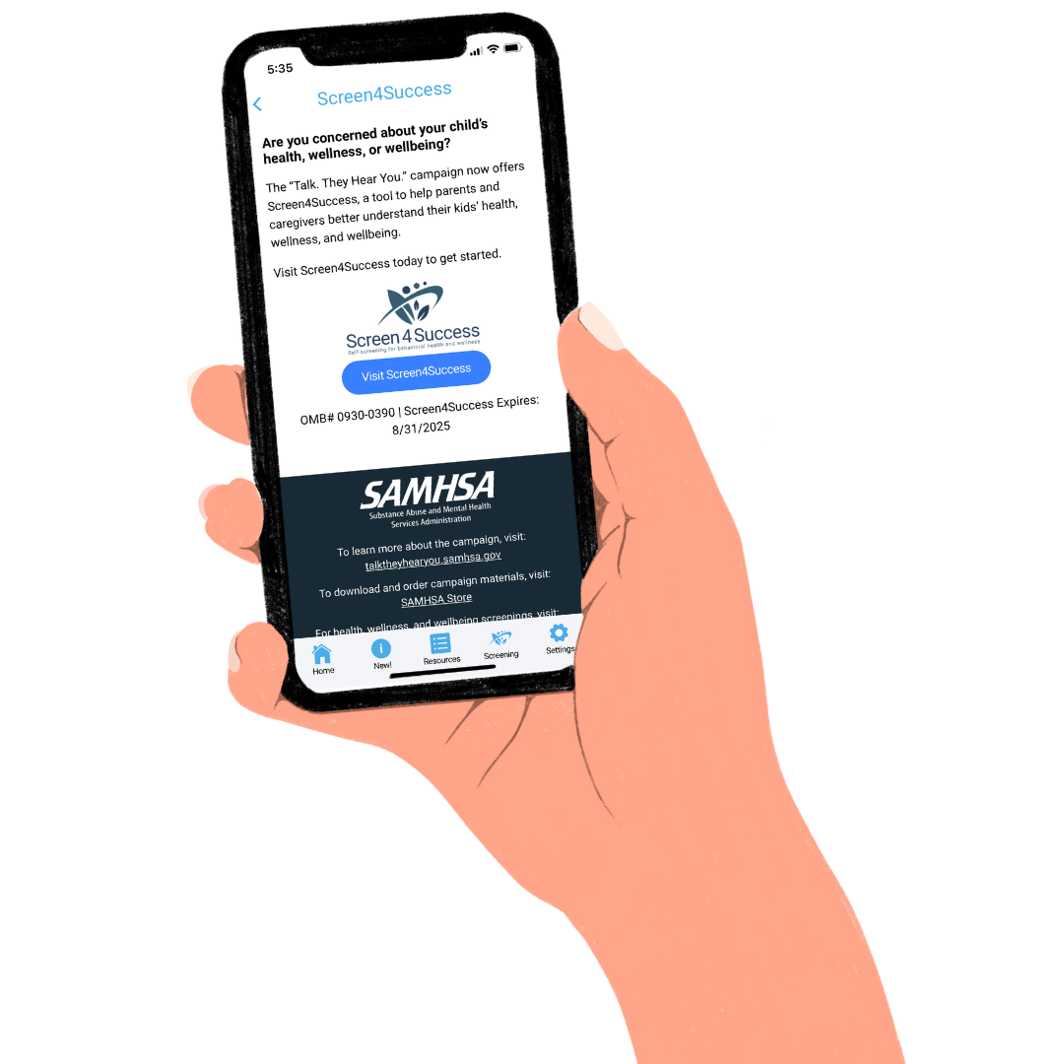

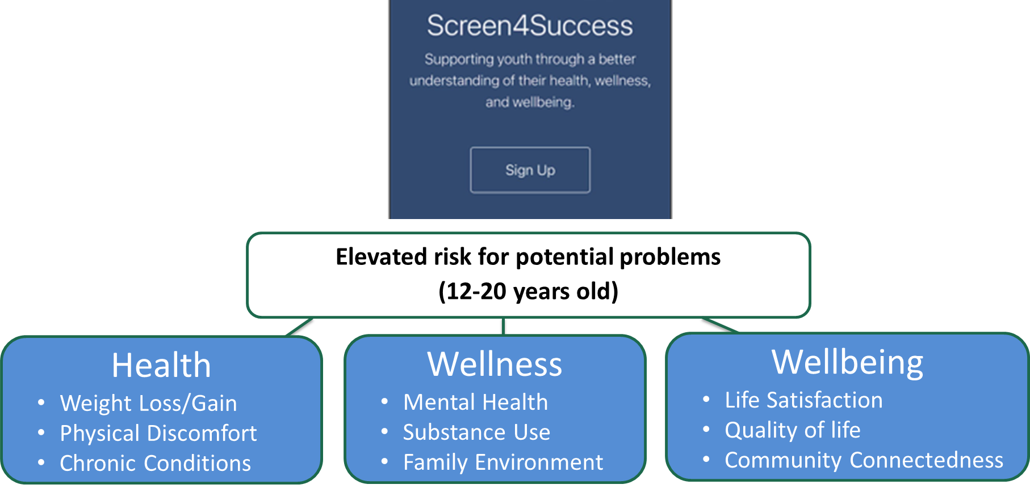

New Resources: Screening as a Prevention Strategy
Live Now!
Phase 1:
Personal Implementation
(Parents & Caregivers)
Summer 2024!
Phase 2:
Professional Implementation (Organizations & Entities)
www.samhsa.gov/talk-they-hear-you/screen4success

Slide 40

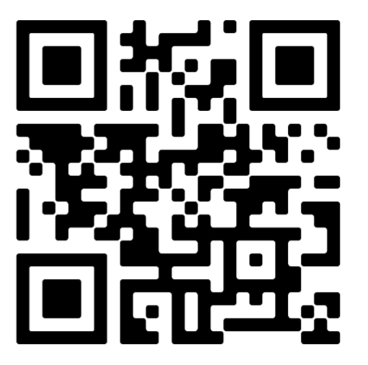
Harm Reduction Framework
First document to comprehensively outline harm reduction and its role within HHS
Provides a roadmap of best practices, principles, and pillars that anyone can apply to their work.
Will inform SAMHSA’s harm reduction activities moving forward, as well as related policies, programs, and practices

Slide 41

SAMHSA Overdose Prevention and Response Toolkit
Updated to reflect latest overdose trends
Practical tips for preventing, recognizing, and responding to an overdose
Information on available opioid overdose reversal medications (OORM)
Information for specific audiences
  People who use drugs
  People who take prescription opioids
  Practitioners and health systems
  First Responders
  Policy and systems considerations
Overdose Prevention and Response Toolkit (Spanish Version) | SAMHSA Publications and Digital Products

Slide 42
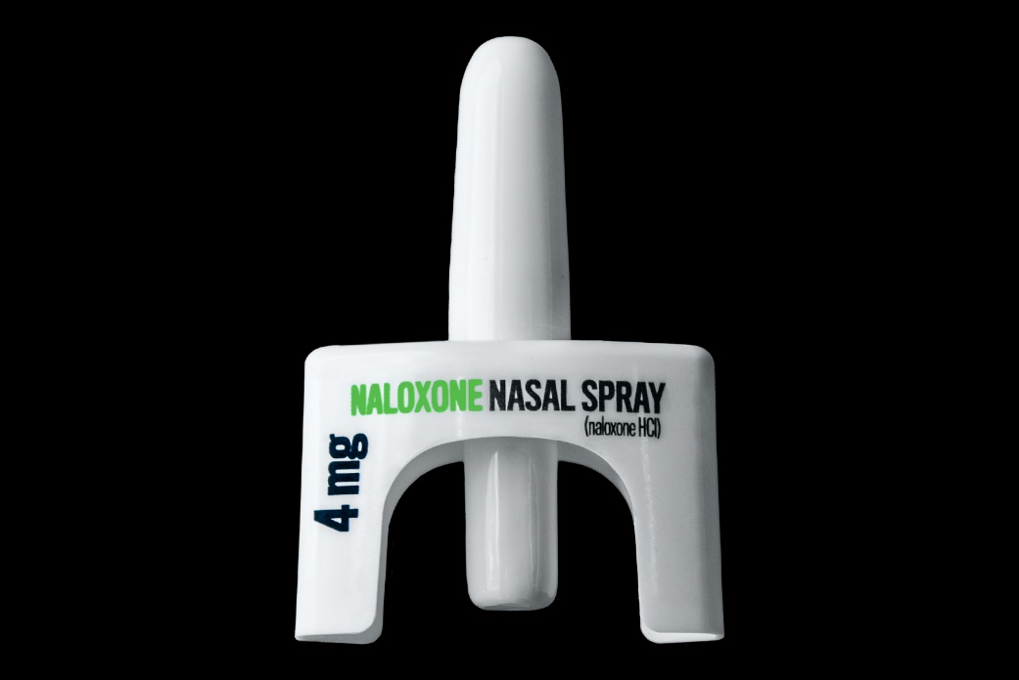
Holistic Approach to Saturation
Naloxone saturation plans (SOR application)
  Learning Community
  Policy Academies
  Learning collaborative
Guidance to States
Collaborations with External Partners
Programmatic Funding
  SOR/TOR
  SUPTRS
  FR-CARA, PDO, ODTA
  Harm Reduction

Slide 43

Youth Empowerment and Engagement
Voices of Youth: FY2024 Strategic Partnerships
  Communities Talk to Prevent Alcohol and Other Drug Use
  Community Anti-Drug Coalitions of America (CADCA)
  HOSA – Future Health Professionals
  4-H – Positive Youth Development, Mentorship, and Education
  SAMHSA’s Youth Summit, Fall 2024
https://www.samhsa.gov/prevention-week/voices-of-youth

Slide 44
A Comprehensive Path Forward to Meet the Moment
Data-driven and nimble incorporating the changing substance landscape
Centered in the voices and experiences of community(ies) being served
Holistic and Comprehensive – Addressing Spectrum of Risk & Protective Factors
  Individual
  Relationship
  Community
  Societal
Evidence-based policies, programs and practices as well as integrating practice-based evidence and community-defined evidence
Evaluating, innovating, and continuing to build the knowledge of what works in communities
Opportunity to broaden tent of partners
PREVENTION…
  Supports parents, caregivers, & strengthens families
  Increases exposure to positive role models & youth empowerment opportunities
  Supports healthy social & emotional development
  Strengthens problem solving, conflict, & relationship skills
  Expands evidence-based programs & policies across settings
  Prevents & addresses ACES & trauma
  Addresses structural & social determinants of health
  Improves the safety, stability, & livability of community environments

Slide 45



Thank You!
SAMHSA’s mission is to lead public health and service delivery efforts that promote mental health, prevent substance misuse, and provide treatments and supports to foster recovery while ensuring equitable access and better outcomes.
Grant Opportunities
www.samhsa.gov/grants
www.grants.gov/web/grants
988 Suicide and Crisis Lifeline Toolkit
www.samhsa.gov/find-help/988/partner-toolkit
@samhsagov @samhsa_leader
/samhsa
/samhsa

