Slide 1
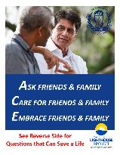
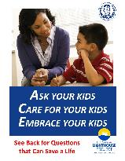
March 12, 2024
Helping Save Lives with the Columbia Protocol:
A Vital Part of Health and Wellness for Healthcare Workers, Families and Communities Across States & Nations; Reducing Suicide, Redirecting Scarce Resources & Protecting Against Liability in Healthcare & Beyond
Kelly Posner Gerstenhaber, PhD
Professor, Columbia Psychiatry
Founder and Director, The Columbia Lighthouse Project
Recipient, Secretary of Defense Medal for Exceptional Public Service

Slide 2
Suicide is a Problem of Humanity, But It is Preventable! It is the Tragic Paradox That Takes…
More Fire Fighters than Fire
More Police Officers than Crime
More Soldiers than Combat
More People than Car Accidents
…More Lives than Natural Disasters, War and Homicide
But the Good News...or So We Thought Suicide rate decreased 2% in 2019 for the first time in 2 decades, fell another 6% in 2020 amid the COVID-19 but only among white Americans.
2021: it went back up 4% with the largest increase in males 15-24. 2022: Up 2.6% but 8% decrease in youth.

Slide 3
Increasing Crisis in Youth, Particularly in Non-White Communities
Suicide is the leading cause of death for Asian American/Pacific Islanders age 15-24
#1 Killer of Adolescent Girls Across the Globe 2nd Leading Cause of Death Among U.S. 10-24 year-olds
Suicide rates among AI/AN youth ages 10–24 are nearly 3x higher than their peers in the U.S. general population (CDC, 2020).
In 2020, 40% of AAPI LGBTQ+ youth ages 13 to 24 seriously contemplated suicide.
Suicide among 8-14 year olds was up 150% in recent 7 years
Suicide is the leading cause of death for Asian American/Pacific Islanders age 15-24
Increase in suicide in 5-year-old African American preschoolers
Between 1999 and 2018, the suicide rate for Black youth age 10-17 rose 87%

Slide 4
Suicide Touches Everyone 135 People Affected by Every Death and Effects Linger Across Generations Because of the Silence that Often Follows 50% of the Nation is Affected
Working with Ukraine: Priests won't bury, like many other nations
WHO: religious countries that condemn suicide have lower reported suicide rates because of the consequences, thus rates are underreported or misclassified. Saudi Arabia: "From our cultural perspective, it’s a very huge step to ADMIT what is going on in our society"
Stigma, Barrier to offering help: Saudi Arabia has one of the lowest scores in social acceptance and offering help for a suicidal person as well as the highest suicidal disclosure disapproval.
"The Ripple Effect" 123 x 135

Slide 5
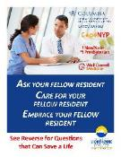
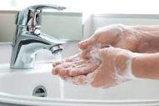
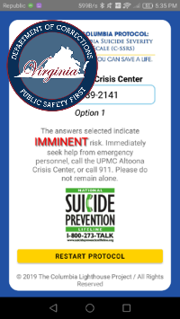
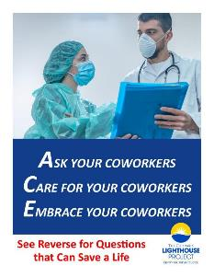
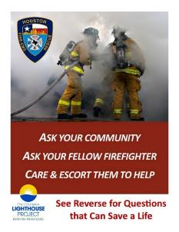
#1 cause of death for nurses and male medical residents
Vital Part of Health & Wellness for Employees & Their Families: When treated like wellness, breaks down barriers of stigma & facilitates people getting help
Caring for the Caregivers
In a company of 100,000 employees:
Every 6 days, one employee or family member will die by suicide
Every day, 3 attempts
DHS is committed to the well-being of all of their employees – providing mental health resources alongside nutrition and physical fitness.
Black physicians are dying from suicide much more, relative to other causes of death, compared to White physicians.
Black male physician suicide, which continually increases, was double the rate compared to White male physicians.
Healthy Employees = Improved Earnings
Depression - #1 cause of work related absence costs US workplaces $23 billion annually in lost productivity
45-98% of costs of depression treatment could be offset by gains in work productivity
Firefighters utilize the C-SSRS in 3 ways:
1) To screen civilians in the community who are potentially suicidal to determine what treatment is appropriate.
2) To identify members in the Department who are in need of assistance.
3) To recognize family members of firefighters who may be at risk of suicide.

Slide 6
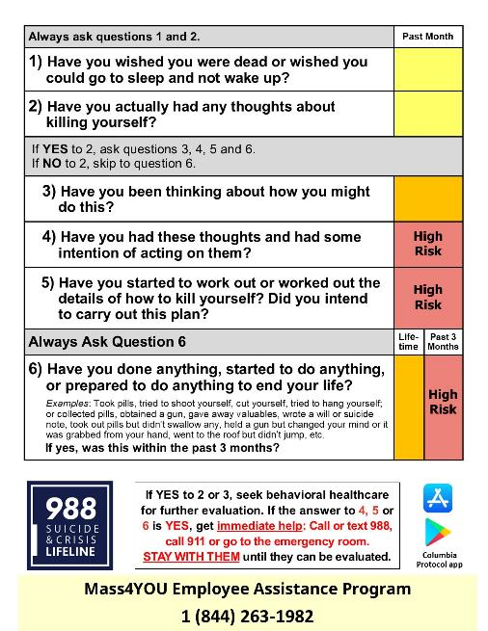
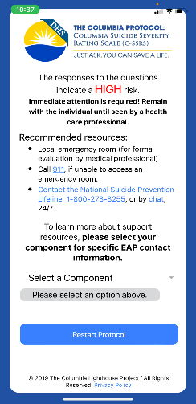
Mass4YOU Employee Assistance Program
1 (844) 263-1982

Slide 7
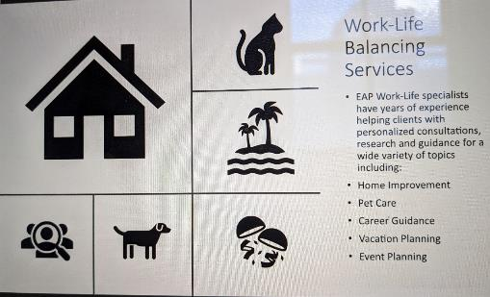
Saving Lives of Families: Example from U.S. Department of Homeland Security In EAPs Alongside Other Services and Resources
Counseling benefits (family issues, substance use, stress management)
Legal assistance (family law and retirement planning)
Childcare and elder care support
Work-Life balancing services

Slide 8
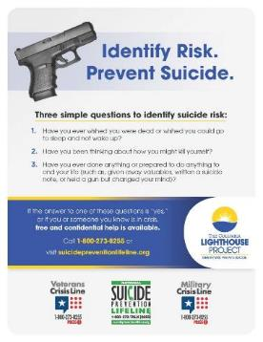
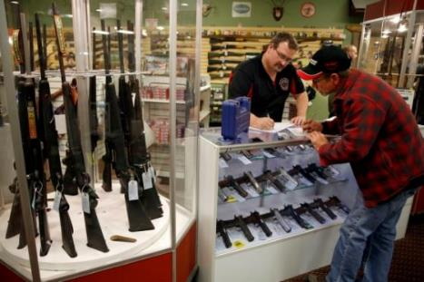
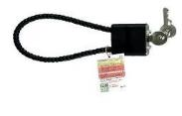
The Gun Death Crisis and the Need to Go Beyond the Hospital: 2/3 of Gun Deaths are Suicides
Thousands of
Mass Shootings in the US Since Sandy Hook
The Gun Buyer Wants to be Saved
SECTION 3: Risk Protection Orders, Risk-Based Search and Seizure Warrants, and Risk Protection Order Investigations
General Orders utilize the Columbia to determine imminent risk: protective orders, removal of weapon, and that the person is prohibited from acquiring or possessing a firearm, deadly weapon, or ammunition.
90% of school shooters have a history of suicidal issues
“The Highest Form of ‘See Something Say Something’”

Slide 9
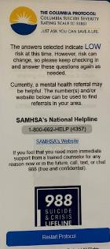
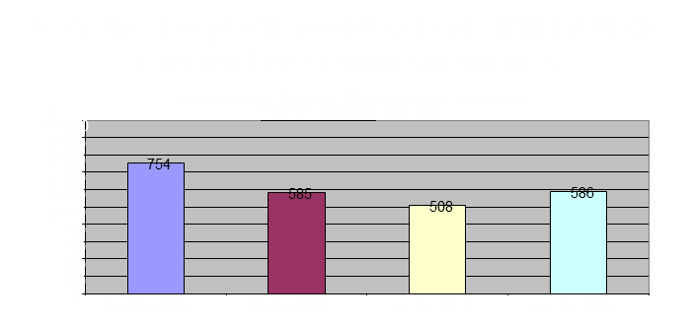
Dramatically reducing unnecessary interventions NEXT STEPS
Finally Knowing Who to Worry About:
Screening with Evidence Supported Thresholds for Imminent Risk: Reduction of Workload, Reduction of False Positives
Low/Moderate Not Treated Like Crisis!
The Critical Importance of Screening at Least 6 and Up 6-12 Same Odds of Being Identified as High-Risk as 13-17!; Screening Did Not Increase ER LOS Improving Youth Suicide Risk Screening and Assessment in a Pediatric Hospital Setting by Using The Joint Commission Guidelines (Latif et al 2020)
Basis for JC Regulatory Policy: "Intent to Act"
Rhode Island: Reduced Suicide and ED Holds
Suicide watch goes down and police do not have to hospitalize
Indicates Need
for
Next Step
Only approx 1% require a next step
Recent study from Sweden – C-SSRS Screen Version: initial screening for suicide risk in a psychiatric emergency department – Predicted death by suicide (Bjureberg 2021)
Danish students predicted future attempts.

Slide 10
The Critical Importance of Screening at Least 6 and Up 6-12 Same Odds of Being Identified as High-Risk as 13-17!; Screening Did Not Increase ER LOS Improving Youth Suicide Risk Screening and Assessment in a Pediatric Hospital Setting by Using The Joint Commission Guidelines (Latif et al 2020)
Setting % High Risk Patients
OPC Age 6-12 3.6%
Importantly, it also showed that children ages 6-12 had similar probability of being identified as high risk according to the C-SSRS screener as adolescents ages 13-17.

Slide 11
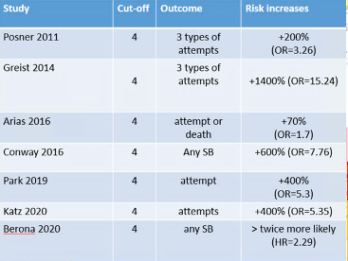
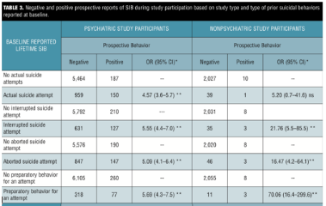
1-Have you wished you were dead or wished you could go to sleep and not wake up?
“Most people in my agency view METHOD and PLAN as the same thing since clients are impulsive, they don't have a specific day and time. This interpretation makes every client with a METHOD as a high risk client. How can this error be alleviated?”
2-Have you actually had any thoughts of killing yourself?
If yes to 2, ask 3, 4, 5, and 6.
3-Have you been thinking about how you might do this? E.g. “I thought about taking an overdose but I never made a specific plan as to when, where, or how I would actually do it … and I would never go through with it.”
4-Have you had these thoughts and had some intention of acting on them? As opposed to “I have the thoughts but I definitely will not do anything about them.”
5-Have you started to work out or worked out the details of how to kill yourself? Do you intend to carry out this plan?
6-Have you ever done anything, started to do anything, or prepared to do anything to end your life? Examples: Took pills, tried to shoot yourself, cut yourself, tried to hang yourself, took out pills but didn’t swallow any, held a gun but changed your mind or it was grabbed from your hand, went to the roof but didn’t jump, collected pills, obtained a gun, gave away valuables, wrote a will or suicide note, etc.
4X
If yes: How many times in your life did this happen?
If yes: Was this within the past three months?

Slide 12
The High Cost of NOT Screening or Doing Threat Assessment as Upstream as Possible: . What Not Identifying High Risk Costs Society
US (2010): $91 billion in lost wages and work productivity
Worldwide: $300 billion in years of life disabled or lost
General ED at Colorado University
Prior: 400% increase in hospitalizations
Over past 2 years: 300% increase in ED visits
Increases in psych ED evals – largest proportion Black and Latino
Extremely long wait times, over 3 hours
Look What Happens When You Do:
the largest provider of outpatient community behavioral healthcare in the U.S., reduced their suicide rate 65% over 20 months, and reduced ED recidivism from 40% to 7%.
acute care facilities saw a 50% reduction in suicide after implementing C-SSRS in April 2019.
Atrium Health Behavioral Health Service Line saw an 86% reduction!
Tremendous Critical Law Enforcement Time Wasted:
20% of police calls are behavioral heath and each transfer to an ER takes 2.5 hours on average (CA Prison: $24m in suicide watch in one year)
Alaska Chaplain for Police and Fire: "Reducing burden"
Peace Corps; Determines who actually needs to be medivacked; keeping the vital frontline doing their important work.

Slide 13
Huge Overspending of First Responder and Law Enforcement Time and Resources The Challenge to Caring for Students: No One Knew Who to Worry about or Who to Refer
Four hospitals in NYC: 61-97% of student referrals did not require hospitalization
NYC DOE:
“The great majority of children & teens referred by schools for psych ER evaluation are not hospitalized & do not require the level of containment, cost & care entailed in ER evaluation.”
“Evaluation in hospital-based psych ERs is costly, traumatic to children & families, and may be less effective in routing children & families into ongoing care.”
One student sat 9 hours in the principal’s office waiting for an EMT!

Slide 14
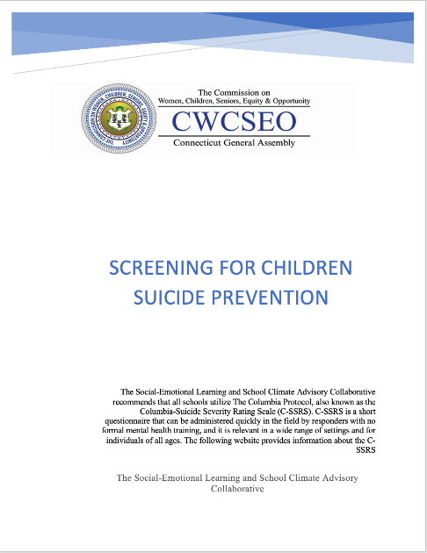
DCS really wants and needs the Columbia to triage and determine the kids that DON’T need to go to the hospital.
2021 CT children 10-17 highest prevalence of ED visits for ideation and attempts AMONG ALL AGE GROUPS. Use of youth mobile crisis services decreased while INAPPROPRIATE ED UTILIZATION INCREASED. This actually does harm. Children are traumatized by the exposure, waiting for hours, what they see, etc.
In fact, “it has been found that many of the children coming to the ED for suicidal ideation when screened are not actually in imminent risk and would be better served by community resources.” 44% of kids referred by schools; 39% self or family members.
Approximately 1% of kids are high-risk on the Columbia.

Slide 15
Questions Used to Facilitate Appropriate Care: Science Says People who Receive Lowest Level of Care in Community have Better Outcomes! They Ask for Help More Often & Better Quality of Life
Police Asking is Critical to Optimizing
Your Scarce Resources, Decreasing ↓ Unnecessary ED Holds
http://youtu.be/fx3N3uDUQbo

Slide 16
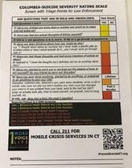
Reduction of Force! Reduction of Police Taking People Back to the ER Multiple Times and De-escalation Tool
As a de-escalation tool. Parents are saying no no no and your officer says, “Ok, I understand you don’t want that, but maybe we can just go through these series of questions.” Even with somebody who’s in a psychiatric crisis, you run them through these questions and it tends to lower the level and calm them down.
Filling gaps: Determination of who doesn't need to go to the hospital - call mobile crisis, do warm hand-off. After C-SSRS determination that they don’t need to go to the ER, officer can make a safety plan with family or friends or other interventions.
How many calls do you get where it’s the same person? Issue of efficiency
Kid ran off into the woods, had to do a search for him, found him, called mobile crisis, within 1 hour he was in the hospital
DWI crash, driver had taken fentanyl and was given Narcan, was at the hospital and give the C-SSRS within 19 minutes of arrival

Slide 17
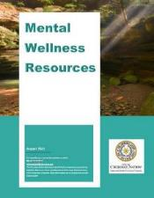
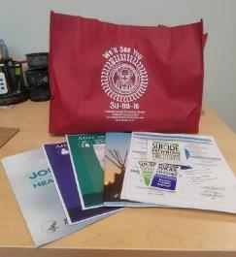
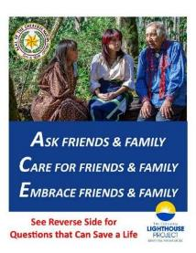
Cherokee Nation ROI: Risk Stratification Enables You to Deliver Your Care to the People that Need it
Redirecting Much-Needed Scarce Resources
Improving Access to Services: Able to triage waitlist better with the C-SSRS
Knowing how to get to those who need it right now and give the right services
15,000 follow-up calls all provided a list of all community resources: legal services, food banks, transportation, substance abuse counseling, etc
Risk stratification for appropriate management of resources:
i.e. rooms, beds, staff as well as finances
In all hands in addition to Behavioral Health including:
Custodial staff
Sanitation workers
Dock workers
Cafeteria staff
Tremendous Reduction in Burden to System
Example: OK saved millions in reduction of days
Reduction over time in # of high risk
Cherokee "Life Resource Kits"
Provider by Provider
All Services
Between Services
All Systems of Care

Slide 18
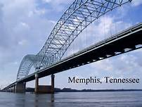
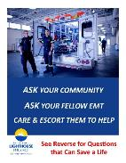
Additional Benefits of Screening Beyond Risk Detection: Facilitating Treatment
The Power of Asking Beyond the Doctor’s Office: Look at the Effect This Has Already Had in Largest Community BH System in US
Reduced their suicide rate 65% over 20 months
10-18 year old Medicaid patients
Outpatient follow-up visit within one week of acute psych inpatient treatment associated with ½ risk for suicide attempt at 6 months
Black youth less likely to have a follow up visit
C-SSRS Screening Leads to Improved Mental Health Follow-up and Treatment Engagement in the Veterans Health Administration: probability of 1 month follow-up and 90 day engagement increased 60%
U.S. Study: Emergency Medical Technicians use C-SSRS and see an increase in voluntary hospitalization

Slide 19
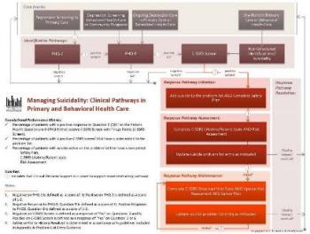
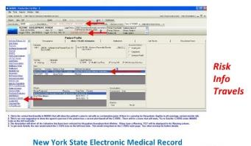
Well Delineated Streamlined Big System Alerting Policies:
Optimizing Identification of Those at High Risk Across the Continuum of Care “With so many patients it’s like mining for gold and the Columbia is the sifter”
Alerting System… suicide reduction in primary care
How High Risk Data Gets Used:
The Importance of Tracking and Alerting Across a State

Slide 20
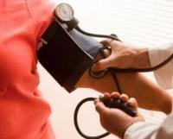
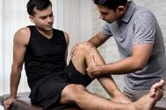
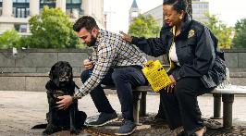
Vital Part of Saving Lives: Need to Ask Like Blood Pressure to Find People Suffering in Silence
Over 50% of people who die by suicide saw their primary care doctor the month before they die
2/3 of adolescent attempters in ER are not typically present for psychiatric reasons
Lifetime Suicide Attempts in Otherwise Psychiatrically Healthy Individuals
Maria A. Oquendo, et al, JAMA Psychiatry, February 21, 2024
One implication of our findings is that screening for suicide risk, which in most contexts is focused on those with recognized psychiatric conditions, may miss 20% of those at risk.
Thus, policy makers, clinicians, and health systems should weigh the costs and benefits of expanding suicide risk screening beyond the current targets and consider universal screening to prevent suicide attempts, which have significant morbidity as well as medical and other costs.
Majority of youth will not actively seek help from professionals, parents, teachers, and oftentimes not even peers.
Agencies use ROUTINELY
e.g., FBI Victims Services Division
I in every Victim Needs Assessment
Screen more at times of higher risk, e.g. transition from active duty to veteran status, mass shootings, injury, relocation, Wartime in Ukraine, etc
Part of daily safety checks
Increase vigilance at times of high risk
25% of teachers reported being approached by an at-risk child
VITAL OPPORTUNITIES FOR PREVENTION:
In Israel, Gives Voice: Use simple questions to talk about suicide, which will serve as a model to talk about other taboos, historical or current trauma, across religious and cultural divides … healing suffering and building resilience.
Imagine every school nurse, physical therapist or EAP asking about mental health alongside physical checkups. If we ask, we can find those suffering in silence. .
With Universal Screening: Noted increase in comfort levels related to discussing suicide and the destigmatization of the word suicide among both clinicians and patients

Slide 21
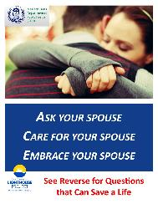
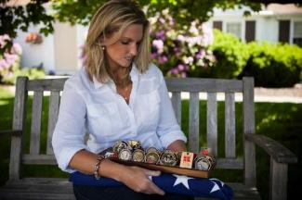
Why Don’t People Get the Life-Saving Care They Need?
Vital Role of Family, Spouses and Parents in Screening for Detection of High Risk: Find People Where They Work and Live
[My husband] said to his buddy, his fellow marine, “everybody goes through this.” He was empathic; he said “you know, we’ve all been there. Take some time, take care of yourself. But don’t go to treatment and don’t go on medication because you cannot do that and fly.” - Kim Ruocco
“If I had the Columbia Scale, I never would have left him alone in that hotel that day.”
Until 2010, pilots were banned from flying if on antidepressants, causing many pilots to lie about or ignore signs of depression
8 suicides in 15 months

Slide 22
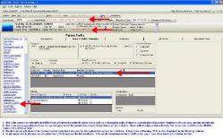
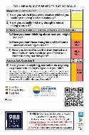
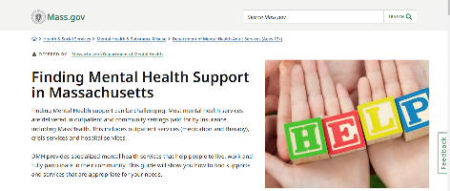
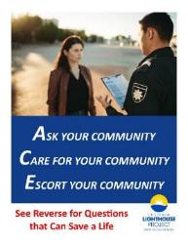
Partnership between Medicine & Public Health
High-Risk Tracking and Alerting Across a State
Quickening Care Delivery through Linking of Systems Across the Continuum of Care:
All Agencies and Systems Across a State or Nation
Cerner EHR: Now millions of screens, using data to address barriers to health equity
Provider by Provider
All Services
Between Services
All Systems of Care
Every crisis line or call center needs screening questions at 1st contact
The C-SSRS “has catapulted a transformation of practices in TN by ensuring professionals and family members who come in contact with an individual who may have thoughts of taking their own life receive the help they need before it is too late”
Hospitals
Primary Care
Homeless Services
“Nevada has implemented The Columbia Suicide Severity Rating Scale in suicide prevention gatekeeper trainings across the state. From its initial use in First Responder trainings to Community and into Health/Behavioral Health professions. Now it is moving into school systems and military professions throughout our community.” -Richard Egan
First Responders & Crisis Lines
What New School Safety Law Means for South Florida Students: "The district said it's also in compliance with the new law by utilizing the Columbia Suicide Severity Scale, "which is the same suicide screening tool used by the local mobile response teams and approved by [the Florida Department of Education],"
CT Alliance to Benefit Law Enforcement that do all the CITI trainings worked closely with mobile crisis providers: When Communicating with hospitals or mobile crisis upon arrival, they provide the C-SSRS findings.
Linking Systems
Tennessee, Utah, Rhode Island
Melissa Sparks, Director of Crisis Services and Suicide Prevention, Tennessee
National and State Parks
Transportation
A school counselor used C-SSRS to identify that a 4th grade boy was suicidal. He was sent to mobile crisis services who confirmed his C-SSRS results, then sent him to hospital who provided counseling and safety planning. This timely intervention and continuity of care was all facilitated by each touch point using the common language of CSSRS.
Missouri received $2 million U.S. Dept. of Justice grant to fund threat assessment in rural school districts using the Columbia.
School & Children’s Services
Medicaid/
Medicare
Justice/
Law Enforcement/
Lawyers
Rhode Island reduced ED holds
Used throughout government agencies including DHS, HHS, VA, DoD, SAMHSA, and the Office of Refugee Resettlement (HHS Administration for Children and Families)

Slide 23
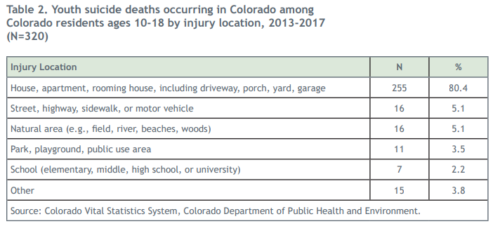
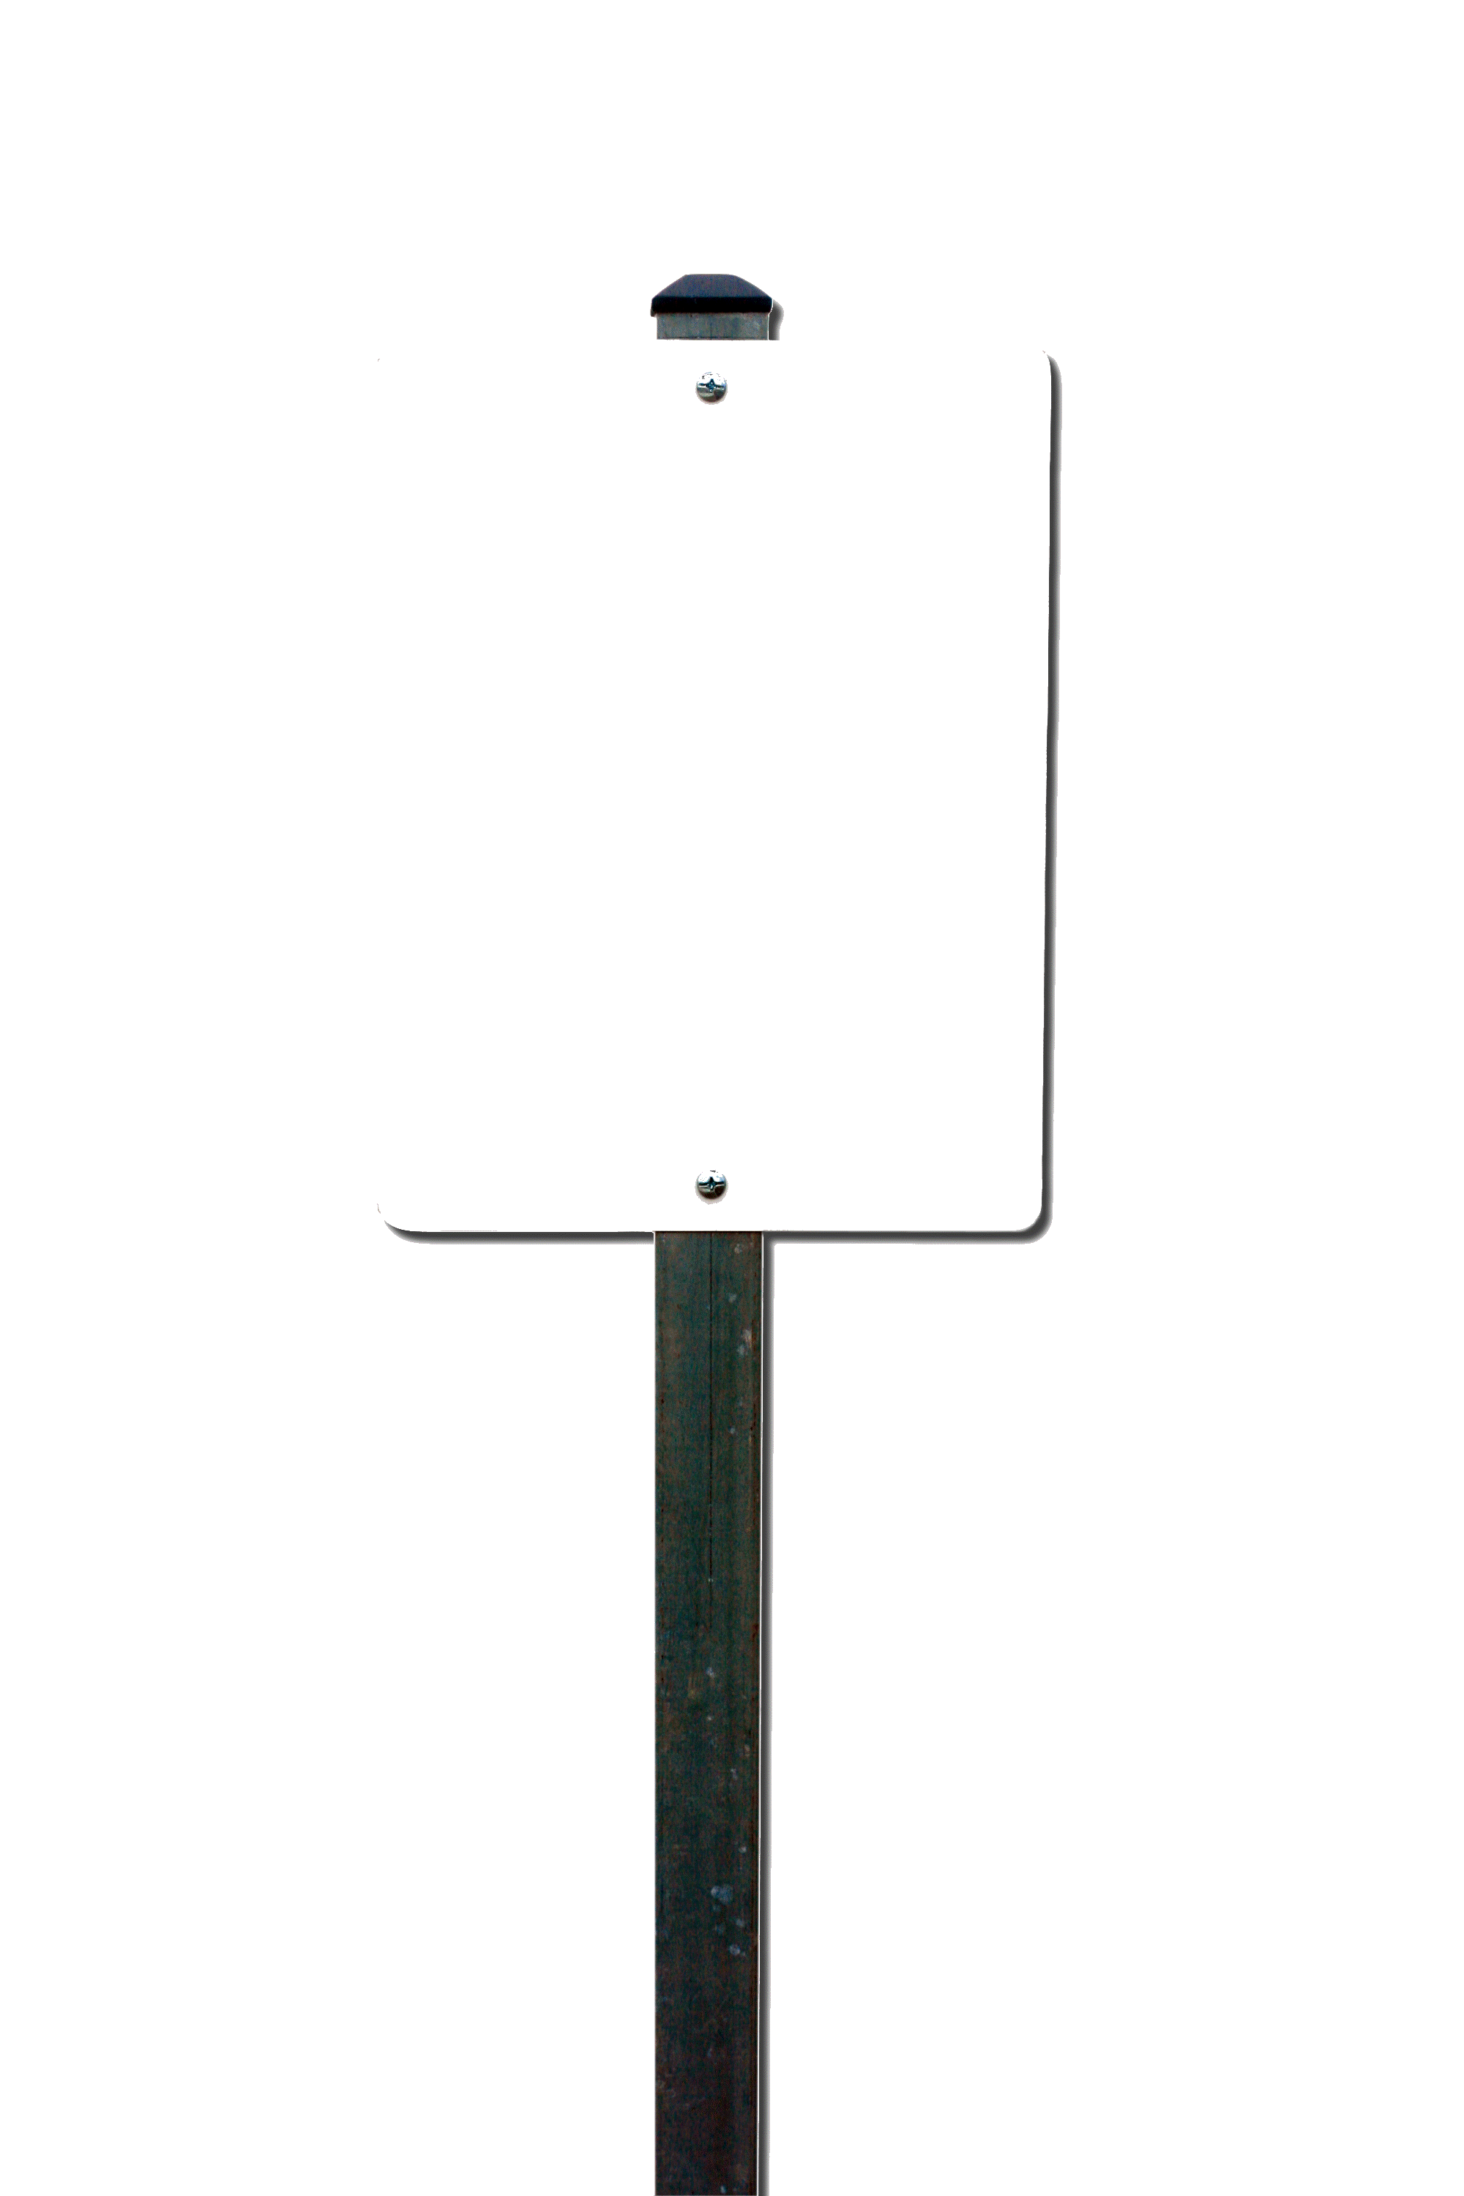
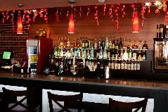

Slide 24
Ideal Vision: Implementation Across All State or City Agencies
Department of Labor
Department of Motor Vehicles
Gaming Commission
Office of Parks and Recreation
Department of Agriculture
Bridge and Transportation Authority
Liquor Control Board
Division of Criminal Justice Services
Authorities Budget Office
Division of Human Rights
Department of Financial Services
Office of Addiction Services
Human Resource Directors
Job Corps Managers at government agencies and local businesses
Division of Emergency Services
Office for the Prevention of Domestic Violence
Department of Civil Service
Department of Taxation and Finance
Housing and Urban Development
Office of Children and Family Services
Office of Emergency Management
Office of Fire Prevention and Control
Power Authority
Workers Compensation Board

Slide 25
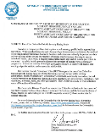
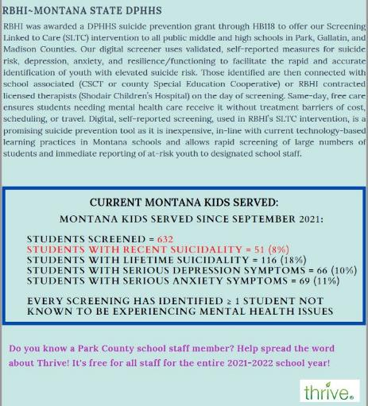
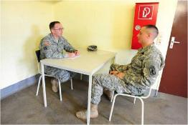
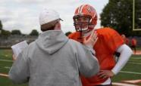
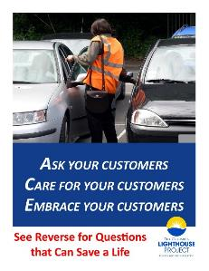
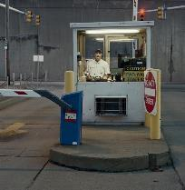
We Must Find People Where they Work, Live, Learn and Thrive:
People Don’t Necessarily Have the Will to Come to You
MT: Theater staff with at risk youth video games
80% of Colorado residents age 10-18 end their lives at home (house, apartment, rooming house, including driveway, porch, yard, garage).
79% of Black youth who die by suicide die at home – for ages 5-11, it’s 95%
VT Policy recommendation and role play for school janitors
Zero Suicide community workshop for custodians and receptionists
Future VA stand-down: From canteen worker to cemetery worker
EVERY SCREENING has identified >1 student not known to be experiencing mental health issues.
“I think everybody needs to ask these questions… Marines may not go to their leadership to talk about these things but they may talk to a bartender or their barber… or at the gym with a trainer. Whenever they see something they’re concerned about in a service member they need to know what to ask and that tool is invaluable…” -Kim Ruocco

Slide 26
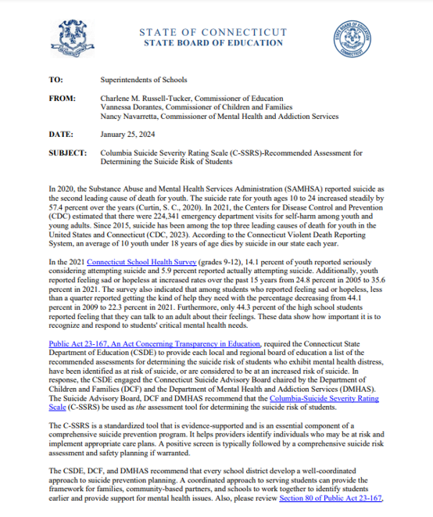
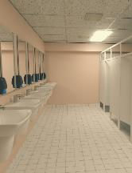
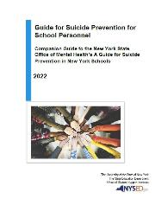
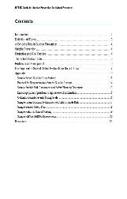
Why Asking Our Kids Routinely is Critical
Whether You’re a Parent, Coach, Teacher or Peer
In a typical classroom, it’s likely that 3 students (1 boy and 2 girls) have attempted suicide last year
AVERAGE HIGH SCHOOLERS
18% seriously considered in the prior year
8% of boys and 12% of girls attempted in the prior year
15% of Latinas – highest group
CDC: In 2020, Suicidal ideation in youth increased
The proportion of children's mental health-related ED visits increased 24% compared to 2019 (ages 5-17). ED presentation of girls age 12-17 went up 50% (only 4% for boys).
Parents weren’t taking kids even with high fevers to the ER, but psych visits increased.
Meeting Parents Where They Are:
PTA meetings, school orientations, sports meetings, in the backpack folders that go home, school website, at the YMCA, after-school programs, school library, bathroom stalls, crossing guards, cafeteria workers, parent-to-parent, clubs.
JUMPING OFF SCHOOL BUILDINGS

Slide 27
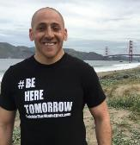
Detection/Intervention Effective Up Until the Last Moment Kevin Hines Survived Jumping Off the Golden Gate Bridge: If Just One Person Had Asked...
All Survivors Wanted to Be Saved
“Most people considering suicide want someone to save them. What we need is a culture in which no one is afraid to ask. What we needed were the questions people could use to help save us. That’s why the pioneering change the C-SSRS is enabling is so essential to our humanity.” - Kevin Hines, Survivor
“I was a victim of sex trafficking and tried to take my life and believe if we had had the Columbia I wouldn’t have.”
- Director of an agency that cares and advocates for victims of sex trafficking and exploitation.
People Want to Be Saved & Need to be Asked
Suicide Can Be Prevented Even Up to the Last Moment
93% of people who are intervened with
will never go on to do it again.

Slide 28
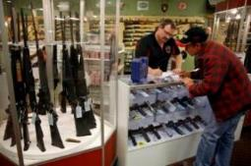
Everywhere People Acquire Means:
A Life Can Be Saved Up Until the Last Minute
Transit Workers
Pharmacies
Gun shops
Pesticide Suppliers
Parks
Bathrooms
JUMPING OFF SCHOOL BUILDINGS

Slide 29
Finding Everyone in Our National Parks
Trail Guides
Natchez Trace Parkway (Nashville)
"Used by a LE Ranger with a fellow employee who was experiencing some difficulties. The Ranger that utilized it was immediately able to identify someone that was at high risk and took immediate action. Very simply it works, our Ranger got the care that was needed, and I feel strongly that an observant peer, armed with a little bit of knowledge prevented my Ranger from becoming another statistic." J. Fish Chief Ranger Lassen Volcanic National Park.
Rest stops
Visitor bathrooms, camp grounds, brochure boxes at each end of the bridge

Slide 30
Policy and Implementation Challenge: Dissemination to All Parents, Teachers, Coaches
The Power of Asking to Help Reduce Gun Deaths and Their Traumatic Aftermath:
Former Deputy Secretary of Education
Said The Columbia Can Help Keep our 64 Million Children Safe
Need more policy
After the Navy Yard shooting… “What is it going to take to make this ubiquitous?”
“...The Columbia has the potential to keep the 64 million children in our schools safe physically and mentally by helping prevent school violence.”
- James Shelton, Former Deputy Secretary US Dept. of Education
Early Identification & Prevention Through Public Health Outreach
“I want every parent in our community to hold each other accountable. We should ask ourselves on social media and at the grocery store, have you asked the questions, right?” - Ryan Petty on CNN
Dr. Kelly Posner, Ryan Petty, and Senator Marco Rubio at the U.S. Senate forum on school safety, April 2018.

Slide 31
Must Go Beyond the Medical Model and Outside the Hospital Walls Towards a Public Health Approach:
Lifesaving Synergy Between the Medical Model &
the Public Health Approach
Marines reduced suicide by 22% while at the same time there was a reduction in domestic violence, alcohol incidents & sexual assault
Undersecretary of Defense Urgent Memo
We must develop suicide prevention strategies that are relevant for a diverse population and transcend the medical model (WHO, 2022).
Total force roll-out, in the hands of whole community
ALL support workers including lawyers, financial aid counselors, chaplains, family advocacy workers, substance abuse specialists, advocates

Slide 32
Finding At-Risk Youth Where They Live, Learn and Play
Child and Family Services/Child Welfare
Parks, Ski Slopes Beaches and
Playgrounds
Pediatricians
First Responders
Bartenders
Youth
Pastors
At-Risk
Youth
Libraries and Schools
Juvenile
Justice
Food
Trucks and Restaurants
Theaters

Slide 33
Finding Veterans Where They Work, Live, and Thrive 60% don’t get care at the VA
Veterans on Campus Program
They can be the Ambassadors bringing awareness and resources to their peers
Gives a Renewed Sense of Purpose
Developed award-winning Guardian app to evaluate social media posts for warning signs and link to the Columbia Protocol
VA parking lot attendants
Transportation Services: Van drivers taking vets to appointments
Gyms/Crossfit: fitness meet-ups
Lawyers & Legal assistants: legal problems are a major precipitant
Reaching Veterans
Everywhere in the Community
After a VA attorney used the Columbia to help save the life of a suicidal client, the OGC decided to make it scalable and put it in the hands of all attorneys and legal aids throughout the VA nationwide.
Custodial staff
Dept of Parks & Recreation
Veterans Benefits Officers
At the DMV: Vets get special driver's licenses

Slide 34
Finding At-Risk Individuals: Vital For Everyone in Your Organization and Community to Be Part of the Solution
A front desk staff member noticed a patient in the waiting room who did not appear well. Because she had undergone training to know it’s okay to ask, she had the knowledge and courage to ask the suicide question, which revealed high risk and disclosure of a suicide note which led to him being transported to the hospital.

Slide 35
Global Models: Detection Across All Sectors of Society, Across the Continuum of Care
Nations Solving Public Health Challenge With Science Infused Solution
Open Doors Center in local orphanages in Ukraine
Child and Family Services/Child Welfare
Korean Firefighters
Healthcare
First Responders
Clergy
Saudi Arabia
"From our cultural perspective, it’s a very huge step to admit what is going on in our society, mainly in our university. So we are very excited to go for the next step and to work on this executive program between these two nations."
National Governments
Schools and Universities
Namibian Priests
Corrections and Justice
Military
Crisis Line: National Registry: South Korea: Predicts Suicidal Behavior across the nation
Policy for all Israeli schools
Implementation of the C-SSRS in New Zealand Corrections: Prisons and Probation uses it to manage parolees: Study found corrections officers were able to effectively identify current suicidal ideation and behavior (Wilson 2017)
Israeli Defense Force (IDF: Lowered suicide
Commanders ask their soldiers

Slide 36
Nations Identify Needs and Respond with Science: Chile Schools Highlight
The Issue: Given the high rates of suicide rates in the adolescent population and the reluctance of this population to seek help, developing proactive and effective strategies to timely detect individuals at high risk for suicide in nonclinical contexts is a worldwide recognized need
The Response: general sample of 1645 Chilean adolescents 13-18, Columbia screener differentiated suicidal thoughts according to their severity, accurately identifying SI risk level

Slide 37
What Communities, States, and Nations Can Do
Form a coalition of national, private and nonprofit stakeholders that will help continue to build momentum and make suicide screening a public health campaign
Namibia Example: KHOMAS SUICIDE PREVENTION TASKFORCE (KSPT)
KSPT was initiated because of high rate of suicide and suicidal behaviours in Khomas region
KSPT’s purpose is to create awareness, educate the public, and implement interventions for the prevention of suicide and suicidal behaviours, striving towards “ZERO” suicides in Khomas region
Ministry of Gender Equality, Poverty Eradication and Social Welfare: Child Welfare Services
Debmarine Namibia
Philippi Trust
Londoloka Counselling Association
Faith foundation
The Regional Psychosocial Support Initiatives (REPSSI) Namibia
Mekenificent Wellness Centre
Ministry of Works and Transport
Office of the Prime Minister
Old Mutual Namibia
Office of the First Lady
KSPT (Who we are?)
We have 21 stakeholders on board:
Ministry of Health and Social Services
Ministry of Defence and Veterans Affairs
Ministry of Home Affairs, Immigration, Safety and Security – NAMPOL
High Commission of India
Ministry of Education
Ministry of Information and Communication Technology (MICT)
School of Destiny Associates (SODA)
Office of the Auditor General
Lifeline/ChildLine Namibia
Namibia Red Cross Society

Slide 38
Barriers to Screening: Stigma, Fear and Liability
The Data Supports the Public Health Approach, Getting the Highest Risk People to Care
“I’m afraid to ask because I don’t know what to do with the answer.”
“If I ask, will I put the idea in their head?”
Protects Against Liability: Internal and External “If a practitioner asked the questions... It would provide some legal protection”
– Mental Health Attorney, Crain’s NY
Asking actually relieves distress — people who are suffering want help but don’t necessarily have the will to come to you
Over 120 studies supporting across cultures, properties and sub-populations
Over 1000 published studies reference it
Sweden study from 2021: Proven ability to predict death by suicide in imminent risk timeframes

Slide 39
Schools are legally required to take “reasonable measures” to keep students safe when they express intent to act on suicidal thoughts (C-SSRS Question 4 or 5) or if there has been a suicide attempt at school or soon before matriculation that they have knowledge of. (C-SSRS Question 6)
MA State Supreme Court ruling → C-SSRS “provides useful guidance”

Slide 40
Liability Barrier Knocked Down: Columbia is “A Game Changer” and a De-escalation Tool
Previously, it was “simply an officer relying on their gut feeling and maybe transporting somebody to the ER because of liability reasons.
This [C-SSRS] changes the game to the extent that now they have something to hang their hat on.”
- Fargo MN Police Department Article
Also, Reduction of Force! Reduction of Police Taking People Back to the ER Multiple Times and De-escalation Tool – Can Have the Same Function in a Hospital, Prison, Etc.
As a de-escalation tool. Parents are saying no no no and your officer says, “Ok, I understand you don’t want that, but maybe we can just go through these series of questions.” Even with somebody who’s in a psychiatric crisis, you run them through these questions and it tends to lower the level and calm them down.
Determination of who doesn't need to go to the hospital
Having the C-SSRS to assist the officer in determining the next steps to take when responding to a person who is having a mental health crisis can be an indispensable tool to help make crucial decisions ... Departments that embrace the use of the C-SSRS will have added protection against liability for the discretionary acts of their officers in this area. Much like the introduction of de-escalation techniques into the realm of police response, the C-SSRS acts as a tool for officers to solve the problems they encounter and bring the proper resources to their communities that help save lives.
Policy for Police Officers Across Connecticut →

Slide 41
600+ Studies Support Use: 50 Predictive

Slide 42
Breaking Down Barriers:
Asking These Questions Protects Against Liability
“If a practitioner asked the questions... It would provide some legal protection”
–Bruce Hillowe, mental health attorney specializing in malpractice litigation
(Crain’s NY, 11/8/11)
Implemented by national risk managers of The Doctor’s Company, a medical malpractice insurance company, to be used by physician members
“I believe it sets the standard…we take a proactive position in patient safety” – Patient Safety Risk Manager
“People don’t get sued for something bad happening, they get sued for negligence.”

Slide 43
Before leaving, the man had told staff members of the East Stroudsburg hospital he was thinking about suicide, and hospital staff took some steps to determine if he was at risk of hurting himself and others. But a subsequent Pennsylvania Department of Health investigation found that an important and required step was missed.
The hospital didn’t complete a suicide risk assessment for this at-risk patient, which according to state investigators violated the patient’s right to receive care in a safe setting under federal regulations and his rights to good quality care and high professional standards that are continually maintained and reviewed under state regulations.
A physician was informed of the patient’s suicidal ideation, but a suicide risk assessment wasn’t completed.
However, a suicide risk assessment was required under LVH-Pocono’s “Suicide Assessment And Prevention — Patient Care Services” policy. The policy states that “all patients who are being evaluated or treated for behavioral health conditions as a reason for care will be screened for their risk of self-harm” using the Columbia Suicide Severity Rating Screen, which will help determine the right course of precautions to take. If a patient expresses suicidal ideations during or after they are admitted, a suicide risk assessment also must be completed.

Slide 44
National Research Agenda: Common Goal, Method and Data Elements: Inconsistency in definitions and lack of uniformity in method of detection is one of the major impediments to prevention (US National Suicide Prevention Strategy 2012, National Academy of Medicine 2002).
Progress depends on large research program collaborations (e.g., NNDC, NIMH biomedical research toolkit PhenX 2009).
Why National Agencies, Regulatory Bodies, States and Nations Have Clarified the Critical Need for a Common Method
Standard Embedded within NIH Common Data Element Repositories, e.g.
“ Research on suicide is plagued by many methodological problems… Definitions lack uniformity… reporting of suicide is inaccurate.”
Reducing Suicide Institute of Medicine, 2002

Slide 45
The Importance of a National & Global Common Language
Increases Knowledge and Improve Standard of Care
Adopted by CDC: “The Need for Consistent Definitions”
“The C-SSRS is changing the paradigm in suicide risk assessment in the US and worldwide” – Alex Crosby
From the HHS National Strategy for Suicide Prevention full report:
Surveillance and Detection Across a Nation: Korean National Registry used C-SSRS to predict attempts
“ Research on suicide is plagued by many methodological problems… Definitions lack uniformity… reporting of suicide is inaccurate…” Reducing Suicide Institute of Medicine, 2002
Also from CDC: “Unacceptable Terms”
Completed suicide
Failed attempt
Parasuicide
Successful suicide
Suicidality
Nonfatal suicide
Suicide gesture
Manipulative act
Suicide threat
New meta-analysis: Structural brain alterations associated with suicidal thoughts and behaviors in young people: Results from 21 international studies from the ENIGMA Suicidal Thoughts and Behaviours consortium
From the ICE Health Service Corps Suicide Prevention and Intervention policy document:
“Playing from the same sheet of music”

Slide 46
Evidence-based Thresholds for Imminent Risk:
Full Range of Behavior, Precision on Passive Suicidal Thoughts
Risk increases with each step and utilization predicted death by suicide imminently (Bjureberg 2021)
Wish to die
Increases risk of suicidal behavior 5-6x (Beck 2000) over a 20 year period
Thoughts with methods
Actual attempt, interrupted attempt, aborted attempt, preparatory behavior
Thoughts of killing self
Thoughts with any intent to act
Thoughts with any intent and plan
Evidence-based threshold for imminent risk
ALL behaviors equally or more predictive as an attempt (interrupted 4x in non psychiatric)
87% of suicidal behaviors are not actual attempts
Risk of suicidal behavior increases 100% with intent to act (Greist 2014) 4 or 5 x more likely
ASQ/PHQ “better off dead” is NOT suicidal ideation
Increases false positives
NOT on the ASQ or PHQ9
ASQ/P4 has only actual attempts
PHQ9 has NO behaviors
ASQ only “Have you ever tried to kill yourself?”
ASQ ideation stops here
ASQ “In the past week, have you been having thoughts about killing yourself?”
Q1
Q2
Q5
Q3
Q4
Q6
Miss all the thresholds and their resultant benefits
Risk increases 45%
4x

Slide 47
Normalizing Screening and Reducing Stigma Saves Lives in the US Army
U.S. Army PTSD Treatment Outcome
Data leads to additional funding
Millions of Screens
Military, highest risk post-hospitalization – struggle to reintegrate into unit, stigma, false sense of recovery so this prevents post-hospitalization risk sequelae
Elevated risk for 2 years after discharge
Treatment no longer at a stigmatizing outpost
Mental health questions integrated into other care
Inpatient overnights reduced 41%, saving $30-40 million since 2012
Decrease in suicide

Slide 48
From Congress to Regulatory Bodies ̶ Medical and Beyond Joint Commission: Vital Signs
The U.S. National Regulatory Body Says this Needs to be a Vital Sign and Every Part of an Organization Needs to Ask the Same Questions .
Joint Commission: Vital Signs
“By adopting the C-SSRS, organizations ensure that one tool is being used by all caregivers … Using the same language helps all caregivers understand what the patient needs” … “focus on folks who are at highest risk.”
Basis for JC Regulatory Policy: "Intent to Act"
[Hospitals and health care systems] “have either developed something themselves or they’re using a piecemeal approach, with different tools in different departments: What may appear to be a person at risk in one area may not appear to be at risk in another. When the ED is asking their set of questions, and then the social worker asks another set, then the psychiatrist asks another, you’re reducing the signal strength. You’re not homing in on the needle in the haystack.”
C-SSRS presented to Congress:
Services learning from each other
DoD: “Central to National Strategy”
https://www.youtube.com/watch?v=wnoAMC4voLI

Slide 49
Evidence Support for the Columbia Risk Stratification
INTENT TO DIE and/or INTENT TO DIE AND PLAN
Risk of suicidal behavior increases 100% or more
Posner et al 2011
Mundt 2013
Greist 2014
Madan 2016
Arias 2016
Conway 2017
Azcurra 2017
Matarazzo 2019
Katz 2020
Berona 2020
Bjureberg 2021
Study | Cut-off | Outcome | Risk increases
Posner 2011 | 4 | 3 types of attempts | +200% (OR=3.26)
Greist 2014 | 4 | 3 types of attempts | +1400% (OR=15.24)
Arias 2016 | 4 | attempt or death | +70% (OR=1.7)
Conway 2016 | 4 | Any SB | +600% (OR=7.76)
Park 2019 | 4 | attempt | +400% (OR=5.3)
Katz 2020 | 4 | attempts | +400% (OR=5.35)
Berona 2020 | 4 | any SB | > twice more likely (HR=2.29)
Air Force Zero Suicide at family health clinics: at risk (intake) 16% PHQ9 vs 6.5% C-SSRS at risk (follow-up) 13% PHQ9 vs 1.3% C-SSRS
Cleveland Clinic:
Outpatient Psychiatry
6% positive on C-SSRS vs.
24% endorsed PHQ item 9
Screen
Triage
ALL BEHAVIORS
equally or more predictive than actual attempt
87% of suicidal behaviors are not actual attempts
Posner 2011
Mundt 2013
Greist 2014
Horwitz 2015
Gibson 2015
Madan 2016
Arias 2016
Ellis 2016
Conway 2017
Azcurra 2017
DeBeer 2018
Nam 2018
Matarazzo 2019
King 2019
Grendas 2019
Katz 2020
Berona 2020
Brown 2020
Guiterrez
Bjureberg 2021
Identification
Of High Risk
3 in One
3 in One

Slide 50
Why Are These Questions Different?
Each type of suicidal behavior is equally predictive
4X
Multiple behaviors = greater risk
When you get to a 4 or 5, risk jumps 100%

Slide 51
Only 14 out of 2962 screened positive (.47%)
Only 5 (.17%) required more acute care
VA SAFE-VET demonstration project – First large-scale study of C-SSRS in the VA Bridget Matarazo and Lisa Brenner Severity, Intensity and Behavior subscales predict suicidal behavior 6 months later

Slide 52
A Common Language is an Intervention In and of Itself:
Asking Can Literally Be Medicine Because it Shows You Care
Huge Study Showed Biggest Impact in Stopping Kids From Trying to Take Their Own Lives is Peers Helping Each Other
“Just Ask” is much more than a screening intervention
Study in 10 EU countries with >11,000 students: peer-to-peer component is most effective
Common language develops Connectedness which saves lives
Even if you are lucky enough to see a professional it’s likely only once a week, so we all need to check on our friends, coworkers and neighbors more consistently
We also help kids by helping ourselves, just like putting on your own oxygen mask first

Slide 53
The Magnitude of Connecting:
Devastating Health Effects of Loneliness Equivalent to 15 Cigarettes a Day More Lethal than Heart Disease or Obesity
The Youth-Nominated Support Team Intervention for Suicidal Adolescents-Version II (YST-II) for 13-17 | adolescents nominate “caring adults” from their family, school, and community to serve as support persons weekly supportive telephone calls psychoeducation to learn about the youth’s problems and treatment plan, warning signs, communication, supporting treatment adherence and positive choices. | first intervention for suicidal adolescents associated with reduced mortality overall and self-injury mortality
This is more than just a method to identify when someone is at risk.
It’s a framework for normalizing the tough conversations and reducing stigma around talking about suicide and promotes connectedness.
Potential to reduce impact of mass trauma:
Social support (lack of social support has been found to predict greater anxiety & poorer quality of life)
Young people who experience youth–adult and school connectedness, and community involvement have better heath.

Slide 54
The Importance of Peer to Peer
What is Peer Support? The relationships that people build as they share their own experiences to help and support each other.
Particularly helpful after trauma
Battle Buddies, ranger to ranger, VSW to VSW, fellow wingmen, cop to cop, first responders who feel that only others who have “been there” can relate
“Peer support plays an important role in the treatment of mental and substance use disorders and holds a potential for helping those at risk for suicide.”
- The National Strategy for Suicide Prevention
Can be the first line of defense in getting help:
Some won’t go to the hospital – but they will call a friend
Is very natural and organic
Helps with “after care” - which is a very high-risk period
Able to reach a person in a way we wouldn’t otherwise be able to
Provides encouragement along the care pathway
Helps people realize they are not alone – people care and provides hope

Slide 55
When You’re There for Your Peer, Friend or Neighbor, It … (The Science Says So)
Increases Hope! control, ability to start self-care
Improved quality of life and increased access to care
Decrease hospitalizations and inpatient days
Reduces the use of the ER – which can escalate people who are already struggling
Normalizes experiences
Facilitates skill development, problem solving skills
Links at risk people to resources in a safe, familiar way
Improved engagement and satisfaction with services and supports
Reduce the overall cost of services

Slide 56
From Seatbelt Public Health Campaigns to Suicide Prevention:
The same way we moved people to wear seatbelts or quit smoking to lower mortality, we can now mobilize and ask simple questions to prevent suicide.
Just as Important to have Flexible and Innovative Delivery as to Have the Right Questions
The Columbia Mobile App: With Individualized Community Crisis Information
Electronic delivery,
automatic risk notification
sticky pads
Posters in Workplaces
Telehealth: Research shows it is equivalent to in-person care in quality of care, and patient satisfaction
Search the app store for Columbia protocol
University of Tennessee Chattanooga
“Badge Buddies”

Slide 57
Evidence for C-SSRS vs. Single Item
Single item measures (PHQ-9; MADRS; HAM-D) [blend ideation and behavior, do not include critical components, in case of PHQ-9, attempt history or current ideation, provide no definitions] result in insufficiency and misclassification of suicidal events
NNDC long-term, prospective, observational registry affiliated with 15-academic centers specializing in depression: N=841 PHQ-9 generated 3x the number of patients as C-SSRS (Na et al. 2018)
Cleveland Clinic N=1,416: PHQ-9 generated 4x the number of patients as C-SSRS and missed high-risk pts (Viguera et al 2015)
HAM-D suicide item (3=“suicide ideas or gesture” - on the CDC list of unacceptable terms because ambiguous and subjective).
N>1K Misclassification with 1-item screen significantly reduced statistical power and lead to false conclusions BUT embedding Columbia SB reduced misclassification by 50%. (Millner et al. 2015).
Need no association with a specific diagnosis (e.g., “have you felt so depressed that you wanted to kill yourself? would be a wrong question, MADRS 0=“enjoys life or takes it as it comes” which refers to anhedonia symptom of depression).
Air Force Zero Suicide: Increased sensitivity with C-SSRS across family health clinics:
at risk (intake)16% PHQ9 vs 6.5% C-SSRS,
at risk (follow-up) 13% PHQ9 vs 1.3% C-SSRS
ED-SAFE: Increased detection 40%.
Consequences of false positives: decreases specificity and increases resource utilization
With C-SSRS improved detection, e.g. ER recidivism from 40% to 7%
Consequences of false negatives: decreased sensitivity and missed at-risk patients.
Moss et al. (2022). Identifying suicidal risk in adolescents and young adults with type 1 diabetes: are depression screeners sufficient?. Diabetes care.
The PHQ-9 failed to detect nearly 50% of patients who reported suicide risk on the C-SSRS.

Slide 58
From Congress to Regulatory Bodies ̶ Medical and Beyond Joint Commission: Vital Signs
The U.S. National Regulatory Body Says this Needs to be a Vital Sign and Every Part of an Organization Needs to Ask the Same Questions .
Joint Commission: Vital Signs
“By adopting the C-SSRS, organizations ensure that one tool is being used by all caregivers … Using the same language helps all caregivers understand what the patient needs” … “focus on folks who are at highest risk.”
Basis for JC Regulatory Policy: "Intent to Act"
[Hospitals and health care systems] “have either developed something themselves or they’re using a piecemeal approach, with different tools in different departments: What may appear to be a person at risk in one area may not appear to be at risk in another. When the ED is asking their set of questions, and then the social worker asks another set, then the psychiatrist asks another, you’re reducing the signal strength. You’re not homing in on the needle in the haystack.”
C-SSRS presented to Congress:
Services learning from each other
DoD: “Central to National Strategy”
https://www.youtube.com/watch?v=wnoAMC4voLI

Slide 59
Moss et al. (2022). Identifying suicidal risk in adolescents and young adults with type 1 diabetes: are depression screeners sufficient?. Diabetes care.
The PHQ-9 failed to detect nearly 50% of patients who reported suicide risk on the C-SSRS.
Screen - Triage -
Identification
Of High Risk
3 in One
As Opposed To...
Air Force Zero Suicide at mental health clinics at risk (intake) 16% PHQ9 vs 6.5% C-SSRS at risk (follow-up) 13% PHQ9 vs 1.3% C-SSRS
And LOWERED SUICIDE.
PHQ9 Single Item
Risk Determination with C-SSRS
Cleveland Clinic: Outpatient Psychiatry
6% positive on C-SSRS vs. 24% endorsed PHQ item 9

Slide 60
The ROI of Routine Screening: Primary Care and Beyond Using C-SSRS as Part of Zero Suicide Implementation
52% reduction in emergency psychiatric assessments
32% reduction in rehospitalization
200 diversions from inpatient treatment, saving $200,000/year
Deaths reduced to zero
8% decrease in hospital admissions in 1 year, saving $23,400
Decreased suicide 44%
C-SSRS-PHQ9: Reduce False Positives and Workload While Finding the Right People
Air Force Zero Suicide: Increased sensitivity with C-SSRS across family health clinics at risk (intake) 16% PHQ9 vs 6.5% C-SSRS at risk (follow-up) 13% PHQ9 vs 1.3% C-SSRS
32% decrease in suicide deaths over 2 years in community BH centers

Slide 61
DATA ON REDUCING BURDEN AND REDIRECTING RESOURCES VIA EVIDENCE-SUPPORTED THRESHOLDS FOR IMMINENT RISK
Largest provider of outpatient community behavioral healthcare – Centerstone:
REDUCED EMERGENCY DEPARTMENT RECIVIDISM from over 40% to approximately 7%
Saved approximately $750,000 for 250 patients
Reduced suicide 65% in 20 months in one state
EHR algorithm to place in or remove from clinical pathway. Every visit including multiple per day and still only approximately 1% positives
Detroit VA Medical Center:
Only 5 of 3,000 high-risk vets (ones going to see psychiatrist) needed more acute care
Atrium Health, large system across two states with acute care facilities saw A 50% REDUCTION IN SUICIDE in the year and a half after implementing C-SSRS in April 2019, and an 86% REDUCTION in calls to the Atrium Health Behavioral Health Service Line.
Behavioral Health Data Portal, Department of Defense: Mental health care including C-SSRS screening was integrated into regular medical care. U.S. Army lowered suicide while reducing unnecessary inpatient overnights by 41%, saving $30-40 million in 4-5 years, facilitating more appropriate use of outpatient services, while preventing the negative sequelae of post-hospitalization.
First ever UNIVERSAL SCREENING at Parkland Hospital in Dallas: Only 1.8% of approx 100k patients required next steps
Specialized algorithm in EHR that triggers appropriate clinical intervention based on patient answers to C-SSRS questions
“When suicidal behaviors are detected early, lives can be saved…. even within the first few days of implementing the screening program, we were able to intervene with patients at high risk.” - Dr. Celeste Johnson, Director of Nursing
Connecticut National Guard: In 38,000 screenings in the Periodic Health Assessment only 17 identified as high risk
Cleveland Clinic:
Improved Identification and Reduced false positives from PHQ-9 by 75% while identifying high risk patients that were missed
Air Force family health clinics: Increased sensitivity, dramatically reduced false positives with C-SSRS: at risk (intake) 16% PHQ9 vs 6.5% C-SSRS at risk (follow-up) 13% PHQ9 vs 1.3% C-SSRS

Slide 62
REDUCTION OF 1:1, PSYCHIATRIC CONSULTS and ED HOLDS
Reading Med/surg hospital reduces 1:1 and psychiatric consultations Pumariega 2020: C-SSRS criteria used for placing on and removing from 1:1 (see the C-SSRS version for 1:1 with response protocols)
Rhode Island youth suicide rates improved while saving millions of dollars on unnecessary ED holds
Northwest Community Hospital – 25% reduction in ED holds
Centerstone - REDUCED EMERGENCY DEPARTMENT RECIVIDISM from over 40% to approximately 7%
C-SSRS criteria used for placing on and removing from 1:1 (see the C-SSRS version for 1:1 with response protocols

Slide 63
REDUCING SUICIDE WHILE REDUCING BURDEN
Total Force Rollout in U.S. Marines Helped Lead to a 22% Reduction in Suicides – Lowest of any branch in that year. Trained all support workers from legal assistants to clergy.
C-SSRS was adopted within the U.S. Air Force across all medical services and peer-to-peer support, with every Airman and their spouses having the questions
The Air Force was the only branch of the U.S. military to see a reduction in suicide the following year, and had the smallest number of suicides in the Reserves since 2012
U.S. Army, Behavioral Health Data Portal: REDUCED INPATIENT OVERNIGHTS BY 41%, SAVING $30-40 MILLION WHILE ALSO REDUCING SUICIDE
Institute for Family Health – Reduction in Suicide in Largest Federally Funded Primary Care System in NY
Buffalo Psychiatric Center has seen over 3 consecutive years with no suicide deaths compared to a few annual deaths previously
Interfaith Medical Center – zero suicides hospital-wide and zero suicide attempts in inpatient psychiatry for over 3 years
State of Utah: Use of the C-SSRS Helped Lead to the First Decrease in Suicide in Almost a Decade, Reversing an Alarming Increasing Trend
Utah Division of Substance Abuse and Mental Health "Increased screening and assessment using the C-SSRS had been an important piece to this comprehensive multi system approach. We are on year 2 of a Statewide Medicaid Improvement Project that highlights the use of the C-SSRS and subsequent interventions based on risk in the public behavioral health care system.”

Slide 64
Helping Students and Youth Athletes
After the suicide death of a 13 year old softball player, this org of 3000 young players in 23 states has integrated the Columbia survey on their website as a resource for coaches, parents, players and their communities
Crucial Partnership with Columbia and the
Firecrackers Softball Turns Tragedy into Hope with the Columbia
Need More Campus Policy and Awareness to get it in Everybody’s Hands:
“I went and trained the athletic coaches at Princeton. And you’ll remember that one of the suicides a few years ago was an athlete. The people that see these kids up close and personal, they’re the front line of defense. They can find them before they ever get to a doctor’s office. This is who we need to equip.”

Slide 65
Breaking the Silence and Helping Communities Heal At one point in history, learning to wash hands began saving lives. Now, just asking and being there for each other gives us permission to connect and build a path of openness and resilience that spans generations and is helping us save lives today.
"The beauty of the Columbia Protocol is that anyone can be involved. So, as a community, we don't have to sit back and feel powerless. We can feel like we're part of a solution. It really does help in our own personal trauma and healing"
Ryan Petty
“This is not only saving millions of lives, it is literally changing the way we live our lives, breaking down barriers that have been built over thousands of years. But we are just one nation and every nation deserves this lifesaving tool.”
- Israeli official
From Israel: Use simple questions to talk about suicide, which will serve as a model to talk about other taboos, historical or current trauma, across religious and cultural divides … healing suffering and building resilience.
Memorial events led by the community are known to be particularly healing
after a mass trauma event

Slide 66
For questions and other inquiries
kelly.posner@nyspi.columbia.edu
Cell: (646)286-7439
Website for more information & downloads:
cssrs.columbia.edu

