Slide 1


Relaxation Techniques
Hinda Dubin, M.D.

Slide 2


Slide 3
Evidence-based Relaxation Techniques
Progressive Muscle Relaxation
Cognitive Behavior Therapy
Guided imagery
Relaxation response
Guided Imagery
Diaphragmatic Breathing
Transcendental Meditation
Autogenic training
Reference 1

Slide 4
Mindfulness based stress reduction
Emotional freedom technique
Reference 1

Slide 5
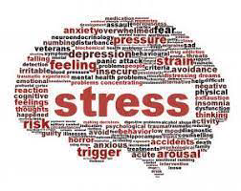
Stress
Evidence based stress reduction techniques can lower stress levels, reduce disease symptoms, improve quality of life

Slide 6
Evidence Based Stress Management Techniques
Progressive Muscle Relaxation – long term benefits include:
Reduction of salivary cortisol levels and generalized anxiety
Decreased blood pressure and heart rate
Decreased headaches
Reference 1

Slide 7
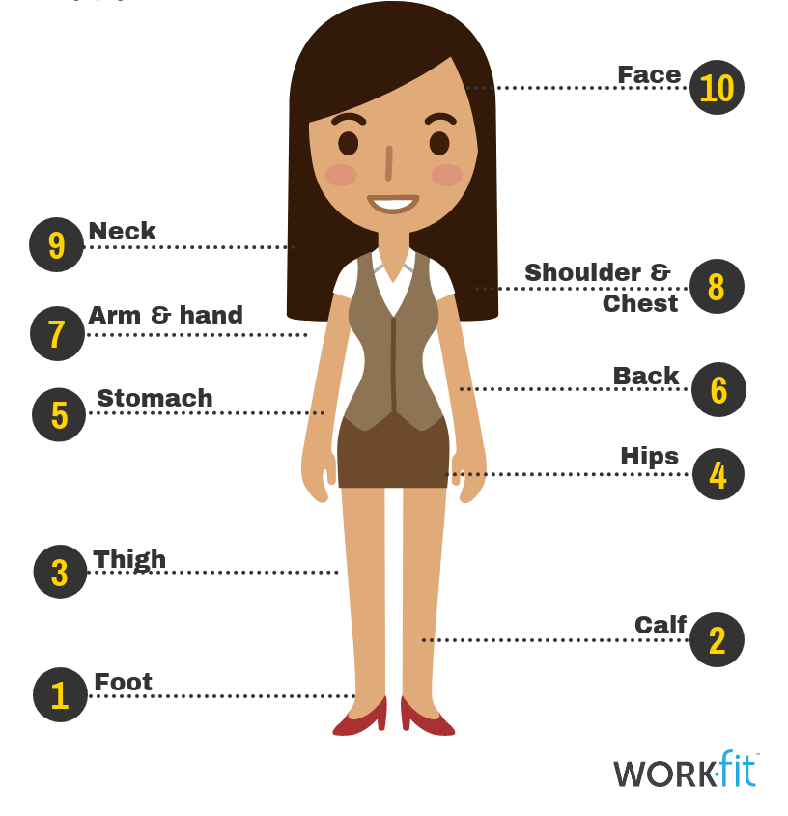

Slide 8
Cognitive Behavior Therapy
Cognitive Model
Situation--->Automatic Thought--- > Feeling, Behavior, Physiological Response
Reference 2
Notes:
8

Slide 9
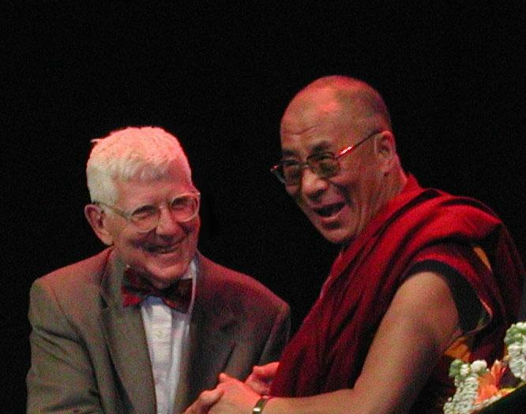
Automatic thoughts influence emotions, behaviors and physiology

Slide 10
Dysfunctional Thought Record
Directions: When you notice your mood getting worse, ask yourself, “What’s going through my mind right now?” and as soon as possible jot down the thought or mental image in the Automatic Thought column.
Date/Time | Situation What actual event or stream of thoughts, or daydreams, or recollection led to the unpleasant emotion? What (if any) distressing physical sensations did you have? | Automatic Thought(s) What thought(s) and/or images(s) went through your mind? How intense (0 – 100% was the emotion? | Emotion(s) What emotion(s) (sad, anxious, angry, etc.) did you feel at the time? How intense (0 – 100% was the emotion? | Alternative Response (optional) What cognitive distortion did you make? Use questions at bottom to compose a response to the automatic thought(s). How much do you believe each response? | Outcome How much do you now believe each automatic thought? What emotion(s) do you feel now? How intense (0 – 100%) is the emotion? What will you do? (or did you do?)
Questions to help compose an alternative response: (1) What is the evidence that the automatic thought is true? Not true? (2) Is there an alternative explanation? (3) What’s the worst that could happen? Could I live through it? What’s the best that could happen? What’s the most realistic outcome? (4) What’s the effect of my believing the automatic thought? What could be the effect of changing my thinking? (5) What should I do about it? (6) If _____ (Friend’s name) was in the situation and had this thought, what would I tell him/her? (7) What’s a more adaptive way to view this situation?

Slide 11
Guided Imagery
Well established in many traditions
Helpful for stress reduction, smoking cessation, pre medical or surgical procedure, pain management
Reference 1

Slide 12


Slide 13
CME Accreditation and Designation
Presenters and Planners: Hinda Dubin, MD, Amanda Robinson, MSHP, CHES, Shmuel Fischler, LCSW-C, have reported no relevant financial relationships to disclose. Aliya Jones, MD and Steve Whitefield, MD have reported no relevant financial relationships to disclose.
MedChi CME Reviewers: The reviewers from the MedChi Committee On Scientific Activities (COSA) for this activity have reported no relevant financial relationships to disclose
Webinars jointly sponsored by the BHA and MedChi

Slide 14
Guided imagery relaxation video
https://youtu.be/sYRddKHMhOM

Slide 15
References
1. Stress Management Techniques: Evidence based procedures that Reduce Stress and Promote Health, Varvogli, L. And Darviri, C., Health Science Journal, Vol 5, Issue 2, 2011
2. Cognitive Behavior Therapy: Basics and Beyond, Judith S. Beck, The Guilford Press, 2011

Slide 16
CME Accreditation and Designation
CMEs will be available at no cost, as will Participant Certificates, which for other disciplines can qualify for continuing education credit.
This activity has been planned and implemented in accordance with the Essential Areas and policies of the Accreditation Council for Continuing Medical Education (ACCME) through the joint providership of MedChi, The Maryland State Medical Society and the Behavioral Health Administration of the Maryland Department of Health. MedChi is accredited by the ACCME to provide continuing medical education for physicians. CMEs will be available at no cost, as will Participant Certificates, which for other disciplines can qualify for continuing education credit.
MedChi designates this webinar educational activity for a maximum of 1 AMA PRA Category 1 Credits™. Physicians should claim only the credit commensurate with the extent of their participation in the activity, as should other disciplines who claim credit for Participant Certificates. For CME/Participant Certificate questions please contact Frank Berry at fberry@medchi.org
Webinars jointly sponsored by the BHA and MedChi

