Slide 1
Maryland Situation Update on Coronavirus Disease 2019 (COVID-19)
Maryland Department of Health
Infectious Disease Epidemiology and Outbreak Response Bureau
January 21, 2022

Slide 2
Webinar Agenda
COVID-19 Epi Summary
Omicron Update
Science Updates
Q&A

Slide 3
COVID-19 Epi Summary

Slide 4
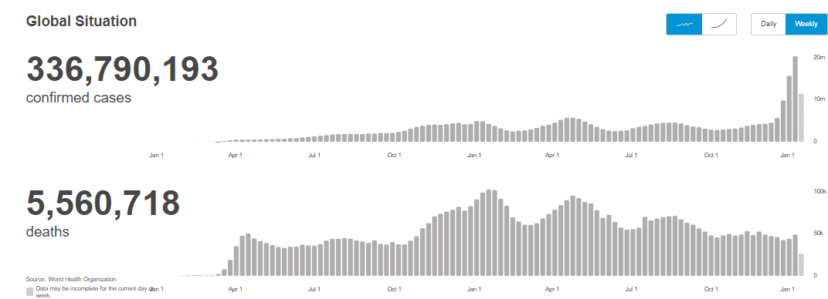
Worldwide: COVID-19
Source: https://covid19.who.int/ accessed 1/21/22

Slide 5
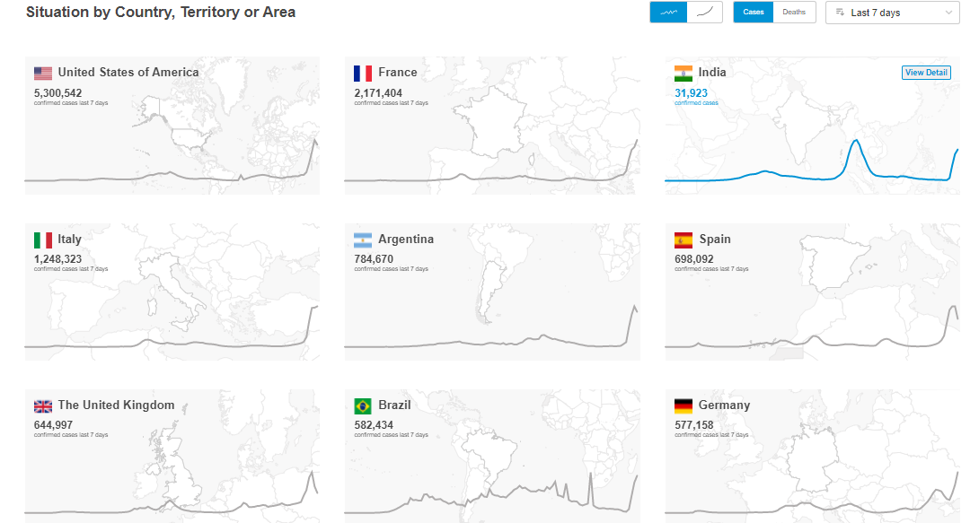
Worldwide: COVID-19
Source: https://covid19.who.int/ accessed 1/21/22

Slide 6
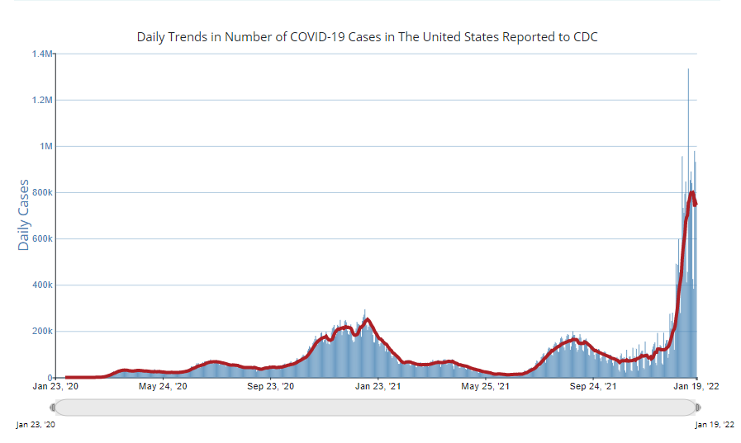
U.S.: COVID-19
https://covid.cdc.gov/covid-data-tracker/#trends_dailytrendscases, Accessed 1/21/22

Slide 7
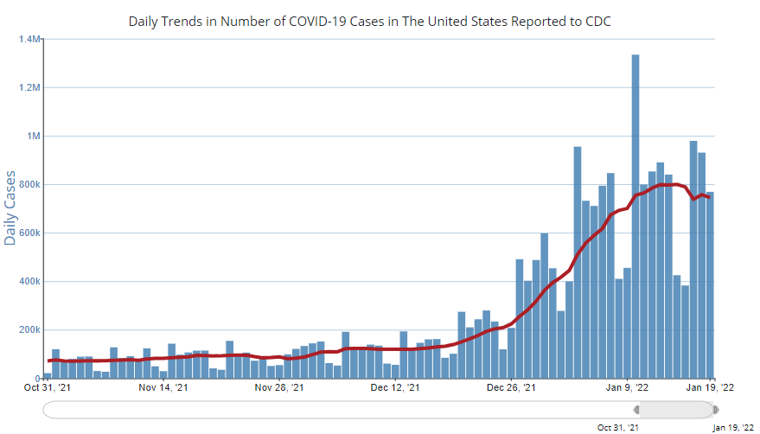
U.S.: COVID-19
https://covid.cdc.gov/covid-data-tracker/#trends_dailytrendscases, Accessed 1/21/22

Slide 8
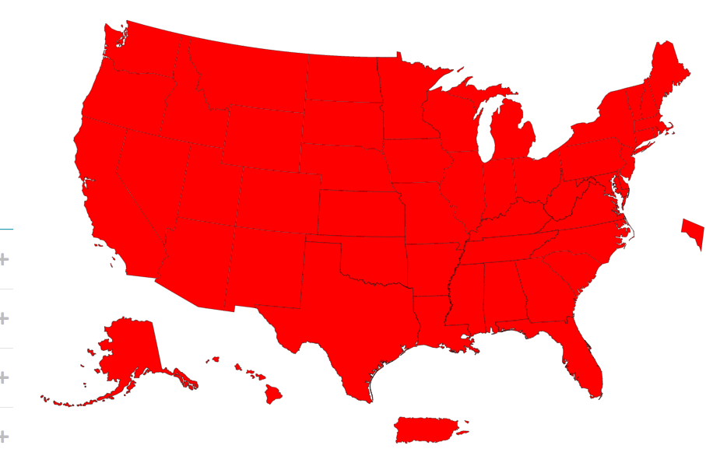
US: Community Transmission
covid.cdc.gov/covid-data-tracker/#cases_community accessed 1/21/22

Slide 9
Maryland COVID-19 Dashboard
https://coronavirus.maryland.gov/ accessed 1/21/22

Slide 10
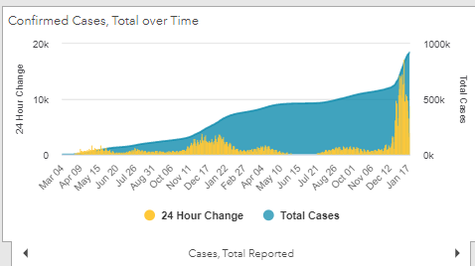
Maryland Confirmed Cases
https://coronavirus.maryland.gov/ 1/21/22

Slide 11
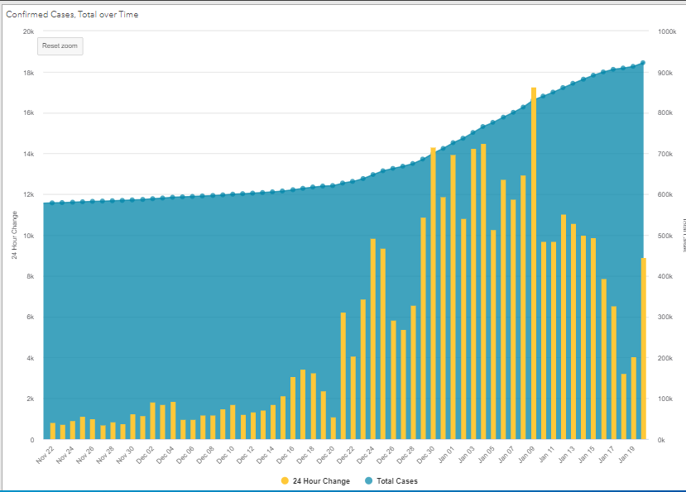
Maryland Confirmed Cases
https://coronavirus.maryland.gov/ 1/21/22

Slide 12
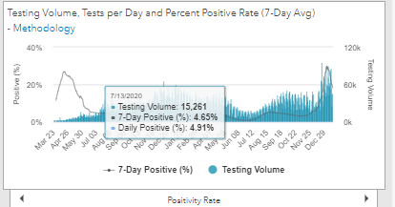
Maryland Testing Volume and % Positivity
https://coronavirus.maryland.gov/ accessed 1/21/22

Slide 13
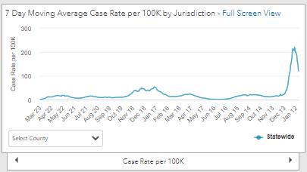
Maryland Case Rate
https://coronavirus.maryland.gov/ accessed 1/6/22
High: 1/9/2022: 210.39 per 100,000
Today, 1/19/22 118.97 per 100,000

Slide 14
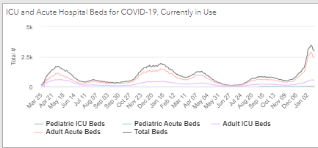
Maryland Hospitalizations
https://coronavirus.maryland.gov/ accessed 1/21/22

Slide 15
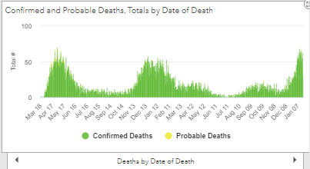
https://coronavirus.maryland.gov/ 1/21/2022

Slide 16
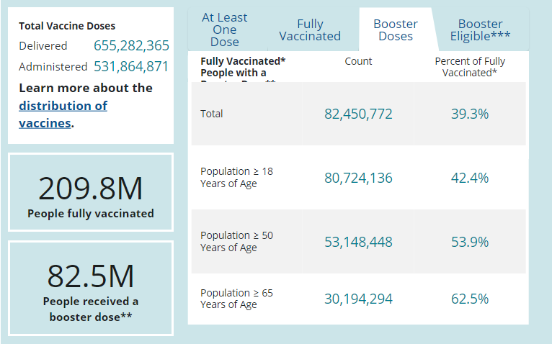
US: COVID-19 Vaccinations
https://covid.cdc.gov/covid-data-tracker/#vaccinations accessed 1/21/22

Slide 17
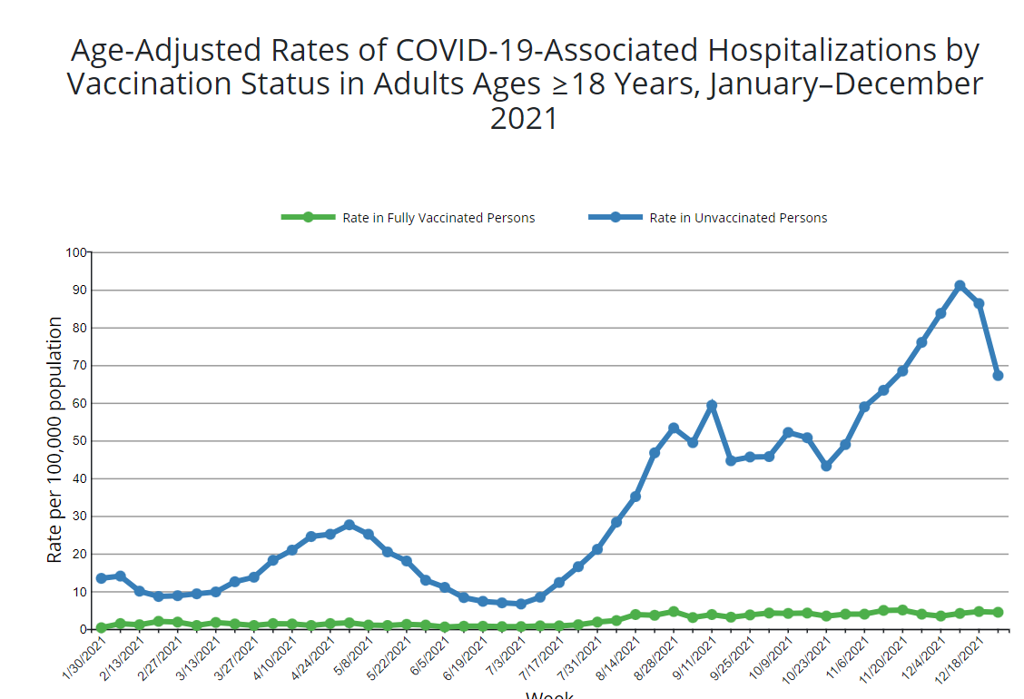
US: COVID-19 Vaccinations
https://covid.cdc.gov/covid-data-tracker/#covidnet-hospitalizations-vaccination accessed 1/21/22

Slide 18
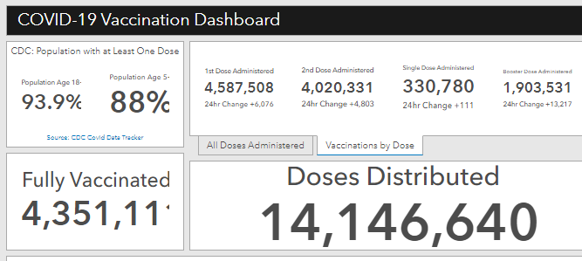
Maryland Vaccine Dashboard
https://coronavirus.maryland.gov/#Vaccine accessed 1/21/22

Slide 19
Maryland Vaccine Dashboard
https://coronavirus.maryland.gov/#Vaccine accessed 1/21/22

Slide 20
Omicron Variant

Slide 21
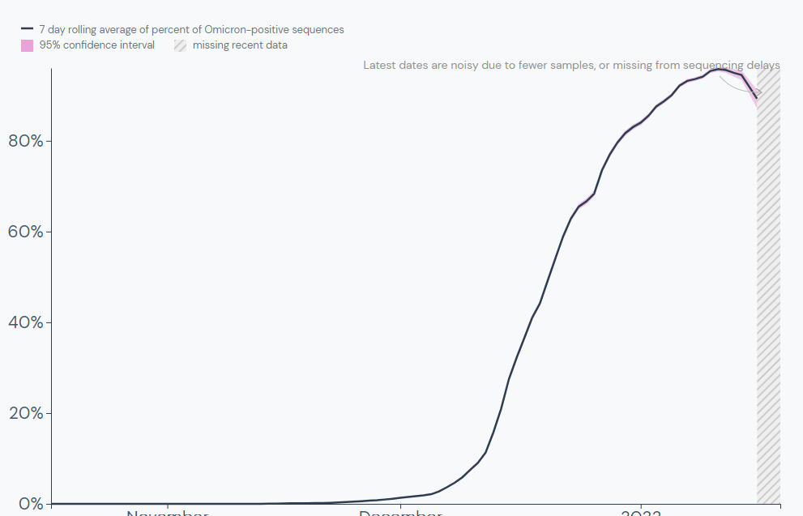
Worldwide: Omicron Variant
https://outbreak.info/situation-reports/omicron?xmin=2021-11-05&xmax=2022-01-04 accessed 1/19/22

Slide 22
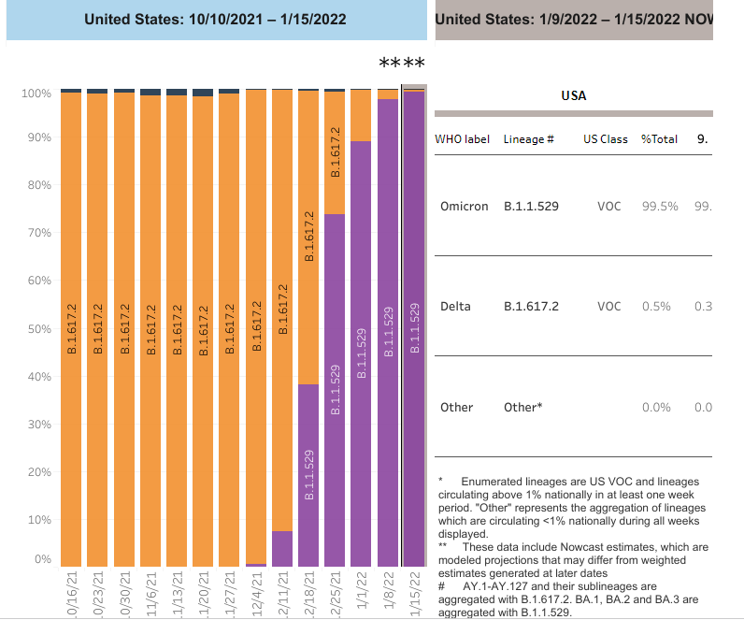
U.S.: COVID-19 Variants
https://covid.cdc.gov/covid-data-tracker/#variant-proportions, Accessed 1/19/22

Slide 23
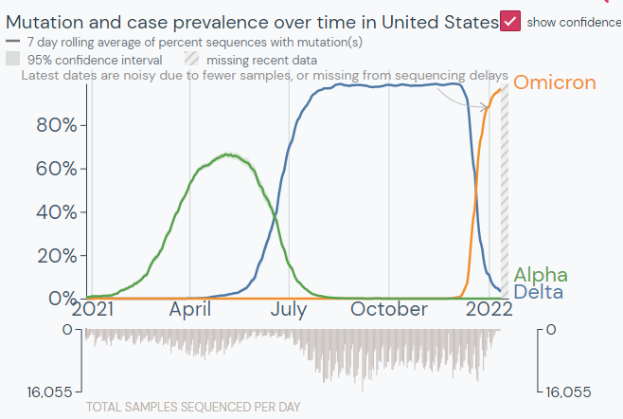
US: Omicron Variant
https://outbreak.info/location-reports?loc=USA&selected=Delta&selected=Omicron&selected=Alpha&xmin=2020-12-27&xmax=2022-01-19 accessed 1/19/2022

Slide 24
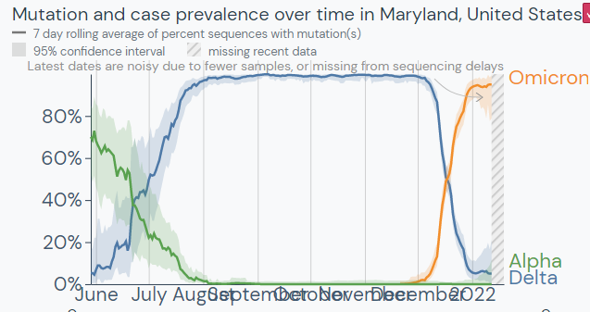
Maryland: Omicron Variant
https://outbreak.info/location-reports?loc=USA_US-MD&xmin=2021-06-10&xmax=2022-01-04&selected=Delta&selected=Omicron accessed 1/19/22

Slide 25
Maryland Influenza Update
https://health.maryland.gov/phpa/influenza/Pages/flu-dashboard.aspx Accessed 1/19/2022

Slide 26
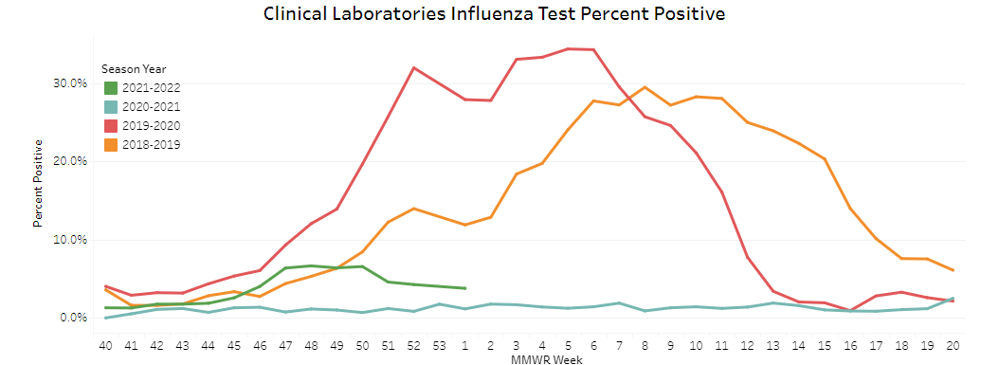
MD Influenza Update
https://health.maryland.gov/phpa/influenza/Pages/flu-dashboard.aspx Accessed 1/19/2022

Slide 27
Science Updates

Slide 28
Risk for Newly Diagnosed Diabetes >30 Days After SARS-CoV-2 Infection Among Persons Aged <18 Years
MMWR 1/14/2022
Persons aged <18 years with COVID-19 were more likely to receive a new diabetes diagnosis >30 days after infection than were those without COVID-19 and those with prepandemic acute respiratory infections.
CDC estimated diabetes incidence among patients aged <18 years (patients) with diagnosed COVID-19 and compared it with incidence among patients matched by age and sex 1) who did not receive a COVID-19 diagnosis during the pandemic, or 2) who received a prepandemic non–COVID-19 acute respiratory infection (ARI) diagnosis
Diabetes incidence was
316 per 100,000 person-years in the COVID-19 group,
118 per 100,000 person-years in the pandemic period non–COVID-19 group,
126 per 100,000 person-years in the prepandemic ARI group, and
125 per 100,000 person-years in the prepandemic non-ARI group
https://www.cdc.gov/mmwr/volumes/71/wr/mm7102e2.htm?s_cid=mm7102e2_w

Slide 29
Risk for Newly Diagnosed Diabetes >30 Days After SARS-CoV-2 Infection Among Persons Aged <18 Years
MMWR 1/14/2022
New diabetes diagnoses in patients under 18 were 166% more likely to occur among patients with COVID-19 than among those without COVID-19 during the pandemic
These findings are consistent with previous research demonstrating an association between SARS-CoV-2 infection and diabetes in adults
The observed association between diabetes and COVID-19 might be attributed to the effects of SARS-CoV-2 infection on organ systems involved in diabetes risk
Alternatively, COVID-19 might have indirectly increased diabetes risk through pandemic-associated increases in body mass index,§§§§ a risk factor for both serious COVID-19 illness and diabetes. Future studies addressing the role of comorbidities and increases in body mass index in post–COVID-19 diabetes are warranted
These findings underscore the importance of COVID-19 prevention among all age groups, including vaccination for all eligible children and adolescents, and chronic disease prevention and treatment
https://www.cdc.gov/mmwr/volumes/71/wr/mm7102e2.htm?s_cid=mm7102e2_w

Slide 30
COVID-19 Cases and Hospitalizations by COVID-19 Vaccination Status and Previous COVID-19 Diagnosis
During May–November 2021, case and hospitalization rates were highest among persons who were unvaccinated without a previous diagnosis
Before Delta became the predominant variant in June, case rates were higher among persons who survived a previous infection than persons who were vaccinated alone.
By early October, persons who survived a previous infection had lower case rates than persons who were vaccinated alone
https://www.cdc.gov/mmwr/volumes/71/wr/mm7104e1.htm?s_cid=mm7104e1_w

Slide 31
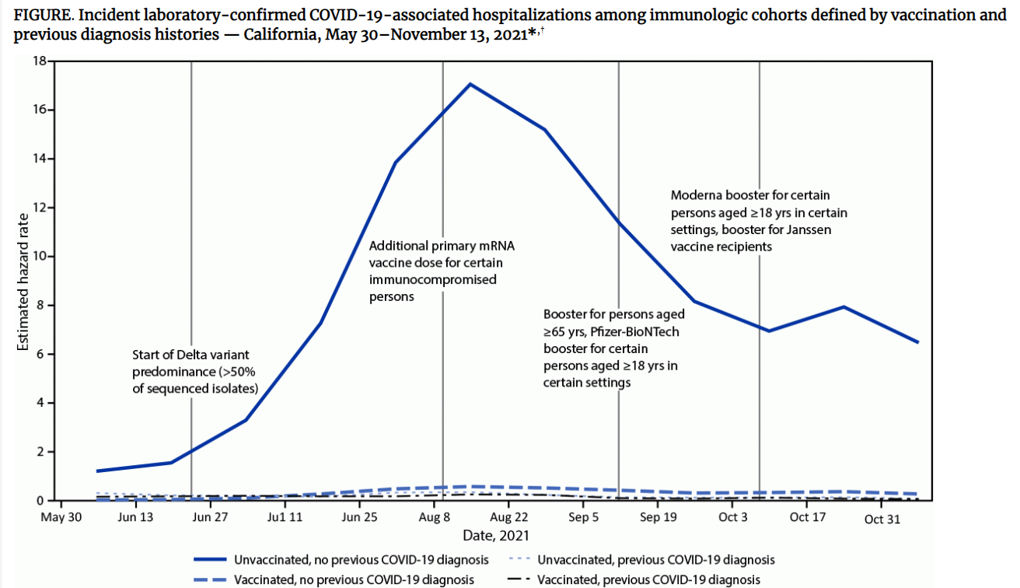
https://www.cdc.gov/mmwr/volumes/71/wr/mm7104e1.htm?s_cid=mm7104e1_w

Slide 32
Questions?
MDH.IPCOVID@maryland.gov

