Slide 1
Walking the Walk
Promoting and Applying Person-Centered Recovery Concepts
Kris Wright, MS, LCPC, RYT

Slide 2
Learning Objectives
How Peers can work with consumers, families, natural supports and clinical supports to identify and facilitate progress on person-centered goals and objectives.
Promoting exploration and discovery as critical components of holistic, person-centered plans and services.
Influencing interdisciplinary teams’ meaningful use of recovery oriented language and their application of recovery concepts to team members’ treatment plans and interventions.
Using key concepts in using Person-Centered Care Planning (PCCP) to foster work on recovery goals consistent with consumers’ hopes and dreams and to collaborate with natural and clinical supports.
Questions? Don’t hesitate to Ask!

Slide 3

Take A Moment To Reflect
In your roles, when is easy to advocate for people’s wants, needs, and preferences? When is it harder?
And for your own?

Slide 4

PCCP Overview Warm Up
Write 3 goals/areas of meaning you have for yourself on a piece of paper.
Hand that paper to the person sitting next to you…
Notes:
the partner cross one out and pick one of the remaining two in order of priority then hand back – what is it like to see one of your goals crossed out? What was it like to cross out and prioritized for someone else?

Slide 5


Recovery… a fuzzy concept
Or Should We Say Discovery
Everyone recognizes overall meaning
different connotation for different people
Core elements of concept are clear
but unclear on the periphery
Can be difficult to operationalize in measurable elements

Slide 6

Recovery vs. Discovery

Slide 7
What is Recovery?
Patricia Deegan’s definition of recovery:
“…The need is to reestablish a new and valued sense of integrity and purpose within and beyond the limits of the disability; the inspiration is to live, work and love in a community in which one makes a significant contribution.”
Deegan, P. (1988) Recovery: The lived experience of rehabilitation. Psychosocial Rehabilitation Journal. XI (4) 11-19
Notes:
Have staff list words they think of when they think of Recovery.

Slide 8
Recovery
…is possible for people with mental illness and/or substance use.
…is different for each person.
…means that they have a successful, high quality of life even though they have a mental illness.
…means that they could maintain a job, have friends, go to school, or have a home.
…may mean that they experience symptoms everyday, but can manage them and still do the things they want to do.
Recovery does not mean that they are cured!

Slide 9
The Ultimate Goal of Recovery-Oriented Transformation
A healthcare system that promotes whole health
Consumer and family driven — each adult and child will have access to a full spectrum of integrated services needed to support their wellness/recovery vision
Focuses on wellness/recovery — a strengths-based approach to help each person experience health, independence, self-esteem, and a meaningful life in the community
Builds resilience — the ability to face life’s challenges and maintain health

Slide 10
The Recovery Plan as a Road Map
Provides hope by breaking a seemingly overwhelming journey into manageable steps for both the provider and the person served
B
C
D
A
E
“life is a journey…not a destination”
10
10

Slide 11

Key Practices: The Process of Plan Development
Person is a partner in all planning activities/meetings
Provide advance notice
Agree upon location
Person has reasonable control over logistics
Time, invitees, etc.
Person offered a written copy
Education/preparation regarding the process and what to expect
Encourage participation by person’s support network/family
Language as a key practice
Notes:
Several opportunities for you to participate and support the individual in their self-advocacy
Review different ways the planning process can elicit and incorporate feedback

Slide 12
Consider Structure &
Roles in Planning Meetings
Treatment Team members arrive on time; introductions
The person is given the team’s full attention, e.g., cell phones are turned off; there are no side-bar conversations
The person is not “talked about” during the meeting. All comments and questions are directed first to the individual and are a collaborative exchange between the person and his/her Treatment Team.
Eliciting the person’s goal (vision/hopes) for their life via a strengths based inquiry
“What comes next” is explained to the person, including an opportunity for them to review the plan; provide input
Notes:
team member’s are not completing/reading other paperwork/texting/ responding to e-mail, etc.

Slide 13
Building A Plan
Outcomes
Interventions/Action Steps
Short term Goals/Objectives
Strengths/Barriers
Desired Results/Goals
Prioritization
Understanding
Assessment
Request for services
13
13

Slide 14
A Plan is Only As Good As the Assessment

Slide 15
When Assessments Differ….
team members disagree about what may be behind
what is going on…
or
there are differences in team members’ assessments of how individuals are doing in different parts of their lives…
… odds are they are operating from different information!
What can you do?

Slide 16
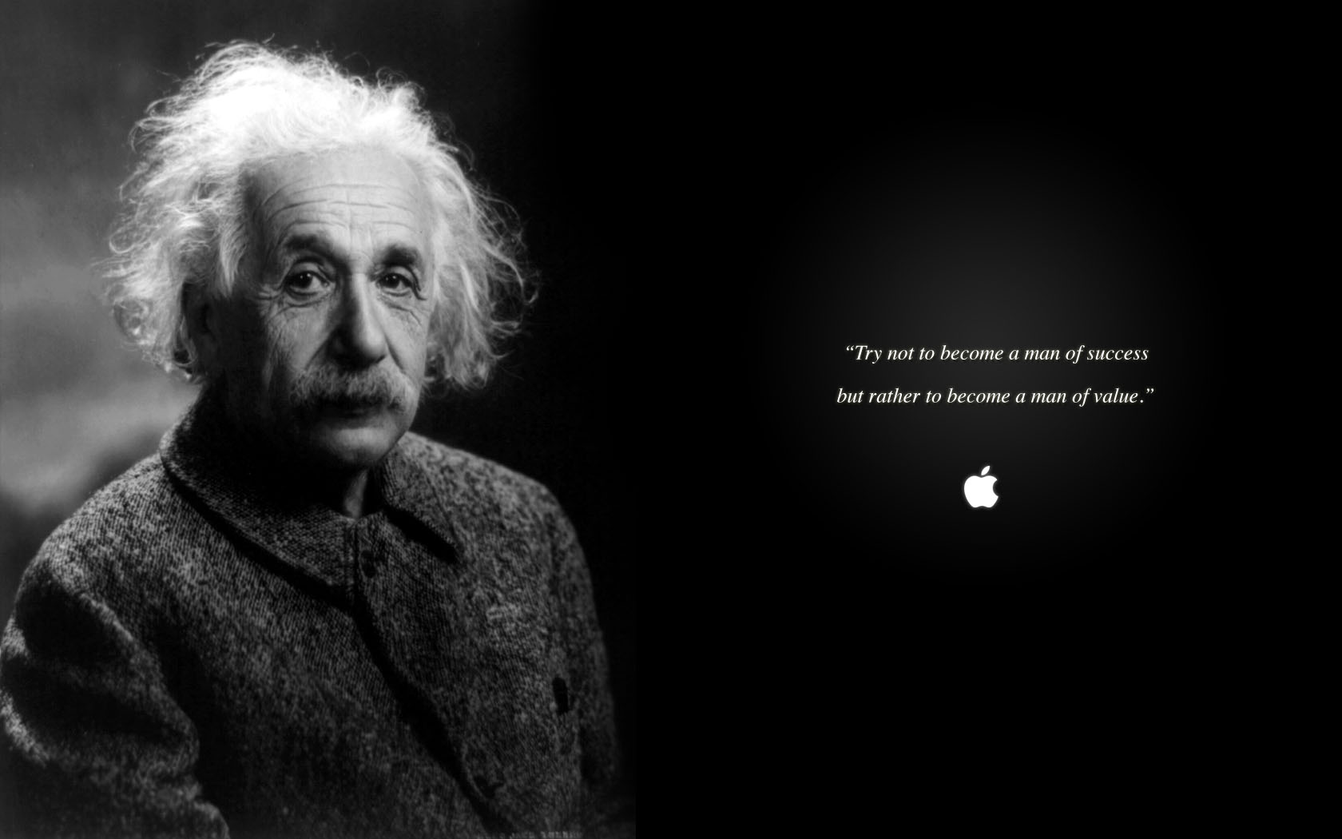
Observations: Poor eye contact, unresponsive to social cues, preoccupation with parts of things.
Rule Out: ASD
Plan: Encourage client to explore part-time employment opportunities such as lawnmower repair or animal grooming.
Notes:
What one could have said about Albert Einstein. Comes from searching for impairments and labeling clients based on their diagnosis. Strengths must be valued by the program culture.

Slide 17
Observations: Recurrent depressed mood leading to breakdowns, social relationships strained by control issues
Rule Out: MD w/PF
Plan: Encourage to practice social skills building with family connections, consider part-time employment opportunities in seasonal work or piece-rate with flexible deadlines
Notes:
Clara Barton –
Ordered to Europe by her doctor for a rest cure in 1869, Barton met with the International Committee of the Red Cross. She participated in relief efforts during the Franco-Prussian War in 1870-1871, but was forced into temporary retirement by ill health in 1872. After recovering, she campaigned to establish an American branch of the Red Cross, despite government resistance due to fears of foreign entanglements. The U.S. Senate finally ratified the Geneva Convention in 1882 and formed the American Association of the Red Cross. Barton became its president.
The newly formed organization sprang into action in the fall of 1881 when forest fires ripped through Michigan. It provided relief during many other natural disasters and epidemics in the U.S., including the Johnstown, PA, flood in 1889. Clara directed many of the relief operations herself. In 1898, at age 76, Barton traveled with nurses to Cuba during the Spanish-American War to nurse the wounded and provide supplies and food. In 1900, after several contentious attempts, the U.S. Congress granted the American Red Cross a charter, making the independent, non-profit organization responsible for fulfilling the provisions of the Geneva Conventions, providing family and other support to the U.S. military, and providing a system for disaster relief. However, Barton’s unwillingness to delegate responsibility had created dissent within the ranks of the Red Cross and, in 1904, she resigned from the organization she had founded and built. https://www.biography.com/news/clara-barton-biography-facts

Slide 18
My battles with addiction definitely shaped how I am now. They really made me deeply appreciate human contact. And the value of friends and family, how precious that is.
Notes:
First stint in rehab in the 80’s. Sober or not, known in the industry for What would we have lost if people had written of Robin Williams as one whose relapses were more notable than his ablity to connect with people?

Slide 19
Data is not enough!!!!!!!!!
Assessment
Intake
Data
Interpretive
Summary
Critical Thinking

Slide 20

The Importance of Understanding
Data collected in assessment is by itself not sufficient for service planning
Notes:
Collecting data is a necessary, but not alone sufficient step in building a Person-Centered plan. Instead, providers must use the assessment data to come to a holistic understanding of the person and the barriers they face in achieving their goals. This understanding should move from “what to why” and reflect “critical clinical thinking” and be recorded in the chart. It is often referred to as the “formulation”, the “narrative summary”, the “diagnostic summary,” the “interpretive summary," the “integrative summary”, etc. and serves as a bridge between the data gathered for assessment and the written plan.
Developing this kind of understanding typically requires some degree of clinical skill and experience (clinical judgment) and should always include some consideration of the role of culture and ethnicity as critical to achieving a true appreciation of the person served. It should be included in the record in a several paragraph narrative. It should be shared with the person (and the family if so desired by the individual). This sharing of information is consistent with the notion of “transparency” and partnership.
The integrated summary of assessment data is more than a re-telling of the facts. Instead, the formulation helps set the stage for prioritizing needs and goals as well as suggesting solutions to the barriers and challenges that have lead the individual to seek help.
The understanding of the individual should serve as the basis for the development of the plan, should help to determine priorities (what comes first? –recognizing that not all issues/goals can be tackled at once or simultaneously.
Most people can only manage one or two personal development goals at a time. Yet often times reflect the expectation that a person with a serious mental illness, who has many issues to contend with in their life, should be working on many simultaneous goals while they are in treatment!
Our understanding of the person should emphasize the person’s strengths, and their stage of change/readiness/recovery (so we can determine the appropriate service interventions –matching the stage of change to the intervention)

Slide 21
Assessment
Critical Thinking
Plan
Notes:
How can you promote critical thinking? Spirit of exploration and discovery vs concluding and prescribing….

Slide 22
Hypotheses
Critical Thinking sometimes generate questions more than answers
Helps prioritize and sequence services to fit the individual’s unique needs
Best guess about what’s going on
Identifies important information that is not known
Important for dual diagnosis or when multiple factors are present
Example: “It’s not clear whether irritability and aggression are caused by substance use, manic symptoms or a combination of both.”
Notes:
Not Known – maybe person can’t/won’t tell you something that seems important
- Most common is mental illness & substance use – chicken or the egg? And MI and IDD/head injury – two different courses of treatment depending on the cause

Slide 23
Understanding Barriers
What is getting in the way of the person achieving their goal(s)?
Why can’t they do it tomorrow
Why can’t they do it themselves
Our focus is removing/reducing/resolving barriers that are a result of the mental illness: symptoms and functional impairments
Describe the impact the barriers has on client’s recovery.
WHY does the client need support?
Describe the challenges that are reaching the client from reaching their goals. What gets in the way?
Specify where the client’s behavioral health symptoms and life stressors
Notes:
What’s getting in the way?
need for skills development
Intrusive symptoms
lack of resources
need for assistance / supports
problems in behavior
challenges in activities of daily living
threats to basic health and safety
challenges/needs as a result of a mental/ alcohol and/or drug disorder = medical necessity

Slide 24
Exploring Barriers
If there are both mental health symptoms and substance use, discuss the interaction
What symptoms constitute warning signs for relapse – when a client is doing well, or does not acknowledge current symptoms, what was going on when things were at their worst?
Specify how the barrier or need impacts the client’s life, not just that it exists and IS impacting them.
What interventions and activities help? Now? In the past?
What are expectations from treatment and what does the client believe his/her responsibilities are?
Notes:
Ecplain why starting with barriers 1st – leveraging strengths specifically to overcome barriers

Slide 25
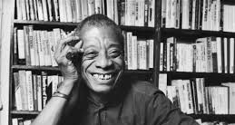
“Not everything that is faced can be changed, but nothing can be changed until it is faced” ~James Baldwin, The Cross of Redemption: Uncollected Writings

Slide 26
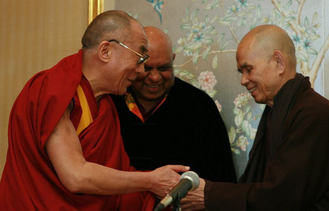
Strengths
If we allow despair to take over, we have no strength left in order to do anything at all.
~Thich Nhat Hanh
David Suzuki and Thich Nhat Hanh: Despair

Slide 27
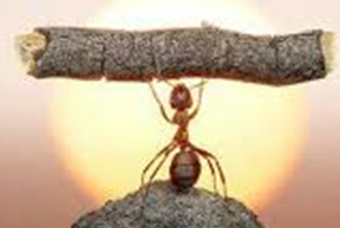
A Recovery Plan Should Be Strength Based
The plan:
explicitly asks for strengths and interests
focuses on the positive, supports the ability to have dreams
revolves around achieving goals rather than addressing deficits
Strengths are identified by the person, the provider, and also natural supporters/collaterals where appropriate and may include:
environmental factors that will increase the likelihood of success
identifying the person’s best qualities/motivation
strategies already utilized to help
competencies/accomplishments
interests and activities, i.e. sports, art

Slide 28
Setting Priorities and Crafting Goals … a Negotiation

Slide 29
Negotiation … “You keep using that word. I do not think it means what you think it means”

Slide 30
Goals on Plans
Reflect the client’s needs and hopes (not yours)
Short, pithy, to the point, memorable statements of WHAT the client wants to achieve.
Worded in positive terms
Long term, global, broadly stated with a target date at least a year, perhaps more, in the future.
Provides a life change as a result of treatment
Based upon their strengths, needs, or preferences
Appropriate to stage of change
Linked to discharge/transition plans
Culturally Sensitive
Notes:
Personal: It should be about you.
Potent: Compose your powerful present-tense language. ie: I AM... or I EMBODY... or It IS.....
Pithy: Use no more than eight words.
Positive: Steer away from tricky negatives that masquerade as positives. Like: I will NOT... or NEVER again will I.... or NO one can stop me from....

Slide 31
Respecting Cultural Variables in Goal Setting
The context of an individual’s worldview will impact the desired results process
Providers must always remain curious and open to investigate the cultural aspects of developing desired results

Slide 32
Finding the Recovery Zone
Recovery Zone
Let person do what he/she wants regardless of our concerns. This is not being person-centered; this is
Get the person to do what WE want regardless of their viewpoint. This is not acting in their best interest; this is
Neglect
Coercion
http://www.patdeegan.com/AboutCommonGround.html
32

Slide 33
Balancing Priorities
Important TO the Person
Personal Perspective
Important FOR the Person
Professional Perspective
Meaningful relationships
A home/place of my own
Valued roles/purpose
Independence/Self-determination
Cultural/personal preferences may impact
Faith/spirituality
A job/career
Basic health and safety
Reduction of clinical sx
Maslow’s basic needs
Harm reduction
Management of risk issues
Legal obligations and mandates
Community Safety

Slide 34
Developing Goals and a Vision
Goals and objectives in the recovery plan are not limited to clinically-valued outcomes reducing symptoms, increasing adherence, etc.
Rather, goals are defined by the person with a focus on building “recovery capital” and pursuing a life in the community.
faith
work or
school
treatment & rehabilitation
Self-help
housing
social support
family
belonging
Notes:
34
Setting goals should be based on the individual’s hopes and dreams—for some people this is a hard thing to identify—especially when they are they feeling overwhelmed by their illness and hopeless about their circumstance. Sometimes simply asking a person about their life plans and dreams BEFORE they got sick is a useful strategy for helping people re-connect with a sense of hope and purpose in their life.
Providers and people receiving services cannot do everything at once. Its important to determine, with the person, what is most important and what goals have the greatest priority.
One way to help set priorities is to use Maslow’s hierarchy of needs. Maslow's hierarchy of needs consist of the following items in the following order:
food, clothing, shelter
affection, self esteem,
freedom, beauty, goodness, justice
self-actualization and self-transcendence.
A goal is simply a statement of something someone wants to achieve in their life—and from seeking help. Individuals receiving mental health services should be encouraged to look at their lives and identify what they would like to change .
When consumers of services have an opportunity to be involved in goal setting , they typically identify the goal areas included on this slide as having meaning in their lives. Yet, we often write plans with goals like “be medication compliant”, “commit to abstinence and life long recovery,” or “decrease depression.”
Clearly, people receiving mental health services want the same things in their own lives that we all want: meaningful relationships, jobs, good health, a safe place to live, etc.
Building a life in the community is not a task that comes AFTER discharge!! It’s what recovery planning and services is all about.

Slide 35
“It is a strangely irrational notion that there is something in the very flow of time that will inevitably cure all ills. … We must come to see that human progress never rolls in on wheels of inevitability. It comes through the tireless efforts and persistent work of men…” Dr. Martin Luther King Jr. Letter from the Birmingham Jail
Notes:
Responding to a letter from some who asked if he was in ”too great a religious hurry” “saying it has taken Christianity almost 2000 years to accomplish what it has”

Slide 36
Teaching Methods That Work:
Notes:
The Four Basic Strategies for Creating Excellent Instruction
Stuff That The Instruction Or Instructor Does
Tell
The first component of good instruction is the “Tell” strategy. This is the strategy
used to provide the learner with key information related to their learning. Facts,
concepts, rules, and procedures can all be conveyed using the Tell strategy. For
example, if you were designing instruction to teach individuals to become CTI
trainers, you would tell them the specific steps they would go through to provide the
training and even show a visual outline of the steps.
Show
The second component of good instruction is the “Show” strategy. This is the
strategy used to demonstrate examples of what you want to teach. In the CTI-TTT
example, you would show a variety of real examples of someone facilitating CTI
training. You might show "negative examples" as well – examples of what not to do
when providing training. These examples will help the learner see how the
information you told them is applied.
Stuff That The Learner Does
Do
After providing a variety of examples, you should provide your learners with the
opportunity to “Do” what you have taught them. In the CTI-TTT example, the
learners practice providing key information about CTI and facilitating learning
activities. Others who are knowledgeable about CTI observe and then provide
feedback and guidance. It is important that learners be given plenty of feedback as
they apply what they have learned so that they can improve their skills and abilities.
These practice opportunities should replicate the real-world environment as much
as possible to make the learning experience authentic and engaging.
Apply
the final component is “Apply.” In this step, learners plan out how they will apply
their knowledge and skills in their own environments. In preparing to provide
instruction in CTI, the participants plan out their own approach to create an
engaging, rich, interactive learning experience for others.
These basic strategies align with several known theories of instruction. For example,
they support Merrill's First Principles of Instruction, a well-known theory of
instruction that is based on extensive research. Gagne's 9 Events of Instruction also
align well with these strategies.
The next time you design a piece of instruction, ask yourself how well you are using
these strategies. If you will conscientiously apply them, you will find increased
student learning and instructional design effectiveness.
Adapted from https://elearningindustry.com/tell-show-do-apply-the-anatomy-of-goodinstruction

Slide 37
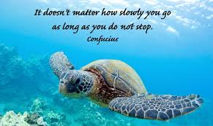

Slide 38
Big Steps Little Steps
Objectives:
address barriers to the goal by breaking larger goals into expected near-term changes
describe changes in behavior, function, or status
relate back to functional impairments
are understandable for the person served and the team
identify key changes that the consumer wishes to accomplish, such as skill building/coping mechanisms
address medical necessity
Reflect the person’s age, culture, developmental stage
Services are not an objective!!
38

Slide 39
What Needs to Be
Accomplished to Achieve the Goal?
Notes:
Ask Questions!!!!! More Critical Thinking?

Slide 40
Use your resources!
Ideas may include:
Skills Building Psychoeducation
Accessing Resources
Practicing Coping Skills
Applying Skills in New Settings
Networking
Exploration
and……………..
Notes:
Exploration is a valid objective

Slide 41
Objectives…
These are the smaller, incremental steps needed to reach the long term goal
There should be enough objectives to the duration of the plan, but target dates should make sense
Objectives should be clear and measurable so that its obvious to all when the objective has been achieved

Slide 42
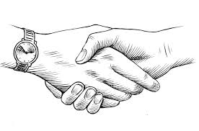
Services & Action Steps
Services & action steps include those “interventions” provided by professionals which…
respect individual choice and preference
are tailored to the stage of change/recovery
describe medical necessity by clearly describing how services are intended to overcome that individual’s barriers
are specific to an objective
But they also incorporate actions by natural supporters and the person him/herself.
42
Notes:
42

Slide 43
Action Steps by The Person In Recovery & Natural Supporters
Traditional plans include only those interventions performed by staff. The recovery model, however, emphasizes the responsibility of a person to participate actively in his or her own care as well as the benefits of seeking contributions of “natural supports” (e.g., family, friends, advocates, & community supporters)
For each objective, consider specifying:
“Personal Actions” (this promotes a sense of self-agency and helps to activate people in their recovery) and
“Natural Support Action” (to help the person build/expand their natural recovery network as a supplement to professional services)

Slide 44
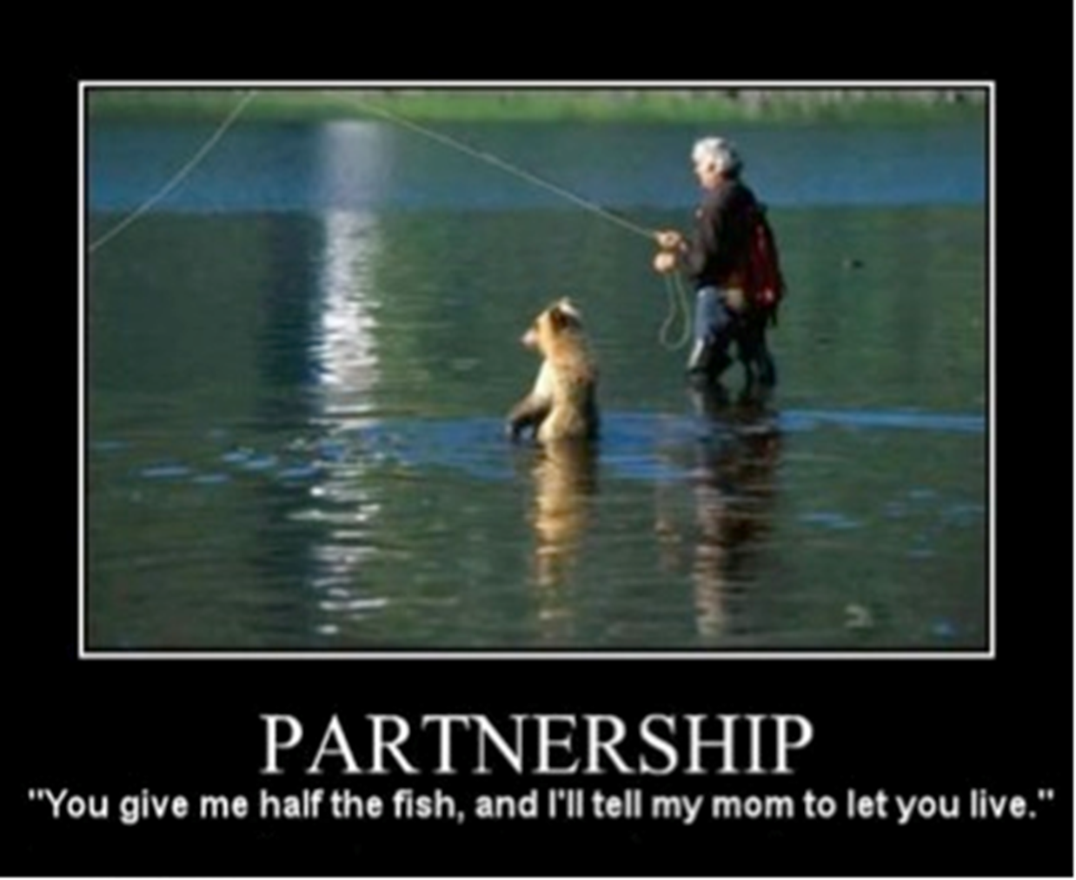

Slide 45


How Are We Feeling?
What seems easy?
What seems challenging?

Slide 46
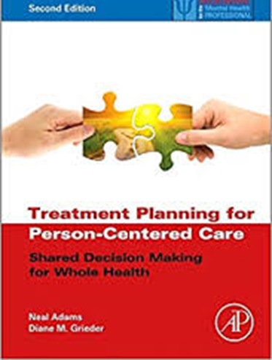
Thank You!!!!
For more information or with questions visit:
The Maryland Behavioral Health website, sign-up and look for “Being Person-Centered” by Diane Grieder (Module 18). CEUs offered.
https://mdbehavioralhealth.com/

