Slide 1

Optimizing the Value of
Peer Support Workers
6th Annual Peer Recovery Specialist Networking and Leadership Conference
Cambridge, Maryland
January 16, 2020
Tom Hill
tomh@thenationalcouncil.org
National Council for Behavioral Health

Slide 2

A Beginning Premise
Imagine that individuals with MH and SUD disorders are capable of:
Making sound decisions and choices
Controlling their own lives and destinies
Defining a personal recovery vision
Exploring recovery pathways
Achieving long-term recovery on their own terms
Everyone here is living proof that these capabilities are possible.
This premise flourishes in the unique relationships in Peer Support.

Slide 3

What Do We Mean when We Say, Unique Relationship?
Evidence that recovery is possible
Learning positive self-talk
Using mutual aid and wellness tools
Reframing our past
Developing a vision for our future
Develop dreams and goals
Offer encouragement
Moving beyond our comfort zone
Walking alongside others in recovery
Sharing lived experience to inspire hope
Mutual healing

Slide 4
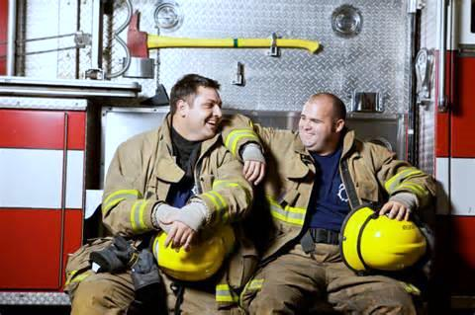
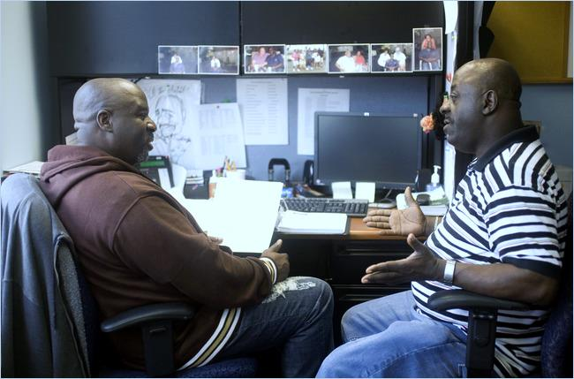
Mutual Healing: A Spiritual Axiom
“…we heal ourselves by helping others heal. This is related directly to the fact that we recover together. It’s through our sense of brokenness and our journey to recovery that we’re fully able to show up and help others who are going through similar experiences. By doing that, by extending ourselves though service, we get healed in the process. It’s a mutual exchange of helping and healing.”
Tom Hill, 2012

Slide 5

Changing the Initial Questions
“Can you tell me a bit about your hopes or dreams for the future?”
“What are some things in your life that you hope you can do and change in the future?”
“What kinds of activities make you feel happy and fulfilled?”
“If you went to bed and a miracle happened while you were sleeping, what would be different when you woke up? How would you know things were different?”

Slide 6

Peeling the Onion: Going Deeper in Recovery
Forming new relationships and social networks
Developing goals and aspirations
Rethinking and reframing personal narratives
Childhood development and family of origin work
Developing strong esteem and identities

Slide 7
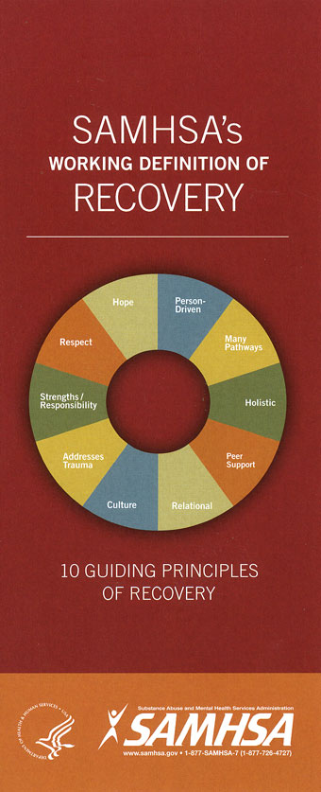
SAMHSA’s Working Definition of Recovery
A process of change through which individuals improve their health and wellness, live a self-directed life, and strive to reach their full potential.
(SAMHSA, 2011)
Ten Guiding Principles:
Hope
Respect
Strengths/Responsibility
Addresses Trauma
Culture
Relational
Peer Support
Holistic
Many Pathways
Person-driven

Slide 8

Recovery Principles and Values
Primacy of recovery
Authenticity of lived experience
Diversity and inclusion
Multiple pathways
Leadership development
Participatory process

Slide 9
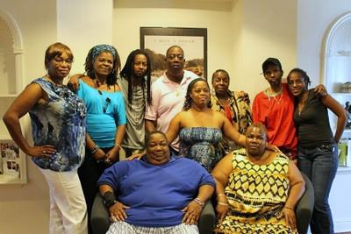
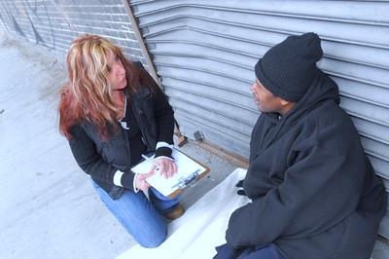
Definition of Peer Support Worker:
A Role within a Context
Key components:
Mutuality and reciprocity
Relationship: respect and trust
Authority and expertise of lived experience
Strength-finder
Appropriate sharing
Agency: never do for others what they can do for themselves
Recovery first: modeling self-care

Slide 10

Peer Support Workers: MH & SUD
Parallel systems of training, certification, funding
Different role titles
  SUD: Peer Recovery Coach
  MH: Peer Support Specialist
Also, differences in language and, sometimes, focus
Peer Support role is similar across disciplines
Synergy is important, but so is distinction in practice across disciplines
MH and SUD Peer Support Workers often work with individuals with co-occurring issues, but not always explicitly
Trauma is often a common denominator
Notes:
Language of professionalism

Slide 11
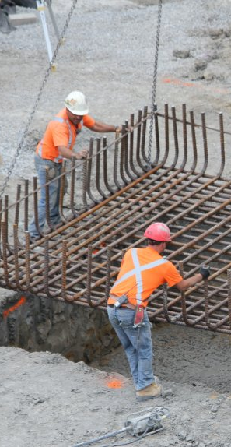
Philosophical Foundation of
Peer Support Practice
Recovery-oriented practices, programs, and systems
The Wounded Healer = Mutual healing
Recovery Capital = build upon strengths
Focus on strengths, resiliency, and wellness
Informed by awareness of life experiences: culture, family history, and trauma
Setting recovery expectations and goals
Notes:
Recovery Capital is the sum of the strengths and supports – both internal and external – that are available to a person to help them initiate and sustain long-term recovery from addiction.

Slide 12

Peer Support Worker Role: Profile
Lived experience in recovery from mental illness and/or addiction
A mixture of employed and volunteer roles
Distinct from both clinical and mutual aid roles and practice
Reinforced through training, skills-building, and quality supervision
Guided by ethical framework and decision-making
Practice of boundaries and self-care

Slide 13

Peer Support Worker Skills
Listening, facilitating, guiding, encouraging
Leveling power differentials
Helping others to gain hope, explore recovery, and achieve life goals
Reinforcing voice and choice
Building on strengths (Recovery Capital) to develop solid recovery foundation
Development of person-owned recovery plans
Applying trauma-informed and culturally-appropriate strategies
Role-modelling successful recovery

Slide 14

What Do Peer Support Workers Do?
Help build recovery capital and facilitate recovery tools
Provide social support and identify and overcome obstacles
Make introductions to recovery community
Connect to services and community resources
Facilitate informed decision-making
Advocate and promote self-advocacy
Help navigate systems
Work as change agent in advancing cultures of recovery

Slide 15

Tasks and Activities that Compromise the Peer Support Worker Role
Counselling
Giving advice
Doing for someone what they can do for themselves
Breaking trust and confidences
Coercing, forcing, or manipulating
Performing tasks that:
  are inappropriate to Peer Support role
  undermine the peer-to-peer relationship
  jeopardize the Peer Support Worker’s recovery
Notes:
Examples for last bullets:
Medication adherence
Treatment “compliance”
Driving personal vehicles
Controversies of emergency room peers

Slide 16

Placing Peer Support Workers in
Pre-existing (Non-peer) Roles
Creates a “bad fit”
Undermines the integrity of peer practice
Underutilizes the full potential of lived experience in a peer context
Promotes and reinforces role confusion
Can set up peer support workers for failure
Creates tension and a sense of threat in the workforce
Notes:
Examples for last bullets:
Medication adherence
Treatment “compliance”
Driving personal vehicles
Controversies of emergency room peers

Slide 17
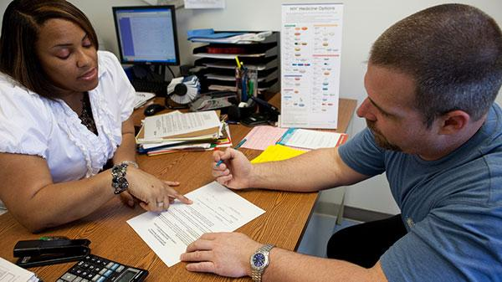
Example: Are Peer Support Workers the Same as Case Managers?
It is a common mistake to confuse the two roles
While they may share similar tasks, such as connecting to resources…
…the approach and purpose is different
The intentionality of lived experience drives this difference and creates new opportunities and potential for engagement
Notes:
Examples for last bullets:
Medication adherence
Treatment “compliance”
Driving personal vehicles
Controversies of emergency room peers

Slide 18
Role Context of Lived Experience
Traditionally educated and trained
Lived Experience
Status disclosure is a choice
Expectations: Disclosure, Boundaries, Therapeutic Relationships
Lived Experience
Status disclosure is imperative
Training and other requirements
Expectations: Mutuality, sharing, reliance on story
Shared Values of Recovery and Resiliency
Non-peer Staff
Peer Support Staff
Adapted after Lyn Legere, 2018
Notes:
We just talked about complementary – we recognize the shared purpose and values around recovery and resiliency. But our professional purposes and ways of supporting people are very different, even when professionals in traditional roles have chosen to share pieces of their own lived experience

Slide 19

Questions about Supervision of
Peer Support Workers
Who is qualified to supervise?
What training is available?
What modalities are the most effective?
How often does supervision need to be scheduled?
Does supervision cover admin, support, trouble shooting, and education?
Are experienced peer support workers able to become supervisors?

Slide 20

Supervision Competencies
Understand peer roles and practices
Use strength-based approaches
Enhance and develop unique competencies of peer practice
Explore ethical and boundary issues
Foster recovery orientation to the program/organization
Assist with system navigation
Promote self-care
Advocate for peer supports across the organization and in the community
Bureau of Justice Assistance/U.S. Department of Justice, 2019

Slide 21

Peer Support Workers Help to Achieve
Positive Outcomes and Cost Savings
Reduced remission rates
Rapid turnaround following remission
Decreased hospitalizations
Reduced length of stay in hospitals
Decreased homelessness
Increased recovery capital
Community and civic engagement
Tapping unrealized potential and recovery milestones

Slide 22
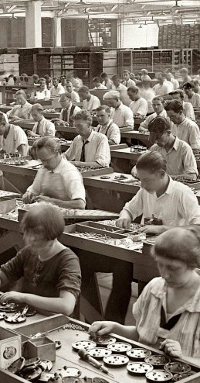
Supporting Success in the Workforce
For Peer Support Staff:
The Peer Support Worker’s recovery must always come first
Ensuring a fair and livable wage and appropriate compensation and benefits
Training and ongoing education
Career and leadership ladder
Thorough orientation to diverse and cross-discipline work environments
Setting and managing realistic expectations and goals with peer support staff

Slide 23

Supporting Success in the Workforce
For Non-peer Staff:
Developing an understanding and appropriate use of the peer support role
Setting and managing realistic expectations and goals
Elevating status of Peer Support Workers as valued resources
Providing qualified supervisors to appropriately oversee and support Peer Support Workers

Slide 24
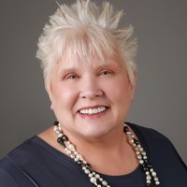
Six Challenges of Making Peer Services Work
Role Confusion
Being treated as separate from the rest of the workforce
Not being held to the same standard
Training for supervision
Career paths
Areas of focus
Sue Bergeson, 2019

Slide 25

Final Thoughts
Peer Support Practice is contingent on elements such as person-centered care, personal choice and decision making, and individuals actualizing their full potential.
For peer-to-peer support to be effective, the uniqueness of the peer relationship – especially its foundation of mutuality and mutual healing – must be fully understood, supported, and elevated.
This needs to be reflected and codified in all policies, procedures, written documents on systems, service, and community levels.
The addition of the Peer Support Worker to the workforce has the potential to transform systems and services to a recovery orientation.

Slide 26

A Shared Future Vision
That individuals in and seeking recovery:
Be active agents of change in our own lives – not passive recipients of services
Manage and move beyond symptoms and not be defined by our illness
Have valued social roles and relationships
Embrace purpose and meaning in our lives and make worthwhile contributions
Live self-actualized lives of fulfillment and abundance
Become empowered by creating recovery-oriented cultures and environments
Adapted from Ijeoma Achara

Slide 27

A Renewed Vision
  Recovery Works
  Recovery is Possible
  Recovery is an Expectation!

