Slide 1

The Treatment and Recovery Continuum in the Age of Opioids
Yngvild Olsen, MD, MPH
Medical Consultant
Maryland Behavioral Health Administration
May 16, 2019

Slide 2
LEARNING OBJECTIVES
Describe the current status of the overdose and addiction crisis in Maryland
Review the basis for opioid addiction as a chronic disease
Discuss how different systems can collaborate under a recovery umbrella to save and improve lives of people with substance use disorders

Slide 3
OVERDOSE CRISIS
https://bha.health.maryland.gov/OVERDOSE_PREVENTION/Documents/Drug_Intox_Report_2017.pdf
Notes:
Not news to those in this room that we have an overdose crisis in Maryland and one that is costing more and more lives every year

Slide 4
https://bha.health.maryland.gov/OVERDOSE_PREVENTION/Documents/Drug_Intox_Report_2017.pdf
Notes:
This overdose crisis has affected all ages, ethnicities and genders across Maryland

Slide 5
https://bha.health.maryland.gov/OVERDOSE_PREVENTION/Documents/Drug_Intox_Report_2017.pdf

Slide 6
https://bha.health.maryland.gov/OVERDOSE_PREVENTION/Documents/Drug_Intox_Report_2017.pdf

Slide 7
https://bha.health.maryland.gov/OVERDOSE_PREVENTION/Documents/Drug_Intox_Report_2017.pdf

Slide 8
Too Many Lives Lost…..... But Hope Is Alive!

Slide 9
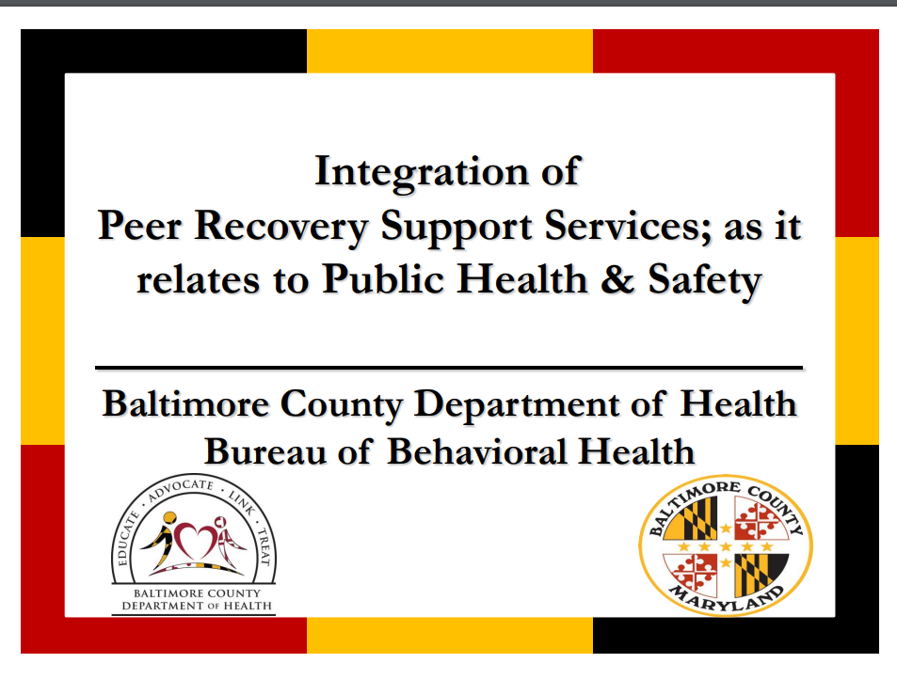


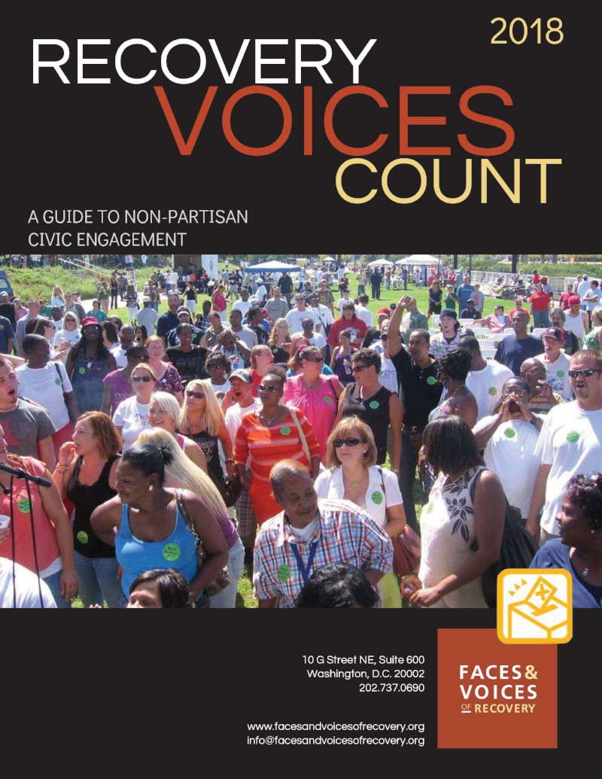
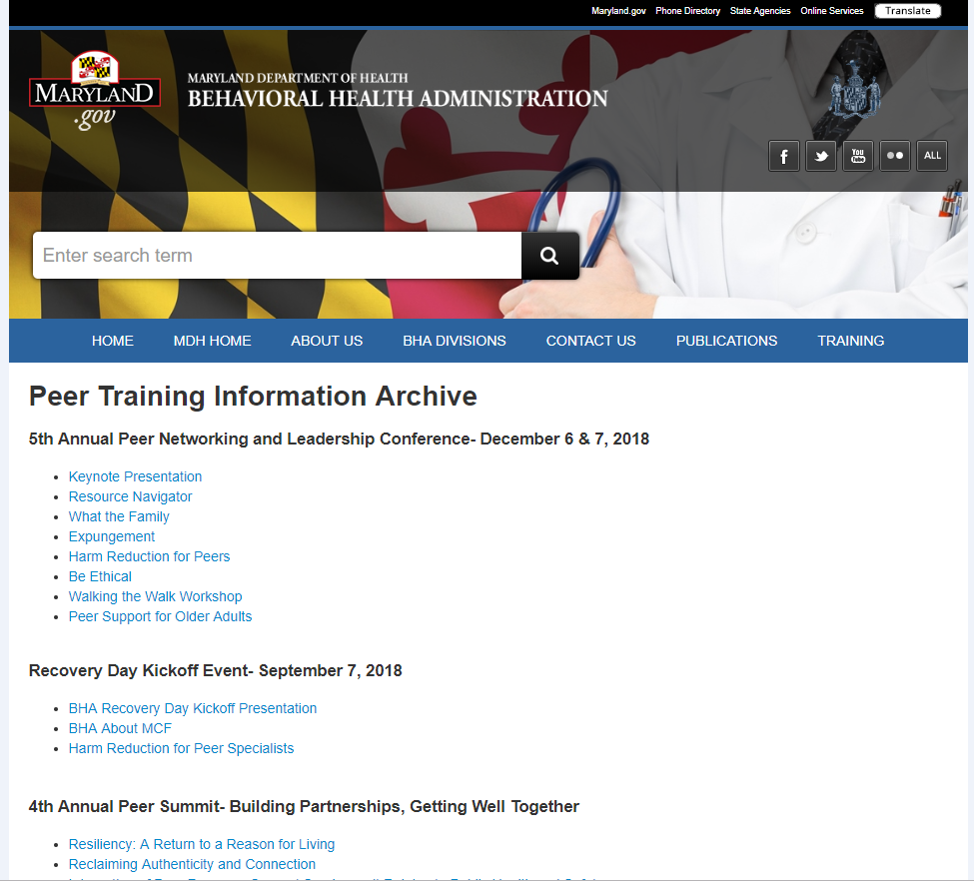
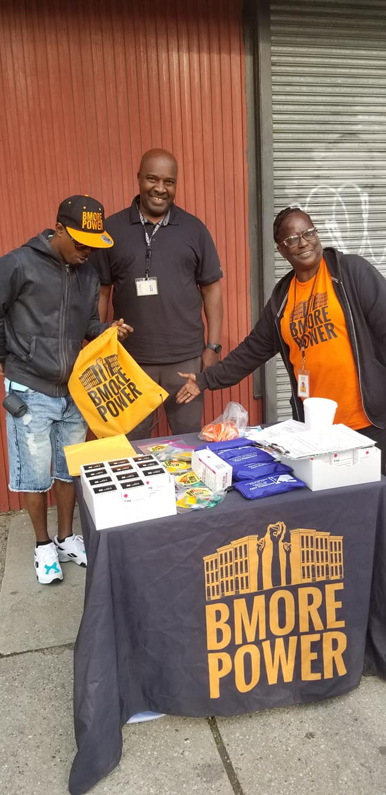

Notes:
The hope is alive because of you all. You and so many others across the harm reduction and recovery support spectrum that have raised your voices to push for recognition that you count, that you have valuable experience, knowledge, and information to share that can help others.
Your voices have been heard. Not only are there national large influential organizations such as Faces and Voices of Recovery but here at home, there are local organizations such as Voices of Hope, harm reduction coalitions such as Bmore Power, and peer workforce development efforts at the state and county levels.

Slide 10
Recovery in Focus….
NIDA and SAMHSA:
Recovery is a process of change through which people improve their health and wellness, live self-directed lives, and strive to reach their full potential. Even people with severe and chronic substance use disorders can, with help, overcome their illness and regain health and social function.
Notes:
Your voices have also been heard at the federal level. Federal organizations that set and fund research and treatment policy for the country recognize the need for an understanding of recovery and a recognition that people can and do recover from addiction.

Slide 11
Whole Person Approach
“The study of disease and of identity cannot be disjoined. To restore the human subject at the centre—the suffering, afflicted, fighting, human subject— we must deepen a case history to a narrative or tale; only then do we have a ‘who’ as well as a ‘what’, a real person, a patient, in relation to disease.”
Oliver Sacks, Preface to The Man Who Mistook His Wife for a Hat
Notes:
What you and others have shown us is that we need to consider the person, the “who”, and not just the “what” when thinking about how to be effective healthcare providers. So even though we talk about addiction as a disease and the science behind it, I put this in here to illustrate that healthcare providers need to understand that we can’t just focus on the disease; we have to understand the person with the disease. And we have a lot of work to do collectively get rid of the stigma that exists towards people with addiction and engage people in care and treatment.

Slide 12
Stigma of Addiction
Barry CL, McGinty EE, Pescosolido BA, Goldman HH (2014). Stigma, Discrimination, Treatment Effectiveness, and Policy: Public Views about Drug Addiction and Mental Illness. Psychiatric Services, 65(1): 1270-1272
Notes:
Because there is a lot of stigma out there…….
Web based national public opinion survey of 709 adults in 2013 – half assigned to answer attitudinal questions about addiction and other half answered same questions about mental illness
Also asked about support for policies on insurance parity, and government spending on treatment, housing, and job support – lower support for these policies among respondents assigned drug addiction questions
(oppose insurance parity 43% vs 21%) (oppose increased government spending on treatment 49% vs 33%) (oppose government spending on housing subsidies 75% vs 45%) (oppose government spending on job support programs 46% vs 32%)

Slide 13
Stigma Among Healthcare Professionals
Survey of primary care providers noted less than 10% felt primary care was “an appropriate setting to work with drug users.” (Deehan et al, Br J Gen Pract 1997)
Survey of health professionals found lower levels of regard for patients with SUDs compared to those with diabetes or depression (Gilchrist et al, Addiction, 2011)
From a focus group study of physicians (Baldacchino A et al, Addict Behav 2010):
“I think they’re generally seen as people who use tax payers money to fund their drug and alcohol addiction so….I think there’s a prejudice towards them….they’re probably not treated like other patients are” and are “generally seen as timewasters”.

Slide 14
Language Matters
Current language focuses on labeling and stigmatizing people
“Abuse”¹
Long implied the willful commission of an abhorrent (wrong and sinful) act
Involving forbidden pleasure
Come to characterize those of violent and contemptible character-those who abuse their partners, their children or animals
Defined in terms of immorality, not as health problem
Study of 728 MH professionals randomly presented one of 2 vignettes with different descriptive language of person portrayed²
“Substance Abuser”
“Person with Substance Use Disorder”
Those assigned “substance abuser” vignette more likely to view the individual as personally culpable for condition, able to self-regulate behavior, and intervention should be punitive (jail)
¹White, The Rhetoric of Recovery Advocacy: An Essay on the Power of Language, 2006
²Kelly et al Int J Drug Policy, 2010
Notes:
Measured extent of agreement with different causes of problem, social threat level of person, ability to self-regulate behavior, and appropriate response (therapeutic vs punitive action)

Slide 15
What About Internalized Stigma?
Newer area of research in recovery science
Robert Ashford, MSW: pilot survey on self-labels
66% used “addict”
39% used “person with a substance use disorder”
35% only used “addict”
7% only used “person with a substance use disorder”
May be link between those using “person with SUD” having greater levels of recovery capital and level of flourishing; longer lengths in recovery and lower levels of internalized stigma and shame – needs more research
Ability to discern when to use which term
Notes:
Survey of 54 adults recruited through private SUD recovery groups on Facebook, average 42 yo, about 50% female and 94% white
Asked to complete a number of questionnaires about recovery capital, self esteem, stigma and bias perceptions, characteristics of their treatment and recovery
Self reported whether used word “addict” or “person with substance use disorder” and in what settings.
On average almost 12 years in recovery, 69% participated in 12-step mutual aid; 74% had co-occurring disorder; 53% had engaged in treatment for SUD

Slide 16
Recovery Dialects
Notes:
Recovery dialects may also be important when trying to engage people in care.

Slide 17
Why Focus on Engagement and Retention?
Social, structural, and self-stigma about behavioral health and those with a behavioral health disorder keep people from seeking help
Ambivalence about treatment and recovery is often part of addiction
Retention in services is best predictor of recovery related outcomes
Sustained recovery reduces relapse risk

Slide 18
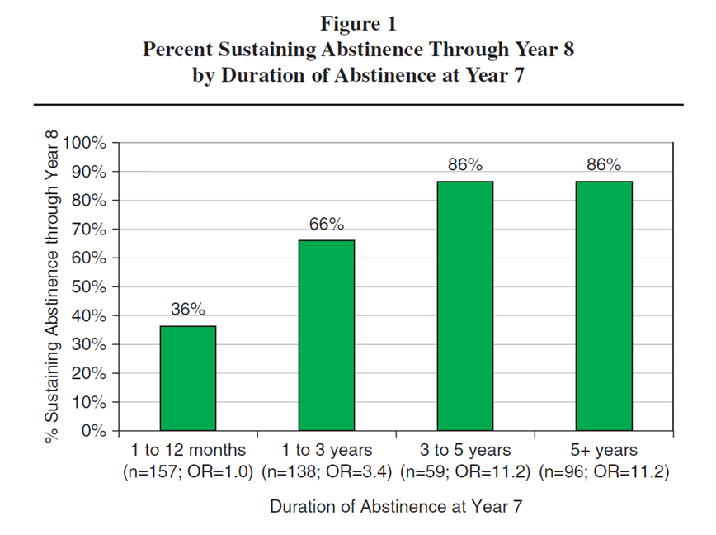
Retention, Remission, and Recovery Reduce Relapse Risk
Dennis M, et al. Eval Review, 2009

Slide 19
Modern Chronic Disease Model
Criticism:
Absolves the person of individual responsibility
Too self-defeating or too lenient
Response:
No cure!
Goal is life long management (“chronic disease management and recovery management”)
Disease severity may change over time but risk of symptom recurrence is always present
Effective treatment often combines medications, counseling services, peer and recovery supports
Behavior change is a key part of management
Behavior change occurs in stages over time
Notes:
It is data like this on relapse risk that contribute to our understanding of addiction as a chronic disease
What does it mean to understand that addiction is a chronic disease

Slide 20
Stages of Behavior Change
Pre-contemplation
Contemplation
Preparation
Action
Maintenance
No intent to change the problem behavior because unaware it is a problem or unwilling to change due to past failed attempts.
Individuals sustain and strengthen changes they have made.
Considering behavior change. May be considering specific personal implications of the problem and what the consequences of change might entail.
Behavior change has clearly begun. Individuals need skills to implement specific behavior change methods.
Ready to change both attitude and behavior. Intend to change soon and have incorporated experiences of previous tries at change.
Prochaska and DiClemente TransTheoretical Model of Behavior Change

Slide 21
Others Who Recognize Addiction as a Chronic Disease
Endorsed by
National Institutes on Health (NIDA, NIAAA)
World Health Organization (WHO)
Substance Abuse and Mental Health Services Administration (SAMHSA)
Surgeon General of the United States
American Society of Addiction Medicine
American College of Physicians
Treatment Research Institute
Facing Addiction with NCADD
Shatterproof
National Council for Behavioral Health

Slide 22
Back to the Future………
Boston Medical and Surgical Journal, October, 1916

Slide 23
What Changed?........Early 20th Century
1914 Harrison Narcotics Tax Act
Regulated manufacture and distribution of prescription opioids
Licensing of pharmacists and physicians
Permitted dispensing opioids “to a patient in the course of [the physician’s] professional practice only”
1919-1920 Supreme Court Cases
Criminalized prescribing/dispensing of opioids for individuals with opioid use disorders
1919 – 1935
25,000 physicians indicted for Harrison Act violations
All morphine maintenance clinics closed
Medical treatment for opioid use disorders disappears

Slide 24
1920 to 1970: Addiction as Moral Failing
Addiction no longer domain of medicine/public health – rather criminal justice
Addiction as moral failing or lack of willpower: “heroin addicts spring from sin and crime”
Vacuum:
Growth of mutual aid societies (AA)
Narcotic “farms”: electroshock treatment, psycho-surgery, aversion therapy, forced sterilization
Medication only to be used for detox

Slide 25
1970 To Present…….Return to Science
1974: Narcotic Addict Treatment Act
Recognized use of opioid agonist to treat opioid use disorder – defined “maintenance” treatment
Established NIDA
Separate DEA classification for physicians who dispense opioids for addiction treatment
2000: Drug Addiction Treatment Act (DATA 2000)
2002: Buprenorphine first medication approved by FDA under DATA 2000
2006 and 2010: FDA approval of injectable naltrexone for alcohol use disorder and then opioid use disorder relapse prevention

Slide 26
Addiction Causation Theories
Moral failing or
insufficient willpower
Reward deficiency syndrome
Deficiency of inhibitory control
Conditioned learning and habituation/neuroadaptation
Self-medication of unrecognized underlying psychiatric disorder
Disorder of bonding and connectedness
“Disease of despair”
VS

Slide 27
Addiction Definition
A complex, chronic disease of brain reward, motivation, memory and related circuitry.*
A chronic, relapsing disease characterized by compulsive drug seeking and use despite harmful consequences as well as neurochemical and molecular changes in the brain.**
A brain disease whose symptoms are overwhelming cravings and resultant behaviours.
*American Society of Addiction Medicine
**National Institute on Drug Abuse (NIDA)

Slide 28
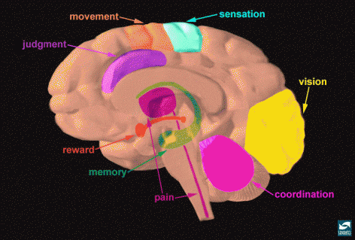
The Human Brain
Source: NIDA. www.drugabuse.gov

Slide 29
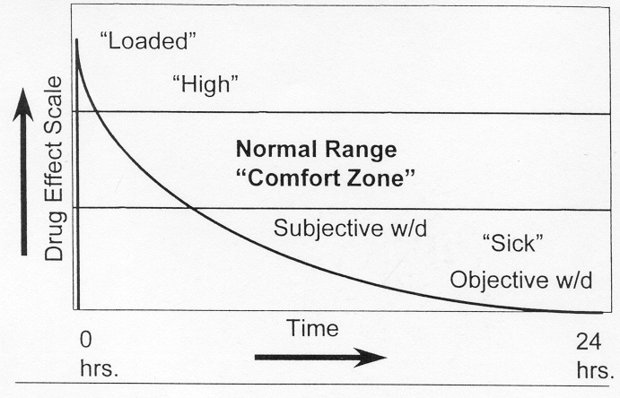
Heroin Dose-Response

Slide 30
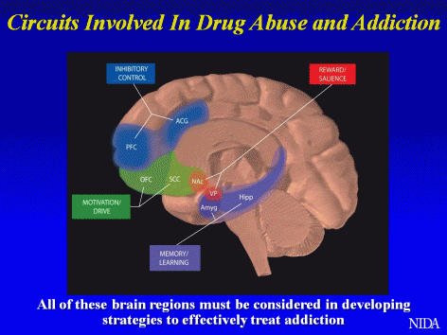
Connect and Disconnect

Slide 31
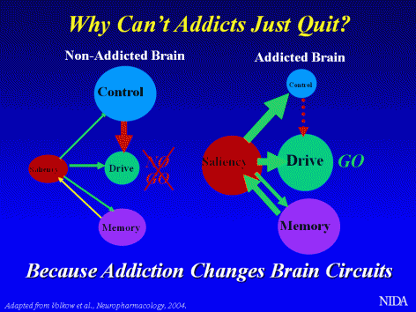
Brain Imbalance

Slide 32
Disorder of Hedonic Tone
Usual sense of well being, happiness, pleasure, contentment
Set by deep internal circuits in the brain
Range: Euphoria ← → Dysphoria
Altered in those vulnerable to SUDs
Further altered by addiction
Human Condition

Slide 33
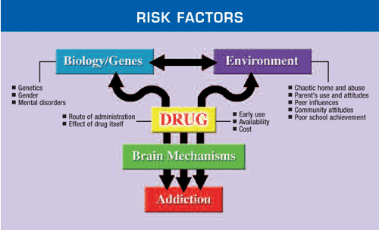
Why Do Some People Develop Addiction While Others Don’t?

Slide 34

Why Do Some People Develop Addiction While Others Don’t?
40-60% of addiction is genetically based
Genetic differences that alter physiology
Genetic differences that alter response to medications or substances
Trauma
using at young age
adverse childhood experiences likelihood of: having had drug problem
had addiction
injected drugs
Notes:
Dube et al. Pediatrics, 2003
Adverse Childhood Experiences Study: Over 8,000 adult men and women (mean age 57 and 55, respectively)
Assessed history until age 18 of abuse/neglect, level of household dysfunction, health-related behaviors, and illicit drug use using standardized questionnaires
Each participant assigned an ACE score based on number of experiences (analyzed as 0-5+)
67% had at least ACE; 42% had 2 or more

Slide 35
Other Risk Factors
Having another mental health condition increases risk by 3-6 fold
Initiation of use at younger age (<14 yo)
Teens with high levels of perceived neighborhood disorganization had 2.6 times odds of diagnostic SUD (Winstanley et al. Drug Alcohol Depend 2008)
Drug characteristics
Short acting
Potent
Injected, smoked, or snorted
Notes:
National Survey on Drug Use and Health (NSDUH) secondary data analysis of adolescent perceptions (N=38,000 youth ages 12-17))
Neighborhood disorganization
Social capital
Outcomes: adolescent substance use and diagnostic SUD
Teens with high levels of perceived neighborhood disorganization had 2.6 times odds of diagnostic SUD
Medium and high levels of social capital associated with lower odds of diagnostic SUD (OR 0.77 (95% CI 0.71-0.83), .06 (95% CI 0.54-0.67)

Slide 36
Substance Use Disorder Diagnostic Criteria, DSM-5
More use than intended | Excessive time spent in acquisition
Unsuccessful efforts to cut down | Craving for the substance
Activities given up because of use | Continued use despite consistent social or interpersonal problems
Failure to fulfill major role obligations | Tolerance*
Use despite negative effects | Withdrawal*
Recurrent use in hazardous situations
Severity measured by number of symptoms; 2-3 mild, 4-6 moderate, 7-11 severe
* These do not apply if the medication is prescribed and no other diagnostic criteria are met
Notes:
36

Slide 37
Physical Dependence Vs. Addiction
“Physical dependence is neither sufficient nor necessary to diagnose addiction.” (Dr. Howard Heit)
Physical dependence is a neuropharmacological phenomenon while addiction is both a neuropharmacological AND behavioral phenomenon.
Physical dependence occurs with many different categories of medications and substances.
Heit HA. Addiction, Physical Dependence, and Tolerance: Precise Definitions to Help
Clinicians, Evaluate, and Treat the Patient with Chronic Pain. J Pain and Palliative Care
Pharmacotherapy. March/April 2003;26:655-667

Slide 38
Why Distinguish Between Physical Dependence and Addiction?
People mistakenly believe that treatment of opioid use disorder with methadone and buprenorphine is just trading one addiction for another. THIS IS FALSE
Methadone and buprenorphine are ordered/prescribed and managed just like medications for other diseases.
Does Not Equal
Physical Dependence
Addiction

Slide 39
Medications for Opioid Use Disorder
Full agonist
methadone
mu receptor site
Partial agonist
buprenorphine
mu receptor site
Antagonist
naltrexone
mu receptor site
Notes:
The analgesic response of an opioid is a function both of the strength by which it binds to a receptor (binding affinity) and its ability to trigger a response when bound (intrinsic effect).^{1,2}
Morphine, a full mu-receptor agonist, has a high affinity for the mu opioid receptor, at which it has a high intrinsic effect. There is no apparent ceiling to the effects of full agonists, which increase the effects with dose.^{1,2} The ceiling to analgesic effectiveness is limited only by side effects.
The partial agonist buprenorphine also has a high affinity for the mu receptor, but has a lower intrinsic efficacy. In humans, buprenorphine produces typical mu-opioid agonist effects, but as a partial agonist, does not fully activate the mu opioid receptor site.² As a result, a ceiling has been reported to the physiologic (including respiratory depression), subjective, and behavioral effects of buprenorphine.³
Antagonists, for example naloxone, bind selectively to opioid receptors, but have no pharmacologic effect. They do, however, block agonist activity at the receptor.¹
1. Cherny NI. Opioid Analgesics. Comparative Features and Prescribing Guidelines. Drugs. 1996;51:714-37.
2. Zuurmond WW, Meert TF, Noorduin H. Partial versus full agonists for opioid- mediated analgesia—focus on fentanyl and buprenorphine. Acta Anaesth Belg. 2002;53:193-201.
3. Walsh SL, Preston KL, Stitzer ML, et al. Clinical pharmacology of buprenorphine: ceiling effects at high doses. Clin Pharmacol Ther. 1994;55:569-80.

Slide 40
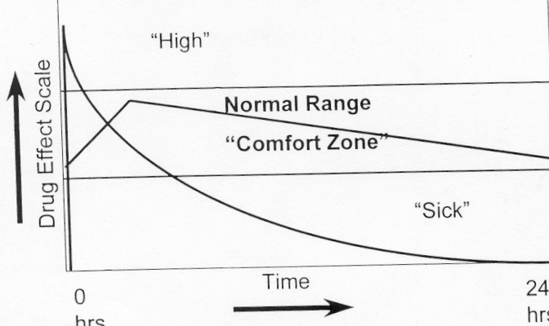
Methadone/Buprenorphine Dose-Response

Slide 41
Summary of Evidence for Medication Effectiveness
Decrease in use of illicit opioids (methadone, buprenorphine, XR-NTX)
Improvement in health conditions (methadone, buprenorphine)
Decrease in HIV rates and transmission (methadone, buprenorphine)
Decrease in needle sharing (methadone)
Decrease in criminal activity (methadone)
Increased retention in treatment (methadone, buprenorphine, XR-NTX)
Increase in employment (methadone, buprenorphine)
Increase in social stability (family, living situation) (methadone, buprenorphine)
Reduction in overdose deaths (methadone, buprenorphine, XR-NTX?)
Notes:
The three pharmacotherapies have all shown clear clinical evidence of effectiveness in reducing opioid use and opioid use-related symptoms of withdrawal and craving as well as risk of infectious diseases and crime – when used as part of a comprehensive treatment approach and in appropriate doses. The effectiveness of these medications is true only when used in continuing care, maintenance regimens; there remains almost no evidence of enduring benefits from any of these medications when used only in detoxification regimens.

Slide 42
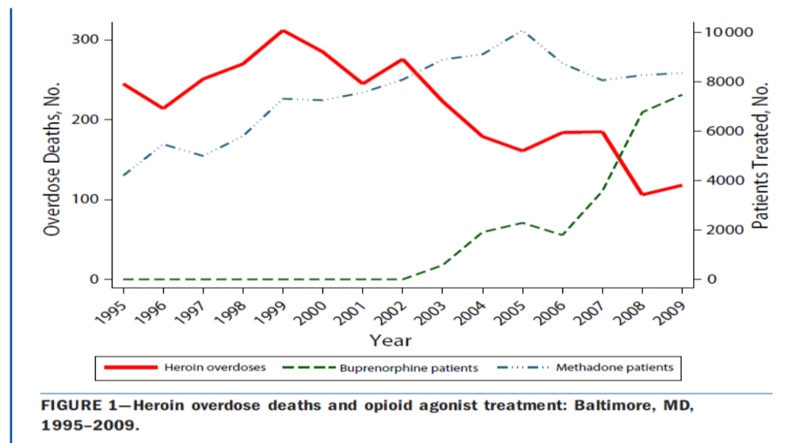
Medication Saves Lives!
Schwartz, et al. AJPH, 2013

Slide 43
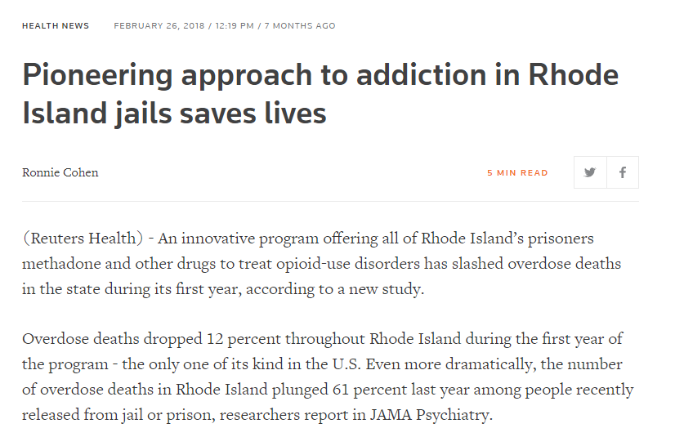

Medication Received (average, SD) | First 6 mo 2016 (N=4822 incarcerations and 4005 releases) | First 6 mo 2017 (N=4512 incarcerations and 3426 releases)
Buprenorphine | 4 (3) | 119 (15)
Methadone | 74 (16) | 180 (25)
Naltrexone | 2 (1) | 4 (1)
Green T, et al. JAMA Psych 2018

Slide 44
Why don’t we just detox everyone?
Gronbladh et al, Acta Psych, 1990
34 VD vs 53 NVD vs 115 controls

Slide 45

How Does All This Fit Together?
Faith Organizations
Transportation
Legal
Judges
Lawyers
Parole/Probation
Recovery System
Internet
DSS/DJS
Community Support
Self-Help Groups
Social/Recreation
Building Life Skills
Housing/Supportive and Independent Living
Treatment System
Vocational
Educational
Medical
Dental
Mental Health
Family Therapy
Senior/Child
Day Care
Employment

Slide 46
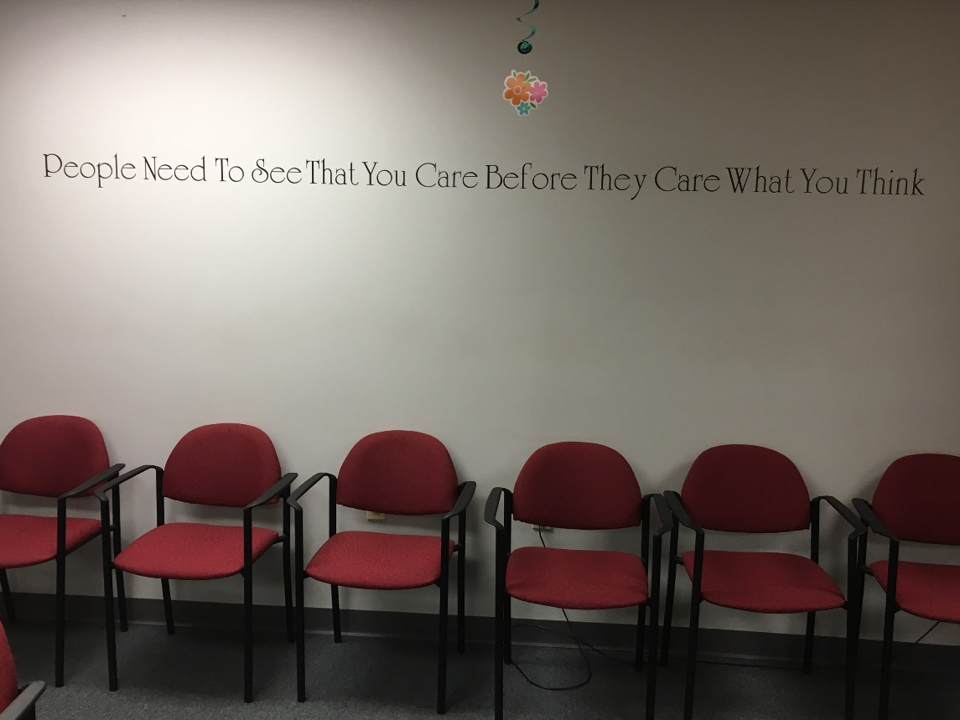

FINAL THOUGHTS…….
People need to see that you care before they care what you think
It Takes a Village

Slide 47
Questions?
Contact information:
Yngvild Olsen: yngvild.olsen1@maryland.gov

