Slide 1
The Impact of Racial Trauma on Providers: Behavioral Health Presentation
Stephanie Slowly, MSW, LCSW-C
December 17, 2020

Slide 2
Today’s Objective
Impact of Racial Trauma
Images have meaning
What is the overall impact of Trauma?
What is Secondary Trauma?
Review the Harmful Impact of Trauma
What can we do if you are experiencing trauma
Doing our part-Call to action
Next Steps and Take away

Slide 3
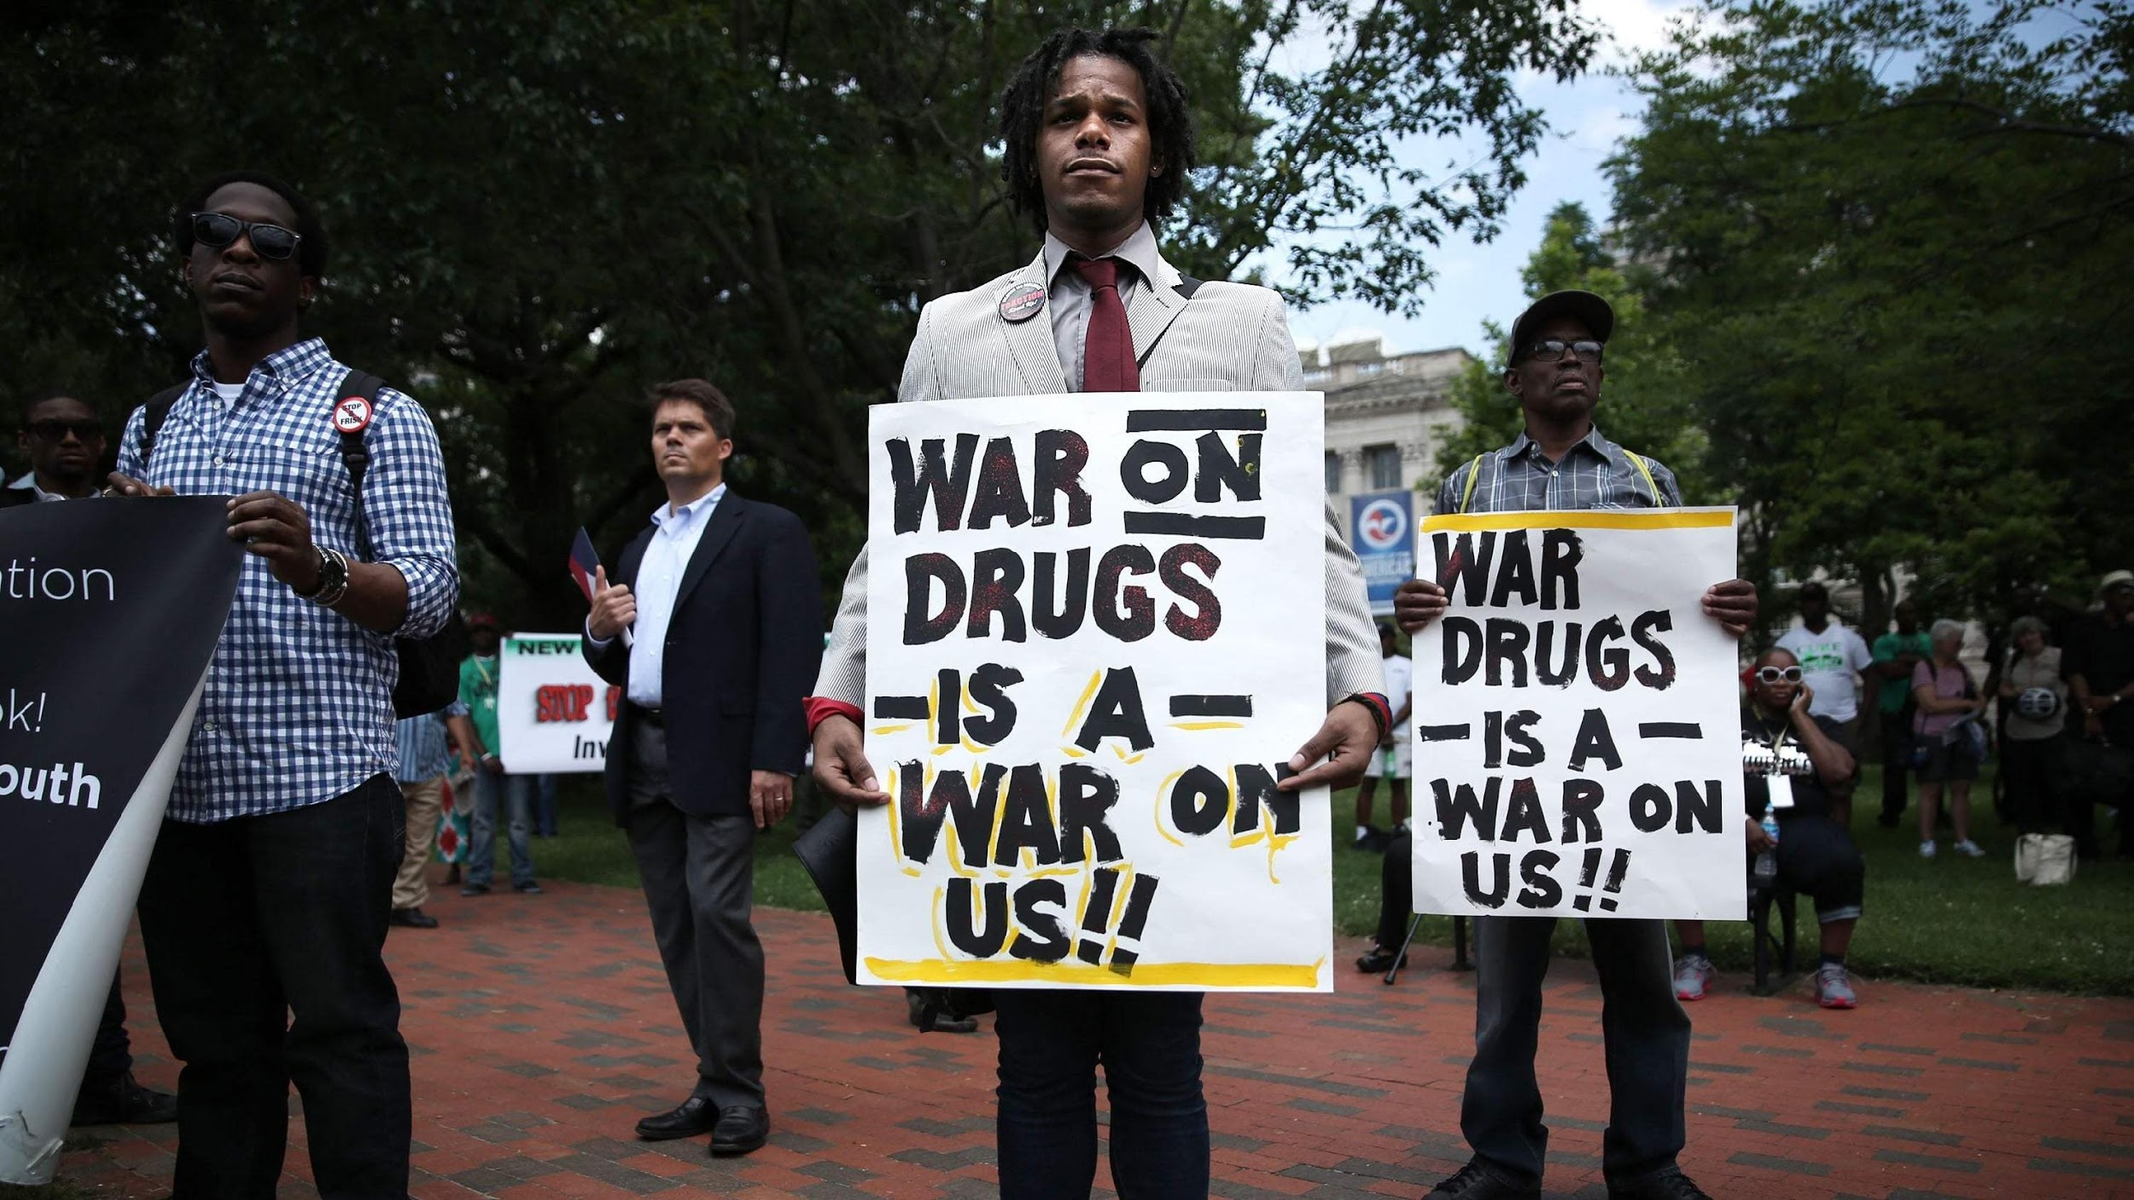
Images Have Meaning
Impact of Racial Trauma
Notes:
Historical images have may compelled you to this profession.

Slide 4
Images Have Meaning
Impact of Racial Trauma
Ms. Breonna Taylor
March 13, 2020
Mr. George Floyd
May 25, 2020
Notes:
In this era of having witnessed multiple police killings of African American boys and men and girls and women either directly or vicariously through media accounts, communities of Color may experience post trauma symptoms. According to Boston College Website

Slide 5
Images Have Meaning
Notes:
We also have the grappling impact of COVID has its impact on trauma

Slide 6
Overview of Trauma: Key Terms
Impact of Racial Trauma
Implicit (Unconscious) Bias – attitudes towards people or associate stereotypes with them without our conscious knowledge.
Race – a social construct that refers to belonging to a group of people who shared a common ancestry from a particular region of the globe. Common ancestry is accompanied by superficial secondary physical characteristics such as skin color, facial features, and hair texture.
Racism – prejudicial treatment based on racial or ethnic group and the societal institutions or structures that perpetuate this unfair treatment. Racism can be expressed on interpersonal, structural/institutional, or internalized levels.
Trauma – an emotional response to a terrible/horrific event (e.g., an accident, rape, natural disaster or global pandemic) (APA, 2020)
Racial Trauma – an emotional response to a terrible event like an accident, rape or natural disaster. Immediately after the event, shock and denial are typical. Longer term reactions include unpredictable emotions, flashbacks, strained relationships and even physical symptoms like headaches or nausea. (MHA, 2020)

Slide 7
Overview of Trauma: Characteristics
Impact of Racial Trauma
The pandemic has exposed many problems with our health care system, one of them being the often overlooked racial trauma that affects health care workers.
During pandemic:
Asian American health care workers have endured serious trauma of racial discrimination
Patients refusing to be seen by Asian American providers
Asian American providers accused of causing the pandemic
Have even been physically assaulted
Health care workers are no exception to racial biases the effects and damage of racial trauma can be long-lasting.

Slide 8
Overview of Trauma: Characteristics
Impact of Racial Trauma
Racism-related experiences can range from frequent ambiguous “macroaggressions” to blatant hate crimes and physical assault. Racial microaggressions are subtle, yet pervasive acts of racism.
Amongst people of color, African Americans discrimination experience is more pervasive to that of non-Hispanic whites' experience (11% for whites versus 81% for people of color; Cokley, Hall-Clark, & Hicks, 2011).
The long-term negative effects of racial trauma can impact physical health and can be exacerbated by lack of access to adequate medical services for people of color, which can be a result of systematic racism.
Notes:
Providers are not exempt from these feelings and should also note they are

Slide 9
Overview of Trauma: Characteristics
Impact of Racial Trauma
Individuals who experience Racial Trauma have mirrored systems of Post-Traumatic Stress Disorder (PTSD)
Re-experiencing:
Recurrent re-experiencing of trauma (e.g., flashbacks, nightmares, intrusive thoughts)
Avoidance:
Persistent avoidance of stimuli associated with the trauma (e.g., thoughts, activities, people, and feelings of being detached/estranged)
Arousal:
Persistent systems of increased arousal related to the trauma (e.g., difficulty falling asleep, frequent irritability, impaired concentration and hypervigilance)
Notes:
According to the American Addictions Centers: Healthcare professional are 10-15% More Likely to develop substance abuse than general population.
https://americanaddictioncenters.org/rehab-guide/addiction-statistics/medical-professionals
Trauma symptoms typically last from a few days to a few months. Trauma is tough on the mind. You may not feel like your normal self for a while. In many cases, symptoms will gradually fade as time passes and as you process what happened.
https://screening.mhanational.org/content/what-trauma

Slide 10
Overview of Trauma: Provider Risk
Impact of Racial Trauma
Trauma care professionals are at high risk of burnout, PTSD and other mental health conditions
Provider stress is a serious issue. How can providers learn how to take better care of themselves?
Trauma providers experience "normalized stress" — becoming so accustomed to being stressed that it becomes the norm
Providers experience lots of stressors: life-threatening situations, critically ill patients, high mortality rates, administrative demands, personal life
They need to be equipped with strategies to deal with these stressors
Compassion fatigue: focused so much on needs of others that you neglect your own needs
Feeling emotionally exhausted, depressed or anxious is common
May experience depersonalization, feeling of becoming disconnected
Often providers' responses to this is "I get it, but I don't have time"
Providers feel that they do not have time to take care of themselves
Providers often reluctant to acknowledge feelings of depression, compassion fatigue or burnout because they feel they are "not living up to expectations"
Notes:
According to the American Addictions Centers: Healthcare professional are 10-15% More Likely to develop substance abuse than general population.
https://americanaddictioncenters.org/rehab-guide/addiction-statistics/medical-professionals
Trauma symptoms typically last from a few days to a few months. Trauma is tough on the mind. You may not feel like your normal self for a while. In many cases, symptoms will gradually fade as time passes and as you process what happened.
https://screening.mhanational.org/content/what-trauma

Slide 11
Overview of Trauma: Characteristics
Impact of Racial Trauma
Common Emotional Responses:
Fear, anxiety
Shock, disbelief
Anger
Shame
Sadness, hopelessness
Feeling disconnected, numb
Common Physical Responses:
Trouble sleeping, nightmares
Fatigue, exhaustion
Dizziness
Racing heart, fast breathing
Body aches, muscle tension
Increased substance use
Notes:
According to the American Addictions Centers: Healthcare professional are 10-15% More Likely to develop substance abuse than general population.
https://americanaddictioncenters.org/rehab-guide/addiction-statistics/medical-professionals
Trauma symptoms typically last from a few days to a few months. Trauma is tough on the mind. You may not feel like your normal self for a while. In many cases, symptoms will gradually fade as time passes and as you process what happened.
https://screening.mhanational.org/content/what-trauma

Slide 12
What is Secondary Trauma?
Impact of Racial Trauma
Providing services for traumatized individuals increases the potential for secondary traumatic stress
Clinicians/providers who have their own histories of trauma, may be at risk for experiencing reactions
Vicarious traumatization a term that describes secondary traumatic stress (in the helper/provider)
Secondary Trauma can be precipitated by exposure of client/colleague trauma, media and other images
Secondary Trauma can also disrupt a provider’s life, feelings, personal relationships and overview
Notes:
Providers are not exempt from these feelings and should also note they are

Slide 13
The Harmful Impact
Impact of Racial Trauma
The impact trauma can have on mental health:
Create a hostile and invalidating work or campus climate
Perpetuate stereotype threat
Create physical health problems
Saturate the broader society with cues that signal devaluation of social group identities
Lower work productivity and problem-solving abilities, and be partially responsible for creating inequities in education, employment and health care.

Slide 14
Experiencing Trauma: What can you do?
Impact of Racial Trauma
Organizational Strategies
Encourage Resilience
Team Grounding
Communication
Peer Support
Mindfulness Practice
Individual Strategies:
Self Reflection
Focus here & now
Enhance Self-Compassion
Grounding
Social connection
Separate Work from Home
Maintain a Routine
Listen to your body
Notes:
Organization leaders should understand the needs of their workforce (identify members that may be more vulnerable to mental health difficulties)
They should encourage resilience and wellbeing plans for staff
Team leaders should write plans to describe triggers for stress and how one copes and how they or team members can help
Team grounding: organization leaders should note the emotional and cognitive information being shared in a group and structure an agenda for discussion
Ensure that managers are also considerate of their own individual needs (they are not immune to workplace stressors) - should share stories with other managers and team leaders
Long-term planning to respond effectively to worst case scenarios
Communication is essential (team leaders should be a role model)
Engage workforce in peer support and buddying practices
Mindfulness practices within the workplace can be beneficial
Organization leaders should understand the needs of their workforce (identify members that may be more vulnerable to mental health difficulties)
They should encourage resilience and wellbeing plans for staff
Team leaders should write plans to describe triggers for stress and how one copes and how they or team members can help
Team grounding: organization leaders should note the emotional and cognitive information being shared in a group and structure an agenda for discussion
Ensure that managers are also considerate of their own individual needs (they are not immune to workplace stressors) - should share stories with other managers and team leaders
Long-term planning to respond effectively to worst case scenarios
Communication is essential (team leaders should be a role model)
Engage workforce in peer support and buddying practices
Mindfulness practices within the workplace can be beneficial
Individual level strategies
Self-reflection: identifying personal needs and strengths and sharing them with someone you can trust to plan and prepare (identify personal triggers for stress and personal coping strategies)
Making a self-care plan may be useful
Focus on here and now - one task at a time (do not focus on fears of future threats)
Enhance self compassion (speak to yourself as you would speak to a friend)
Practice mindfulness (manage stress and emotion)
You can use apps to help with this (i.e. Headspace or Calm) - youtube also has narrative examples of mindfulness
Grounding: placing both feed into ground and stomping, clapping hands, or looking around the environment to name and describe three objects you can see or three sounds (use your senses to assist in grounding)
Social connection: connect with friends, family, peers
Separate home and work - do not bring work home with you
Adopt healthy living strategies and maintain a routine
Listen to yourself and your body - notice any changes in sleep patterns, mood changes - and if you notice these things, don't ignore the

Slide 15
Experiencing Trauma: What can you do?
Impact of Racial Trauma

Slide 16
What is the impact on mental health? Life Expectancy – 79 years vs. 70 years
Impact of Racial Trauma

Slide 17
Doing Our Part: Call to Action
Impact of Racial Trauma
Learn the language of racial equity and inform yourself about the struggle. There are many resources out their highlighting ways to fight racism.
Actively engage in discussions with community members, influencers, and decision makers at all levels and of all backgrounds.
Don’t perpetuate stereotypes. Before you re-tweet, re-post, or repeat what you see or hear, think to yourself: “am I contributing to the problem?”
Be an ally. Challenge yourself and your friends to stand against racism in your circles as boldly as you would any other form of discrimination.

Slide 18
Doing Our Part: Call to Action
Impact of Racial Trauma
Talk to your children and family about race. Diversity and multiculturalism mean more than eating ethnic foods and having friends of color.
Recognize the additional challenges faced in minority communities. Everyone has stressors in life. Minorities often deal with the significant added stressor of discrimination. Turning a blind eye to this perpetuates the cycle, vs. supporting a solution.
Help those who need help, get help. If someone is experiencing trauma or a mental health issue, encourage them to seek professional help.

Slide 19
Takeaways and Next Steps
Impact of Racial Trauma

Slide 20
Some Resources for you
Impact of Racial Trauma
KIRWAN INSTITUTE
Guideline to responding to mental health trauma for healthcare workers
The link between Racism and PTSD
Organizational response to bias
Normalized stress and compassion fatigue
Racial trauma on health-care workers

Slide 21
CME Accreditation and Designation
CMEs will be available at no cost, as will Participant Certificates, which for other disciplines can
qualify for continuing education credit.
This activity has been planned and implemented in accordance with the Essential Areas and
policies of the Accreditation Council for Continuing Medical Education (ACCME) through the
joint providership of MedChi, The Maryland State Medical Society and the Behavioral Health
Administration of the Maryland Department of Health. MedChi is accredited by the ACCME to
provide continuing medical education for physicians. CMEs will be available at no cost, as will
Participant Certificates, which for other disciplines can qualify for continuing education credit.
MedChi designates this webinar educational activity for a maximum of 1 AMA PRA Category 1
Credits™. Physicians should claim only the credit commensurate with the extent of their
participation in the activity, as should other disciplines who claim credit for Participant
Certificates. For CME/Participant Certificate questions please contact Steve Whitefield at
steven.whitefield@maryland.gov.

Slide 22
CME Disclosures
Presenters and Planners: Aliya Jones, MD and Steve Whitefield, MD have reported no relevant financial relationships to disclose. Stephanie Slowly, MSW, LCSW-C and Shanta Powell, MD have reported no relevant financial relationships to disclose.
MedChi CME Reviewers: The reviewers from the MedChi Committee On Scientific Activities (COSA) for this activity have reported no relevant financial relationships to disclose.

Slide 24
Questions??

Slide 25
THANK YOU
Stephanie Slowly, MSW LCSW-C
Director, Systems Management
Behavioral Health Administration
Stephanie.slowly1@maryland.gov

