Slide 1
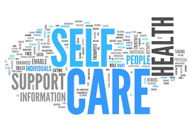
Supporting Success & Sustainability
for Peer Recovery Specialists
5th Annual Maryland Peer Summit, May, 15th, 2019
Presented by Beth D. Terrence, BA, CPRS, CRNC

Slide 2

Settling In Meditation
Intention Setting

Slide 3
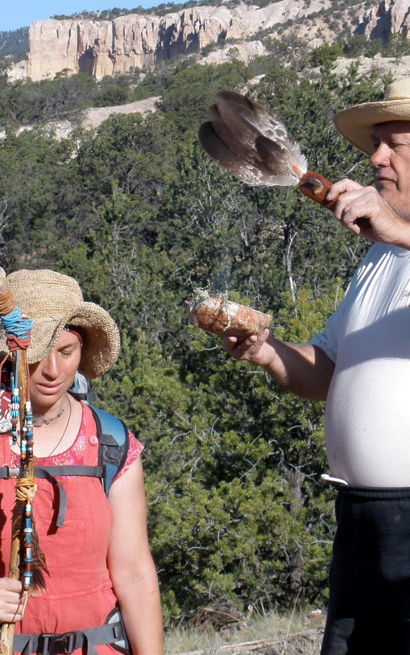
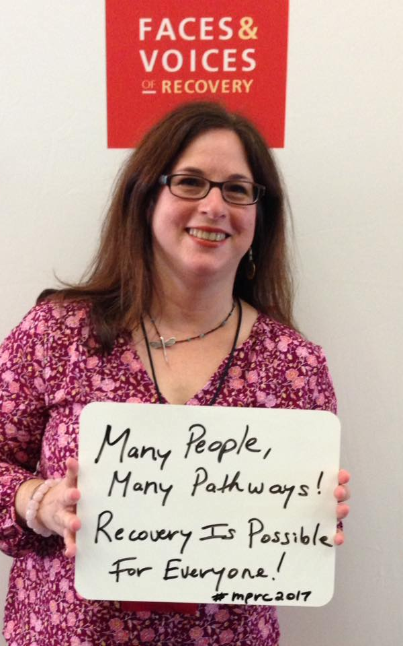

Introducing Your Presenter Beth Terrence
Person In Long-Term Recovery
MH 28 yrs., SU 13 yrs.
Family Member, Ally & Advocate - always
Holistic Health Practitioner – 25 yrs.
Trained Shaman – 11 yrs.
Recovery Coach & Trainer – 5 yrs.
Facilitator & Program Developer – 22 yrs.
Inspirational Speaker – 15 yrs.
Writer – 20 yrs.
Notes:
Shaman picture, cherry blossoms, this is my brave – change focus???

Slide 4
Learning Objectives
In this workshop, we will explore…
What self-care is and why it is an essential practice for peer recovery specialists
Challenges to self-care related to serving in peer recovery roles
The Stress Response and how we experience stressors
Self-care practices and tools that can be used as part of our personal self-care plans as well as in our work with peers in our communities
Red flags and warning signs that self-care is at risk
Notes:
Abbreviate bullets

Slide 5
What Is Self-Care?
Self-care is:
Taking an active and pro-active role in one’s own overall health and wellness
A framework for managing stress, life challenges, professional burnout and compassion fatigue
An empowerment process that creates balance and equilibrium across our personal, social and work lives
Any activity that we do deliberately in order to take care of our physical, mental, emotional and spiritual health and well-being

Slide 6
Self-care creates a foundation for sustaining long-term recovery and overall wellness.
Lack of self-care in a helping profession can contribute to burnout or compassion fatigue.
Depletion, whether physically, mentally, emotionally or spiritually, can lead to reactivity; and we may even experience challenges to our perceptions and judgments.
Lack of self-care combined with work and life stressors may put personal recovery and wellness at risk, as well as our jobs, and our relationships.
A primary role of a recovery coach is to be a role model– As we practice good self-care, we model long-term recovery for the individuals, groups and communities we serve.
Self-Care:
An Essential Practice for Peers

Slide 7
Self-Care & Recovery Coaching
Self-Care is important to key areas of recovery coaching including:
Recovery & Wellness
Mentorship & Education
Advocacy
Ethics

Slide 8
Self-Care supports a recovery coach in:
Bringing a strengths-based and person-centered approach
Walking Your Talk – modeling recovery & wellness
Setting and maintaining appropriate boundaries
Exploring and sharing your experiences with specific wellness tools and multiple pathways of recovery
Cultivating positivity in your life and work relationships
Recognizing and addressing conflicts
Supporting recoverees in exploring their own wellness and self-care plans

Slide 9
Challenges for Peer Recovery Coaches
Challenges to self-care can often arise when serving in the role of peer recovery coach. This may impact our:
ability to serve our recoverees
professional relationships with our peers and other staff
personal relationships with family and friends
relationship with our self
personal recovery and wellness

Slide 10

Patterns Affecting Self-Care
Challenges to self-care often relate to patterns that may become amplified or out of balance due the stressors and intensity of experience while working in a peer role or as a result of other life experiences. Patterns to be aware of may include:
Workaholism
Stress
Burnout
Boundaries
People Pleasing
Perfectionism
Life Changes & Transitions
Compassion Fatigue

Slide 11
At Risk for Compassion Fatigue
"Compassion Fatigue is a state experienced by those helping people or animals in distress; it is an extreme state of tension and preoccupation with the suffering of those being helped to the degree that it can create a secondary traumatic stress for the helper.“
– Dr. Charles Figley
Risk factors may include:
Hesitant to set boundaries
Over-achievers
Stressful home life or life situation
Minimal self-care

Slide 12



Role Stressors
Role Stressors are conditions in the work environment that decrease one’s ability to do their job; and may threaten one’s safety, wellness and comfort. There are a number of specific role stressors that Peer Recovery Coaches may experience.

Slide 13
Role Stressors
Role Ambiguity is the experience of inadequate knowledge about one’s role responsibilities, task priorities, and line of accountability. (What is my job? What tasks are most important? Who do I report to?)
Inadequate Role Feedback or Supervision is the lack of information on the adequacy of role performance and methods of improving performance.
Role Overload is caused by excessive and unrealistic expectations regarding the quantity and quality of work to be completed within a particular time-frame.

Slide 14
Role Stressors
Role Safety Problems create apprehension about one's physical and psychological safety during the performance of one’s job.
Role Security Problems are associated with the experience of uncertainty about one’s future role in the agency.
Role Connectedness Problems stem from a worker’s isolation from, or over-connectedness to, other members of the organization.

Slide 15
The Stress Response
Stress is our systems way of responding to any kind of demand.
Caused by both positive and negative experiences.
Our body reacts by releasing chemicals into the blood to give us more energy and strength to cope.
Can be debilitating when there is no outlet for this extra energy or when we find ourselves in a chronic stress response.
Triggered by a physical danger; however response occurs from any type of stress.

Slide 16
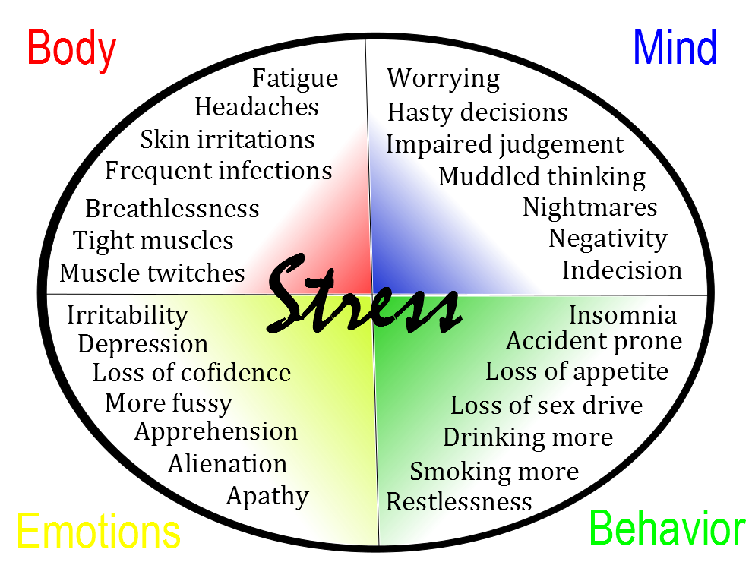
Stress Effects

Slide 17

Red Flags & Warning Signs
Loss of pleasure or enjoyment at work; and/or in our personal life
Depression
Concentration problems
Anxiety
Increased mistakes or errors
Loss of objectivity
Isolation
Emotional reactivity
Relationship issues
Insomnia or disturbed sleep
Fatigue
What are your personal warning signs?

Slide 18

Benefits of Self-Care
Stress Happens! Self-Care is one of the most important prevention tools that we have! Benefits of practicing Self-Care include:
Being at your best at work, in your relationships, in life!
Maximizing your potential
Improving your quality of life
Enhancing physical, mental, emotional and spiritual wellbeing
Building resources to deal with the life and work stressors
Sustaining long-term recovery and wellness

Slide 19
5 Essential Self-Care Strategies
Sleep
Exercise
Eating Well
Relaxation
Connection

Slide 20

SLEEP
Getting good sleep is essential for being healthy in body, mind, emotions and spirit. On average, people need 7 - 8 hours of sleep a night to feel refreshed and energized. Sleep disturbances can affect quality of life and work performance. Ways to improve sleep can include:
Creating a regular sleep schedule; cultivating sleep rituals e.g. drinking tea, journaling
Limiting caffeine and sugar, especially at night
Utilizing relaxation practices including breathing or listening to music to encourage sleep
Minimizing light or noise in your bedroom
Getting proper nutrition through food and supplements
Limiting activities prior to sleep, especially cell phones, social media, etc.
Practice: Breath Awareness

Slide 21

EXERCISE
Getting adequate exercise is essential overall health and wellness. Physical activity for 20-30 minutes each day helps in reducing your body’s physical reaction to stress by relaxing tension. It also helps in releasing negative thoughts, reducing anxiety and boosting your self-esteem. Practices that support getting regular exercise include:
Going to a gym or taking fitness classes
Taking up yoga or tai chi
Walking or hiking
Taking a dance class
Biking or swimming
Weight or strength training
Martial arts
Gardening
Practice: Yoga/Stretching

Slide 22

EATING WELL
Eating Well is essential for creating a healthy and well-balanced life. We cannot function without sustenance; and to function optimally good nutrition is needed. Nourishing body, mind, emotions and spirit with is a key to long-term recovery and wellness. Practices that support eating well:
A healthy eating plan that is right for you
Replacing fast-food with whole foods and grains
Becoming aware of food sensitivities e.g. gluten, dairy, soy, etc.
Eating lots of fruits and vegetables
Drinking plenty of water (suggested at least 8 glasses per day)
Not skipping meals or going longer than 3 - 4 hours without eating or snacking, especially if you tend to experience low blood sugar
Practice: Drinking Water

Slide 23

Relaxation
Relaxation supports us on all levels body, mind, emotions and spirit; it helps to integrate and absorb our life experiences. Relaxation replenishes mental resources and allows the body to recover. Making time to relax is essential for recovery and wellness. The are many ways to practice relaxation:
Spending time in nature - walking, hiking
Taking a hot bath or sauna
Breathing exercises
Meditation & Mindfulness
Yoga
Reading
Journaling
Creativity
Listening to music
Practice: Music

Slide 24
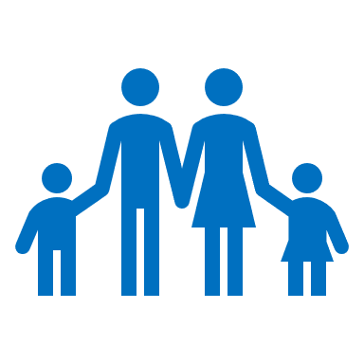
Connection
Connection is vital to our personal recovery and well-being as well as our ability to serve as peer recovery coaches. There are many practices that cultivate a sense of connection:
Spiritual practices such as prayer, meditation, or contemplation
Participating in community e.g. spiritual, recovery, family, work
Spending time with family and friends
Accessing peer support or mentorship
Connecting with self through meditation, journaling, and self-reflection
Spending time in nature
Quiet Time
Having fun!
Practice: Connecting with Nature

Slide 25
Recognize
Recognize there is a limit to what you can do or take on. By doing more, you risk your ability to serve your recoverees, your organization and most of all yourself!
Try
Try not to take your work home. Leave time for transition between work and home. Transition is the perfect time for a self-care ritual.
Explore and practice
Explore and practice stress management techniques, get regular exercise and do fun activities that take you completely away from your work and life stress.
Remind
Remind yourself that peer recovery coaches cannot fix other people’s problems. We can be of support and help, but making other’s pain go away is beyond our control. We can only do our best - and let go and trust the rest!
Share
Share perspectives. Get support from other peer recovery coaches. Spend time with people outside your profession so that your work life doesn’t inhabit your whole life.
Additional
Self-Care Tips

Slide 26
Recovery Rituals Include Self-Care
William White highlights four Rituals of Recovery that mark the essence of daily life in recovery; and are seen as sources of sustenance and stability for recovery coaches, counselors and professionals in the Recovery field. These rituals include:
Centering Rituals - acts of prayer, meditation and self-reflection that help keep one’s “eyes on the prize”.
Mirroring Rituals - reaching out to kindred spirits for support and inspiration.
Acts of Self-Care - taking care of oneself and one’s intimate circle physically, emotionally and spiritually.
Acts of Service - reaching out to others outside the context of our professional duties in ways that elevate our spirits.

Slide 27

Build Your Own
Self-Care Tool Box
What are 10 things that you can due in
5 minutes or less that can support you in
practicing self-care?

Slide 28
Sustainable Self Care Begins With You:
• Be kind to yourself.
• Enhance your awareness with education and experiences.
• Accept where you are on your path at all times.
• Exchange information and feelings with people who can validate you.
• Clarify your personal boundaries. What works for you; what doesn't.
• Express your needs verbally.
• Take positive action to change your environment.
Create a network of support.
Build your Self-Care Toolbox and use it every day!

Slide 29
Beth Terrence, BA, CPRS, CRNC is founder of Holistic Recovery Pathways. She is a Shaman, Recovery Coach, Holistic Health & Wellness Practitioner, Speaker and Writer. She is also a person in long-term recovery. Beth’s vision is to support individuals, families, communities and organizations in embracing holistic pathways that enhance life, well-being and the journey of long-term recovery.
Beth offers workshops, trainings, retreats and consulting services focused on recovery and wellness and transformational change.
Contact Info:
Beth Terrence
Holistic Recovery Pathways, LLC
Email: holisticrecoverypathways@gmail.com
Phone: 443-223-0848
Website: www.holisticrecoverypathways.com
Presenter Information

