Slide 1

Supporting Success & Sustainability
for Peer Recovery Specialists
4th Annual Peer Networking Conference, November 30, 2017
Presented by Beth D. Terrence, BA, CPRS, CRNC

Slide 2

Welcome
Welcome
Settling In Meditation
Intention Setting

Slide 3
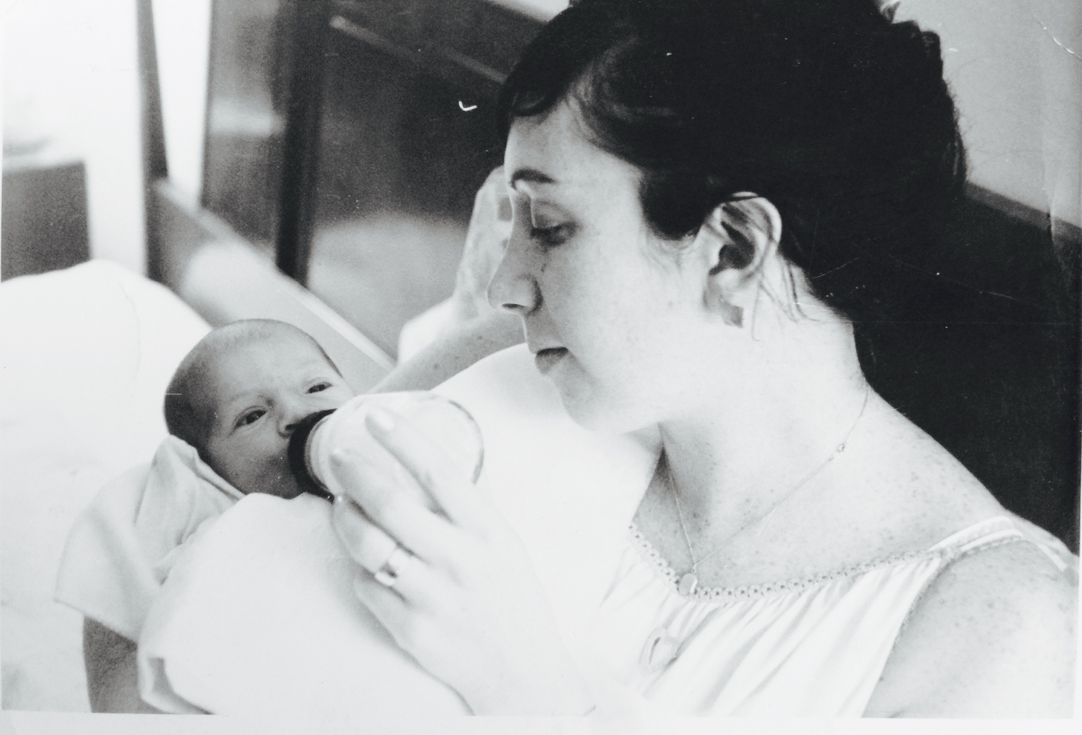
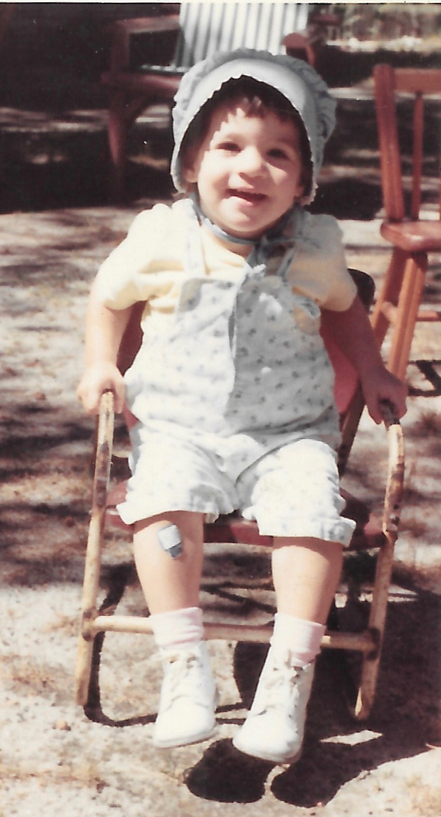
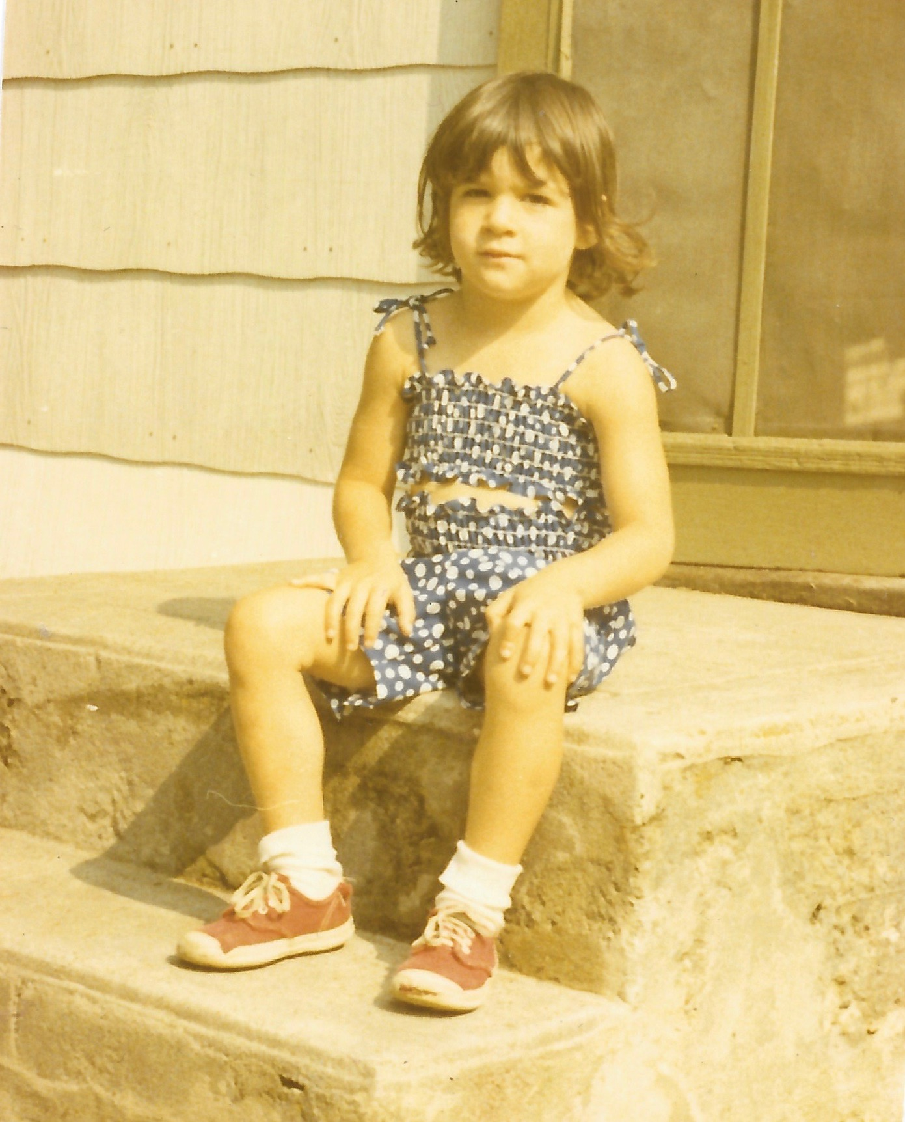
Introducing Your Presenter
Person In Long-Term Recovery
Family Member, Ally & Advocate
Holistic Health Practitioner
Trained Shaman
Recovery Coach & Trainer
Facilitator & Program Developer
Writer
Social Media Maven

Slide 4
Learning Objectives
In this workshop, we will explore…
What self-care is and why it is an essential practice for peer recovery specialists
Challenges to self-care related to serving in peer recovery roles
Red flags and warning signs that self-care is at risk
A holistic approach to wellness and recovery focused on supporting body, mind, emotion and spirit
Self-care practices and tools including mindfulness, meditation, journaling and rituals of recovery that can be used as part of our personal self-care plans as well as in our work with peers in our communities

Slide 5
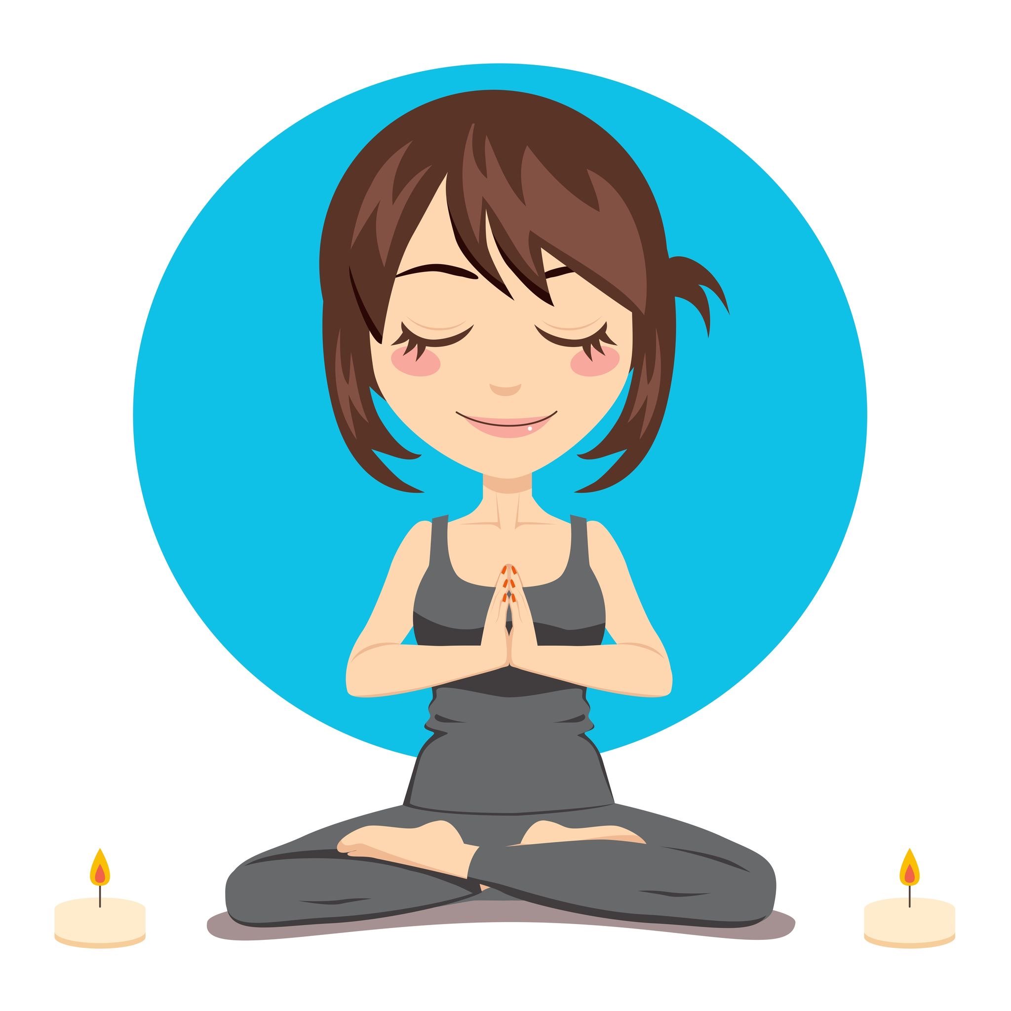
Practices We’ll Explore…
Setting Intentions
Meditation & Mindfulness
Diaphragmatic Breathing
Movement / Stretching
Journaling
Rituals of Recovery
Lovingkindness

Slide 6
What Is Self-Care?
Self-care refers to active participation in enhancing our physical, mental, emotional, and spiritual health and well-being.
Self-care includes practices and activities that we engage in on a regular basis that support our overall wellness and quality of life.
Self-care is a empowerment process that creates balance and equilibrium across our personal, social and work lives.
Self-care is a framework for managing stress, life challenges, professional burnout and compassion fatigue.

Slide 7
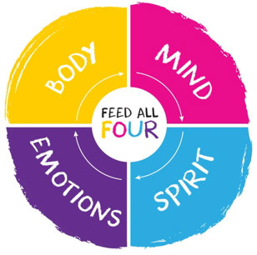
Holistic Self-Care
Today, we will take some time to explore Holistic Self-Care, which includes nurturing and supporting:
#FeedAllFour

Slide 8
What Is A Holistic Approach?
Supports the whole person – body, mind, emotion and spirit;
Offers a framework for optimal health, wellness, and personal growth by working to foster balance and integration within all parts of ourselves
Includes alternative modalities and natural healing methods in addition to conventional approaches.
Understands that each person as unique; and that self-care and wellness must be guided by the individual and their needs.

Slide 9
Self-Care: An Essential Practice
for Recovery Coaches
Self-Care is an essential practice for Peer Recovery Coaches…
A primary responsibility of a recovery coach is to model recovery for the peers we serve.
This requires a strong commitment to our own personal recovery and wellness.
As we practice good self-care, we model long-term recovery for the individuals, groups and communities we serve.
When we are depleted whether physically, mentally, emotionally or spiritually, we may become reactive or experience challenges to our perceptions and judgments.
When our self-care is comprised and stress is rising, we may increase our risk of recurrence and/or risk doing harm to those we serve.

Slide 10
Self-Care & Recovery Coaching
Self-Care is a essential part of Recovery Coaching. It an important component in all of the key areas or domains of peer support including:
Recovery & Wellness
Ethics
Mentorship
Advocacy
Some of the ways self-care relates to these areas include:
Walking Your Talk
Bringing a Positive, Strengths-Focused Perspective
Being open to and knowledgable about multiple pathways of recovery
Maintaining your own personal recovery and wellness; and involvement in recovery pathways
Modeling and sharing your recovery story including self-care approaches
Self-Improvement - Improving yourself, giving your best, showing up fully
Setting and maintaining appropriate boundaries; and recognizing conflicts
Supporting peers in advocating for their own wellness and recovery needs; and/or advocating for them

Slide 11
Challenges for Peer Recovery Coaches
There can be many challenges that arise when serving in the role of peer recovery coach. This can effect our professional relationships with peers and staff as well as our personal relationship with family and friends. Over time, our own recovery and wellness may become at risk.
Challenges often relate to patterns that we carry that are or may become out of balance as well as the stressors and intensity experienced while working in the field of Recovery.
Some areas of challenge to be aware of include:
Workaholism
Compassion Fatigue
Burnout & Stress
Boundaries
People Pleasing
Perfectionism

Slide 12
Role Stressors
Role Stressors are conditions in the work environment that decrease one’s ability to do his or her job, and may threaten one’s safety, wellness and comfort. Role stressors that Peer Recovery Coaches may experience:
Role Ambiguity is the experience of inadequate knowledge about one’s role responsibilities, task priorities, and line of accountability. (What is my job? What tasks are most important? Who do I report to?)
Inadequate Role Feedback or Supervision is the lack of information on the adequacy of role performance and methods of improving performance.
Role Overload is caused by excessive and unrealistic expectations regarding the quantity and quality of work to be completed within a particular time-frame.
Role Safety Problems create apprehension about one's physical and psychological safety during the performance of one’s job.
Role Security Problems are associated with the experience of uncertainty about one’s future role in the agency.
Role Connectedness Problems stem from a worker’s isolation from, or over-connectedness to, other members of the organization.

Slide 13

Red Flags & Warning Signs
It’s easy to overlook red flags and early warning signs that our wellness is at risk. Here are a few things be a signal that greater self-care and support is needed:
Loss of pleasure or enjoyment at work; and/or in our personal life
Depression
Concentration problems
Anxiety
Increased mistakes or errors
Loss of objectivity
Isolation
Emotional reactivity
Relationship issues
Insomnia or disturbed sleep

Slide 14
Stress Awareness / Practice
Stress is our bodies way of responding to any kind of demand.
Stress can be caused by both positive and negative experiences.
When we feel stressed by something going on around us, our bodies react by releasing chemicals into the blood.
These chemicals give us more energy and strength, which can be a helpful if our stress is caused by physical danger; however it can also cause us to become reactive.
Stress can be debilitating, especially when there is no outlet for this extra energy or we find ourselves in a chronic stress response.

Slide 15
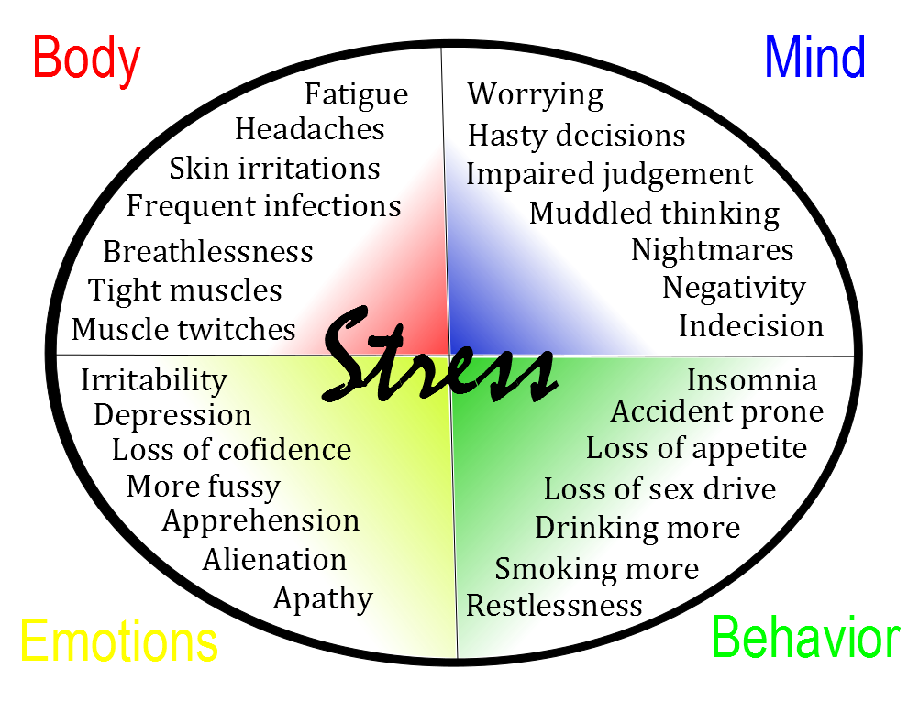
Stress Effects

Slide 16

Benefits of Self-Care
Stress Happens!
Self-Care is one of the most important prevention tools that we have! Benefits of practicing Self-Care include:
Being at your best
Maximizing your potential
Improving your quality of life
Increasing your physical, mental, emotion and spiritual wellness as well as building resources to deal with the many stressors of life
Enhancing your experience of long-term recovery

Slide 17
Recovery Rituals & Self-Care
In several of his articles on Recovery, William White has highlighted four Rituals of Recovery that mark the essence of daily life in recovery. These are also seen as sources of sustenance and stability for recovery coaches, counselors and professionals in the Recovery field. These rituals include:
Centering Rituals ~ acts of prayer, meditation and self-reflection that help keep one’s “eyes on the prize”.
Mirroring Rituals ~ reaching out to kindred spirits for support and inspiration.
Acts of Self-Care - taking care of oneself and one’s intimate circle physically, emotionally and spiritually.
Acts of Service - reaching out to others outside the context of our professional duties in ways that elevate our spirits.

Slide 18
Five Essential Self-Care Strategies
In order to be healthy and well, we need to support and nurture all parts of ourselves - body, mind, emotions and spirit. The following
Five Strategies are essential parts of practicing Self-Care and can also offer a framework for our recovery and wellness planning:
Sleep
Exercise
Eating Well
Relaxation
Connection

Slide 19
Sleep
Getting appropriate sleep is essential for having a healthy body, mind, emotions and spirit. Most people need 7 - 8 hours of sleep each night in order to feel refreshed, and energetic in the morning. Sleep disturbances can affect your work performance and your quality of life. Practices that help to improve sleep include:
Creating a regular sleep schedule
Limiting caffeine and sugar
Utilizing relaxation practices including diaphragmatic breathing
Cultivating sleep rituals e.g. drinking tea, prayer, gratitude journal
Keeping your bedroom as free of light or noise as possible
Getting proper nutrition through food and supplements
Limiting activities prior to sleep esp. cell phones, social media, etc.
Practice: Deep Diaphragmatic Breathing

Slide 20
Exercise
Getting adequate exercise is essential for having a healthy body, mind, emotions and spirit. Physical activity for 20-30 minutes each day helps in reducing your body’s physical reaction to stress by relaxing muscle tension. It also helps in relaxing negative thoughts, reducing anxiety and boosting your self-confidence. Practices that support getting regular exercise:
Going to a gym or taking fitness classes
Taking up yoga or tai chi
Walking or hiking
Taking a dance class
Biking or swimming
Weight or strength training
Martial arts
Gardening
Practice: Walking / Stretching

Slide 21
Eating Well
Eating Well is essential for creating a healthy, well-balanced and meaningful life. We cannot function without sustenance; and we cannot function optimally with poor nutrition. Nourishing body, mind, emotions and spirit with a healthy diet is a key to long-term recovery and wellness. Practices that support eating well:
Create a healthy eating plan that is appropriate for you
Replace fast-food with whole foods and grains
Become aware of food sensitivities e.g gluten, dairy, soy, etc.
Eat lots of fruits and vegetables
Drink plenty of water (suggested at least 8 glasses per day)
Don’t skip meals or go longer than 3 - 4 hours without eating or snacking especially if you tend to experience low blood sugar
Practice: Drinking Water

Slide 22
Relaxation
Relaxation supports us on all levels body, mind, emotions and spirit. It is also helps us to integrate and process our life experiences. Relaxation replenishes our mental resources and helps the body to recover. Making time in your daily schedule for relaxation is essential, even if it’s 10 or 15 minutes. The are many ways to practice relaxation:
Spending time in nature
Taking a hot bath or sauna
Deep breathing exercises
Meditation & Mindfulness
Yoga
Reading
Journaling
Creativity
Practice: Breath Awareness

Slide 23
Connection
Connection is so vital to our personal recovery and well-being as well as our ability to serve as peer recovery coaches. It is essential that we cultivate practices that help us to feel connected and to be able to access support when we need it. Practices that support connection:
Spiritual practices such as prayer, meditation, or contemplation
Participating in community e.g spiritual, recovery, family, work
Spending time with family and friends
Accessing peer support or mentorship
Connecting with self through meditation, journaling, and self-reflection
Spending time in nature
Quiet Time
Practice: Loving-kindness Meditation

Slide 24
Additional Self-Care Tips
• Recognize there is a limit to what any one individual can take on: by doing too much, you’re risking your ability to serve your peers, your organization and most of all yourself!
• Try not to take your work home. Try as best you can and be sure to leave several hours between work and sleep.
• Explore and practice stress management techniques, do regular exercise and engage in hobbies or fun activities that take you completely away from your work.
• Remind yourself that peer recovery coaches cannot fix other people’s problems. We can be of support and help, but making other’s pain go away is beyond our control. We can only do our best and then let go and trust the rest!
• Share perspectives and get support from peer recovery coaches doing similar work. Also, spend time with people outside your profession so that your work doesn’t inhabit your whole life.

Slide 25
Closing Quotes
"When you recover or discover something that nourishes your soul and brings joy, care enough about yourself to make room for it in your life. " – Jean Shinoda Bolen
"It's not selfish to love yourself, take care of yourself, and to make your happiness a priority. It's necessary. " – Mandy Hale
"The greatest weapon against stress is our ability to choose one thought over another. " – William James
"Love yourself first, and everything else falls in line.
You really have to love yourself to get anything done in this world. " – Lucille Ball

Slide 26
Presenter Bio / Contact Info
Beth Terrence, BA, CPRS, CRNC is founder and director of Holistic Recovery Pathways. She is a Shaman, Recovery Coach, Holistic Health & Wellness Practitioner, Speaker and Writer. She is also a person in long-term recovery. Beth’s vision is to support individuals, families, communities and organizations in embracing holistic pathways that enhance life, well-being and the journey of long-term recovery.
Beth offers workshops, trainings, retreats and consulting services and is available to come to your organization or community event to present on Holistic Recovery Pathways. She also serves as a facilitator for SHINE, a 10-Week Mindfulness Program focused on Radical Self-Care.
Beth Terrence ~ Holistic Recovery Pathways
Email: holisticrecoverypathways@gmail.com
Website: www.holisticrecoverypathways.com

Slide 27
Resources / References
Meditation & Mindfulness
Mindful - Online mindfulness magazine and resources. mindful.org
Center for Mindful Awareness - 10-Week SHINE Mindfulness Program. http://centerformindfulawareness.org
May Is For Metta - Loving-kindness Meditation. https://theheartofawakening.wordpress.com/may-is-for-metta/
William White Papers - Ultimate resource on Recovery! http://www.williamwhitepapers.com
Wellness Recovery Action Plan - (WRAP). https://www.wrapandrecoverybooks.com
Health Magazine - Online resource for health and wellness. https://health.com
PositiveHealthWellness - Living Healthier & Happier Blog. https://www.positivehealthwellness.com
Holistic Recovery Pathways - Holistic resources and wellness programs for addiction and mental health recovery. http://www.holisticrecoverypathways.com

