Slide 1
SAMHSA’s Service Members, Veterans, and their Families
Technical Assistance Center
Peer Curriculum Learning Community
Session #1 – November 5, 2015

Slide 2
While we’re waiting…
Please tell us:
Have you taken part in any of our other
SMVF TA Center Learning Communities?
Type your answer in the chat box to right.

Slide 3
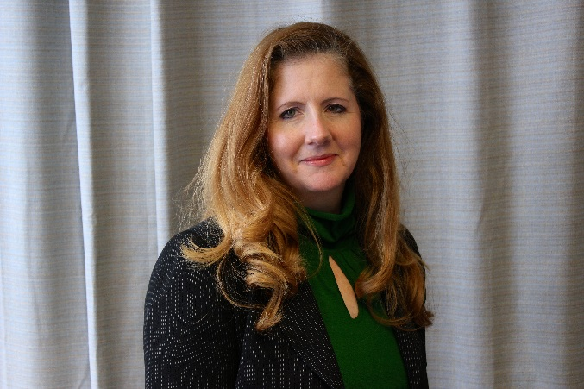
Welcome
SMVF Peer Support: The Science, Support Services, and State-Specific Resources for Training, Credentialing, and Reimbursement
Michelle Cleary
Senior Project Associate,
Session Facilitator
Sarah Degnan
Project Assistant,
Session Administrator

Slide 4
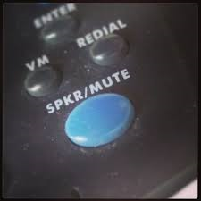
Housekeeping
Please identify yourself each time you speak
“This is…”
Please mute your phones when not speaking
Highly Interactive
Respectful environment

Slide 5
Participant Introductions
States/Territories | Names
Washington | Morgan Keys
Washington | Vincent Collins
Washington | James Rose
Texas | Suzanna Hupp
Texas | Perry Jeffries
Texas | Bettie Peebles Beckworth
Maryland | John Keller
Maryland | Shauna Donahue
Maryland | Jason Peer
Maryland | Michelle Darling
North Dakota | Joe Faller
Massachusetts | Benjamin Cluff
Name
State/Territory
Agency
Role

Slide 6
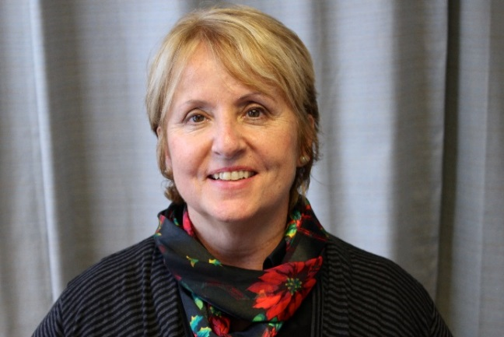
Donna Aligata, R.N.C. Project Director SAMHSA’s SMVF Technical Assistance (TA) Center Policy Research Associates, Inc.

Slide 7
Objectives
Gain knowledge about the core competencies of existing peer trainings
Discuss what tools other states are using to train SMVF peers
Identify state, federal, and private products available to enhance training of SMVF peers in military culture, suicide prevention, and SUDS
Gain a strong understanding of the training needs analysis process to ensure training curriculum and deliveries align with roles and organizational goals
Collect tips for creating participant and facilitator guides, visuals, and training resources and support materials

Slide 8
Today’s Agenda
Looking Across States: Workforce Development Priorities
Round Robin
Considerations When Selecting Training Curricula
Round Robin
Wrap Up

Slide 9
Poll Question
Is your state considering or already adapting training or curriculum to include the topic of SMVF?

Slide 10
Donna Aligata, R.N.C. Project Director SAMHSA’s SMVF Technical Assistance (TA) Center Policy Research Associates, Inc.
Looking Across States: Workforce Development Priorities

Slide 11
Critical Questions
Have you done a gap analysis or a training inventory?
What are the strengths of current training?
How have you identified and addressed the knowledge and skill gaps?
Have you leveraged existing training and workforce development activities to better respond to this population?
Are you optimizing and drawing from existing training resources?

Slide 12
Increasing the focus on this SMVF Population
Common Key Area: Peer Support
State Examples/Activities
Washington | Integrating military culture and increasing access to SMVF community recovery support supports into their CCAR recovery coach curriculum using ATR vouchers
Massachusetts | Sending SMVF SAVE veterans for CCAR Recovery Coach training and credentialing and integrating military culture into coach training
California | Training peers in multiple domains

Slide 13
Increasing the focus on this SMVF Population (cont’d)
Common Key Area: Suicide Prevention
State Examples/Activities
Kentucky | integrating SUDS and SP into their operation immersion and military culture curriculum and is requiring SP and military culture for provider licensing
Washington | requiring SMVF SP for licensing
Kansas | integrating military culture and SMVF SUDS

Slide 14
Increasing the focus on this SMVF Population (cont’d)
Common Key Area: SUDS/Recovery
State Examples/Activities
Illinois | integrating SUDS and military culture into their provider and peer training
Arizona | integrating SUDS training content into their navigators training

Slide 15
Tips
Apply adult learning theory: Interactive learning
Collaborate with others if you do not have expertise or credibility
Instructional Design Basics: Ratio of training design and delivery time (raising awareness, verses changing behavior and skills)
Use of learning technologies, visuals, story telling and virtual webcasts

Slide 16
Group Discussion
As you think about adapting curriculum in your state which if the following are you considering?
Designing your own curriculum
Adapting an existing training to include SMVF specific information
Cross training

Slide 17
Considerations When Selecting Training Curricula

Slide 18
Some Considerations When Selecting Training Curricula
Design or redesign?
Understanding the importance of effective learning objectives
Understanding adult learning theory
Understanding the pros and cons of different training methodologies
Challenges in redesigning
Challenges in designing your own curriculum

Slide 19
Design or Redesign?
First question - what are the skill and learning needs of the trainees?
Have they or have they not lived experience in military culture and or addiction and other mental/health challenges?
Have they or have they not had any experience with coaching?
Are the expectations of the coaching service clearly defined and in line with the capabilities of those selected to be coaches?

Slide 20
Design or Redesign?
The second question is about resources that presently exist.
Do you clearly understand what learning objectives are needed and are these clearly articulated in the curricula you are considering?
Take an inventory of how many of your learning objectives are met and which are missing?
Balance what it would take to redesign existing curricula (or use multiple existing curricula) versus creating your own.

Slide 21
The Importance of Learning Objectives
Learning objectives should be simply stated and measurable.
Use action verbs such as to compare, to list, to relate, to demonstrate.
Verbs such as to understand or to know are not helpful.

Slide 22
The Importance of Learning Objectives
A common mistake with curriculum design is too many learning objectives.
If knowledge acquisition is the goal, then 3-5 learning objectives in a day long training is reasonable.
If skill acquisition is the goal than 1-2 learning objectives in a day long training is reasonable.

Slide 23
Understanding Adult Learning Theory
Adult learners
Desire self-directedness
Are competency based
Make connections to their experience
Have differing predominant learning styles
Auditory
Visual
Kinesthetic

Slide 24
Pros and Cons of Different Learning Methodologies
Lecture
Trainer has control of the environment
Retention rate of the material presented is very low (around 10%)
Discussion
Discussions need to be facilitated so they don’t get off track
Retention rate is considerable higher as more learning theory aspects are met
Experiential
Relies on skilled facilitation as participants have more control of the outcome
Highest rate of retention

Slide 25
Challenges of Redesign
Changes and additions need to be mindful of original learning objectives so that they are still met.
If learning objectives are changed than fidelity is compromised and accreditation may be voided.
Examples and exercises can be modified as long as learning objectives are still met.

Slide 26
Challenges of Designing New
Is somewhat time intensive
Design and writing team needs to have expertise in both the material and training design.
CEU and other accreditation processes will be needed.

Slide 27
States/Territories | Names
Washington | Morgan Keys
Washington | Vincent Collins
Washington | James Rose
Texas | Suzanna Hupp
Texas | Perry Jeffries
Texas | Bettie Peebles Beckworth
Maryland | John Keller
Maryland | Shauna Donahue
Maryland | Jason Peer
Maryland | Michelle Darling
North Dakota | Joe Faller
Massachusetts | Benjamin Cluff
Group discussion and Q&A

Slide 28
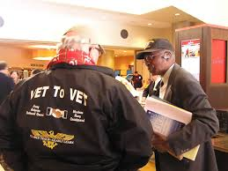
Wrap-up
Recap
Homework:
Training Resource Scavenger Hunt
1. Locate a training resource
Peer Support - CCAR
Military culture - Community Provider Toolkit, STARR
Substance use disorder recovery
Suicide prevention - SPRC, SAVE
Military Families - NTCSN, MFA
2. Tell us what training resource might be adaptable for your state

Slide 29
Wrap-up
Next call:
Thursday, November 12, 2015
Submit your homework by COB November 10, 2015
Please be sure to register for Session #2

