Slide 1
Peers working with diverse populations: LGBTQIA
Created by
Rowan Powell Brendan Welsh, CPRS
TAY Outreach Coordinator Director of the Office of Consumer Affairs at BHA

Slide 2
Things we will cover
SOGIE (Sexual Orientation, Gender Identity and Gender Expression)
Terminology (LGBTQIA)
Microaggressions and how to prevent them
Ethical Considerations
Ways to help and Resources

Slide 3
Think for a minute....
Think about your daily interactions at work, at home, all the places you up end throughout the course of your busy day.
Do you know anyone that identifies as lesbian, gay, bisexual, or transgender?
How do you know the person’s sexual orientation or gender identity?
Do you interact any differently with this person(s) than other people you know?
BONUS QUESTION: How many genders are there?
Notes:
Before presenting slide pass out LGBTQ+ Definition worksheet and allow individuals 5 mins to complete and process out as a group

Slide 4
What is Sexual Orientation
Sexual Orientation- An inherent or immutable enduring emotional, romantic or sexual attraction to other people.
Individuals who identify as Gay or Lesbian have a romantic and/or sexual attraction to people of the same gender that they identify as.
Individuals who identify as Bisexual have a romantic and/or sexual attraction to members of two genders.
In 2016 there is an estimate that 3.7 of Maryland Adults identify as Lesbian, Gay or Bisexual.
Definition from HRC
Data from The Williams Institute

Slide 5
What do those letters mean?
L- Lesbian
G- Gay
B- Bisexual/ Pansexual
Q- Questioning
A- Asexual

Slide 6
Gender Identity
One’s innermost concept of self as male, female, a blend of both or neither- how individuals perceive themselves and what they call themselves. One’s gender identity can be the same or different from their sex assigned at birth.
Individuals whose gender identification is inconsistent with their biological sex are transgender. Currently, 0.3% of American adults and 0.49 of Maryland adults identify as Transgender.
Individuals whose gender identification is consistent with their biological sex are considered cisgender.
Definition by HRC
Data by The Williams Institute

Slide 7
What do those letters mean? Part Two.
Gnc- Gender Nonconforming/ Gender Queer
T- Transgender
2-S – Two Spirit
I- Intersex
Notes:
Gender Variance or Gender nonconforming is behavior or gender expression by an individual that does not match masculine and feminine gender norms.
Transgender is an umbrella term for people whose gender identity differs from what is typically associated with thte sex they were assigned at bith.

Slide 8
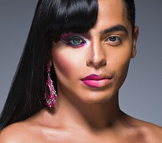
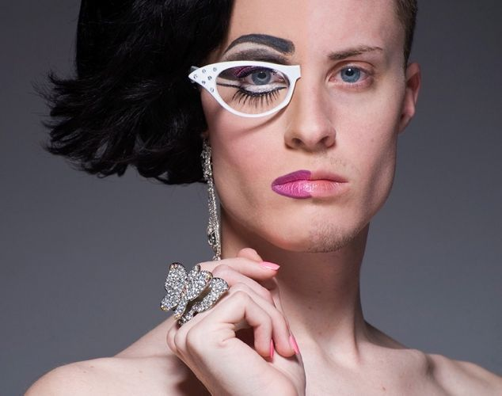
Gender Expression
The way you present yourself and interact with others; masculine, agender, feminine; is on a spectrum.
Notes:
Provide handouts on clear examples of what gender roles look like

Slide 10
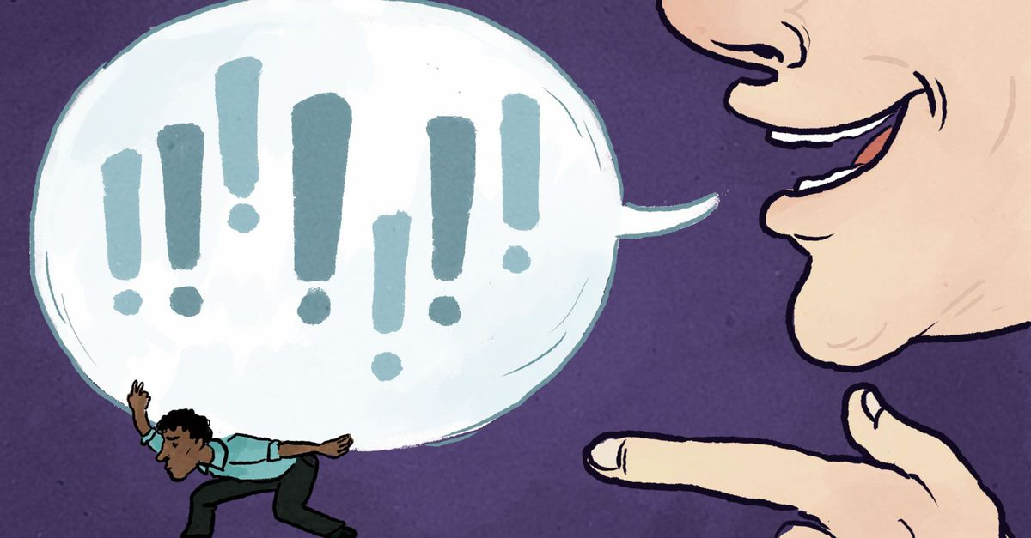
Microaggressions
The everyday verbal, nonverbal, and environmental slights, snubs, or insults, whether intentional of unintentional, which communicate hostile, derogatory, or negative messages to target persons based solely upon their marginalized group membership.
Individuals exposed to constant or ongoing microaggressions can experience the same negative behavioral health consequences as those who experience overt gender-based bullying.
Notes:
Trainer’s Note:
Use the graphic at the bottom of the slide to demonstrate that words have weight

Slide 11
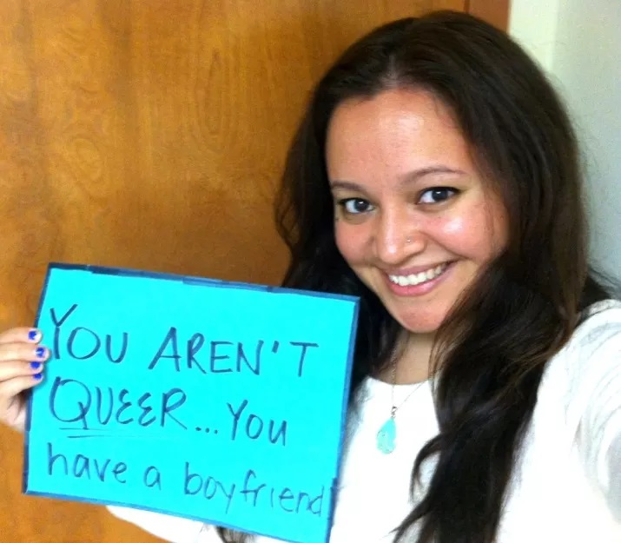
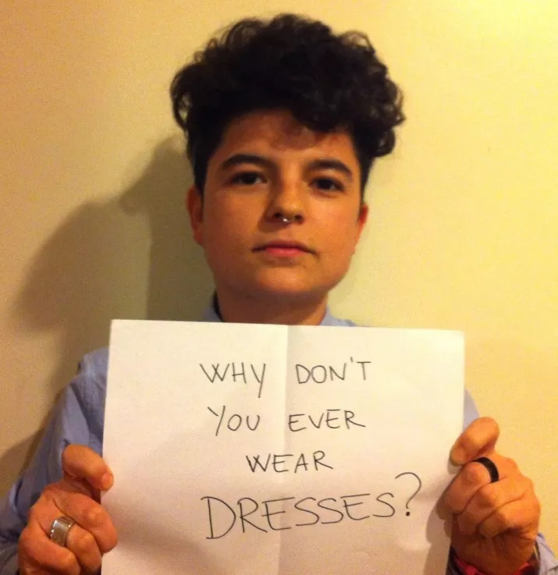
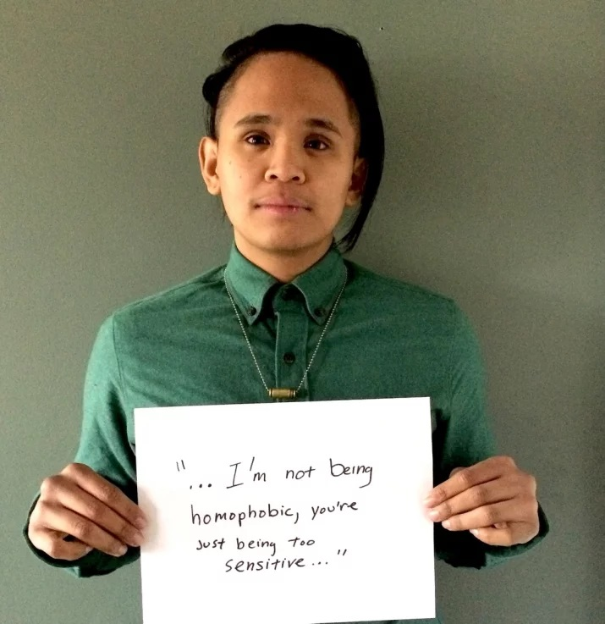
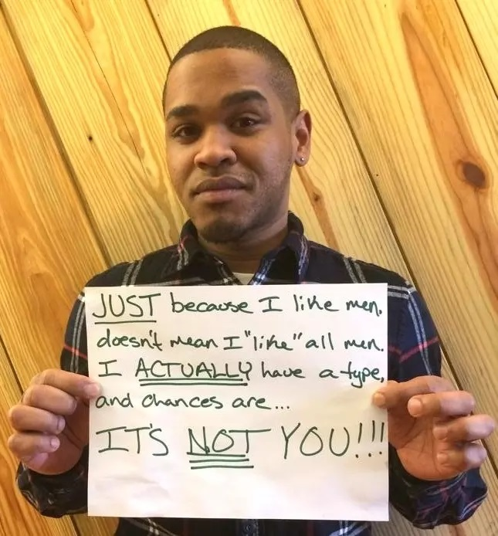
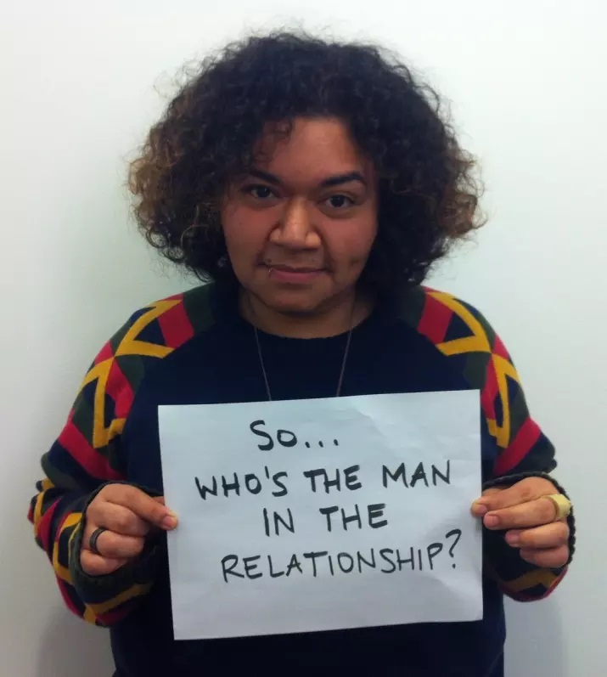
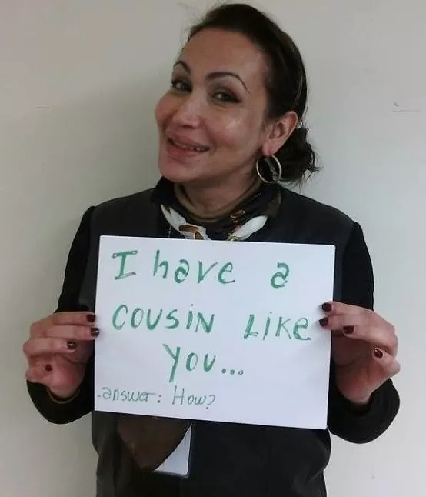
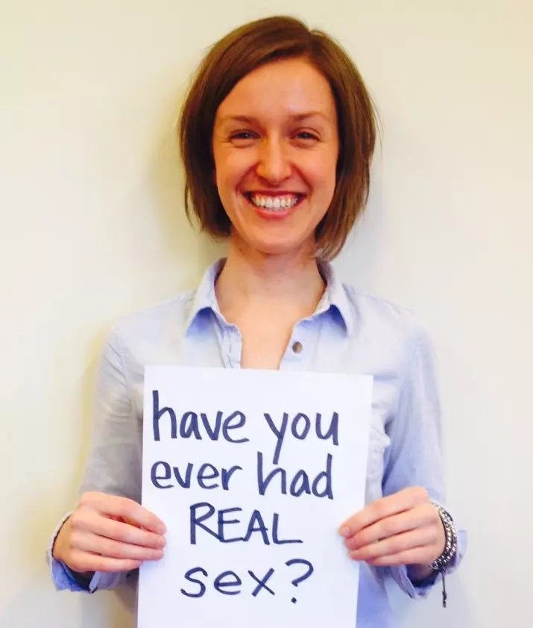
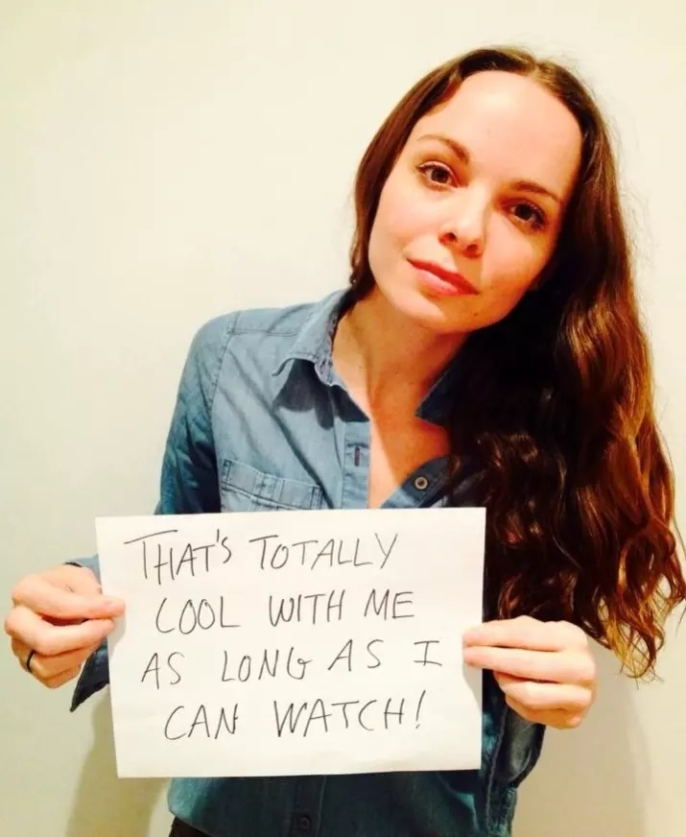
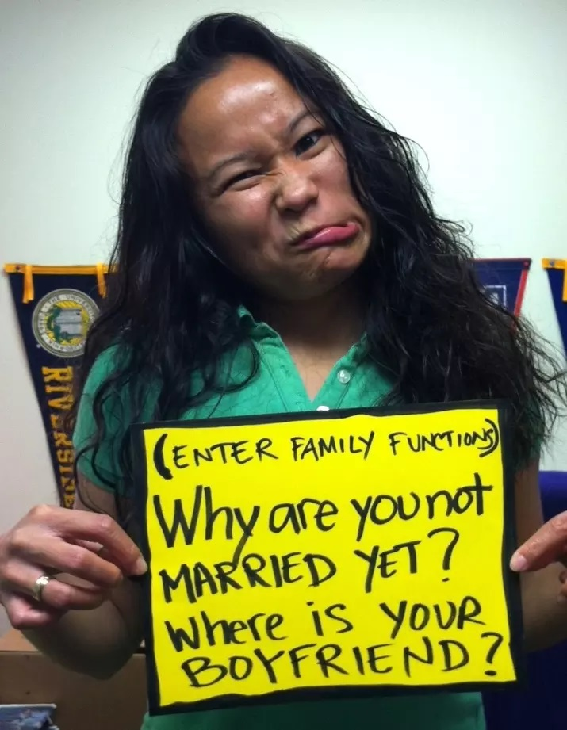
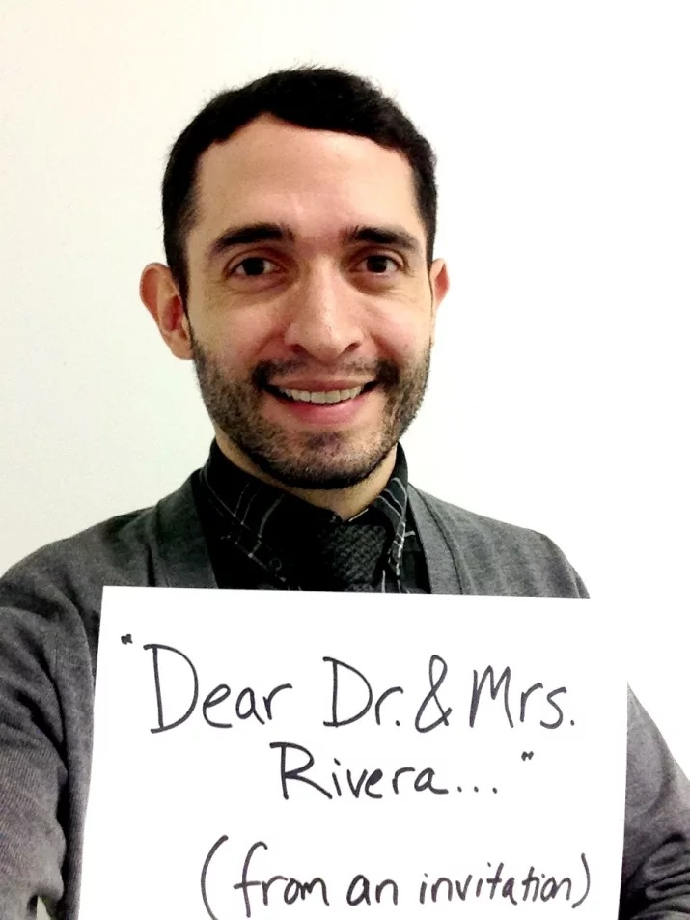
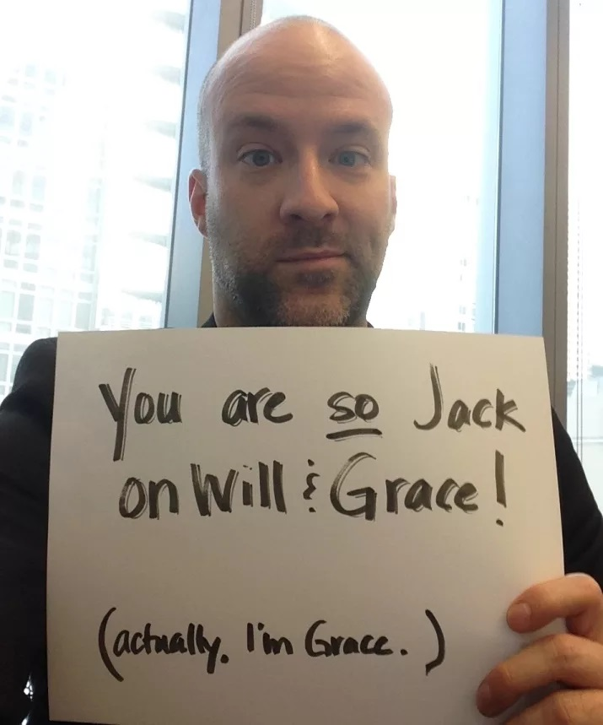
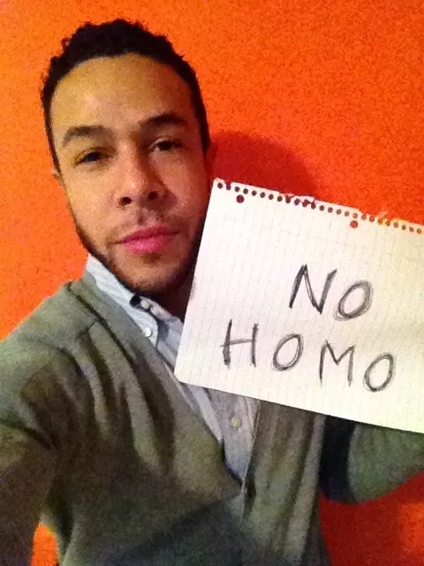
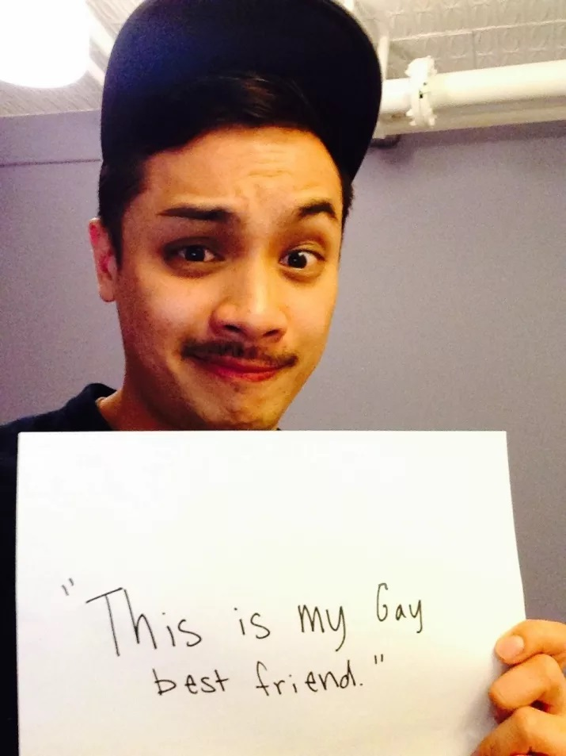
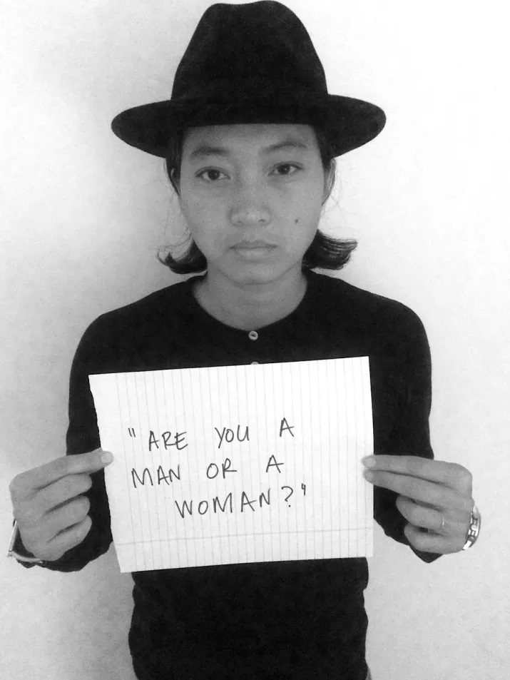
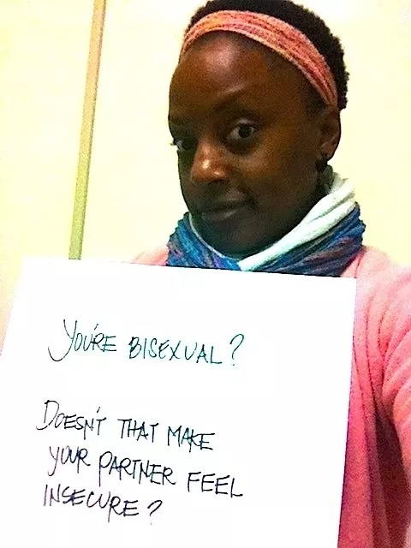
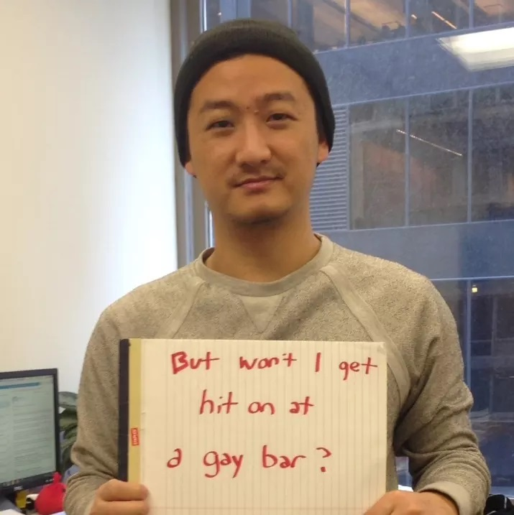
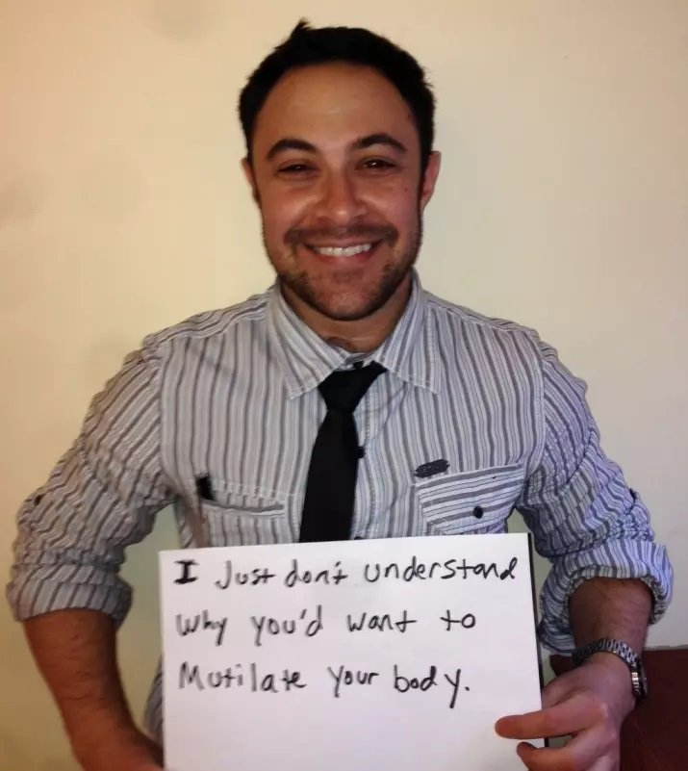
Microaggressions
Notes:
Microaggressions, this is a project that was done by Kevin Nadal, professor of psychology at CUNY, he asked all of his LGBTQ friends what kind of microaggressions they heard on a daily basis

Slide 12
Microaggressions
Examples of Microaggressions for Peers to be aware of include:
Assuming an individual is heterosexual.
Failing to recognize that an individual’s problem can be a result of experiences with discrimination or internalized heterosexism.
Focusing on sexual orientation when it is not relevant.
Underestimating the consequences of “coming out.”
Failing to affirm significant relationships.
Assuming a child’s problems are due to the parents’ orientation.
Excessive displays of acceptance or “understanding.”
Using the wrong pronoun after being told the individual’s preferred pronoun.
Not having access to gender-neutral bathrooms.

Slide 13
Ethical Considerations
Be aware and sensitive of the impact that internalized heterosexism, homophobia and transphobia may have on individuals and their mental health.
Recognize the impacts coming out, and help to identify all the possible negative and positive’s of coming out.
Have an awareness and understanding that coming out is a process, and happens numerous times over a person’s life.
Be aware that language and terminology in the LGBTQ community is ever evolving and varies from person to person.
Honor labels, terms and pronouns used by individuals.
Appreciate and understand the importance of appropriate use of language within the LGBTQ community.
Be aware that certain labels such as queer and gay require contextualization and should only be used if already used by the individual with clear positive identification.
Notes:
So as peers we work with numerous diverse populations, and the LGBTQ community is one of them. And it’s important that we hold ourselves to certain ethical standards and these are some that we’ve come up with for working specifically with this community.

Slide 14
Do LGBTQ people have the same rights?
Maryland and Delaware prohibit discrimination based on sexual orientation and gender identity or expression.
Virginia does not provide the same protections, thus an LGBTQ person may be denied employment, housing, access to public accommodations in Virginia.
Same-gender marriage is legal in all 50 USA states. This recent change is due to the supreme court case, Obergefell v. Hodges.
Free State Justice , in July 2015, filed a lawsuit against a Talbot County school for not allowing a Transgender student to use the bathroom of the gender they identified with.
G.G v. Gloucester County Virginia School Board is a case filed by the ACLU on behalf of Gavin Grimm which addresses the use of bathrooms in public schools by transgender students.

Slide 15
What can you do?
Address the problems that the LGBTQ community face at both the systems and individual level.
Provide a safe and nondiscriminatory recovery environment.
Ensure that your mission statement includes LGBTQ friendly language.
Provide a gender neutral bathroom at your office.
Respect the gender identities and pronouns of all your peers.
Ask all peers what their chosen pronouns are?
Create the opportunities for educational discussions about the LGBTQ community with your peers.
If a peer comes to you with concerns about their sexuality or gender identity, have an open, honest and non judgmental conversation with them.
Notes:
In this section it’s mostly a guided conversation, once you get to ask all peers what their chosen pronouns are, you want to ask them to think of some ways to have those conversations. It may be as simple as in forms having spots for them to choose pronouns. Starting all introductions with “Hi, My name is Rowan and my pronouns are she/her.” I know this seem’s incredibly daunting, and like a conversation that we don’t necessarily have with everyone we encounter. But it is crucial.

Slide 16
Resources
Legal Help- Free State Justice: https://freestate-justice.org
Need to talk to someone- Trevor Project: http://www.thetrevorproject.org/
Need to see that it does get better- It Gets Better Project: http://www.itgetsbetter.org/
General Questions- Human Rights Campaign: http://www.hrc.org
Need information about coming out- Human Rights Campaign Coming Out Guides: http://www.hrc.org/resources/category/coming-out
Parents, Families and Friends of Lesbians and Gays:https://www.pflag.org
Rainbow Youth Alliance Maryland:http://www.rainbowyouthalliancemd.org
Gay, Lesbian, Bisexual, Transgender Community Center of Baltimore and Central Maryland :http://glccb.org
Gay, Lesbian & Straight Education Network :https://www.glsen.org
Sexual Minority Youth Assistance League :http://smyal.org
The Baltimore Transgender Alliance:https://www.facebook.com/bmoretransalliance/?ref=br_rs

Slide 17
References
Institute of Medicine (US), 2009.
Youth Risk Behavior Survey, CDC. 2016.
Raising Issues: Lesbian, Gay, Bisexual & Transgender people receiving services in the public mental health system, Alicia Lucksted, 2004.
Child Sexual Abuse 1: An Overview by Kurt Conklin (February 2012)
Gay, Lesbian and Bisexual Issues by American Psychiatric Association (May 2010)
https://www.buzzfeed.com/hnigatu/19-lgbt-microaggressions-you-hear-on-a-daily-basis?utm_term=.lkLJq3AlBP#.epoOvbzPJ5
The Williams Institute, The LGBT Atlas, 2016
Pew Social Trends, 2013
Centers for Disease Control and Prevention. (2014). Lesbian, gay, bisexual, and transgender health—youth.
GLSEN. (2011). The 2011 National School Climate Survey.
Human Rights Campaign. (2012). Growing up LGBT in America.
Itgetsbetter.org
Killerman, S. (2014). It’s pronounced Metrosexual.
Sue, D.W. & D. Sue. (2013). Counseling the culturally diverse. Hoboken, NJ: John Wiley & Sons.
The Trevor Project. (2014).
Wilbur, S., Ryan, C., Marksamer, J. (2006). Child Welfare League of America best practice guidelines: Serving LGBT youth in out-of-home care. Washington, DC: CWLA.
"The Department of Health and Mental Hygiene." CDP. N.p., n.d. Web. 8 July 2014. <http://phpa.dhmh.maryland.gov/cdp/SitePages/youth-risk-survey.aspx>.

Slide 18
Questions?

